Slide 1
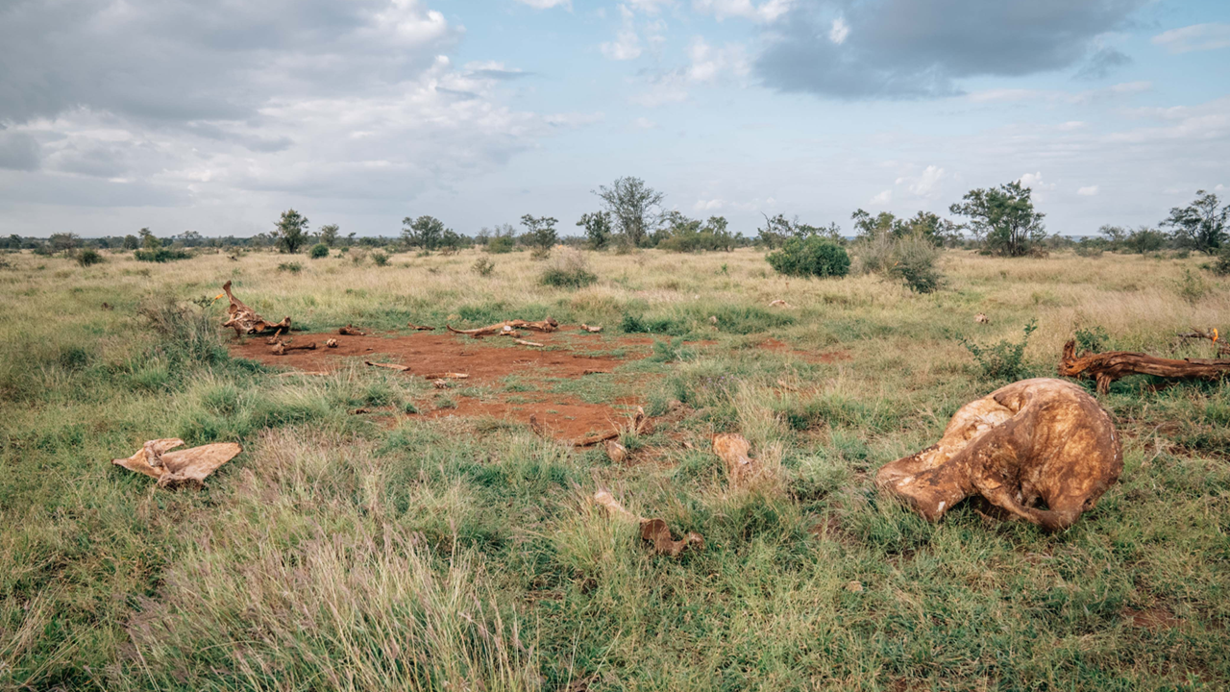
Grass Grows where Giants Fall
Notes:
Intro image: photo credit – Deron Burkpile

Slide 2
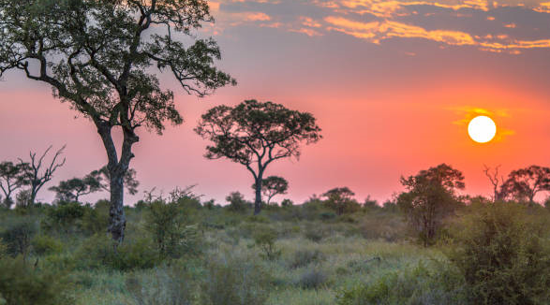
Review: Energy
Energy enters most ecosystems as sunlight.
Energy flows through food webs and is eventually lost as heat.
Notes:
A major point is that energy flows linearly. It (generally) enters ecosystems as energy from the sun and is absorbed by plants, which lose some of it, then plant biomass (containing that energy) is eaten by animals who also release that heat.

Slide 3


Review: Matter
Matter includes atoms and nutrients, such as carbon, nitrogen, phosphorus, oxygen, and water.
Matter cycles through living things, soil, water, and the atmosphere again and again and again and again.
Matter continually cycles through the earth
Notes:
A major point is that matter cycles, it flows from plants into animals (as animals eat them an as plants release oxygen), from animals into plants (as animals breathe out carbon dioxide), into the atmosphere, into the lithosphere, etc, etc. You could give examples of evaporation (water moves from ground into air), precipitation, erosion, condenstation, transpiration, sublimation, and many others. The point is this is MATTER and matter CYCLES.

Slide 4
What do you remember about the cycles?
Notes:
Give students a few minutes to either think-pair-share, or just write down everything they remember about matter (biogeochemical) cycles. Then either write some of what they remember here or elsewhere on the board, or delte this slide and just do the activity verbally.

Slide 5
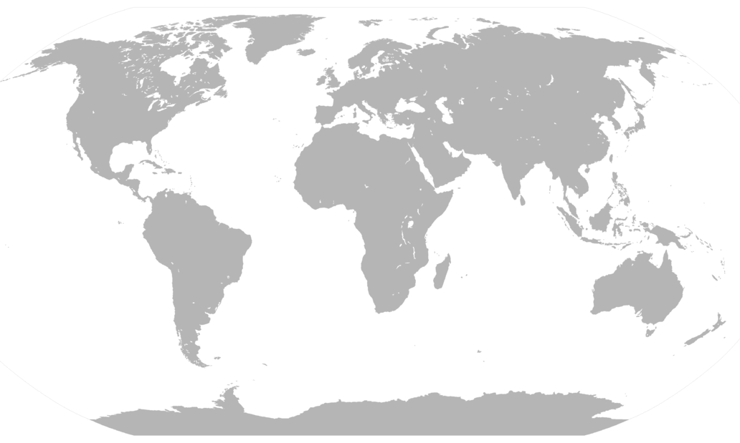
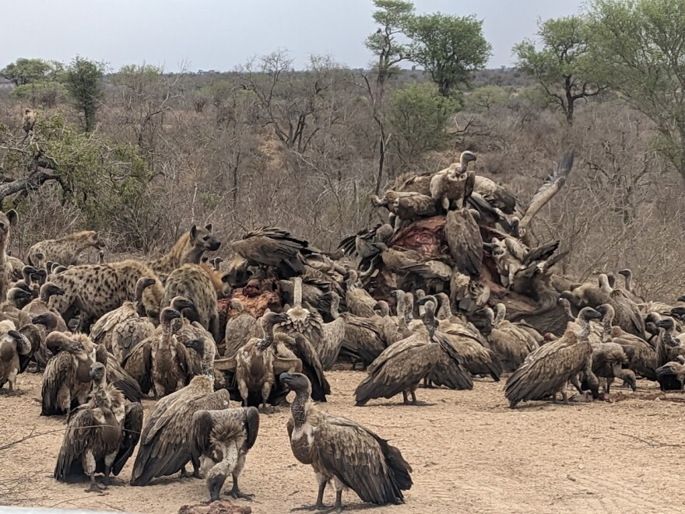

Kruger National Park is in South Africa
We’re studying elephant carcasses!
Notes:
The video will introduce more, but this helps to set the scene

Slide 6
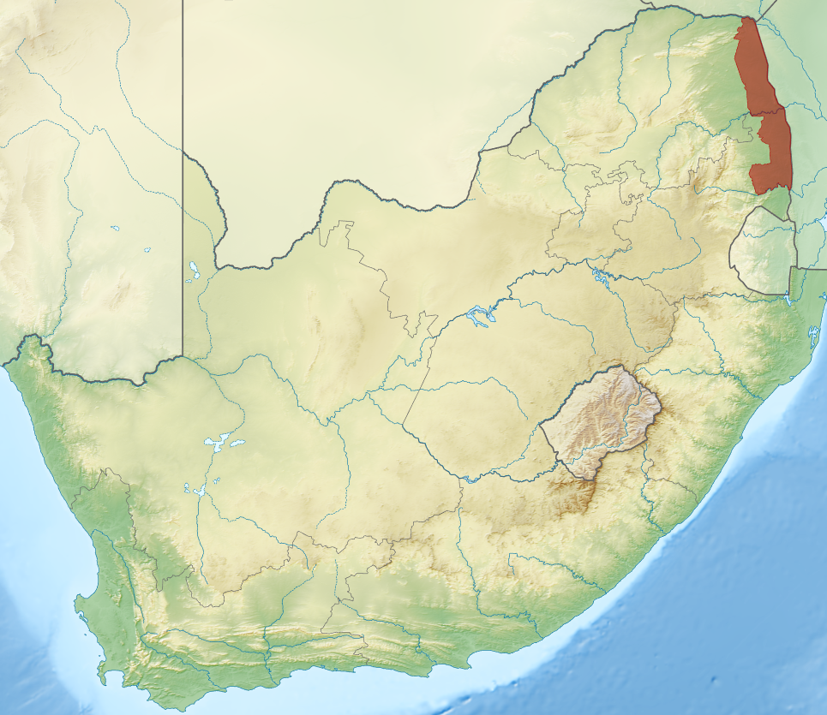
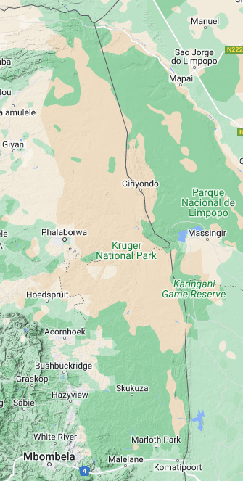

Notes:
Kruger is about the size of New Jersey, it is more than twice the size of Yellowstone

Slide 7
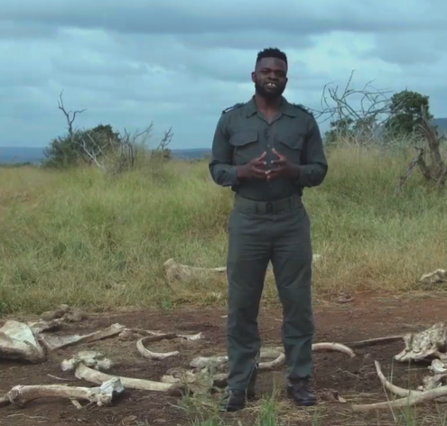
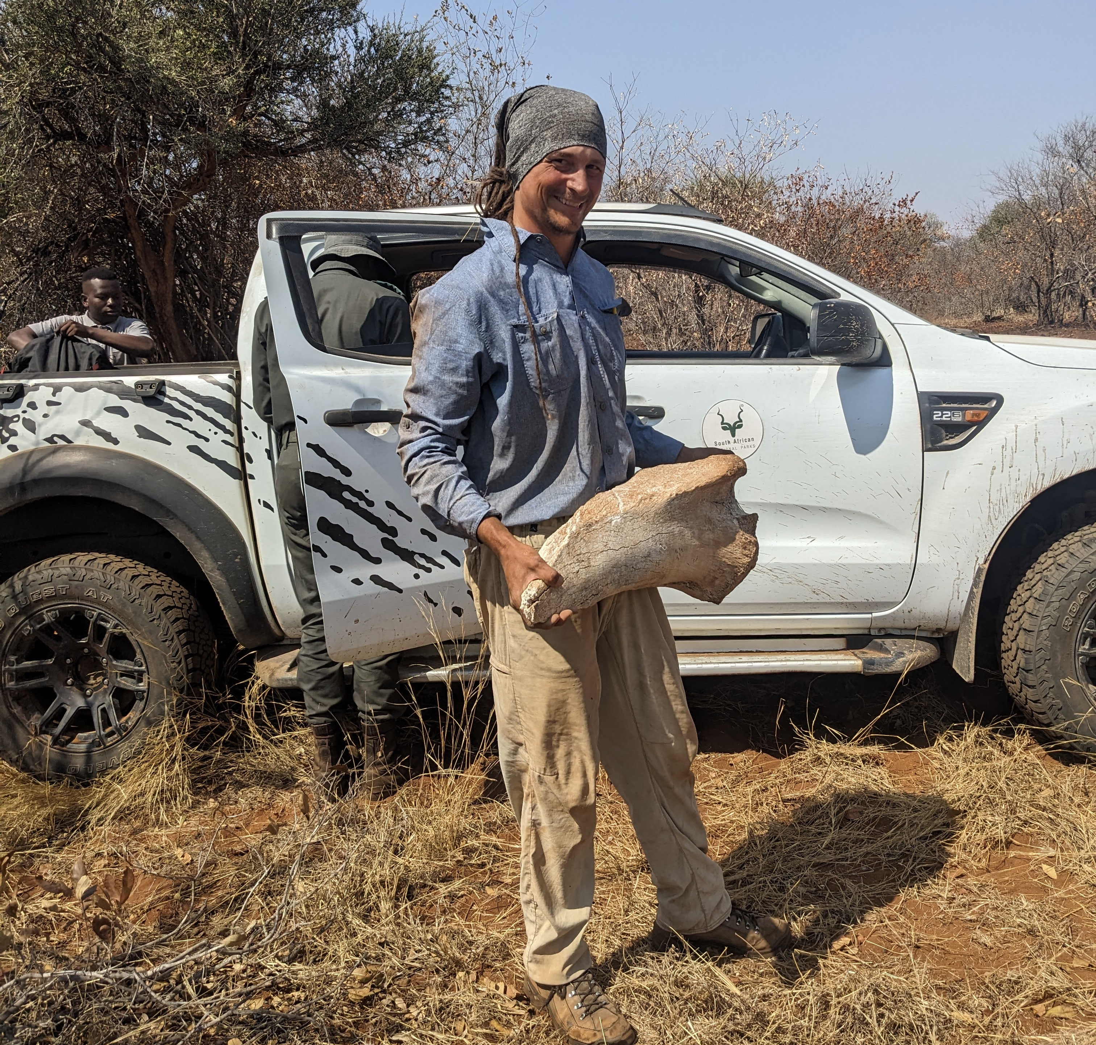
Our Featured Researchers
Kulani Mabuza
Ryan Helcoski
Notes:
Introduce our researchers! Kulani (Koo-LAN-E) Mabuza (ma-Booz-a) and Ryan Helcoski (hell-COS-ki). And then start the video

Slide 8
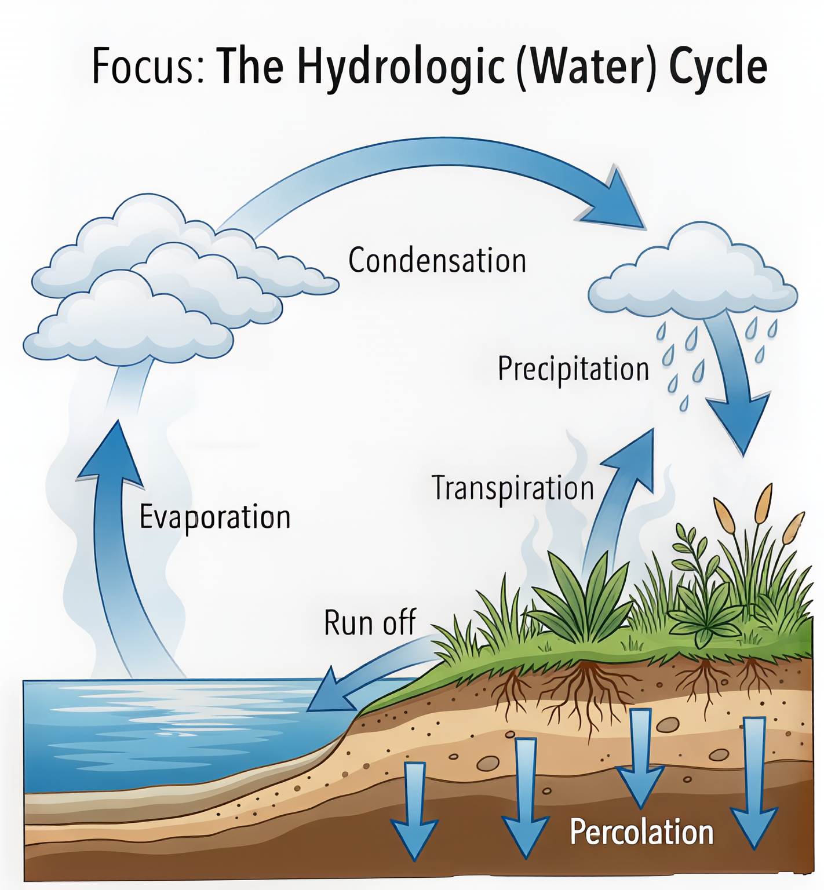

Slide 9
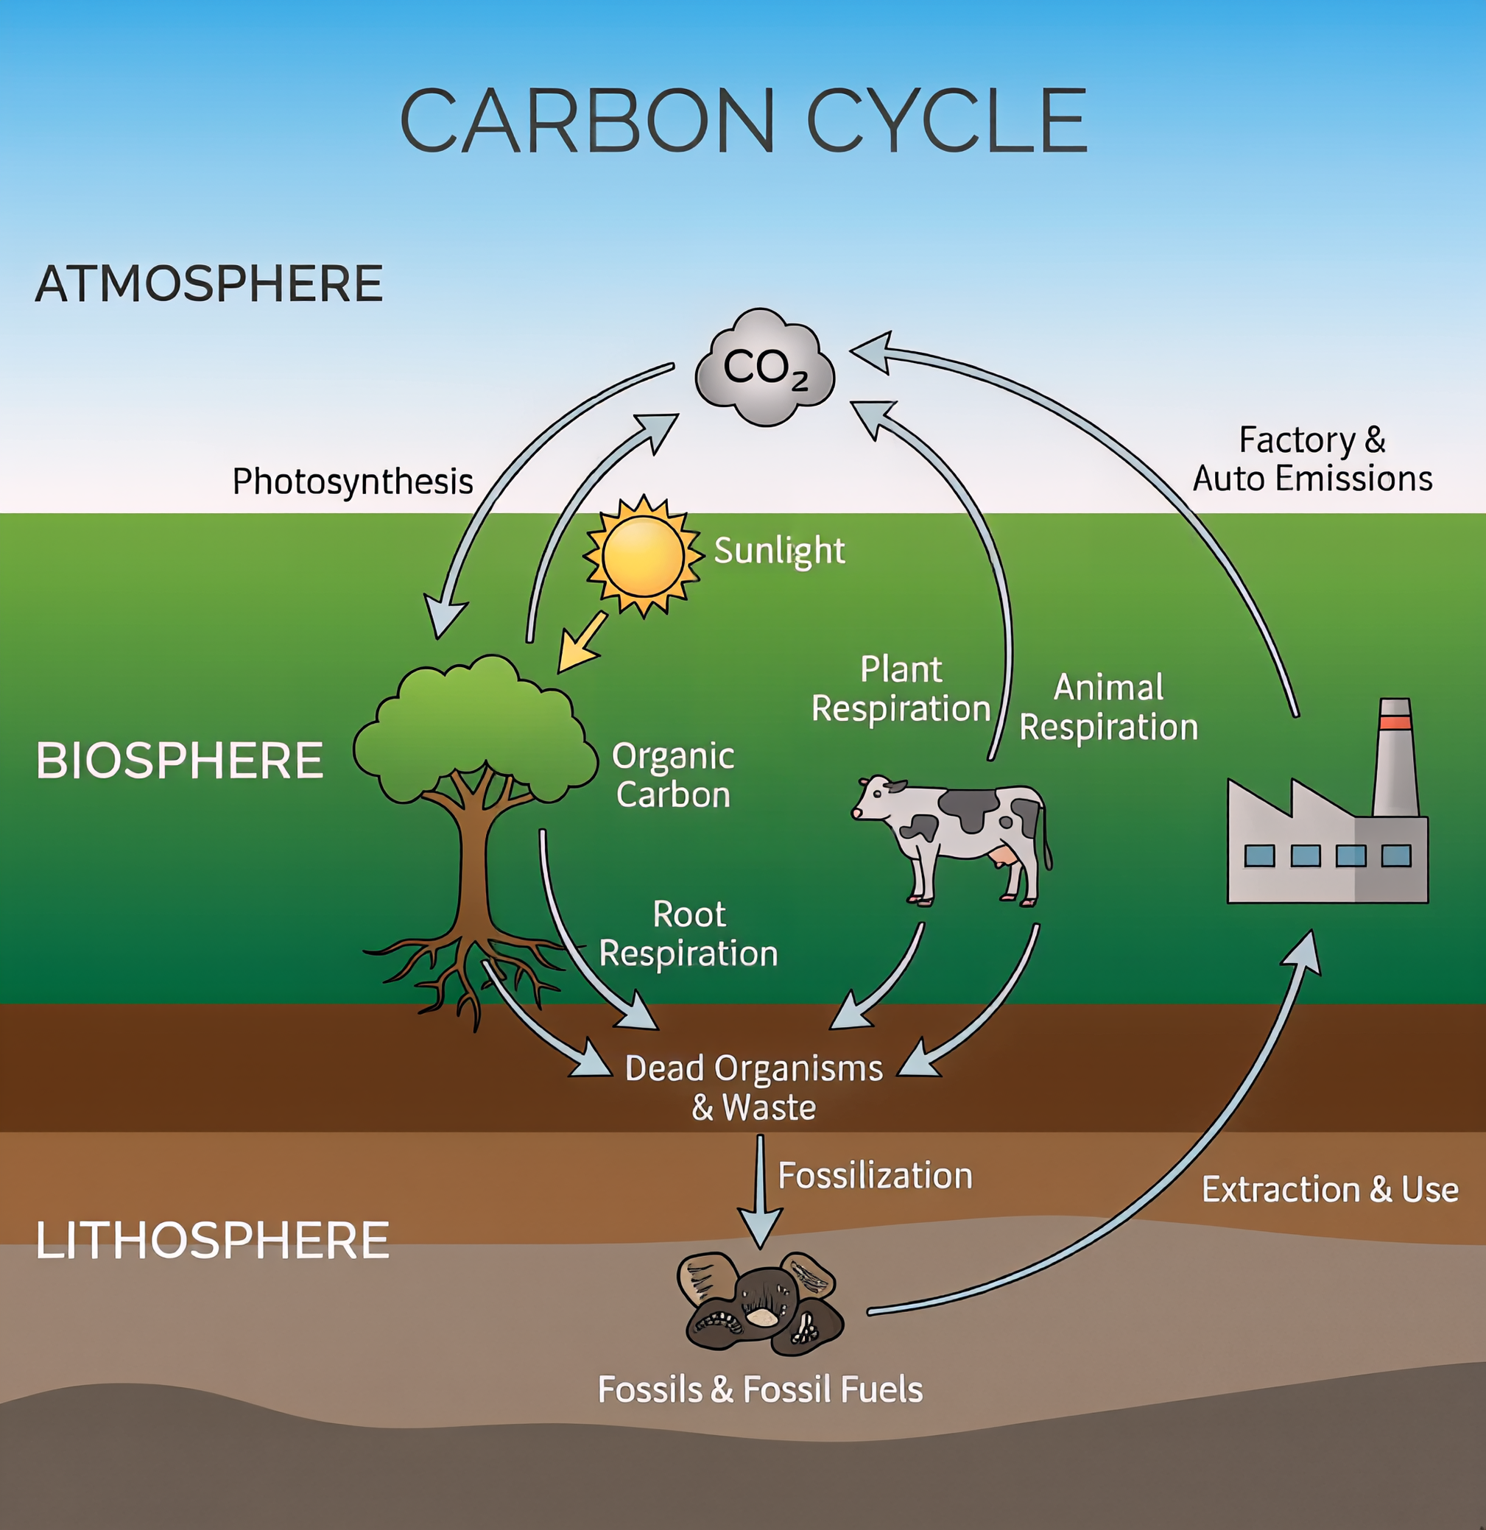

Slide 10
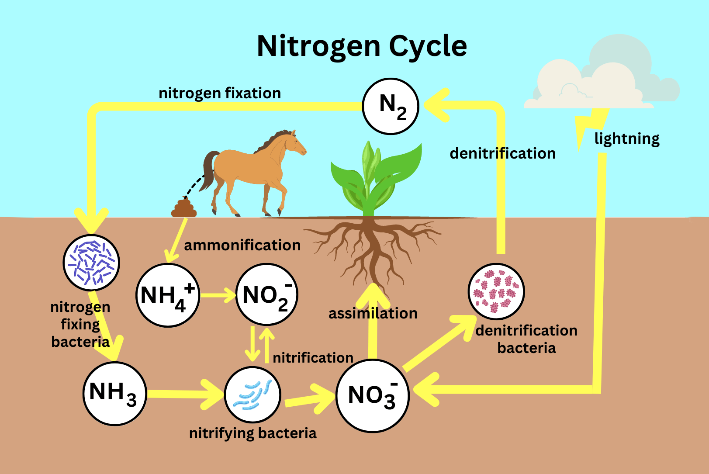

Slide 11
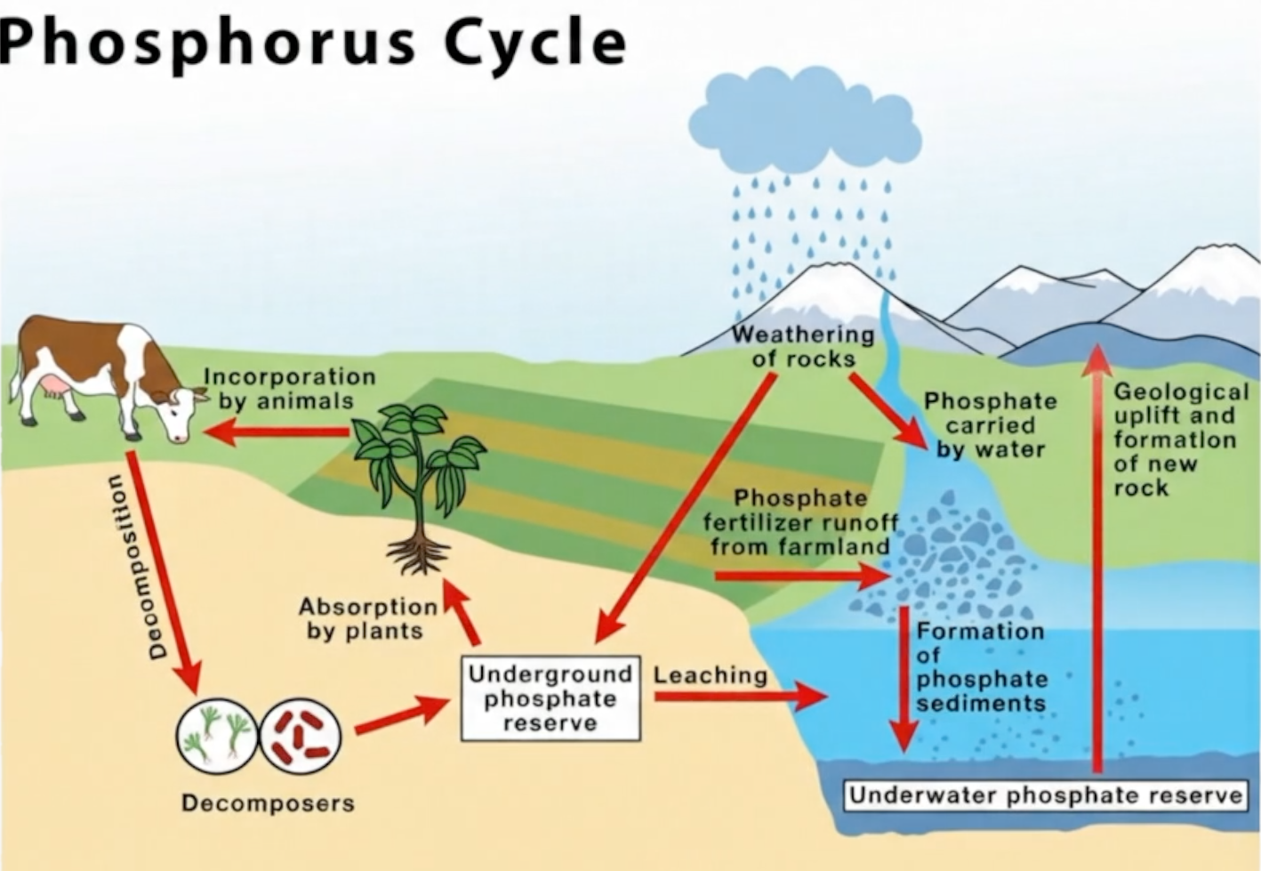

Slide 12
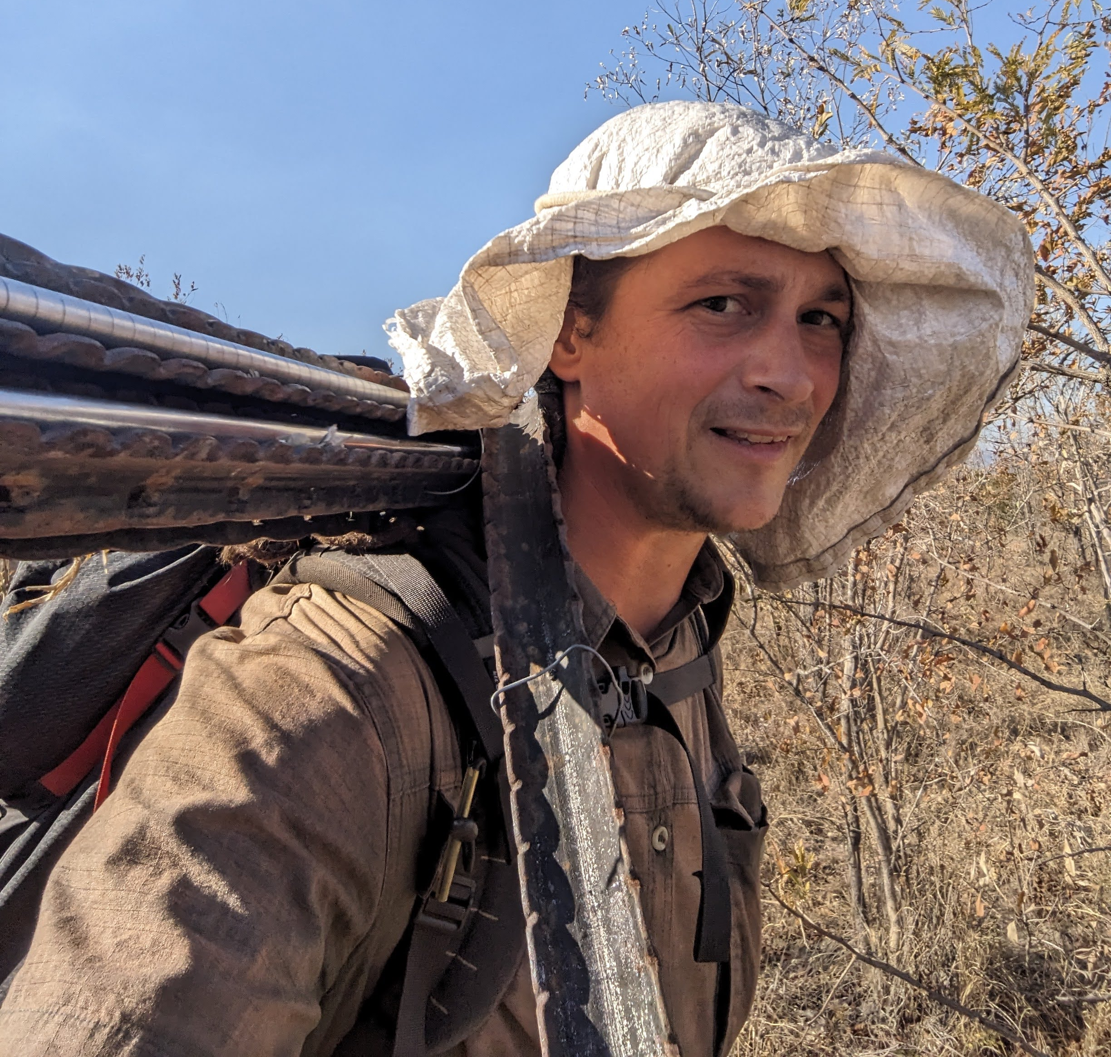
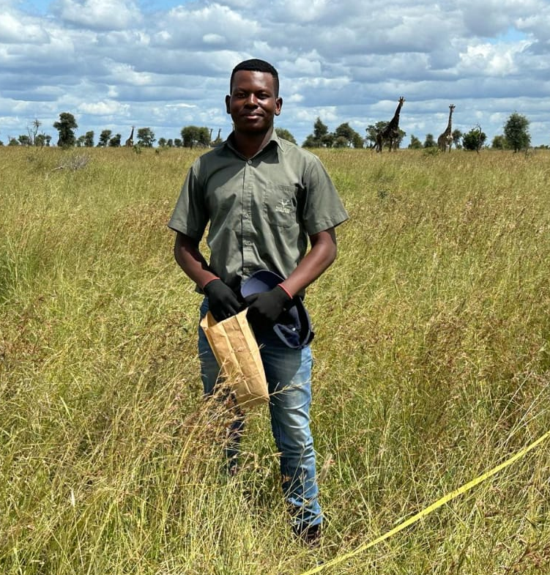
How does distance from an elephant carcass affect grass regrowth and grazing in an African savanna?
Ryan Helcoski (again)
Ndzalama Mkansi (he’s new!)
Notes:
Based on Ryan’s research and their time spent with Kulani, Ryan and Ndzalama (ndz-al-AM-a) Mkansi (mk-ANZ-e) decided to ask a scientific question to learn more about nutrient cycling at elephant carcass sites.

Slide 13
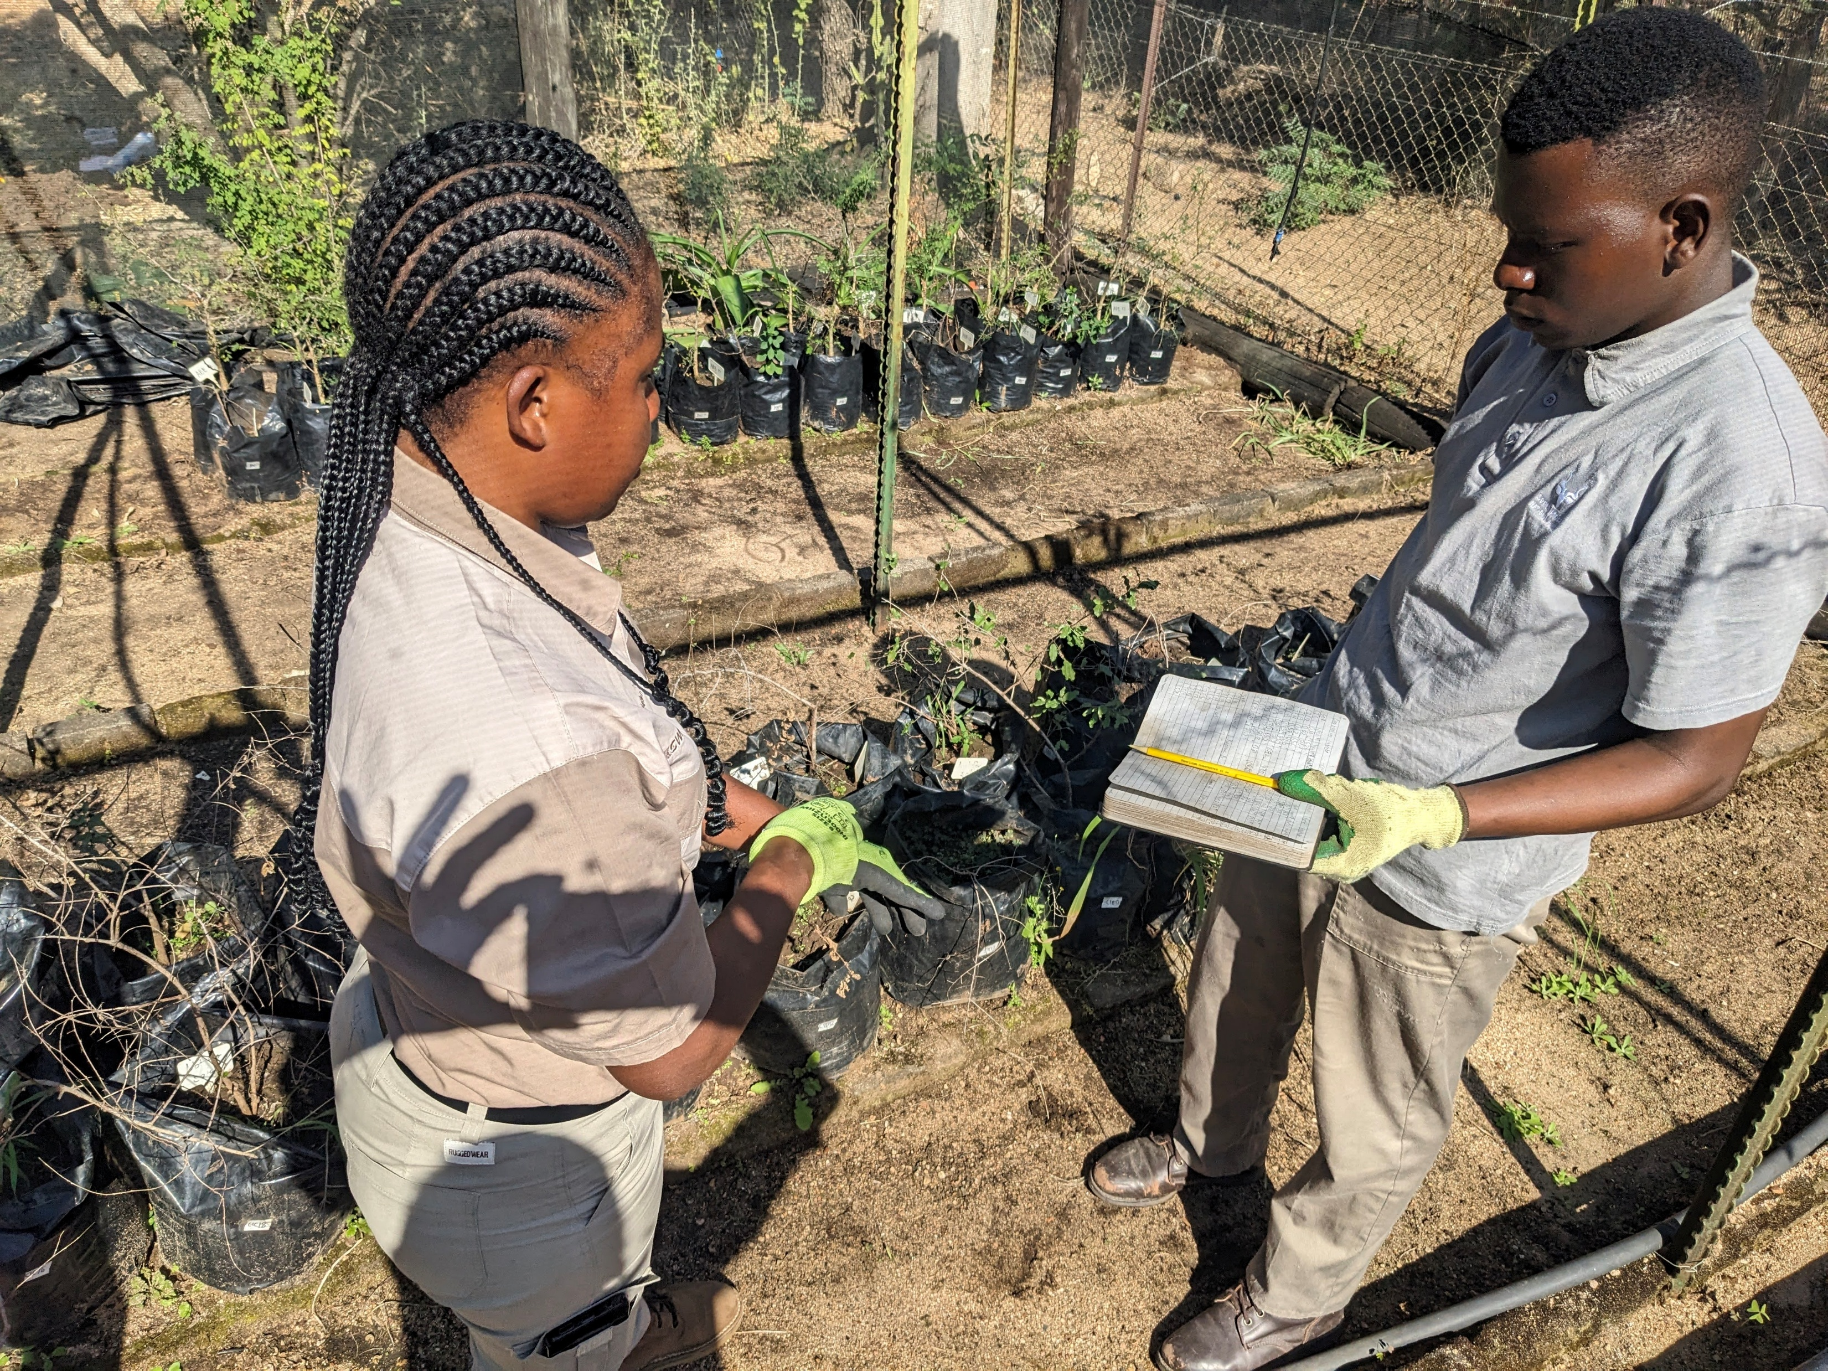
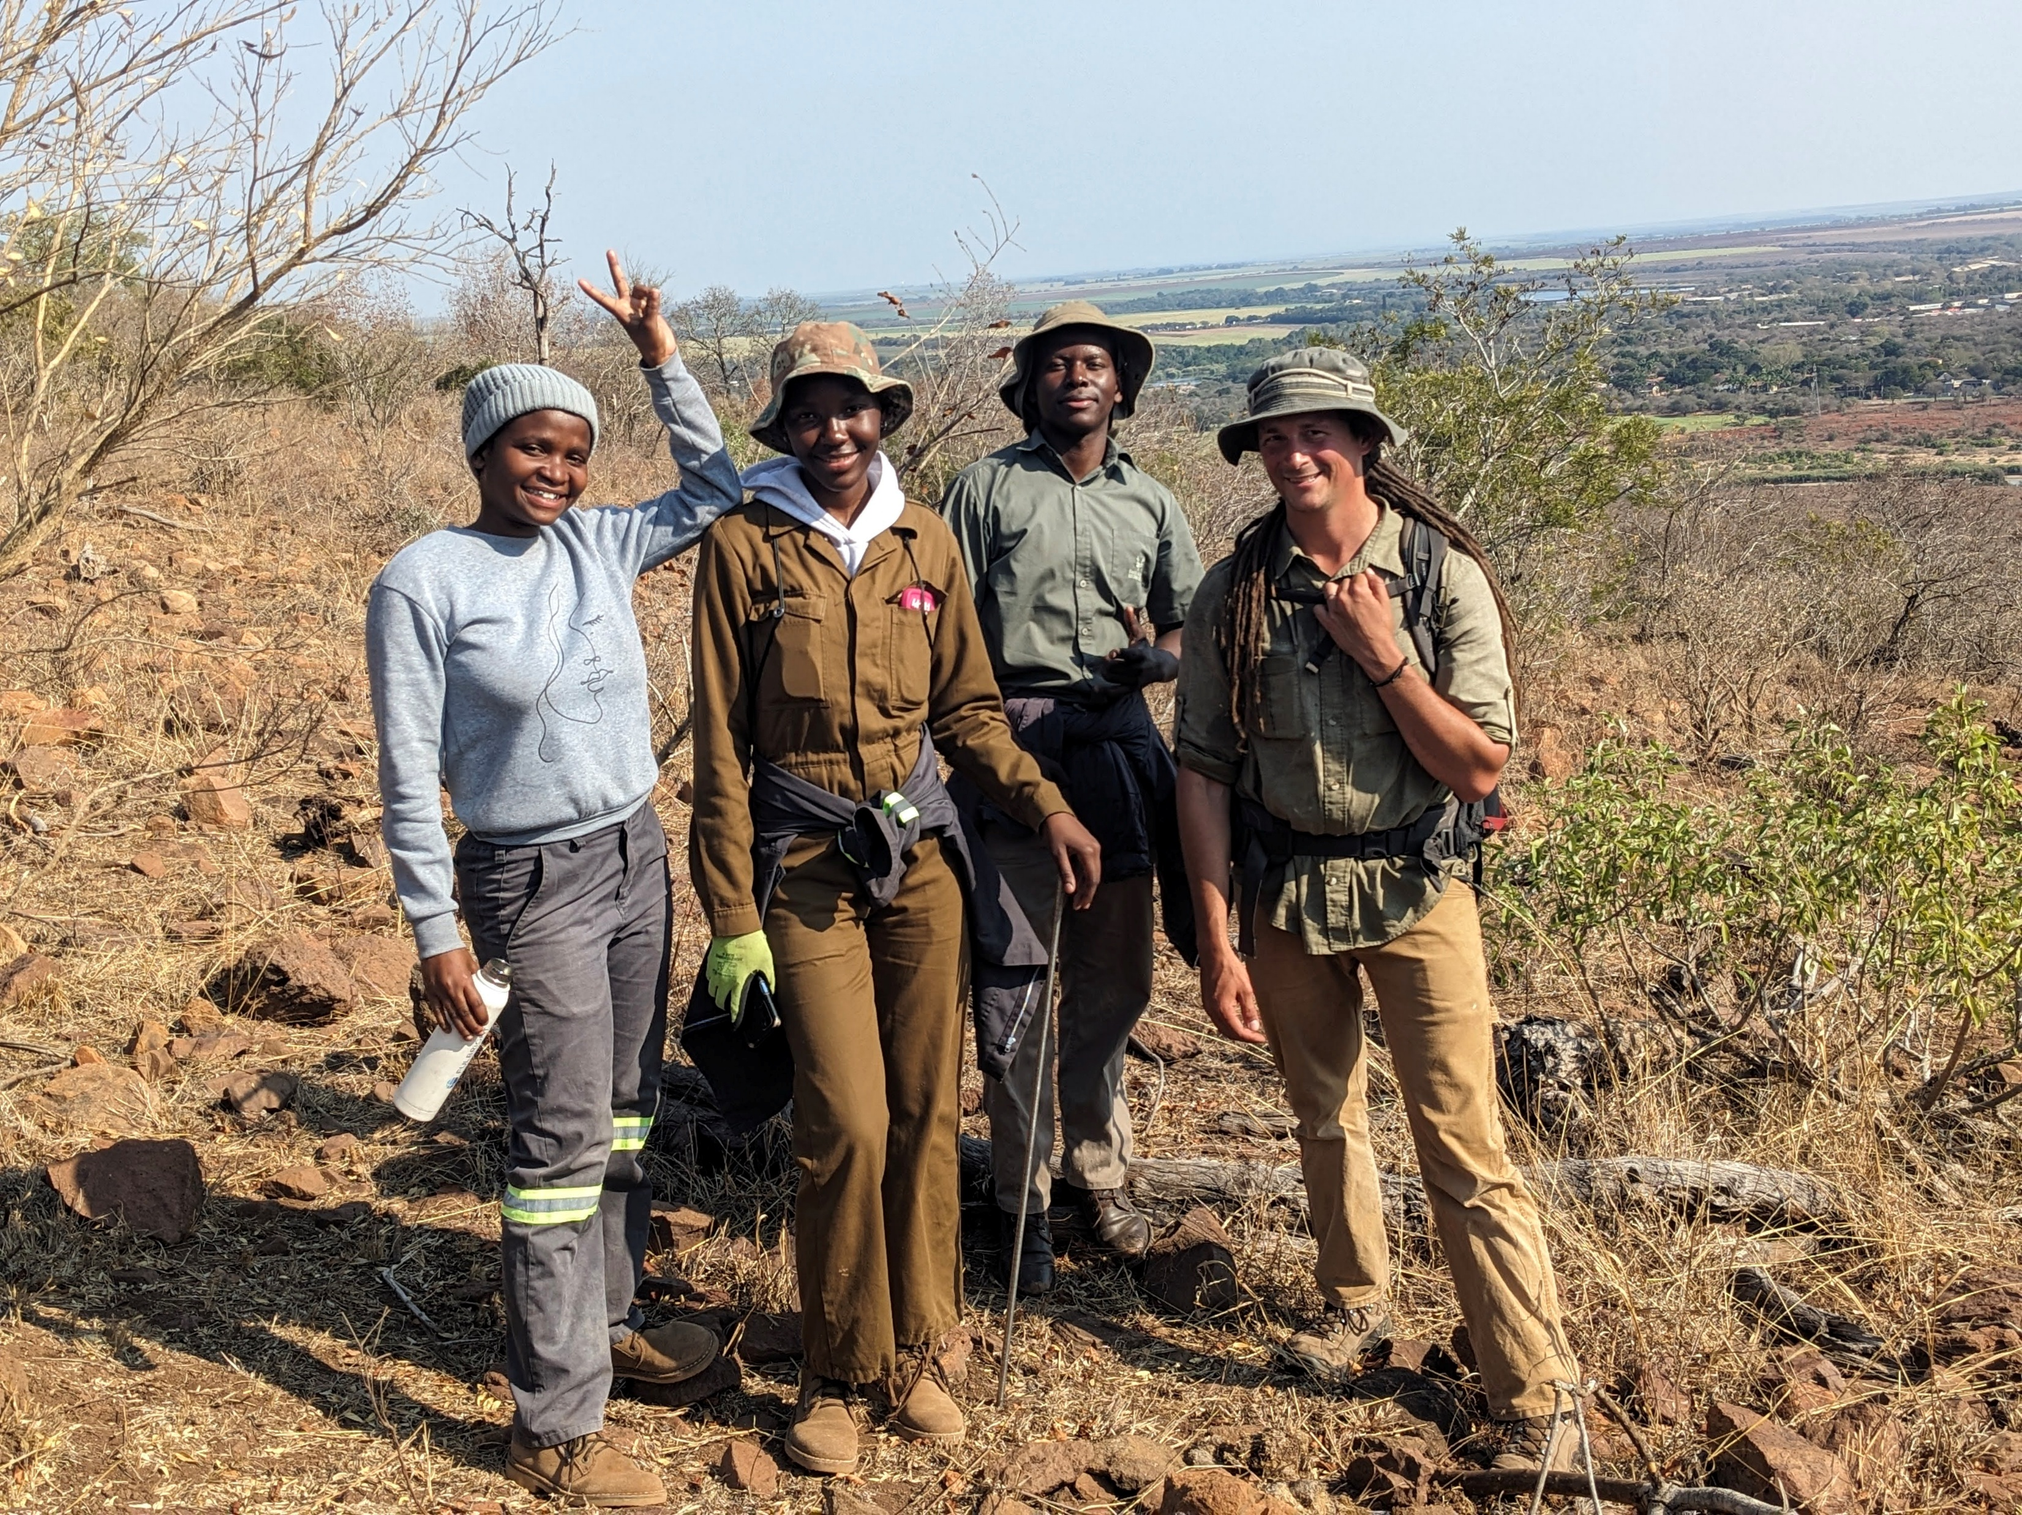
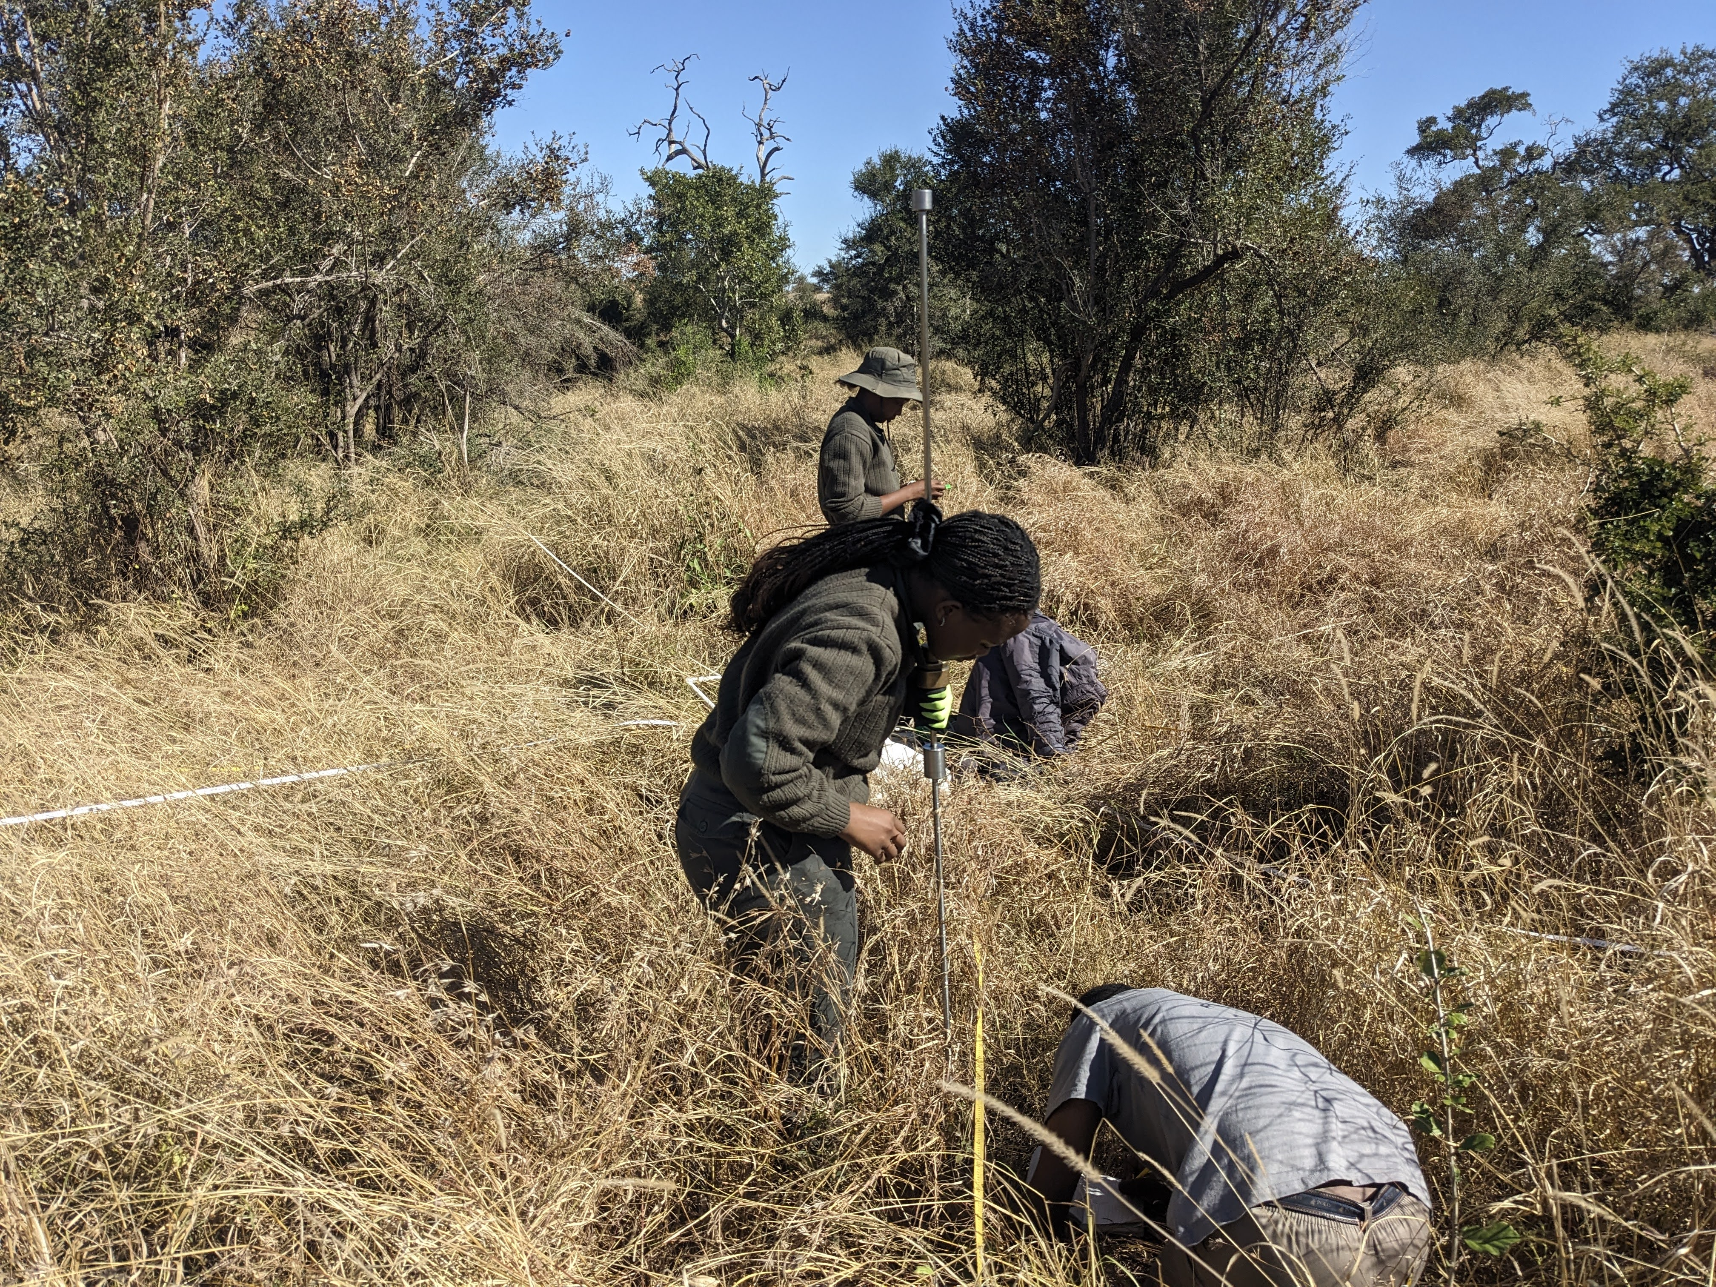
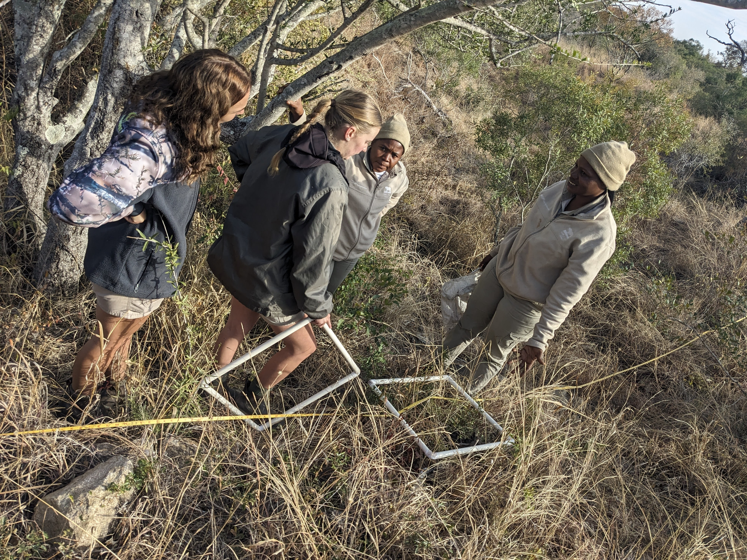
Ryan and Ndzalama and many other students spent years working in the South African Savana!

Slide 14
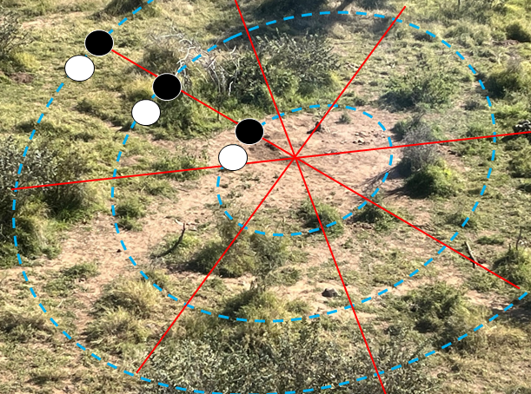
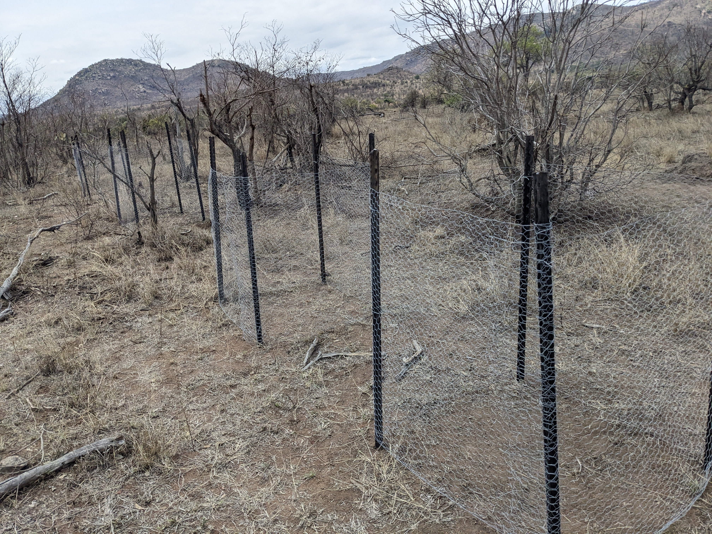
Today you will learn about one of their experiments!
Grass grows where giants fall follows their exclosure study!
You’ll use real data from their experiment and use your knowledge of the cycles of matter to answer their questions.
The black circle is an exclosure, the white is an open control. The question is about grass growth with distance from carcass center
Notes:
In the second image, the red lines converge on the center of the carcass site. We placed exclosures and paired controls at a distance of 2.5m, 5m, 10m, and 15m from carcass center and we left a control next to it open. This way we can see the grass growth in the exclosure vs control and also compare between controls at different distances.

Slide 15
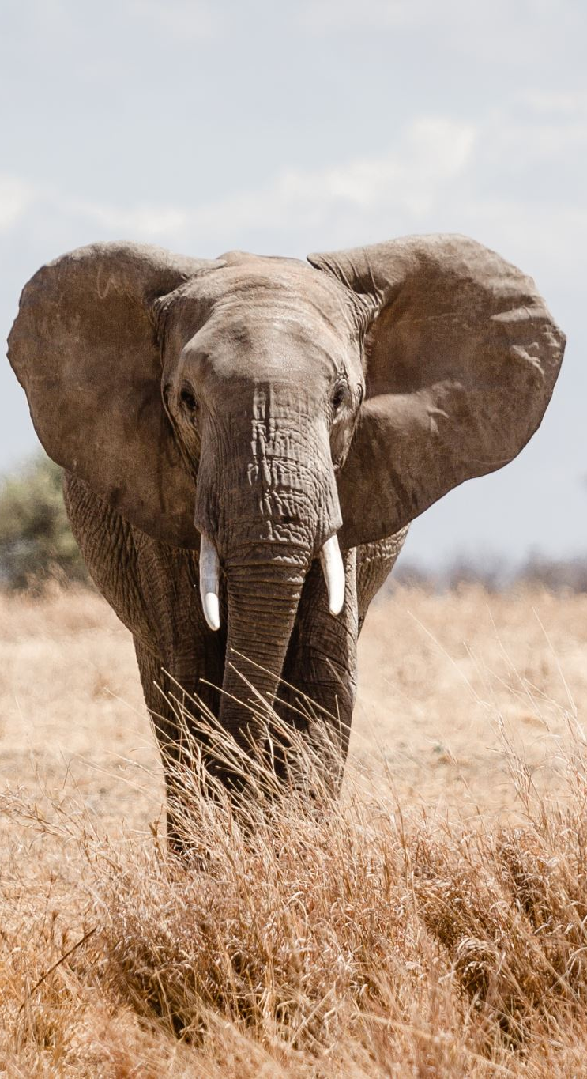
Discussion Question: What ecosystem cycles are hidden in this study?
This study is not just about dead elephants and grass. What materials or processes would need to be involved for dead elephant tissue to become new grass growth? Think about what comes from the carcass, what comes from the air, what comes from the soil, and what comes from the rainy season.
HINT: There are 4 main cycles involved, try listing all four and try and figure out how they played a roll and where their matter came from

Slide 16
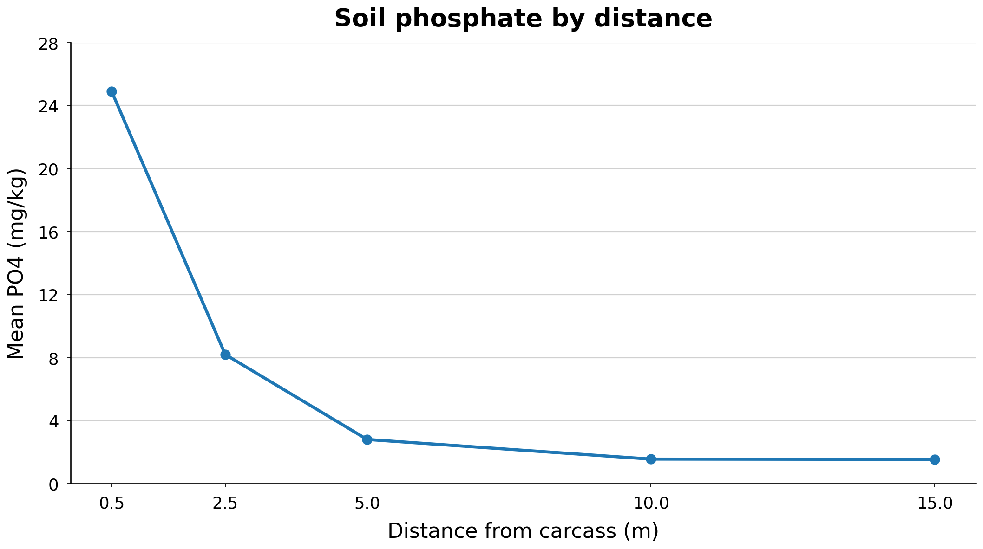

Slide 17
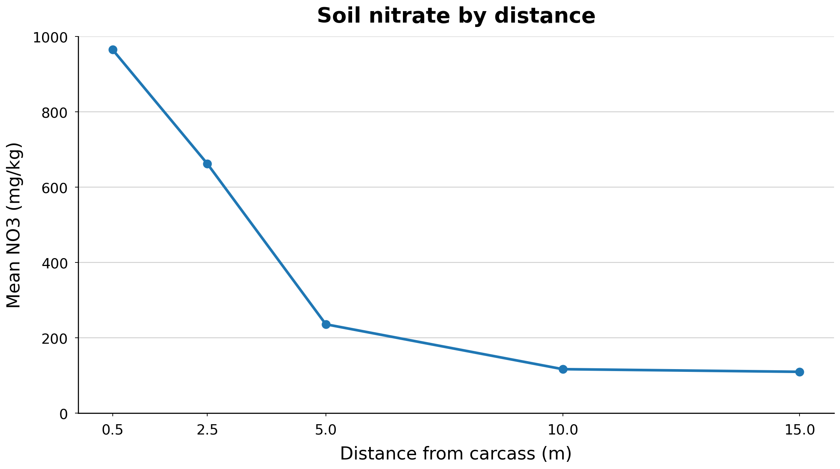

Slide 18
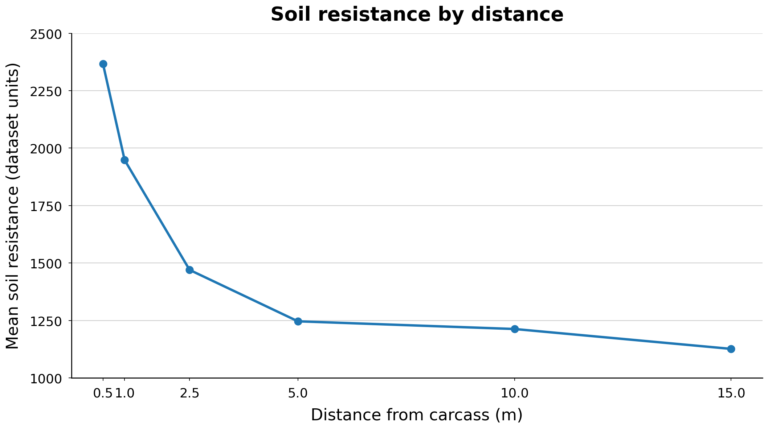

Slide 19
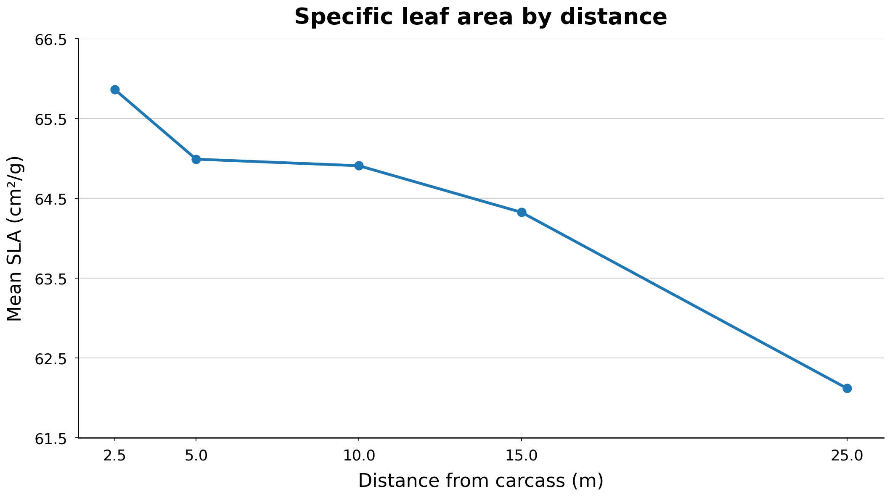

Slide 20
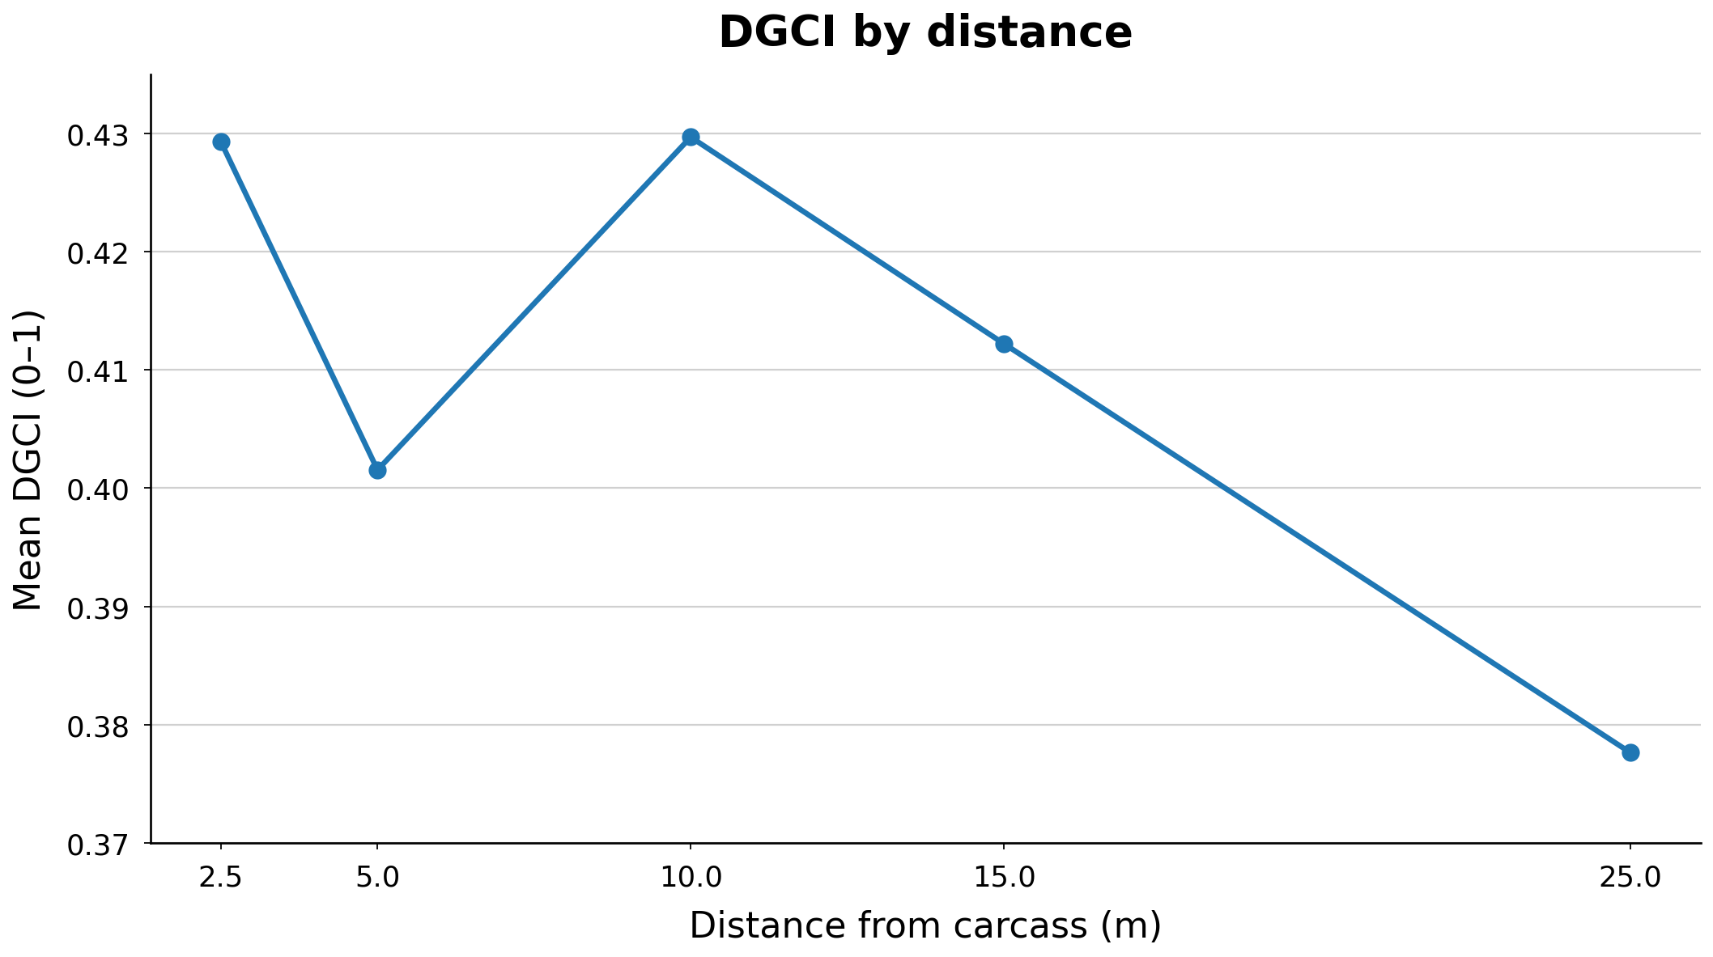

Slide 21
