Slide 1
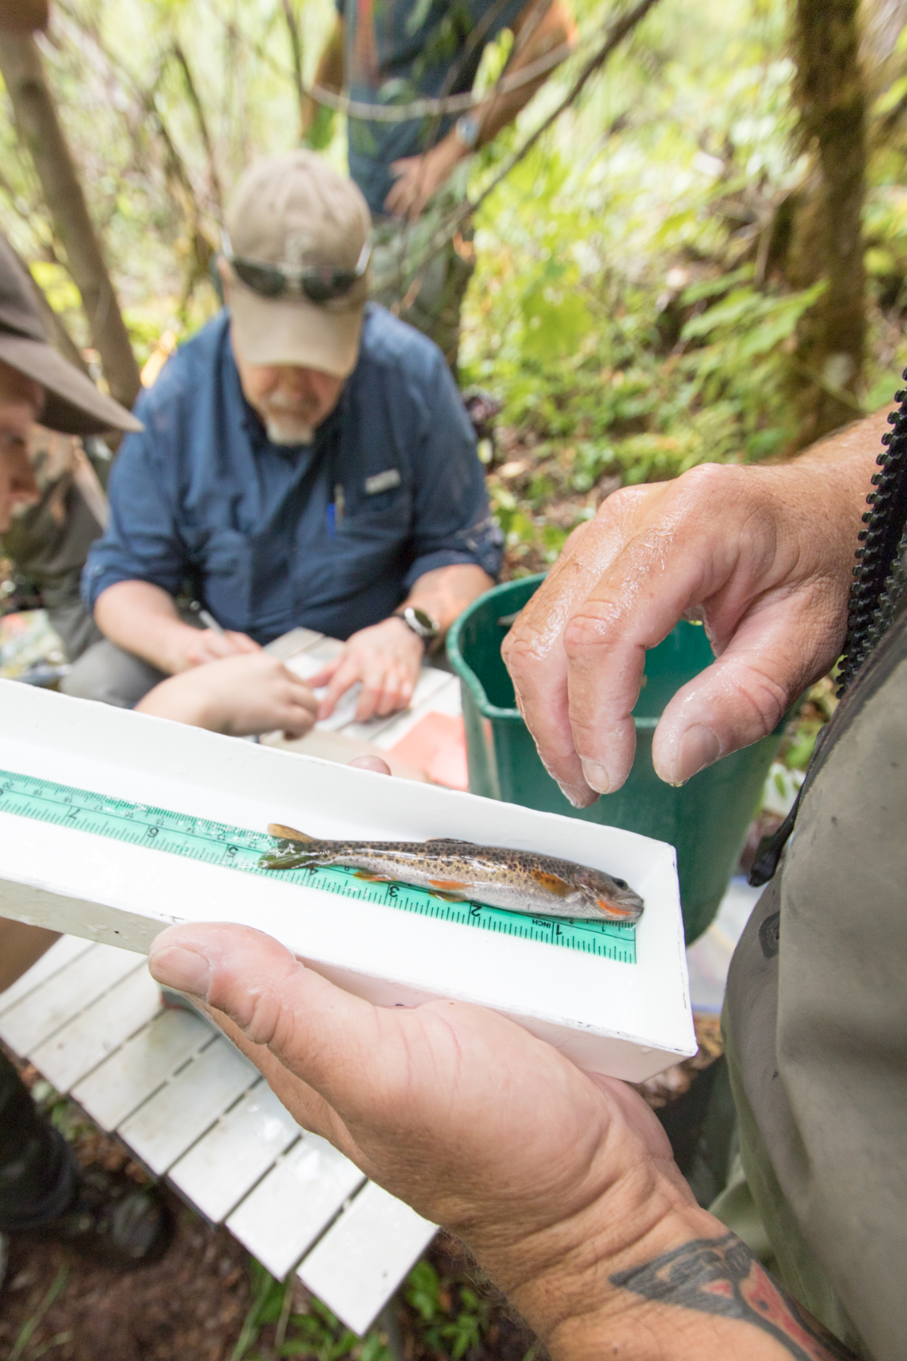
Measuring body length of a cutthroat trout
Photographed by: Lina DiGregorio
Date: 9/7/2022
Photo number: afb_067
(from HJ andrews website)

Slide 2
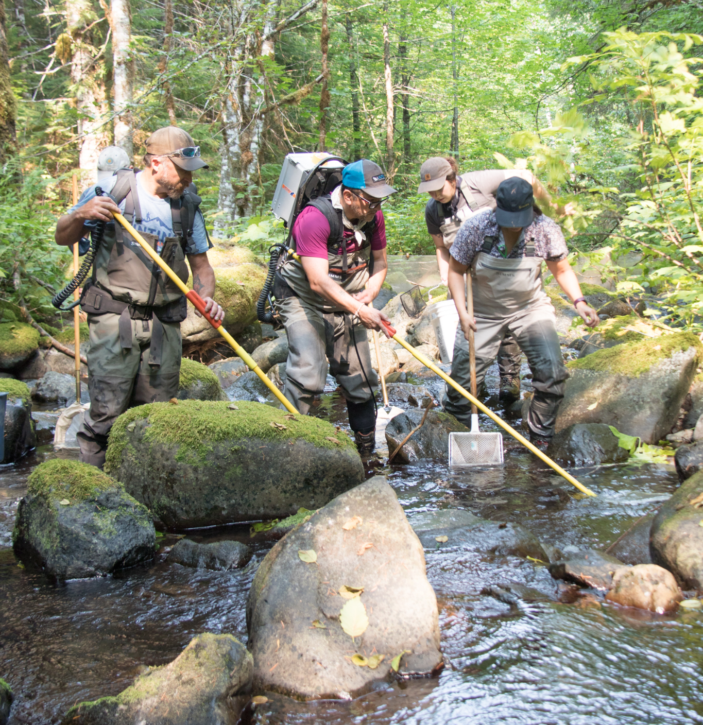
electroshocking and netting fish and salamanders
Photographed by: Lina DiGregorio
Date: 9/7/2022
Photo number: afb_017
(from HJ andrews website)

Slide 3
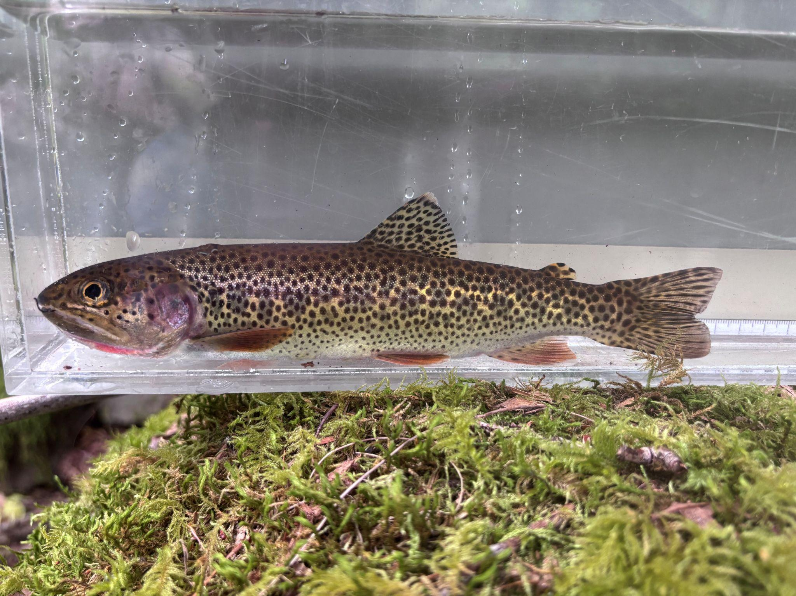

Slide 4
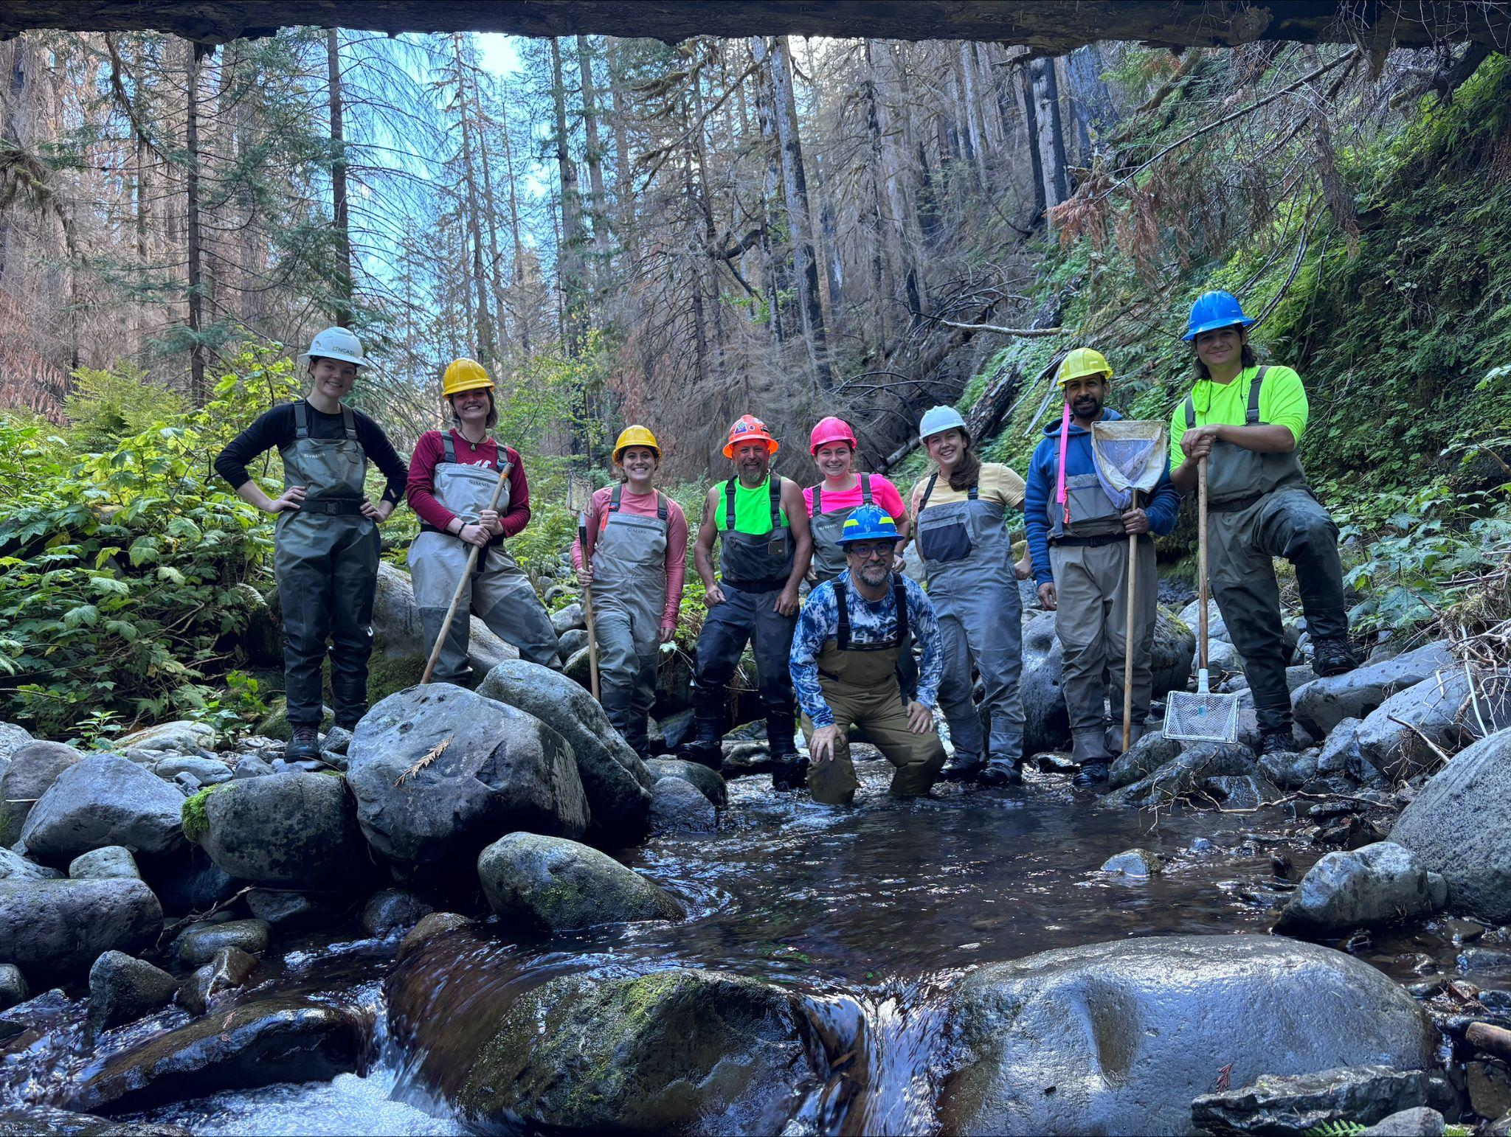

Slide 5
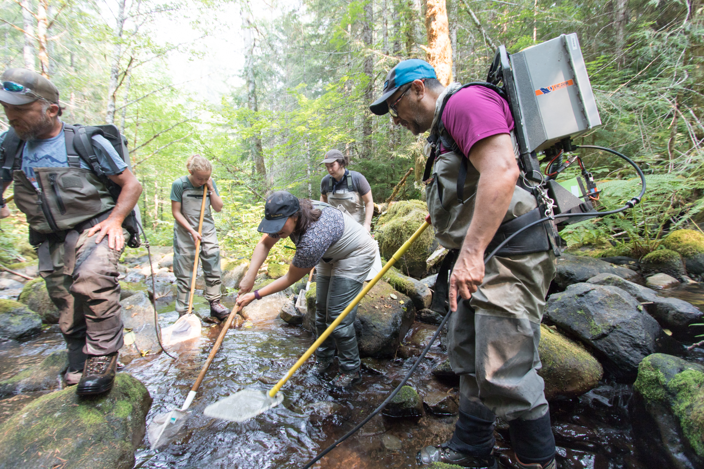
electroshocking and netting fish and salamanders
Photographed by: Lina DiGregorio
Date: 9/7/2022
Photo number: afb_021
(from HJ andrews website)

Slide 6
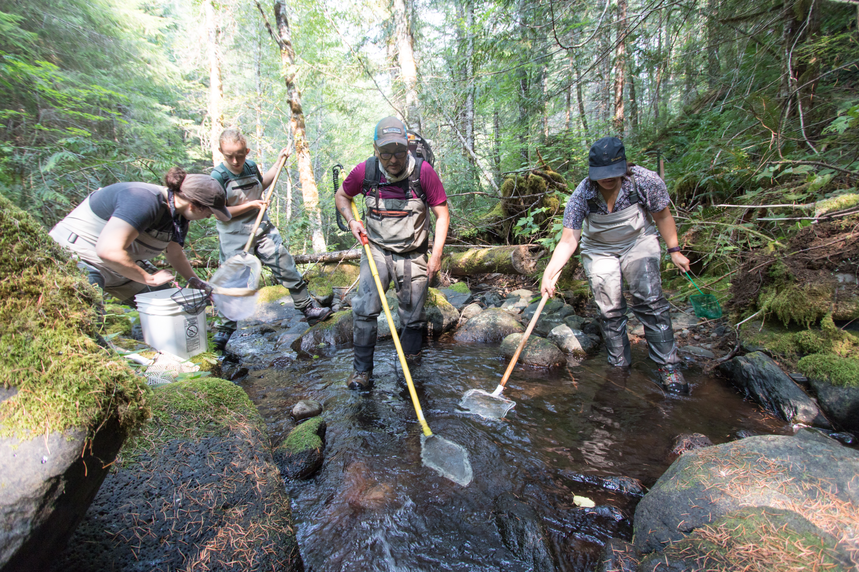
The research team moves as an orchestrated group, electroshocking and netting fish as they move forward
Photographed by: Lina DiGregorio
Date: 9/7/2022
Photo number: afb_027
(from HJ andrews website)

Slide 7
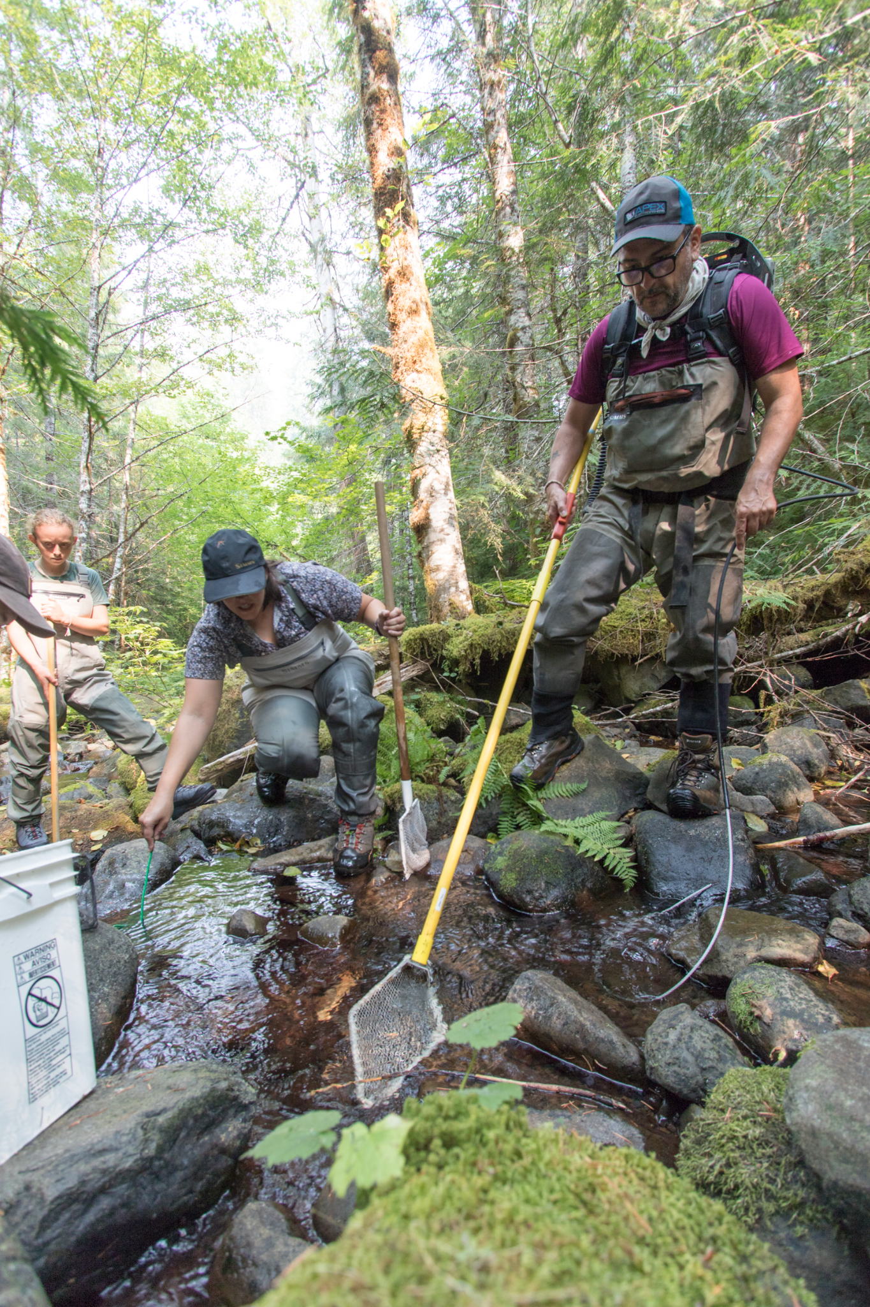
Christina Linkem and Ivan Arismendi netting fish in Mack Creek
Photographed by: Lina DiGregorio
Date: 9/7/2022
Photo number: afb_023
(from HJ andrews website)

