Slide 1

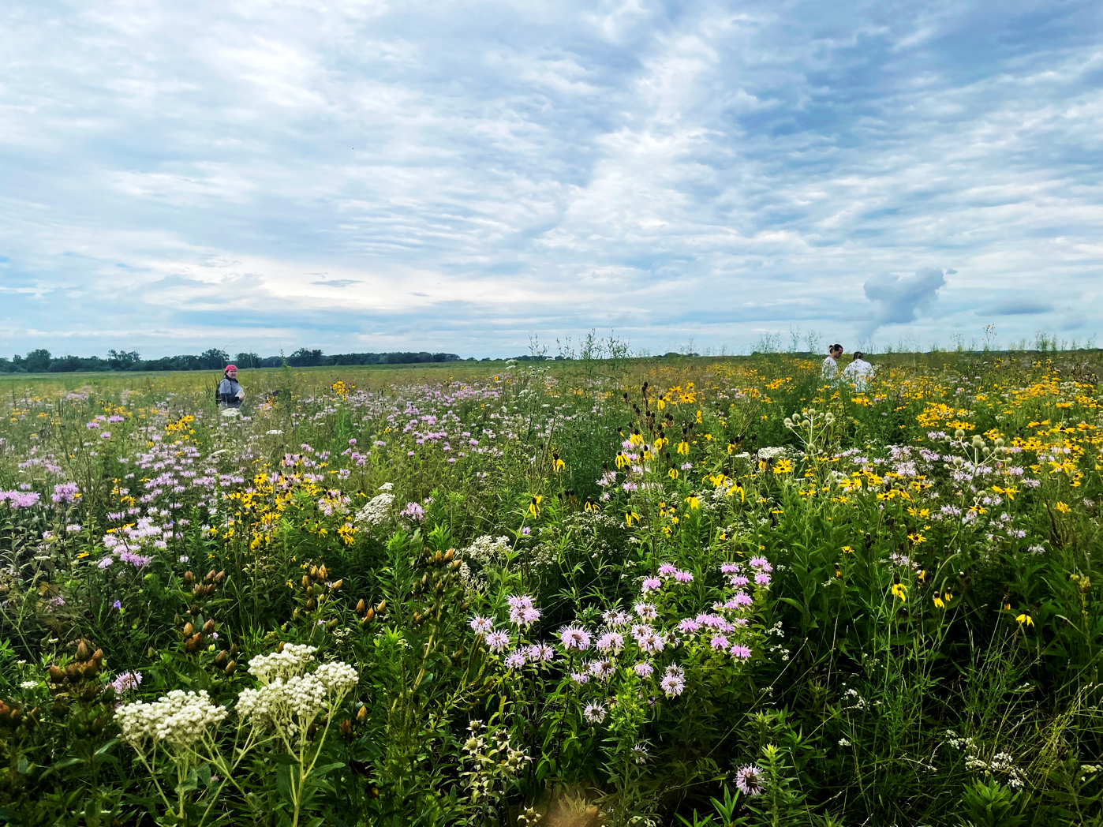
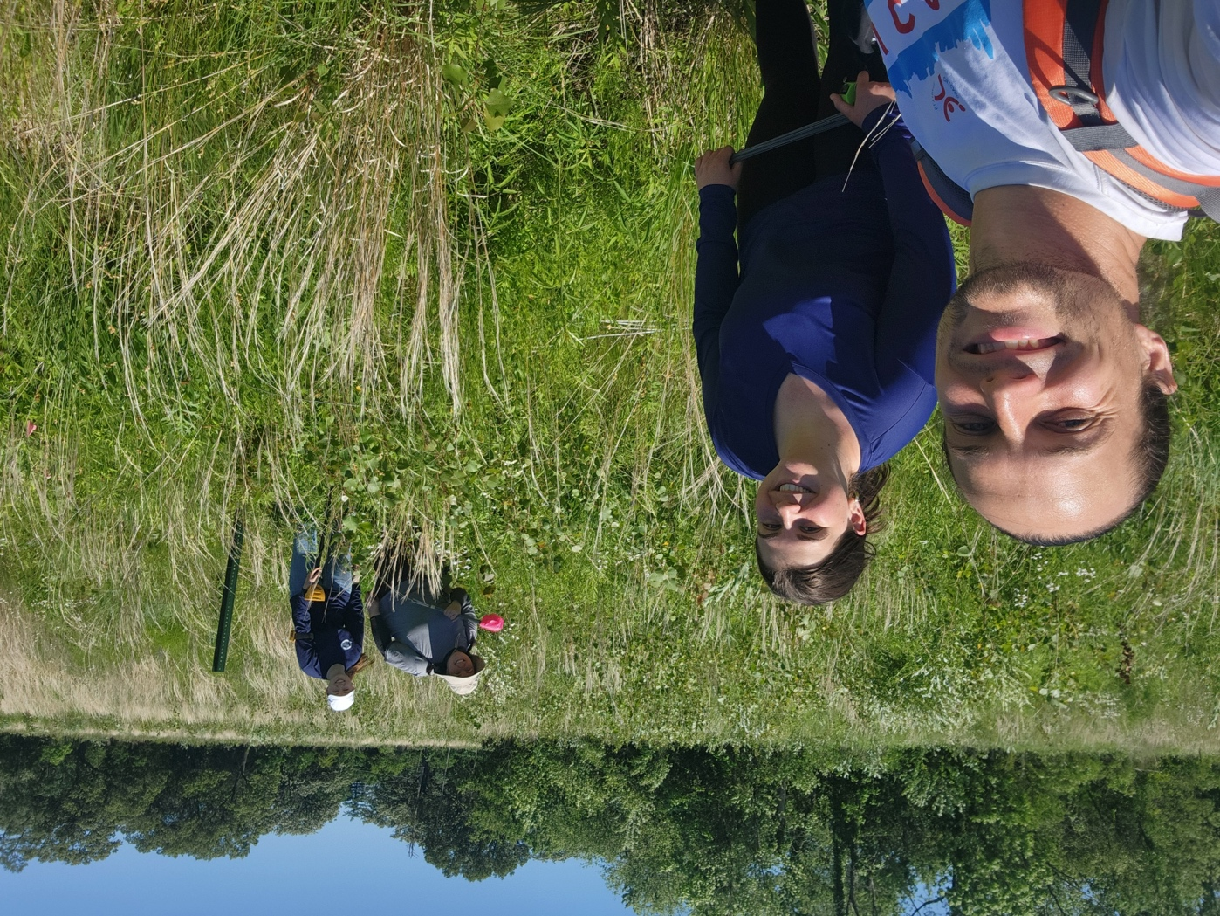
Missing species: the biodiversity of prairie remnants
Featured scientists: Mike Grillo and Jeremy Davis from Loyola University-Chicago and Nick Budde from the Forest Preserves of Will County (IL).
Written with: Kerrie Rovito and Katarina Alvarado from Chicago Public Schools.

Slide 2
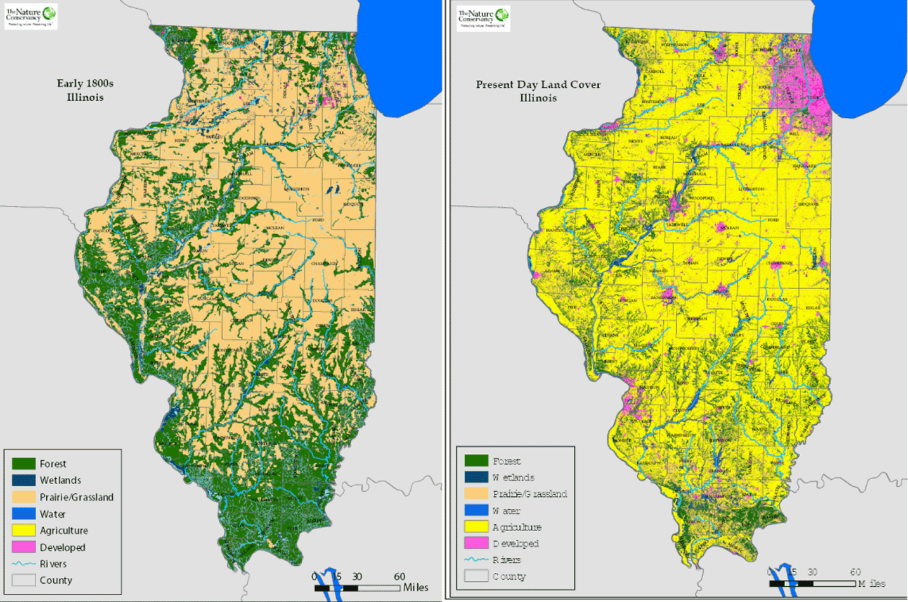
Historical (left) vs present-day (right) land cover in Illinois. The beige represents the prairies. Notice it is very difficult to even spot the prairies on the right. The yellow is agricultural fields, showing how the landscape has changed from prairie to agriculture. Image from The Nature Conservancy.

Slide 3
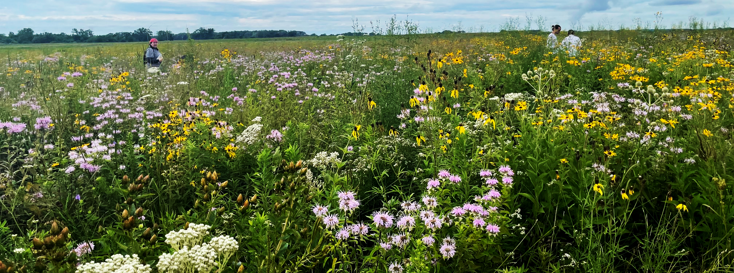
Remnant prairies in Illinois are filled with a diversity of grasses and forbs, as well as microbes, invertebrates, mammals, and more!

Slide 4
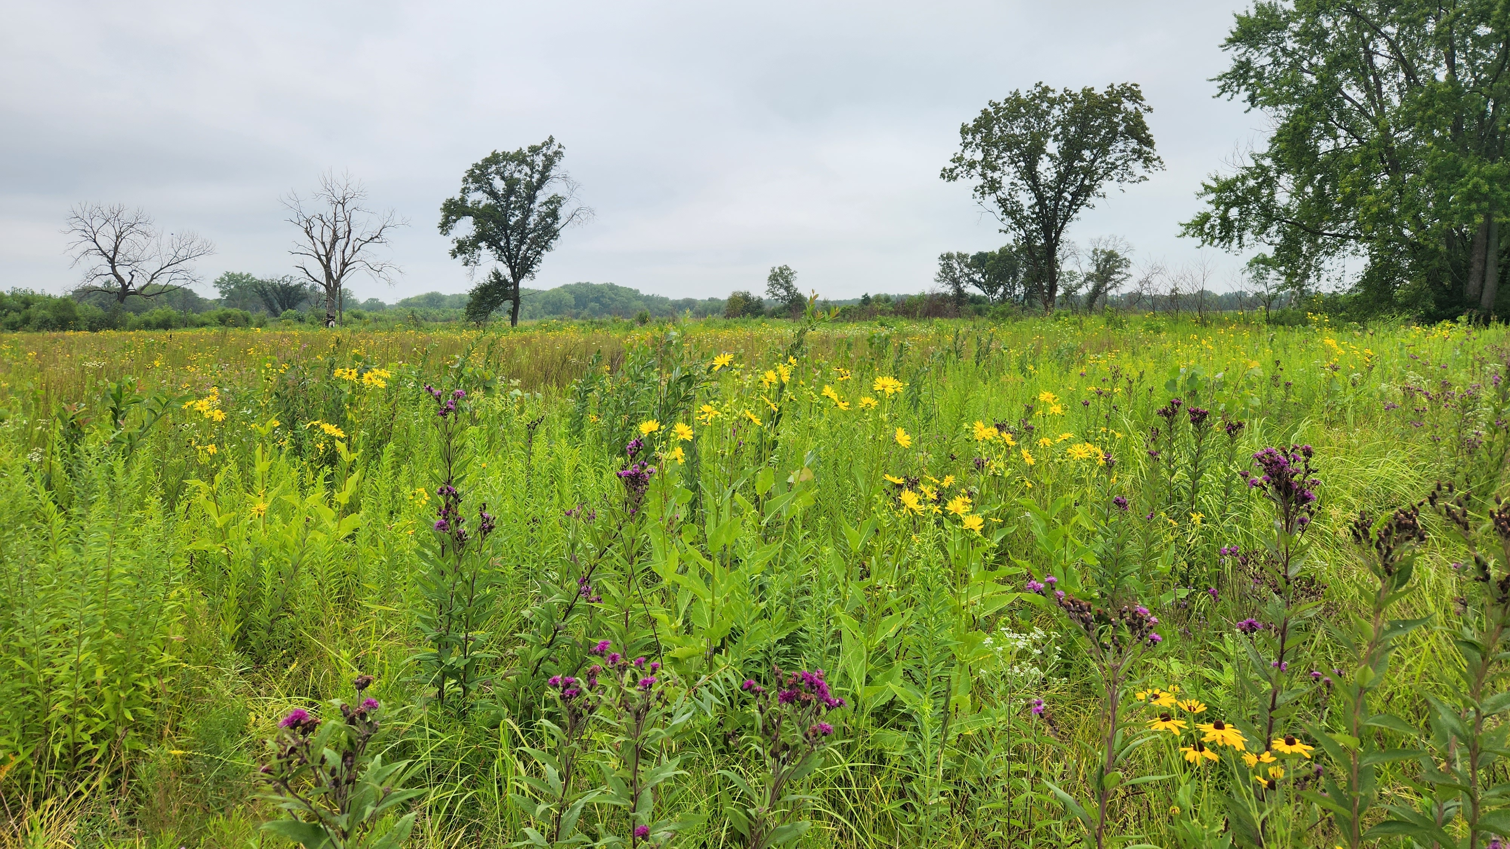

Slide 5
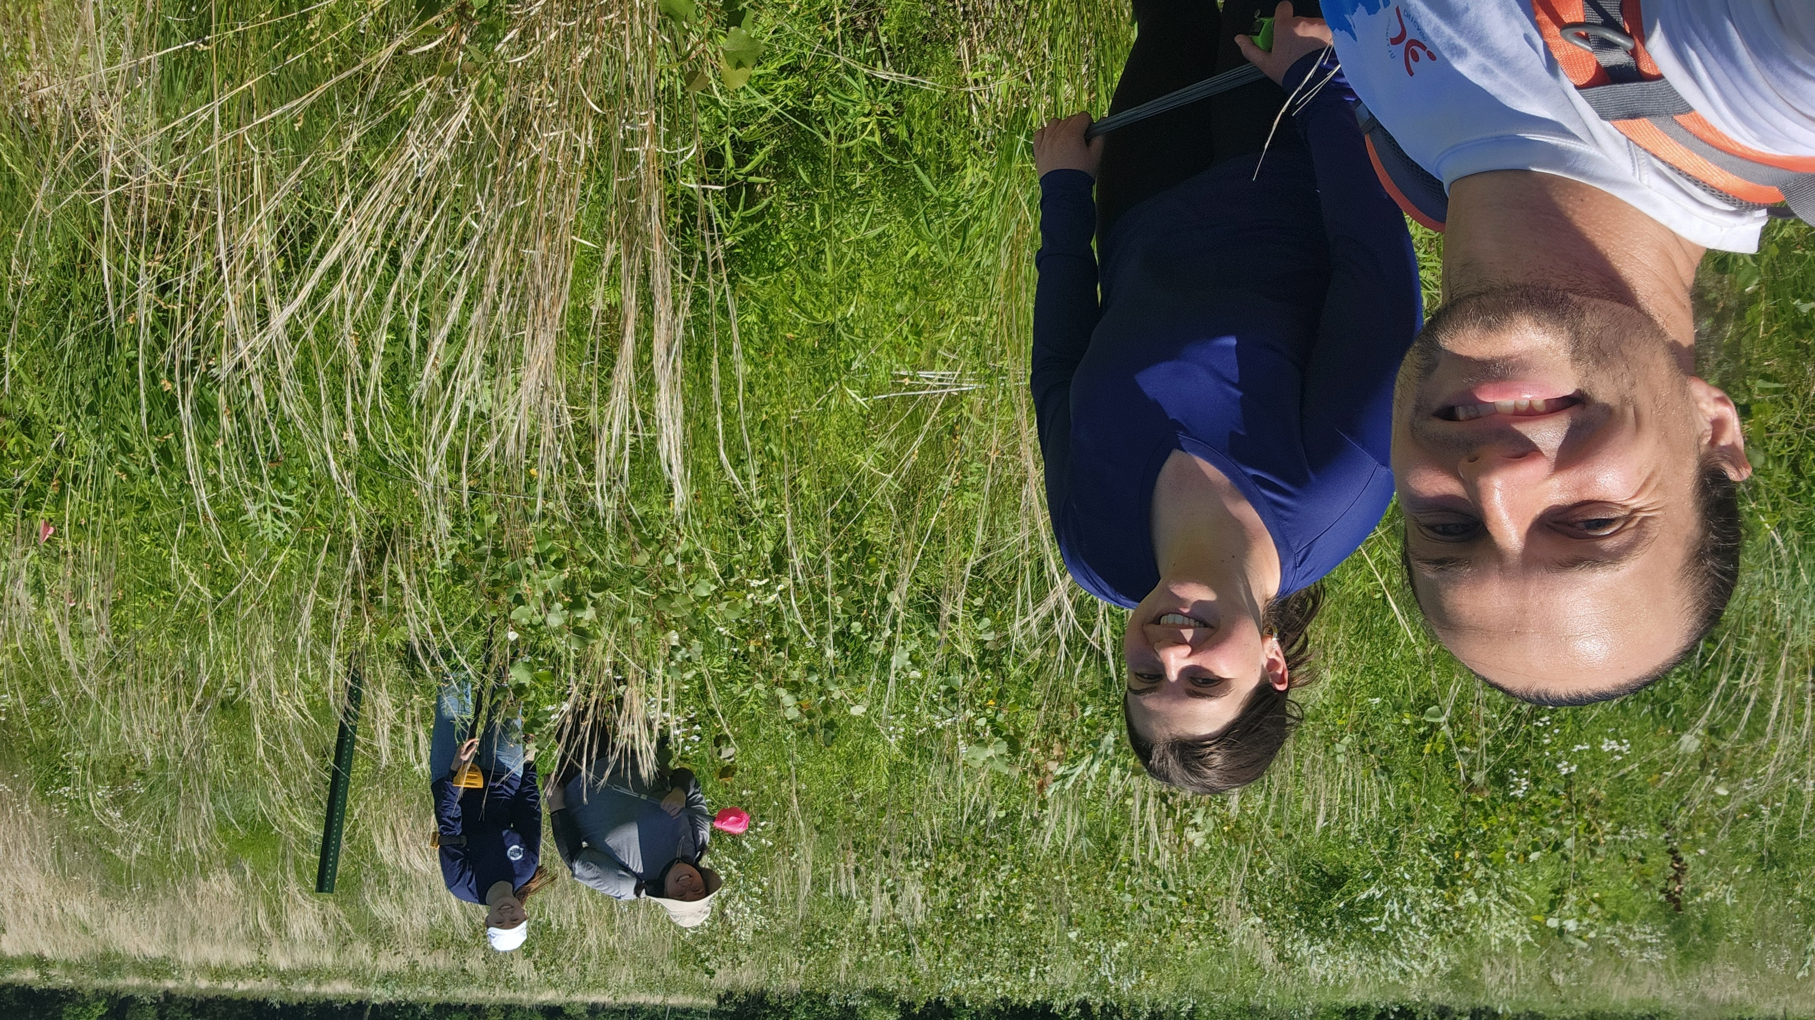

Slide 6
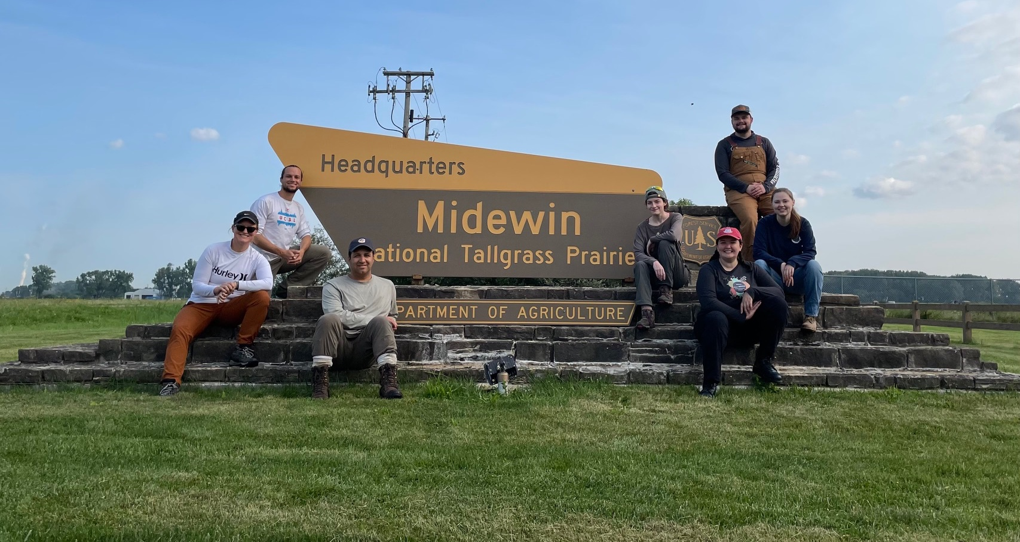

Slide 7
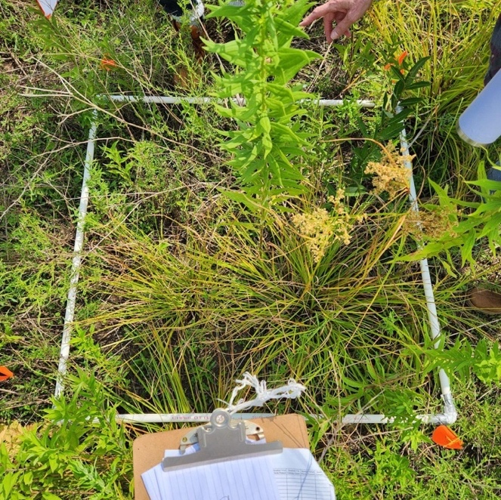
Researchers identifying plants in the remnant prairie site to document species richness.

Slide 9
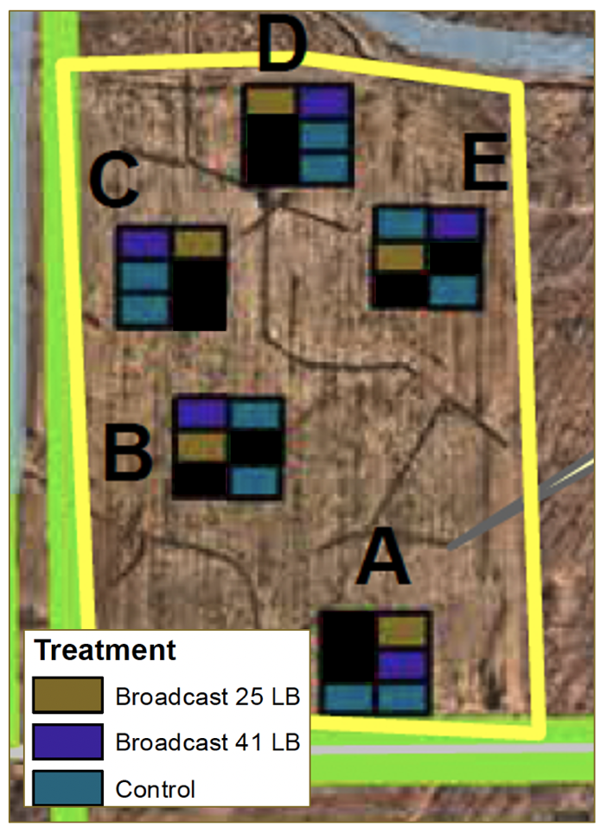
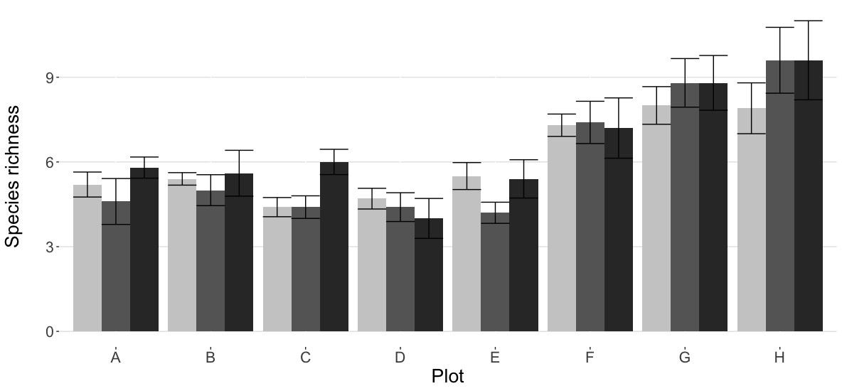
This study was done at several sites, 5 of which are shown to the left. At each site, there were 6 potential plots. The treatments were randomly assigned, 1 with low AMF broadcast, one with high AMF broadcast, and 2 controls.
The full results from all the sites are presented below.

