Slide 1
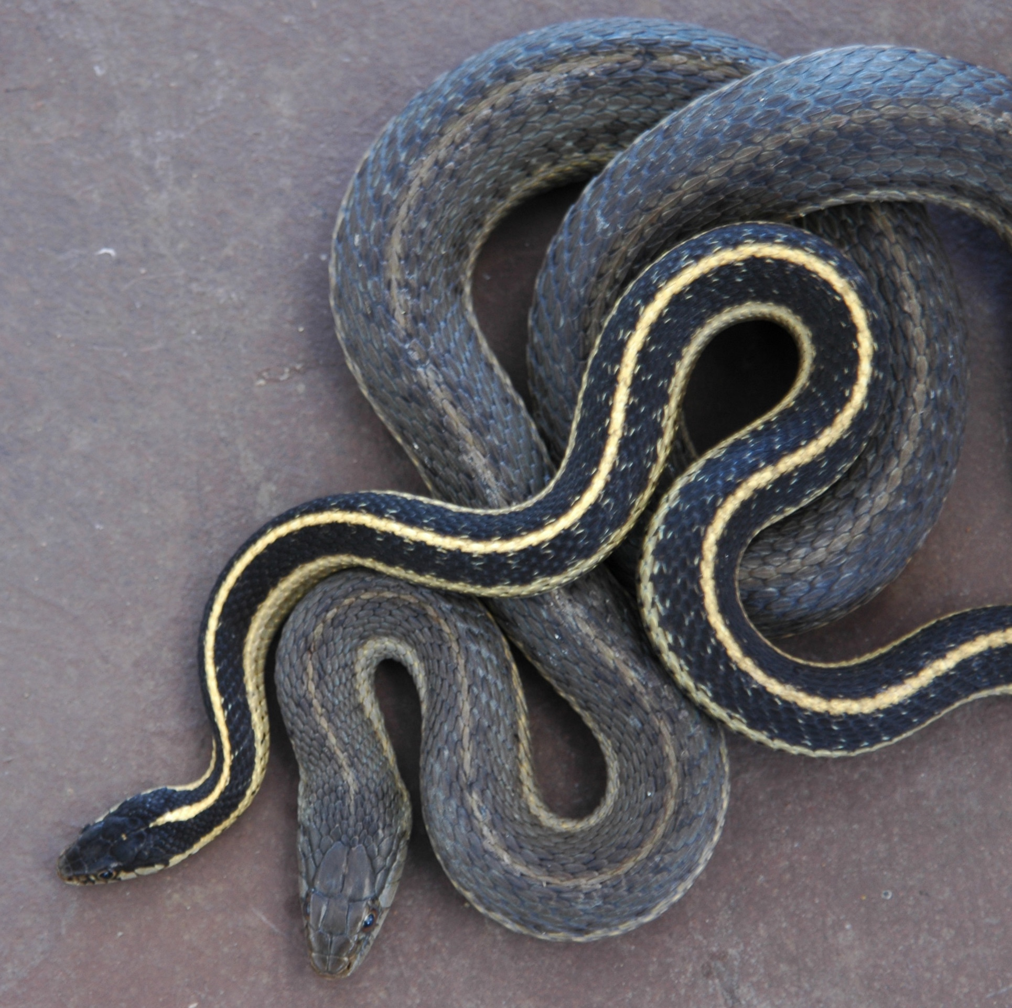

Live fast, die young?
Featured scientists: Kaitlyn Holden (she/her) and Anne Bronikowski (she/her) from Michigan State University

Slide 2
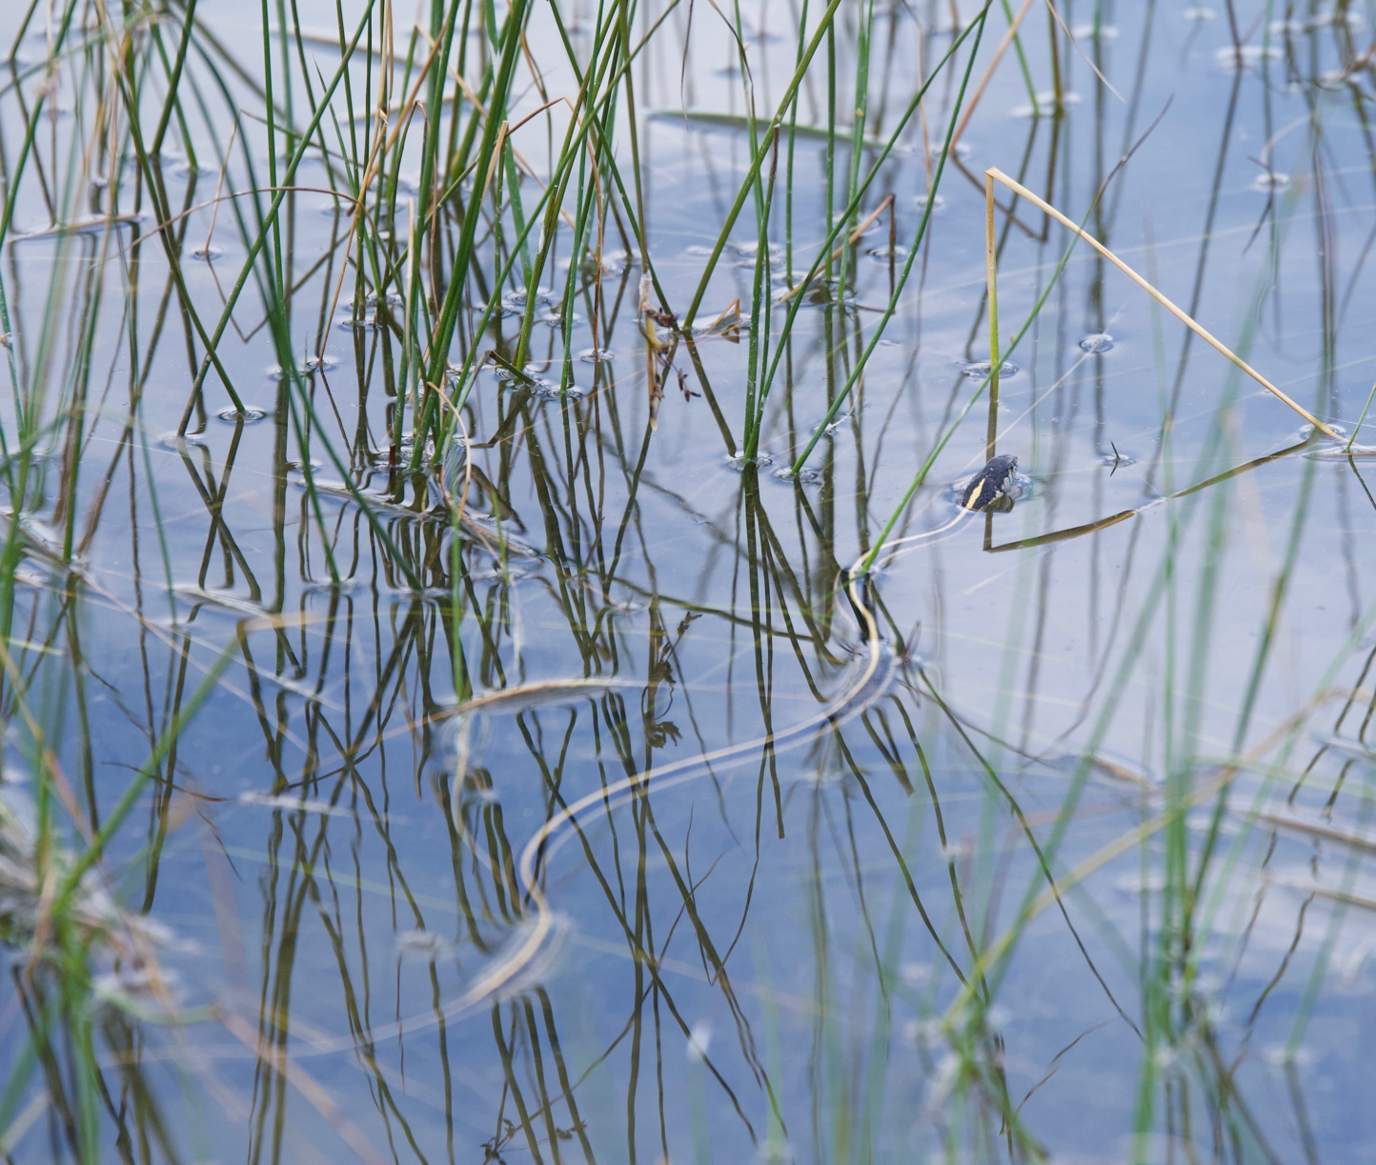
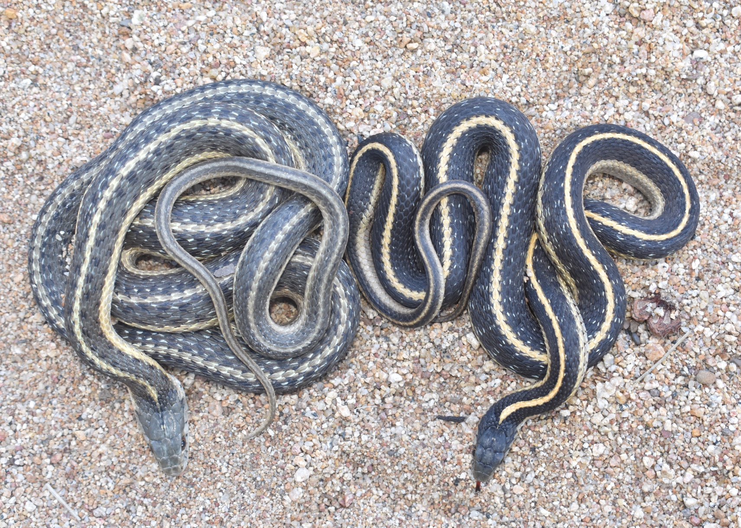
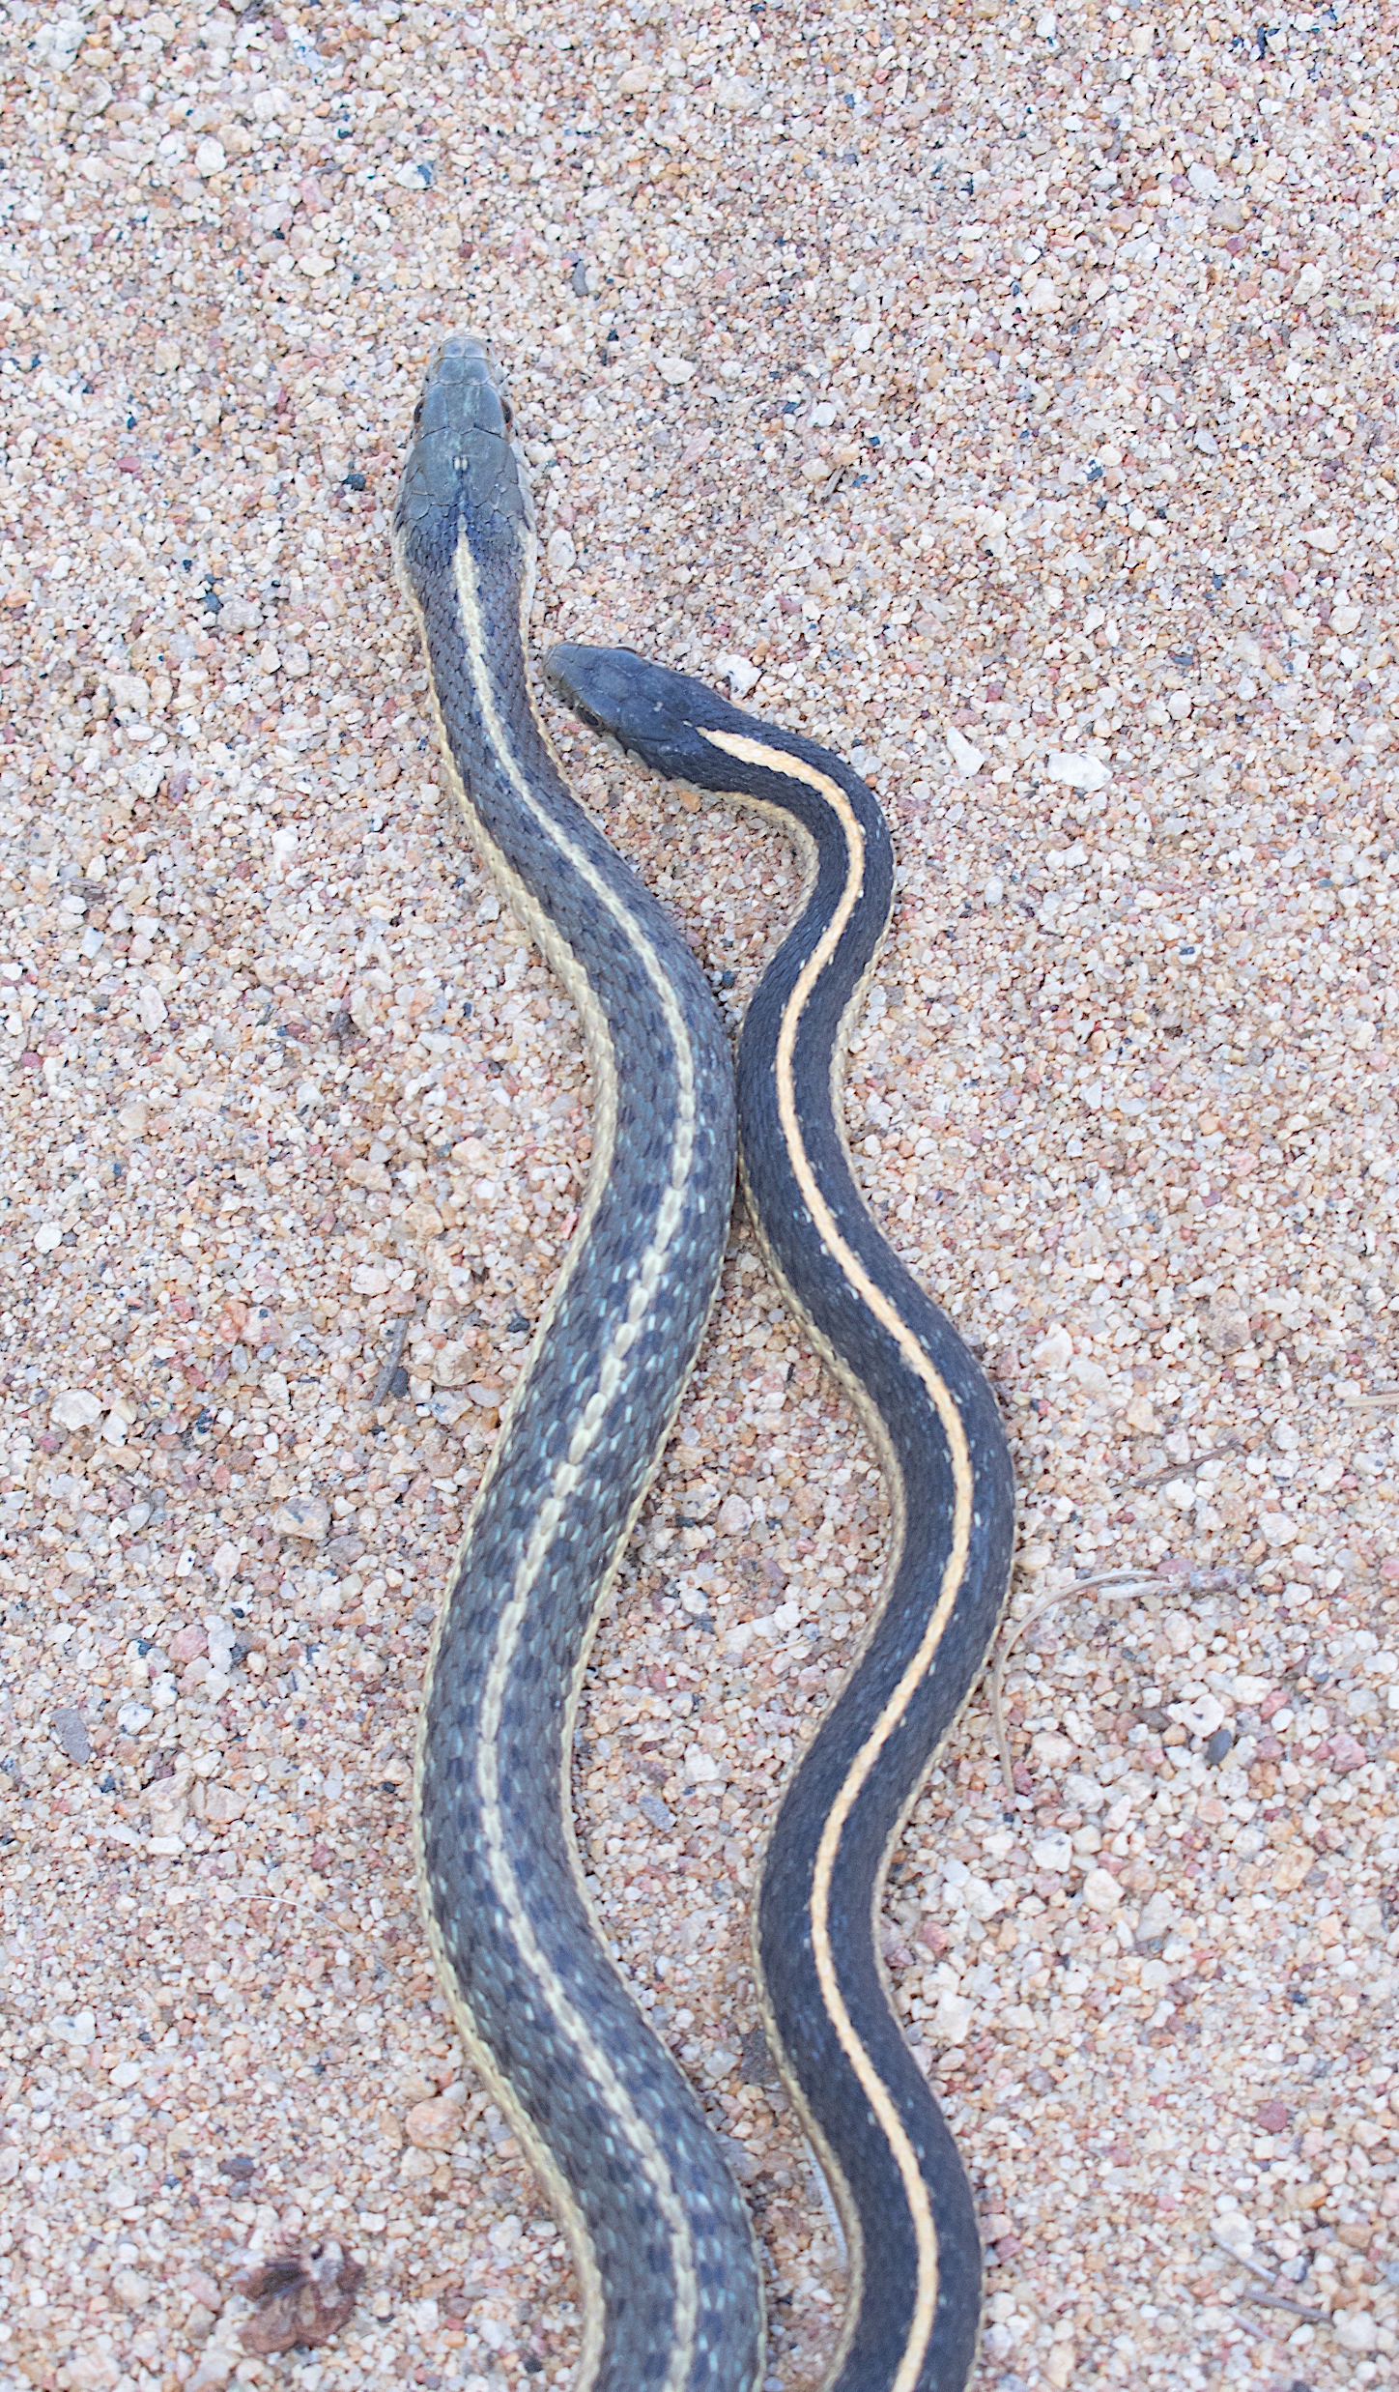
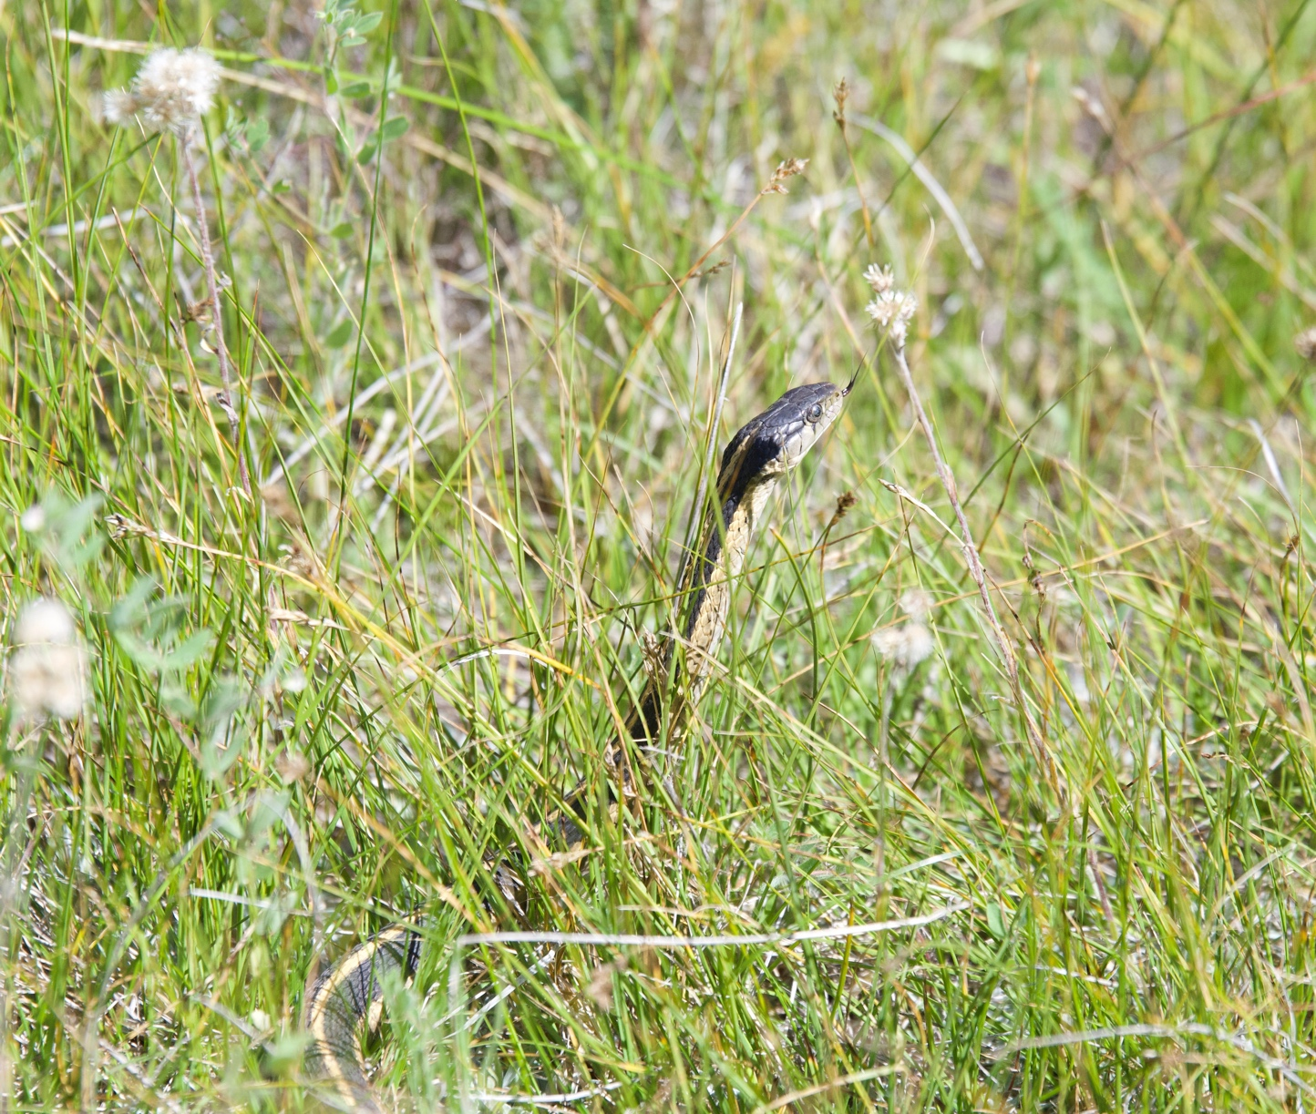
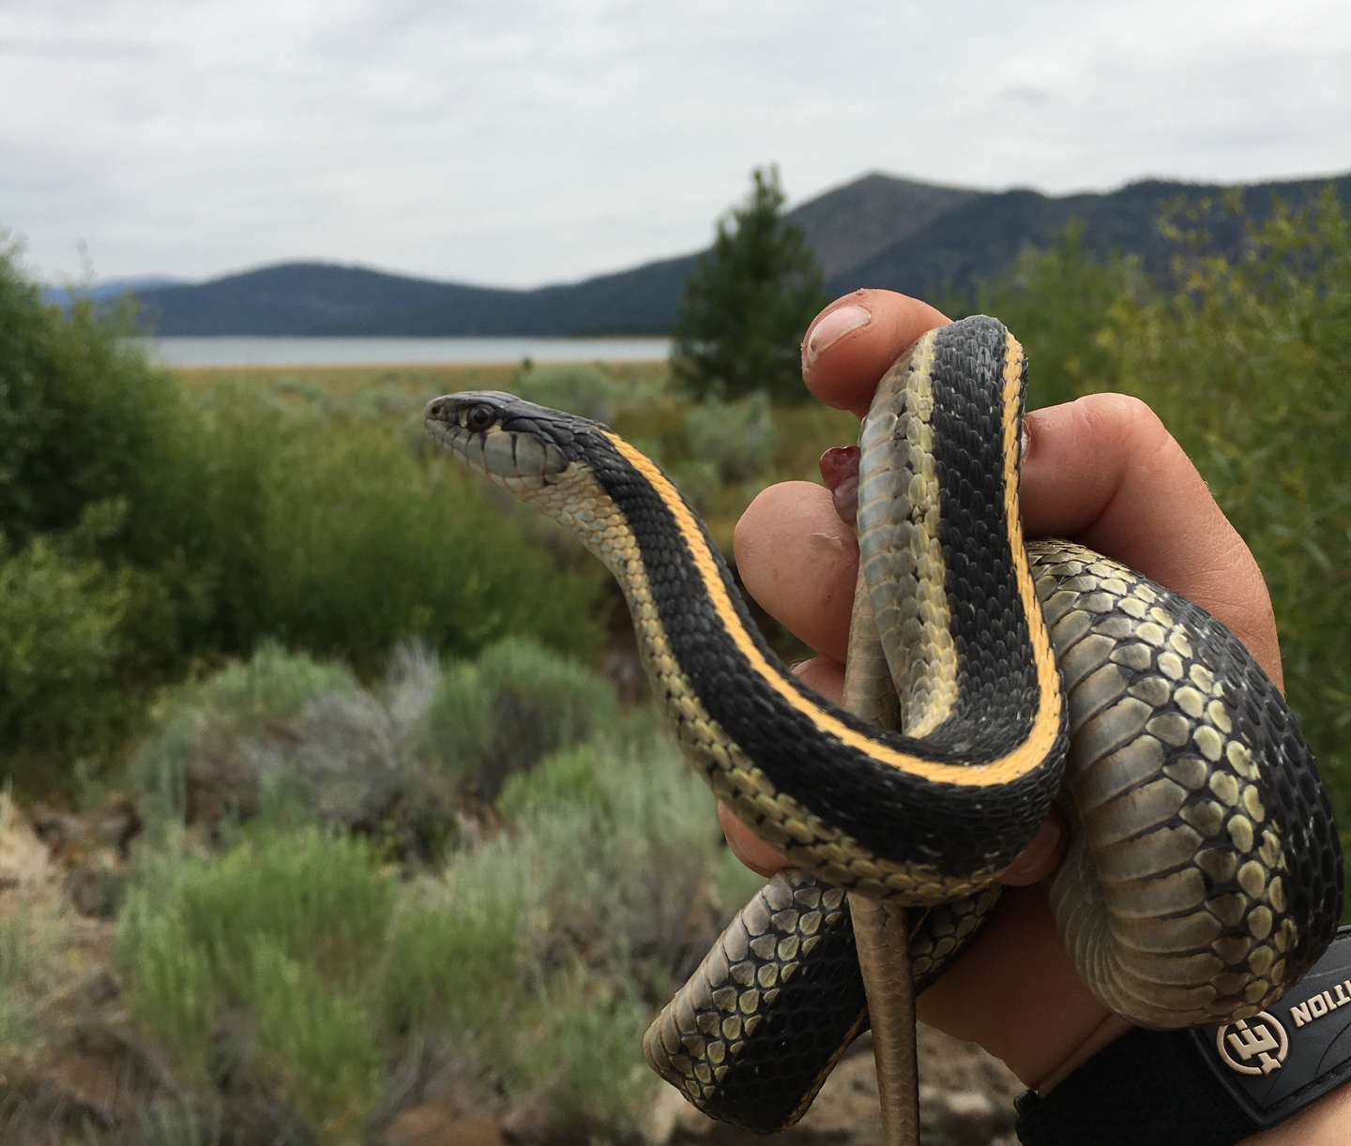
Notes:
Garter snakes are a common sight across North America, but one small species in Northern California has helped scientists learn a lot about how animals adapt to their environment. Since 1972, a long lineage of scientists has studied these snakes and passed their data down through generations. This long-term dataset allows scientists to ask questions about how replicate populations change over time.
These garter snakes live in two very different types of habitats. Some populations live along lakeshores at low elevations. These areas have rocky shorelines, warmer temperatures, and steady access to water and food like small fish and frogs. However, these snakes also face more predators. Other populations live in high-elevation mountain meadows. These habitats are cooler and covered in grass. Water and food are not always available and can change each year depending on snow and rain. Because these habitats are so different, the snakes in each place experience different challenges.

Slide 3
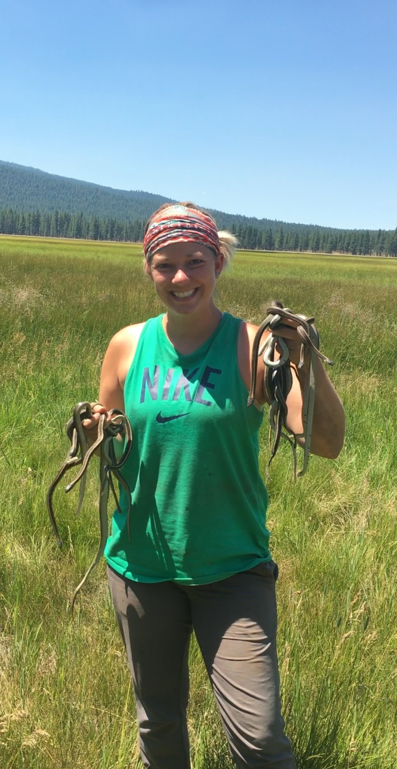
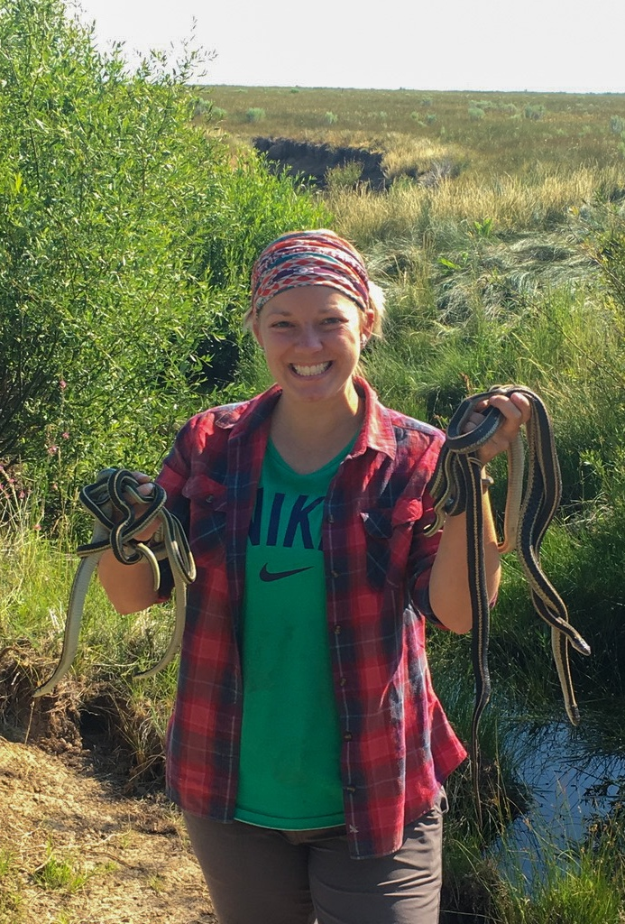
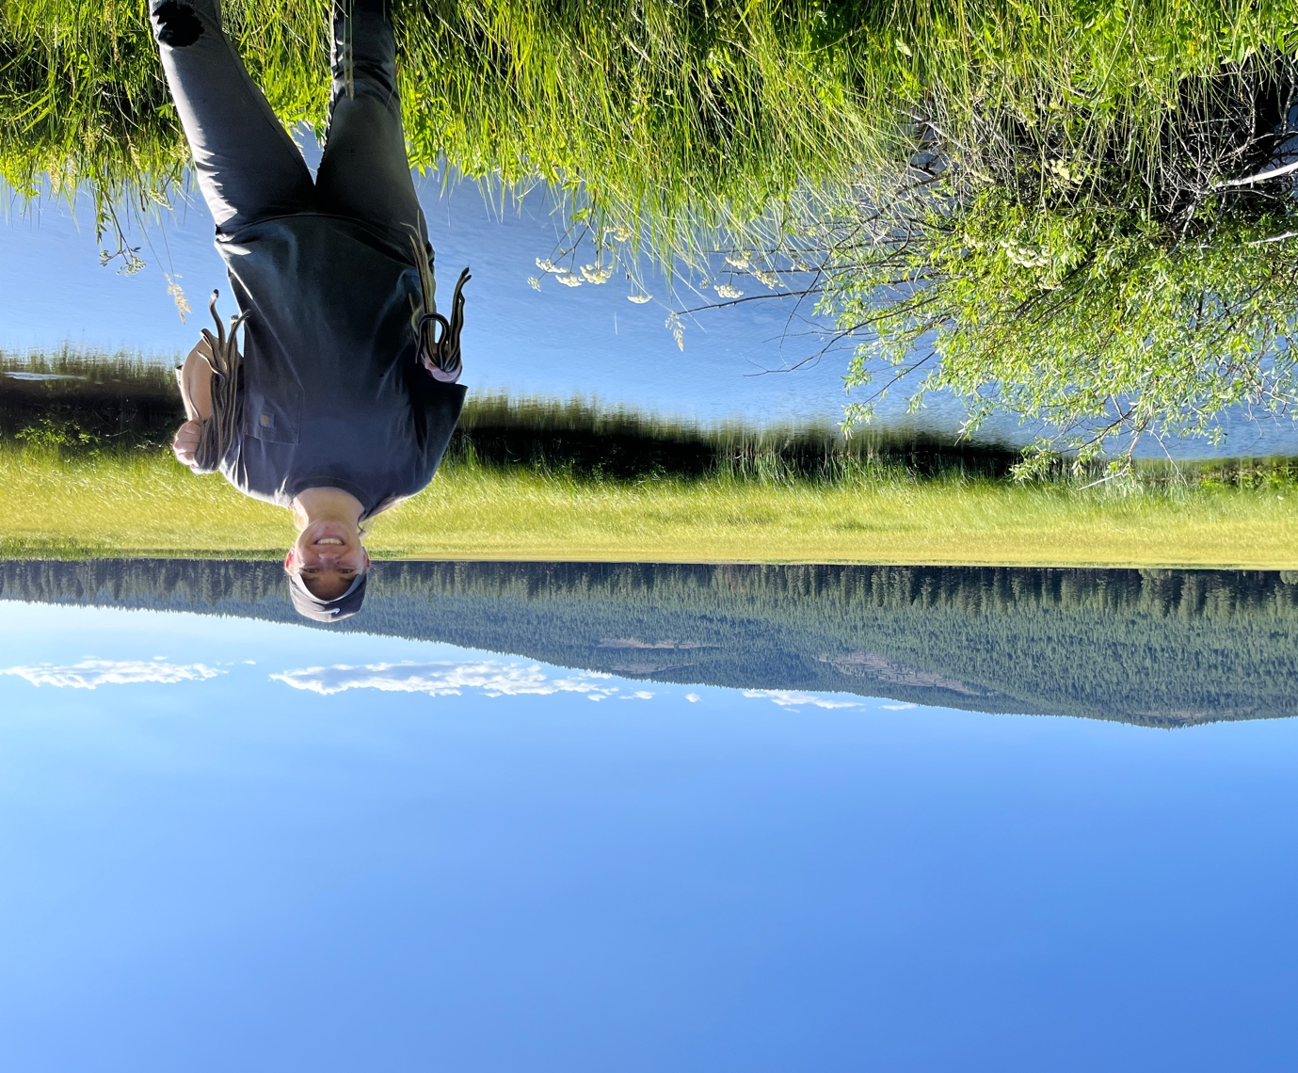
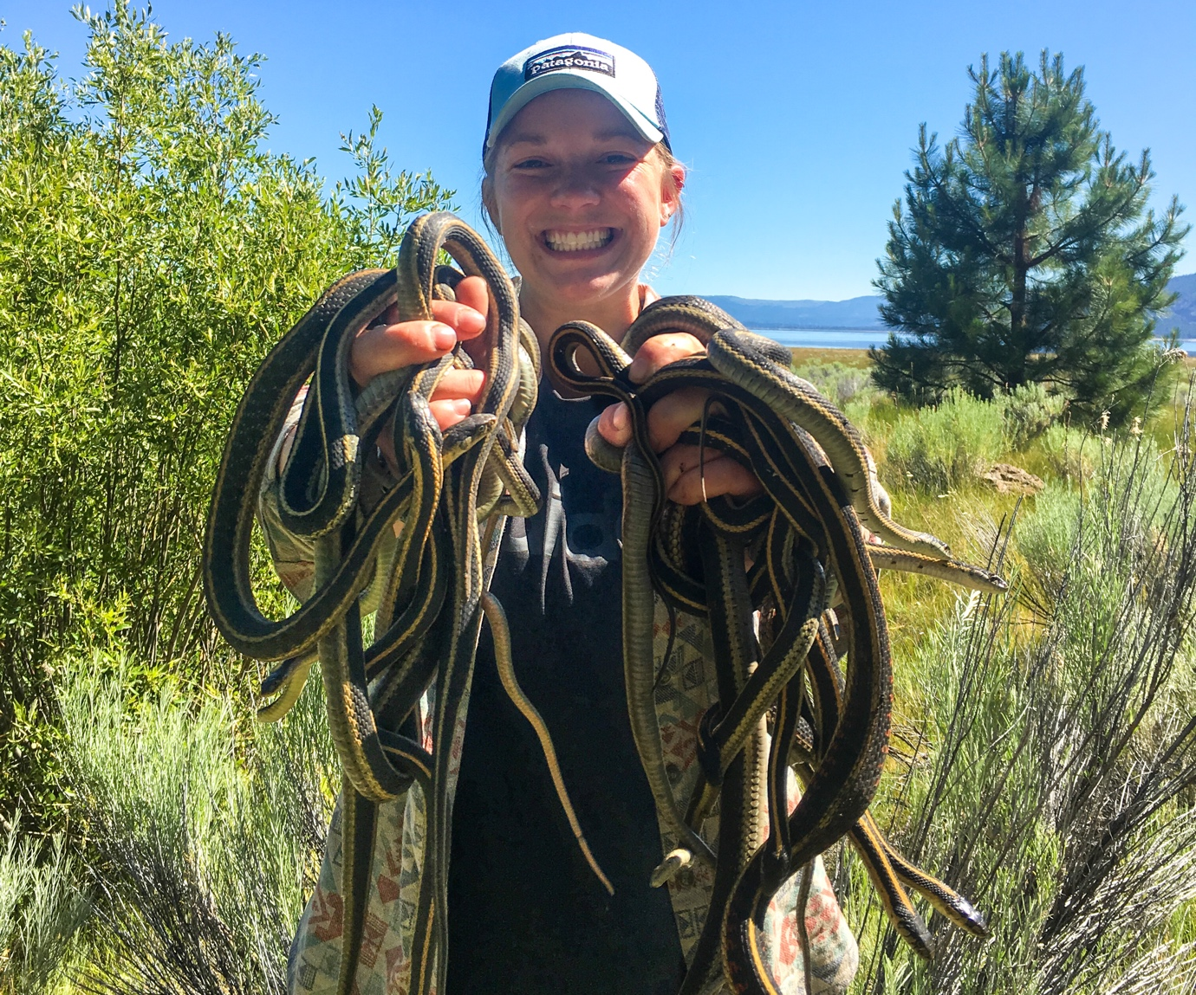
Notes:
Kaitlyn became interested in these snakes after a surprising start to her career. Interested in reptiles since childhood, she originally moved to Texas to join a lab that was studying turtles. Unfortunately, only a few weeks in, the grant money supporting her position fell through - right after she moved from Wisconsin to Texas! Luckily, another researcher invited her to join a lab studying snakes. After earning her Master’s degree, Kaitlyn continued this work during her PhD with her collaborator, Anne.
Kaitlyn and Anne wanted to understand how these snake populations are surviving today, especially after years of severe drought in California. They wondered if survival rates had changed over time and whether snakes in lakeshore and meadow habitats survived differently.

Slide 4
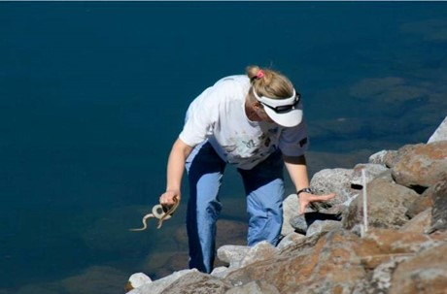
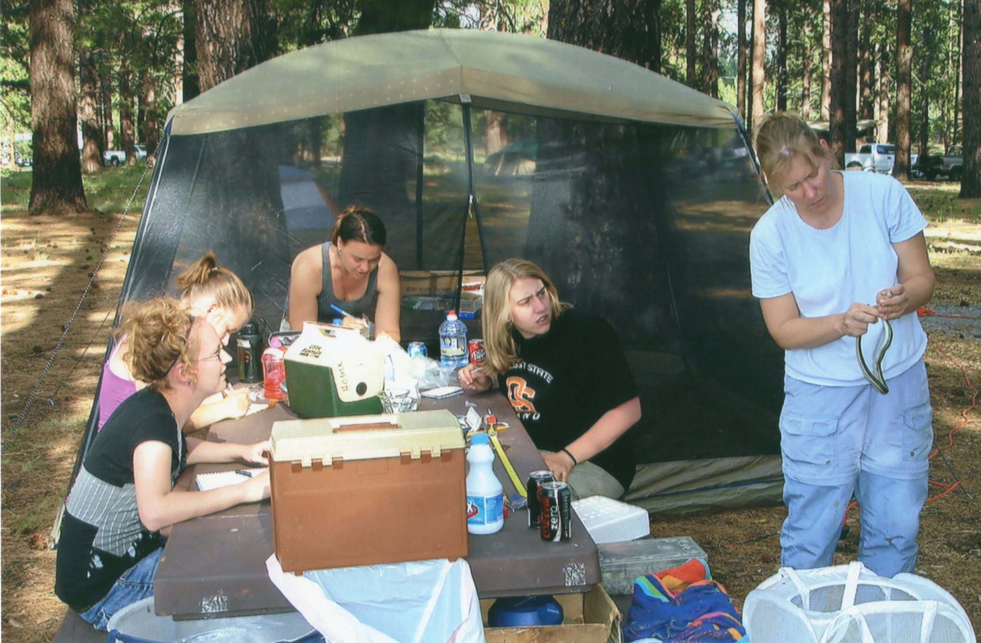
Anne catching lakeshore (fast-living) snakes in the rocks (2005)
Anne demonstrating how to mark a
snake to college and high school students (2012)

Slide 5
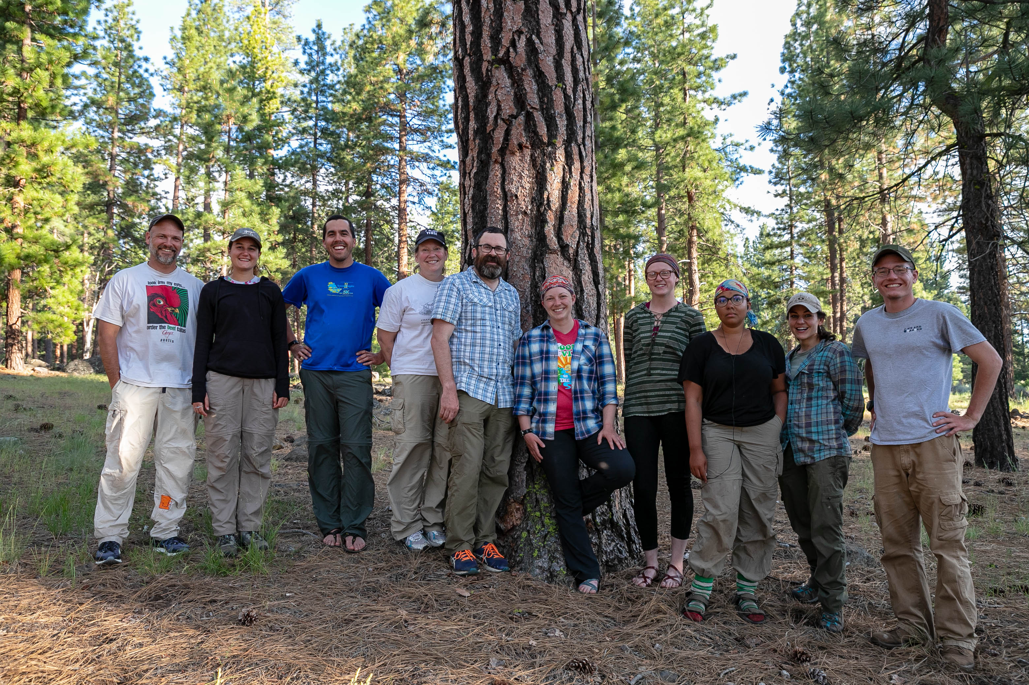
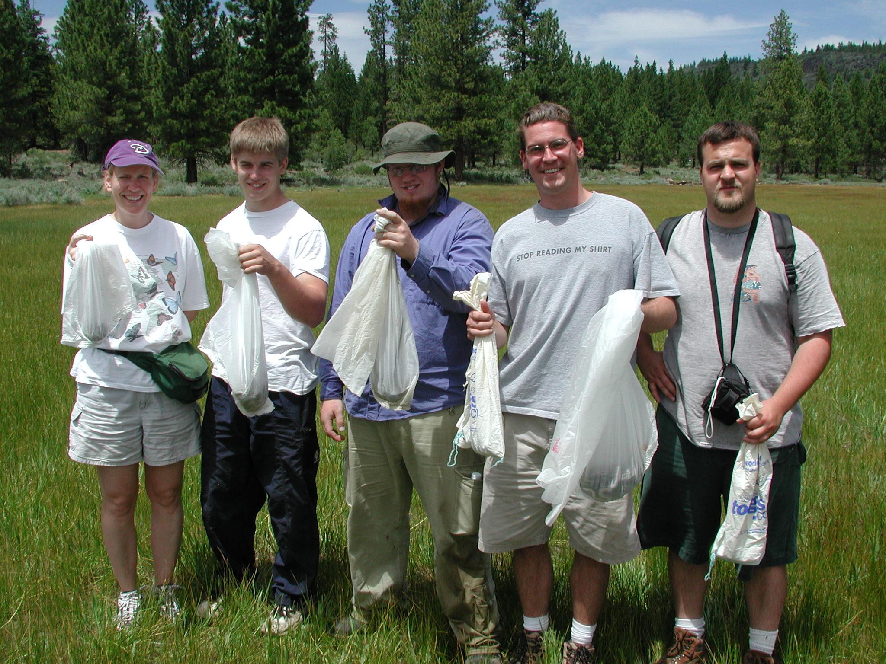
2004 some of the field crew
2019 some of the field crew

Slide 6
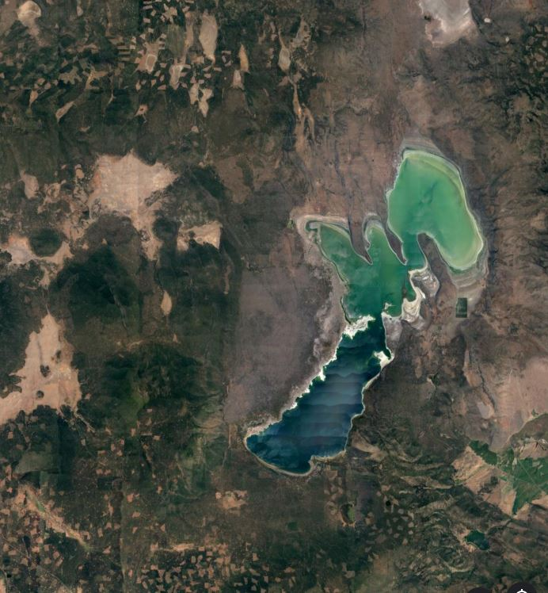
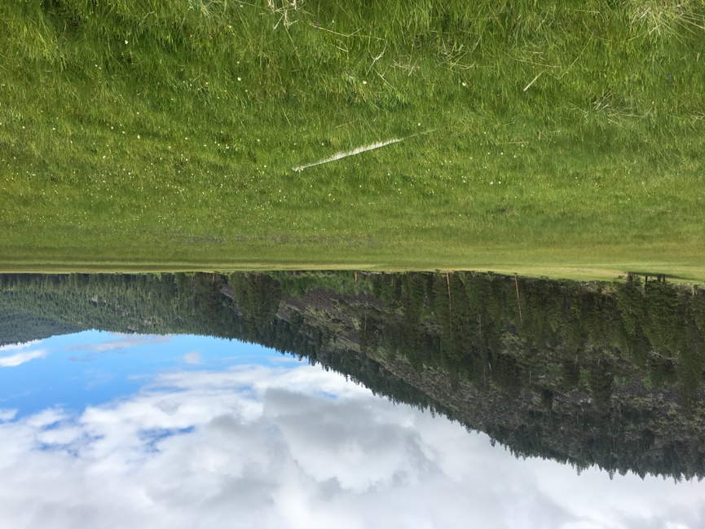
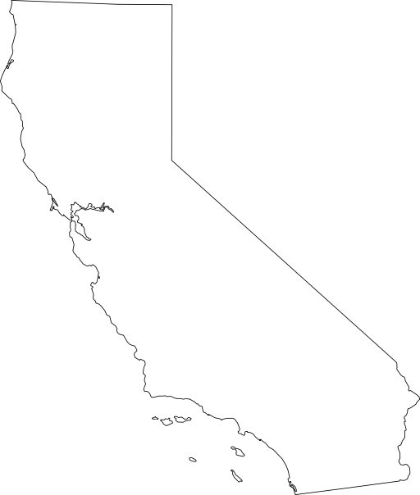
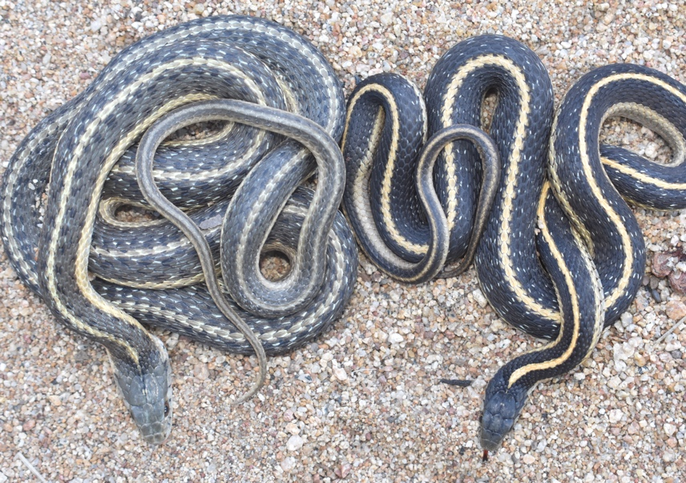
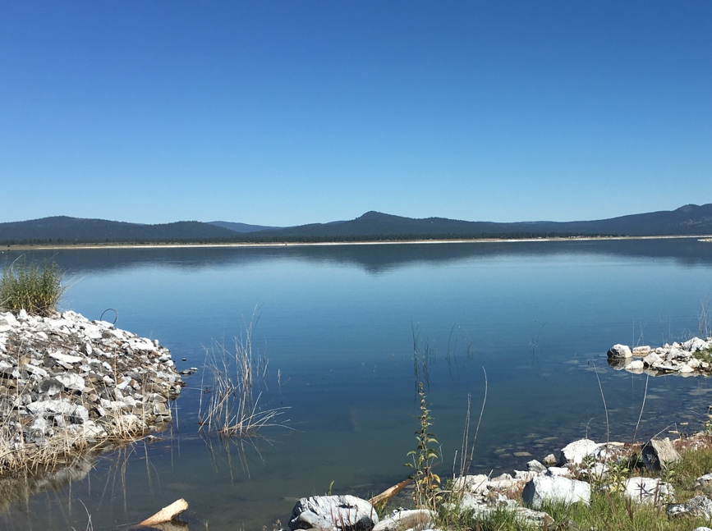
High Elevation
M5
L5
L6
M6
L4
L3
L7
L2
L1
Low Elevation
M1
M3
M2
Eagle Lake, CA
Notes:
Western terrestrial garter snakes (Thamnophis elegans) around Eagle Lake in Lassen County CA – circle with a slash line represents populations that have gone locally extinct
This system is characterized by populations of short-lived garter snakes that live along the rocky lakeshore (red) and long-lived populations that inhabit higher elevation meadows (blue)
These populations have been monitored going back to the 1970s which gives us a unique insight into how rates of growth, survival, and aging may change over time in a natural system
These two habitats are ecologically distinct in temperature, precipitation, elevation, and food availability - with meadow environments experiencing more environmental variability than lakeshore environments. These habitats have driven the evolution of two distinct life-history strategies

Slide 7
M5
L3
L2
L1
M1
M2
M3
M8
M4
Notes:
Satellite image is from 2015 (peak drought)
White outline shows lake boundary from 1984 illustrating shoreline recession

Slide 8
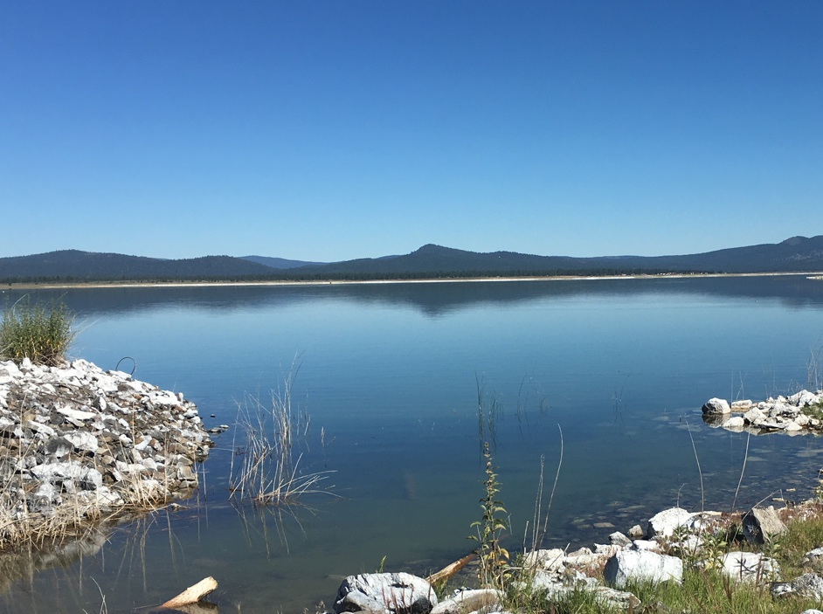
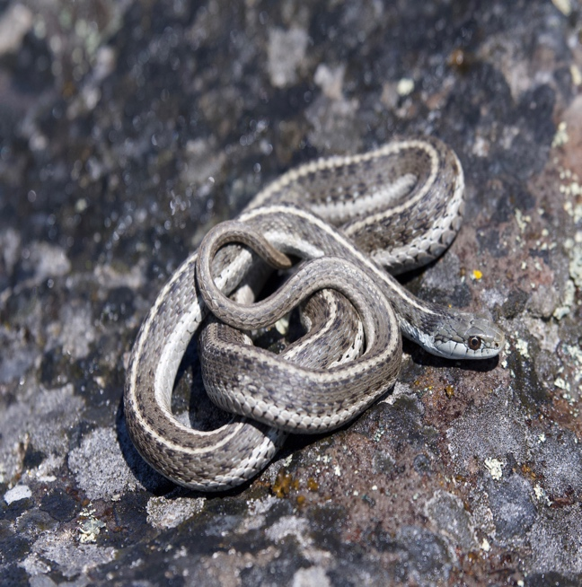

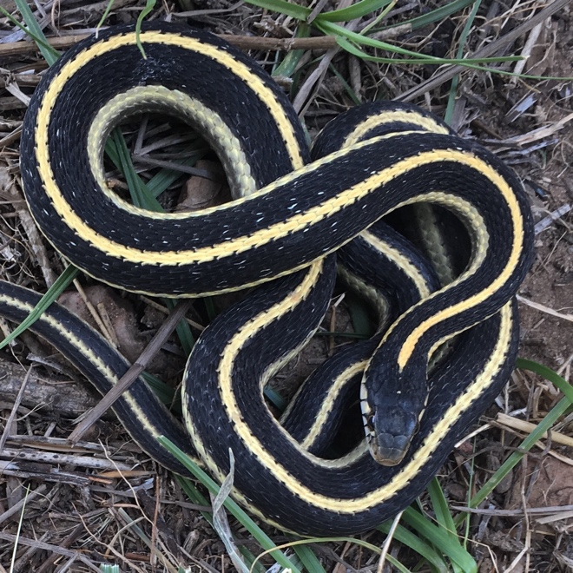
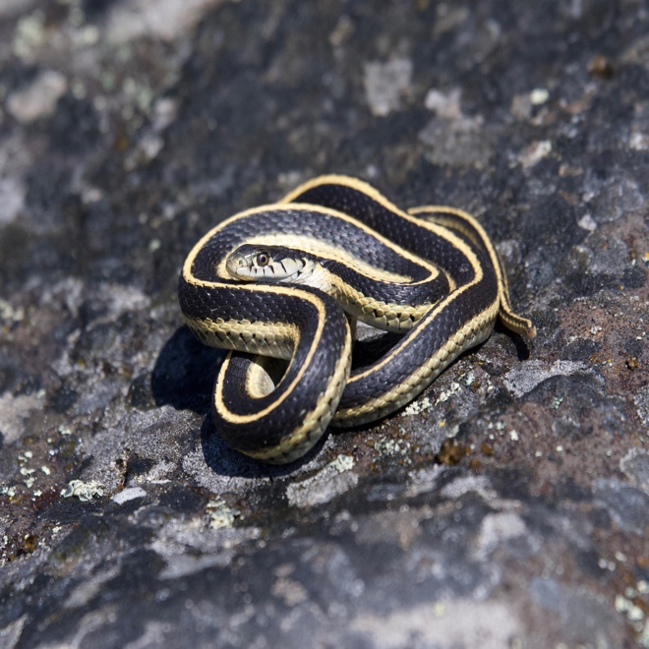
Low Elevation
“Fast pace of life”
Grow Fast
Large Size
Early Maturation
Large Litters
Short-lived
Pace of Life
(Stearns 1992)
Fast
Slow
Growth/Reproduction
High Elevation
”Slow pace of life”
Grow Slow
Small Size
Delayed Maturation
Small infrequent Litters
Long-lived
Lifespan/Aging
Bronikowski 2000, Bronikowski & Vleck 2005, Sparkman et al. 2007, Gangloff et al 2015.
Notes:
Life-history strategies can generally be thought of as a suite of correlated traits that lie along a “pace-of-life” continuum from fast to slow
Life-history theory posits energy-based trade-offs among life-history traits such as growth and maintenance on one hand and reproduction and survival on the other such that an organism isn’t able to maximize both survival and reproduction (and thus fitness).
For example… Salmon are on the “fast” end of the POL continuum – they grow/mature relatively quickly, typically reproduce once with many offspring and are short-lived. While on the other end of the continuum we have organisms such as elephants that are long-lived, reproduce multiple times across their lifetime but have fewer offspring
However, these trade-offs that constrain the covariation of LH traits along the POL continuum can also be found within species but across populations…
Low elevation populations represent a fast POL and are characterized by individuals that grow quickly, mature early, and prioritize current reproduction, often with shorter lifespans.
In contrast, high elevation meadow populations represent a slow POL characterized by slower growth, later maturation with reproduction extended over a longer timeframe, and these individuals live longer - maximizing fitness by prioritizing self-maintenance and survival
Low elevation: mature (~2y), large litters (8), short-lived (4y)
High elevation: mature (4-5y), small/infrequent litters (4), long-lived (9y)

Slide 9
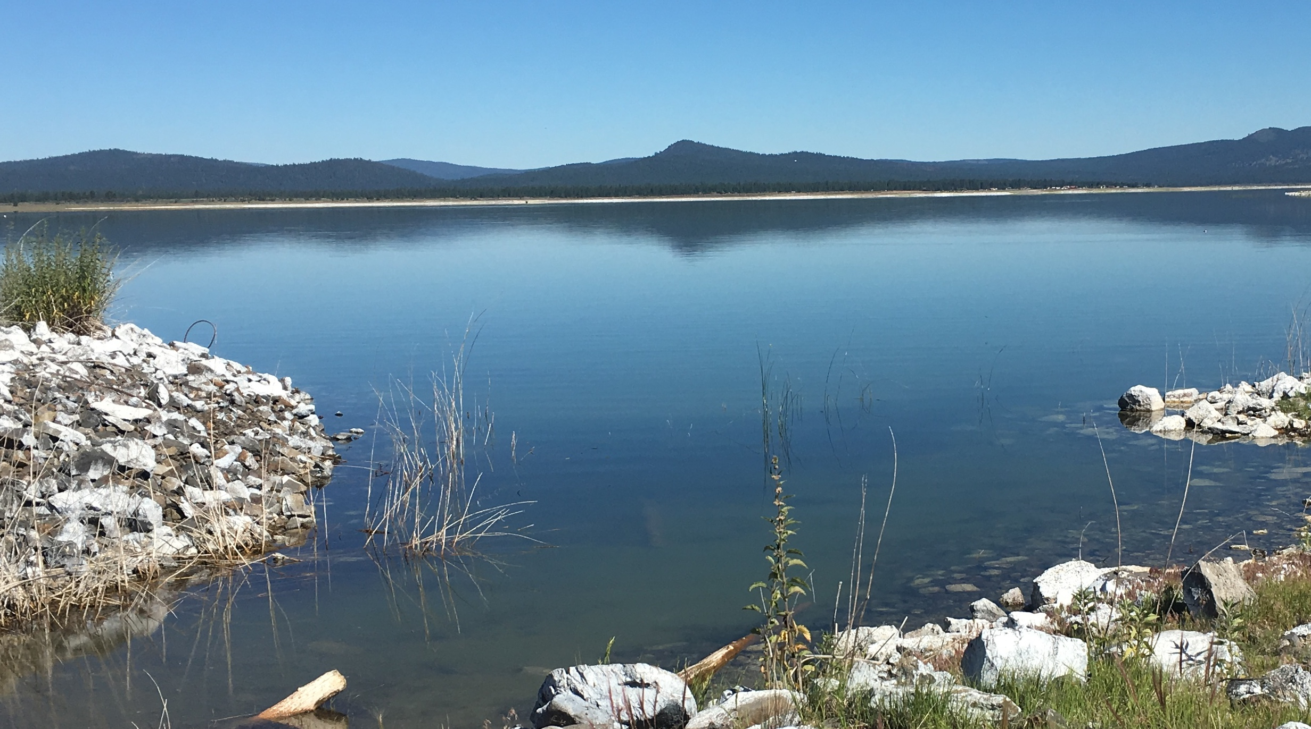
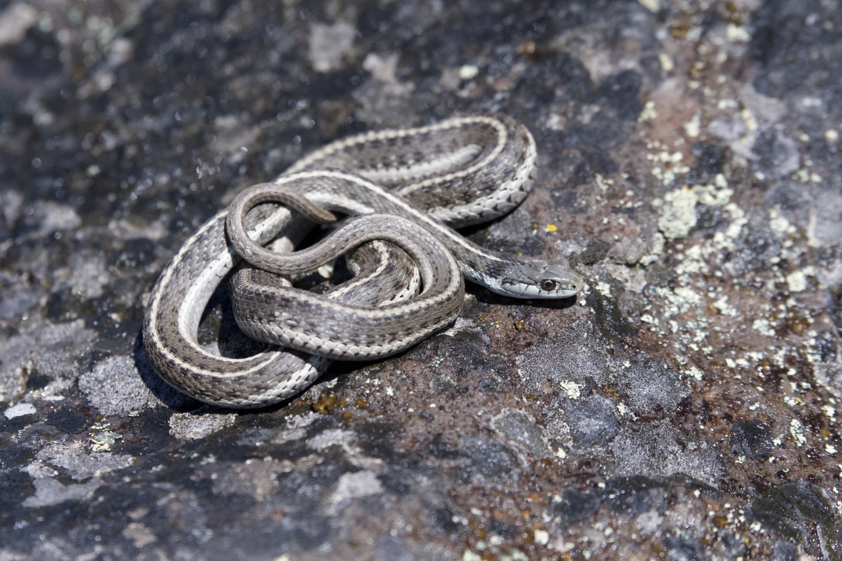
Low Elevation Lakeshore Ecotype “Fast Pace of life”
Life-History Characteristics
Grow Fast
Large Size
Early Maturation (2 years)
Large Litters (mean = 8)
Short-lived (median = 4 years)
Notes:
Populations along the lakeshore represent a fast POL
Fast “pace-of-life” populations are characterized by individuals that grow quickly, mature early, and prioritize current reproduction, often with shorter lifespans.
Having similarities with the ideas of “r and K selection” (Pianka 1970), which hypothesize natural selection as shaping rapid versus slow generation times across species, POL ideas are connected to populations diverging over this continuum due to ecological pressures and subsequent energy allocation strategies.

Slide 10
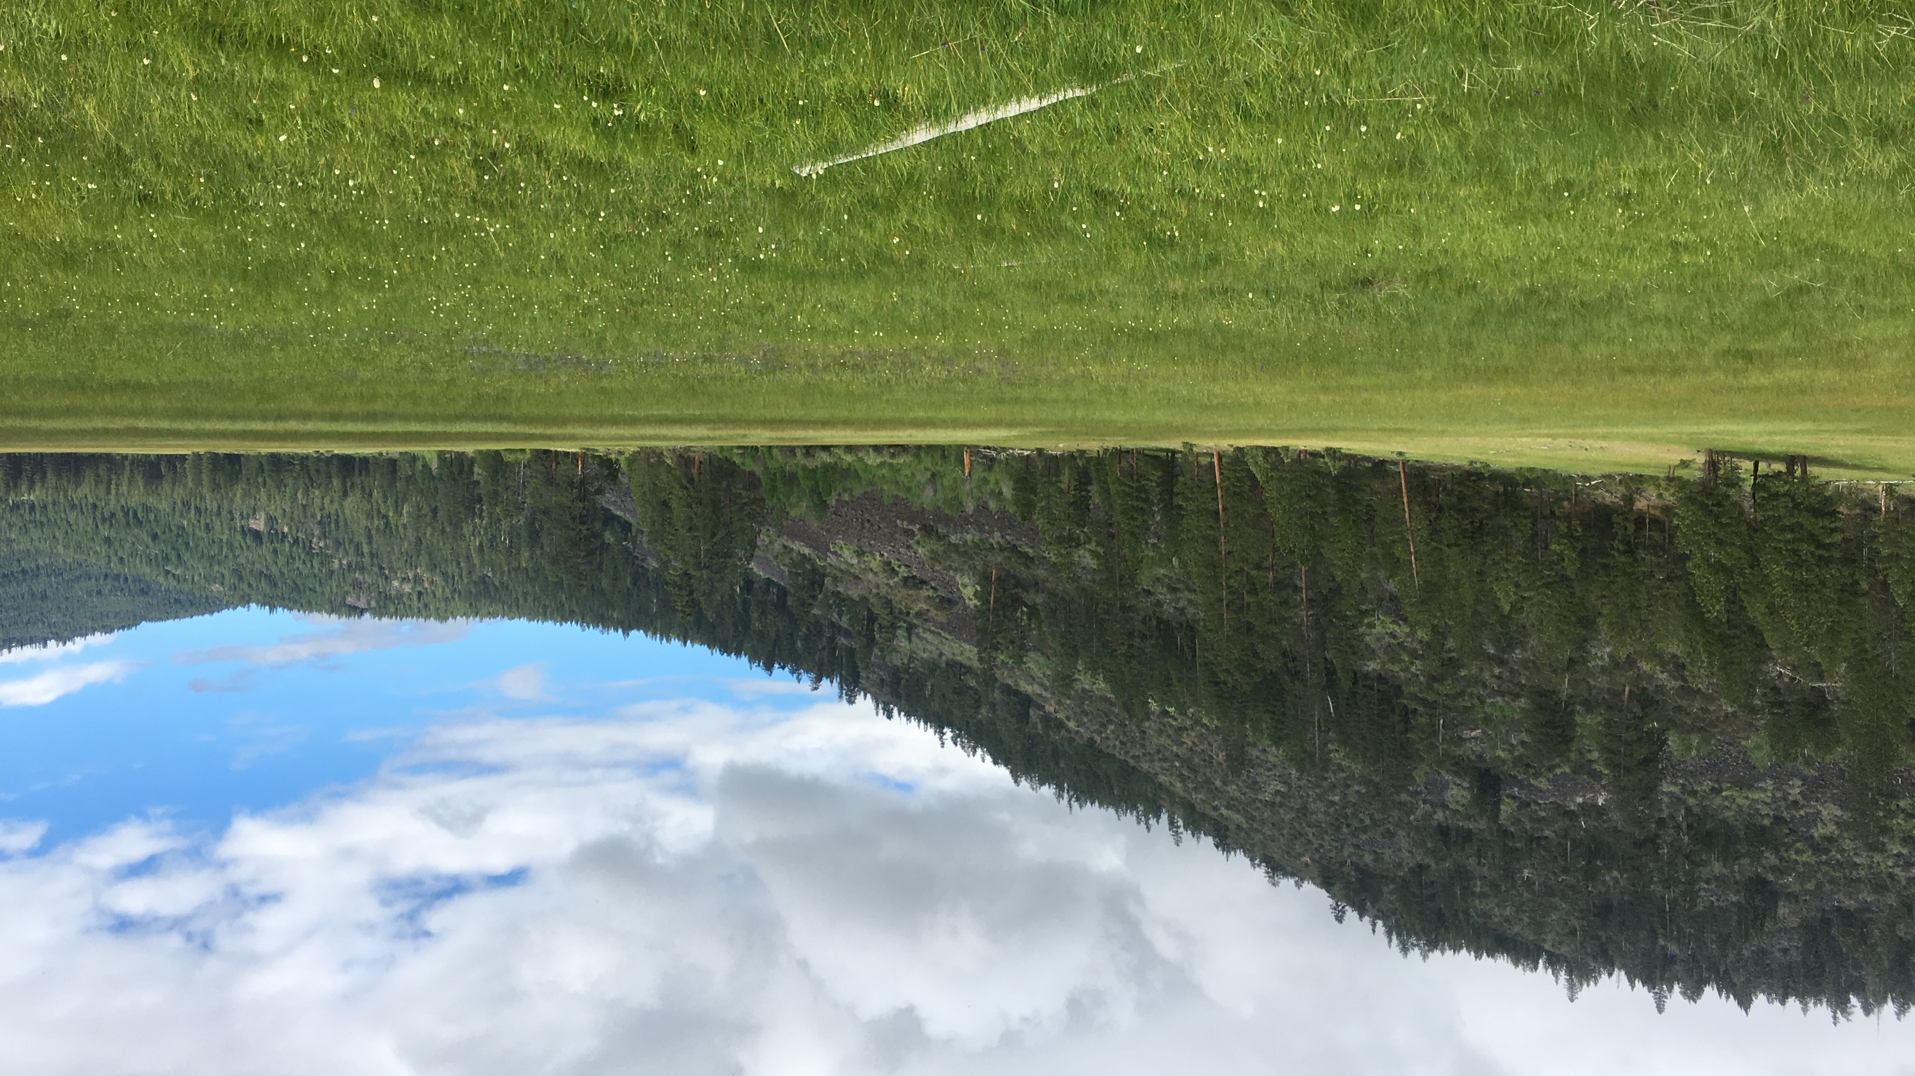
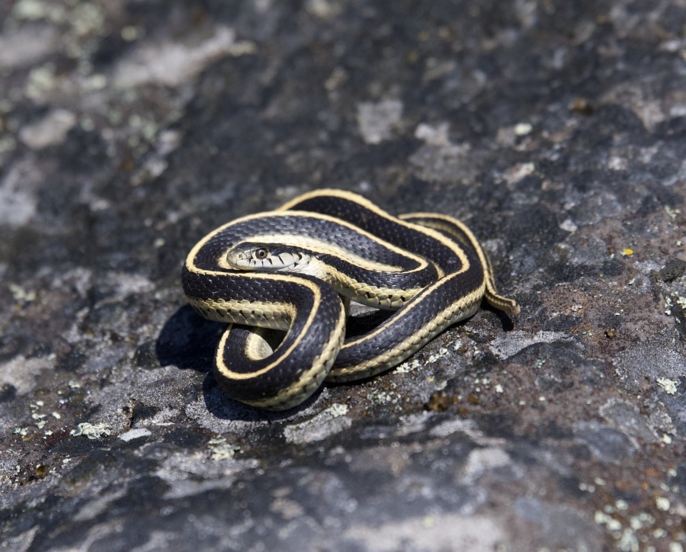
High Elevation Meadow Ecotype “Slow pace of life”
Life-History Characteristics
Grow Slow
Small Size
Delayed Maturation (4-5 years)
Small infrequent Litters (mean = 4)
Long-lived (median = 9 years)
Notes:
High elevation meadow populations represent a slow POL
Slow “pace-of-life” populations are characterized by individuals that grow slow, mature late, reproduce extended over a longer timeframe, and live longer - maximizing fitness by prioritizing self-maintenance and survival

Slide 11
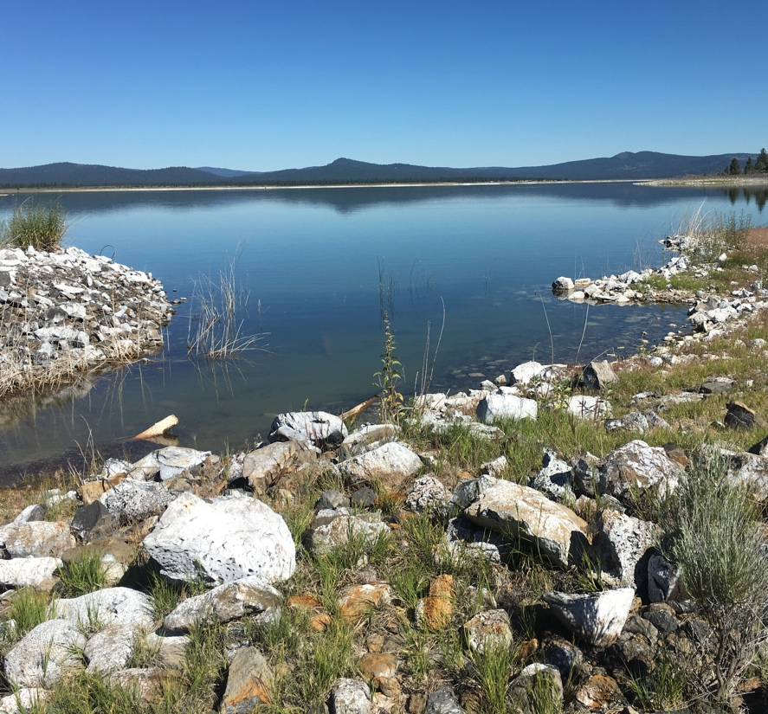
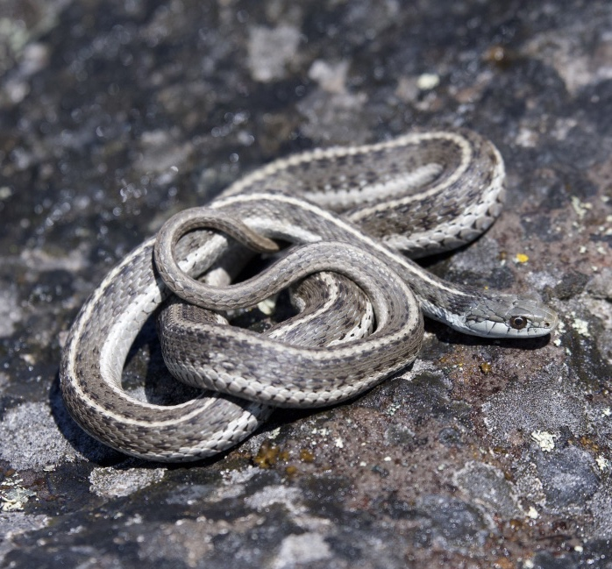
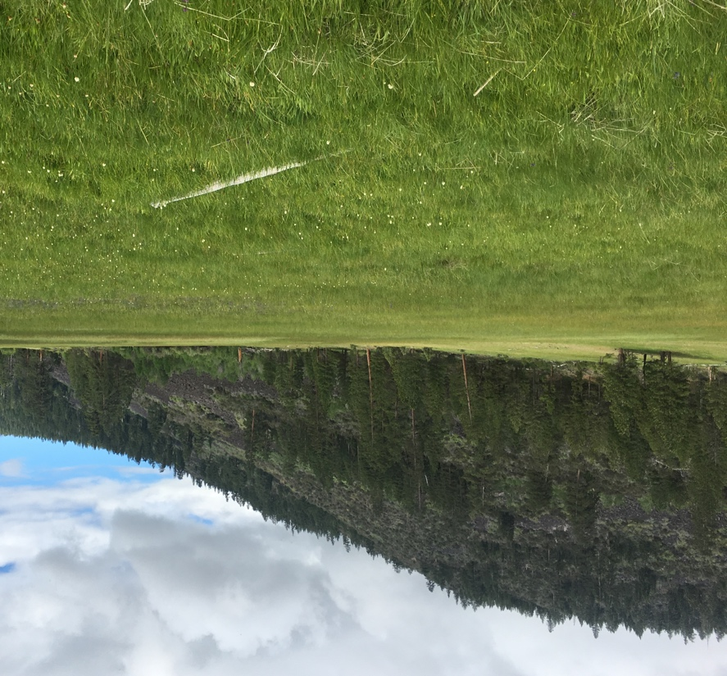
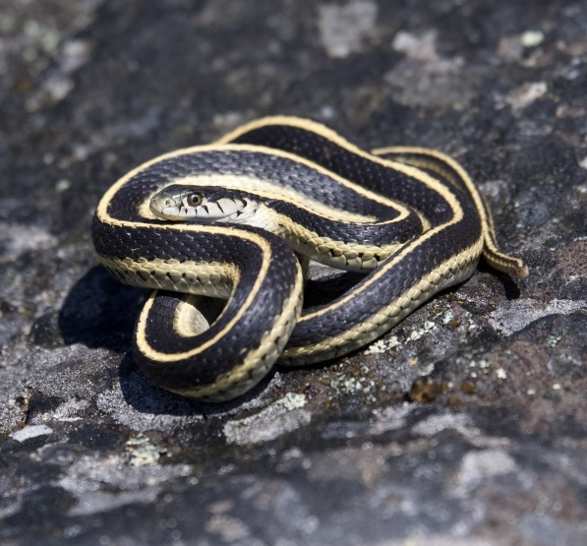
Low Elevation – Lake Snakes
Grow Fast
Large Size
Early Maturation (2 years)
Large Litters (mean = 8)
Short-lived (median = 4 years)
High Elevation – Meadow Snakes
Grow Slow
Small Size
Delayed Maturation (4-5 years)
Small infrequent Litters (mean = 4)
Long-lived (median = 9 years)

Slide 12
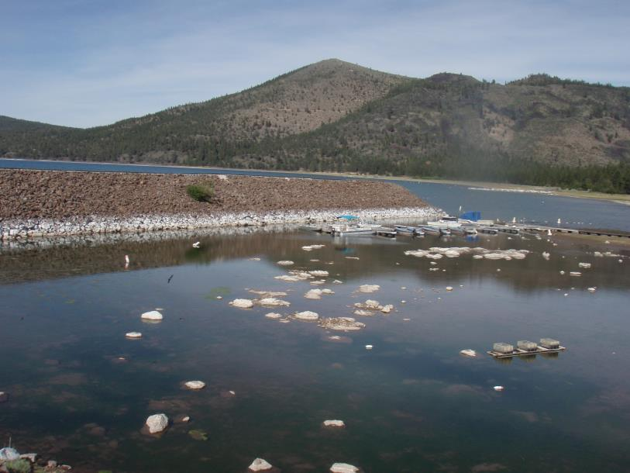
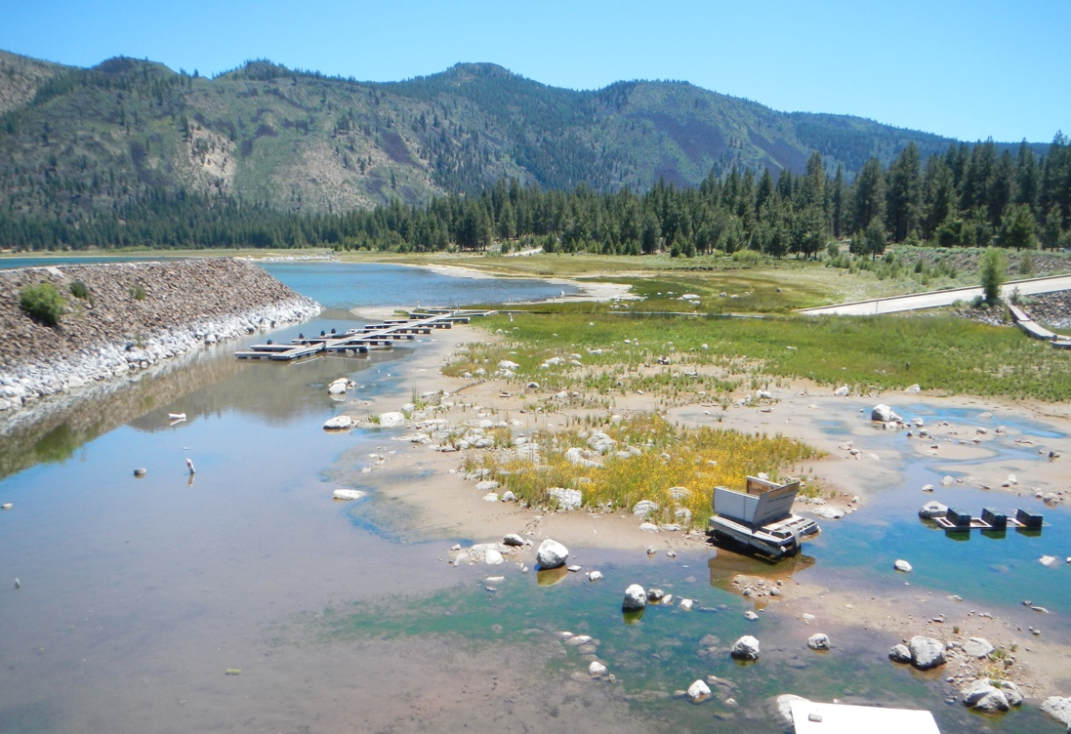
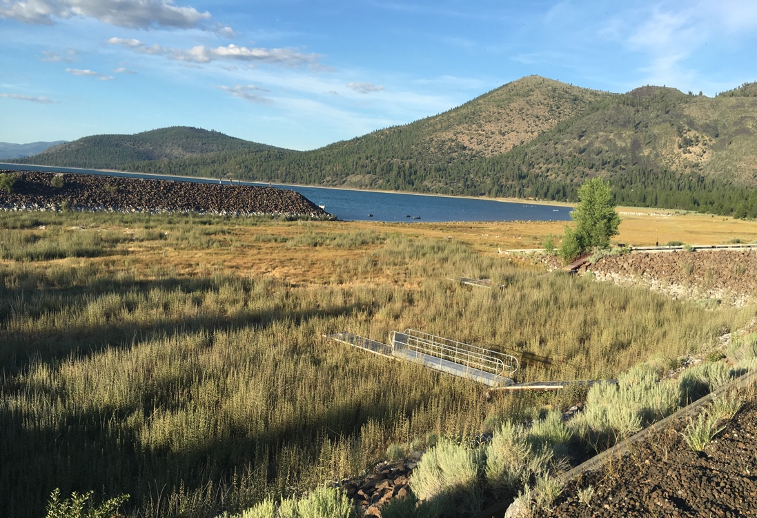
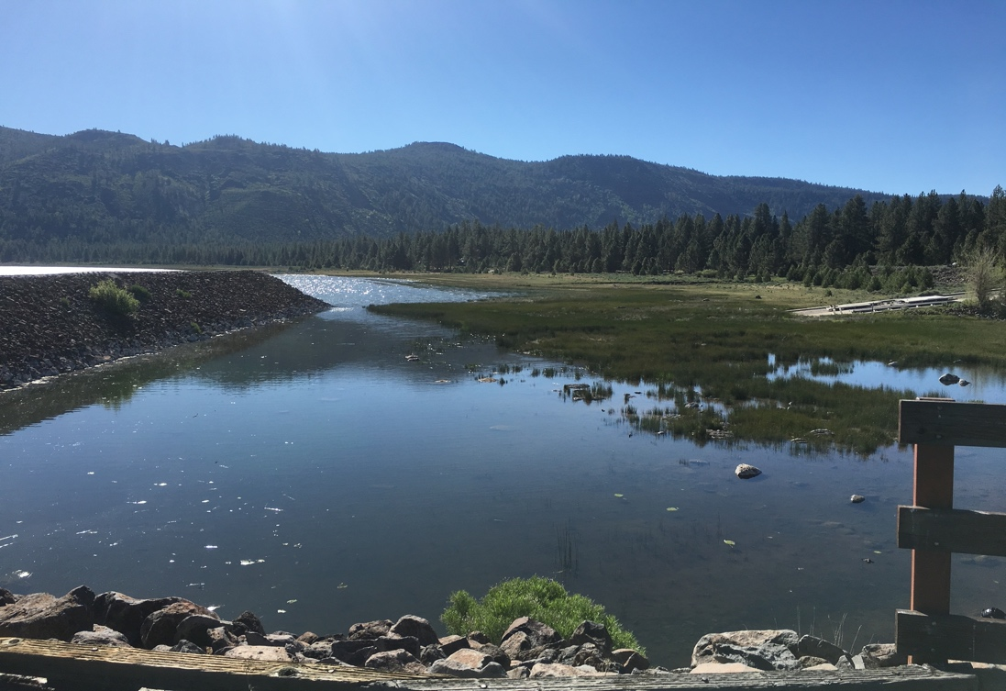
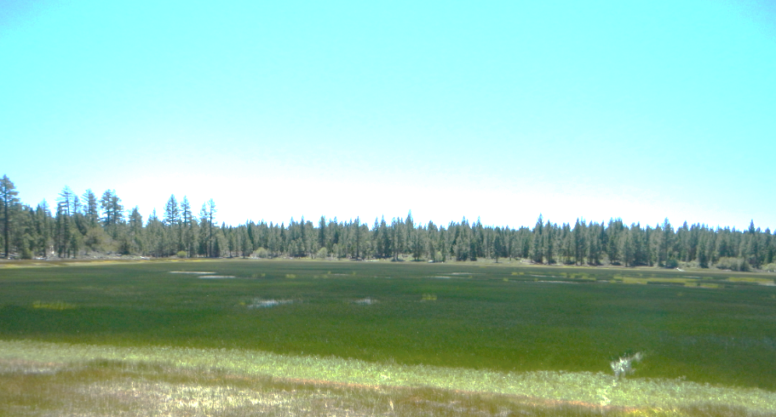
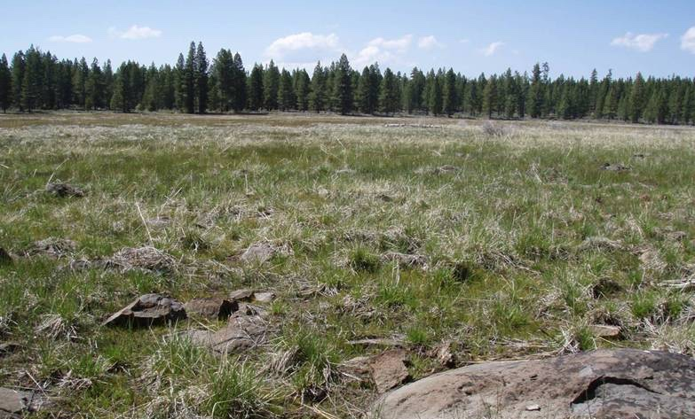
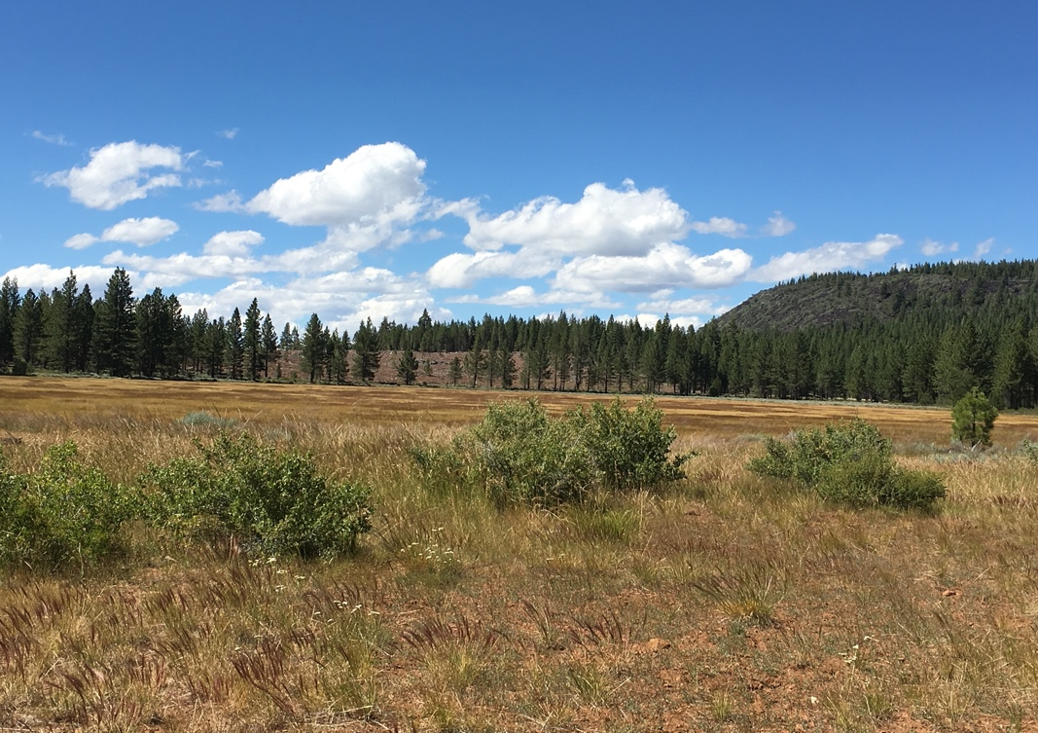
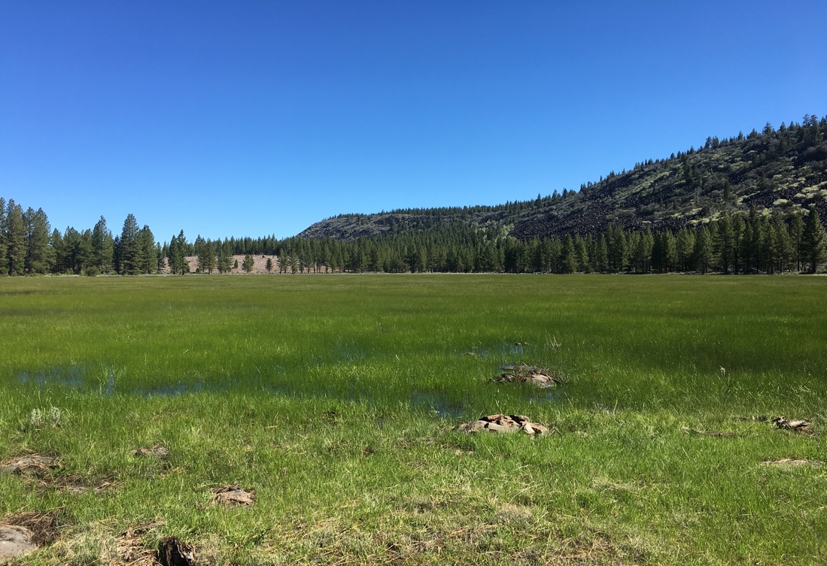
Rapid & Dramatic Landscape Changes
2012
2014
2016
2018
2012
2014
2016
2018
Notes:
2012-2015 categorized as "severe drought”
An additional component to the story is that persistent drought conditions in California have led to major changes in the hydrology of the area
These altered landscapes have led to the local extirpation of multiple Fast-lived lakeshore populations but may also have impacted how these animals interact with their environment to shape their demographic profiles

Slide 13
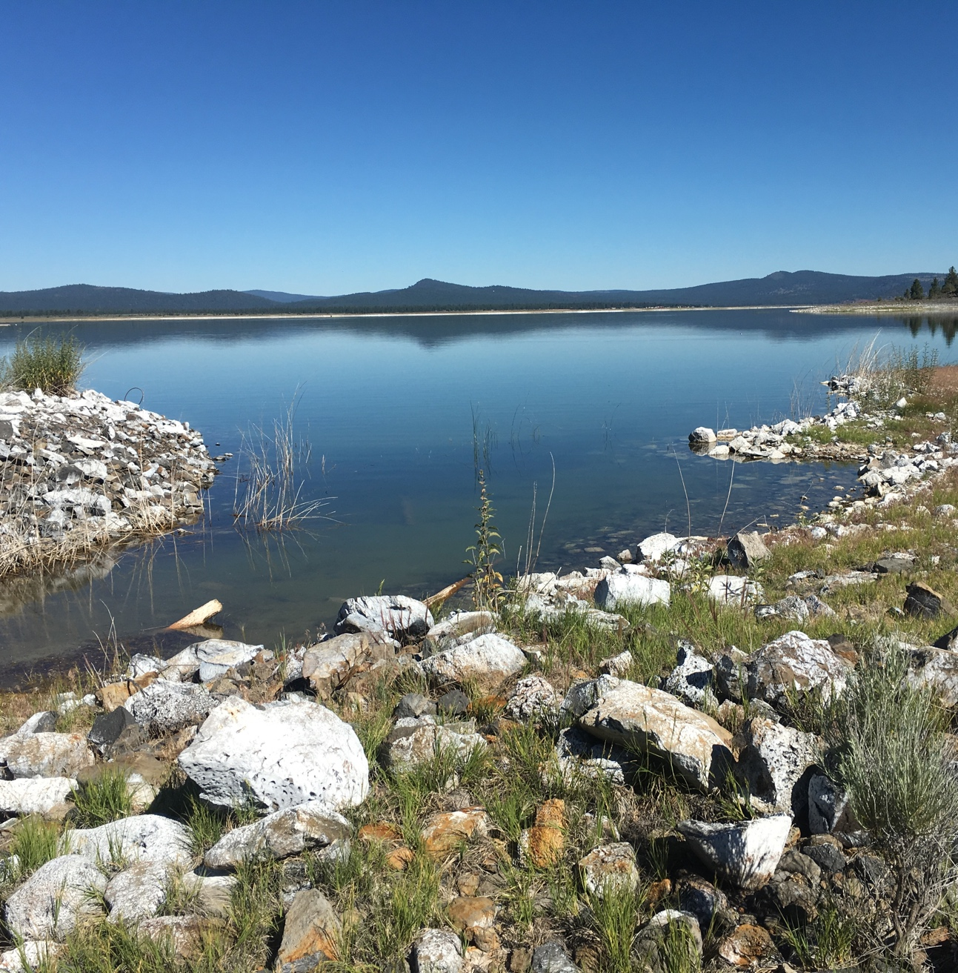
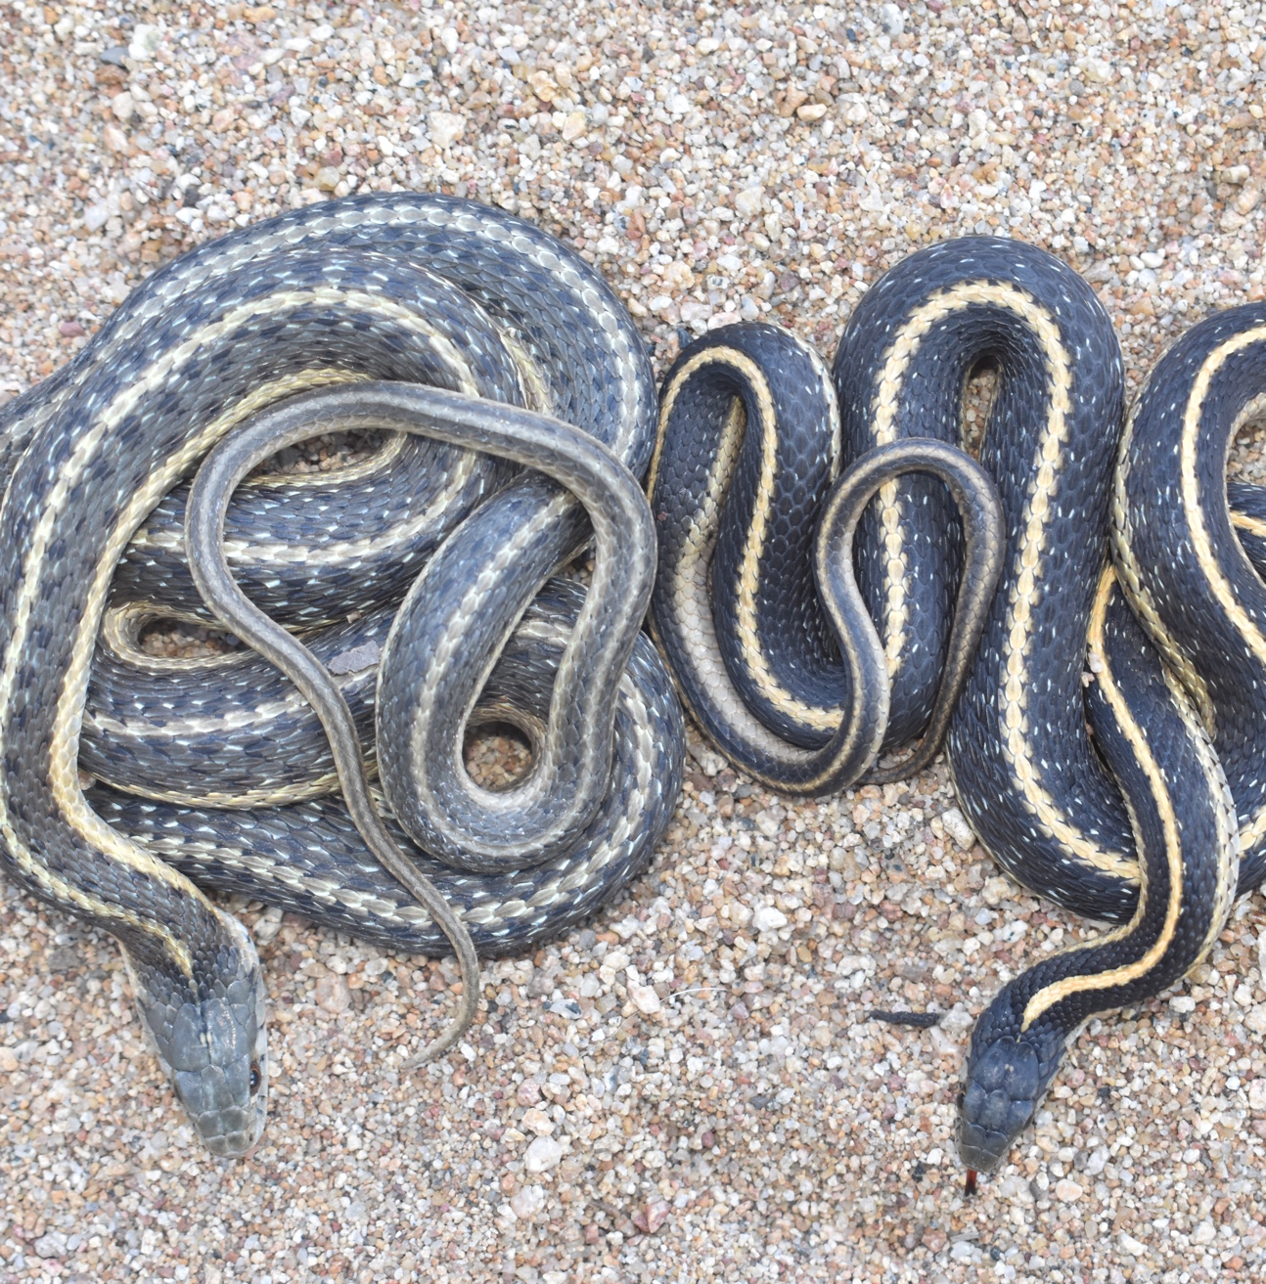
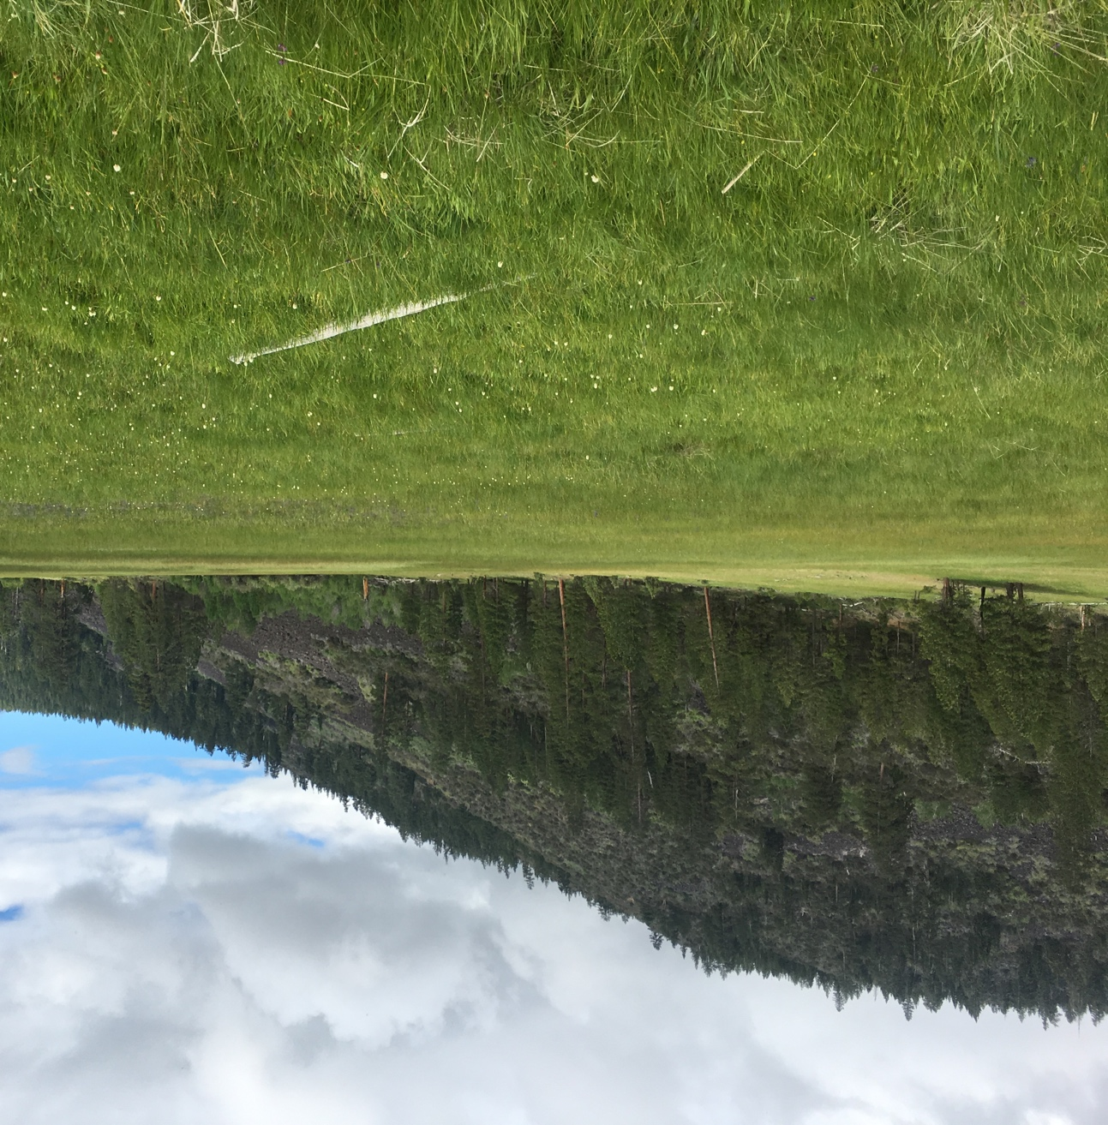
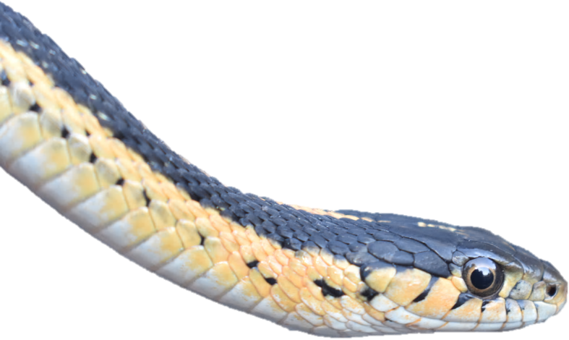
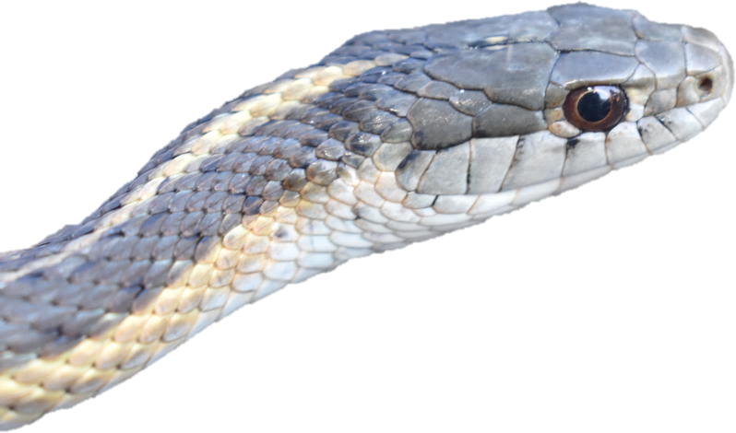
Low Elevation
High Elevation

Slide 14
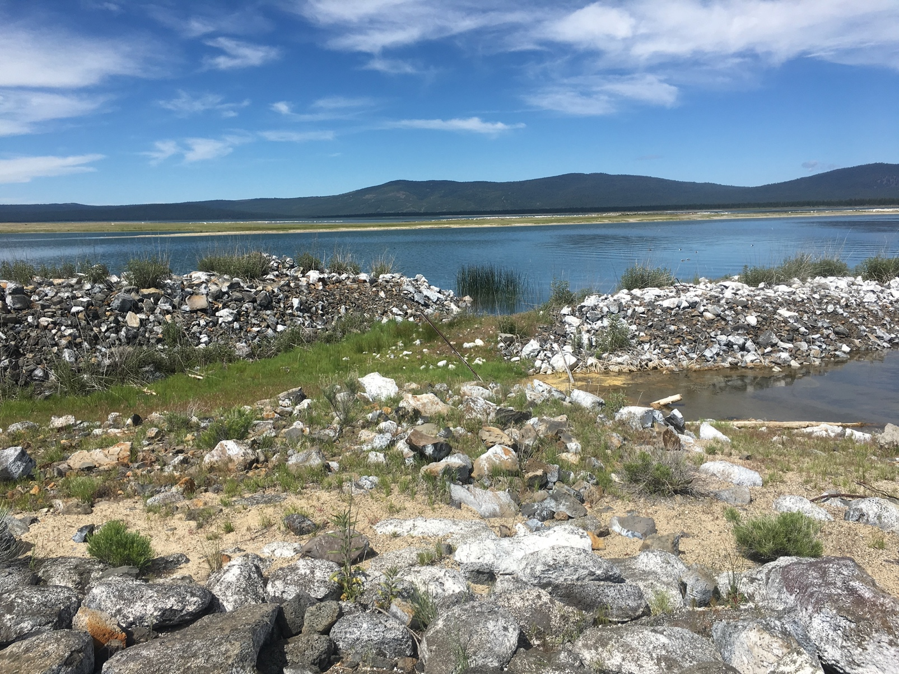
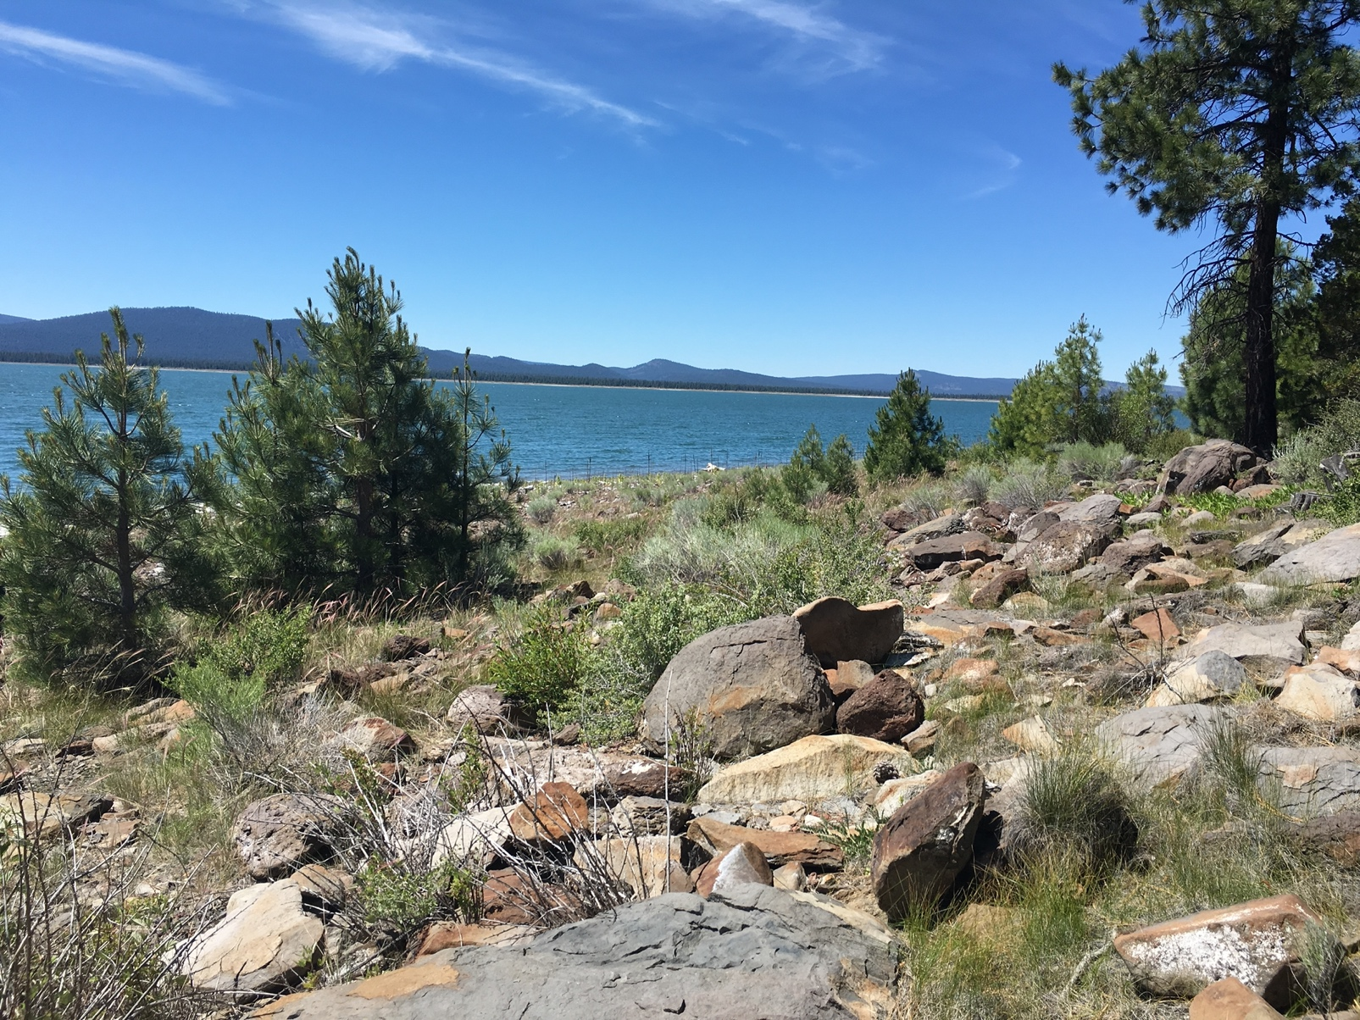
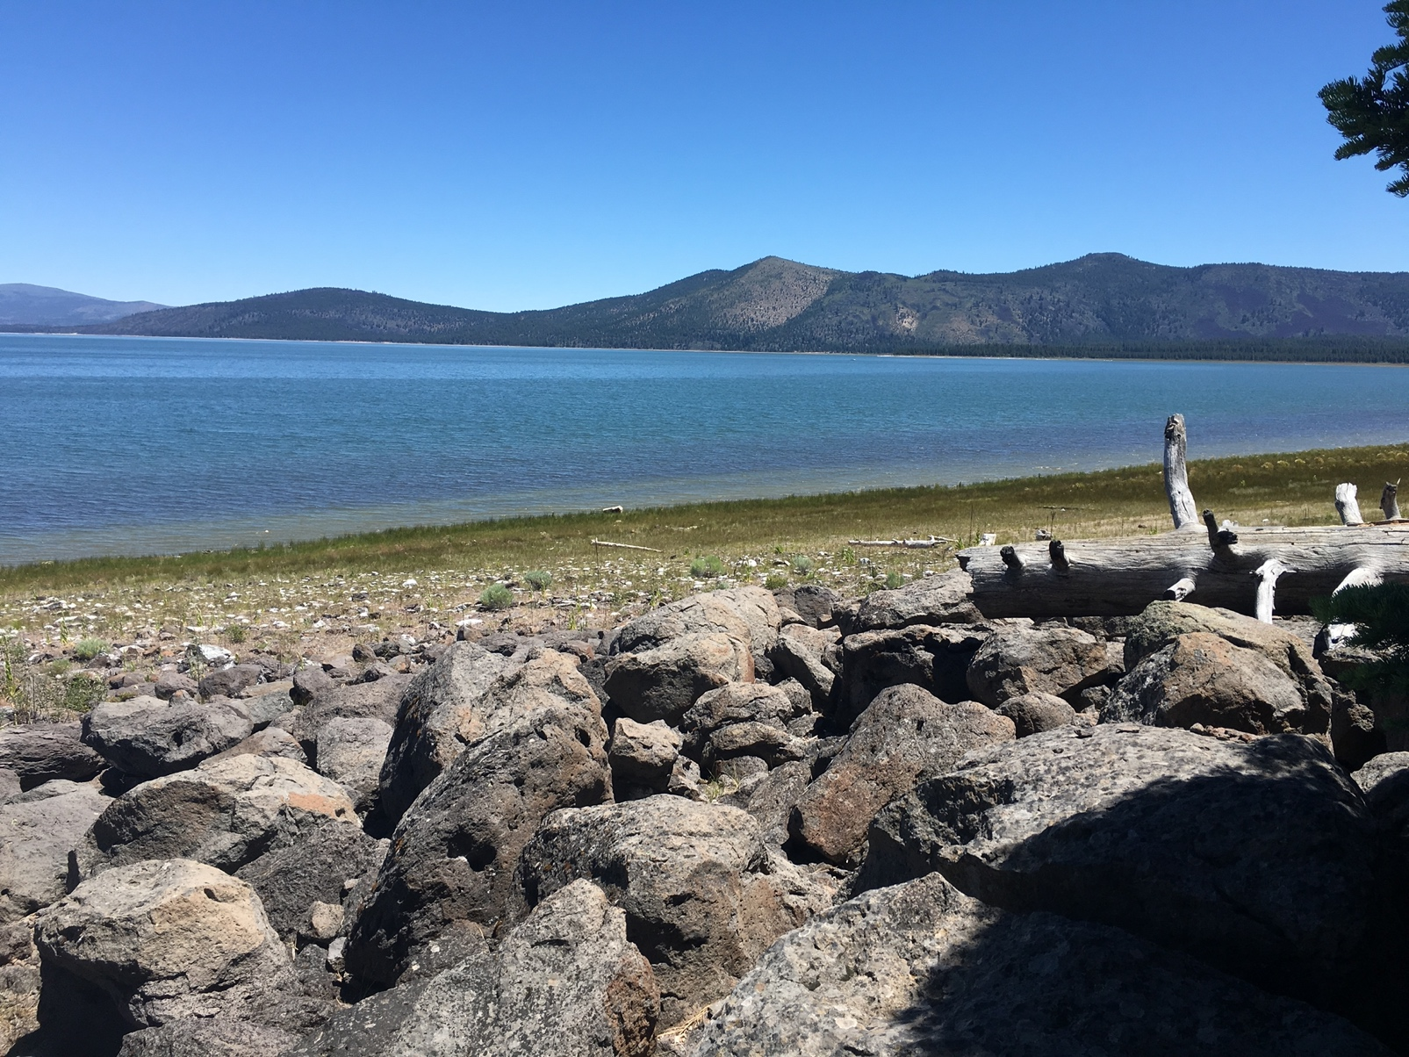

Notes:
Low elevation Lakeshore

Slide 15
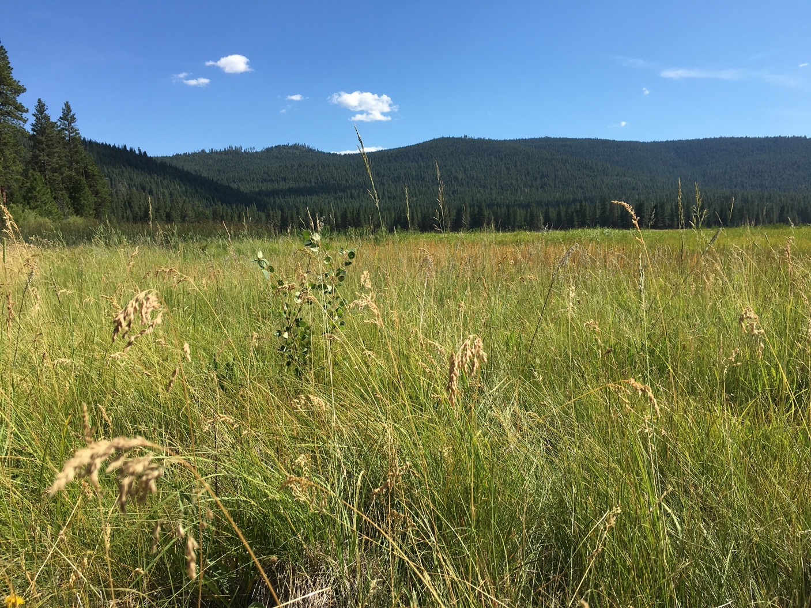
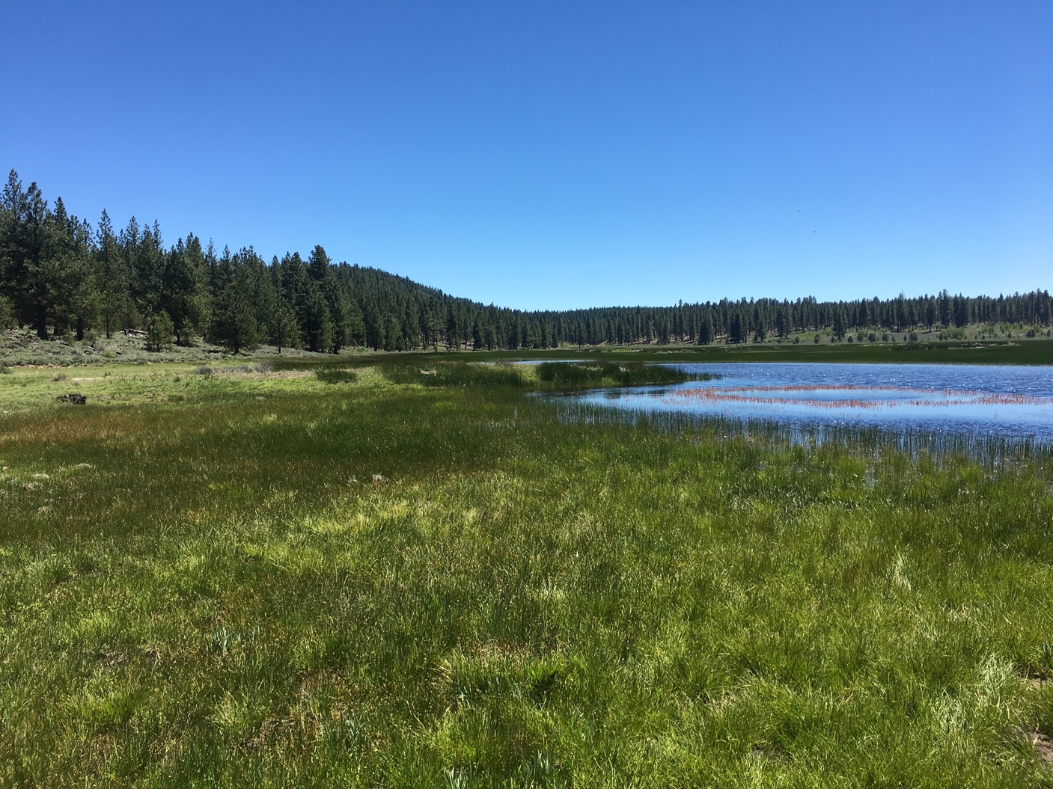
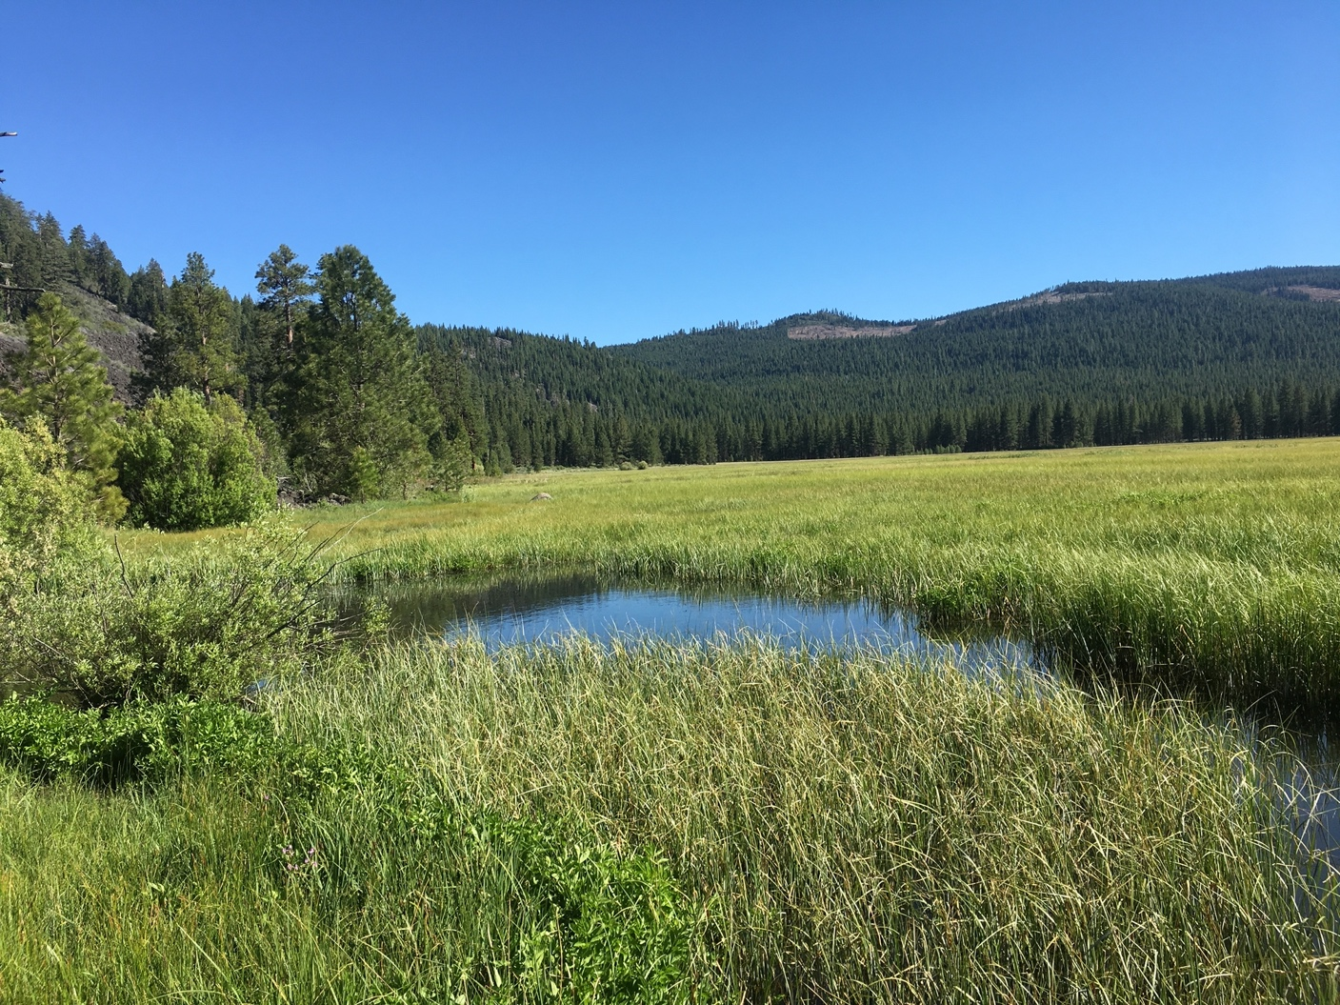


Notes:
High Elevation meadow

Slide 16



2004: Spreading out at a meadow site looking for snakes
Anne’s youngest daughter (Abi, age 2.5)

Slide 17


2004: Flipping rocks and reaching into stinging nettle at Lakeshore sites

