Slide 1





Tiny but mighty: Leaf miners take on aspen trees
Featured scientists: Jenifer Wheeler, Denise Kind, and Diane Wagner from University of Alaska Fairbanks

Slide 2
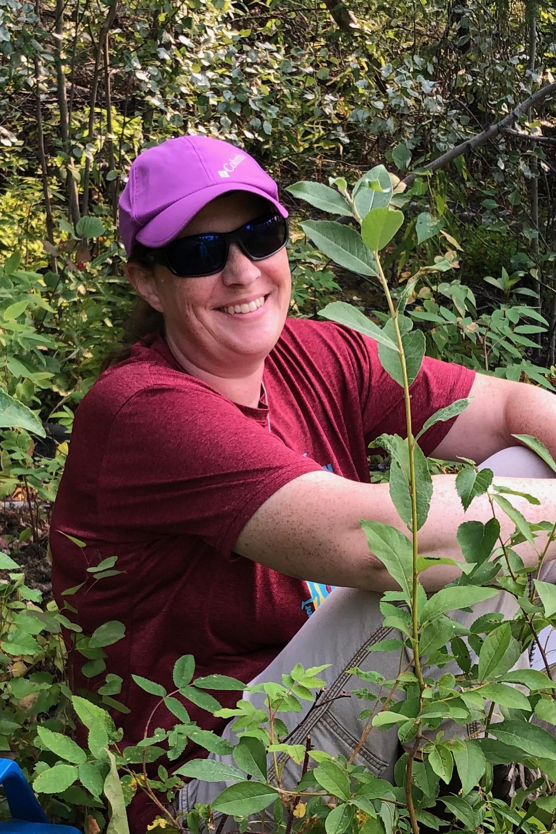

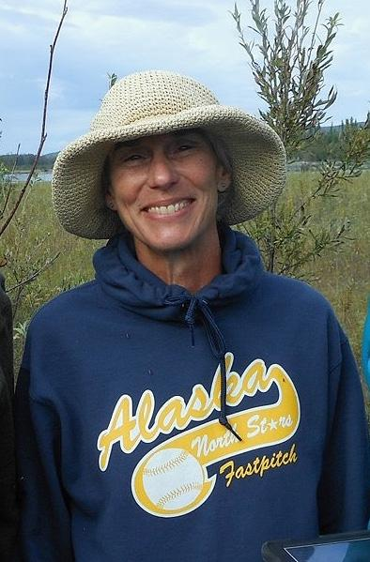
Jenifer Wheeler
Denise Kind
Diane Wagner

Slide 3
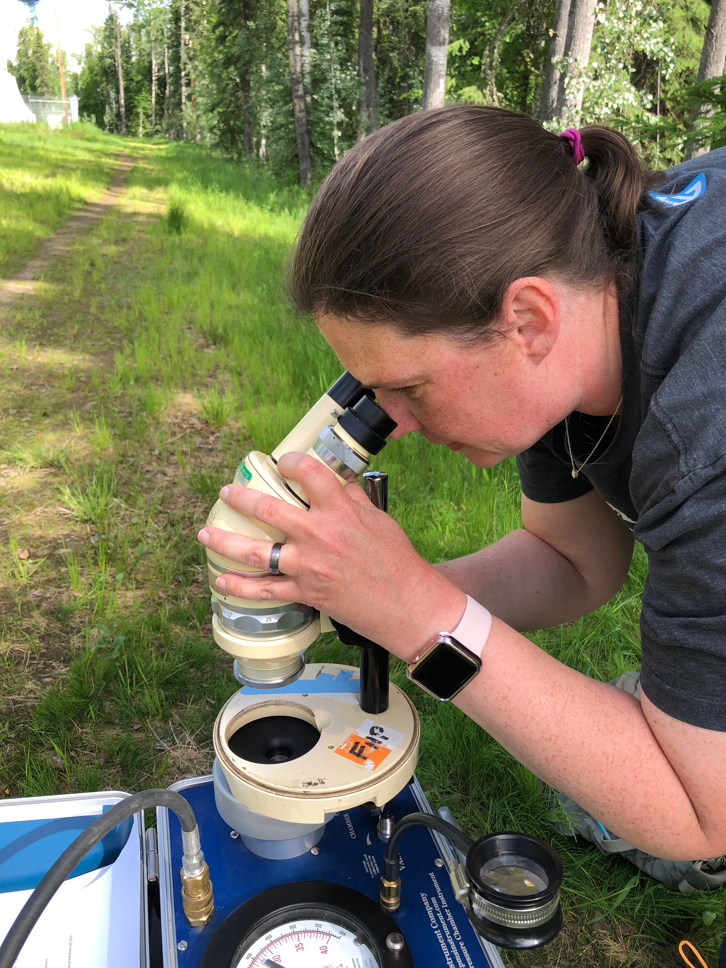
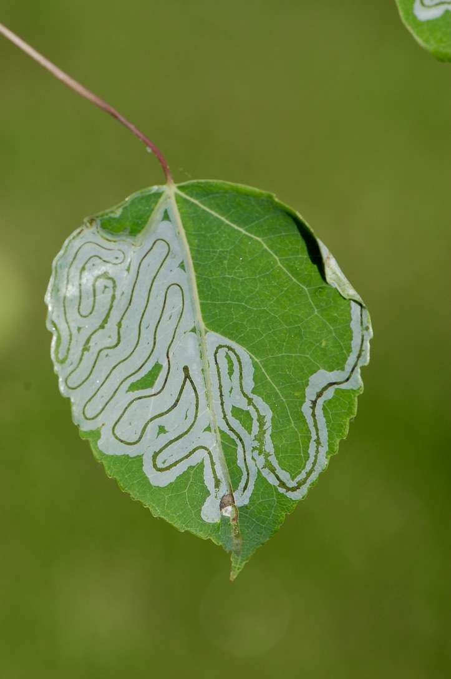
Jenifer measuring leaf water stress

Slide 4
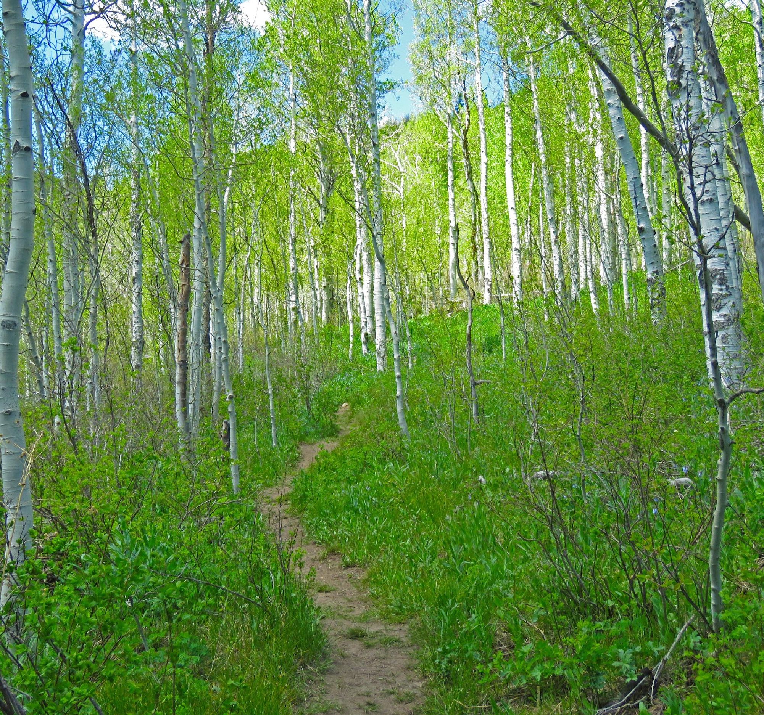
Aspen Trees

Slide 5
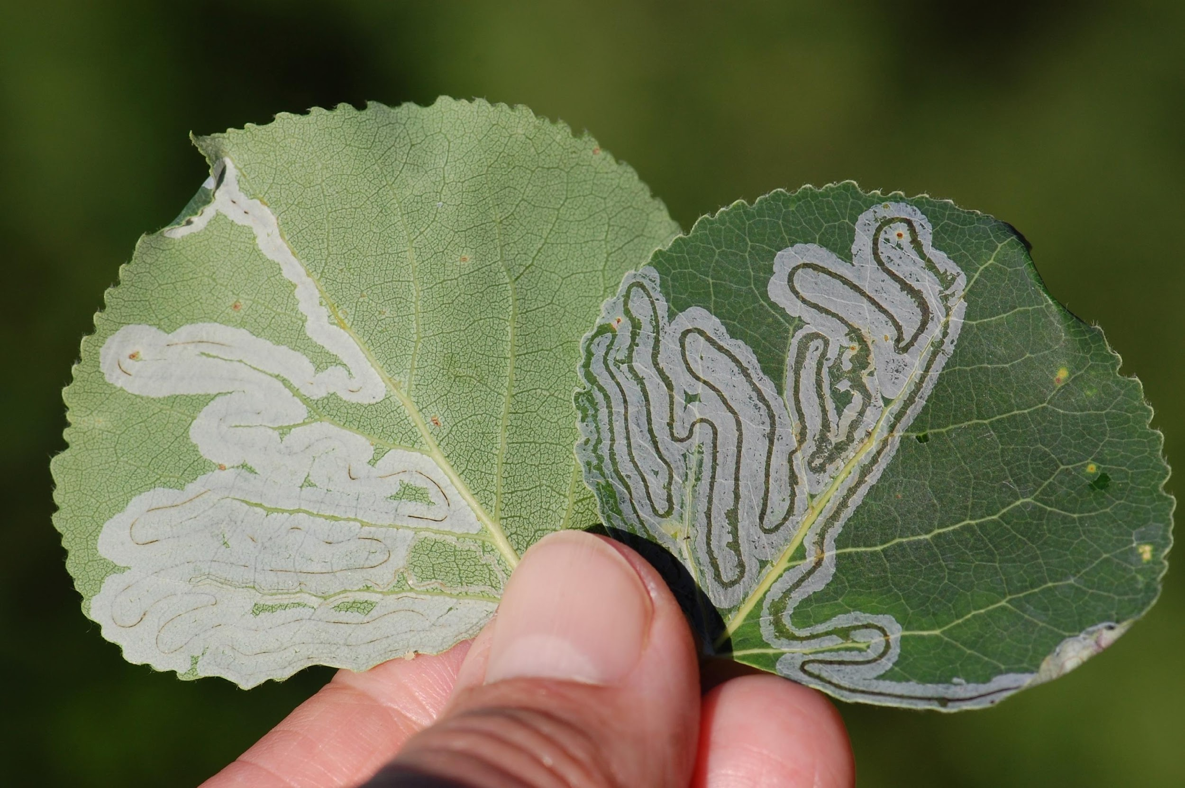
Leaf mining can occur on either side of the leaf

Slide 6
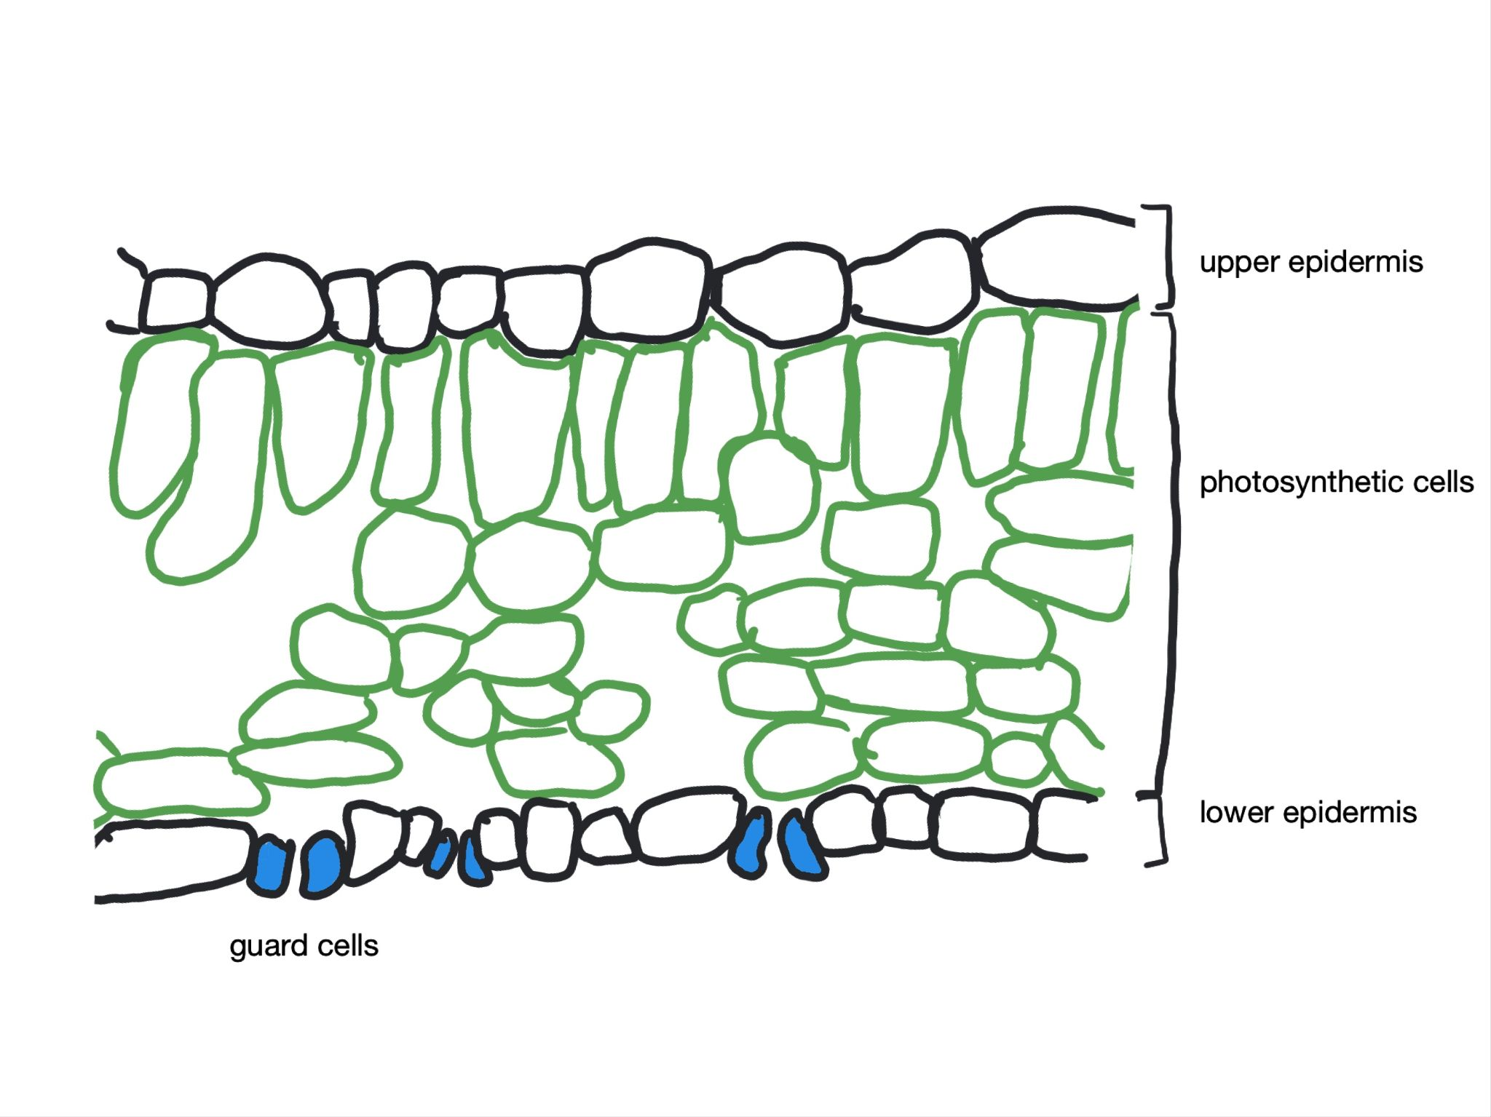
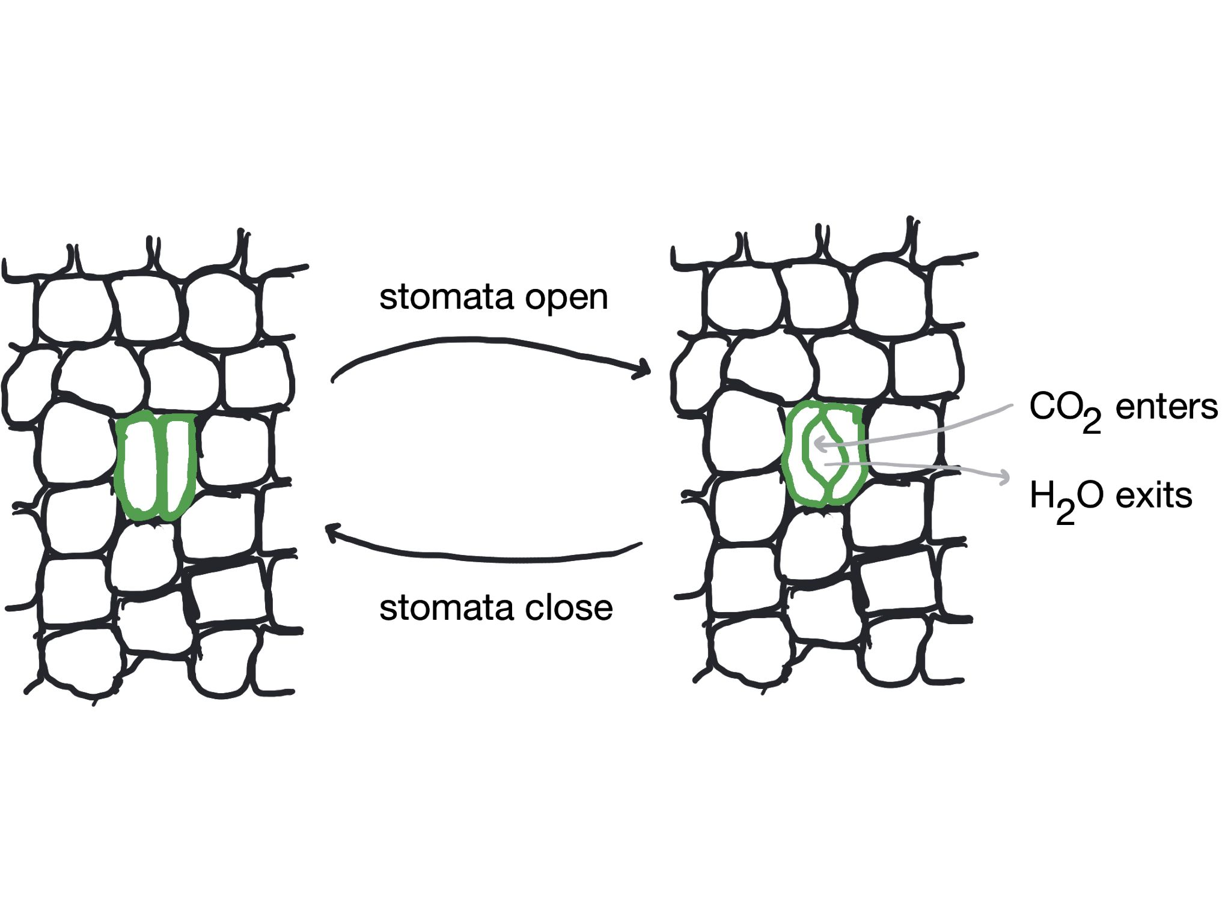
Leaf Structure and Function
Cross section of leaf
Bottom leaf surface

Slide 7
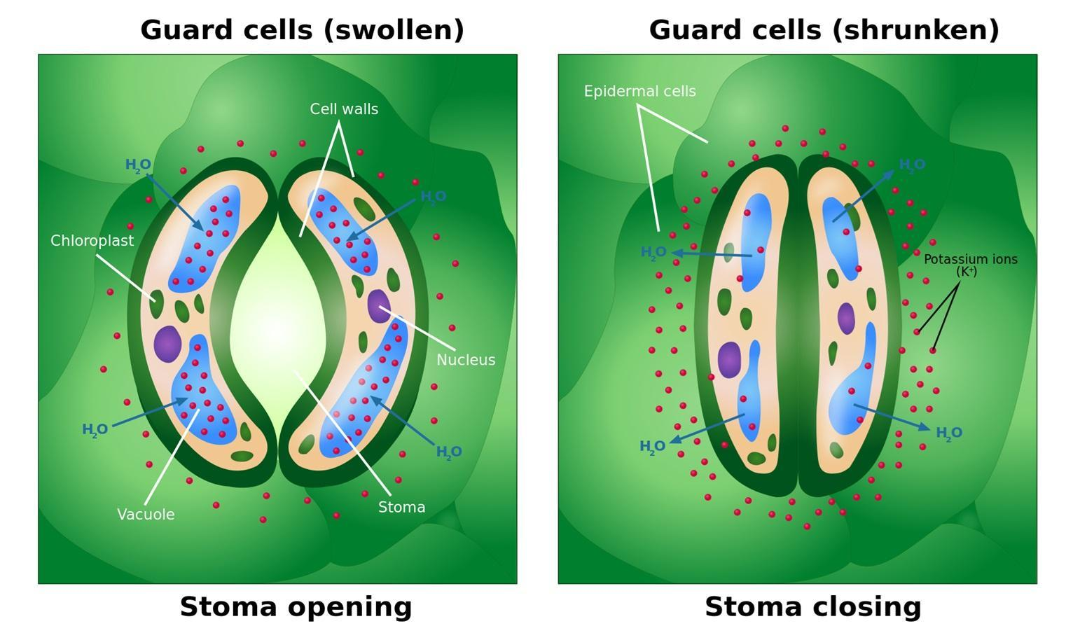
Guard cells
Guard cells open stomata, allowing CO₂ to enter the leaf. Source: https://en.wikipedia.org/wiki/Guard_cell#/media/File:Opening_and_Closing_of_Stoma.svg

Slide 8
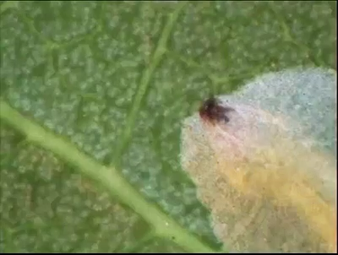
Leaf Miner Feeding on Leaf Bottom
Stomata
…they look like pale dots
Miner’s head
…the mouthparts are dark

Slide 9
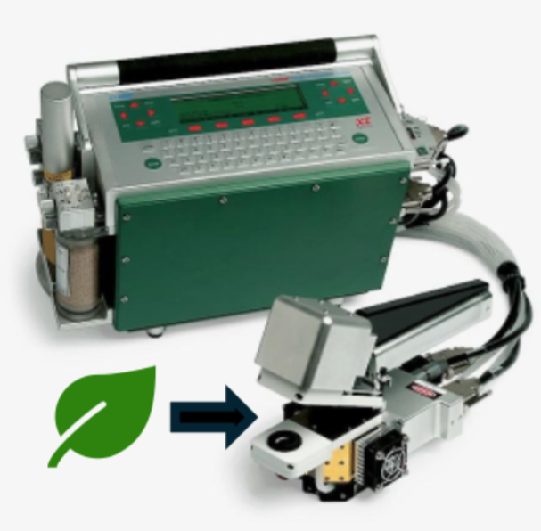
Gas analyzer
Gas analyzer and chamber used to record data for each leaf. Not to scale. Modified version of photo by LI-COR Products

Slide 10
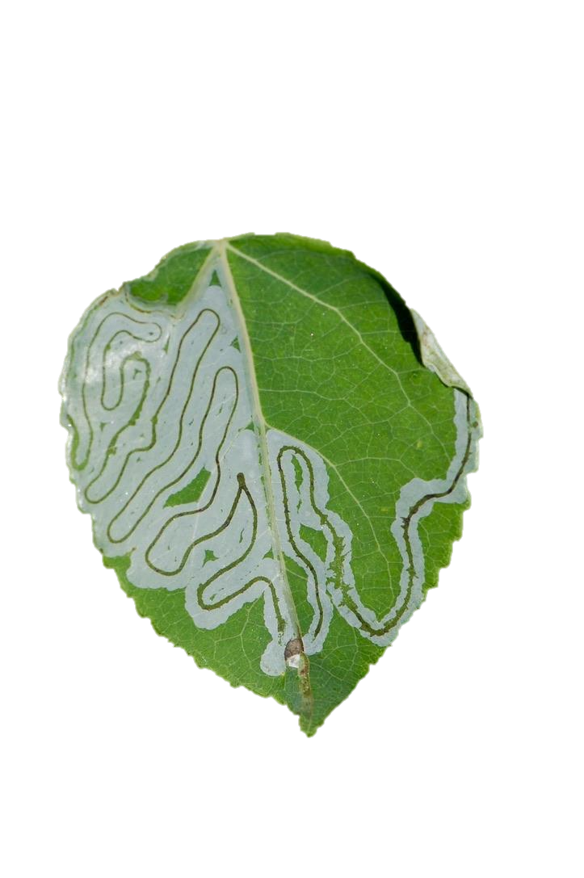
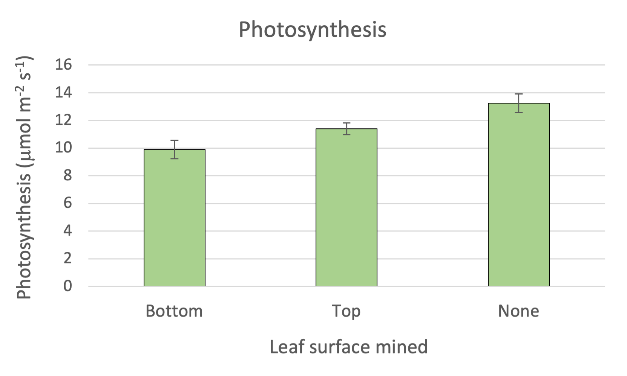

Slide 11
