Slide 1
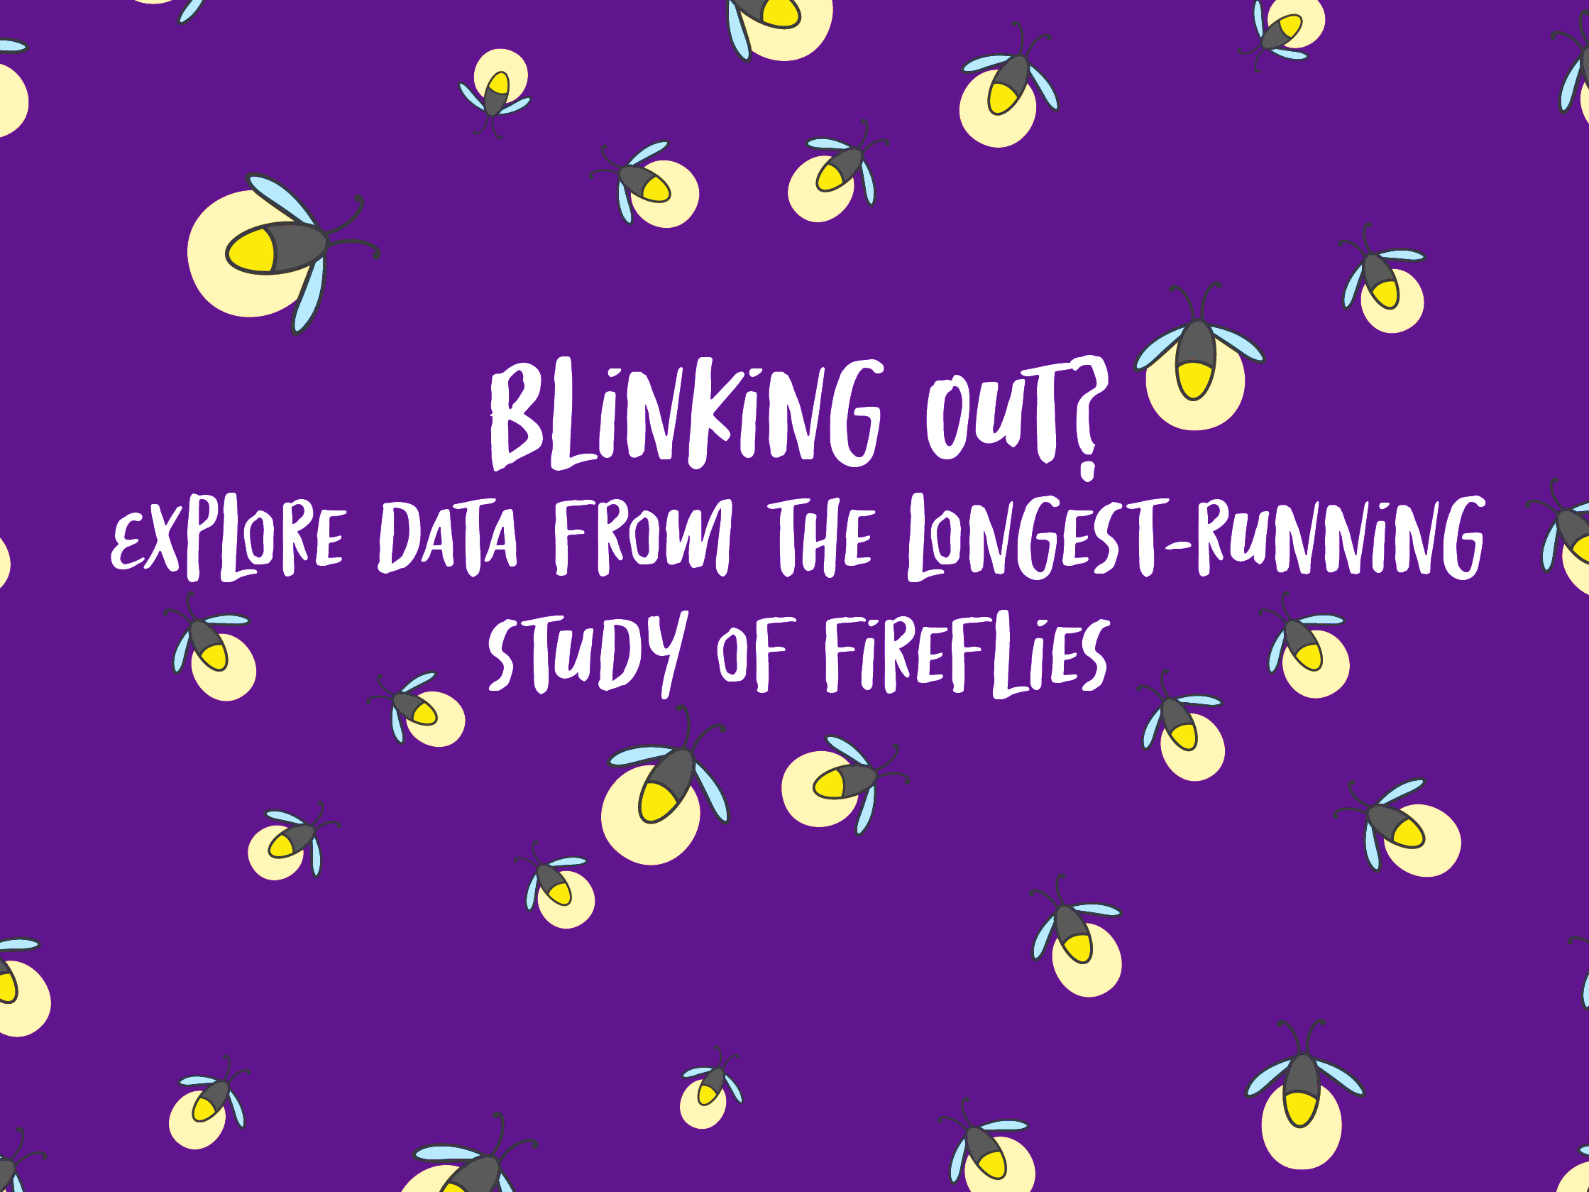


Notes:
Data Nuggets – Blinking Out?
https://datanuggets.org/2021/06/blinking-out/

Slide 2
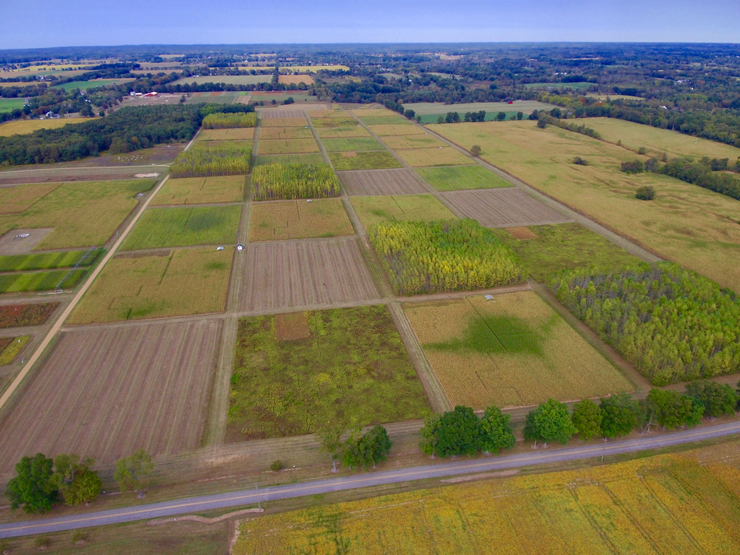
Kellogg Biological Station
Long-Term Ecological Research Program
Notes:
This research was conducted at the KBS LTER, a research site located in Michigan. This experiment was established in 1988 and is funded by the National Science Foundation to answer the question of how to make agriculture more profitable while also providing environmental benefits. There over 100 investigators associated with the LTER from a broad range of disciplines, as well as a network of farmers, teachers, students, and policy makers who we reach with our broader impacts work.
More information at https://lter.kbs.msu.edu

Slide 3
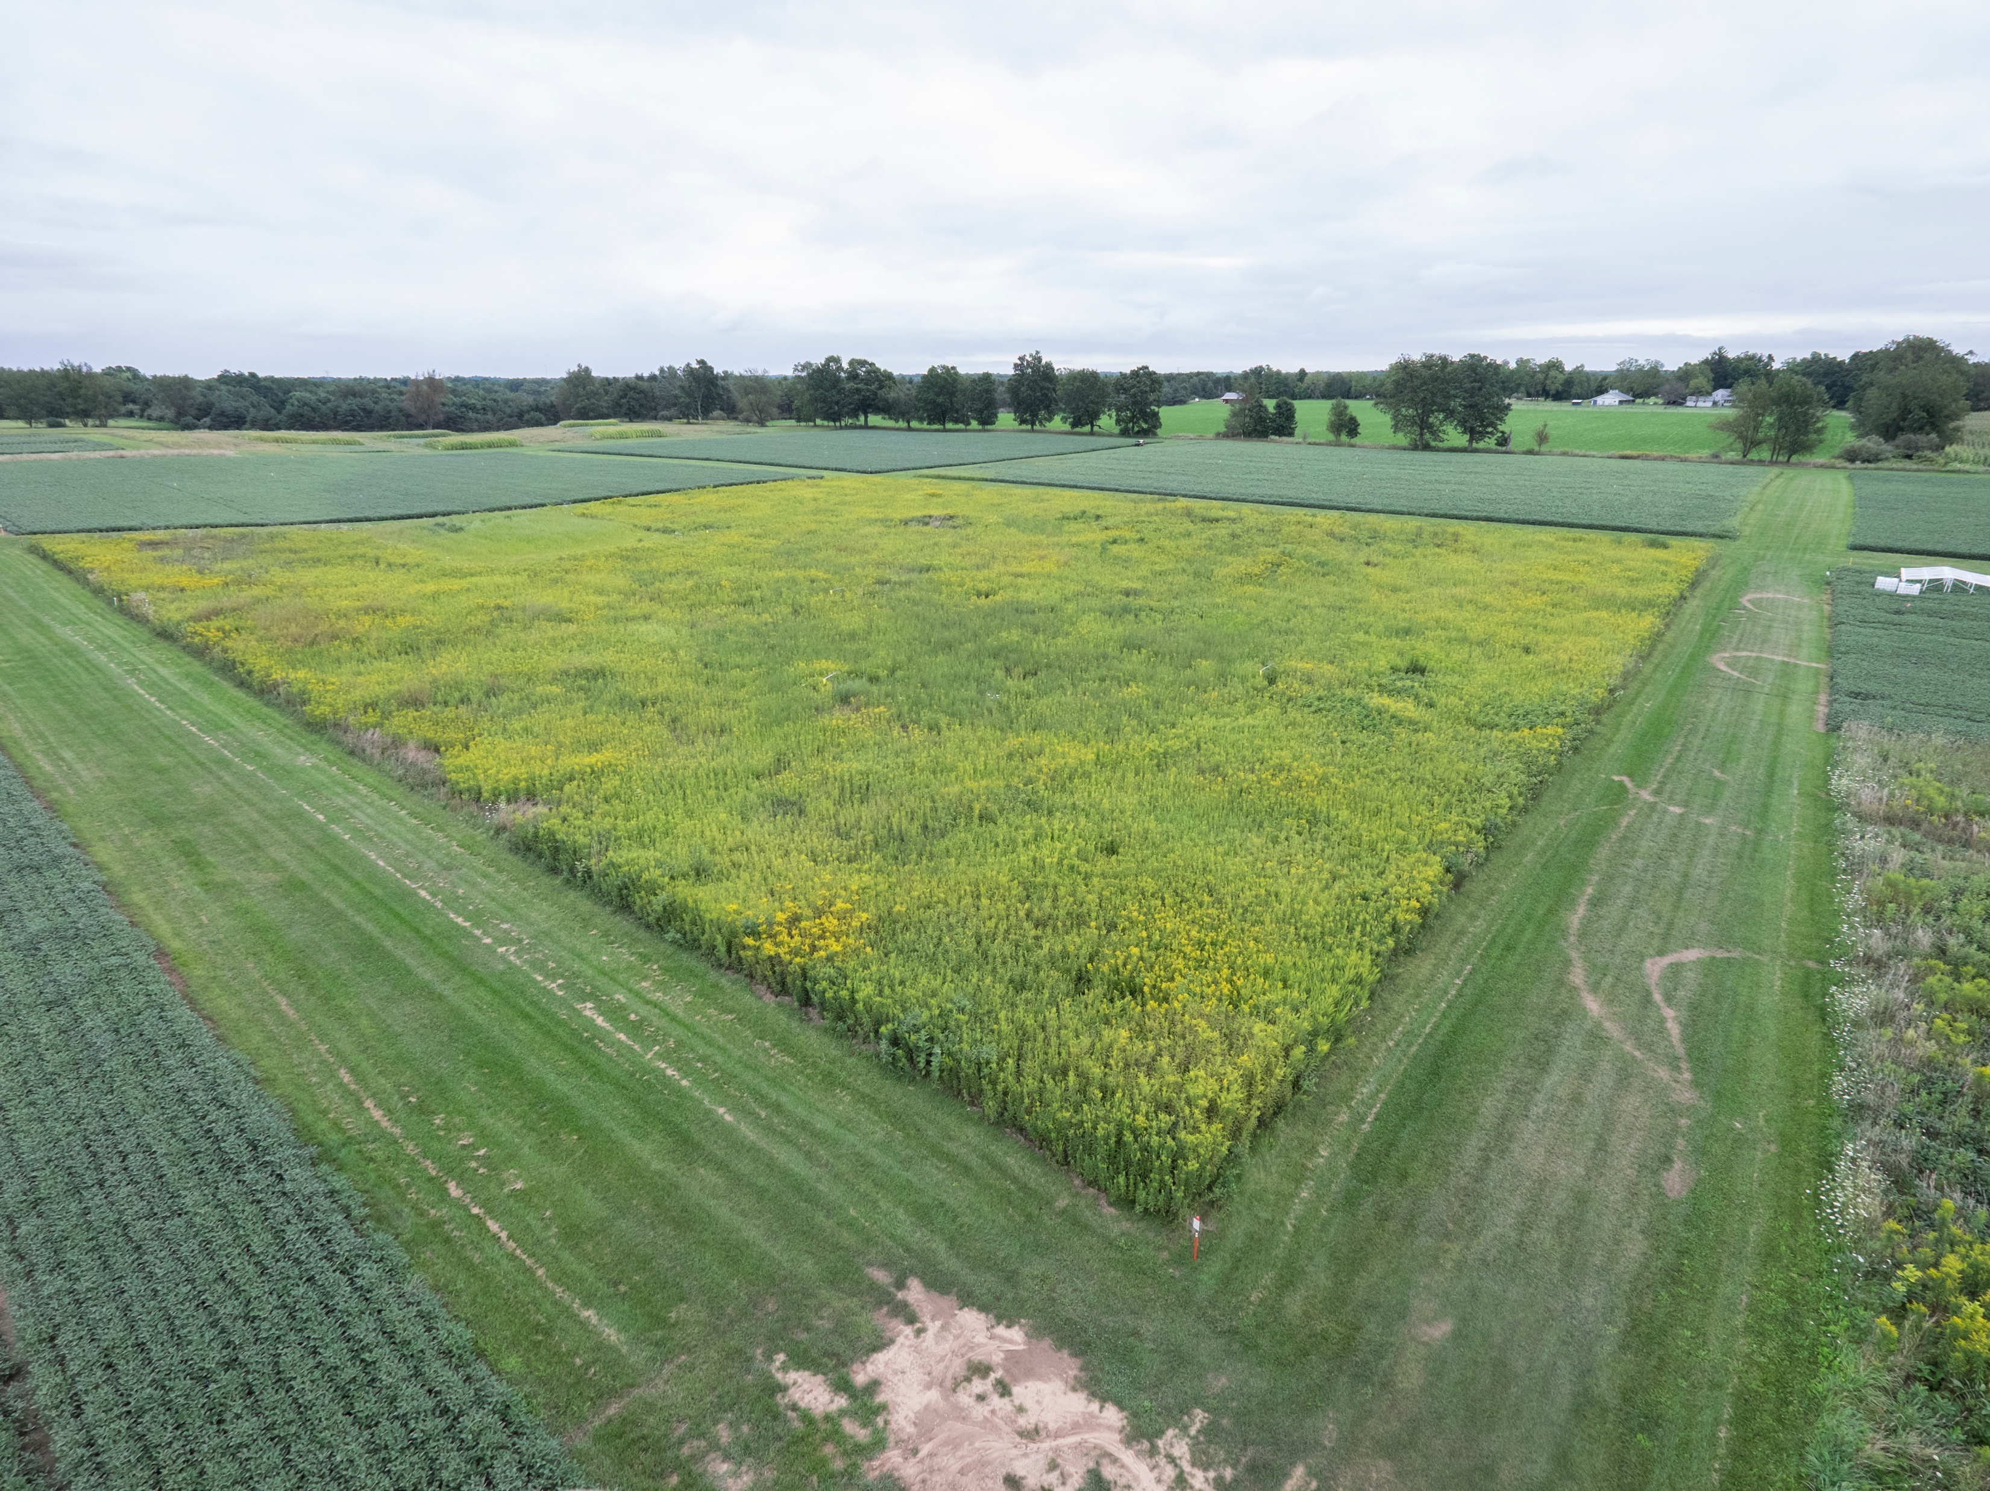
Notes:
The Early Successional treatment (T7) in late summer on the KBS LTER Main Cropping Systems Experiment. Though insects were sampled across all treatments, the data found in this Data Nugget is from this treatment in particular.
Photo Credit: K. Stepnitz, Michigan State University.

Slide 4
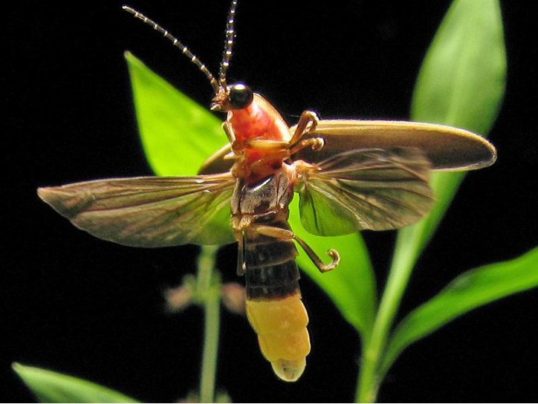
The big dipper firefly
Photinus pyralis
Notes:
The big dipper firefly, Photinus pyralis, a common firefly species caught on sticky cards in Southwest Michigan;
Photo Credit: Terry Priest / wikimedia commons

Slide 5
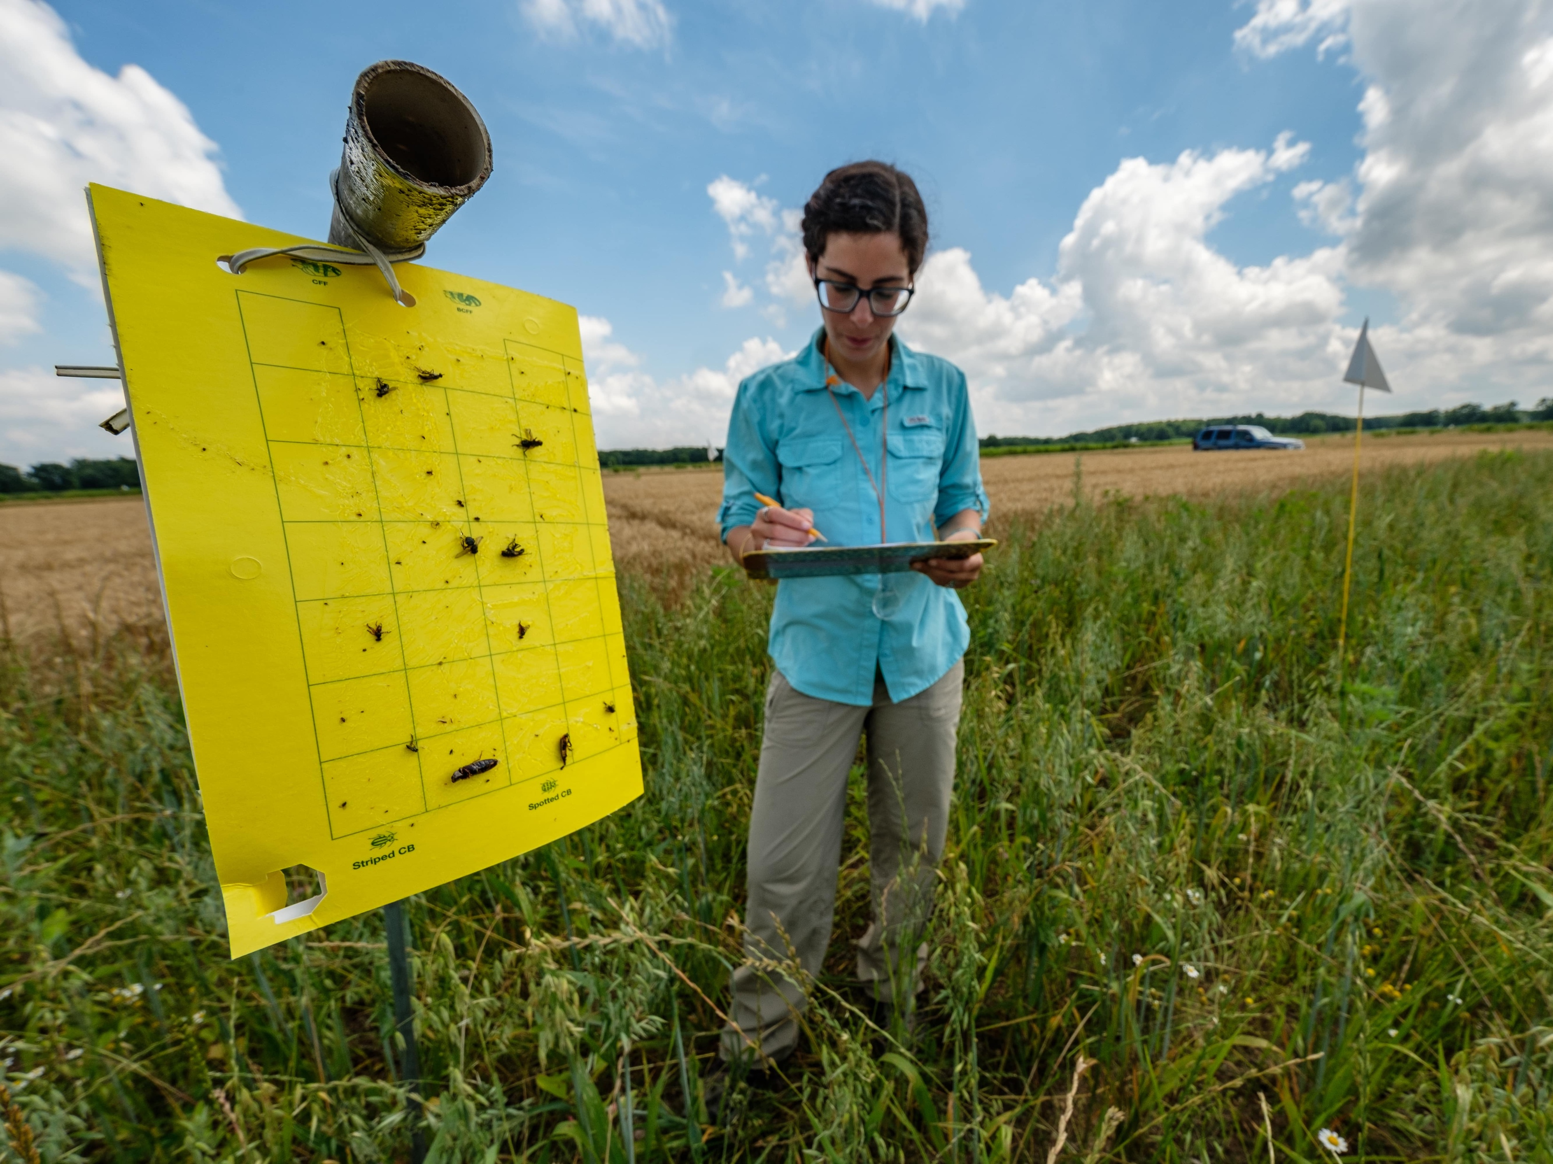
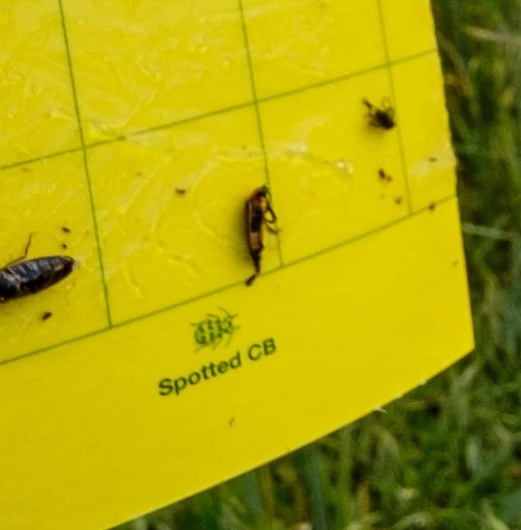
Notes:
A researcher collects data from a yellow sticky card at the MSU KBS LTER site. If you look closely at the bottom right of the card you can see a firefly that was trapped!
Photo Credit: K. Stepnitz, Michigan State University.

Slide 6
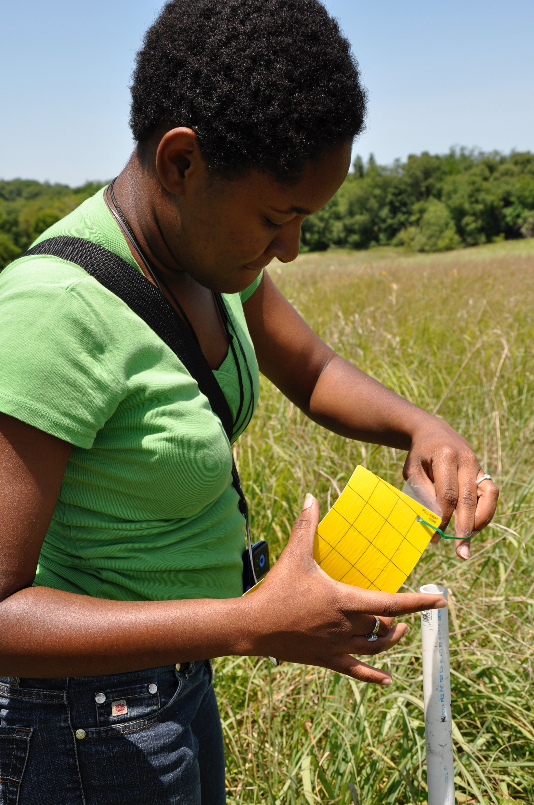
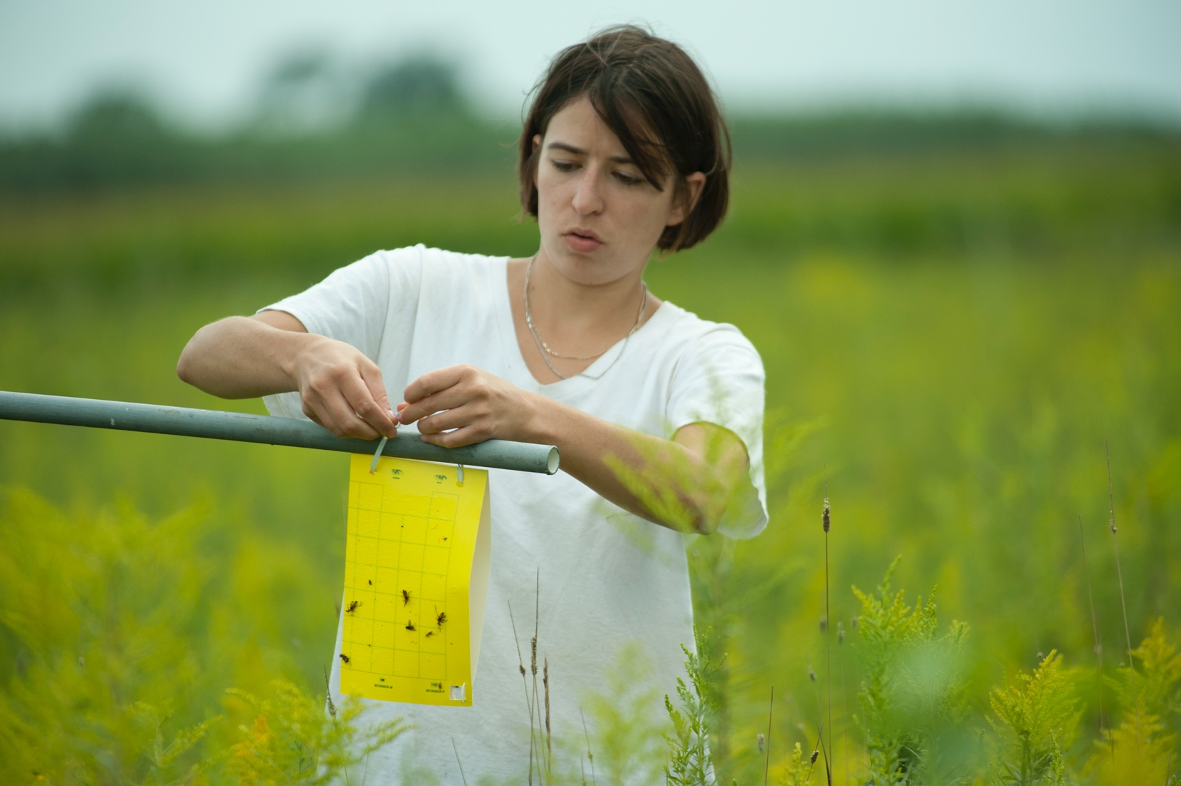
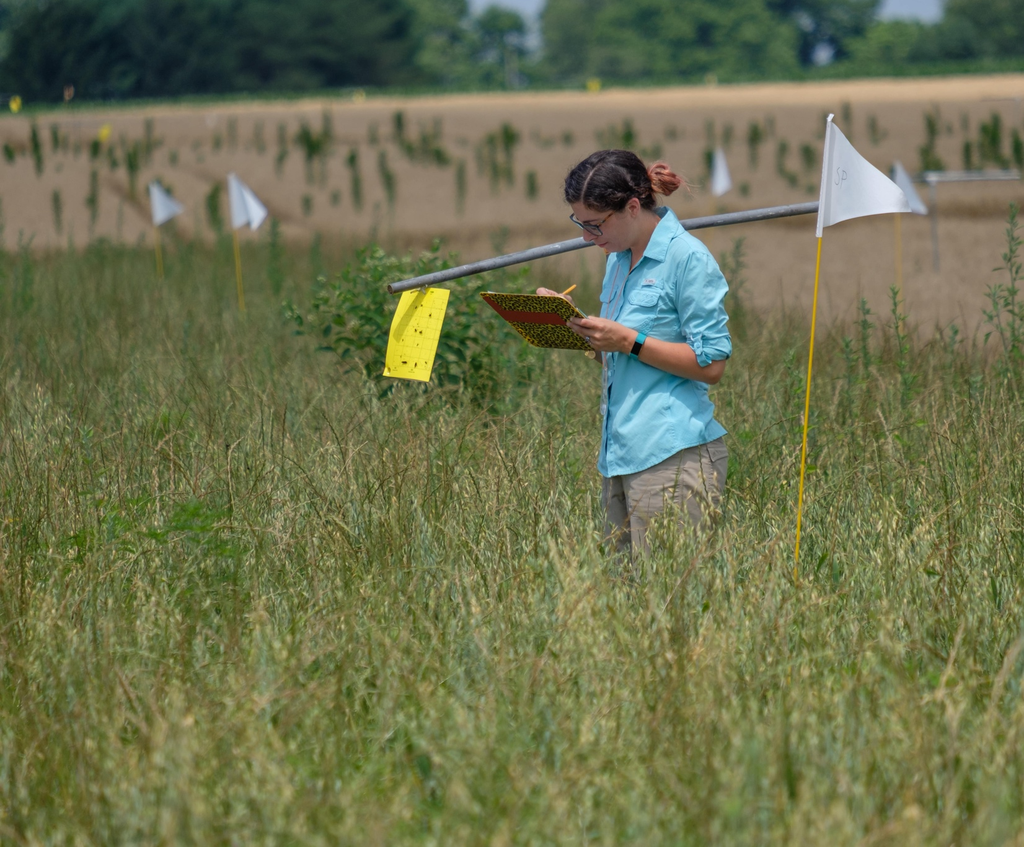
Notes:
Many scientists work together to collect this large dataset.

Slide 7
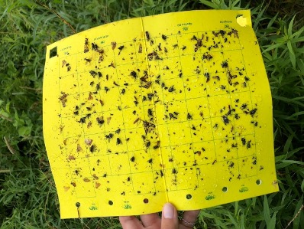

Slide 8
Notes:
20 years of data collection from the Kellogg Biological Station Long-Term Ecological Research Program, funded by the National Science Foundation (NSF).

Slide 9
Firefly population size is highly variable over time

Slide 10
Firefly populations peak about every 6 years

Slide 11
Over 20 years of data show an overall decline in the firefly population

