Slide 1
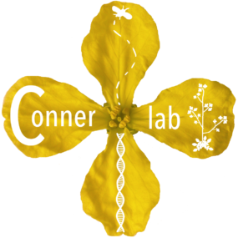
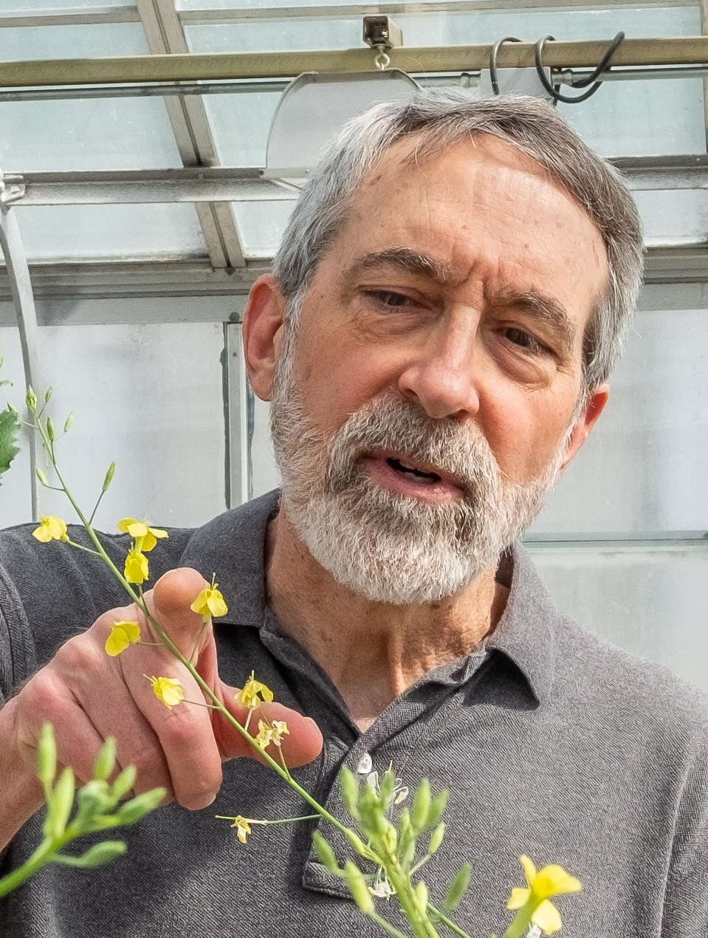
The science of stamen loss
The Conner Lab
Kellogg Biological Station

Slide 2
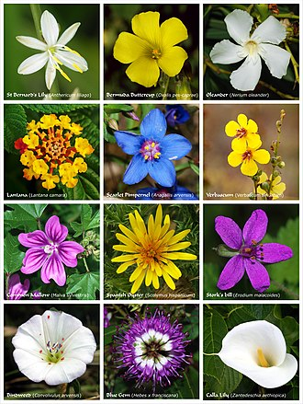
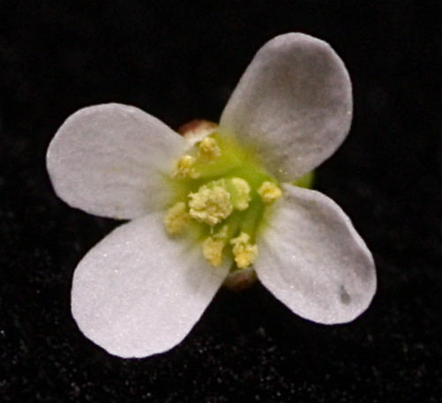
A mustard flower, showing the 4 long stamens (top and bottom) and 2 short stamens (left and right) that are unique to this plant family.

Slide 3
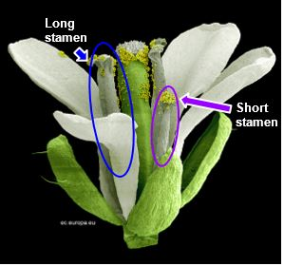
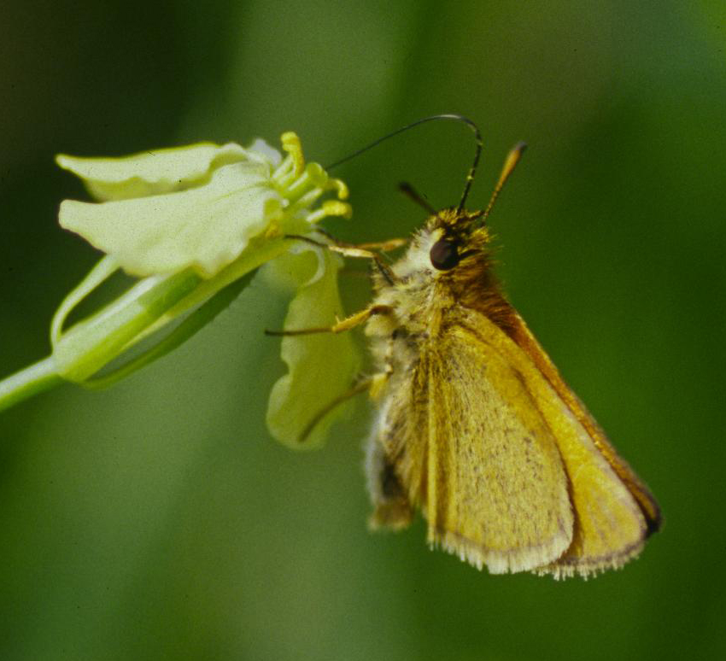

Slide 4
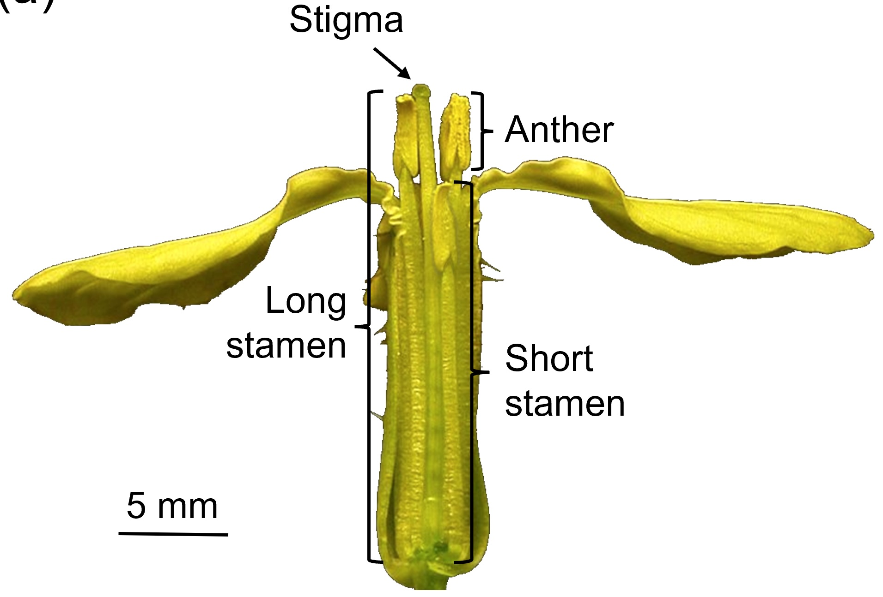

Slide 5
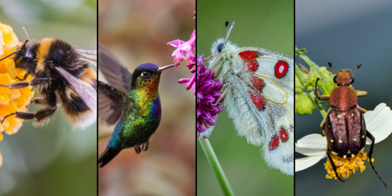
Pollinators help plants reproduce by bringing reproductive parts together. Pollination happens when pollen from the stamen reaches the stigma. This is needed for seeds to form. By moving pollen, pollinators help plants make more seeds.

Slide 6
