Slide 1
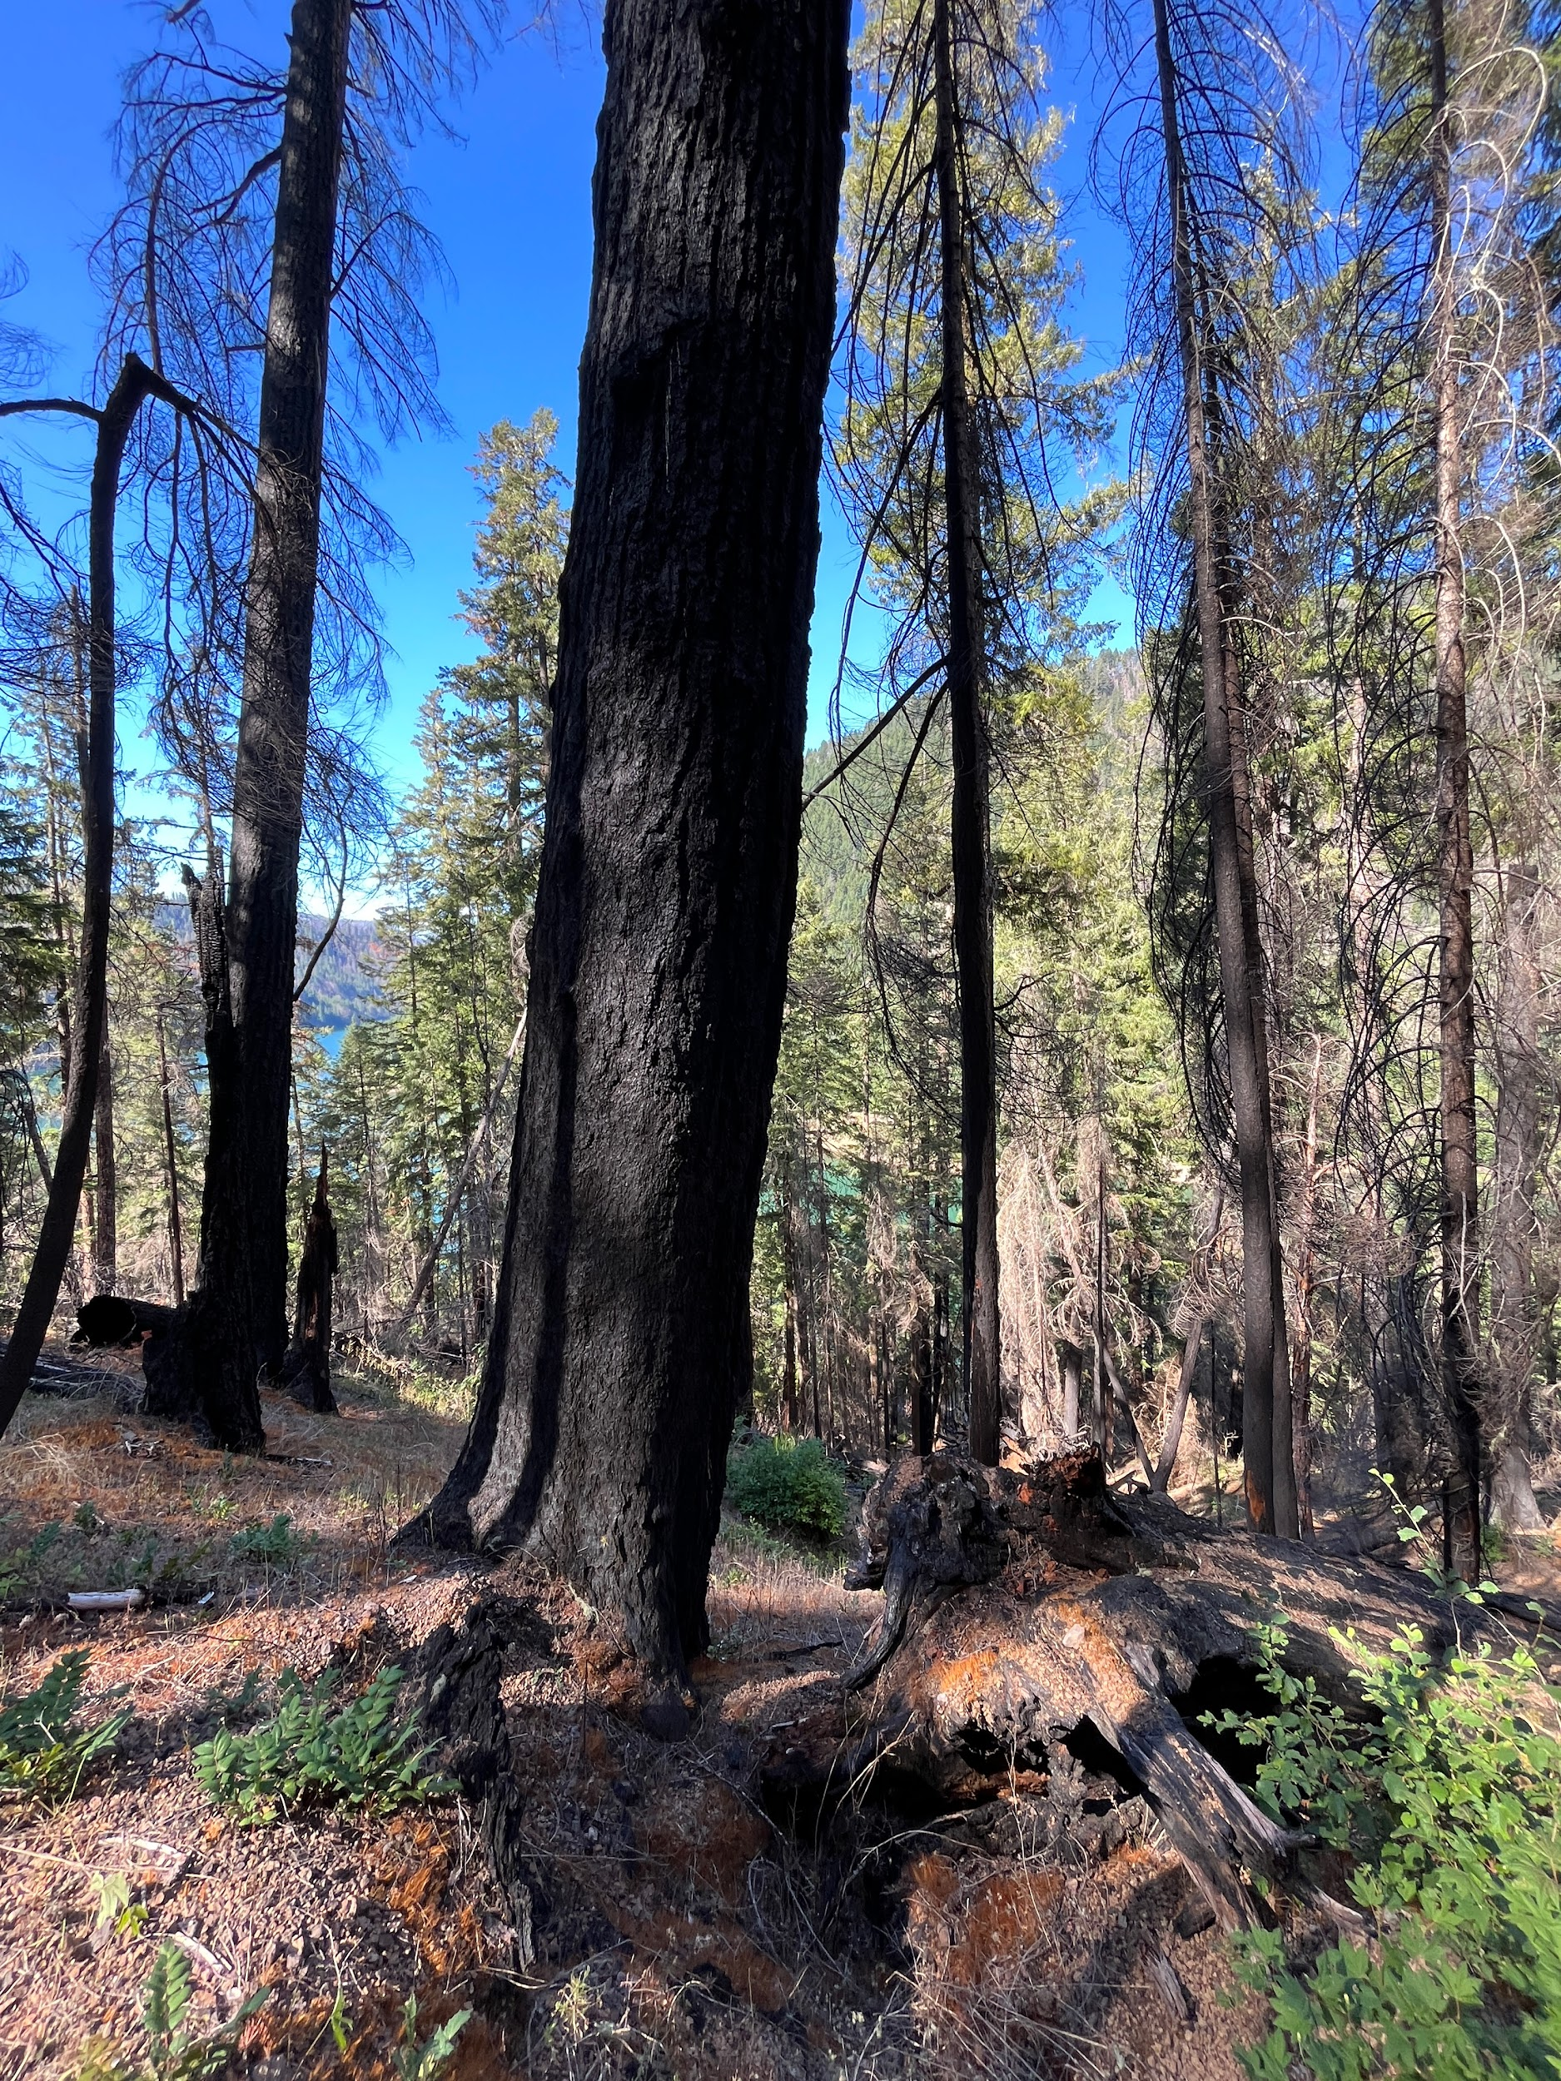
Example of the burned forest

Slide 2
Joe identifying and counting plant species

Slide 3
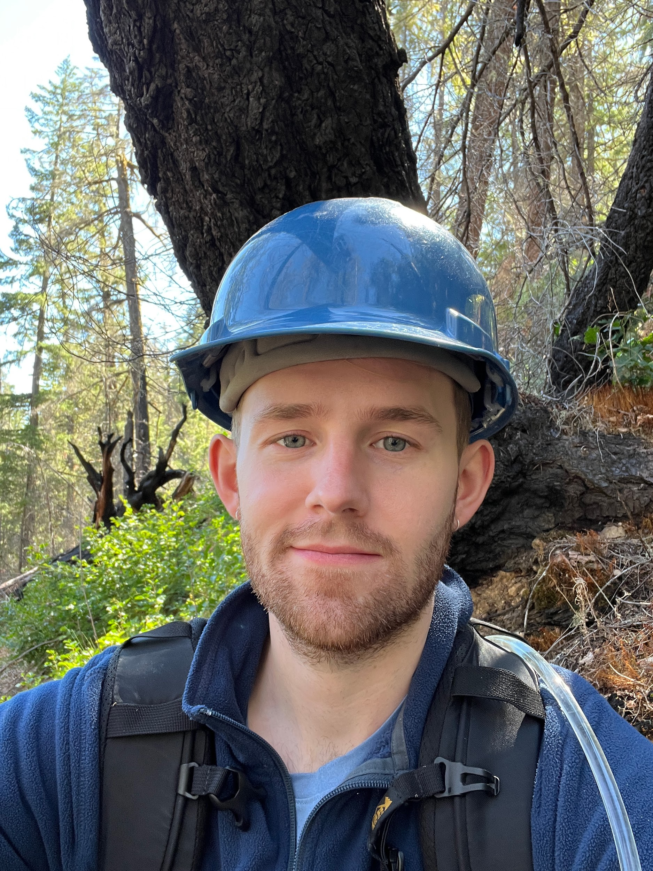
Matt in the burned forest, needing to wear hard hat for safety reasons due to falling tree hazards post fire

Slide 4
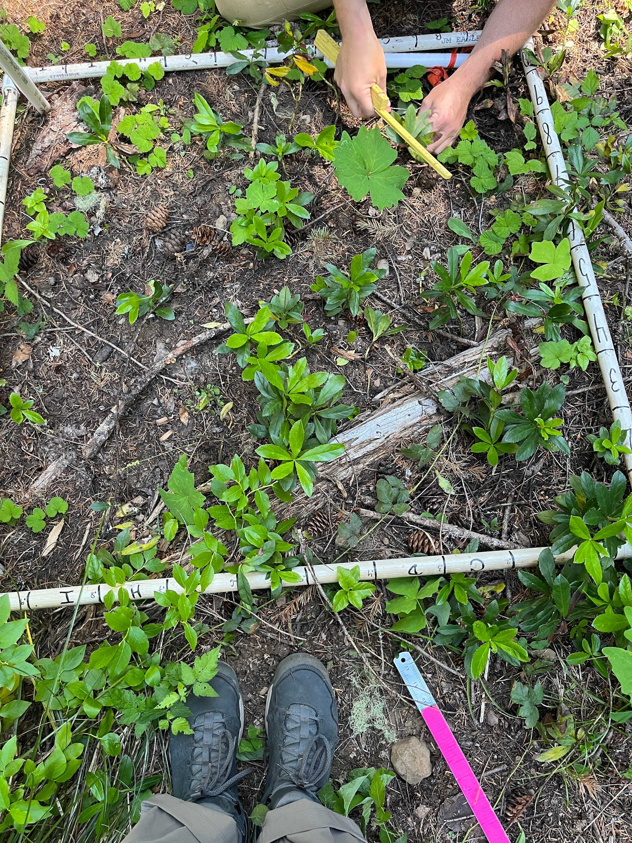
Image of 1-m2 plot beings surveyed

Slide 5
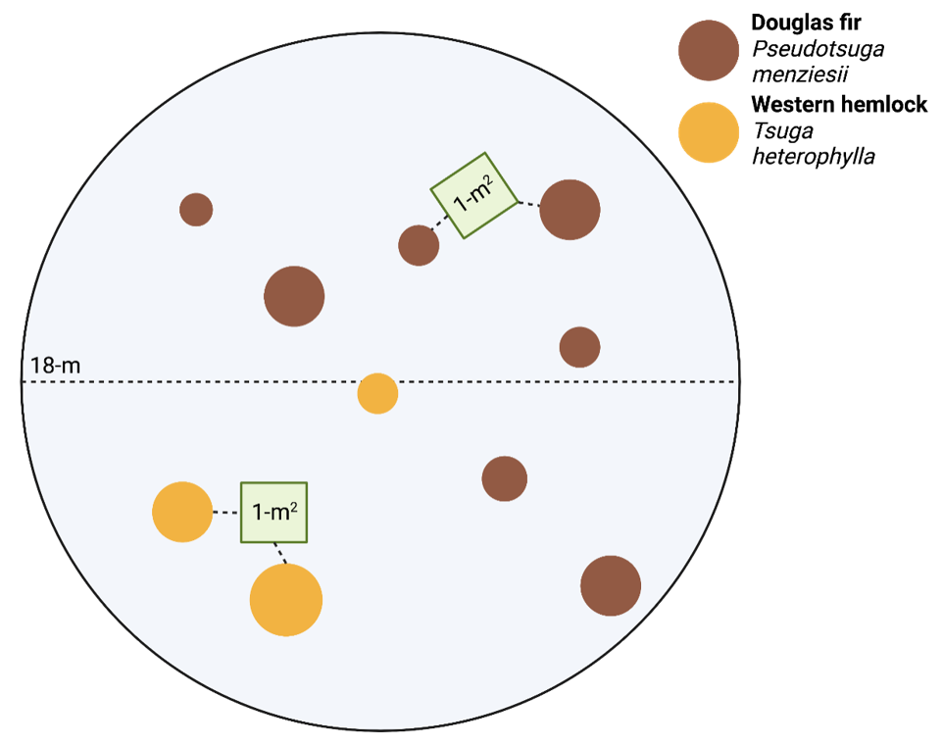
Image of study design

Slide 6
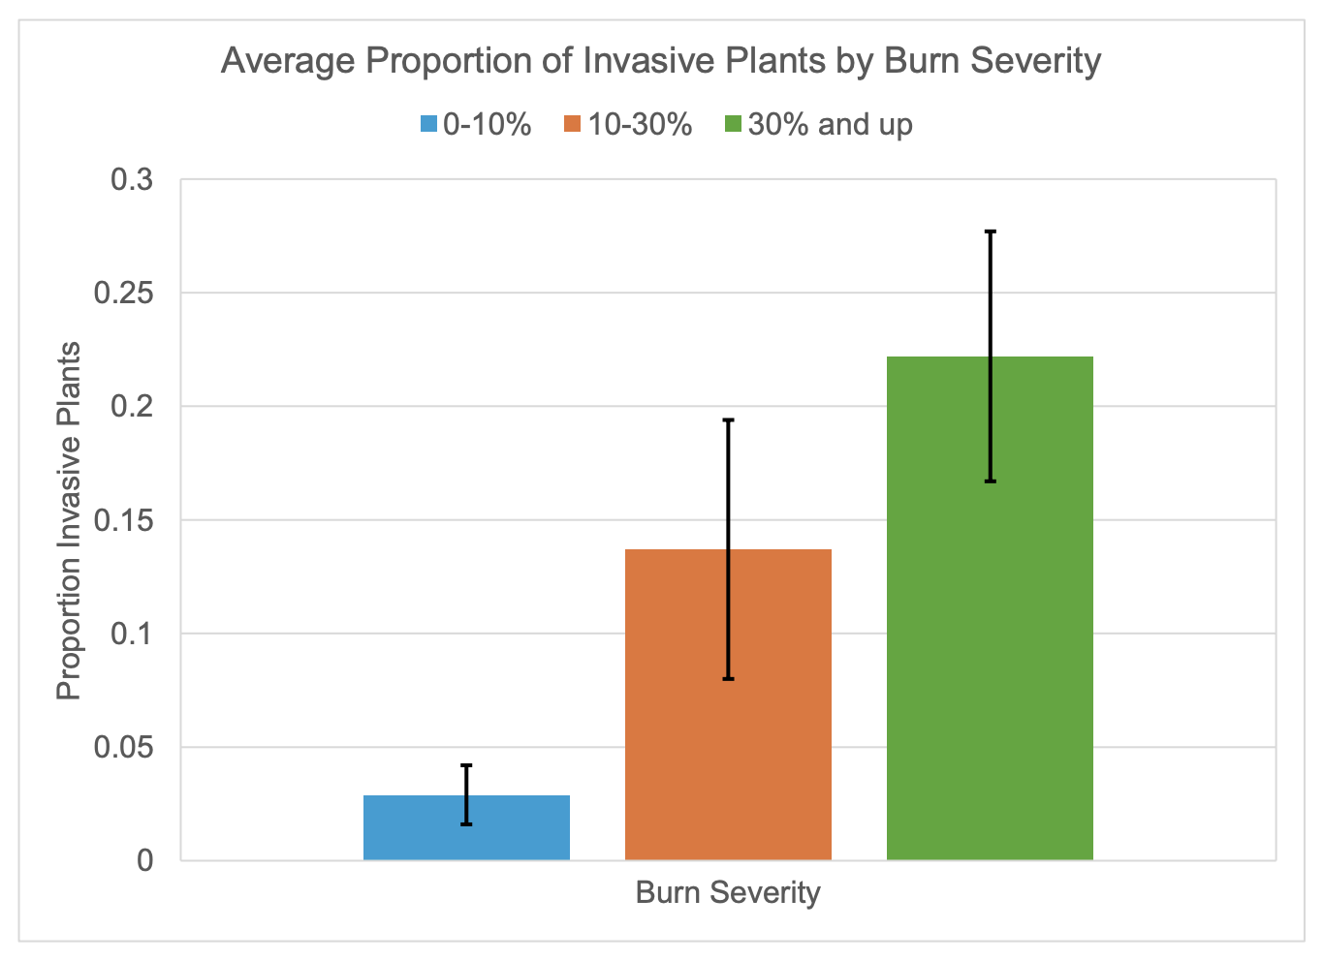

Slide 7
