Slide 1
CO₂ and trees, too much of a good thing?
Featured scientists: Kristina J. Anderson-Teixeira (she/her) & Luca Morreale (he/him) at Smithsonian’s National Zoo & Conservation Biology Institute
Written by Ryan Helcoski

Slide 2
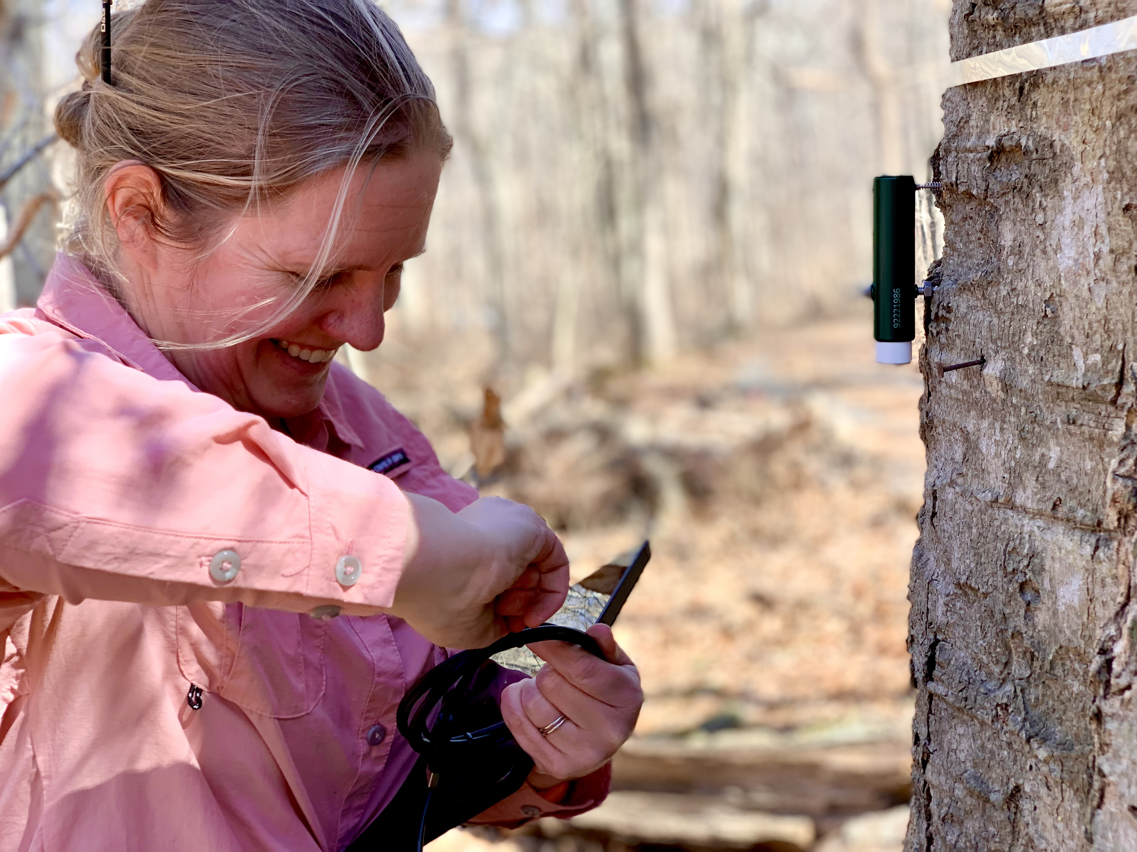
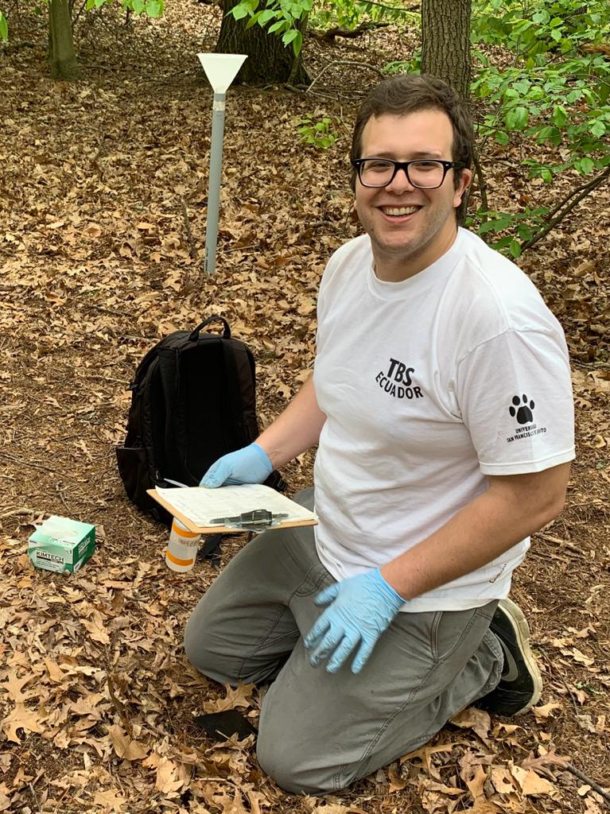
Notes:
LEFT: Kristina Anderson-Teixeira prepares to set-up an automatic dendrometer to measure tree growth
RIGHT: Luca Morreale joined Kristina’s lab in 2022. He and Kristina worked together with many other scientists to collect and process data on tree growth and mortality in 2023.

Slide 3
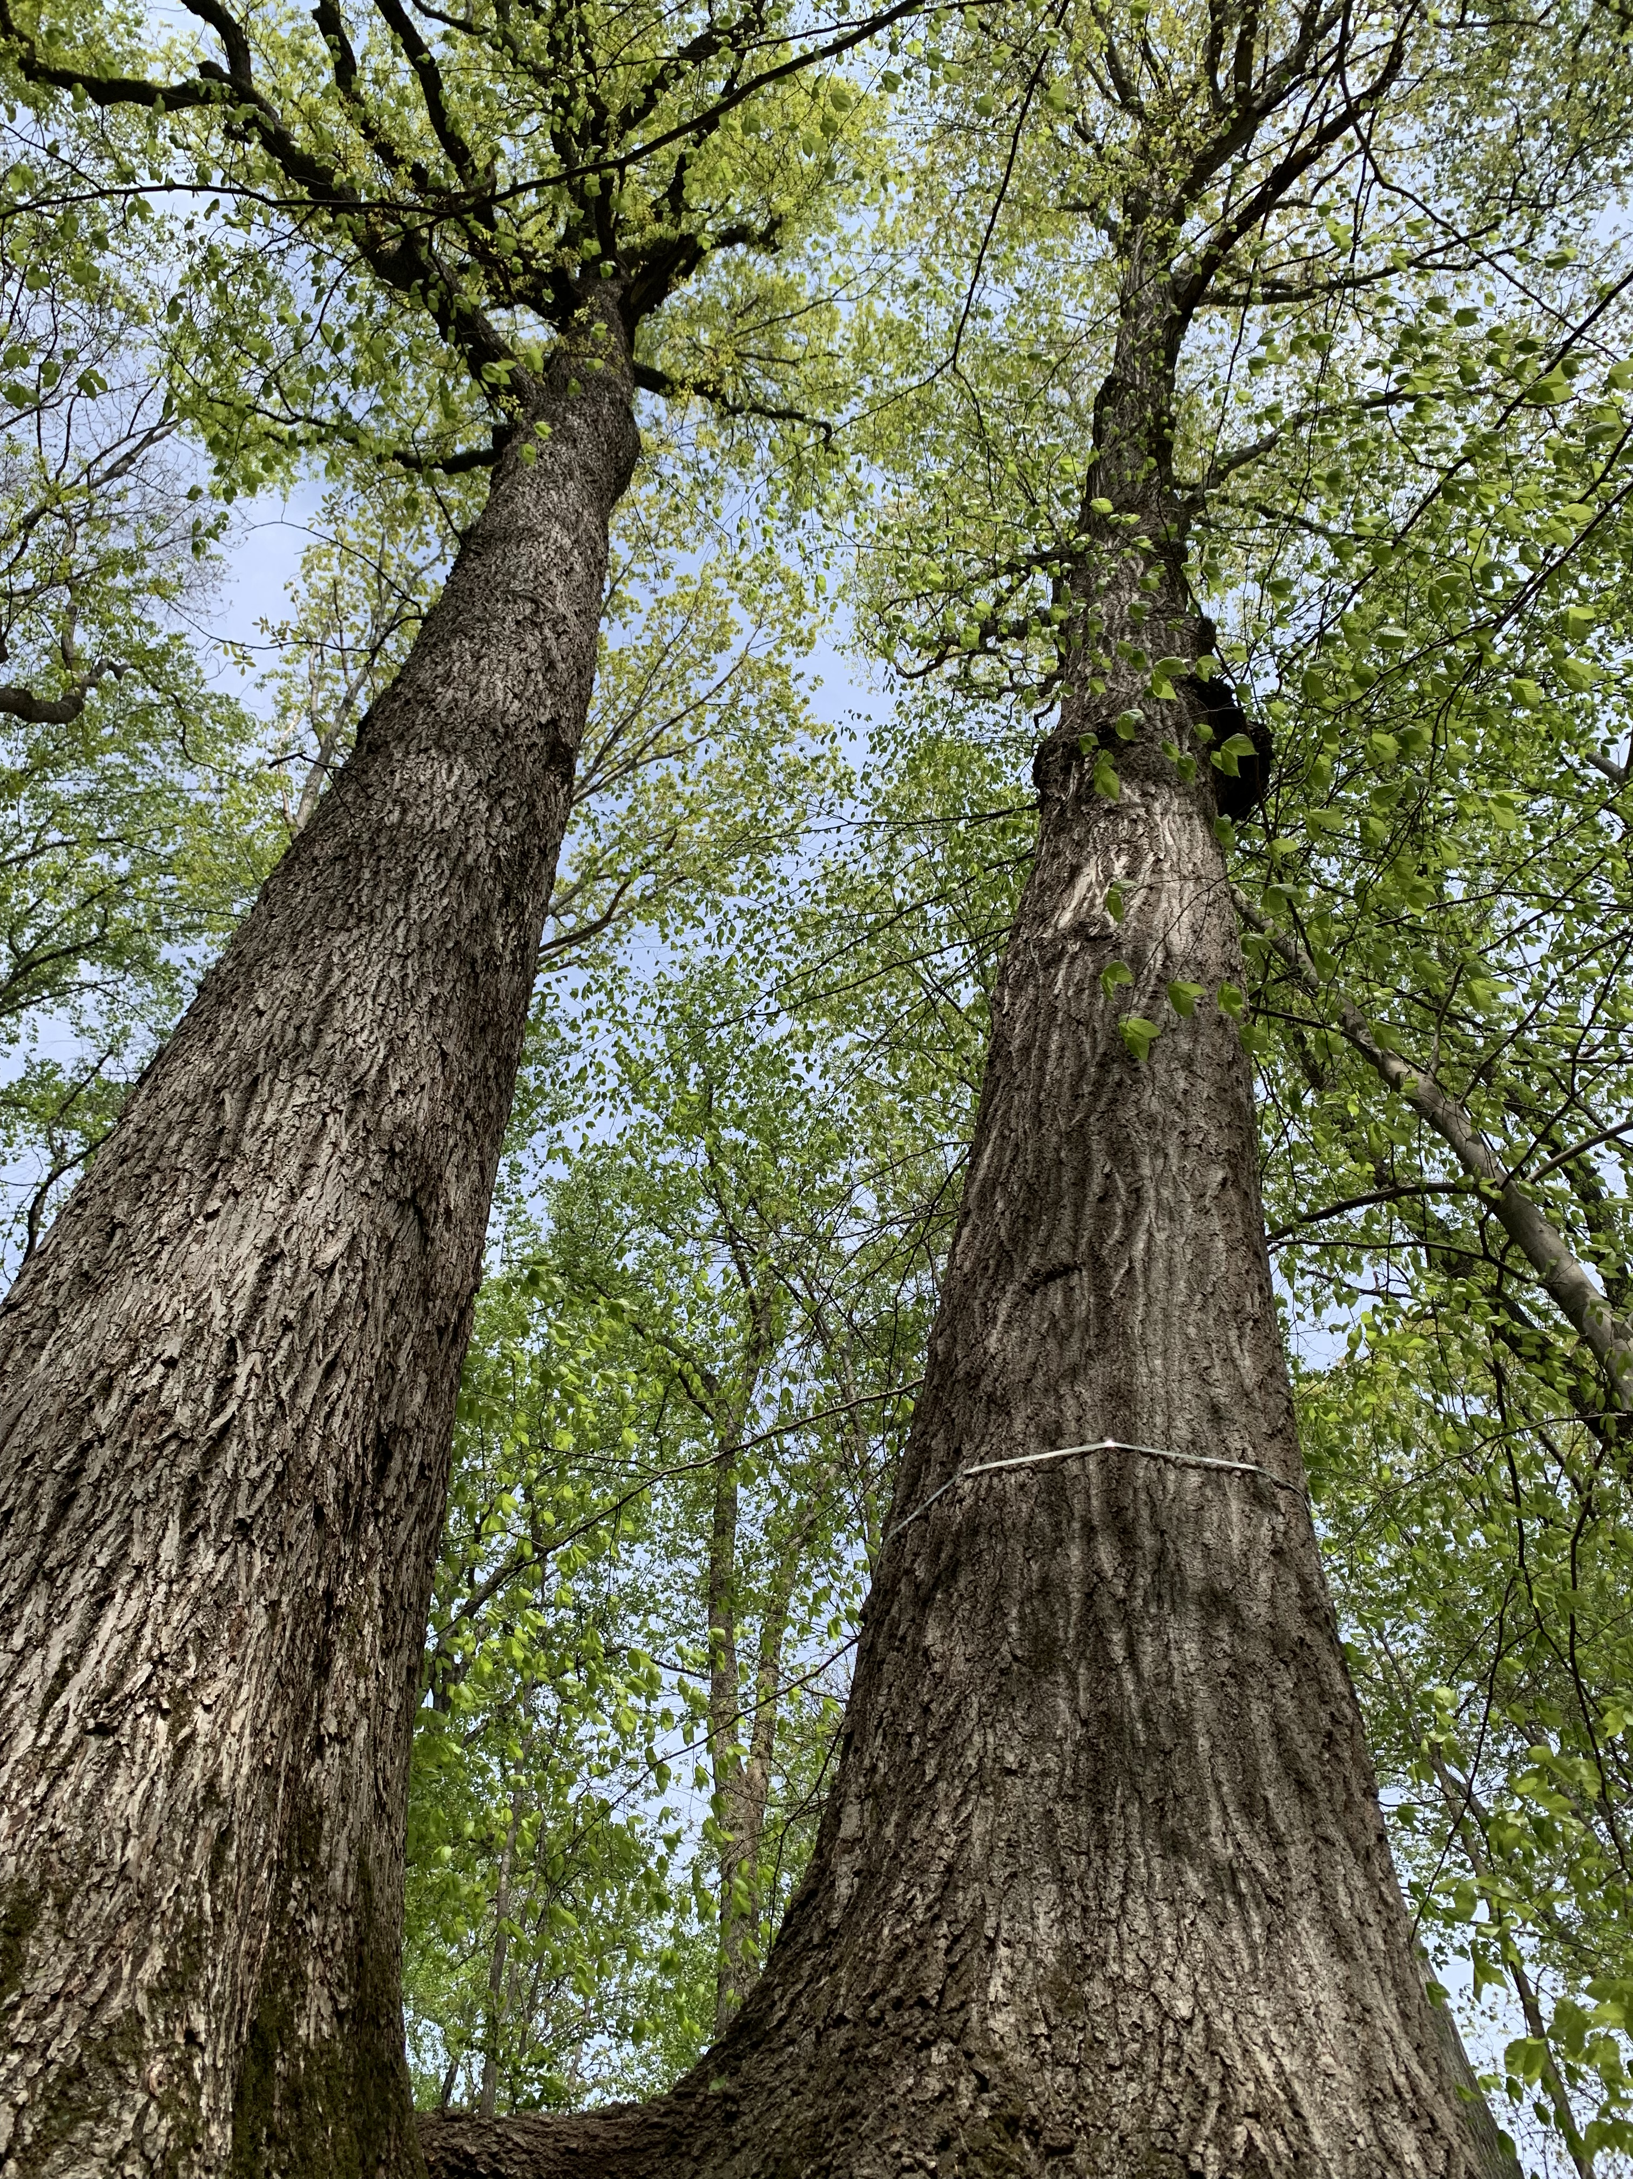
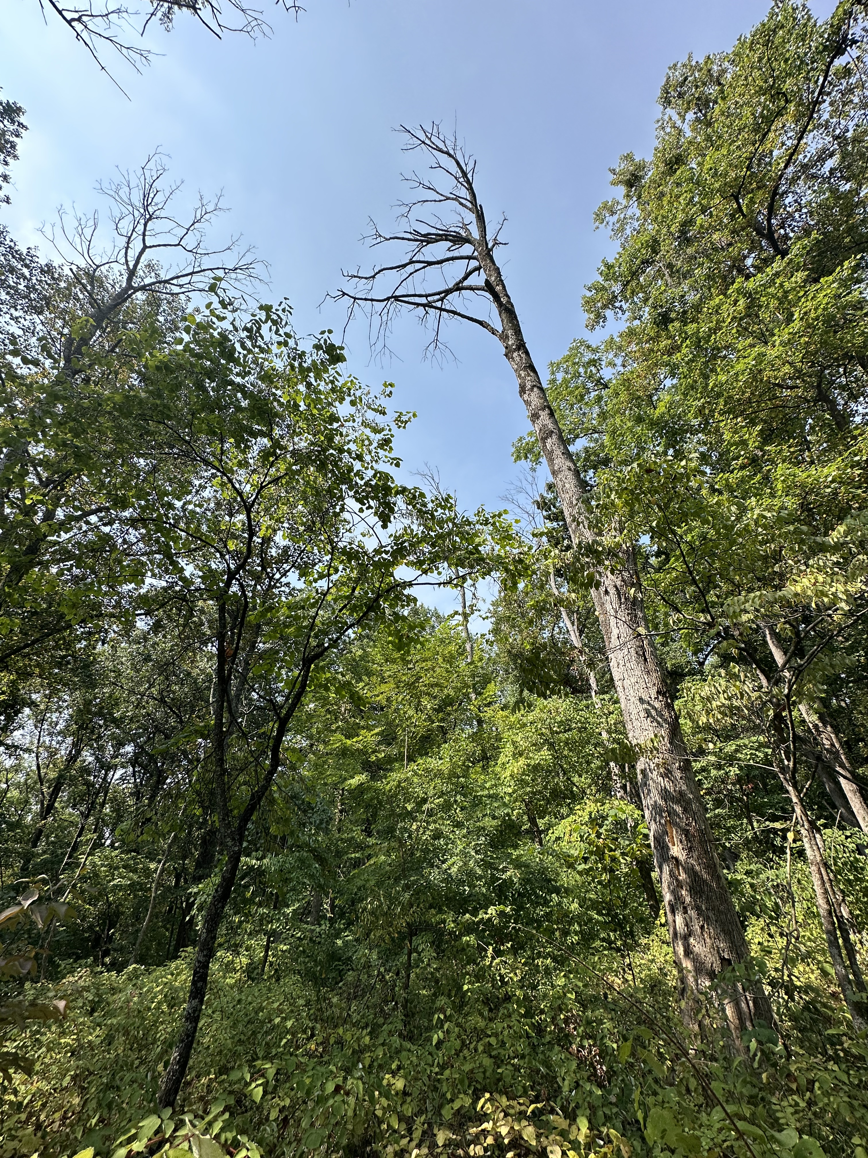
Notes:
LEFT: Two large trees stand in the SCBI experimental plot after a survey. The tree to the right has been banded to measure its growth
RIGHT: A dead ash tree stands in the SCBI experimental plot after a survey. This tree was killed by the invasive emerald ash borer

