Slide 1
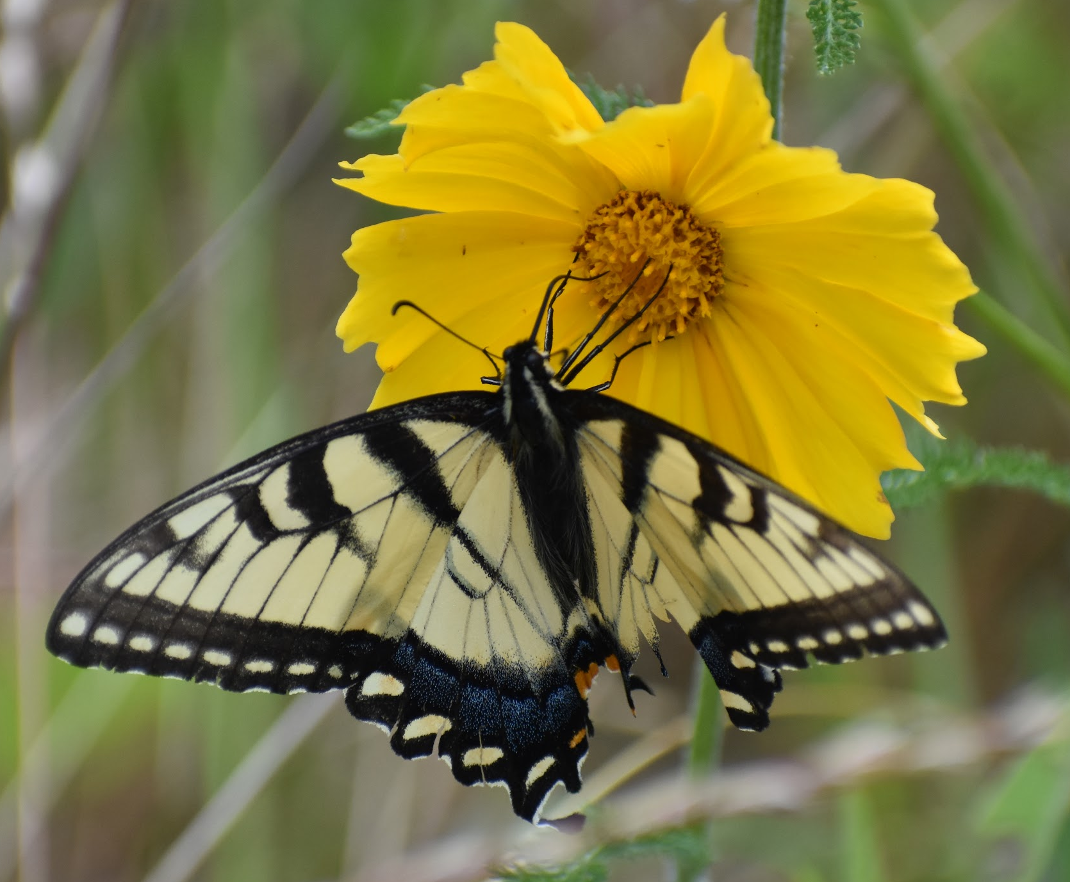
Little Butterflies on the Prairie
Notes:
Both photos by Elaine

Slide 2
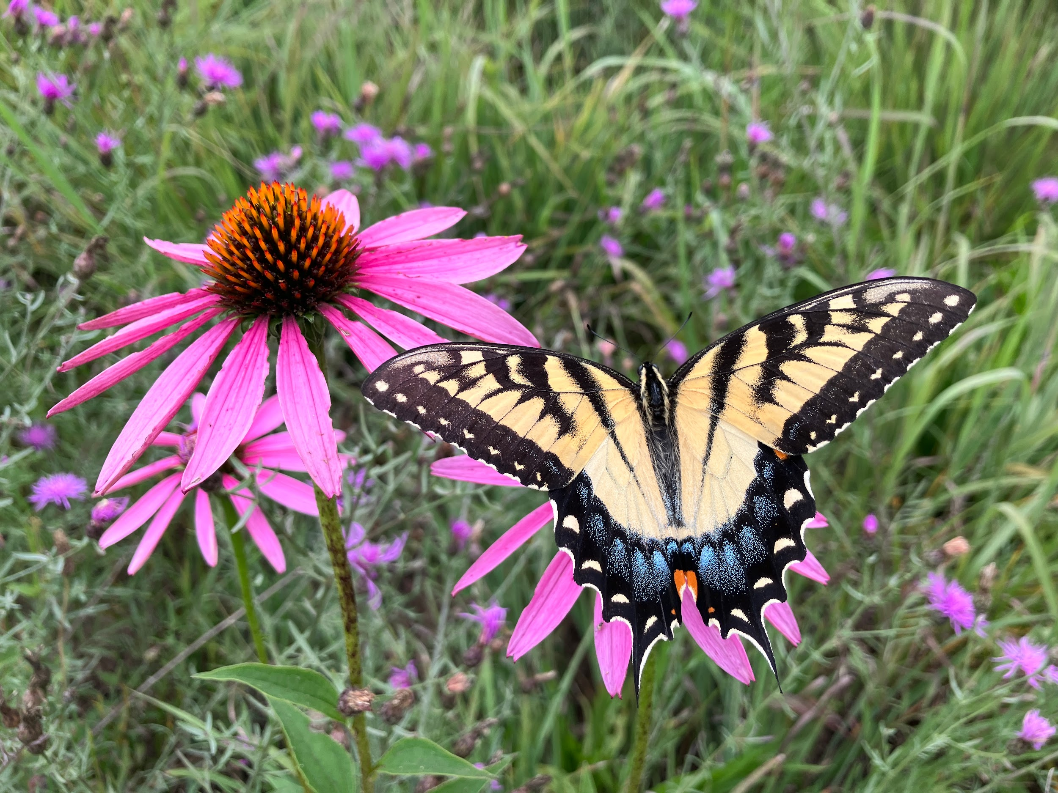
Photo by: Jamie Smith

Slide 3
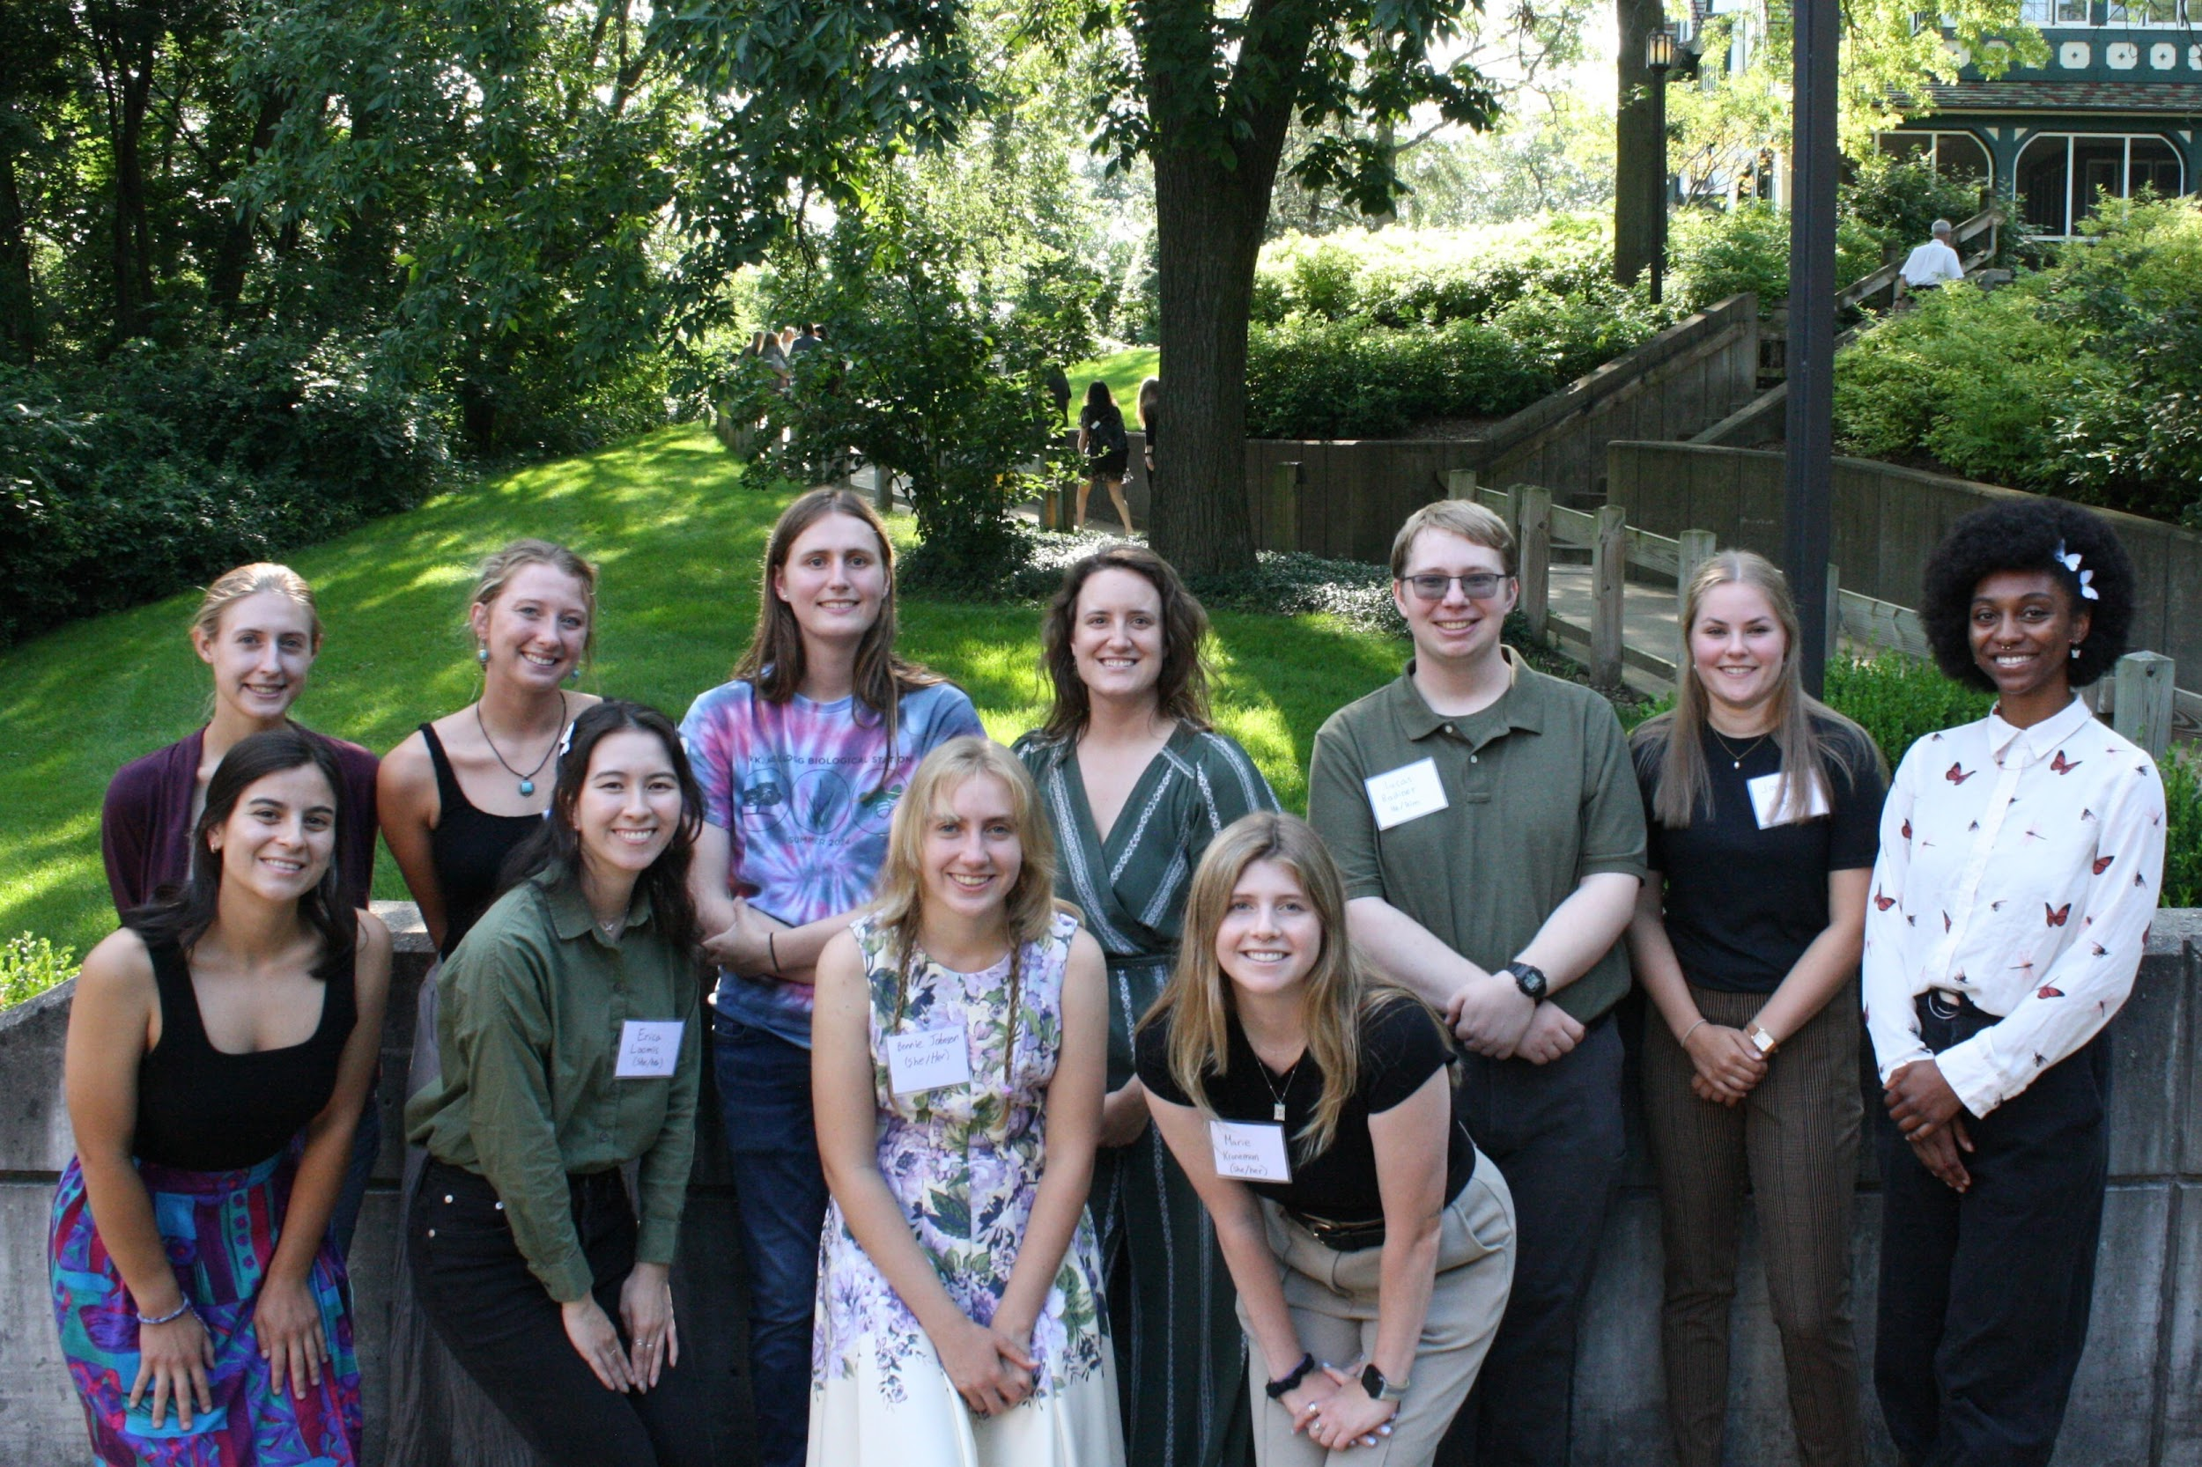
The Haddad Lab
Notes:
Left photo: (Left to right, top to bottom) Ashley, Emma, Elaine, Jamie, Lucas, Jordan, Stephanie, Annabelle, Erica, Bonnie, Marie
Right photo: (Left to right, top to bottom) Sam, Dave, Ashley, Elaine, Stephanie, Stephanie, Jamie ****We will likely take an updated photo ****

Slide 4
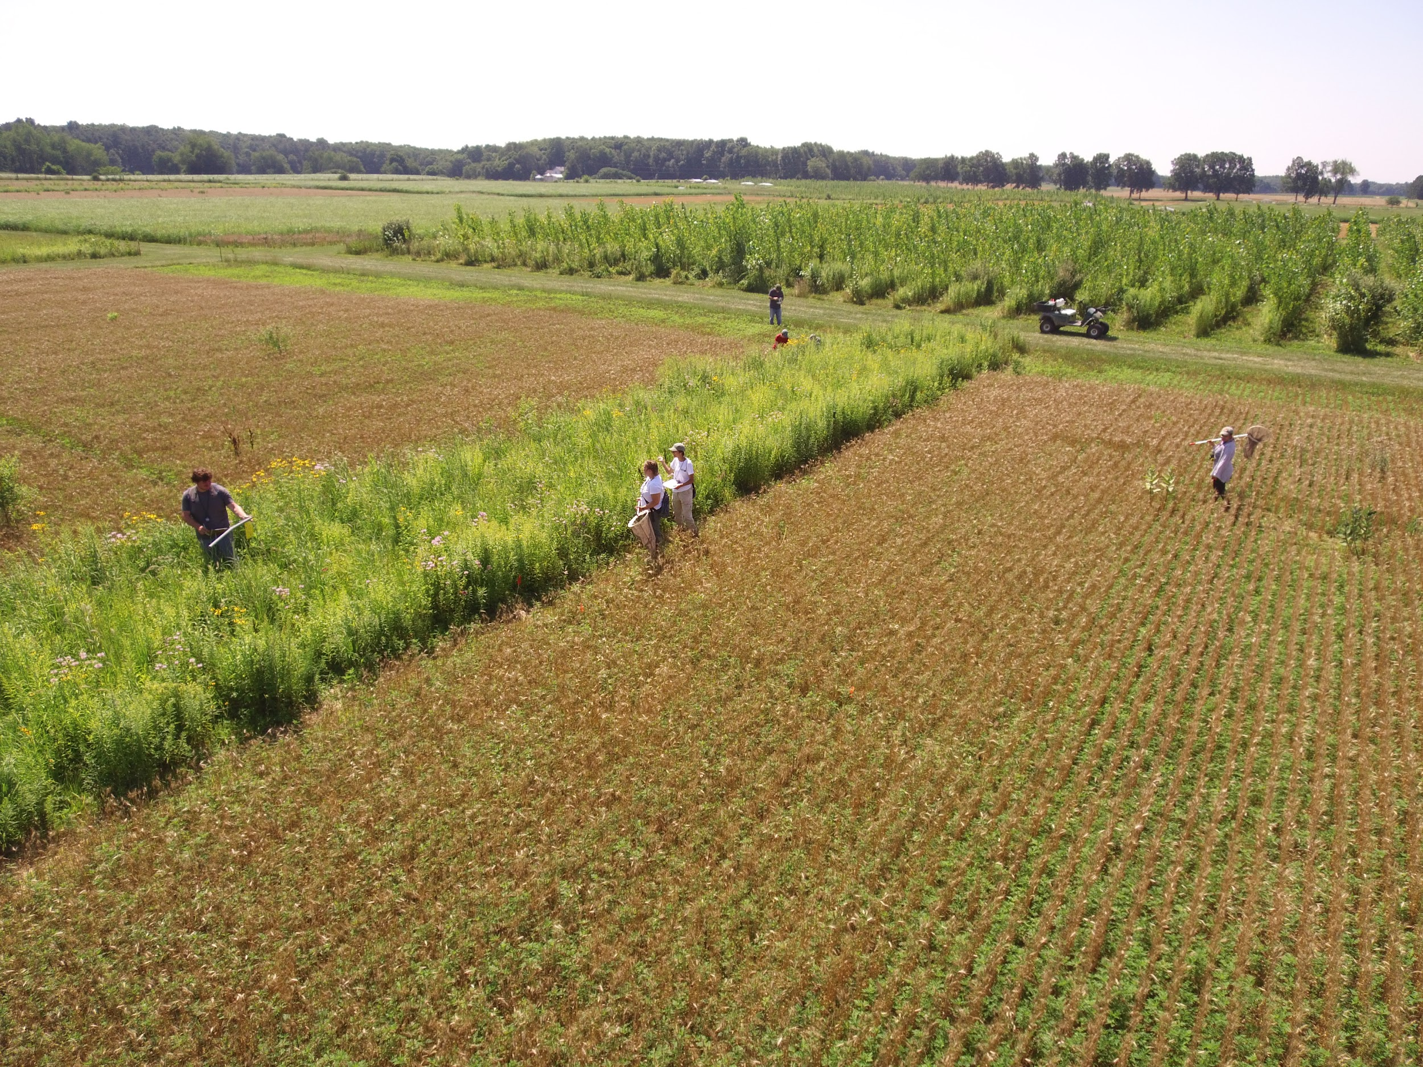
Notes:
L to R: Sean, Alex, Chuck, Esbeiry. Not sure about the two people at the back of the photo, but no faces are visible so it might be okay? This is a drone photo so photo probably by Kevin Kahmark but should confirm

Slide 5
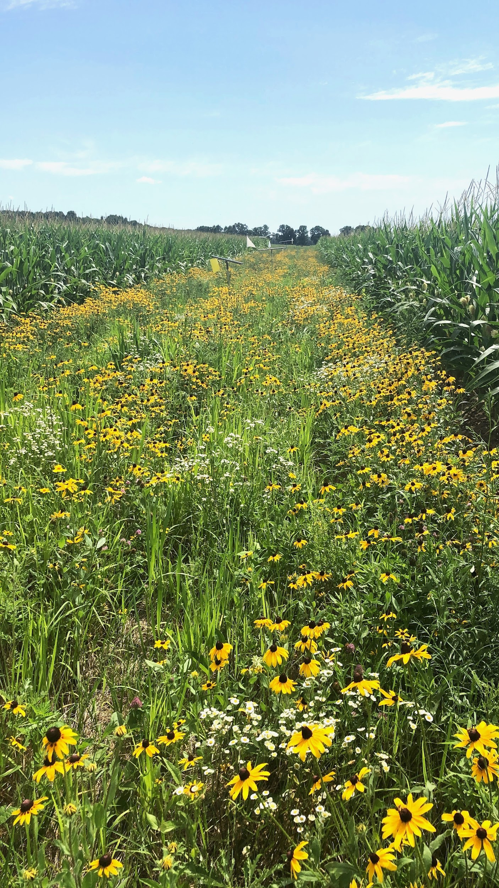
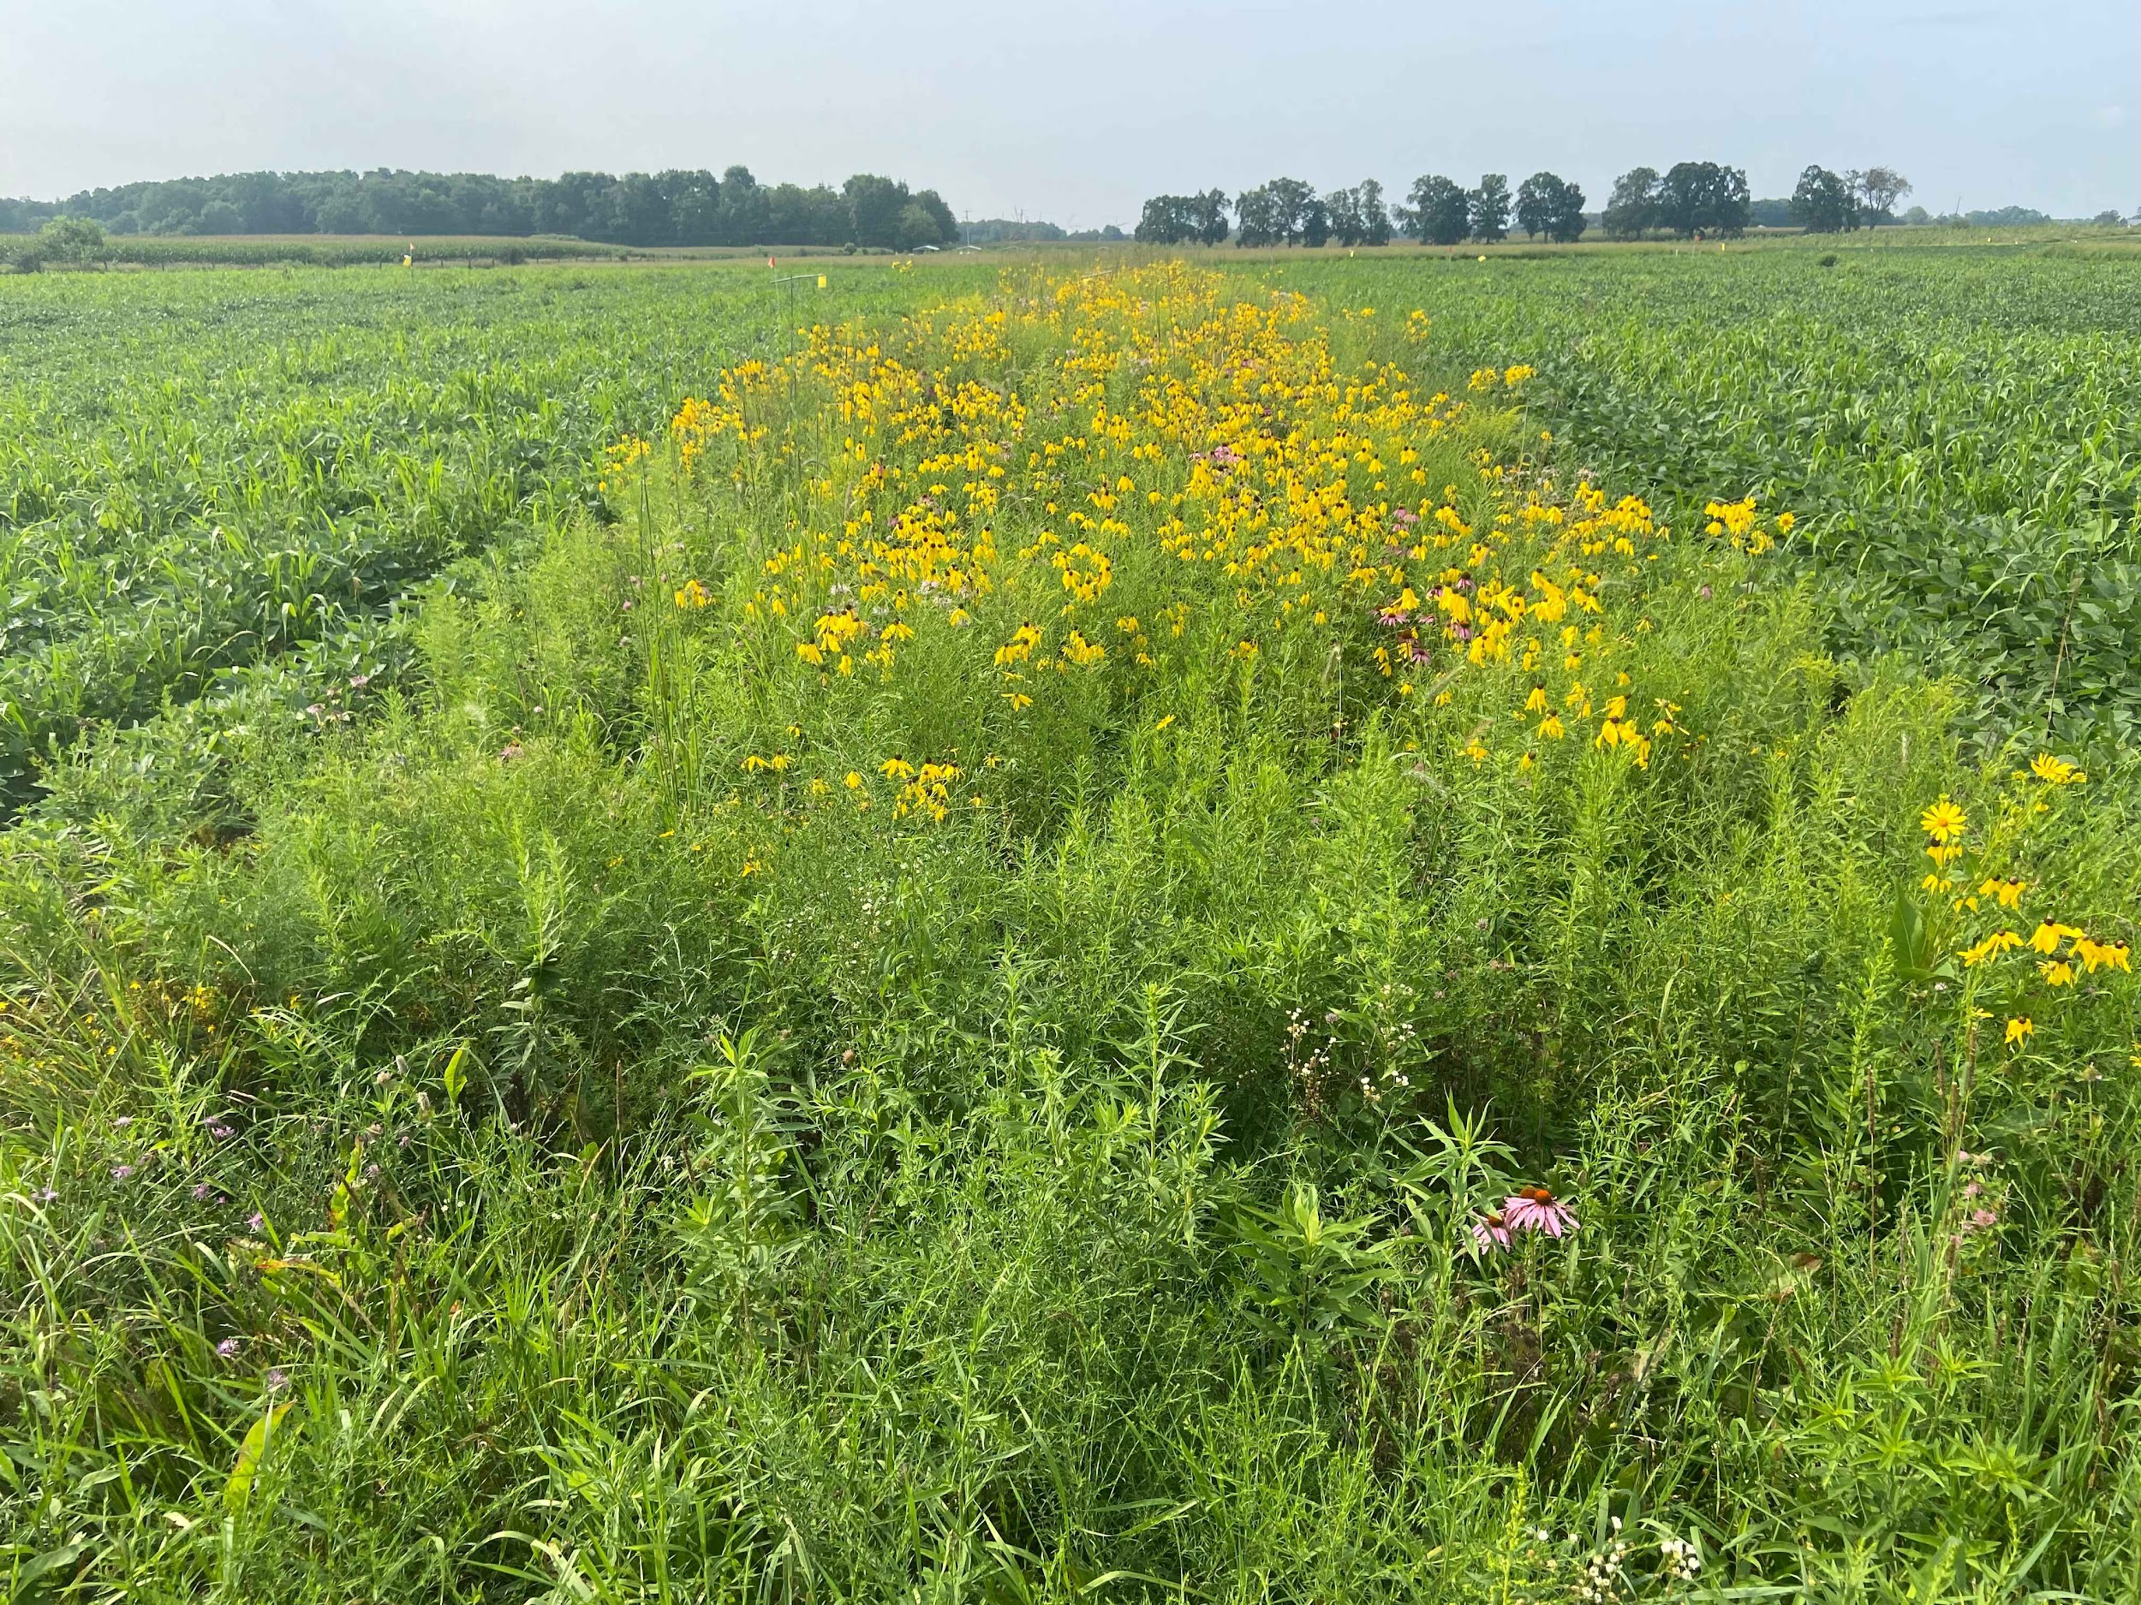
Photo by: Liz Schultheis
Photo by: Jamie Smith

Slide 6
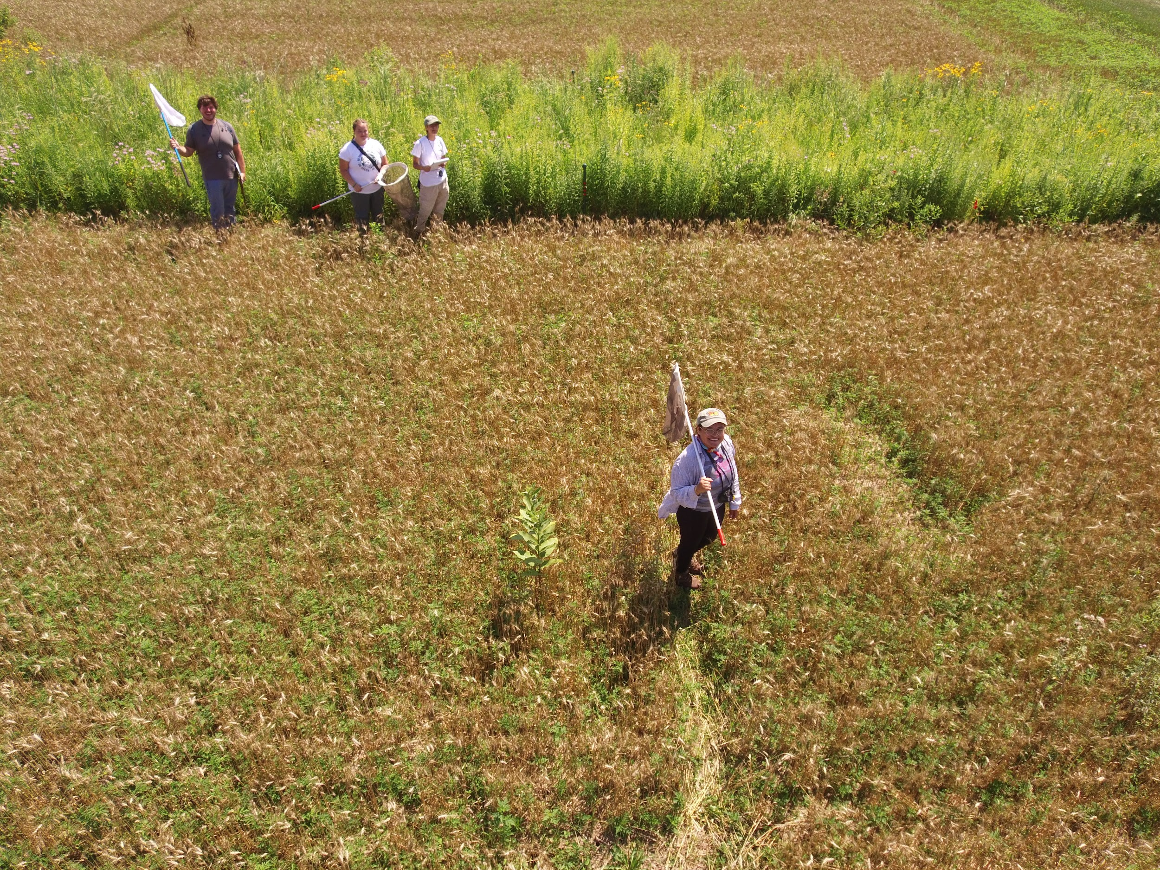
Notes:
Left photo: (Left to right) Sean, Alex, Chuck, Esbeiry. Drone photo, so photo probably by Kevin Kahmark, but should confirm
Right photo: (Left to right) Chuck, Rachel, Jamie, Nikki, Isaiah, Annabelle, Esbeiry, Sean

Slide 7
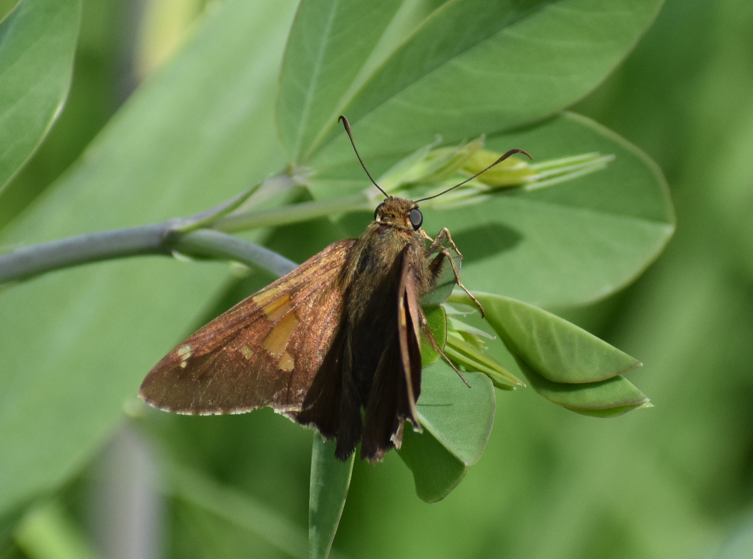
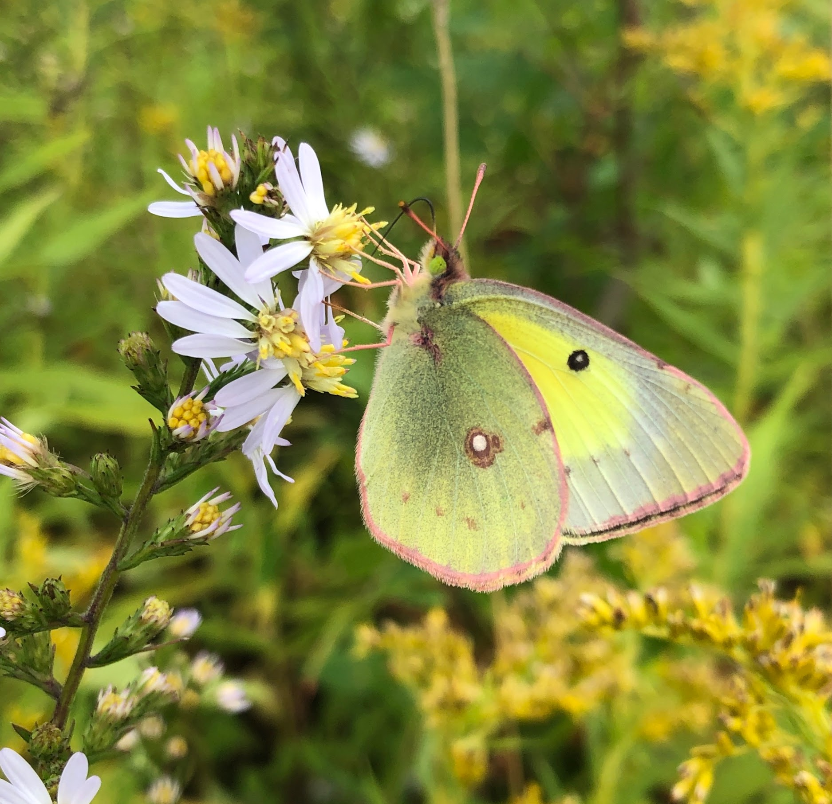
Notes:
Photo Credits: Top left: Elaine, Middle left: Elaine, Bottom left: Jamie, Center: Jamie, Top right: Elaine, Bottom right (both): Elaine

Slide 8
For more photos of prairie strips in the KBS LTER, visit their photo album here: https://lter.kbs.msu.edu/gallery/nggallery/photo-gallery/prairie-strips-56

