Slide 1
A Burning Question: Fire as a Management Tool in the Madison School Forest
Featured scientist(s): Ellen Damschen (she/her) and John Orrock (he/him)from University of Wisconsin-Madison
Written by: Amy Workman (she/her)
Notes:
A Burning Question: Oaks and Forest Diversity in Madison School Forest

Slide 2
Research Background
The Value of Midwestern Forests

Slide 3
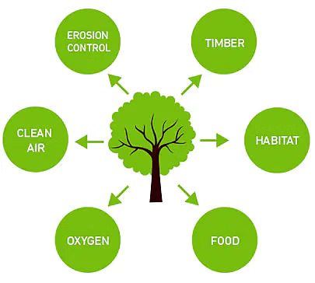
Midwestern forests are important because they…
Capture carbon dioxide from the atmosphere
Host a diversity of plant and animal life
Provide habitat for pollinators and insects
Opportunities for recreation, health and wellness
Support local economies through tourism

Slide 4
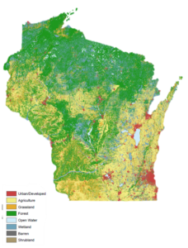
Threats to Midwestern forests…
Climate change (flooding & drought)
Parasites and diseases
Invasive species
Wildfires (unplanned or accidental)

Slide 5
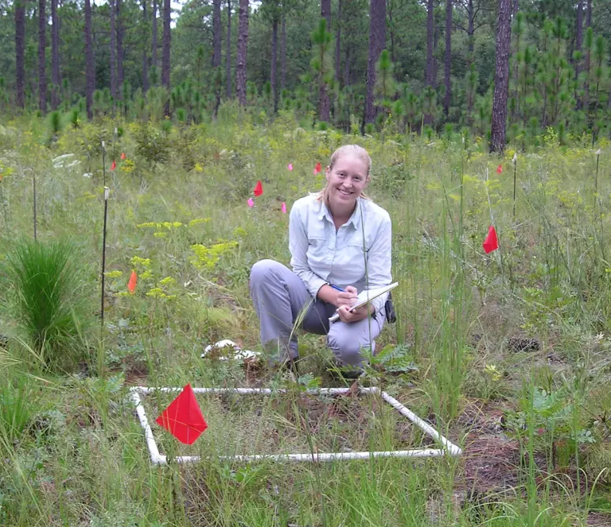
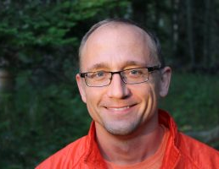
Meet the researchers…
John Orrock
Ellen Damschen

Slide 6
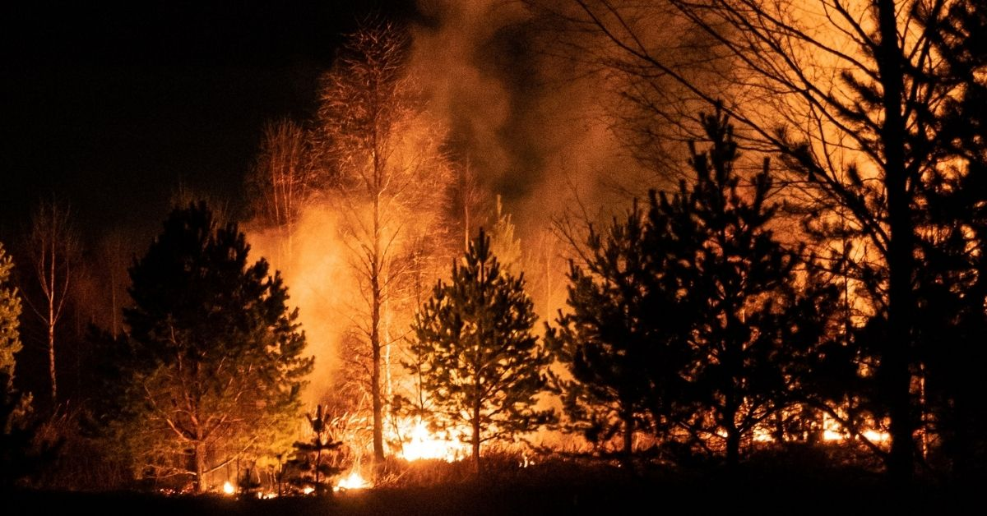
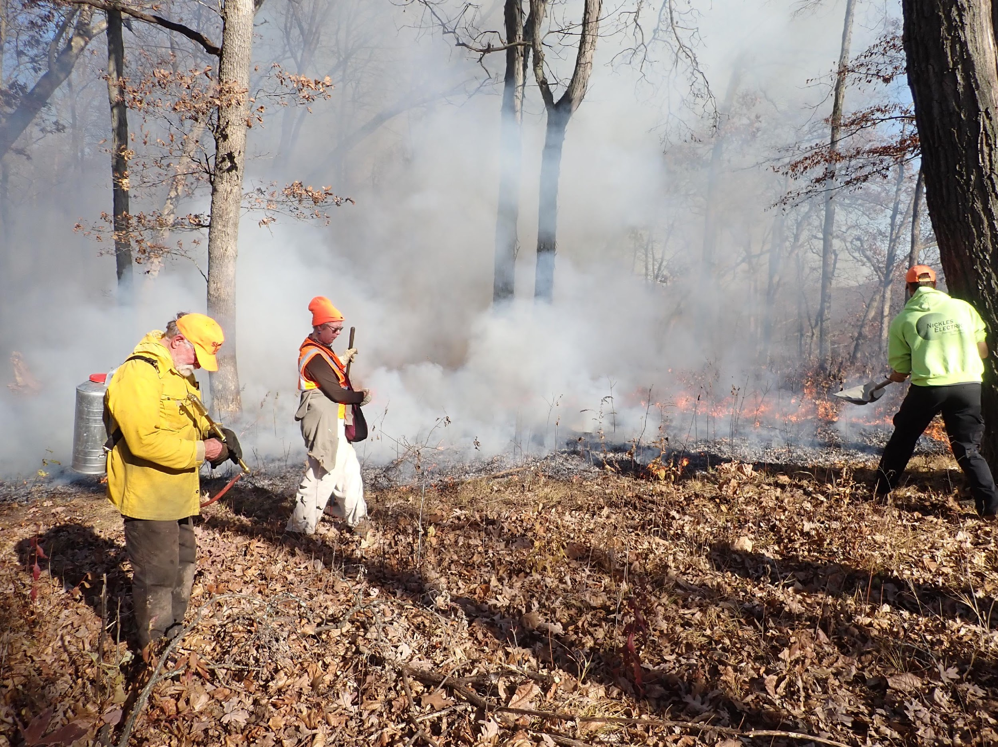
Prescribed Fire versus Wildfire…

Slide 7
Vocabulary
Biodiversity = the variety of species
Prescribed Fire = a planned fire, set on purpose in a given area under specific conditions, used to meet land management objectives
Wildfire = an unplanned, unwanted fire in a natural area caused by natural forces (lightning) or by humans (accidentally or intentionally)
Keystone Species = a species that makes an unusually strong contribution to maintaining the critical structure, ecosystem functions, or success of other species.

Slide 8
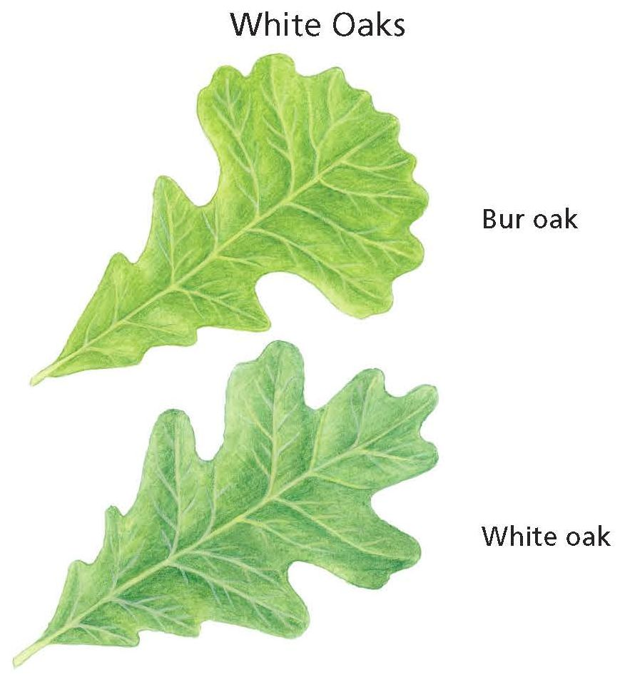
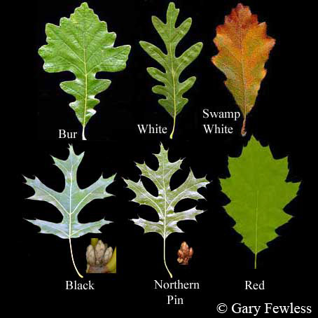
Value of oak trees…
Timber value ($0.15-$1.20/board ft)
Keystone species for biodiversity
Have a large influence on the number of species in an ecosystem
Provide food source for 44 animals

Slide 9
History of Research at Olson Oak Woods

Slide 10
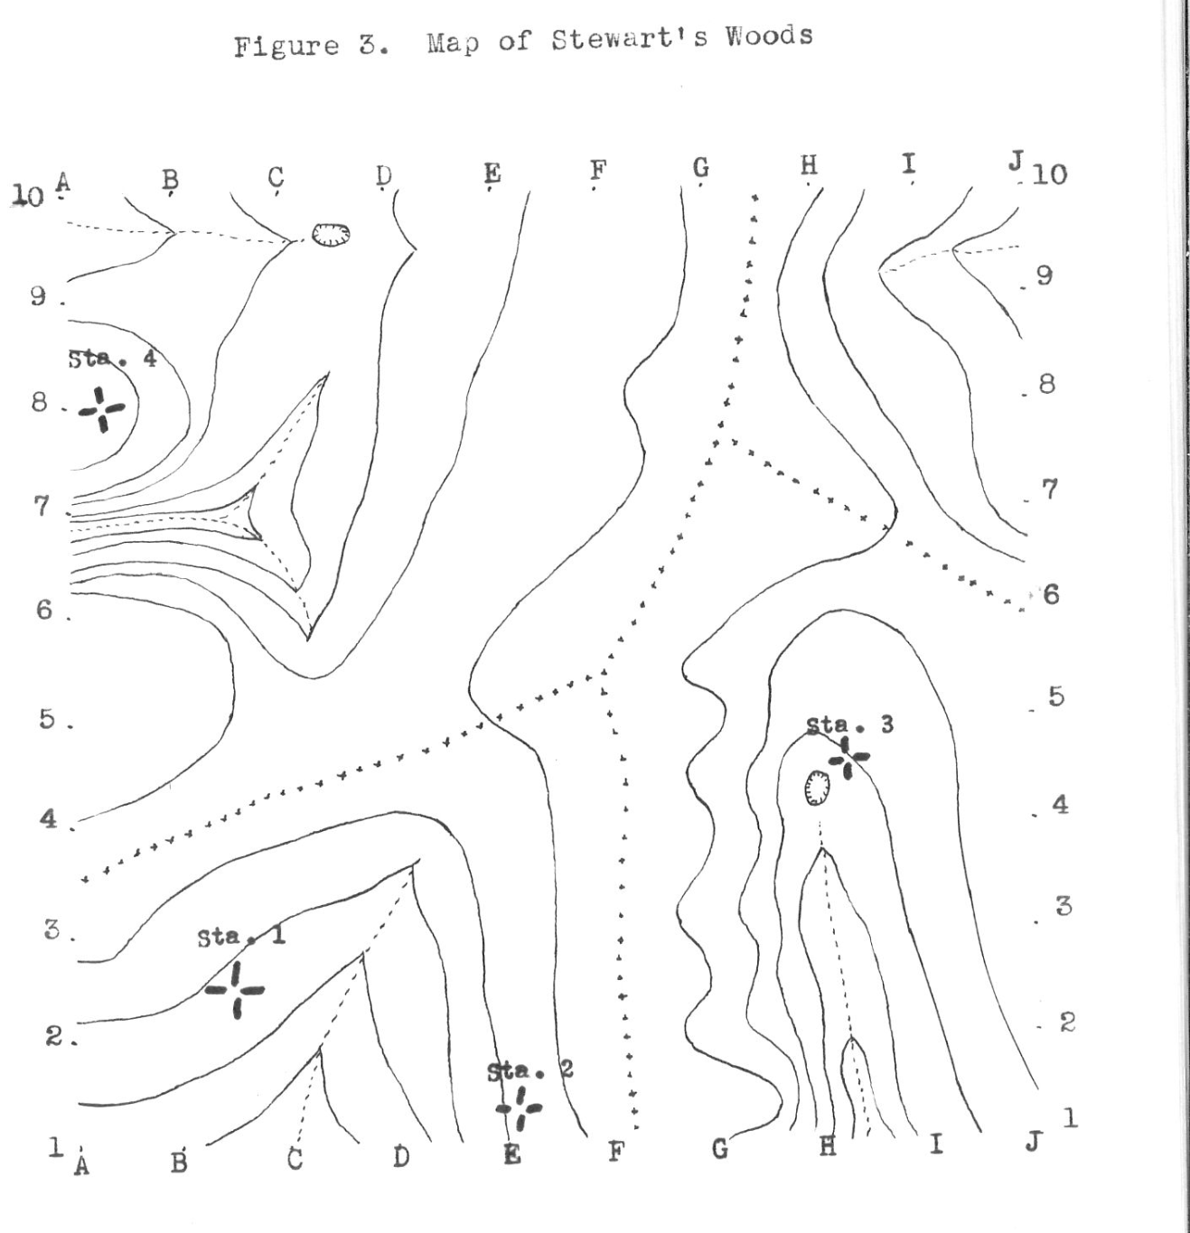
Historic Sampling Effort
Sampled by Grant Cottam in 1946
100 quadrats
Counted trees, shrubs, herbs
167 species total in woods
How does that compare with
more recent sampling?

Slide 11
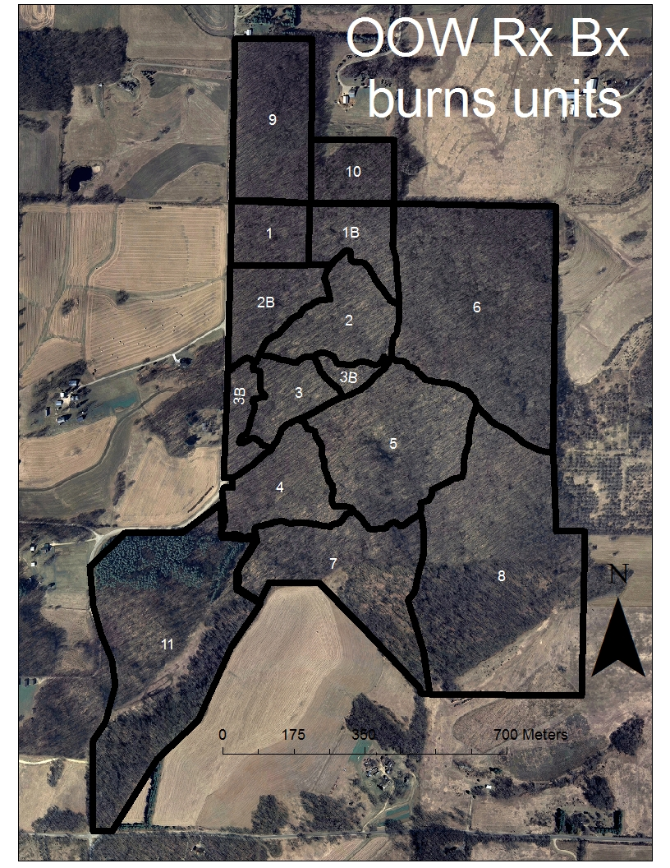
More Recent Research
Studied by Rich Henderson and colleagues in:
1996-97, 2002-03, 2007-08
229 plots in 15 “burn management units”
Counted trees, shrubs, herbs
219 species total in woods
1996 studies were before any management techniques (treatments) were used
Treatments began in 1999
Goal was to study effects of treatment on forest diversity

Slide 12
Most Recent Research
Studied by John Orrock and Ellen Damschen in June 2023
229 plots studied in the same 15 “burn management units”
Counted trees, shrubs, herbs using the “Nested Plot Sampling Method”
Allowed for comparisons with past data and between burn units
200 species total in the woods
Questions:
What effect did previous treatments have on current vegetation?
What treatments led to more oaks in the forest?

Slide 13
More Vocabulary
Management Technique (Treatment): A forestry method used to reduce the number of certain species of plants and increase the number of other species of plants
Nested Plot Sampling Method: Counting the number and species of trees, shrubs and herbs in a study plot

Slide 14
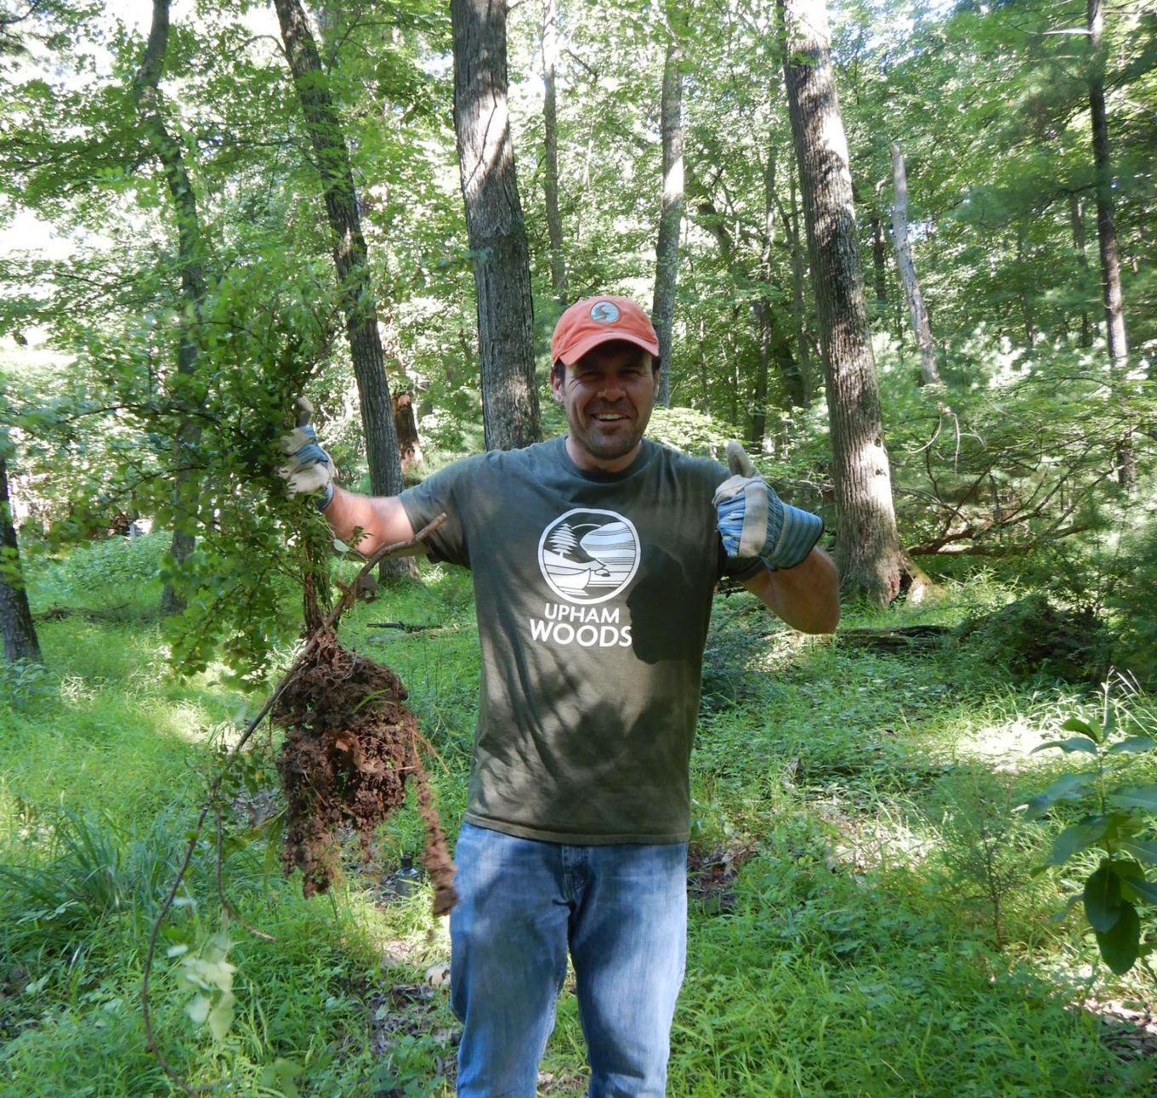
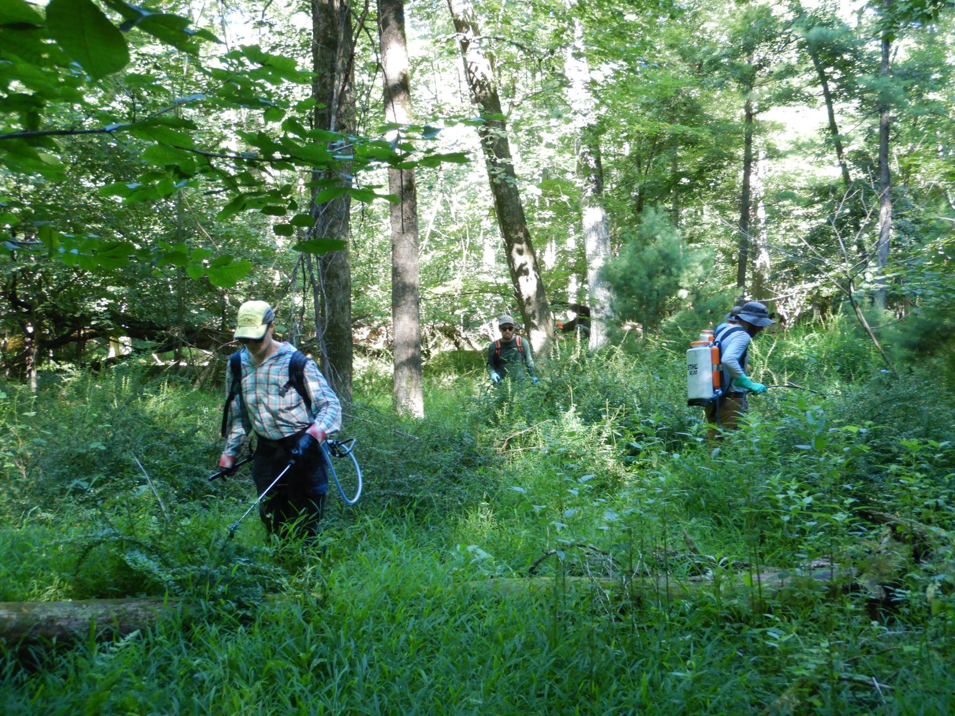
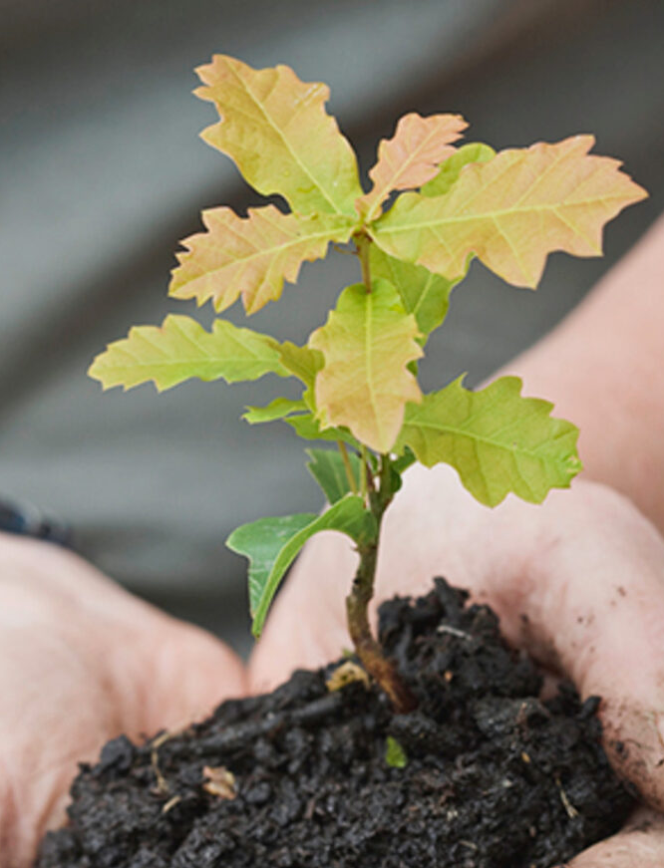
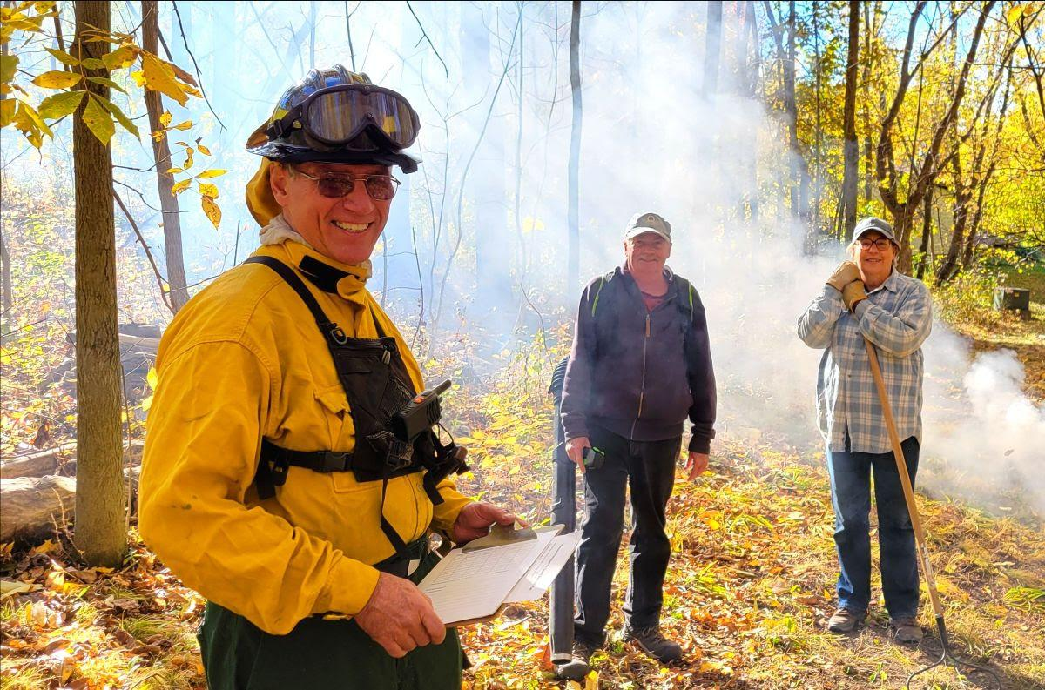
Management Techniques (Treatments)
Invasive species removal
-Hand pulling
-Herbicide (chemical treatment)
- Mowing
Prescribed Fire
Reforestation (planting oak trees)

Slide 15
Question and Hypothesis
Scientific Question:
What is the hypothesis?

Slide 16
Question and Hypothesis
Scientific Question: What is the effect of prescribed fire as a management technique on the biodiversity of MSF?
What is the hypothesis? Biodiversity will be higher in plots where prescribed fire has been used.

Slide 17
Exploring Measures of Biodiversity
Three forest layers to observe

Slide 18
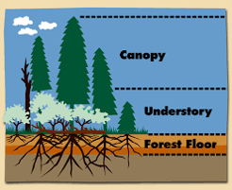
Layers of the Forest
Three layers to observe
Also called Zone 1
Zone 2
Zone 3

Slide 19
Layers of the Forest
Forest Floor (Zone 1):
Herbaceous plants (plants without a woody stem, or “herbs”)
EX: Ferns and wildflowers
Important food source for animals
Shows how much moisture and sunlight received

Slide 20
Layers of the Forest
Understory (Zone 2):
Plants with woody stems
Shrubs (woody plants with several main stems arising out of the ground)
Young trees, called “saplings”
Important shelter and food source for animals

Slide 21
Layers of the Forest
Canopy (Zone 3):
Tallest layer in the forest
Trees (woody plants with a single trunk supporting branches and leaves)
Important habitat for animals
Harvest these trees for wood products

Slide 22
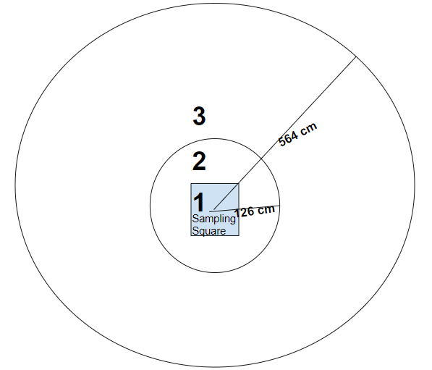
“Nested Plot Sampling Method”:
Zone 1 =
1 meter sampling square for forest floor (“herbs”)
Zone 2 =
126 cm string rotated in a circle, recording understory (plants with woody stems over 50 cm tall)
Zone 3 =
564 cm string rotated in a circle, recording trees in the canopy

Slide 23
Interpreting Historical Data
Reading graphs, drawing conclusions

Slide 24
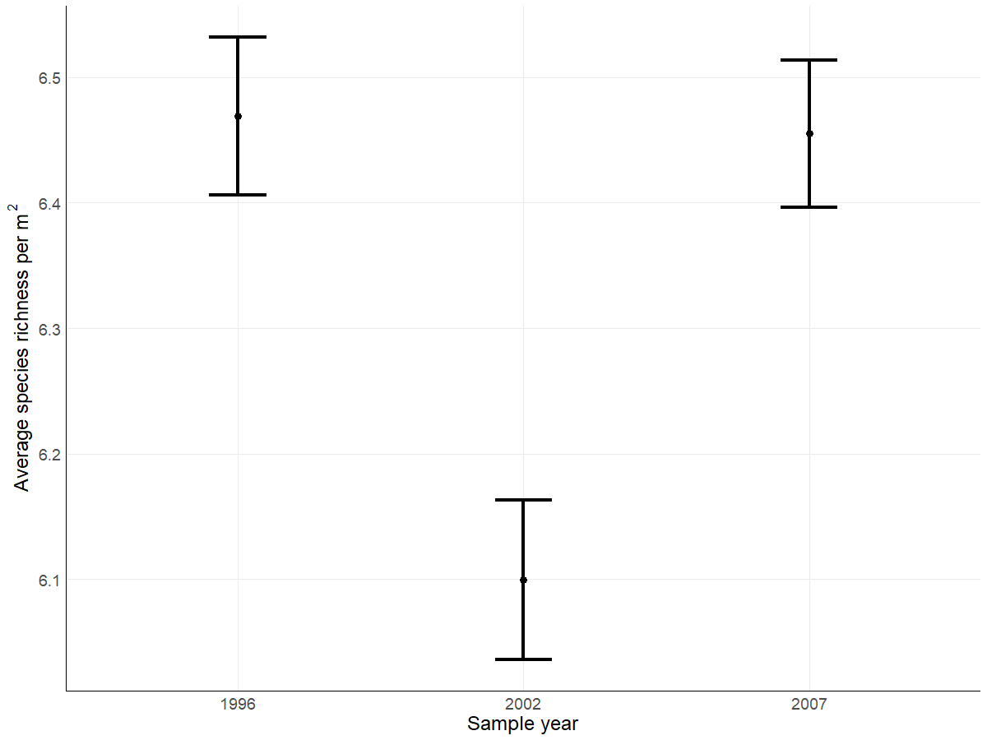
Reading Graphs
Henderson’s average species richness per m² in all plots over three years
Which year showed the highest biodiversity in all plots?
Which year showed the lowest biodiversity in all plots?
Lege݀݀nd:
Average number
⧳ Error bars (range of data outside of the average)

Slide 25
Reading Graphs
Henderson’s average species richness per m² in all plots over three years
Which year showed the highest biodiversity in all plots?
1996
Which year showed the lowest biodiversity in all plots?
2002
Lege݀݀nd:
Average number
⧳ Error bars (range of data outside of the average)

Slide 26
Reading Graphs
Henderson’s average species richness per m² in all plots over three years
The year with the lowest sampled biodiversity is followed by a year with higher biodiversity. Using what you have learned from the research background, what might have happened to explain this?
Lege݀݀nd:
Average number
⧳ Error bars (range of data outside of the average)

Slide 27
Reading Graphs
Henderson’s average species richness per m² in all plots over three years
The year with the lowest sampled biodiversity is followed by a year with higher biodiversity. Using what you have learned from the research background, what might have happened to explain this?
A management technique, such as prescribed fire, might have been used which resulted in lower biodiversity immediately after the fire, but which also led to regeneration in the five years after (2007).
Lege݀݀nd:
Average number
⧳ Error bars (range of data outside of the average)

Slide 28
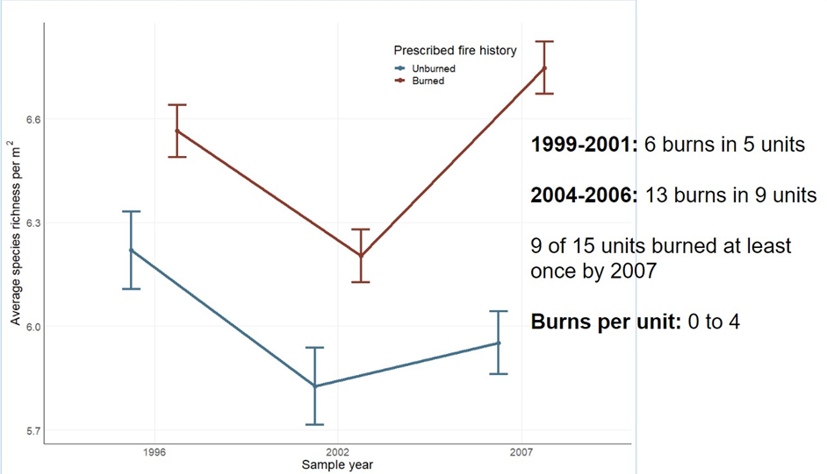
Reading Graphs
Biodiversity in burned versus unburned units in Olson Oak Woods
What do the blue and red colors represent on the graph?
Make an educated guess as to what the lines connecting the error bars represent.

Slide 29
Reading Graphs
Biodiversity in burned versus unburned units in Olson Oak Woods
What do the blue and red colors represent on the graph?
Make an educated guess as to what the lines connecting the error bars represent.
The mathematical slope between the average species richness between years. A mathematical calculation to show trends, not actual data.
Red = burned units
Blue = unburned units

Slide 30
Reading Graphs
Biodiversity in burned versus unburned units in Olson Oak Woods
Research Question: What is the effect of prescribed fire on the average species richness?
Claim:

Slide 31
Reading Graphs
Biodiversity in burned versus unburned units in Olson Oak Woods
Research Question: What is the effect of prescribed fire on the average species richness?
Claim: Prescribed fire increases average species richness.

Slide 32
Reading Graphs
Biodiversity in burned versus unburned units in Olson Oak Woods
Evidence Used to Support the Claim:
In 1996, average species richness was 6.5 in burned units and 6.2 in unburned. In 2002, average species richness was 6.2 in burned units and 5.8 in unburned. In 2007, average species richness was 6.8 in burned units and 5.9 in unburned.

Slide 33
Reading Graphs
Biodiversity in burned versus unburned units in Olson Oak Woods
Reasoning to Support the Claim:
Fire is necessary to maintain oak forests and oaks are a keystone species that support biodiversity. Therefore, burned areas have higher average species richness compared to unburned areas.

Slide 34
Scientific Data:
Use the data below to answer the scientific question:
Year | Average Species Richness per m² in burned units | Average Species Richness per m² in unburned units
1996 | 6.5 | 6.2
2002 | 6.2 | 5.8
2007 | 6.8 | 5.9
2023 | 4.6 | 4.5
Note: Higher values of species richness indicate higher biodiversity.
What data will you graph to answer the question?
Independent variable: ________________________________
Dependent variable: _____________________________________

Slide 35
Draw your graph below:
Identify any changes, trends, or differences you see in your graph. Draw arrows pointing out what you see, and write one sentence describing what you see next to each arrow.

Slide 36
Claim-­Evidence-­Reasoning
Make a claim that answers the scientific question.
What evidence was used to write your claim? Reference specific parts of the table or graph.
Explain your reasoning and why the evidence supports your claim. Connect the data back to what you learned about the relationship between prescribed fire as a management tool and biodiversity.
Did the data support Ellen and John’s hypothesis? Use evidence to explain why or why not. If you feel the data are inconclusive, explain why.

Slide 37
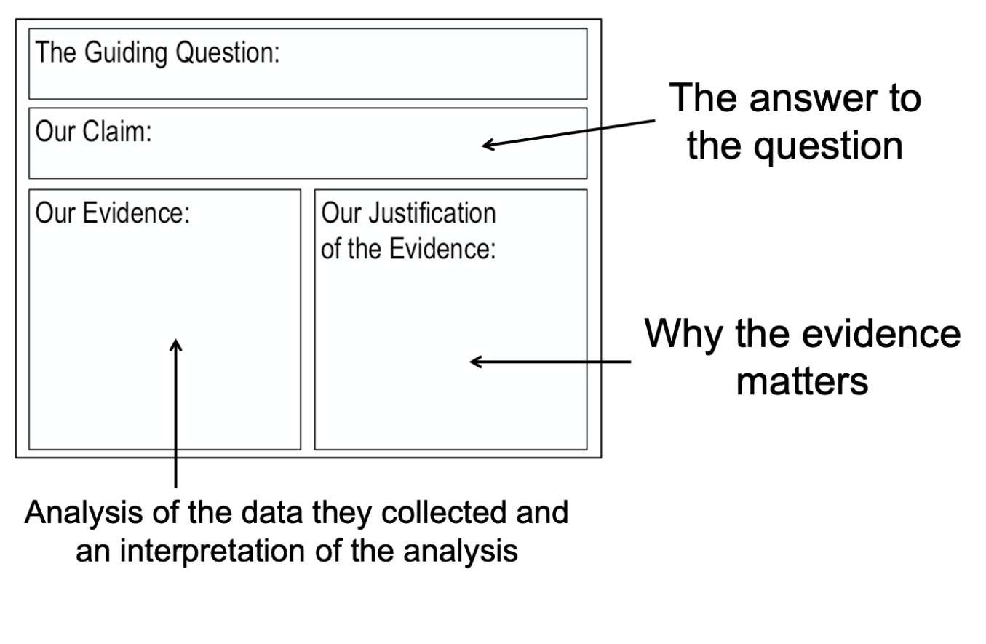

Slide 38
Question:
Claim:
Evidence:
This analysis suggests…
This graph shows…
This figure indicates….
Justification of the Evidence:
This evidence is important because…
We decided to use this evidence because…
When we analyzed the data we assumed…
Our evidence is based on the following assumptions:

Slide 39
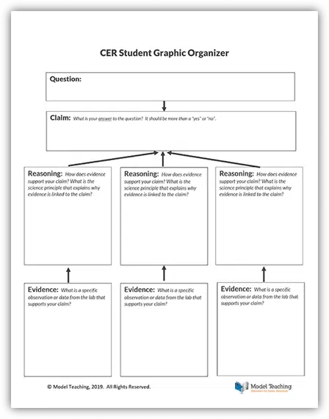

Slide 40
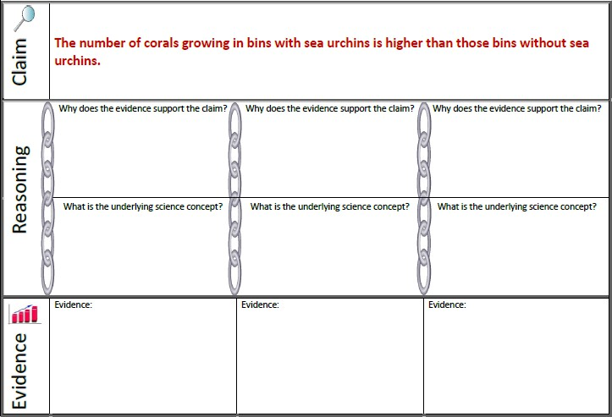
Scientific Question:

Slide 42
Scientist Next Steps
Your next steps as a scientist: Science is an ongoing process. What new question(s) should be investigated to build on Ellen and John’s research? How do your questions build on the research that has already been done?

