Slide 1
Size matters – and so does how you carry it
Data Nugget supplemental images
Featured scientists: Jerry Husak from the University of St. Thomas and John Swallow from the University of Colorado-Denver.
Written by: Sam Holloway

Slide 2
John Swallow in the field at the beginning of his career.

Slide 3
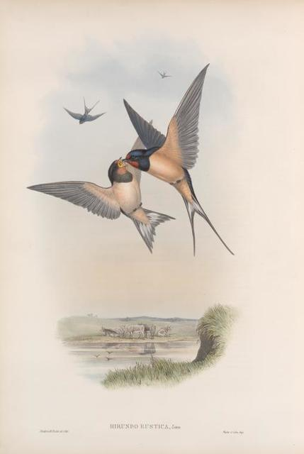
Barn Swallow Inspiration
Artist’s rendition of male and female barn swallows (Hirundo rustica). The female is on the left, and the male is on the right. Barn swallows are sexually dimorphic, and males possess long tails feathers, or streamers. Typically, males with the longest tail streamers are most successful in attracting a mate, illustrating the concept of sexual selection.
Notes:
Public domain (found here).

Slide 4
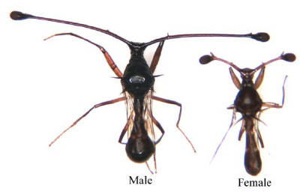
Stalk-eyed flies
Sexual shape dimorphism in eye stalks of Teleopsis dalmanni, a closely related species to the one featured in the Data Nugget. (Photo credit: Jerry Husak)
Notes:
Citation:
The evolution of sexual dimorphism: Understanding mechanisms of shape difference - Scientific Figure on ResearchGate. Available from: https://www.researchgate.net/figure/Sexual-shape-dimorphism-in-eye- stalks-of-Teleopsis-dalmanni-Photo-credit-Jerry-Husak_fig2_237565171 [accessed 15 Jun, 2023]

Slide 5
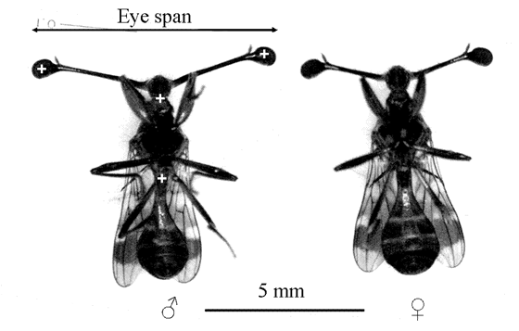
Stalk-eyed flies with a 5 mm reference bar for scale. Eye span is the distance between the two ends of the eyes.
Eye span is greater in males.
Notes:
Ribak, G., Egge, A. R., & Swallow, J. G. (2009). Saccadic head rotations during walking in the stalk-eyed fly (Cyrtodiopsis dalmanni). Proceedings of the Royal Society B: Biological Sciences, 276(1662), 1643-1649.

Slide 6
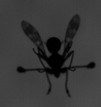
A stalk-eyed fly in flight. The silhouette is used to visualize how large the wings are compared to the rest of the fly’s body.
The researcher’s wanted to know if flies with larger eyestalks also had larger wings to compensate and help them maneuver with the bulky eyestalks.

Slide 7
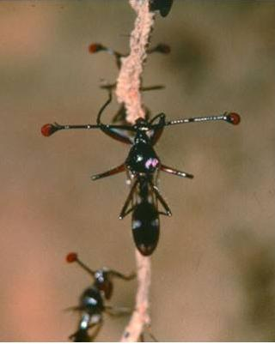
Eye span and body size – two variables of interest
Eyespan
Body size
Notes:
Measuring a stalk-eyed fly for eyespan (horizontal arrow) and body size (vertical arrow). Scientists also measured the wingspan of each fly to relate it to the body size and eye span.
Citation:
Richard H. Baker , Gerald S. Wilkinson, PHYLOGENETIC ANALYSIS OF SEXUAL DIMORPHISM AND EYE‐SPAN ALLOMETRY IN STALK‐EYED FLIES (DIOPSIDAE), Evolution, Volume 55, Issue 7, 1 July 2001, Pages 1373–1385, https://doi.org/10.1111/j.0014-3820.2001.tb00659.x

Slide 8
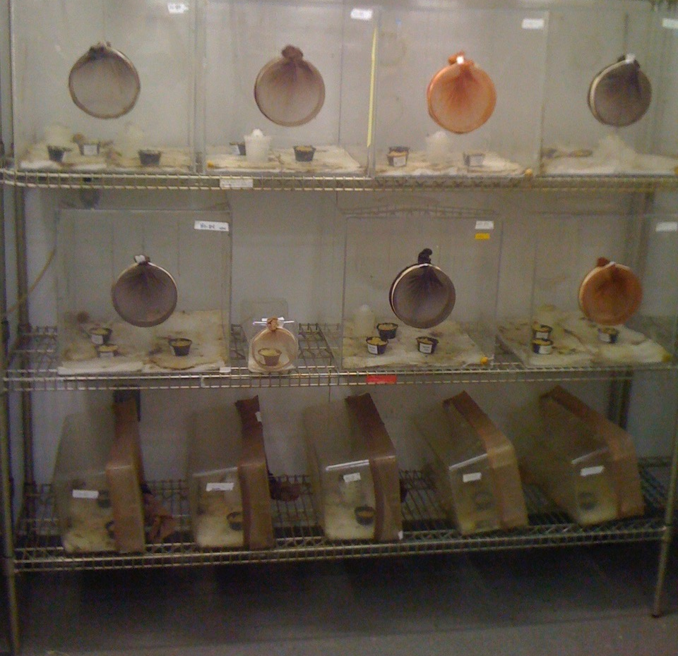
Lab housing
The flies are kept in the lab so they can be monitored and the scientists can collect data on various behavioral, physiological, and morphological traits.

Slide 9
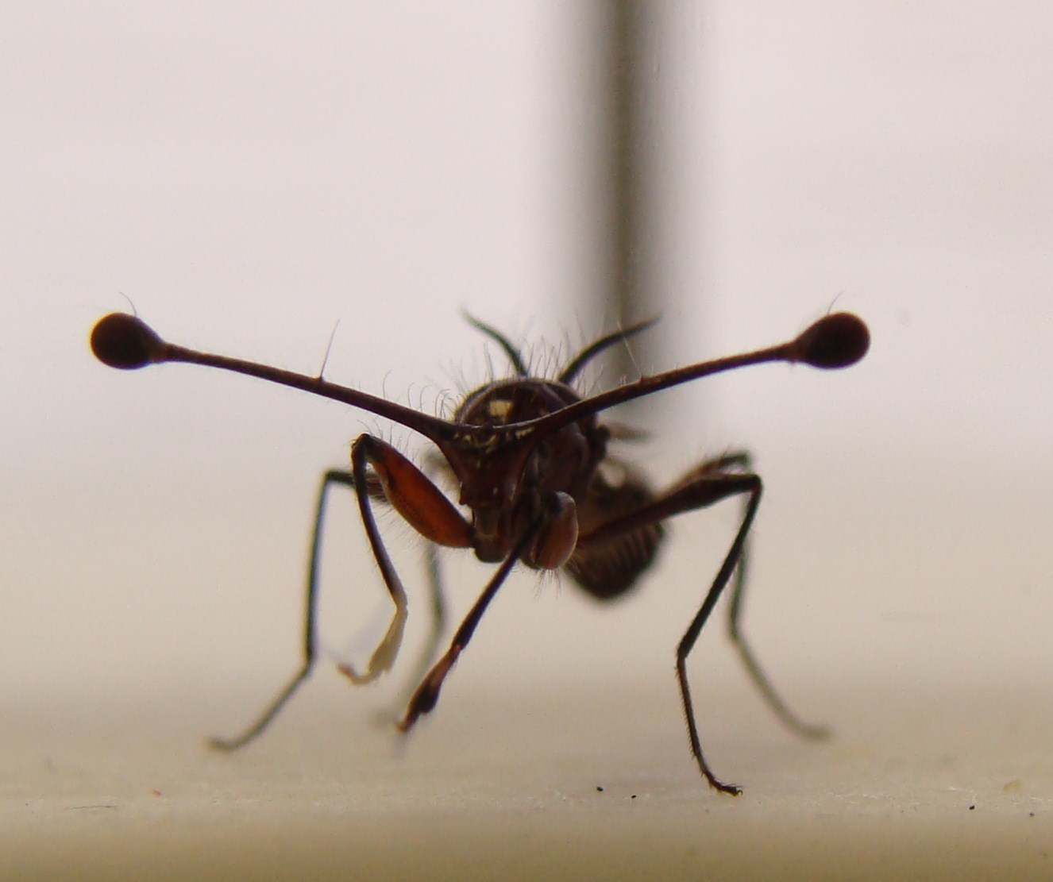
Close-ups of stalk-eyed flies

Slide 10
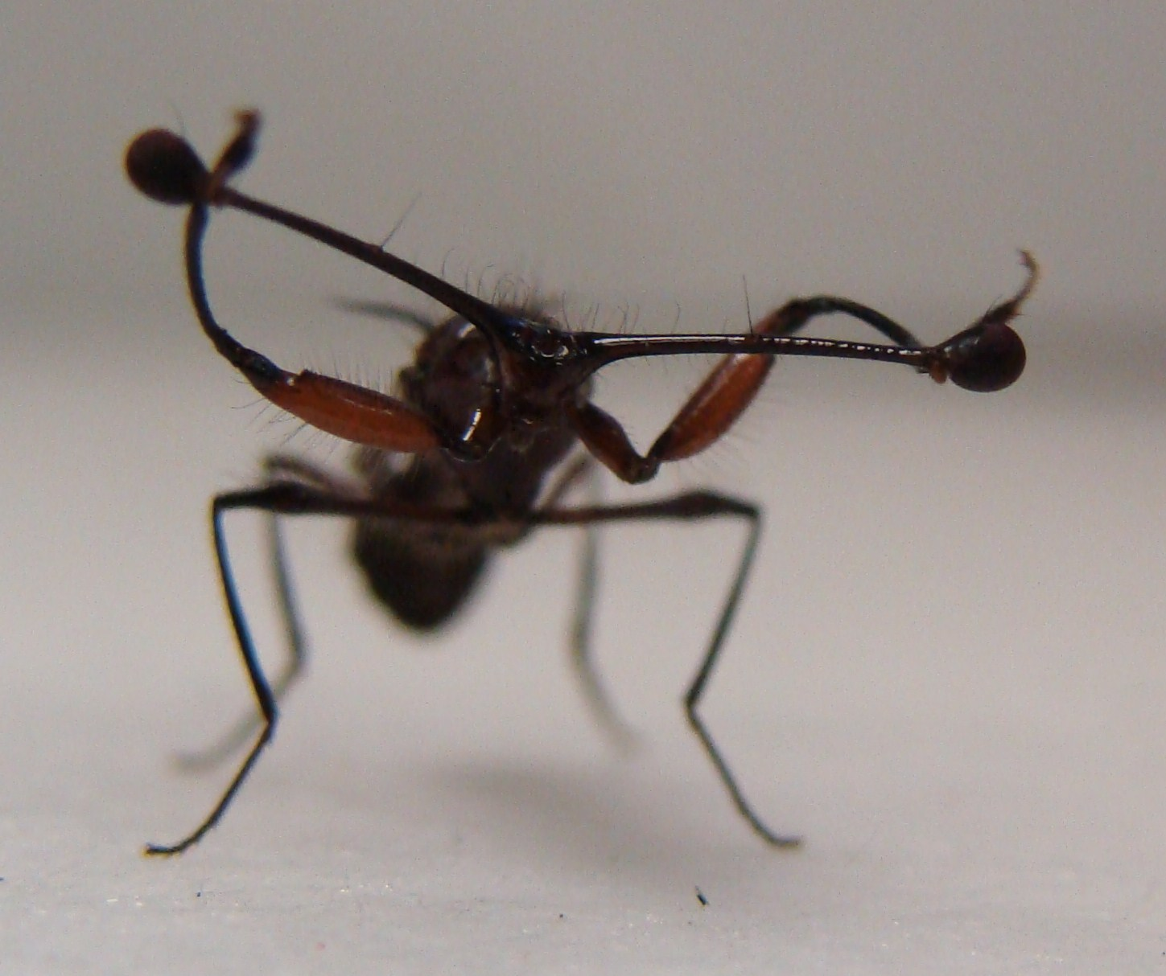
Close-ups of stalk-eyed flies

Slide 11
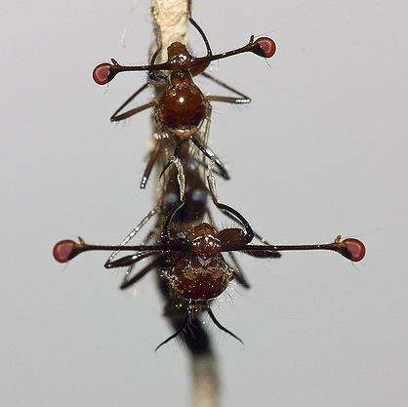
Copulation
Stalk-eyed fly pair mating

Slide 12
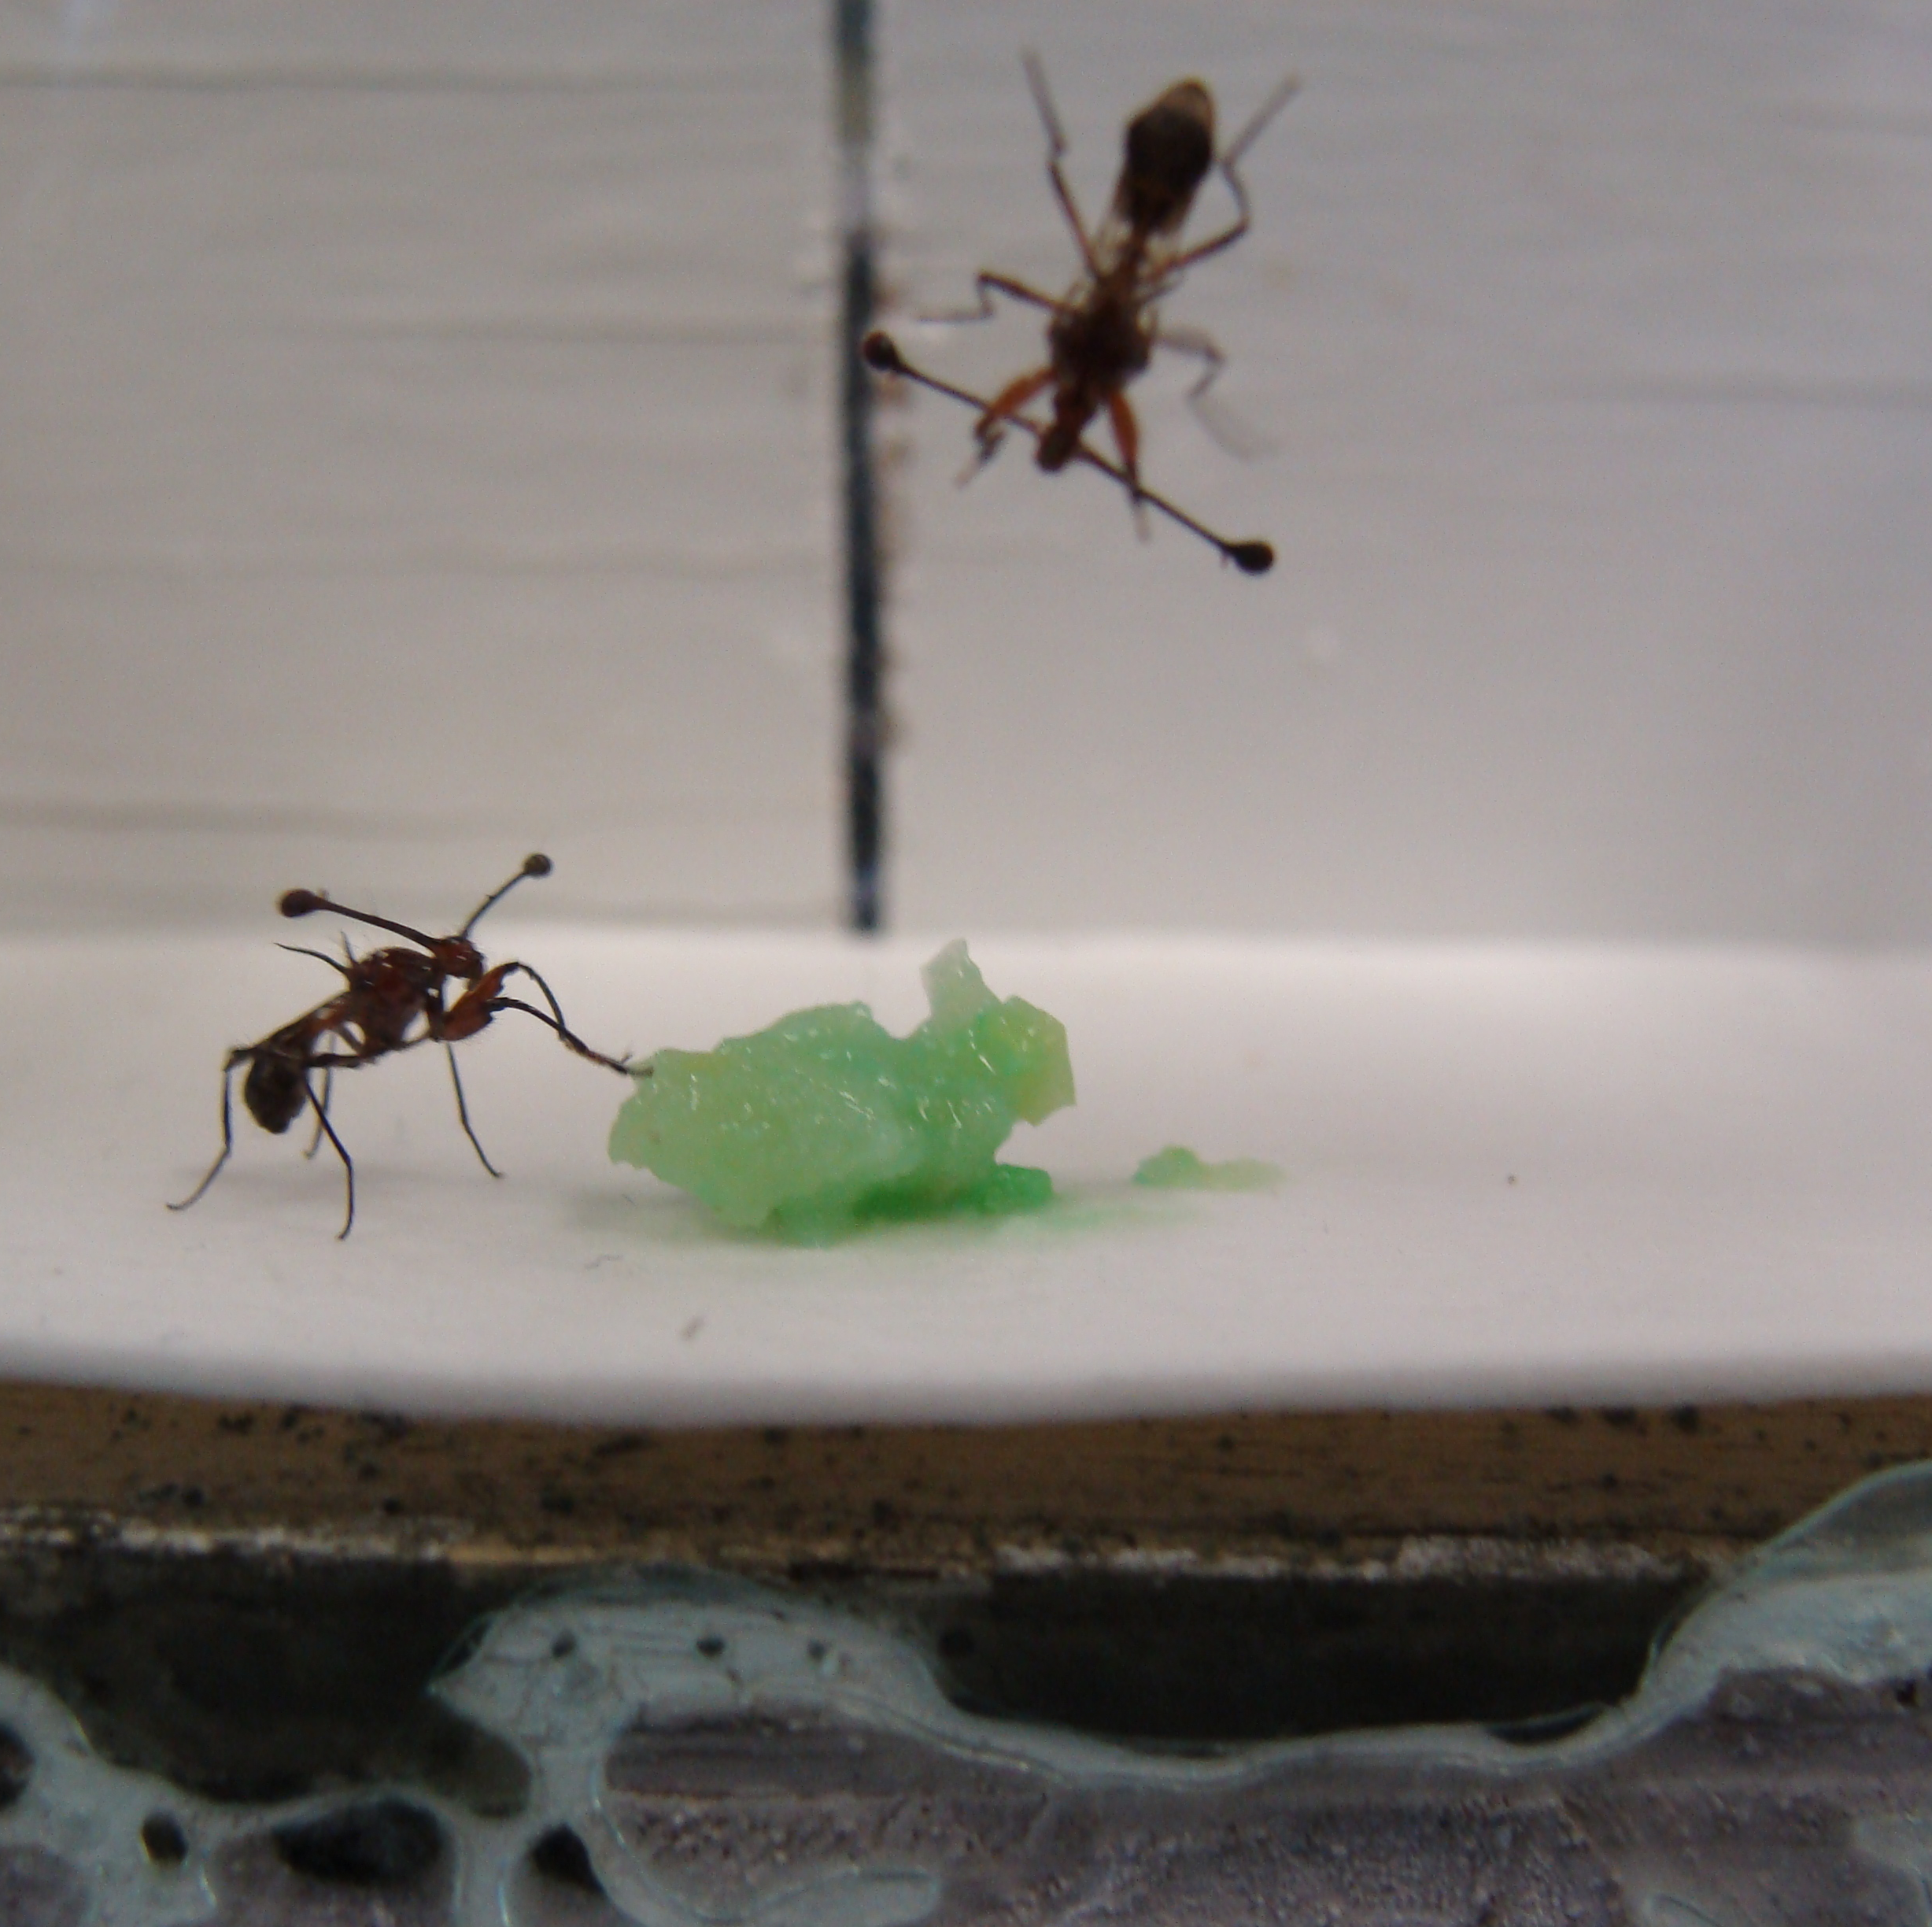
Lab housing
Stalk-eyed flies in a behavioral trial for a different study.

