Slide 1
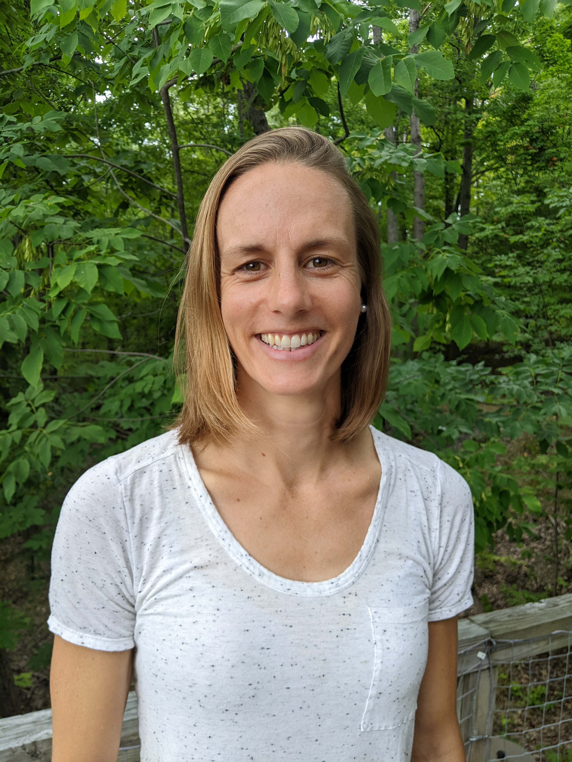


Trees and the City
Featured scientist: Adrienne Keller (she/her) from the University of Minnesota

Slide 2
When Adrienne first moved to the Twin Cities in Minnesota, she started exploring Minneapolis and St. Paul by bike. Biking is done at a slow enough pace where she can travel long distances but still make observations about neighborhoods in these cities. As an ecologist, she naturally found herself looking for patterns in trees.

Slide 3
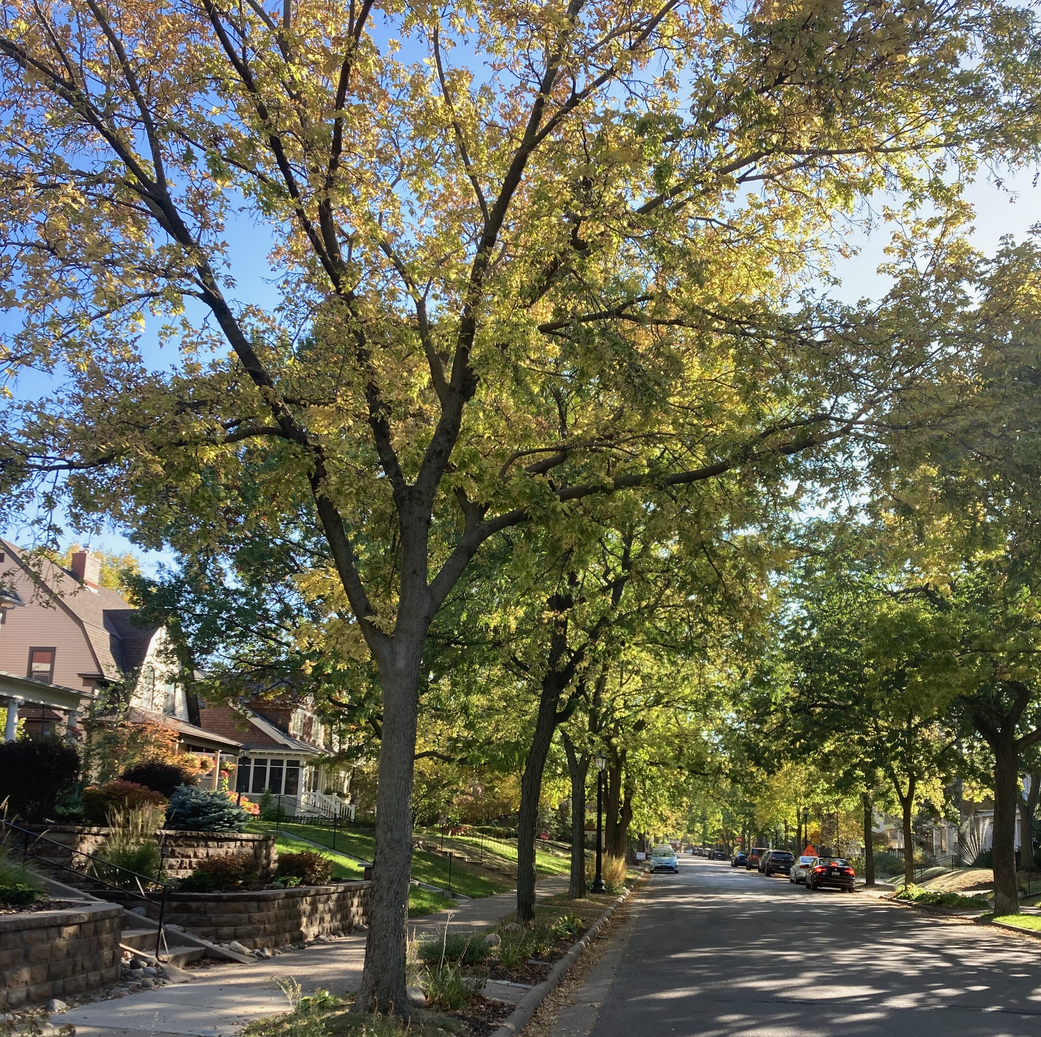
She noticed some older neighborhoods in St. Paul have a lot of large trees that provide plenty of shade and tree cover. In other neighborhoods, Adrienne saw fewer types of trees and noticed that she spent less time shaded by branches and leaves.

Slide 4
Maps of different neighborhoods in Minneapolis and St. Paul. Note that the maps show the key variables that Adrienne was interested in: % tree cover, tree species richness, resident household income levels, and % BIPOC residents. White areas on the maps indicate where there are no data available.
Look closely at the maps and identify any patterns or trends.
Notes:
Making observations that lead to predictions is an important part of the scientific process. Adrienne started this project by making different maps to expand beyond her neighborhood and what she could observe while bike riding. These maps helped her visualize the data and then she made predictions based on her observations.
Below are maps showing the different neighborhoods in Minneapolis and St. Paul. Note that the maps show the key variables that Adrienne was interested in: % tree cover, tree species richness, resident household income levels, and % BIPOC residents. White areas on the maps indicate where there are no data available.
Look closely at the maps and identify any patterns or trends. Draw arrows pointing out important observations and write one sentence describing what you see next to each arrow.

Slide 5
Data For Median Household Income (in dollars)

Slide 6

Graphs For Median Household Income (in dollars)

Slide 7
Data For % BIPOC

Slide 8

Graphs For % BIPOC

