Slide 1
Mowing for Monarchs
Featured scientists: Doug Landis and Nate Haan from Michigan State University and Britney Christensen and Gabe Knowles from Kellogg Biological Station LTER

Slide 2
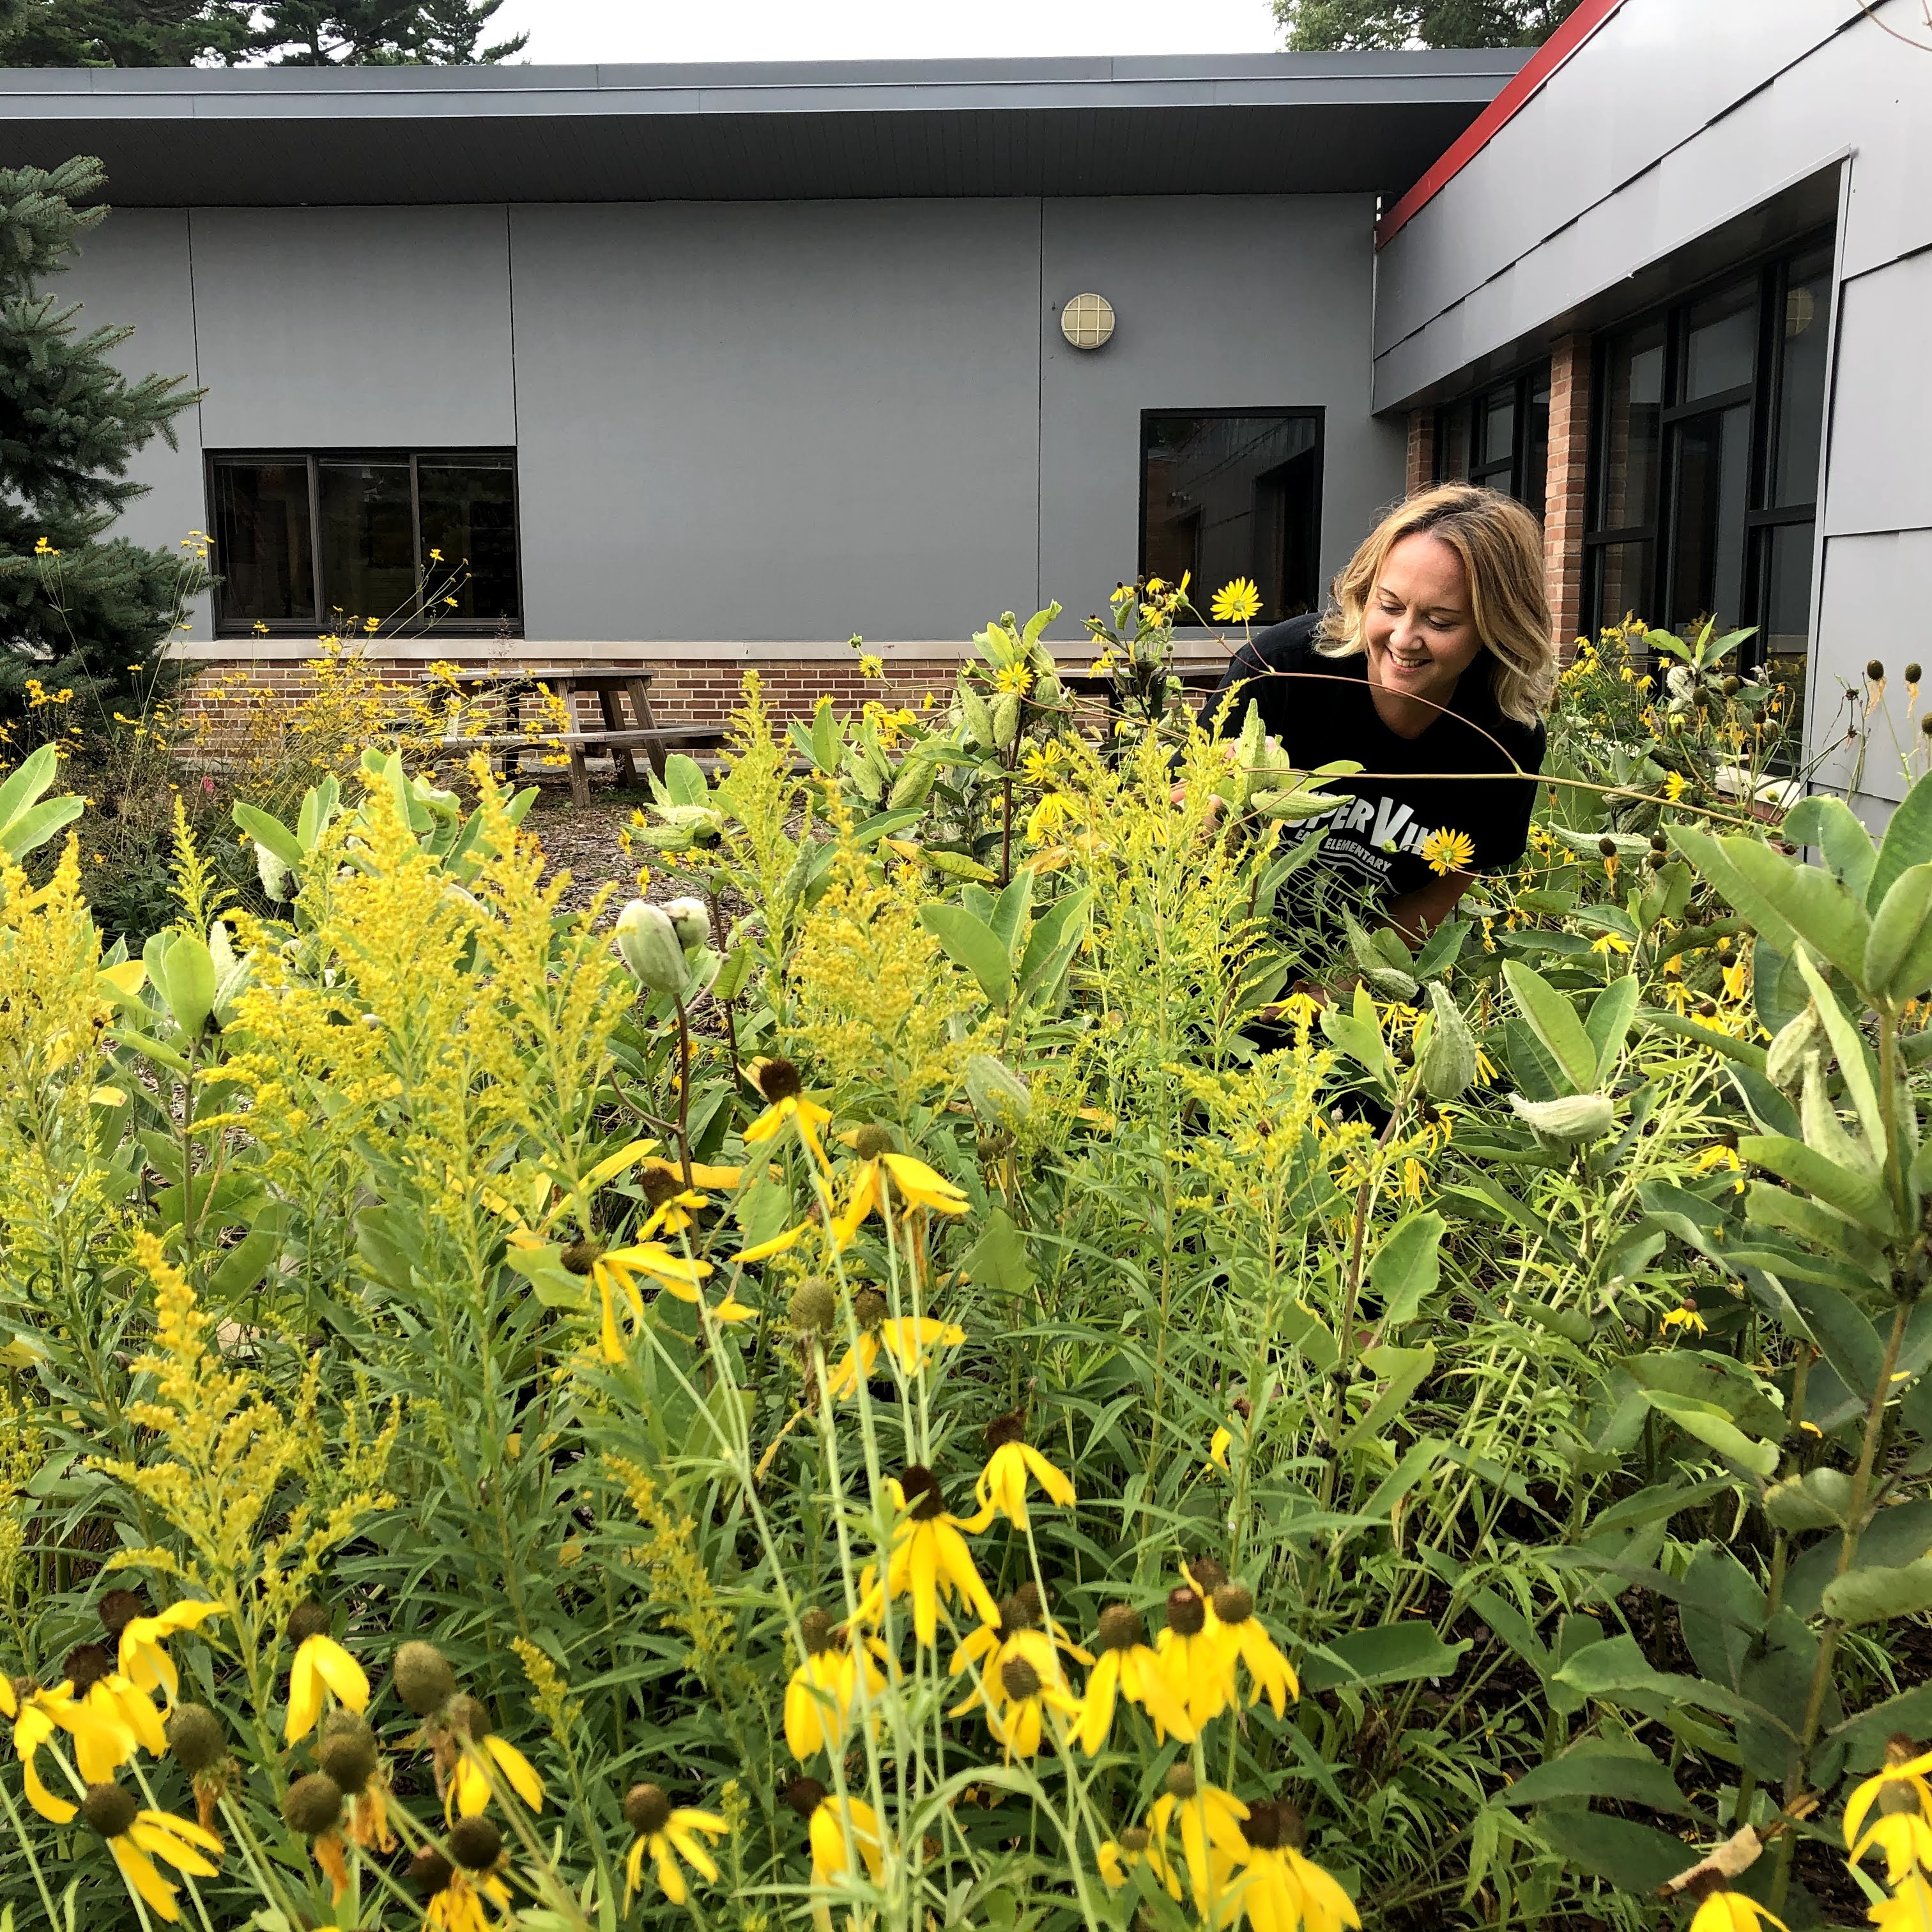
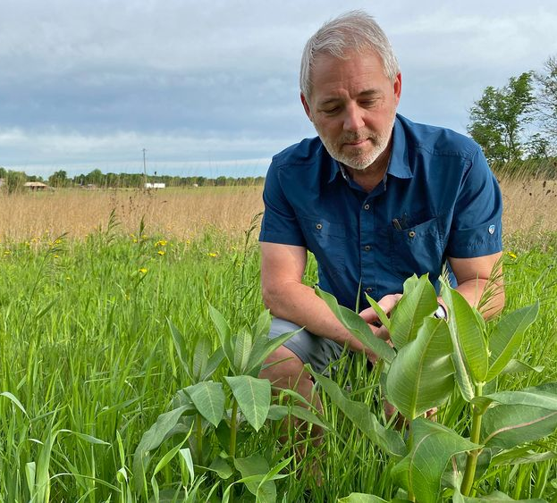
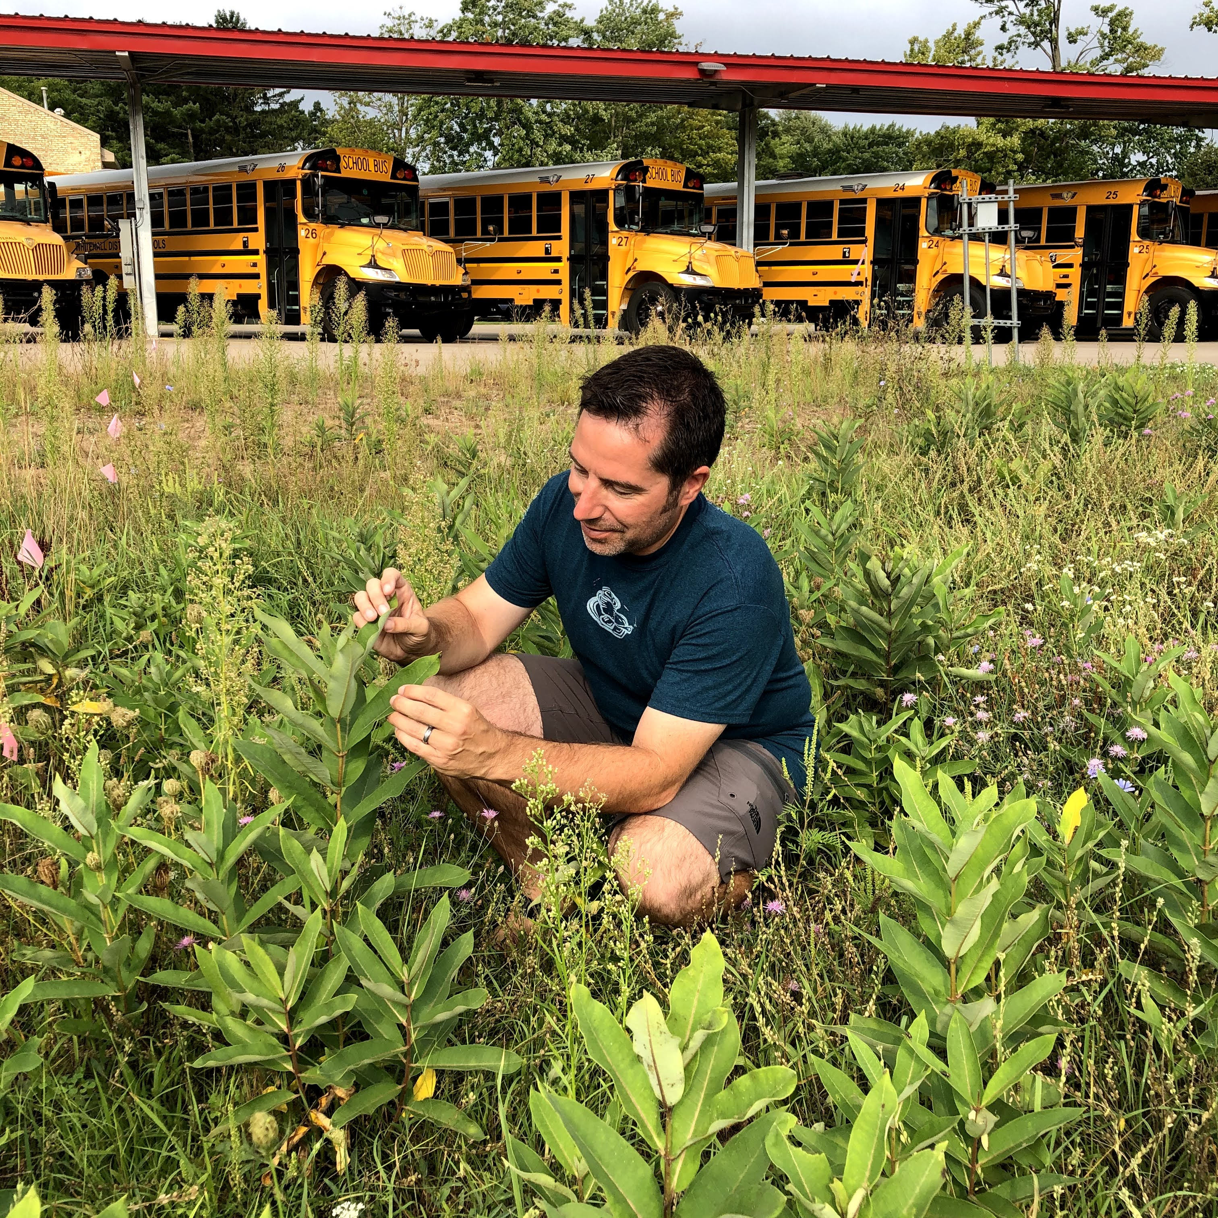
The research team!
Britney Christensen
Nate Haan
Gabe Knowles
Doug Landis
Notes:
Names in clockwise order.
Gabe and Britney were NSF RETs (Research experience for teachers) in Doug’s lab
Nate is a postdoc in Doug’s lab
Doug is a professor with the Kellogg Biological Station Long-Term Ecological Research program at Michigan State University.

Slide 3
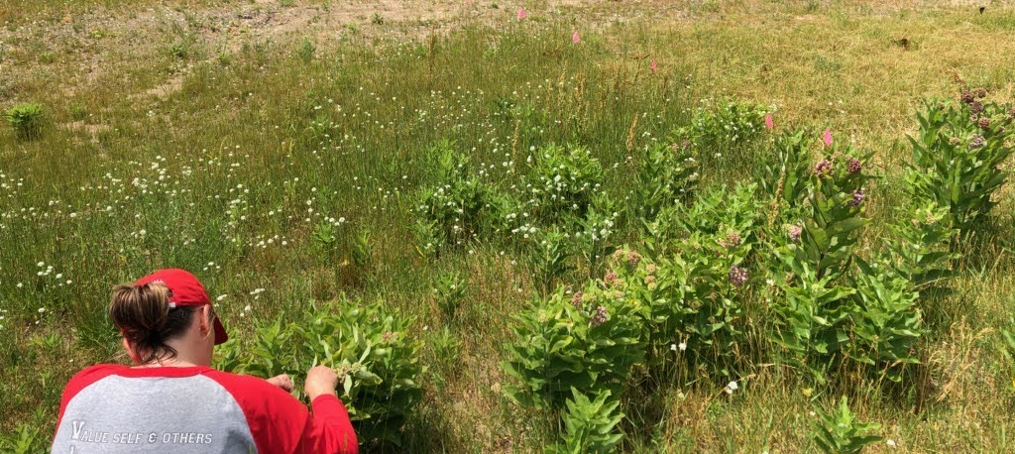
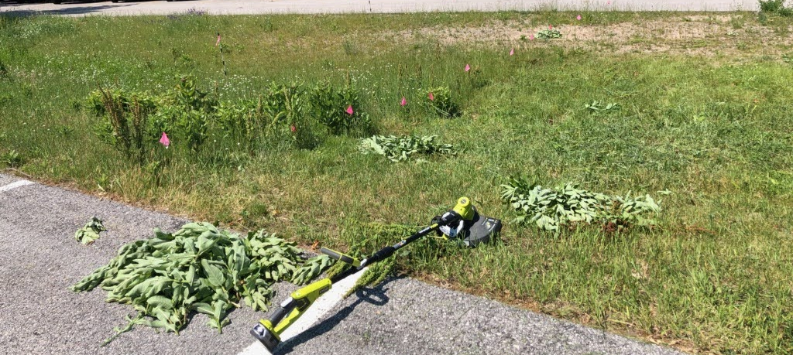
Experimental design
Control patch – not mowed
10 locations
Each location had a control and treatment patch
Treatment patches were mowed
Milkweed plants are younger in treatment patches
Background plant community removed in treatment patches
Treatment patch – mowed

Slide 5
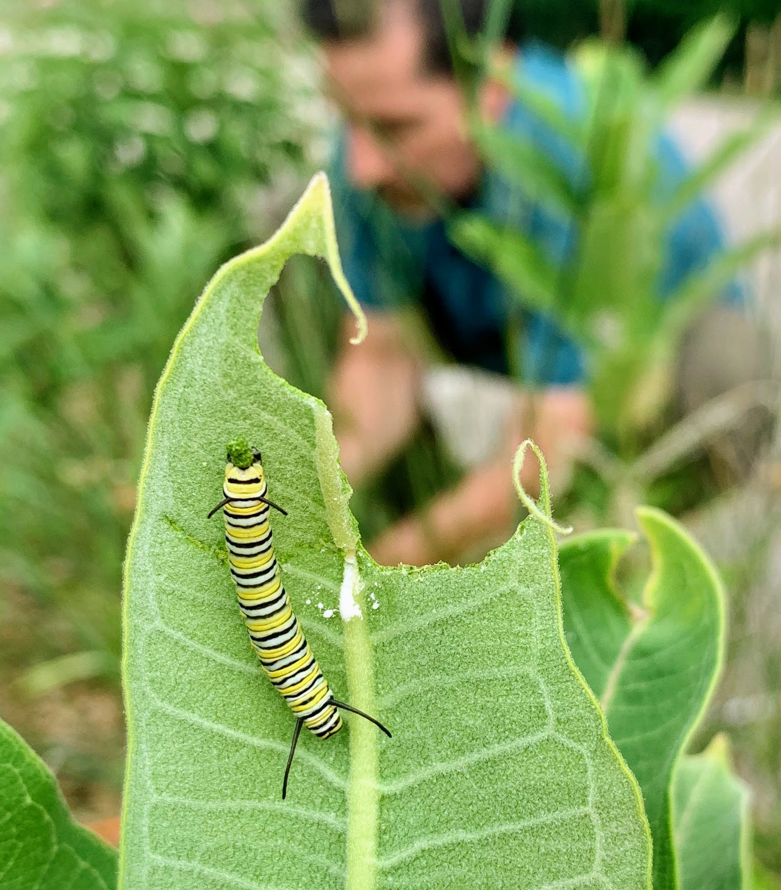
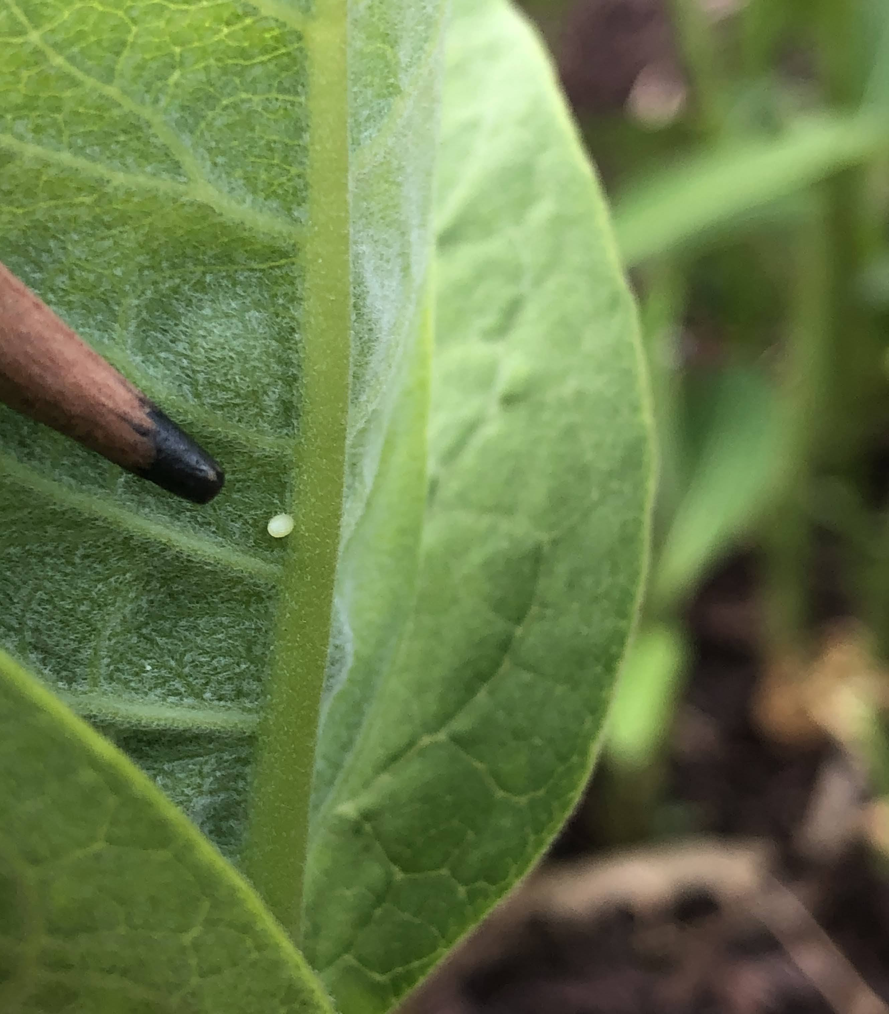
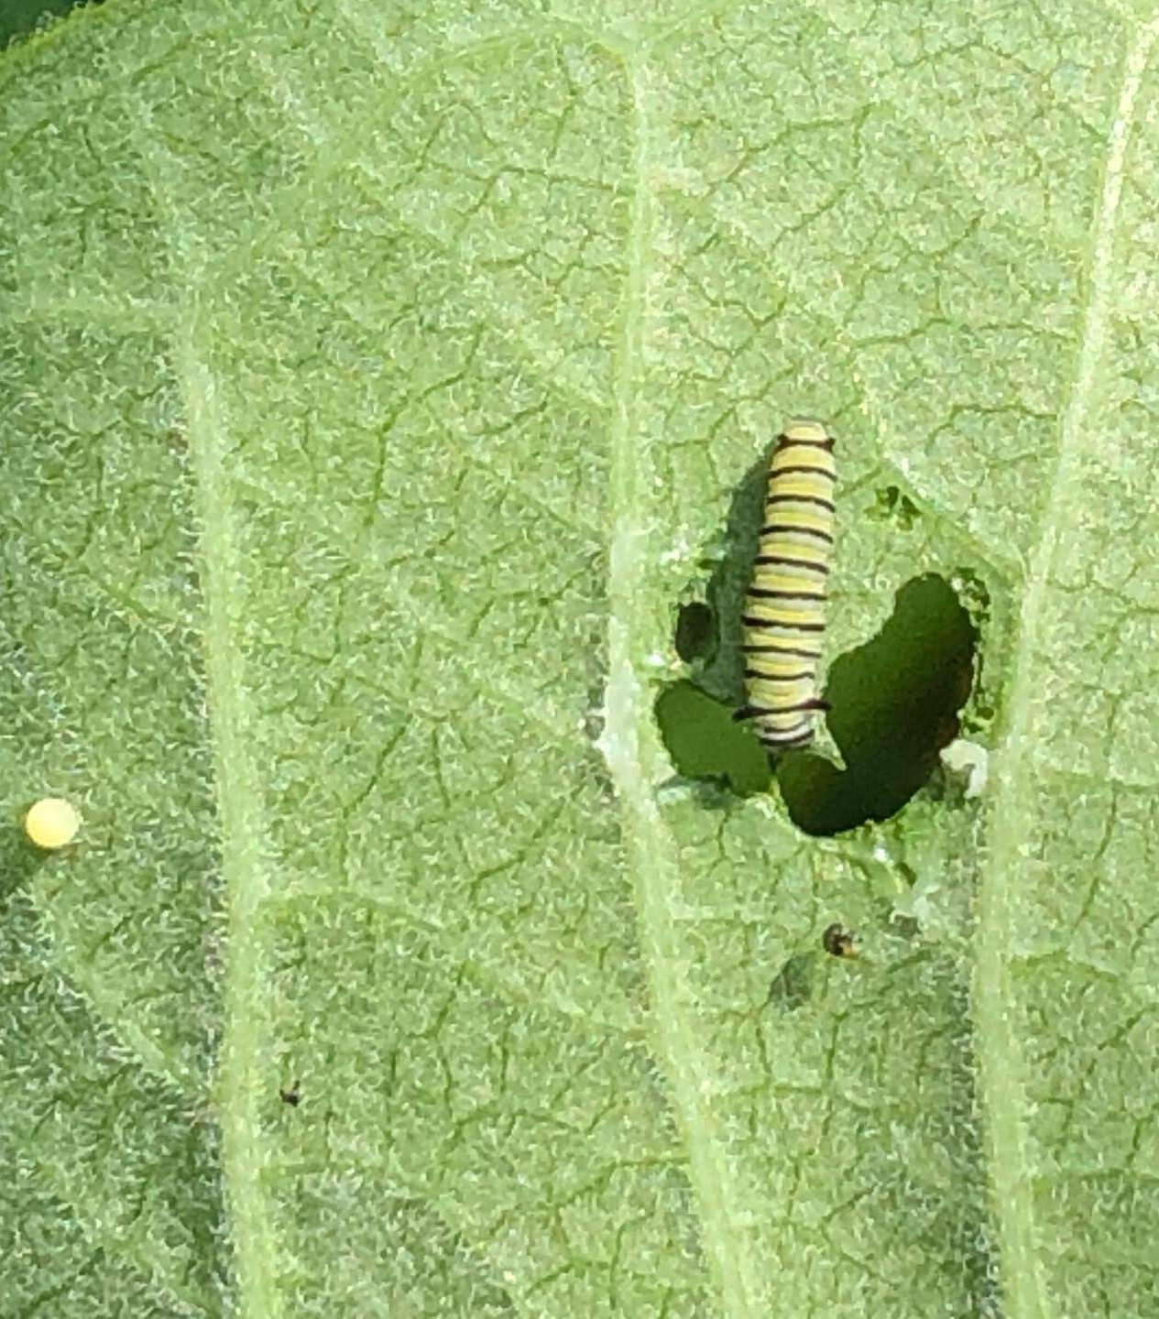
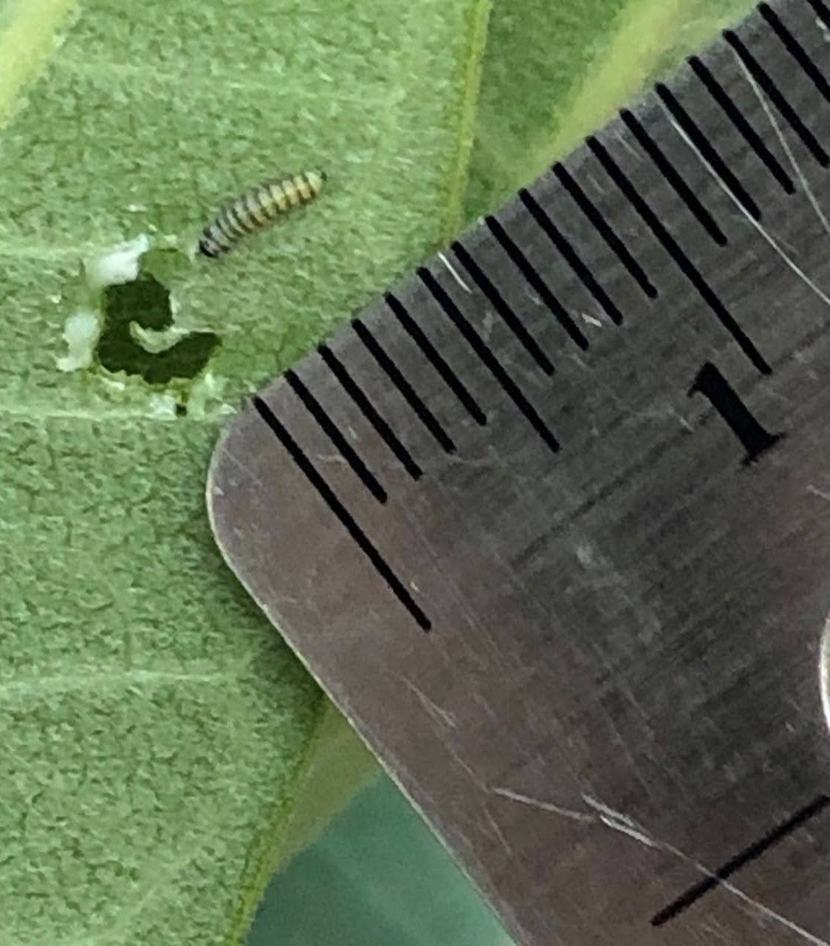
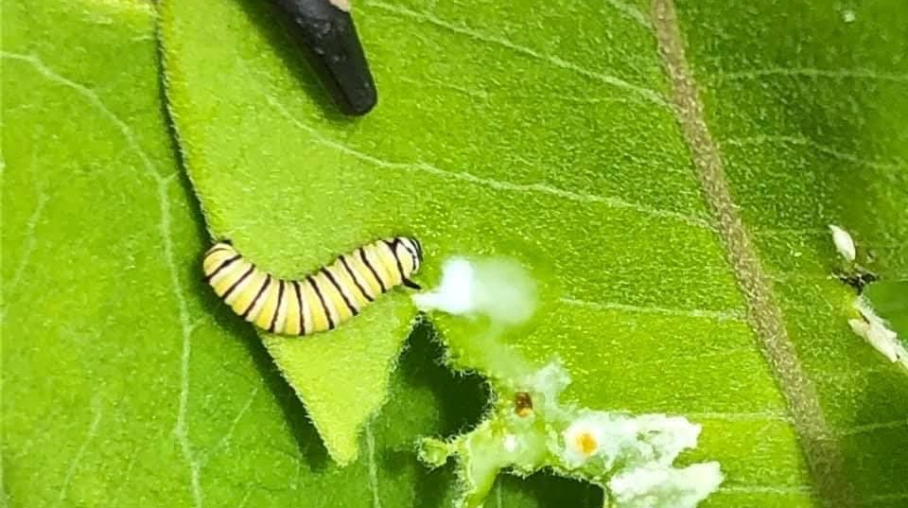
Collecting data
The team counted the number of monarch eggs on all the milkweed plants in the control and treatment patches.
They also measured the size of the plants and the number of predators on each plant.
Returned to the same plants throughout the summer growing season
Total of 1,693 observations!

Slide 6
Part 1 data

Slide 7
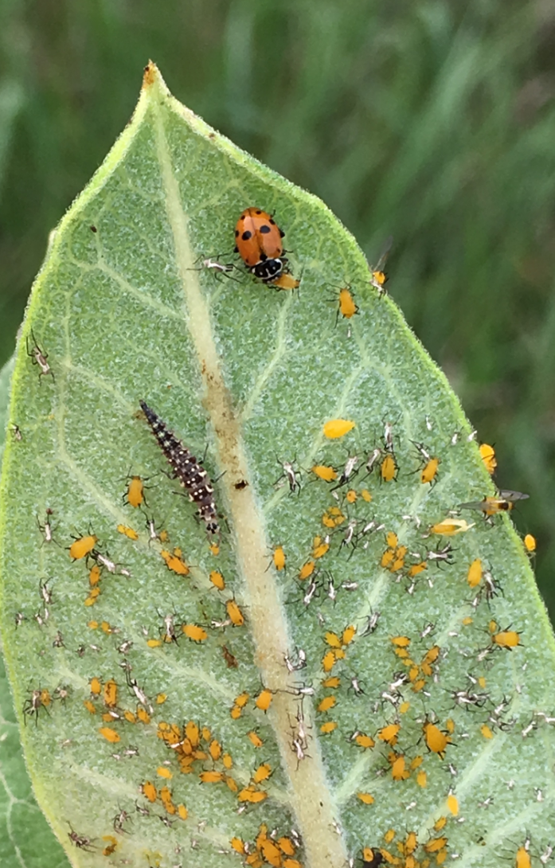
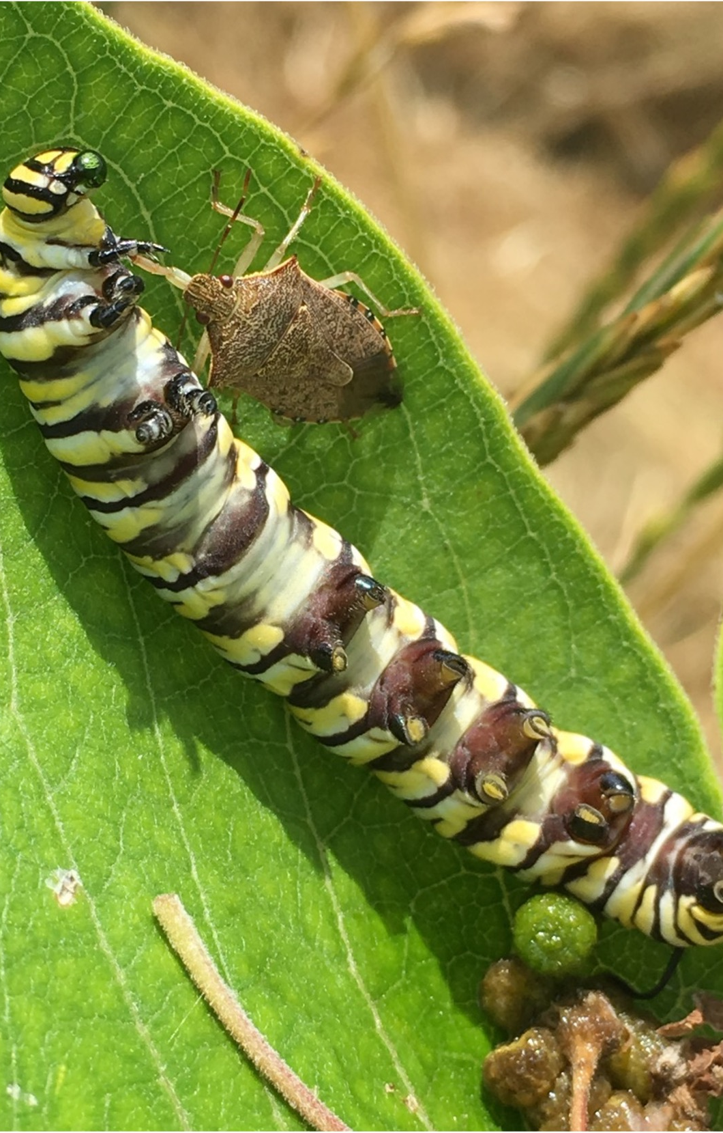
Monarch predators
Monarchs become poisonous from the food they eat. Young caterpillars are less poisonous because they haven’t eaten much milkweed yet. And monarch eggs are not poisonous at all to predators.

Slide 8
Predators of monarch butterfly eggs and caterpillars
Notes:
There are many different species that eat monarch butterfly eggs and young caterpillars. These are just a few of the species that Gabe and Britney observed during their experiment.

Slide 9
Part 2 data

