Slide 1



Bringing Authentic Research and
Data into the Classroom
Liz Schultheis & Melissa Kjelvik
@Data_Nuggets

Slide 2
Welcome to the webinar:
Your mic is muted and your camera is off.
We’ll be recording today’s program.
To ask questions, use the chat or the ‘Q&A’ feature on the black toolbar. Co-hosts will ask questions throughout the event.

Slide 3



Introductions
Dr. Liz Schultheis
Co-founder Data Nuggets, Education and Outreach Coordinator for LTER program at KBS, plant biologist
Dr. Melissa Kjelvik
Co-founder Data Nuggets, Research associate, discipline-based education research, zoologist
Trina Reaves
Director of STEM and Innovation
Clayton County Public Schools

Slide 4
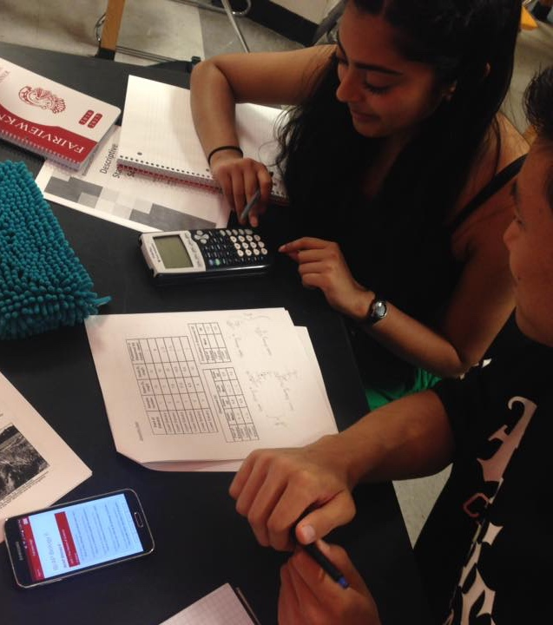
Talk outline
What are Data Nuggets?
NGSS Phenomena in Data Nuggets
Using C-E-R with Data Nuggets

Slide 5

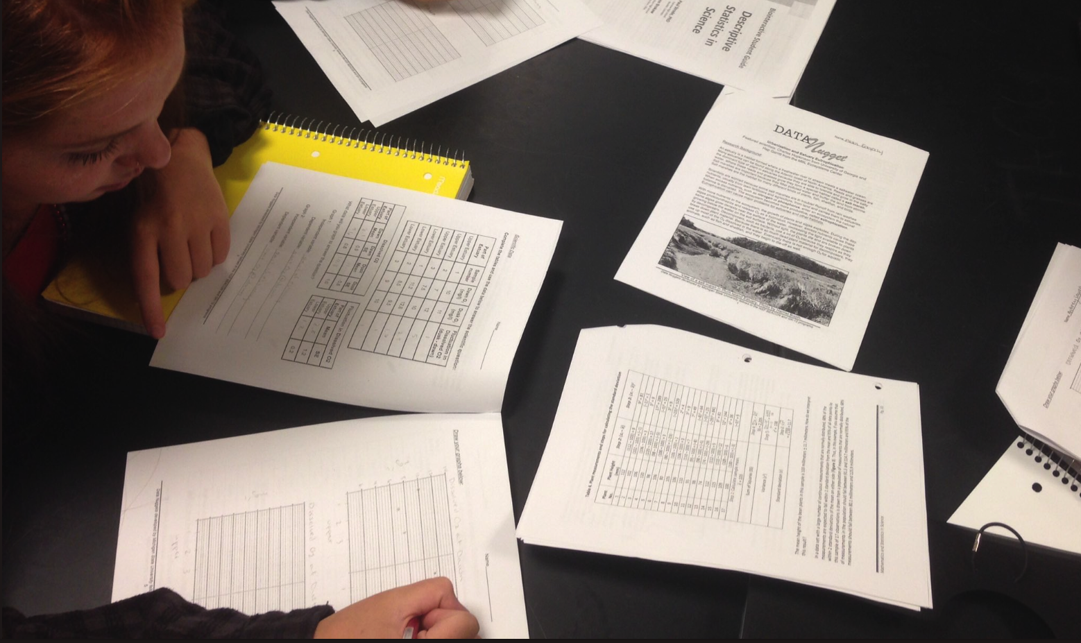
What are
Data Nuggets?
Notes:
So, what are Data Nuggets?

Slide 6
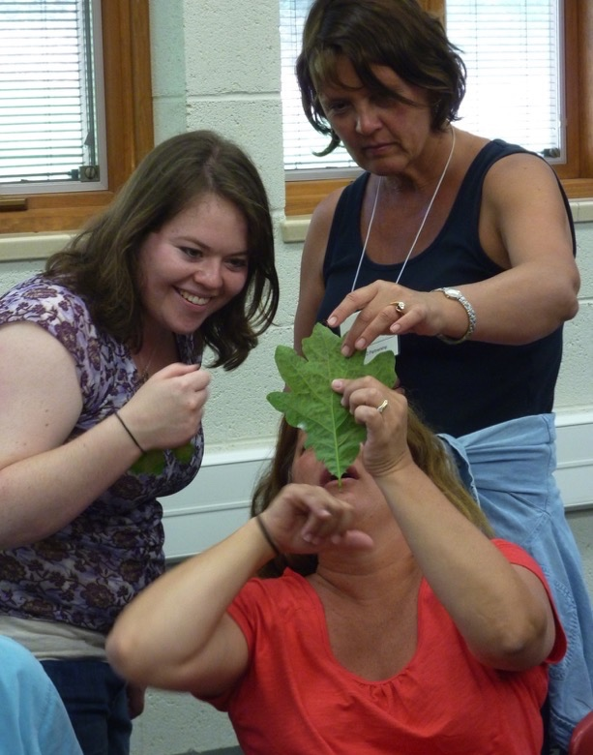
Data Nuggets: Collaboration between teachers and scientists
_
Students need experiences with authentic, messy data
Feeling they did something wrong when results are surprising or data show variability
Notes:
We began to develop Data Nuggets starting in 2011 and originated through conversations between teachers and graduate students during the NSF GK-12 project “New GK- 12: Using the STEM Dimensions of Bioenergy Sustainability to Bring Leading-edge Graduate Research to K-12 Learning Settings” (NSF DGE 0947896). This unique opportunity for collaboration between teachers and scientists led to the creation of teacher-inspired resources. Teachers shared that they were lacking educational resources that helped their students practice working with real, messy data like that collected during classroom inquiry-based projects. Graduate students in the sciences, however, have lots of practice working with messy data and surprising results.

Slide 7
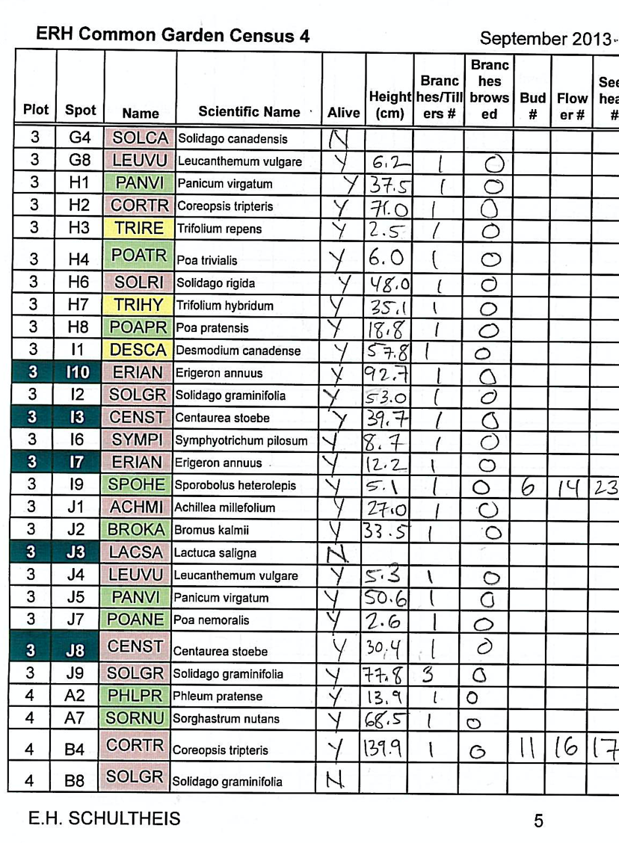
Real-world data
_
There are many exciting, authentic datasets available today
Take time to find, curate, and explore
Goal to work with scientists to make these datasets available for students
Notes:
Authentic data transform a typical lesson on data analysis or interpretation by providing real-world context and making connections to disciplinary content, and students report feeling an increased emotional connection to data when they are better able to recognize practical application and relevance (Langen et al., 2014; Wolff et al., 2017). Connecting science to a learners’ experience makes content more accessible (Stoddart et al., 2010) and increases student interest in the material (Hulleman & Harackiewicz, 2009). By encouraging students to make connections between the data and their everyday lives, authentic data have the potential to give real-world relevance to data literacy instruction and tap into a student’s natural curiosity about their world (Doering & Veletsianos, 2007).

Slide 8

Free activities that bring real data into the classroom, along with all its messiness and complexity
Based on contemporary research
Guide students through entire process of science
Follow familiar template, but provide flexibility to follow the story of the science
https://datanuggets.org
Schultheis & Kjelvik 2015
Schultheis & Kjelvik 2020
Notes:
To this end, we developed Data Nuggets, which are…
By using cutting edge research, DNs capture the attention of students by engaging them with more than just the conclusions of a study, but the story and process of the researcher behind the ideas and data

Slide 9
Phenomena from cutting-edge research
Introduction to scientist role models
Experience with authentic datasets
Visualizing data and identifying patterns
Repeated practice engaging in science practices

Slide 10
Content levels
_
  Based on how difficult the data are to work with, and how complex the science concept is.
  Correspond with Flesch-Kincaid readability statistics and content standards.
Notes:
Graphing and multiple content levels allow for differentiated learning for students with any science or reading background.

Slide 11
Graphing levels
_
  Each activity is provided in all 3 levels (A,B,C)
Notes:
Graphing and multiple content levels allow for differentiated learning for students with any science or reading background.

Slide 12
Scaffolding and Differentiated Instruction
_
Notes:
Touch on the “levels” and how you can use scaffolding - progression over time (e.g., start with A, eventually progress to B and C). Refer to table with the list of Data Nuggets with levels and key features. Allows for differentiated instruction, or teachers to scaffold certain skills early in the year and remove them over time.

Slide 13
Using the teacher guide
_
Teacher Notes: Provide additional background information for teachers, as well as suggestions for discussion topics.
Checks for Understanding: Provide stopping points for teachers to assess student understanding.
Meta Moments: Provide stopping points for students to think about their own thinking.
Notes:
For each Data Nugget we have created a Teacher Guide to help facilitate use in the classroom and provide the teacher with any additional information they might need. This guide has the same structure as the student handouts, but has example student graphs and written responses, as well as suggested stopping points for class discussion and clarifications. There are three types of stopping points:
Teacher Notes: Provide additional background information for teachers, as well as suggestions for discussion topics. For example, we may share information provided by the scientist, detailing what their next research steps were after collecting the data presented in the activity.
Checks for Understanding: Provide stopping points for teachers to assess student understanding. These are particularly useful after students finish reading the Background Information sections or have just started to view and work with the data.
Meta Moments: Provide stopping points for students to think about their own thinking. Stepping back from the research, students can discuss the decisions they are making as they work though the Data Nugget, such as the way they chose to visualize their data to ease interpretation and support their claims.

Slide 14
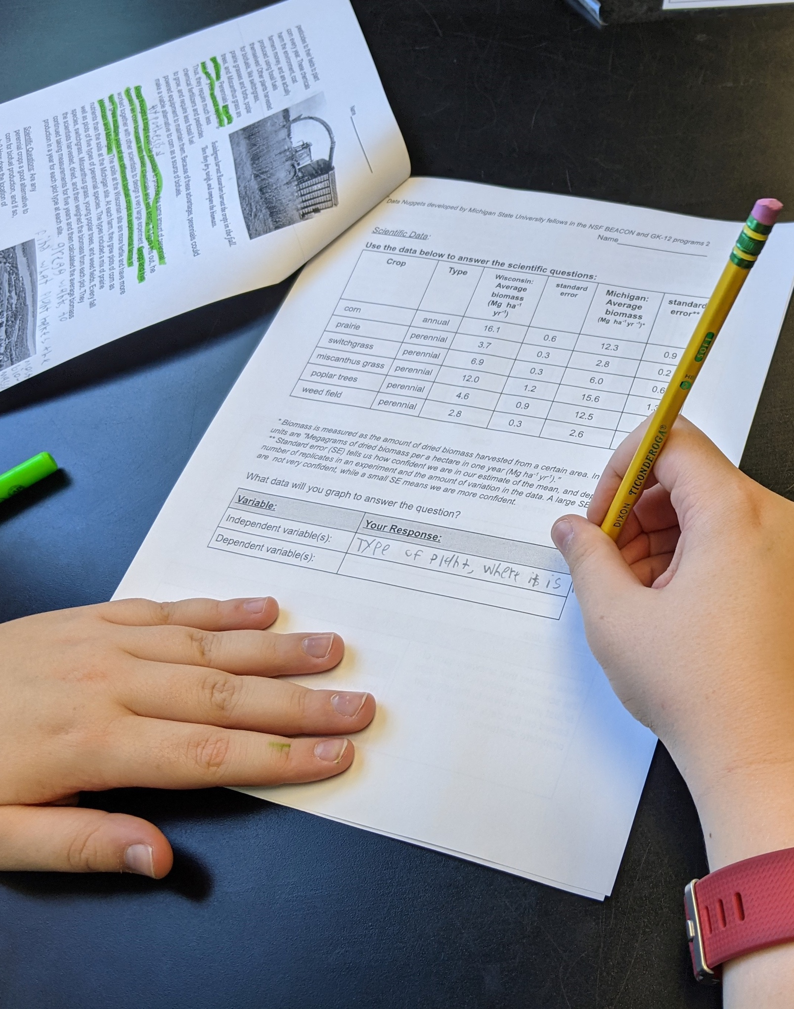
Reading comprehension strategies
_
Highlight the text
Takes notes in the margin
Stop to think
Re-read for clarification
Write out difficult concepts in your own words
Pause for class discussions
Notes:
Elementary specific suggestions
Use level 1s in Elementary
Reminder about the check for understandings to make sure they got important points before moving on

Slide 15
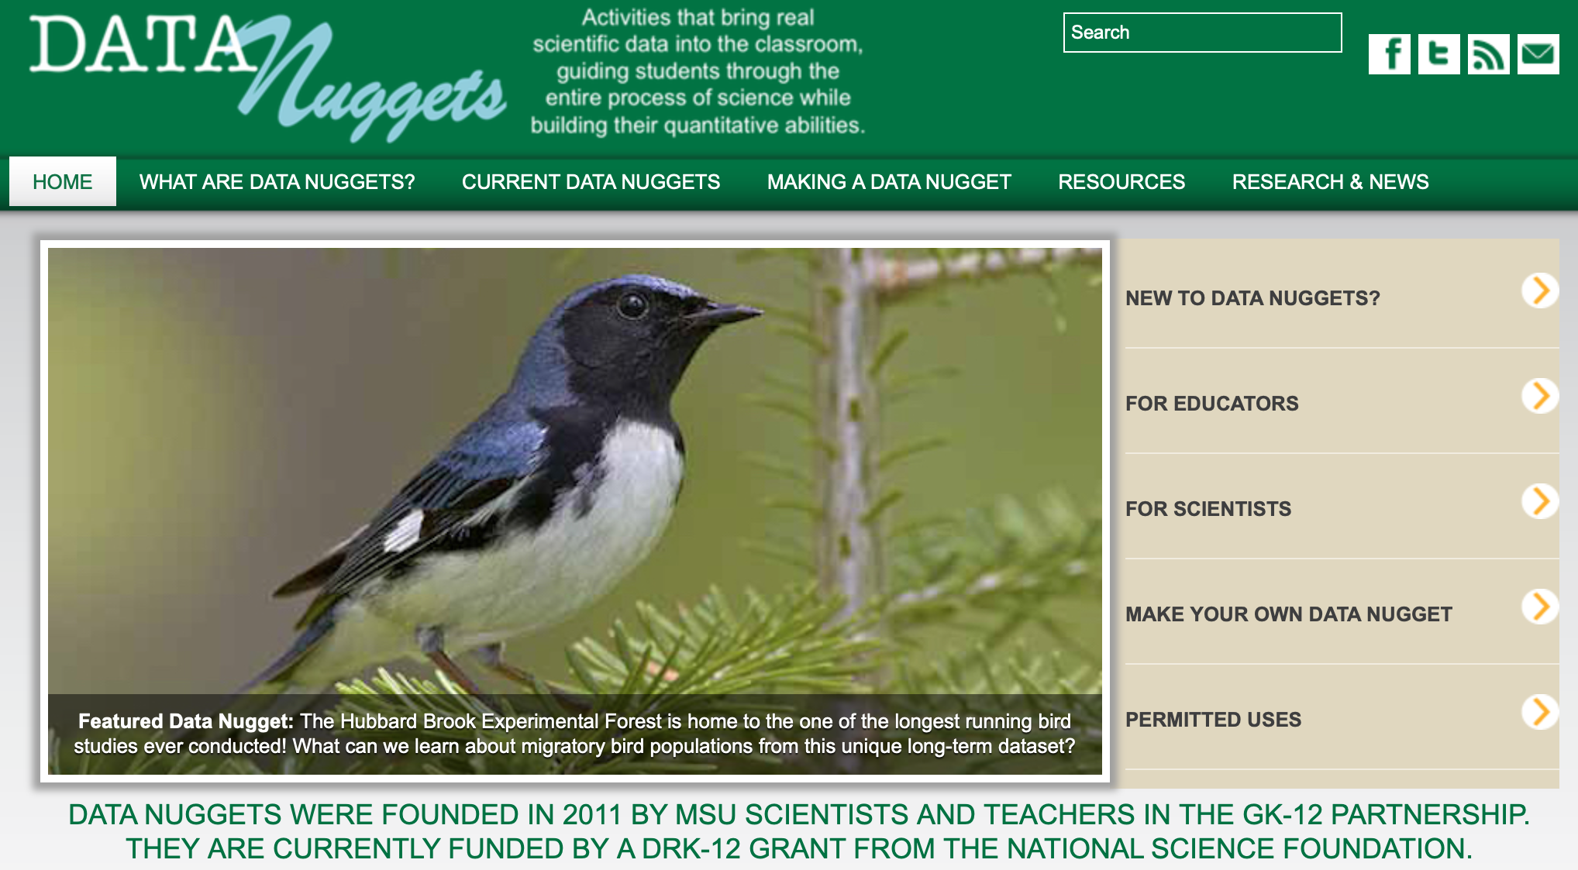

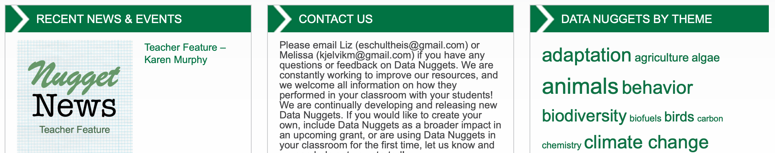
Notes:
All DNs can be found free on our website. Though our ideas started with a small group of teachers in Michigan, we found they have resonated with teachers across the country. Since that time we have continued to fund and grow the program, and today DNs are use in classrooms in all 50 states and across the world. All of our Data Nuggets can be found online at datanuggets.org. We above 1K visitors to our website some days, and thousands of teachers using Data Nuggets in their classrooms.

Slide 16

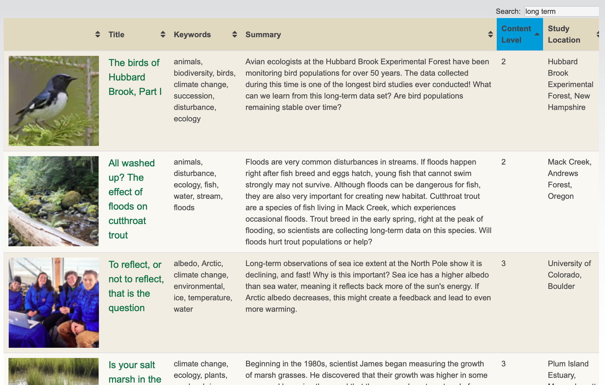
Notes:
Have over 100 Data Nuggets to date
Diversity of topics from biology and ecology, to chemistry and physics

Slide 17
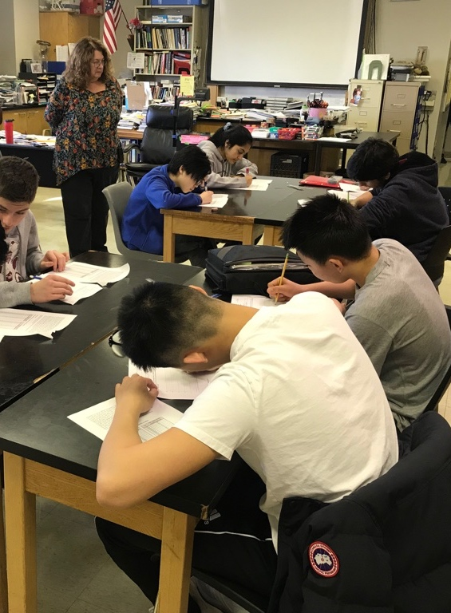
Students using Data Nuggets…
spent more time “doing science”
improved ability to construct explanations
increased confidence with data and science
increased motivation to pursue STEM careers
Schultheis et al. in review
Notes:
We have been doing this for years and just wrapped up our recent NSF DRK-12 grant. The goal of this project was to determine the impact of Data Nuggets on the students using them. We heard anecdotally from teachers… but we want data on DNs. We found that students using Data Nuggets…
The study took place in 42 high school biology classrooms during the 2017-18 school year. While high school biology students in both groups made similar gains in quantitative reasoning in the context of biology (β = -0.03, p = 0.42, Cohen’s d = -0.03), students in Data Nuggets classrooms outperformed students in comparison classrooms in the development of data-based explanations (β = 0.15, p = 0.009, Cohen’s d = 0.20). This indicates that Data Nuggets were beneficial in helping students to develop more coherent explanations of scientific data, a skill that is particularly important in making sense of scientific and socio-scientific phenomena inside and outside of school. Students in the treatment condition showed higher gains in self-efficacy around analyzing and interpreting data (β = 0.271, p = 0.013, Cohen’s d = 0.11) and were more likely to show interest in a science career (β = 0.197, p = 0.029, Cohen’s d = 0.08).
Self-efficacy (confidence)
Figure out what data to collect and how to collect them.
Use data as evidence to support a claim I made.
Work with complicated data sets that may have unclear patterns.
Interpret data from a scientific investigation.
Use or calculate statistics (mean, ratios, percent, etc.)

Slide 18
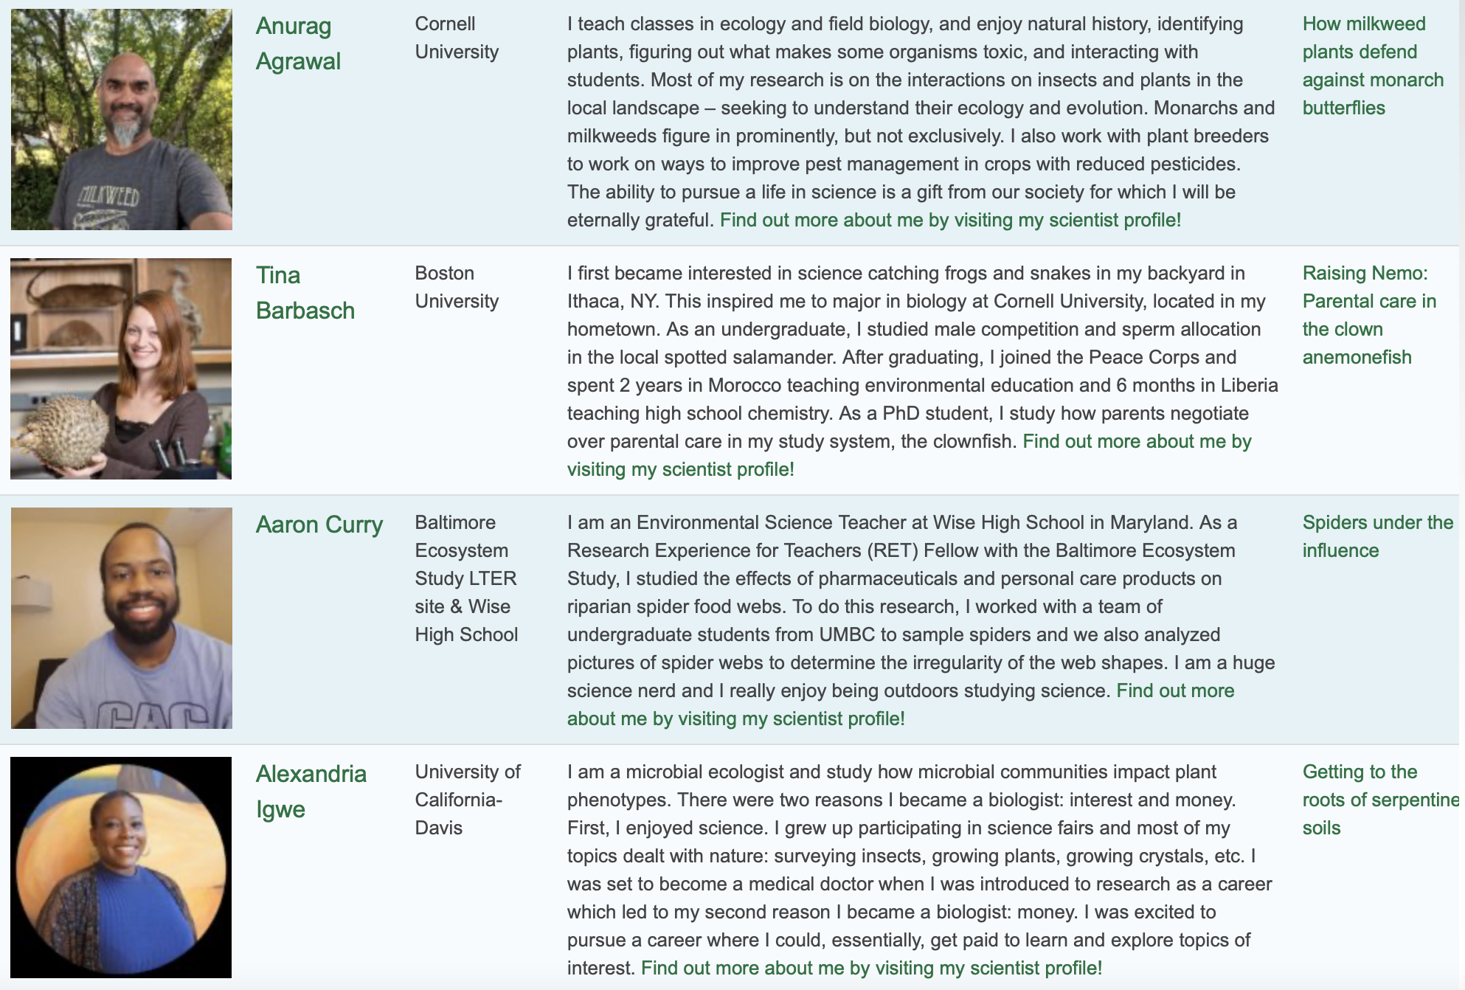
Scientist role models

Slide 19
Introducing NGSS Phenomena using Data Nuggets
Notes:
You can use DNs to introduce NGSS phenomena
NGSS 2016. Using Phenomena in NGSS-Designed
Lessons and Units. https://www.nextgenscience.org/resources/phenomena

Slide 20
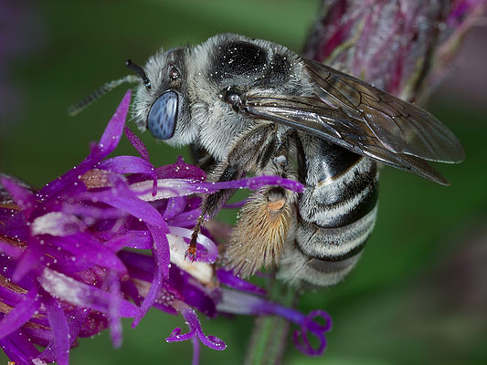
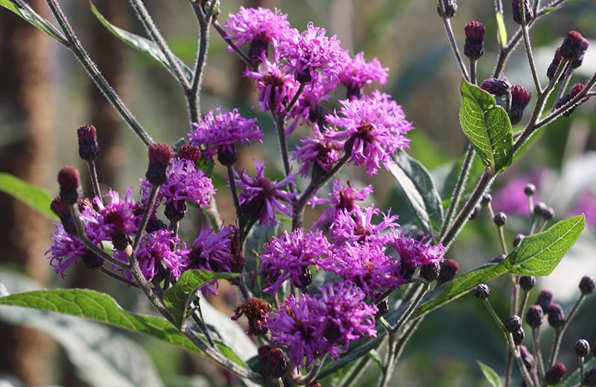
Phenomena:
Real-world contexts for the work of scientists
_
Science is more than a set of facts, but a way of explaining the world and solving problems
Traditionally been a missing piece in science education
Need to apply what they are learning to real-world contexts
Powerful when culturally or personally relevant or consequential to students
NGSS 2016. Using Phenomena in NGSS-Designed Lessons and Units
Notes:
The point if using phenomena to drive instruction is to help students engage in practices to develop the knowledge necessary to explain or predict phenomena. Therefore, the focus is not just on the phenomenon itself, but also the student-generated questions about the phenomenon that guides the learning and teaching.
The most powerful phenomena from an educational perspective are culturally or personally relevant or consequential to students. Such phenomena highlight how science ideas help us explain aspects of real world contexts.

Slide 21
Phenomena in Data Nuggets_
Introduce phenomena
Provides scientific knowledge (DCIs)
Real-world context
Why scientist is interested in their question, and broad significance
Connect to student experience
Students explain phenomena by applying DCIs through use of practices (SEP 4-7)
Give students sufficient grounding to generate their own questions about phenomena to guide future learning and teaching (SEP 1)
Notes:
Two practices related to QR, (4) Analyzing and interpreting data and (5) Using mathematics and computational thinking, explicitly emphasize the importance of engaging students in analyzing and applying quantitative information. Additionally, QR practices (6) Constructing explanations and (7) Engaging in argument from evidence, require the use of evidence, in the form of data, when forming explanations and arguments. Practices 6 and 7 are based in the claim-evidence-reasoning (CER) framework developed by McNeill, Krajcik, and grounded in work by Toulmin (McNeill et al., 2006; McNeill & Krajcik, 2008a; McNeill & Krajcik, 2008b; NRC, 2013; Toulmin, 1958).

Slide 22
Using Claim-Evidence-Reasoning (CER) with Data Nuggets

Slide 23
Claim-Evidence-Reasoning (CER)
_
Structure for constructing explanations
Basis of scientific conclusions
Consists of three parts:
  Restate the scientific questions with the answer after examining the data.
  What evidence (data) supports your claim
  Reasoning links evidence to the claim using scientific principles

Slide 24
Why is CER important
_
  Helps students evaluate how evidence helps answer the scientific question presented in an experiment or reading material
  CER framework trains students to think about how to look at data and make their understanding clear in written responses
  Foundation for discourse that all students can engage in
  Prepares them to be discerning, thoughtful citizens in the future (we hope!)

Slide 25
Constructing Explanations
Claim-Evidence-Reasoning
_
Make a claim that answers the scientific question. Describe the relationship between the dependent and independent variables and what that means.
Support your claim using data as evidence. Reference specific parts of the table or graph.
Explain your reasoning and how the data supports your claim. Connect the data back to what you learned about _______________.
What do the data from this study tell us about the scientist’s hypothesis? Use evidence to explain why or why not. If you feel the data was inconclusive, explain why.

Slide 26



Scientific Question
Make a claim that answers the scientific question.
CLAIM
Why does the evidence support the claim?
Why does the evidence support the claim?
Why does the evidence support the claim?
REASONING
What is the underlying science concept?
What is the underlying science concept?
What is the underlying science concept?
Support your claim using data as evidence. Reference specific parts of the table or graph.
Support your claim using data as evidence. Reference specific parts of the table or graph.
Support your claim using data as evidence. Reference specific parts of the table or graph.
EVIDENCE
Notes:
CER is a scaffold – this tool can scaffold the scaffold! (faded scaffolding)

Slide 27
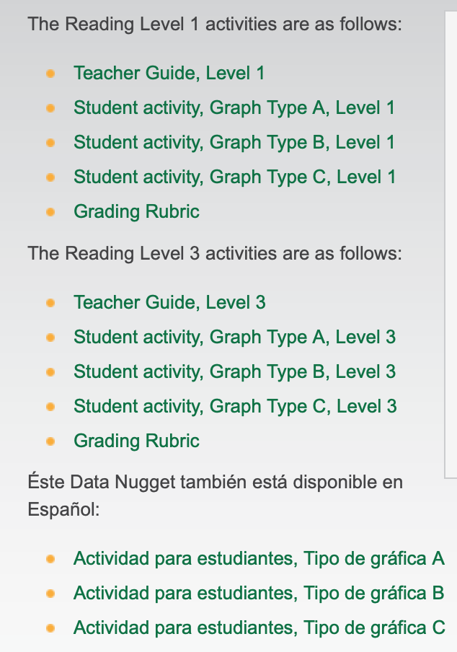
Let’s explore a Data Nugget: Springing Forward
Notes:
http://datanuggets.org/2015/03/springing-forward-does-climate-change-cause-plants-to-flower-earlier/
This is a special Data Nugget because we have it at different reading levels and in Spanish.

Slide 28
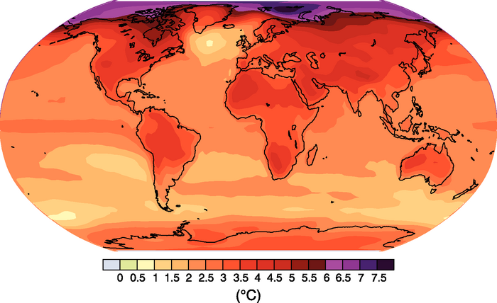
Predicted temperature increases of 2.0-6.2°C by the end of the 21st century
Plants can respond to changing
CO₂ levels, temperatures, and precipitation.
Slides modified from Meredith Zettlemoyer
Notes:
This Data Nugget focuses on the theme of climate change, and how plants respond to those changes.

Slide 29






Plant response to climate change
Phenology
Timing of life-cycle events
Sensitive to local environmental conditions
Slides modified from Meredith Zettlemoyer
Notes:
One way plants respond is by shifting their phenology, or the timing of life cycle events.
These events respond to environmental cues, such as temperature and precipitation.

Slide 30
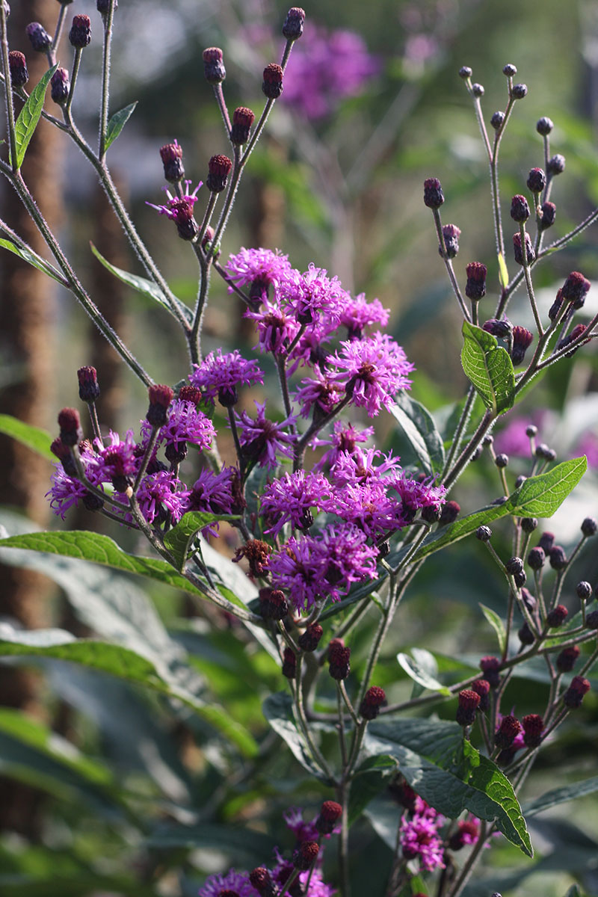
Why does phenology matter?
Plants need to match up with their pollinators
Slides modified from Meredith Zettlemoyer
Notes:
Phenology is important for several reasons. First, it impacts a plant’s interaction with other species. For example, if a plant relies on pollinators to set seed, then if the date of their flowering changes, this could mean that they they are no longer pollinated.
Melissodes (Eumelissodes) denticulatus specializes on Tall Ironweed (Vernonia noveboracensis)

Slide 31

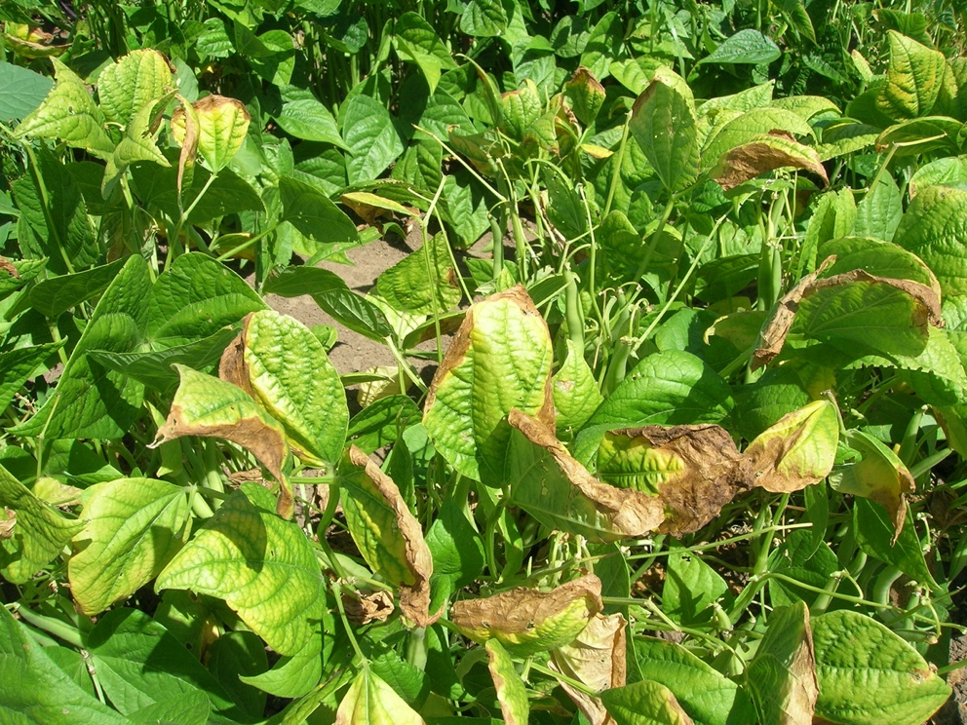
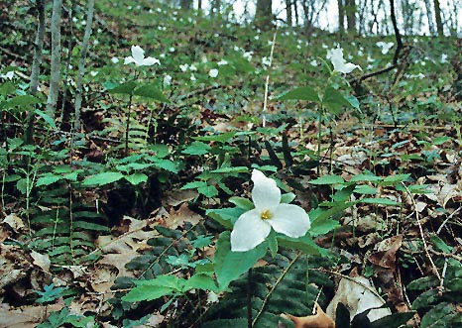
Why does phenology matter?
Early access to light, nutrients, space
Slides modified from Meredith Zettlemoyer
Notes:
Phenology is also important for plant competition. If a species can respond to climate change by sprouting or leafing out earlier, that could give it a competitive advantage over plants that do not respond.
Light competition – forest understory, or tall grasses
Soybeans limited by nutrients
Trillium in patches - space

Slide 32
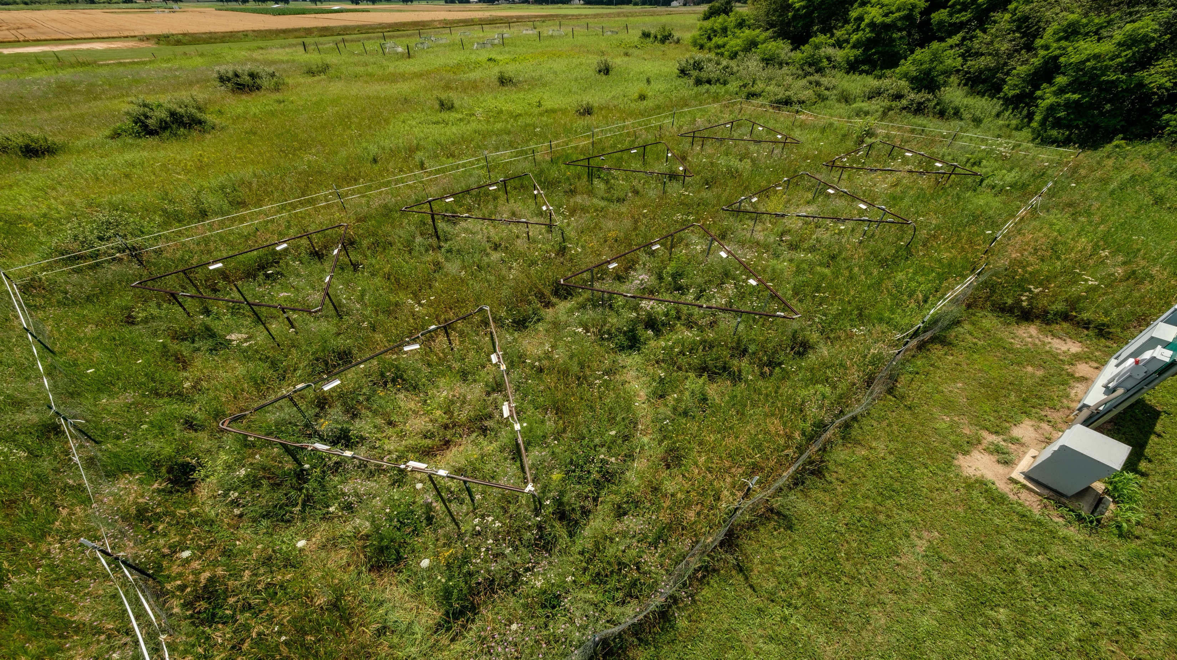
Studying phenology using simulated warming experiment at KBS
Photo by Kurt Stepnitz
Normal vs. heated 3°C
Notes:
The Kellogg Biological Station (KBS) warming array uses infrared heaters to elevate temperatures 3°C above ambient temperatures to mimic regional predictions for the end of the 21st century (0.3°C - 4.8°C; n=4 plots) (Stocker et al. 2013). Each 3 m-diameter warmed plot is surrounded by 6 infrared ceramic heaters (Model FTE-1000, Kalglo, Inc.) in an arrangement that evenly raises temperature across similar plots (Kimball 2008). Dummy heaters are suspended above control plots (n=4) to control for shading effects. Heaters are regulated by a proportional-integrative-derivative (PID) control system, which allows for a constant elevated temperature relative to a focal control (no heater) plot (see Kimball et al. {2008} for a full description of the heating apparatus). Sucsh heating designs are effective at maintaining temperatures within 0.5°C of the target elevated 75% of the time (Kimball 2008, Online Appendix A). The array has been running consistently each growing season (April - October) since 2008. Since 2012, an established old field community that has been occasionally mowed has inhabited the plots.

Slide 33
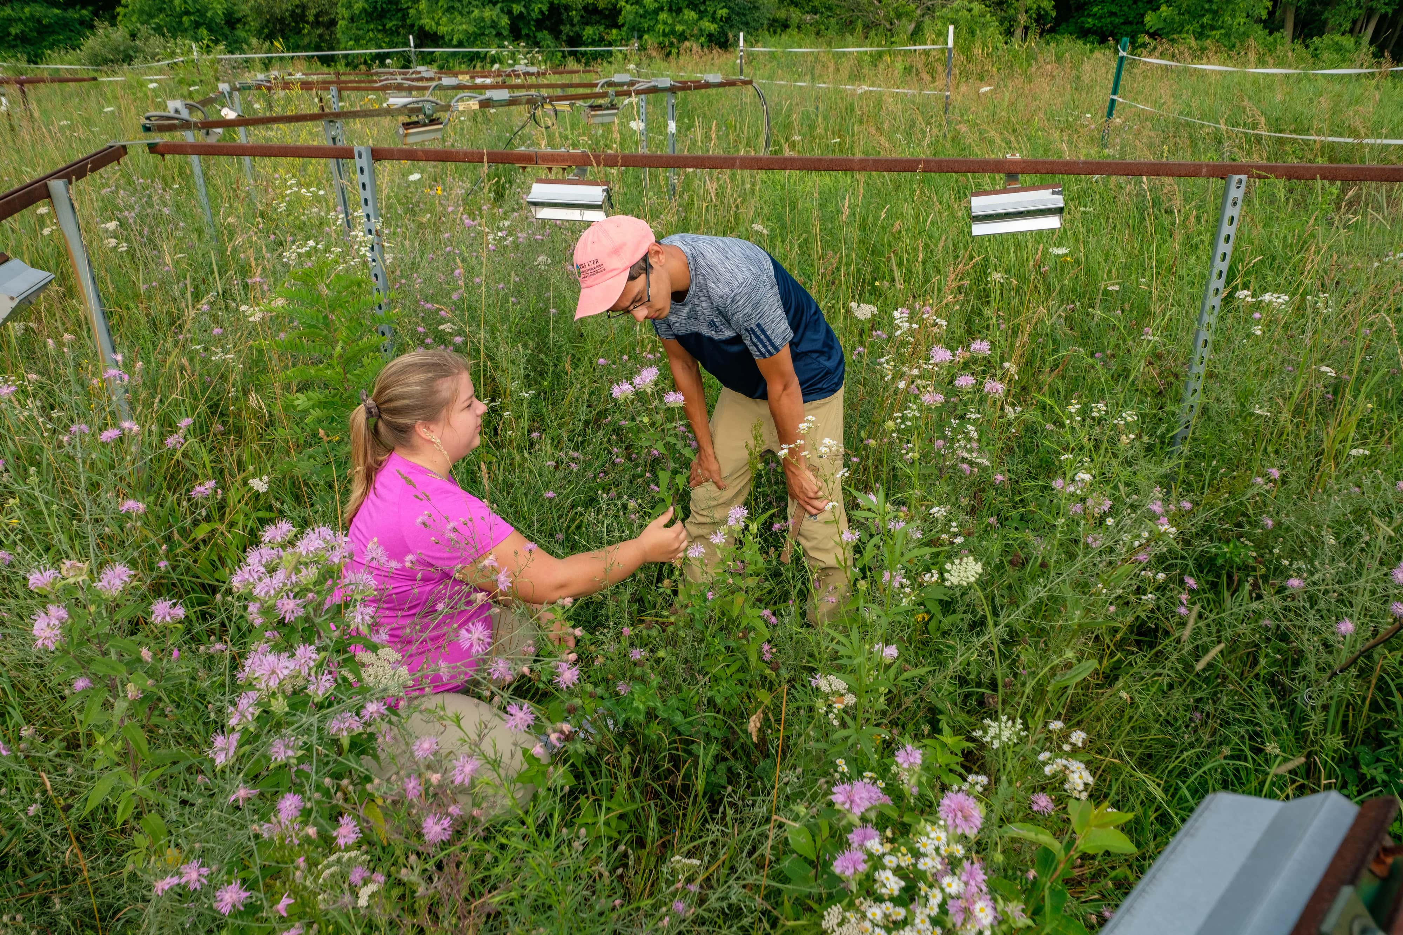
Heating rings in KBS LTER. Photo Credit: Kurt Stepnitz
Notes:
Collecting data from the heating ring experiment at the LTER to study evolution; Photo Credit: K.Stepnitz, Michigan State University

Slide 34
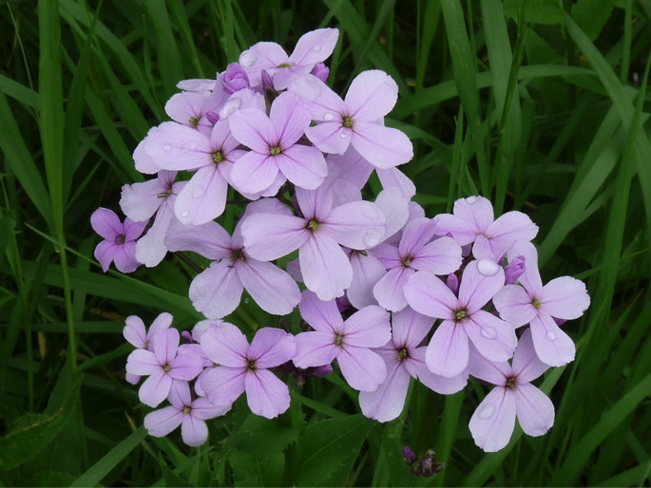
Data – analysis & visualization
Dame’s rocket
Scientific Question:
How does temperature affect the flowering time of dame’s rocket?

Slide 35
Data – analysis & visualization
Identify and interpret:
I see the bar for the normal temperature plots is higher than the heated plots.
There is a big difference in the average number of days it took dame’s rocket to flower in the two treatments.
Notes:
Flowers in the heated plots flowered 10 days earlier, on average.

Slide 36
Scientific Question:
How does temperature affect the flowering time of dame’s rocket?
Claim: for dame’s rocket, warmer temperatures caused plants to flower earlier.
Evidence: The dame’s rocket plants that grew in normal conditions (control) began flowering 16 days after the experiment started, while those in the heated (treatment) began flowering in just 6 days. There is a 10 day difference between the first flowers in both treatments.
Notes:
Make a claim that answers the scientific question.
What evidence was used to write your claim? Reference specific parts of the table or graph.

Slide 37
Scientific Question:
How does temperature affect the flowering time of dame’s rocket?
Reasoning: It took longer for dame’s rocket to flower in the normal plots than it did in the heated plots. Heating is what caused dame’s rocket to flower earlier.
The heating treatment is what we expect in the future for Michigan, so this means that we can expect dame’s rocket to flower earlier and earlier each year as temperatures go up from climate change.
Notes:
Explain your reasoning and why the evidence supports your claim. Connect the data back to what you learned about climate change and how this could affect flowering time.

Slide 38
Questions?

Slide 39
References
NGSS (2016). Using Phenomena in NGSS-Designed
Lessons and Units. https://www.nextgenscience.org/resources/phenomena
Springing Forward Data Nugget
http://datanuggets.org/2015/03/springing-forward-does-climate-change-cause-plants-to-flower-earlier/
Schultheis, E. H. and M. K. Kjelvik (2015). Data Nuggets: Bringing Real Data into the Classroom to Unearth Students' Quantitative & Inquiry Skills. The American Biology Teacher 77(1): 19-29.
Schultheis, E. H. and M. K. Kjelvik (2020). Using Messy, Authentic Data to Promote Data Literacy & Reveal the Nature of Science. The American Biology Teacher 82(7): 439–446.

