Slide 1



Trees and bushes, home sweet home for warblers
Featured scientists: Hankyu Kim, Matt Betts, and Sarah Frey from Oregon State University.

Slide 2
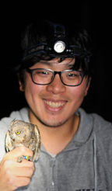
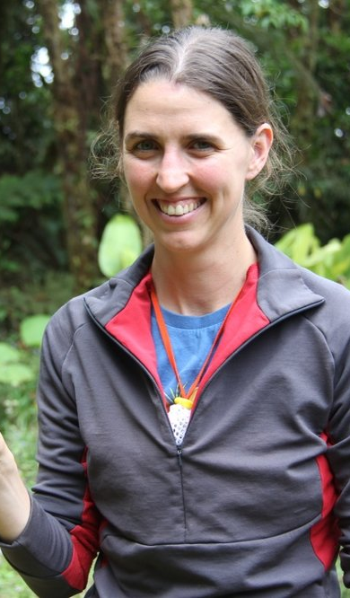
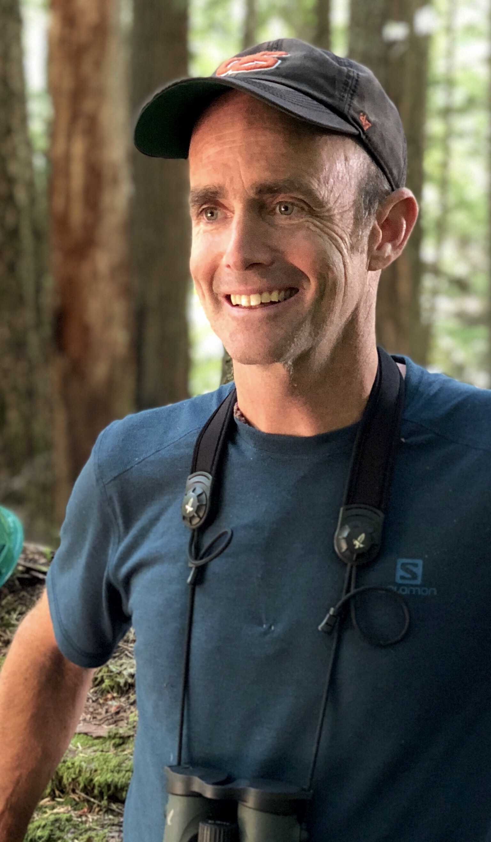
Hankyu Kim
Sarah Frey
Matt Betts
Notes:
Meet the scientists from Oregon State University.

Slide 3
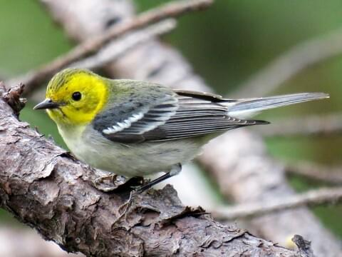
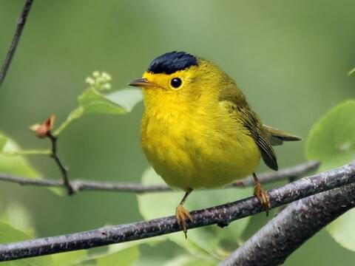
Hermit Warbler
Wilson’s Warbler
Notes:
Photos from allaboutbirds.com

Slide 4
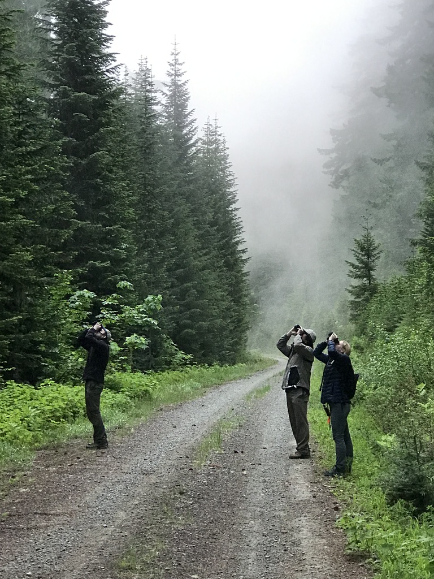
Each year since 2009, scientists at the Andrews Forest Long-Term Ecological Research site have used the same transects to measure bird populations.
Transects are parallel lines along which measurements are taken. At specific points along the transect, the team stops and listens for bird songs and calls for 10 minutes. There are 184 survey locations, and they are visited multiple times each year.

Slide 5
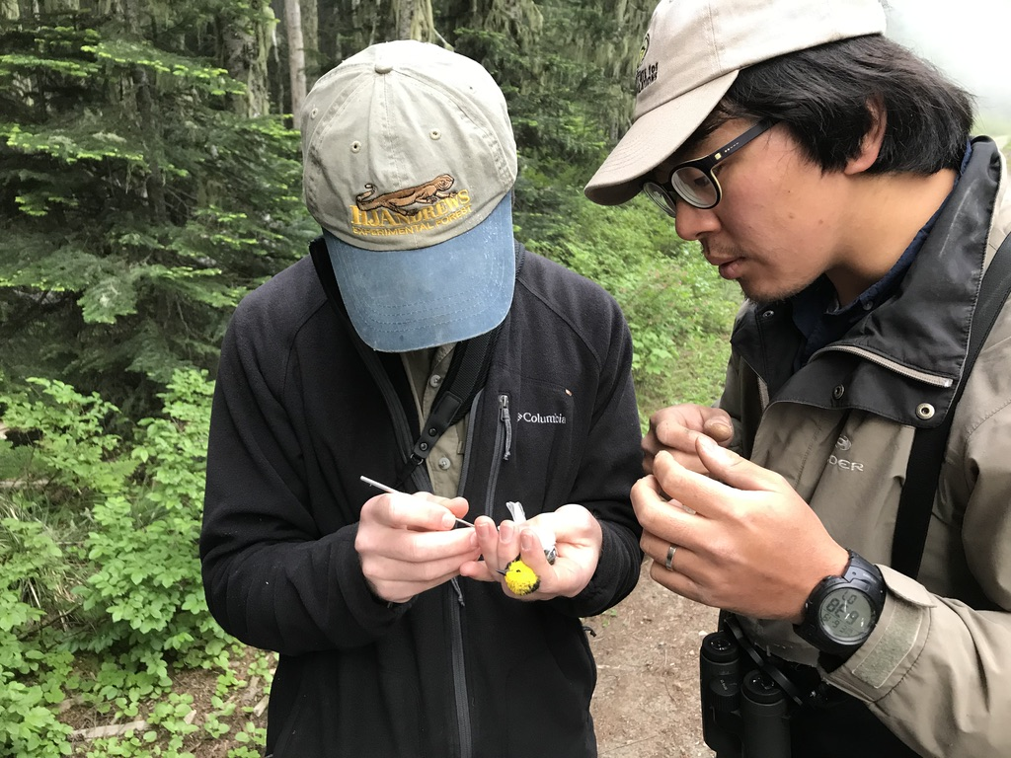

Slide 6
