Slide 1
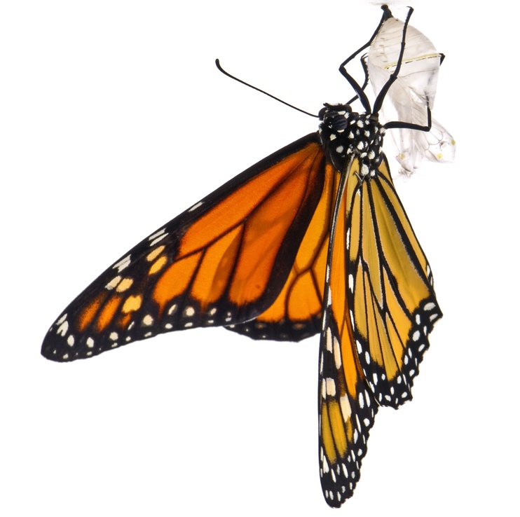
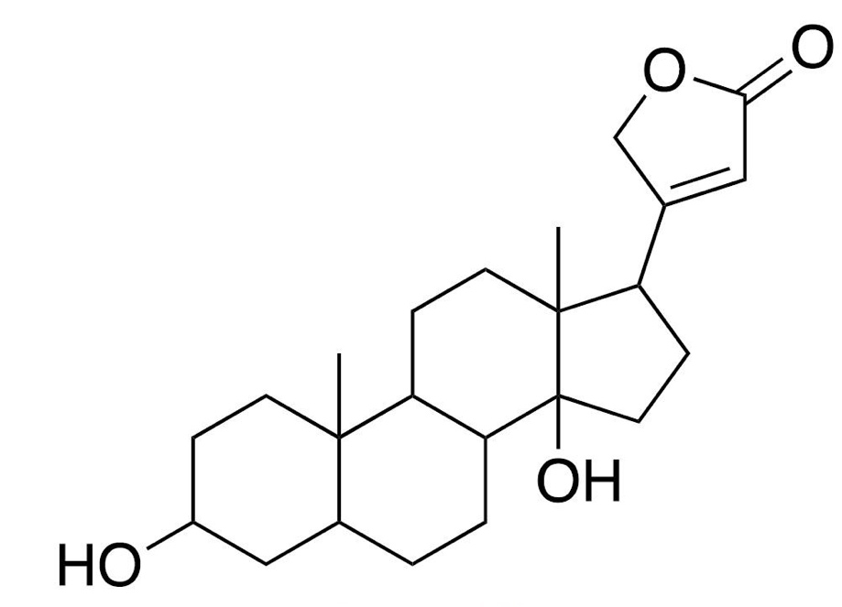
How milkweed plants defend against monarch butterflies
Featured scientist: Anurag Agrawal (He/Him/His)
from Cornell University
Notes:
All photos by Anurag Agrawal unless otherwise noted

Slide 2
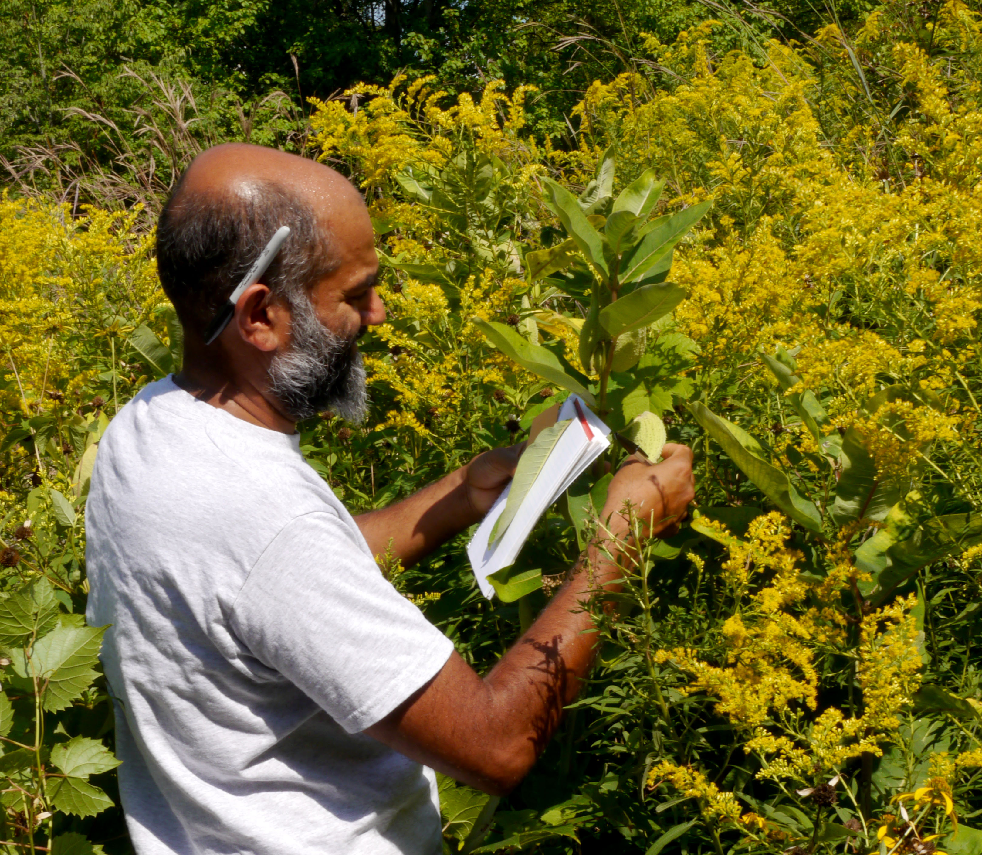
Anurag Agrawal
Notes:
Anurag is a scientist who has long been fascinated by plants and their defenses. He thinks this comes from the fact that his mother was such an avid gardener. She would grow food, such as peppers, squashes, and tomatoes. He looks back and has memories that are associated with garden plants and their defenses. For example, he remembers eating a bitter cucumber as a kid and spitting it out. He also can still recall the bitter aroma on his hand after brushing against the sticky tomato leaves.
Anurag first started studying milkweeds 20 years ago, based on a recommendation from a friend. His friend told him of the bitter, sticky, and furry leaves that were treasured by the monarch butterfly caterpillars. This led him to study the paradox of coevolution.

Slide 3
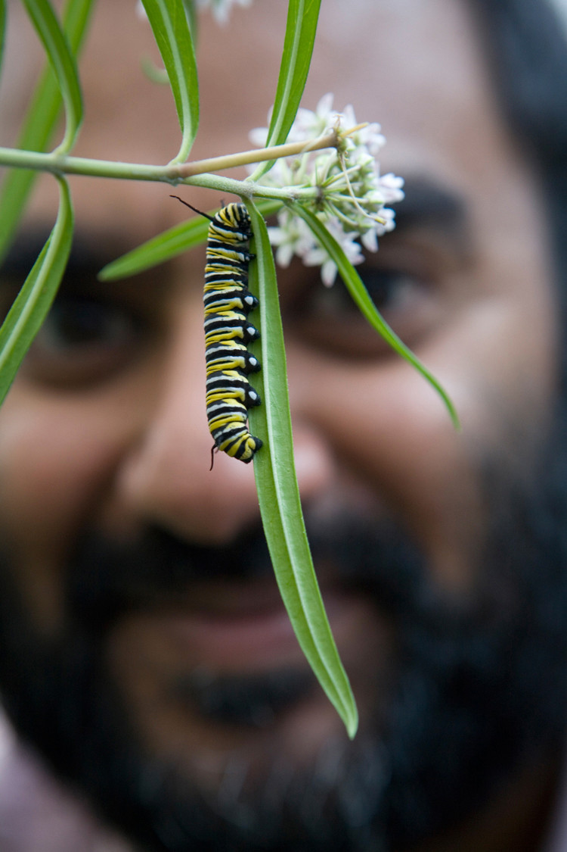
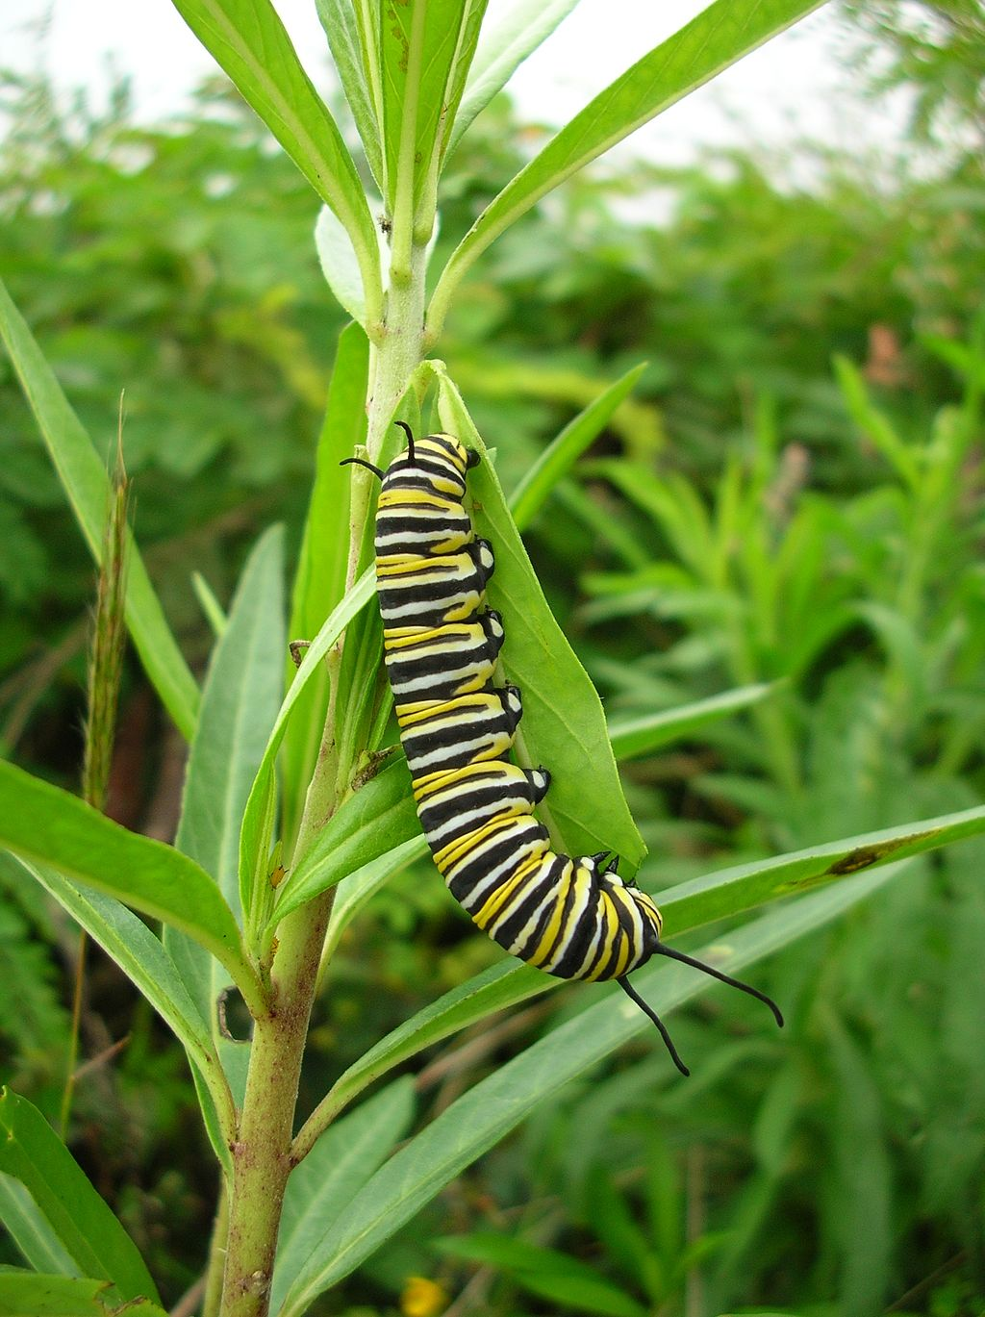
Coevolution between monarchs and milkweeds
Notes:
Coevolution. The milkweed and monarch have such a tight relationship that over time, milkweeds have evolved multiple ways to defend themselves against their herbivores. In response, monarchs have evolved to overcome those defenses because they need to eat the milkweed. This arms race may continue to shift back and forth over the course of evolutionary time.
This back-and-forth battle between caterpillar and plant intrigued Anurag. He wanted to know whether milkweed’s defensive traits are still effective against monarchs, or have monarchs evolved in ways that make them unaffected by the defenses? Because each defense trait might be at a different phase in the coevolution process, perhaps some would be effective defenses to herbivory, but others would not be effective.
(photo on right by Forest & Kim Starr)

Slide 4
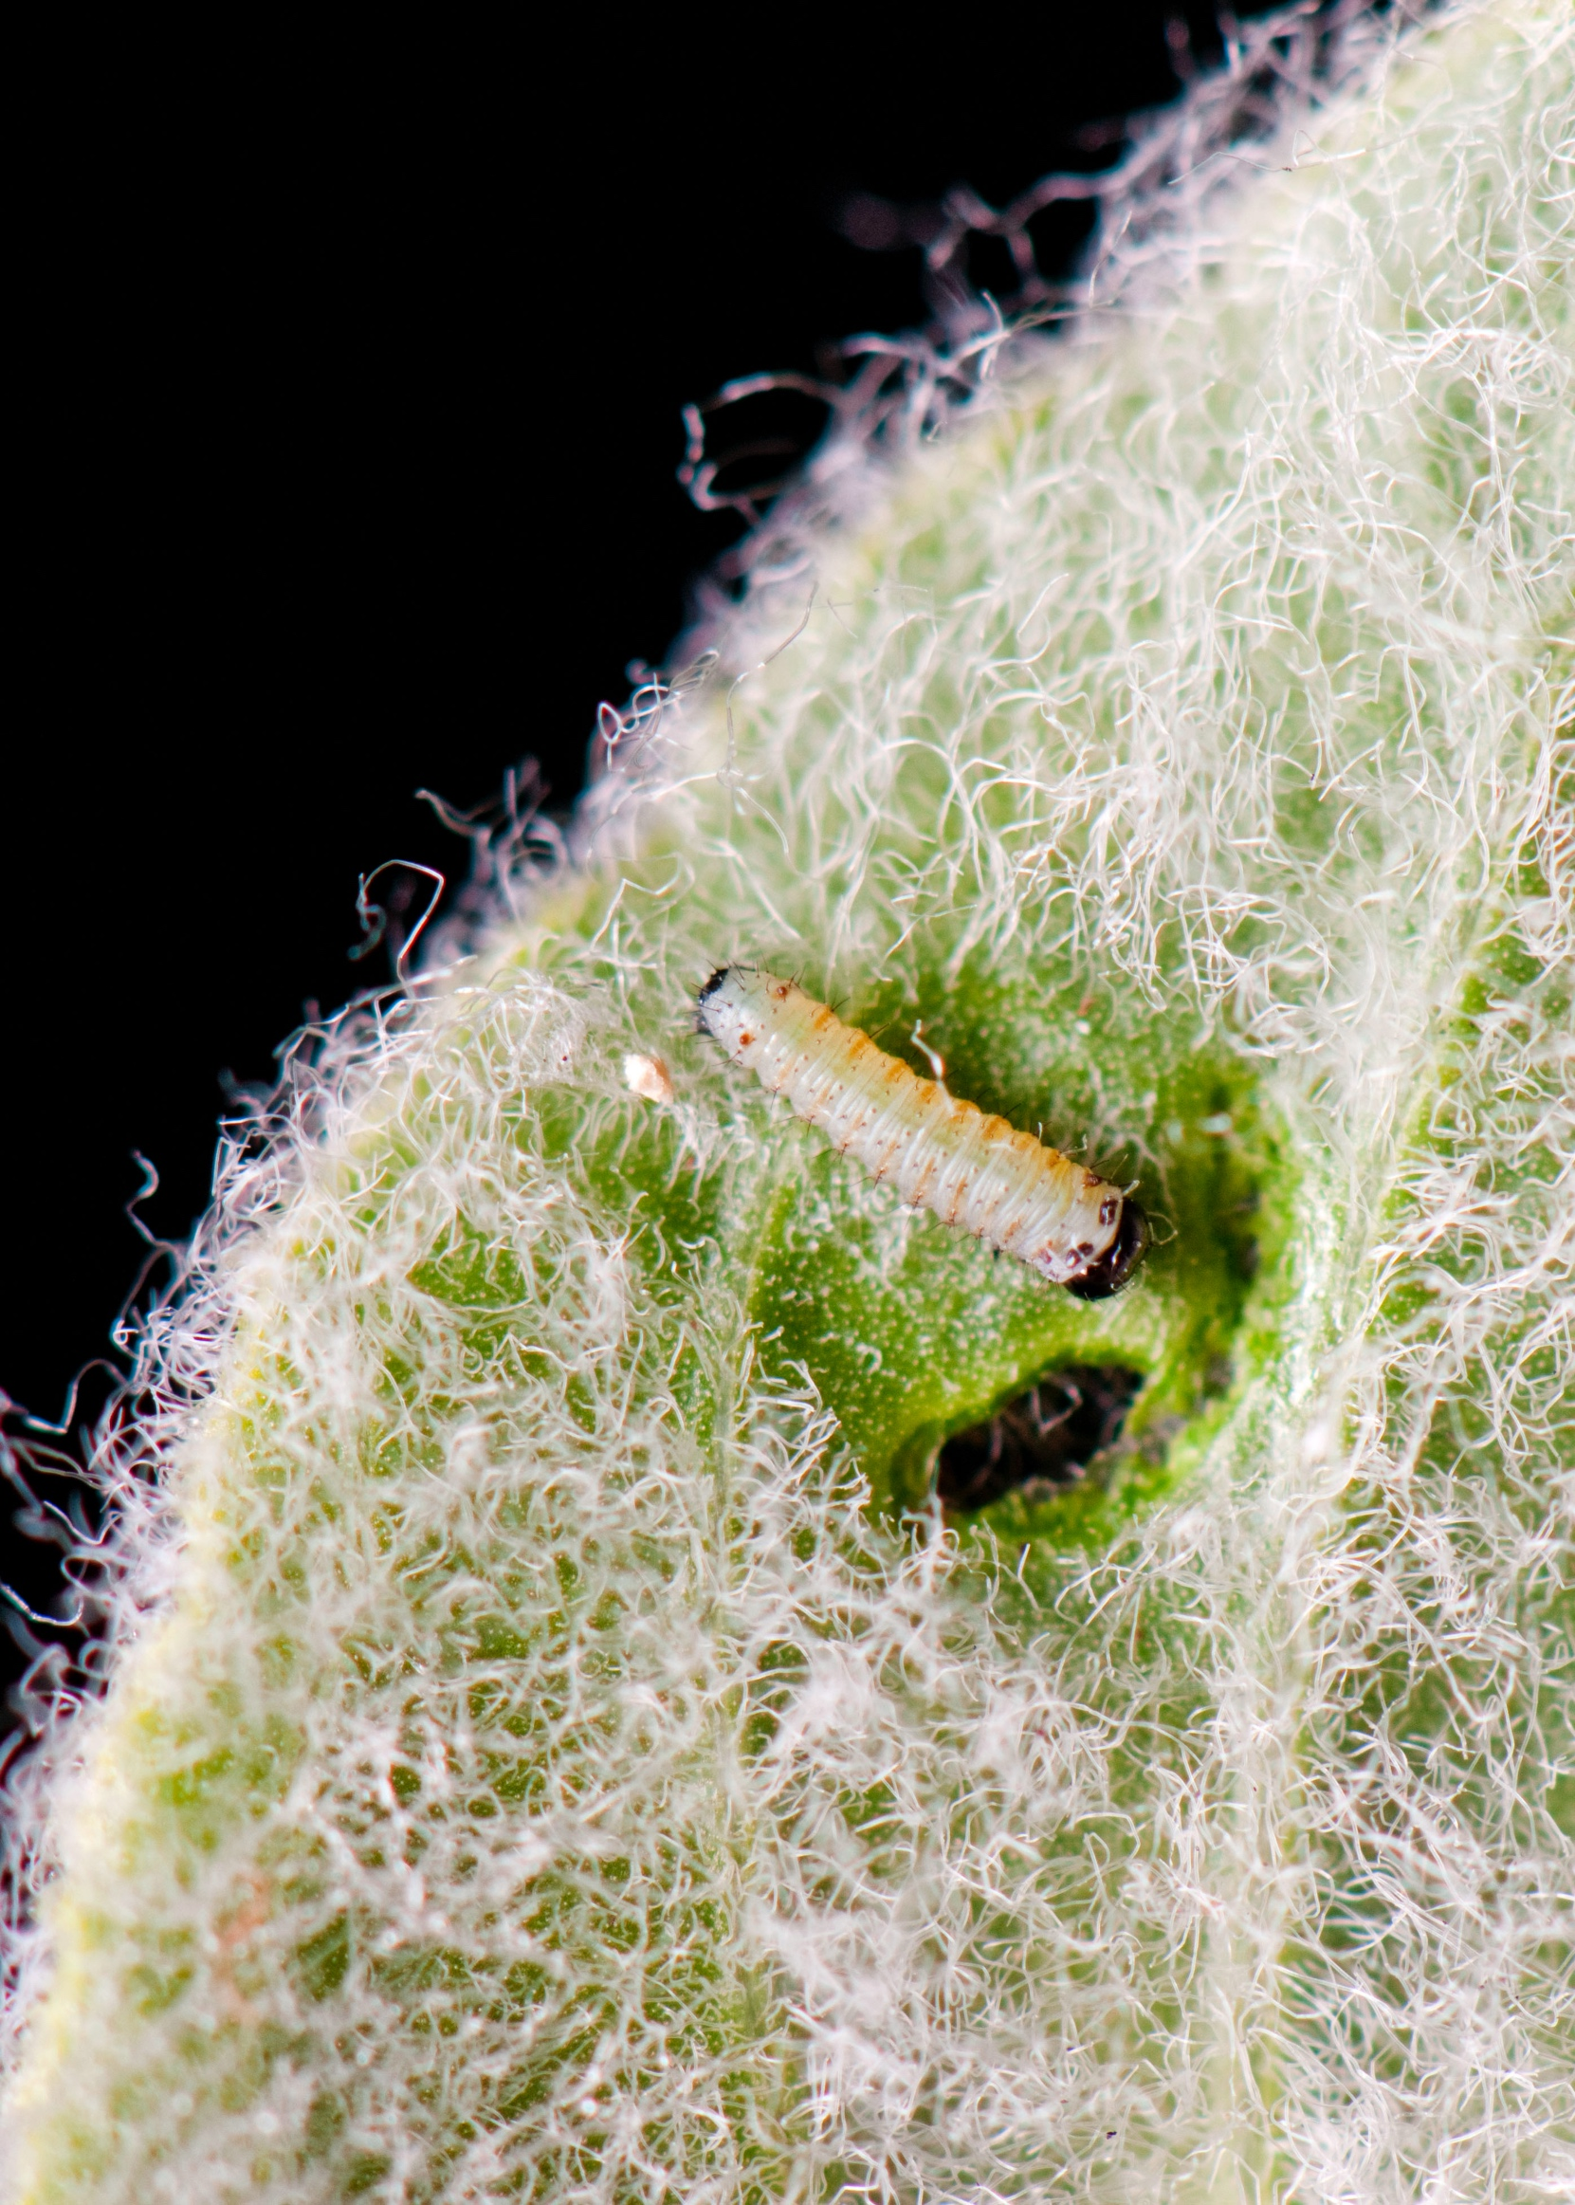
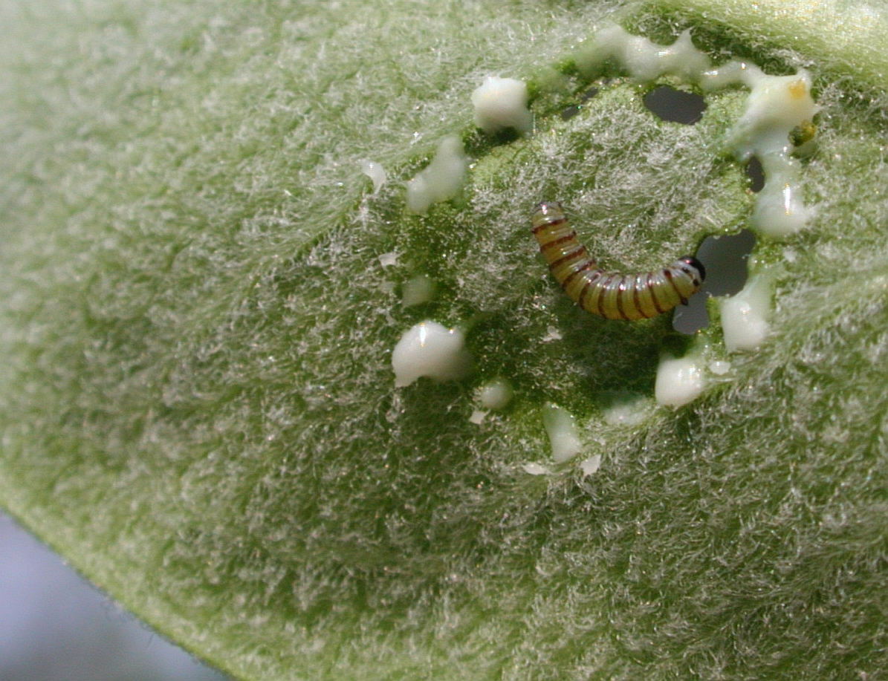
Trichomes
Notes:
Trichomes – defense trait of milkweeds against monarchs

Slide 5
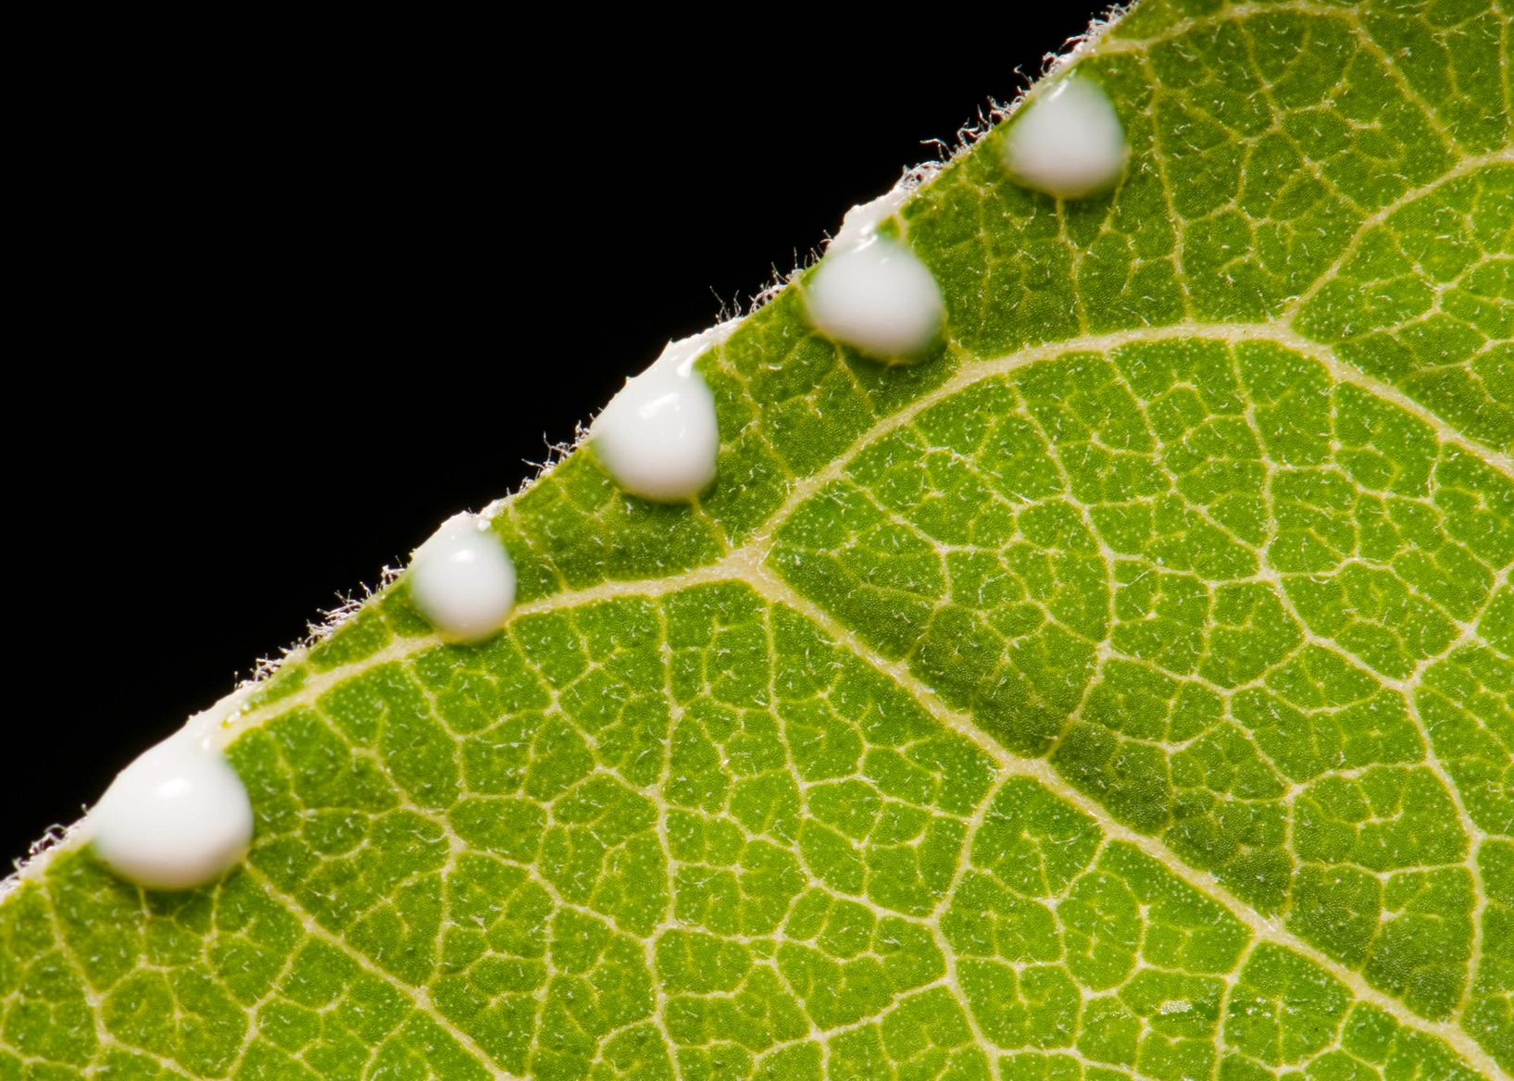
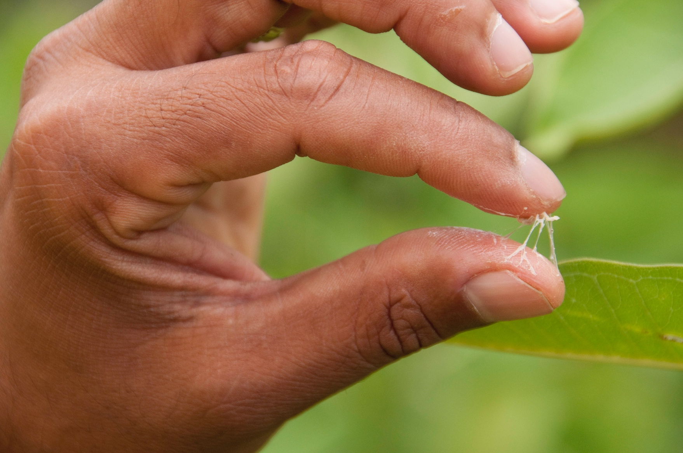
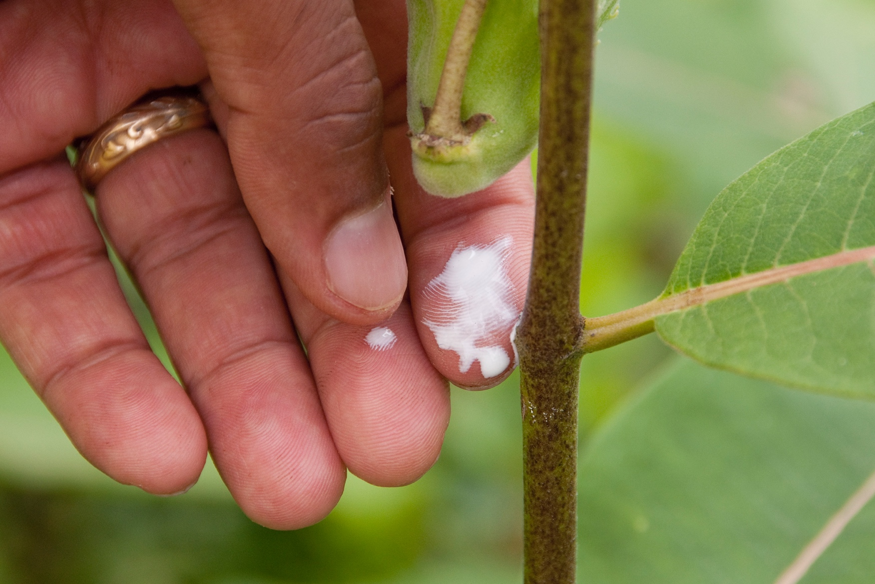
Latex
Notes:
Latex – defense trait of milkweeds against monarchs

Slide 6
Cardiac glycosides
Notes:
Cardiac glycosides – defense trait of milkweeds against monarchs

Slide 7
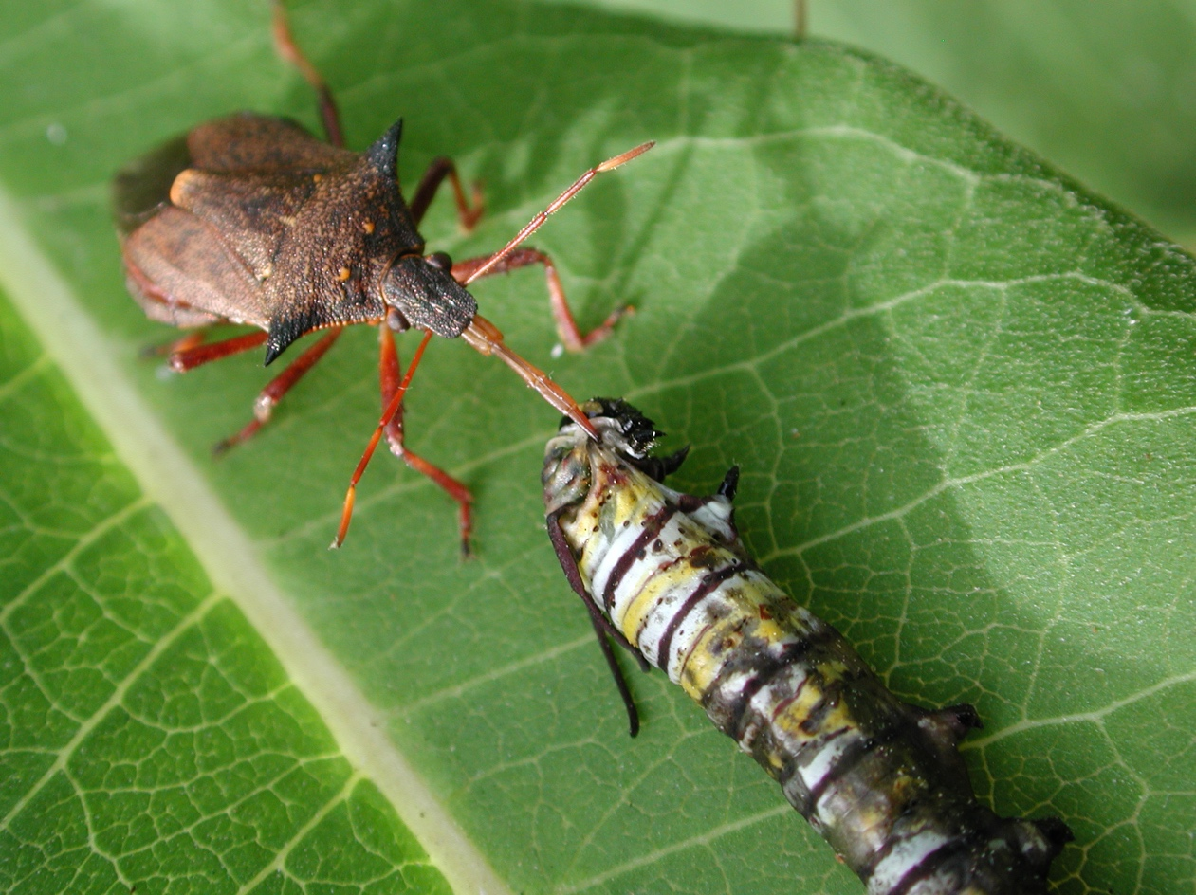
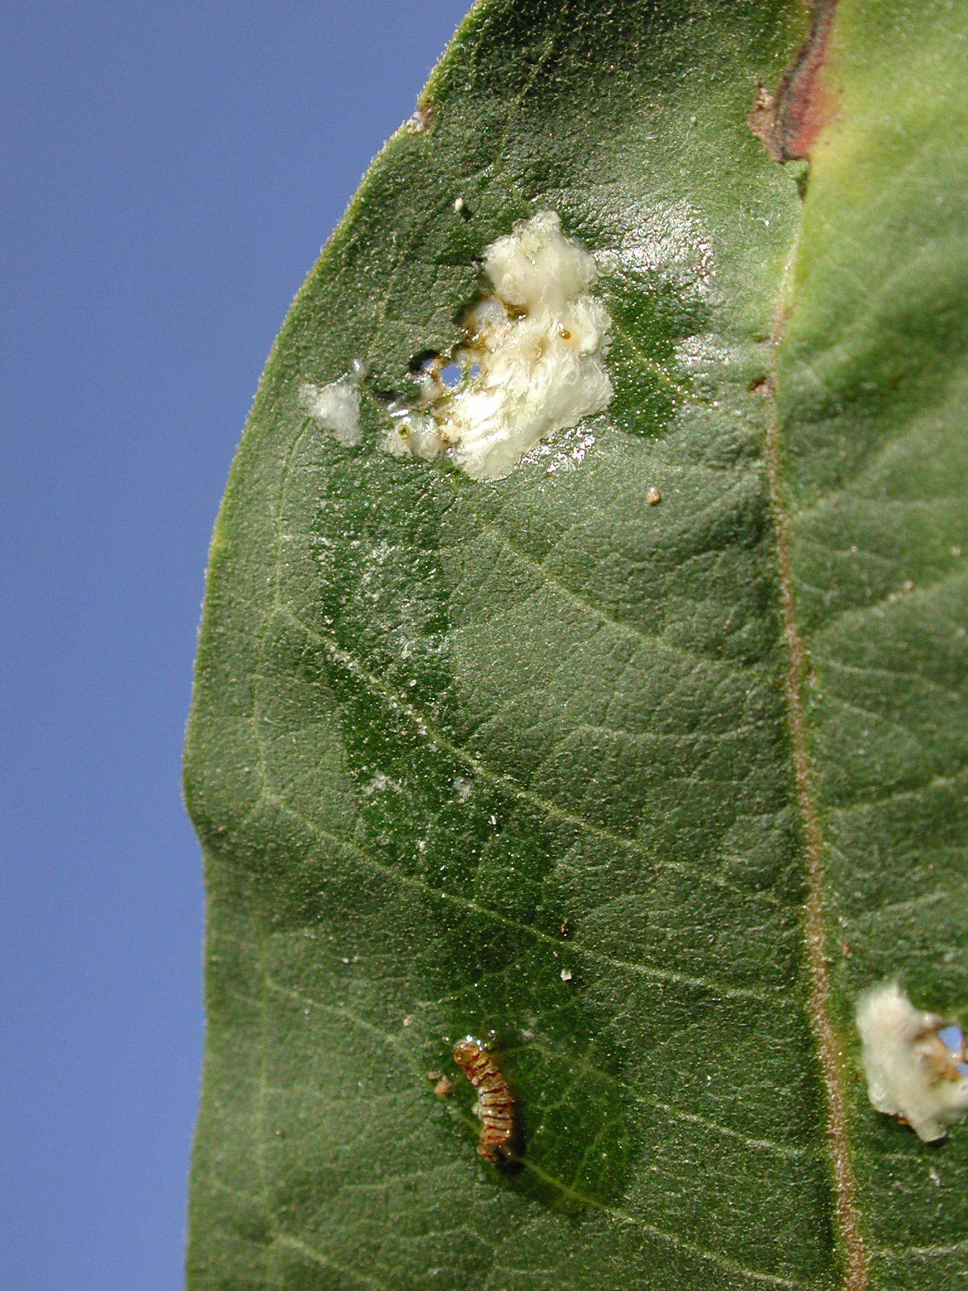
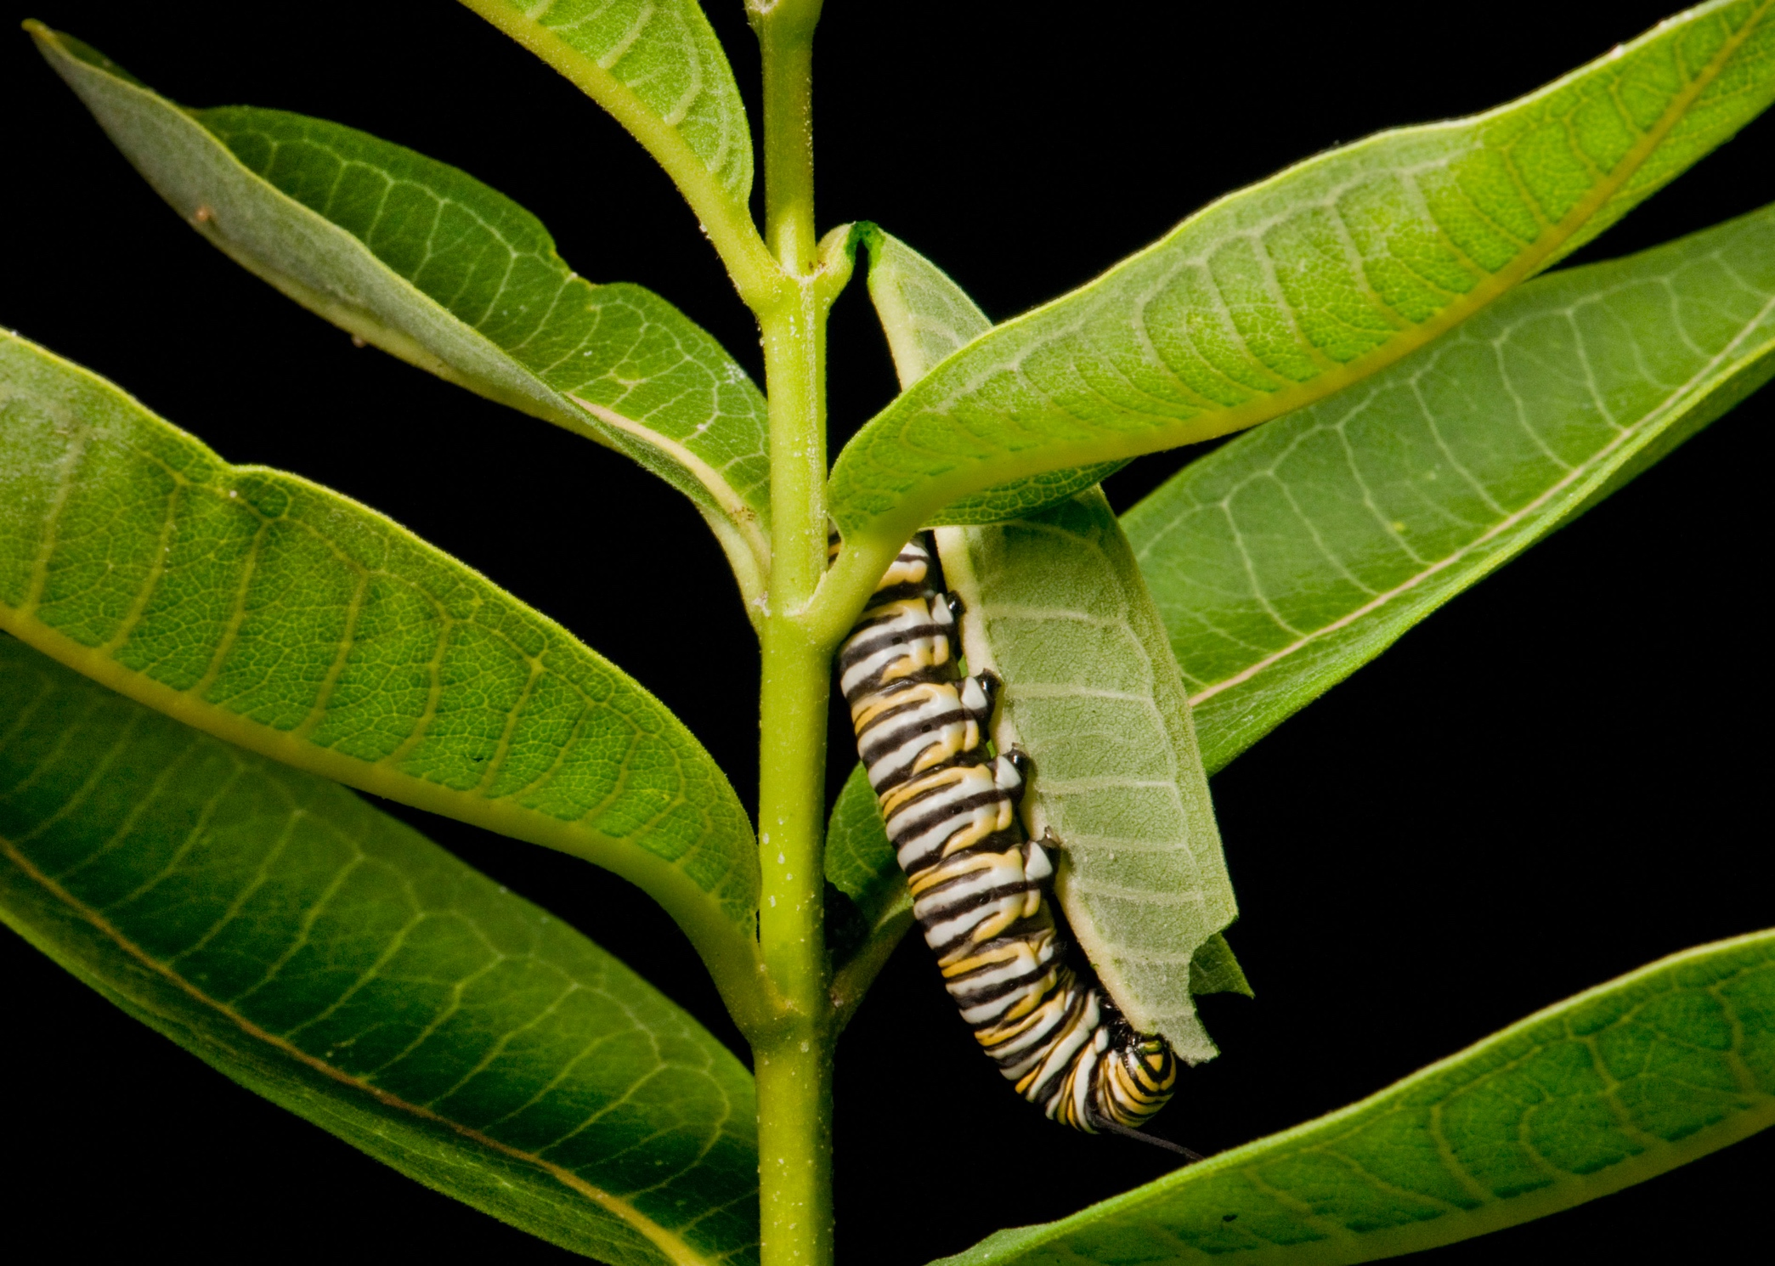
Caterpillar behavior
Notes:
Top left shows a stinkbug predator eating a monarch.
Bottom left shows a monarch cutting the stem to prevent latex from flowing into the leaf.
Photo on right shows a dead monarch that drowned in latex.

Slide 8
Notes:
How they place monarch caterpillars on leaves

