Slide 1
How do the default forest regrowth values provided by the IPCC compare to ForC?

Slide 2
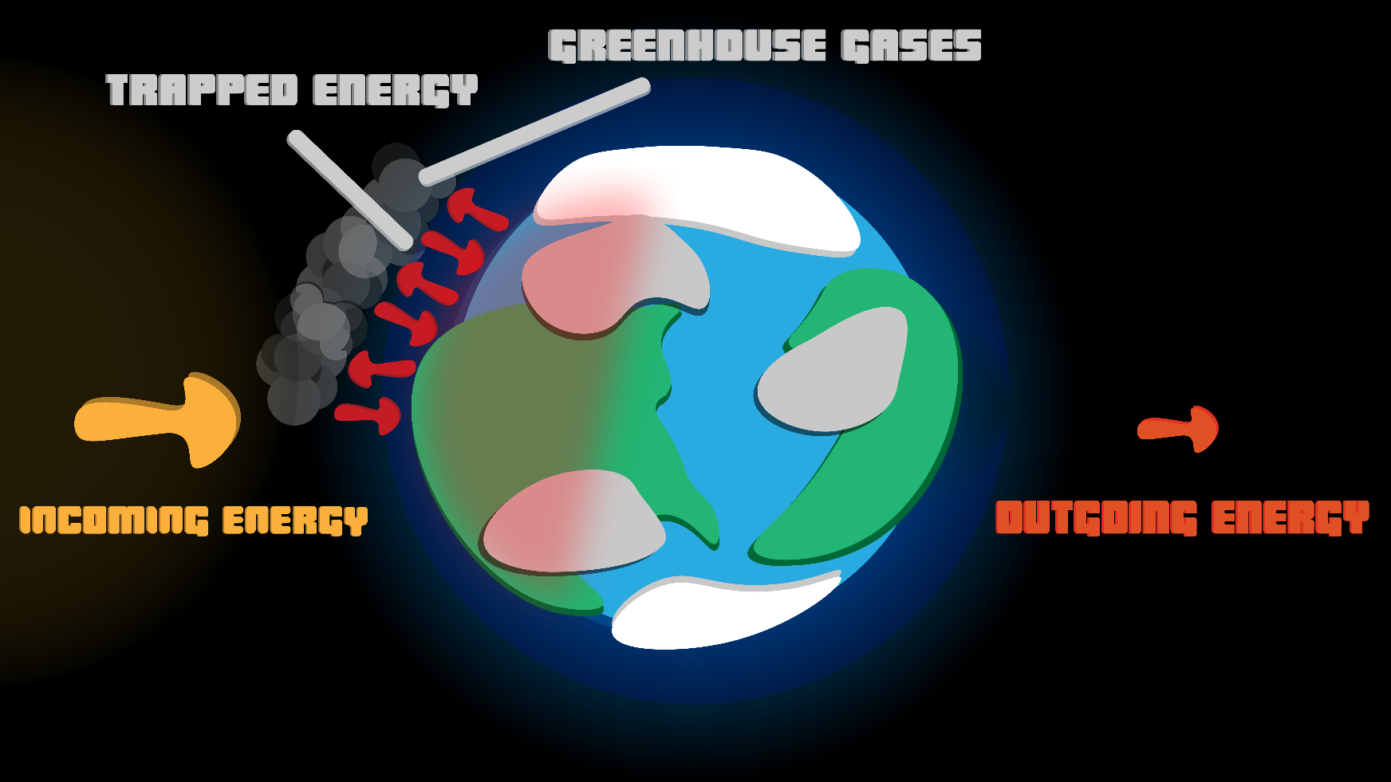
Global Warming
Average global temperatures are now warmer by about 1 °C (1.8 °F)
Greenhouse gases released by human activities keep heat trapped longer and cause global temperatures to rise, slowly but surely.
Notes:
Global warming, illustration by Habib Aina

Slide 3
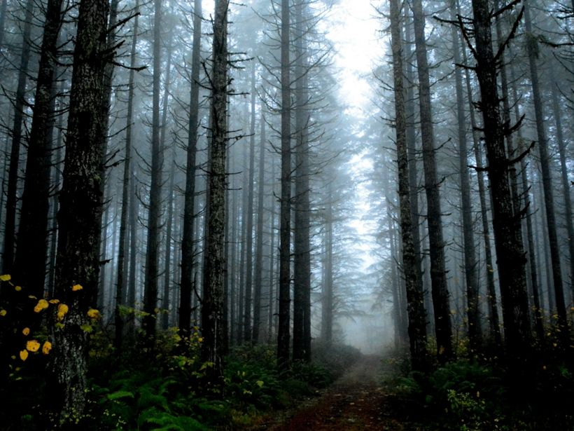
Carbon Accumulation
A natural or artificial process where carbon dioxide is removed from the atmosphere and held in solid or liquid form.
Regrowing forests can absorb carbon quickly
Notes:
FOREST REGROWTH IN OREGON Forest regrowth after a fire in Sweet Home, OR. This photo was entered into The Nature Conservancy's 2018 Photo Contest. © Cindy Christina

Slide 4
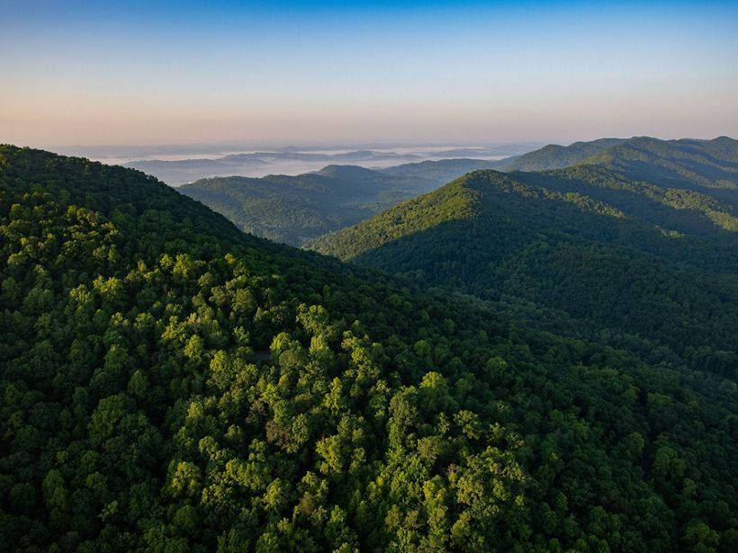
Forest Regrowth
Letting forests regrow naturally has the potential to absorb up to 8.9 billion metric tons of carbon dioxide from the atmosphere each year through 2050
That’s the equivalent of soaking up one-quarter of global fossil fuel emissions from the atmosphere every year.
Notes:
CUMBERLAND GAP Aerial photograph of the Cumberland Gap in Kentucky, USA. © Cameron Davidson

Slide 5
Precision vs Accuracy
Accuracy is how close a measurement is to the “true” value.
Precision is how close measurements of are to each other.
Precision is independent of accuracy
In this study, Kristina and Susan are specifically studying the precision of the values generated by ForC compared to those provided by the IPCC, in different forest types.

Slide 6
Intergovernmental Panel on Climate Change
The IPCC is an intergovernmental body of the United Nations established in 1988
Its primary purpose is to provide objective information relevant to human-induced climate change.
Includes: Research, Policy Recommendations, Economic Impacts, Risks, Possible Response options, etc.
2019 refinement of forest carbon accumulation
This is the report that produced the default forest carbon accumulation values
Notes:
https://www.ipcc.ch/report/2019-refinement-to-the-2006-ipcc-guidelines-for-national-greenhouse-gas-inventories/

Slide 7
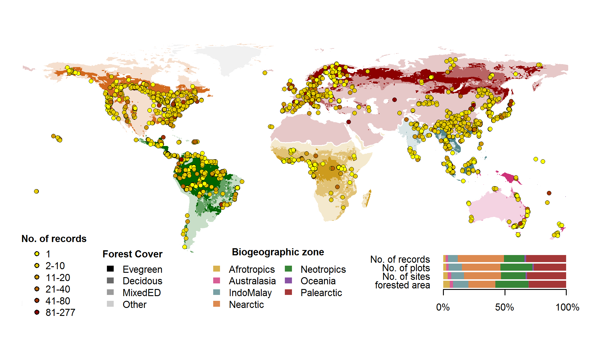
ForC: The Forest Carbon database
ForC is an open-access database containing over 40,000 records from 10,000 plots in 1,500 distinct areas.
Notes:
https://forc-db.github.io/,

Slide 8
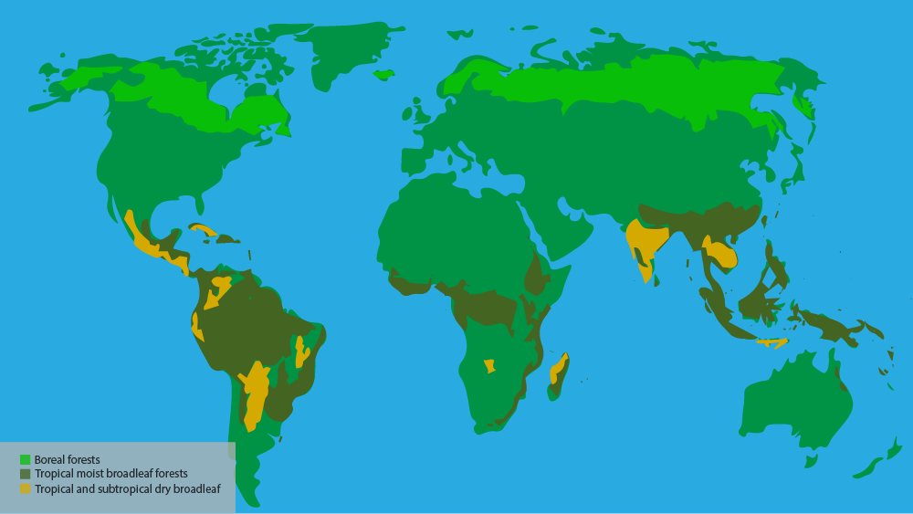
Study Site Locations
Notes:
Illustration by Habib Aina

Slide 9
Stepping Back to Move Forward
Letting previously forested land recover carbon naturally can contribute to the 730 billion metric tons of carbon dioxide the IPCC says must be removed from the atmosphere by the end of this century to avert the worst impacts of climate change.
Increasing forest cover can also bring additional benefits beyond climate change mitigation, such as preventing floods, regulating rainfall, slowing biodiversity loss, and sustaining traditional ways of life and economies.
Equipped with a more detailed understanding of forests’ potential to capture carbon, officials can make rapid assessments on how to best use land for the greatest climate return.
Notes:
https://www.globalforestwatch.org/

Slide 10
Mapping Carbon Accumulation
Notes:
The following maps are designed to highlight some parts of the world that can benefit from natural forest regrowth. Check out the link above to create your own map. These slides are merely screen shots of the larger map. You can have students explore the map and determine some of the best places in the world to reforest. Remember to focus on the legend. The darker green, the more carbon accumulation potential

Slide 11
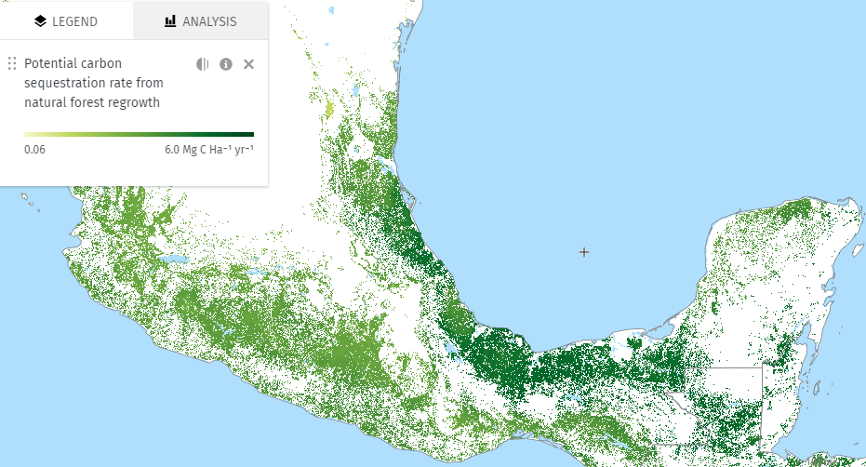
Notes:
Southern Mexico

Slide 12
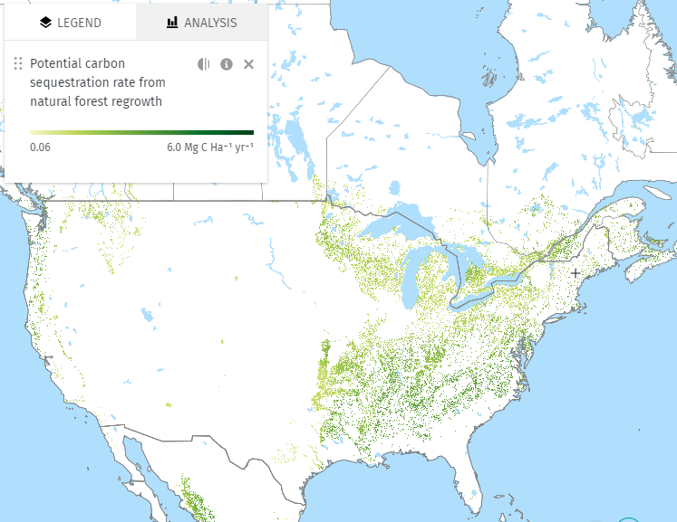
Notes:
Contiguous United States and Southern Canada

Slide 13
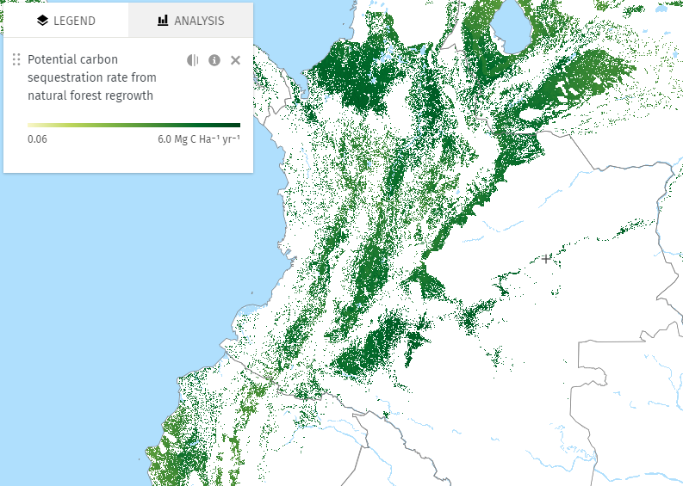
Notes:
Colombia

Slide 14
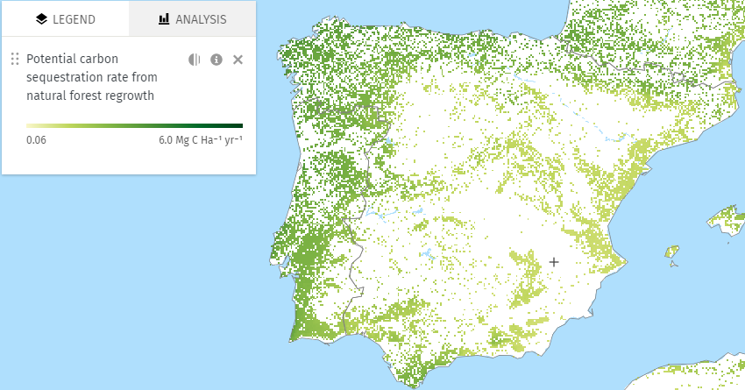
Notes:
Spain and Portugal

Slide 15
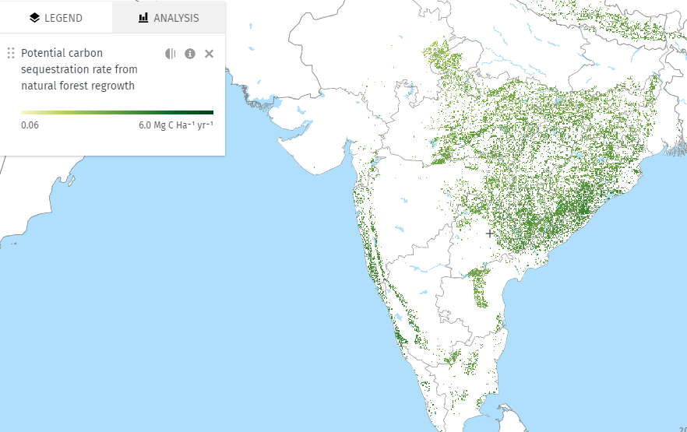
Notes:
India

Slide 16
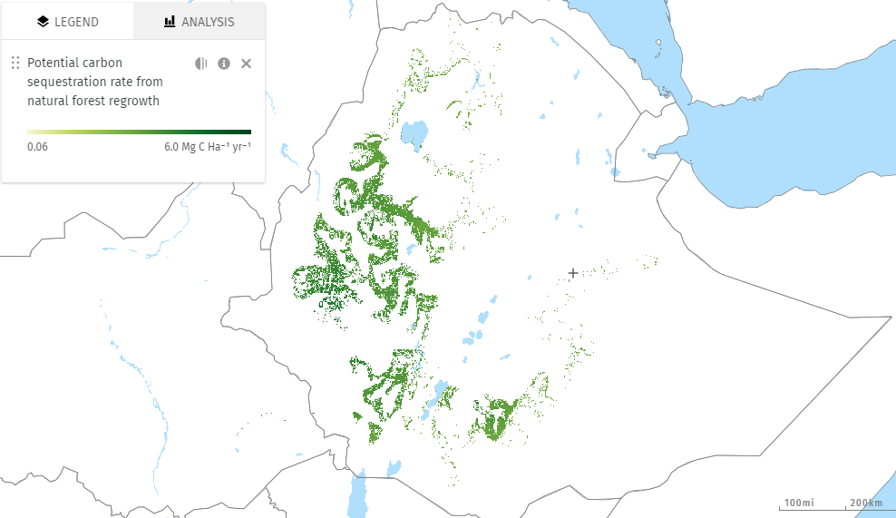
Notes:
Ethiopia

Slide 17
Acknowledgements
We would like to thank the following organizations for providing funding to make this endeavor possible

