Slide 1
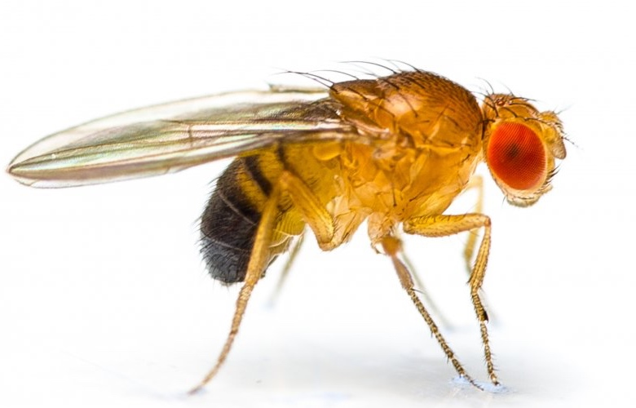
Stop that oxidation! What fruit flies can teach us about human health
Data Nuggets
Featured scientist: Biz Turnell from Technische Universität Dresden

Slide 2
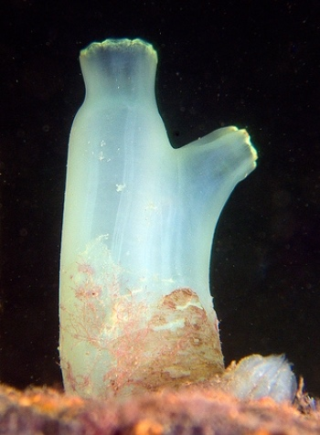
Sea squirts (left) have the alternative oxidase (AOX) gene that lets their mitochondria make fewer reactive oxygen species (ROS).
Fruit flies (below) do not naturally have the gene.

Slide 3
Laboratory fruit flies in their “natural habitat”: a plastic vial

Slide 4
Biz’s colleague Cornelia Wetzker, hard at work in the fly lab
Notes:
Biz’s colleague Cornelia Wetzker, hard at work in the fly lab

Slide 5
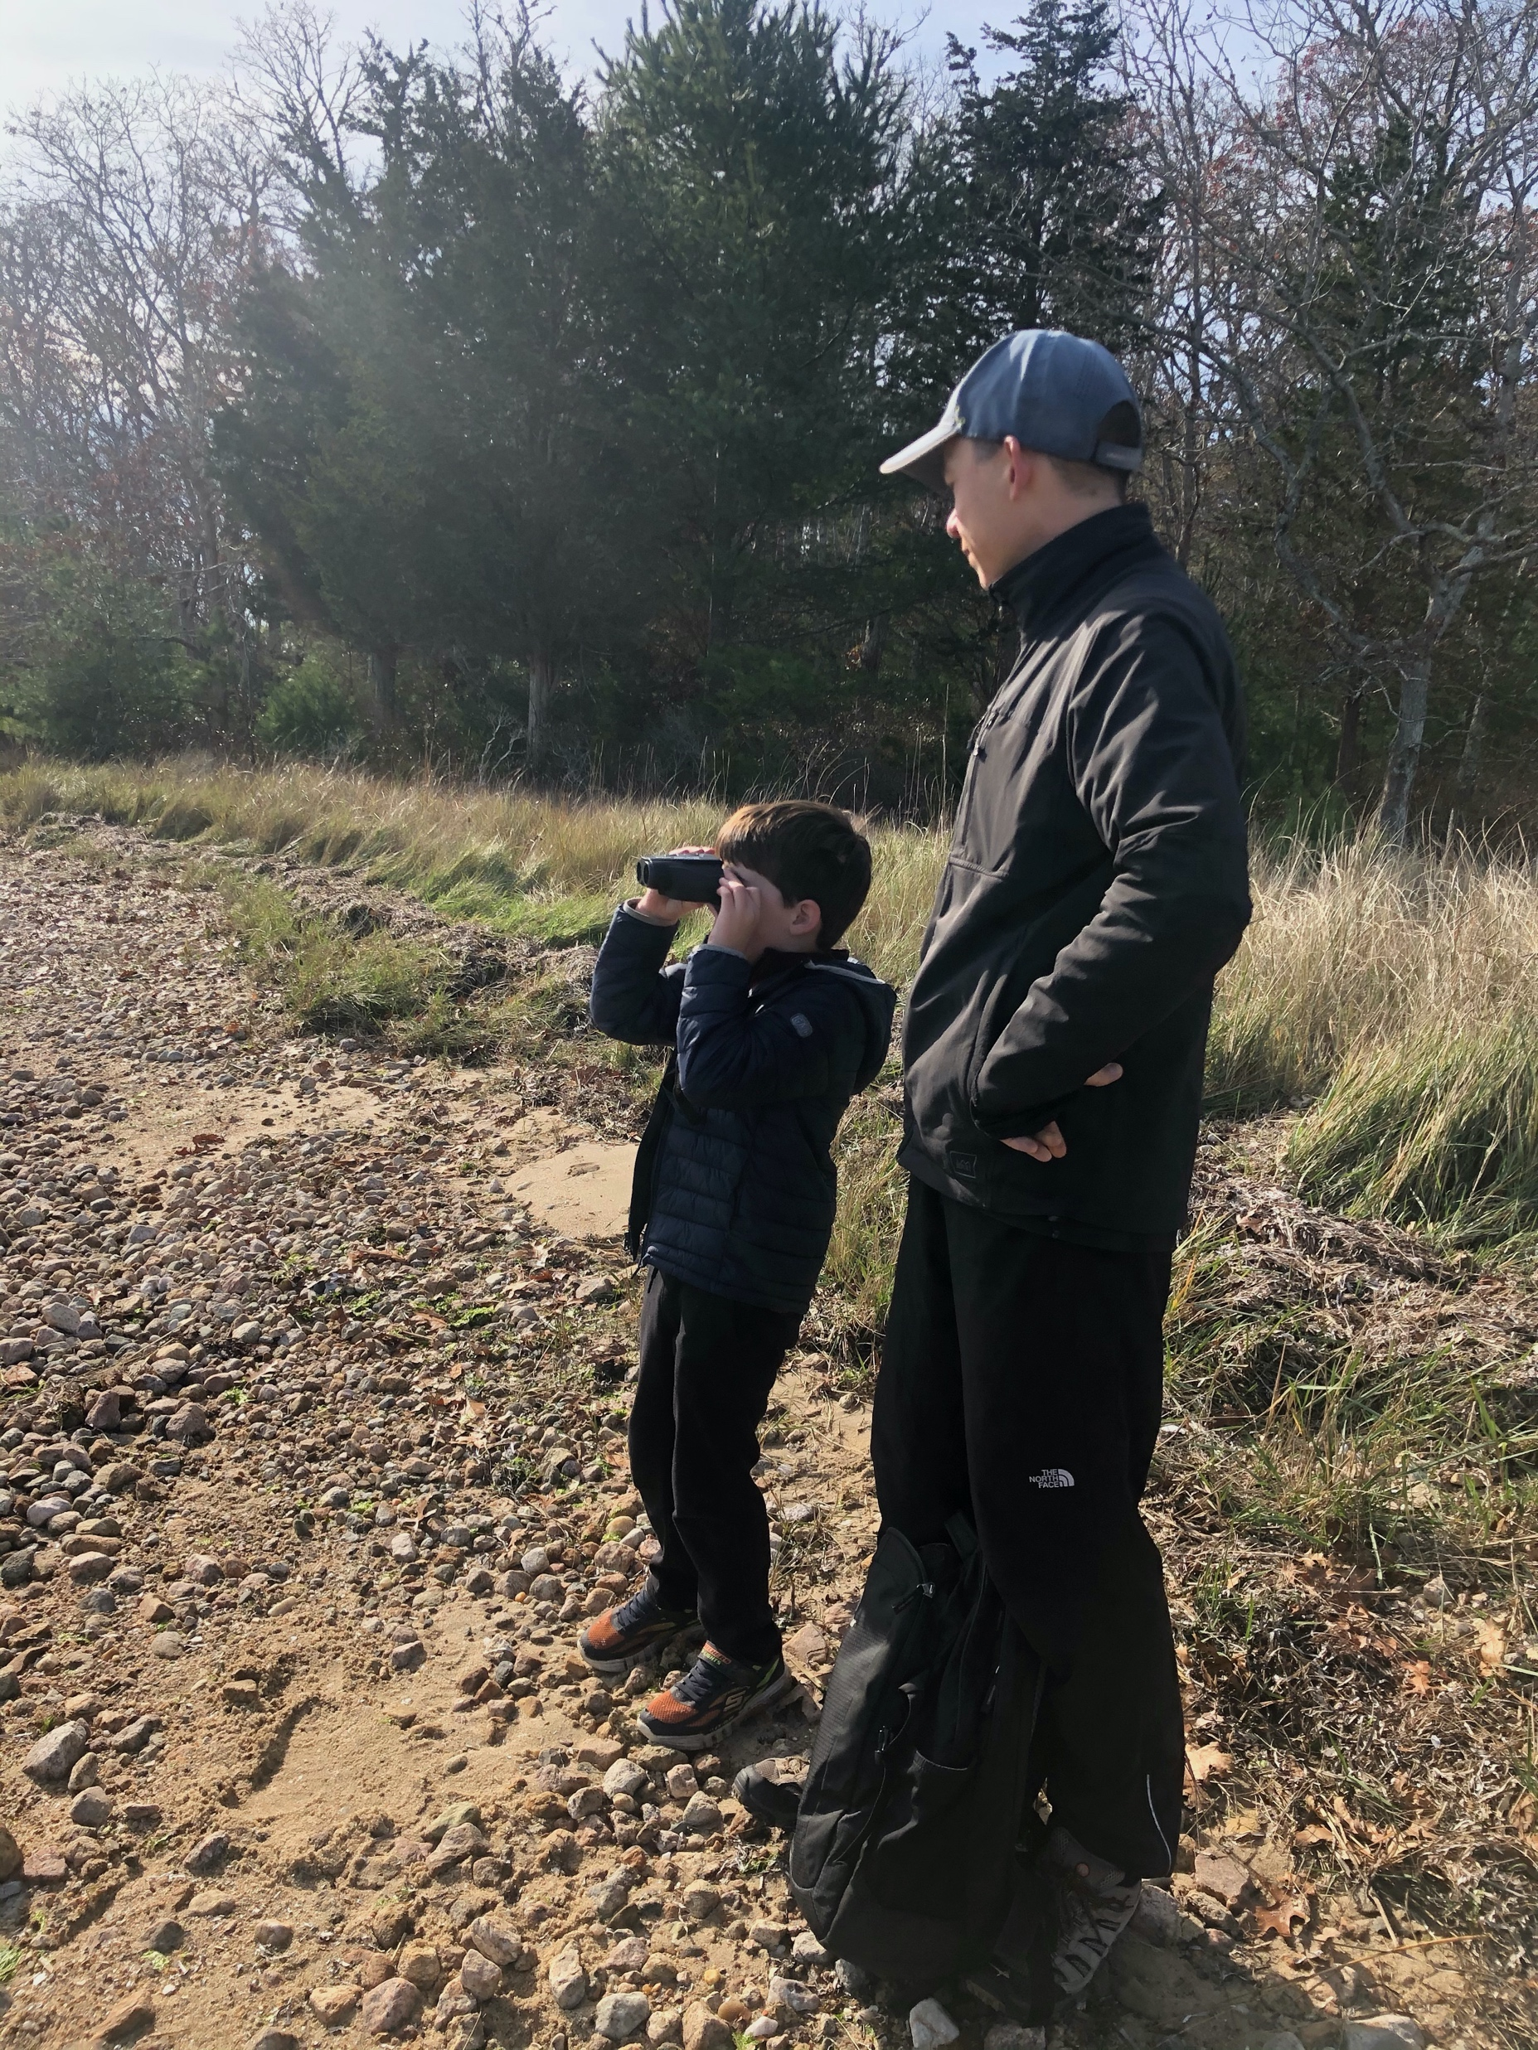
Biz with one of their favorite scientists in training
Notes:
Biz with one of their favorite scientists in training

