Slide 1
Fertilizer and fire change microbes in prairie soil
Featured Scientists: Lydia Zeglin and Christine Carson from the Konza Prairie Biological Station. Written By: Jaide Allenbrand
Notes:
http://lter.konza.ksu.edu/konza-prairie-long-term-ecological-research-lter

Slide 2
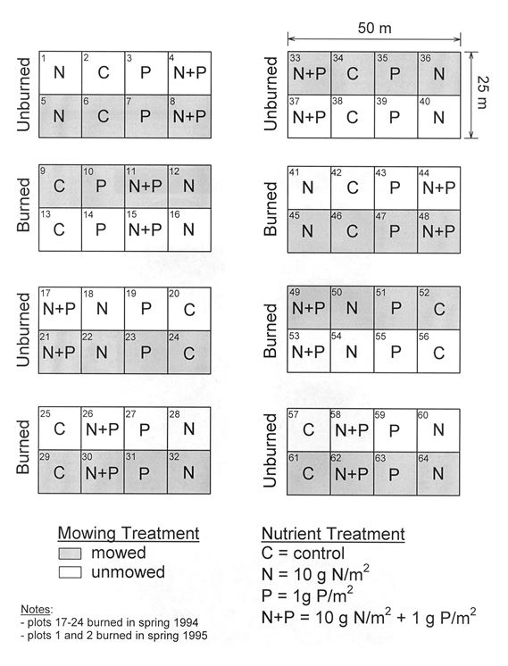
Notes:
The data from this experiment come from the Konza Prairie Biological Station. The experiment was set up in 1986 and the treatments were applied at the field site every year until 2017! Lydia and Christine focused on the fertilizer (nitrogen) addition and prescribed burning treatments to answer their questions. The nitrogen treatment had eight plots where nitrogen had been added and eight with no nitrogen as a control. Similarly, the prescribed burn treatment was applied to eight plots, while eight plots had no burning as a control. These two treatments were also crossed with each other, meaning that some plots were burned and nitrogen was added.

Slide 3
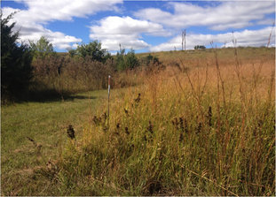
These are two different experimental plots within the large field experiment at Konza Prairie Biological Station. The one with lots of trees is an unburned plot, the one with lots of grass is a burned plot.
Notes:
These are two different experimental plots within the large field experiment at Konza Prairie Biological Station. The one with lots of trees is an unburned plot, the one with lots of grass is a burned plot.

Slide 4
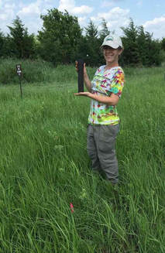
Christine collecting samples from the experimental plots to measure root growth.
Notes:
Christine collecting samples from the experimental plots to measure root growth.

Slide 5
