Slide 1
How does carbon sequestration from natural forest regrowth differ around the world?
Notes:
Ask students for input and predictions (not necessarily hypotheses yet)

Slide 2
Photosynthesis
$$6{CO}_{2}+{6H}_{2}O+Energy→ C_{6}H_{12}O_{6}+6O_{2}$$
Cellular Respiration
$$C_{6}H_{12}O_{6}+6O_{2}→{6H}_{2}O+6{CO}_{2}+Energy$$
Notes:
Review the formulas for photosynthesis and cellular respiration, make sure to discuss their connections

Slide 3
Biological Carbon Cycle
Carbon enters all food webs, both terrestrial and aquatic, through autotrophs (usually through photosynthesis)
Heterotrophs consume the organic molecules, and the organic carbon is passed through food chains and webs.
Carbon is released back into the atmosphere through cellular respiration
Producers, Consumers, Decomposers
Notes:
Carbon can cycle quickly through this biological pathway, especially in aquatic ecosystems. Overall, an estimated 1,000 to 100,000 million metric tons of carbon move through the biological pathway each year. For context, a metric ton is about the weight of an elephant or a small car
(photo - https://commons.wikimedia.org/wiki/File:Giant_Panda_Eating.jpg, by Chen Wu from Shanghai, China)

Slide 4
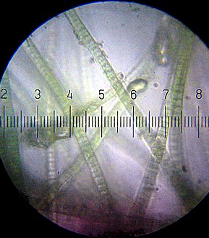
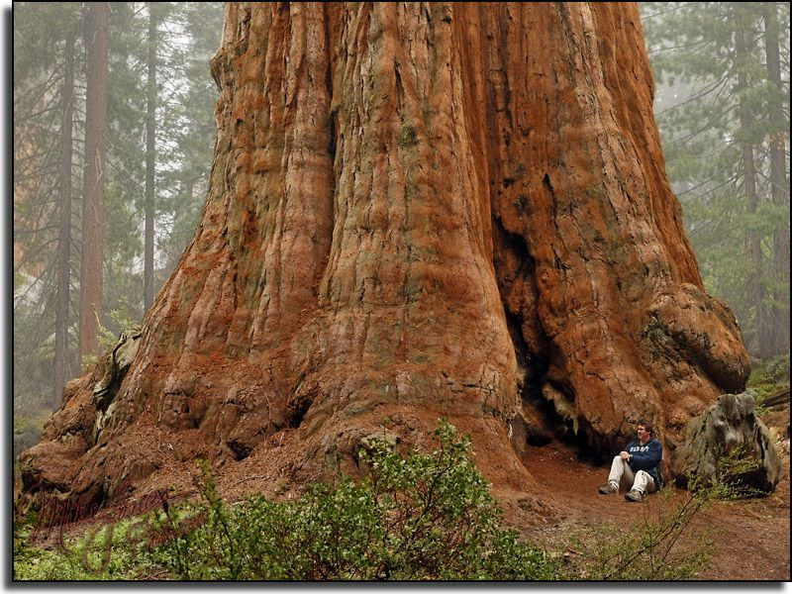
Carbon fixation: the conversion of inorganic carbon (carbon dioxide) to organic compounds by living organisms
Carbon sequestration: a natural or artificial process where carbon dioxide is removed from the atmosphere and held in solid or liquid form.
Notes:
Photos courtesy of Wikipedia commons, basic difference between carbon fixation (the algae) and carbon sequestration (the giant redwood)

Slide 5
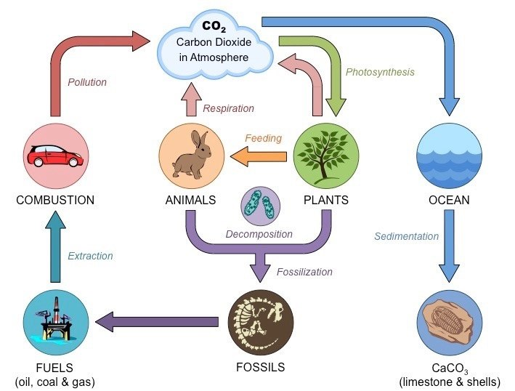
Notes:
Ask for input on the carbon cycle, review the basic process of global warming (where Carbon Dioxide in the atmosphere traps heat causing the global temperature to rise)
(photo credit - https://www.noaa.gov/education/resource-collections/climate/carbon-cycle)

Slide 6
Notes:
This shows fluctuations in carbon stocks. Note that most carbon is cycled through the forest and a small percentage overall is actually put into the forest sink. A negative number means carbon is being pulled from the atmosphere and a positive number means it’s being released.
(photo credit – painting by Kristina Anderson-Teixeira, text by Valentine Hermann)

Slide 7
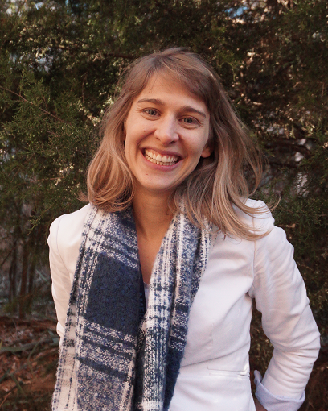
Dr. Susan Cook-Patton
She studies the importance of plant diversity and how changes in climate and biodiversity impact the health of natural and urban ecosystems.
She is a forest restoration scientist for The Nature Conservancy

Slide 8
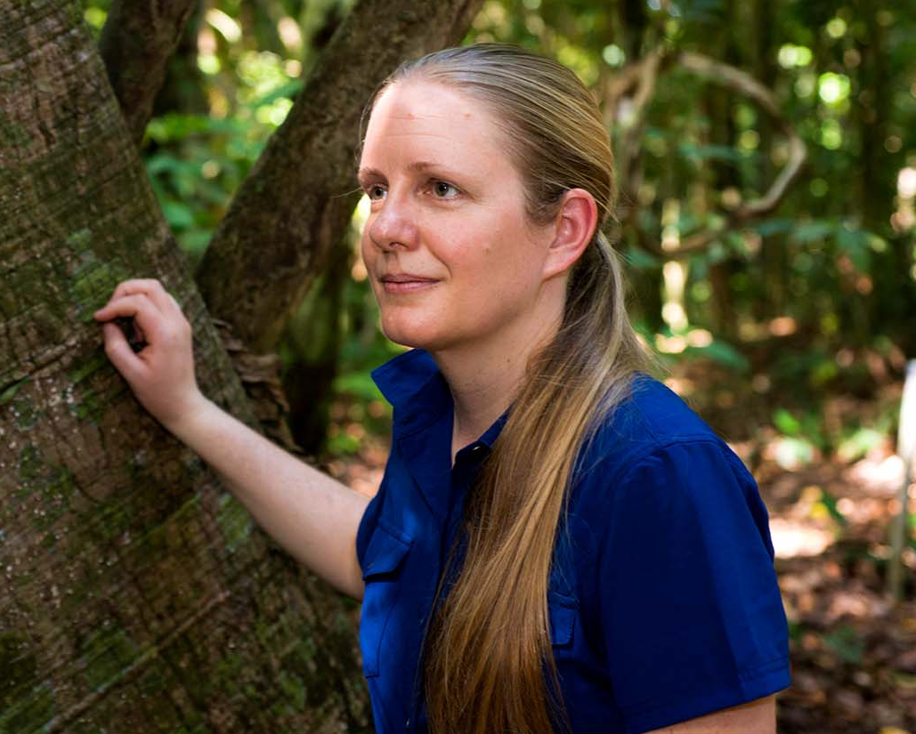
Dr. Kristina Anderson-Teixeira
She studies forest ecosystem ecology, global change ecology, and climate protection through forest conservation.
She leads the Ecosystems & Climate Research Initiative for the Center for Tropical Forest Science-Forest Global Earth Observatory (CTFS-ForestGEO),

Slide 9
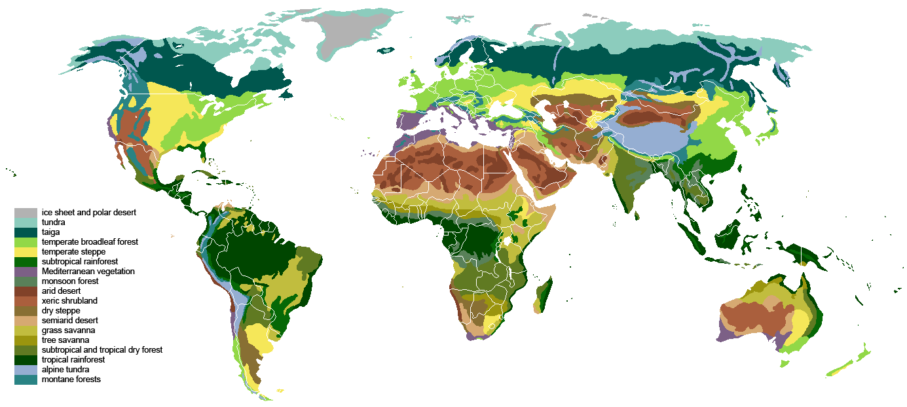
Biome: A distinct community of plants and animals occupying a specific environment
Notes:
Biomes around the world, photo credit Ville Koistinen, Wikipedia commons https://commons.wikimedia.org/wiki/File:Vegetation.png. Though there are many biomes, our study focuses on four: Boreal forests, Temperate forests, Subtropical forests, and Tropical forests

Slide 10
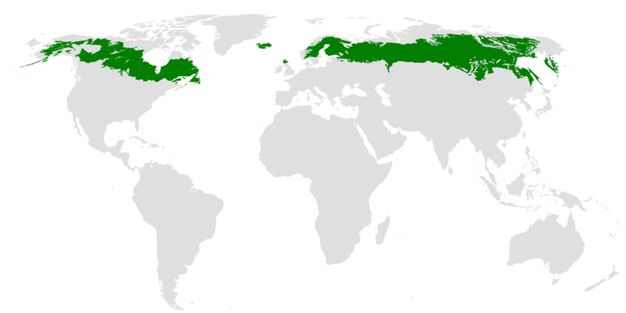
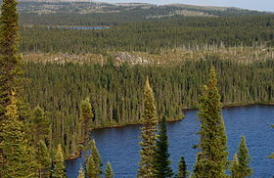
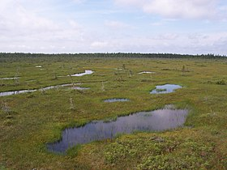
Boreal Forest
Found only in the Northern Hemisphere
Forest is comprised mostly of conifers such as spruce, jack pine, tamarack, and fir along some deciduous trees
Temperatures are generally cool and drop considerably in the winter. Very little rainfall.
Notes:
Photo credits: Wikipedia Commons https://upload.wikimedia.org/wikipedia/commons/thumb/5/5d/Taiga_ecoregion.png/800px-Taiga_ecoregion.png
ALL maps: By Terpsichores - Own work, CC BY-SA 3.0, https://commons.wikimedia.org/w/index.php?curid=22441315

Slide 11
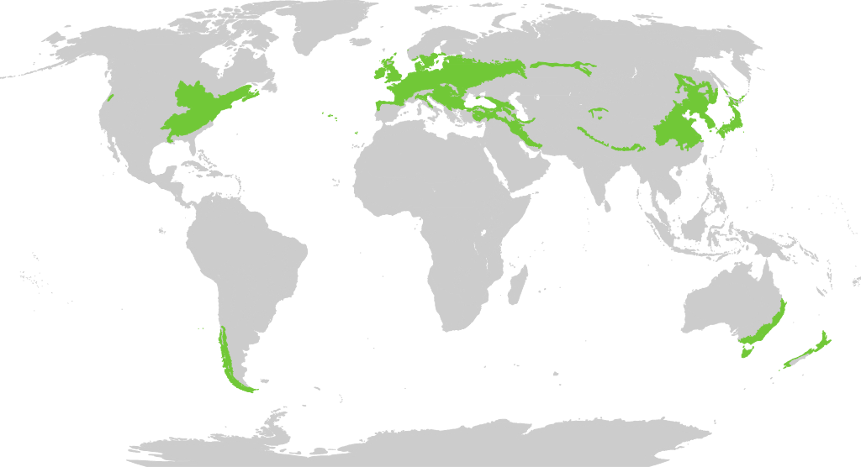
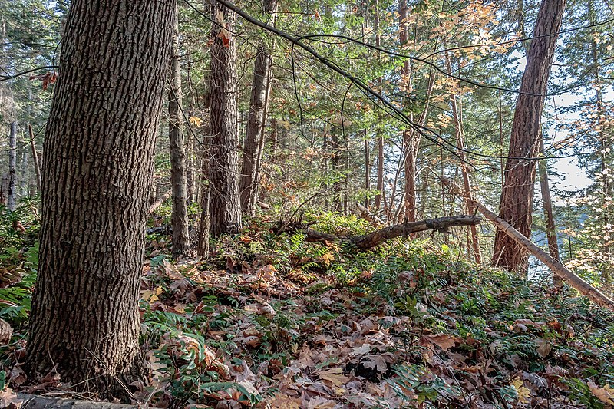
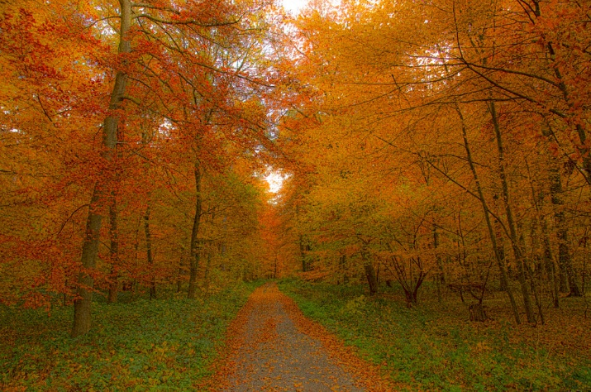
Temperate broadleaf Forest
Found in both the Northern and Southern Hemisphere
Forest is comprised mostly of deciduous trees that lose their leaves in the winter
Temperatures vary throughout the seasons with warm summers and cool winters. Generally moderate rainfall
Notes:
Photo credits: By Terpsichores - Own work, CC BY-SA 3.0, https://commons.wikimedia.org/w/index.php?curid=22441317
By Norbert Nagel, Mörfelden-Walldorf, Germany - Own work, CC BY-SA 3.0, https://commons.wikimedia.org/w/index.php?curid=17255800

Slide 12
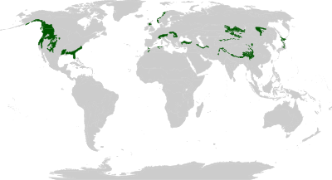
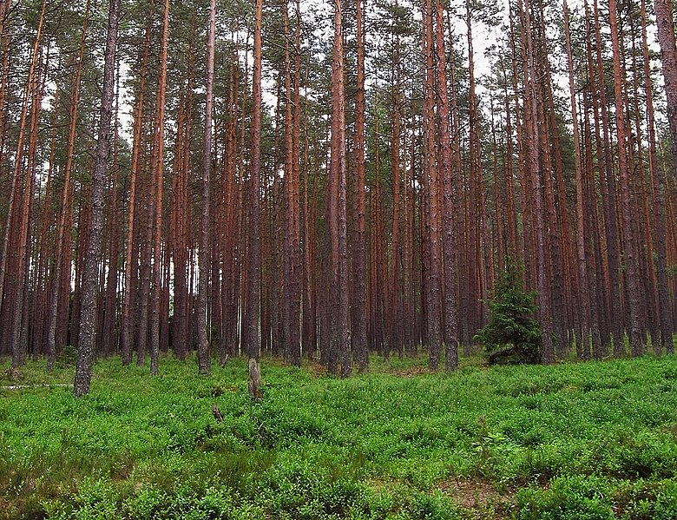
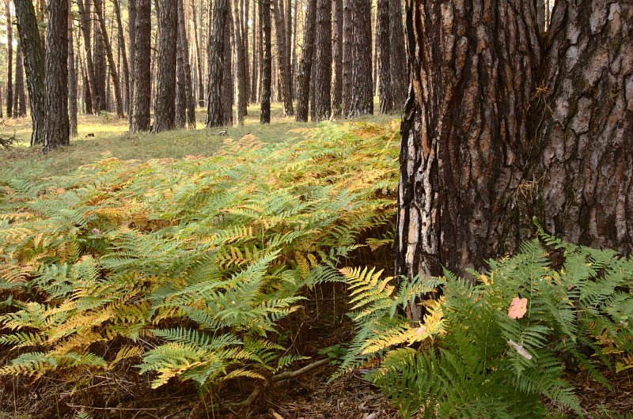
Temperate coniferous forest
Found only in the northern hemisphere
Forest is comprised mostly of evergreens with occasionally huge trees like giant sequoia
Temperatures generally include a moderate summer, cool winter. Rainfall varies by season.
Notes:
Photo credits: By Agnieszka Kwiecień
https://en.wikipedia.org/wiki/File:Las_sosnowy_swiezy02.jpg
By Doronenko
https://en.wikipedia.org/wiki/File:Bor_lowland_typical_forest.jpg

Slide 13
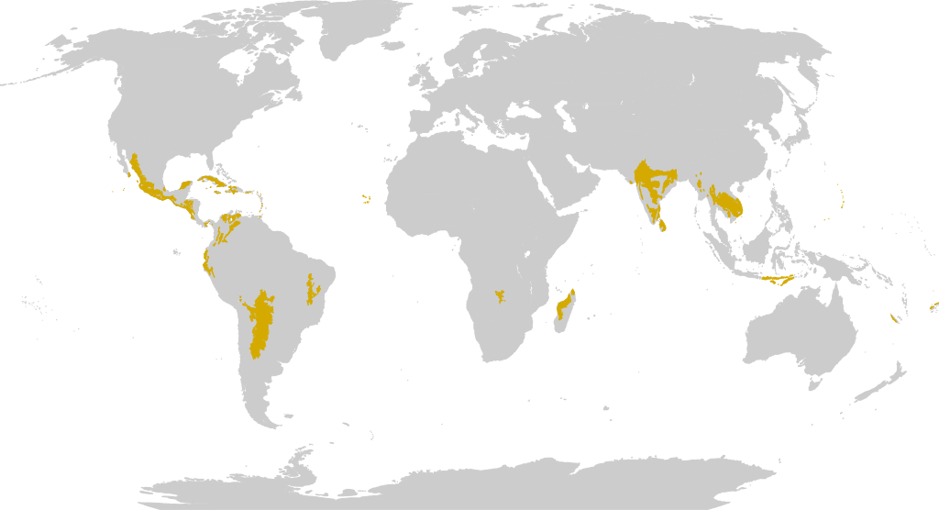
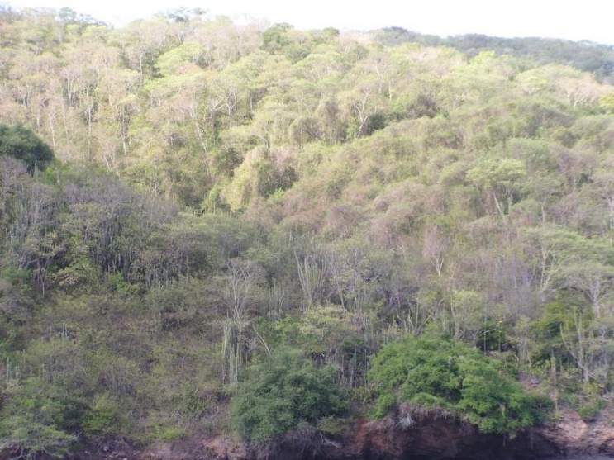
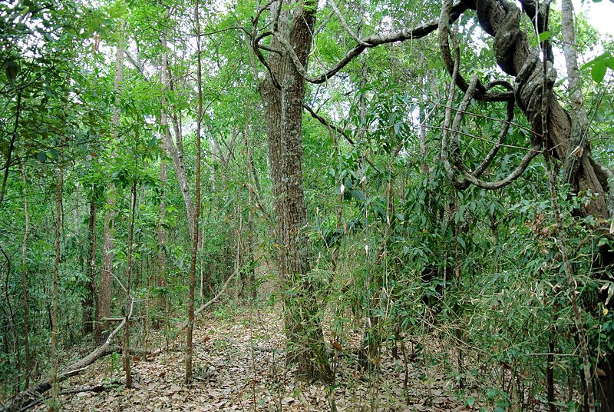
Tropical and Subtropical Dry Broadleaf
Found at tropical and subtropical latitudes in both the northern and southern hemispheres
Forest is dominated by deciduous trees that drop leaves in the dry season
Temperatures are warm year round with long dry periods that may last several months and vary globally
Notes:
Photo credits: By F.B. Lucas
https://en.wikipedia.org/wiki/File:Chacachacare_dry_forest_3.JPG
By Adbar
https://en.wikipedia.org/wiki/File:Subtropical_semi-evergreen_seasonal_forest_in_Northern_Thailand.JPG

Slide 14
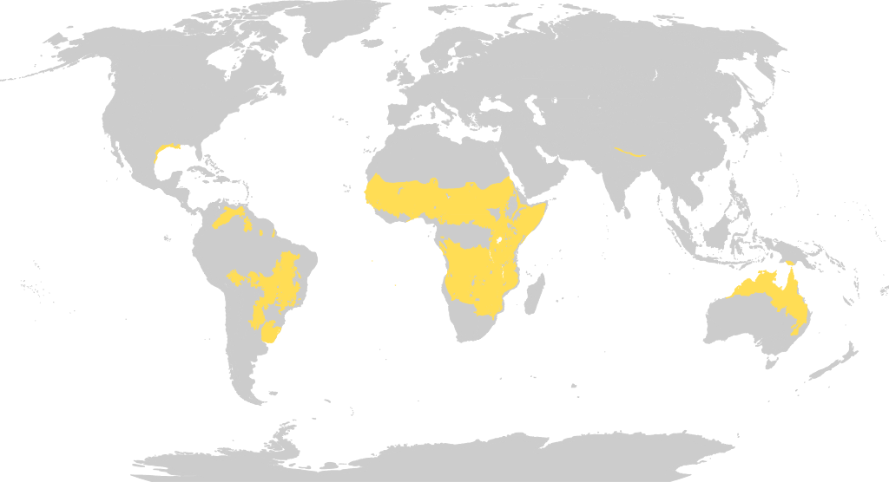
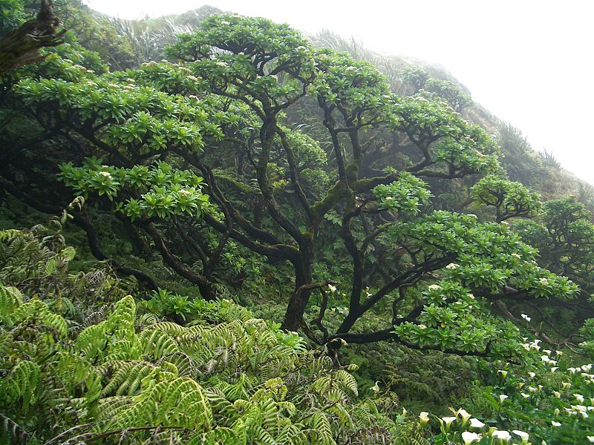
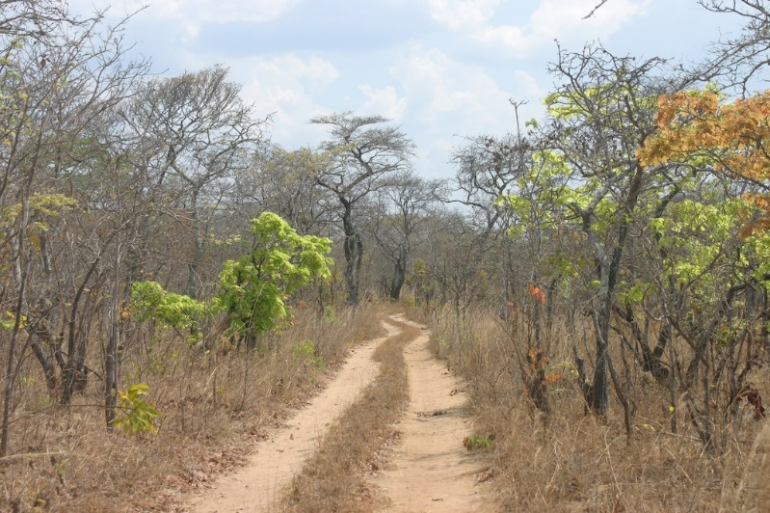
Tropical and Subtropical Savanna Woodland
Found at tropical and subtropical latitudes primarily in the southern hemisphere
Large open areas with tree crowns forming sparse canopies
Temperatures are generally warm and stable, rainfall varies seasonally
Notes:
Photo credit: By Agnieszka Kwiecień
https://en.wikipedia.org/wiki/File:Las_sosnowy_swiezy02.jpg
By Dr. Thomas Wagner - Own work, CC BY-SA 3.0, https://commons.wikimedia.org/w/index.php?curid=5692029

Slide 15
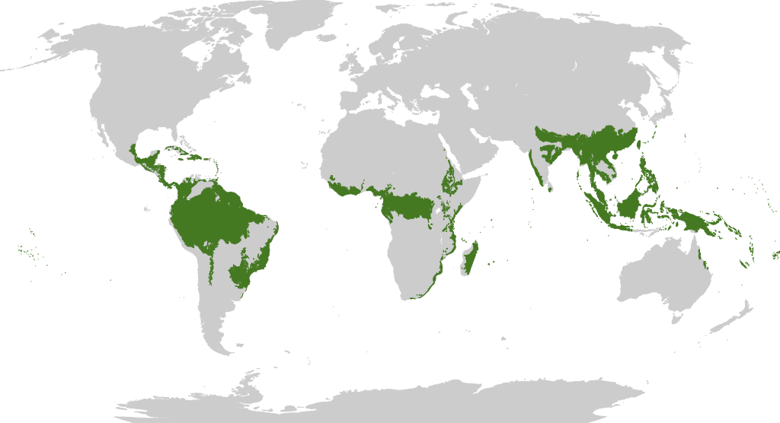
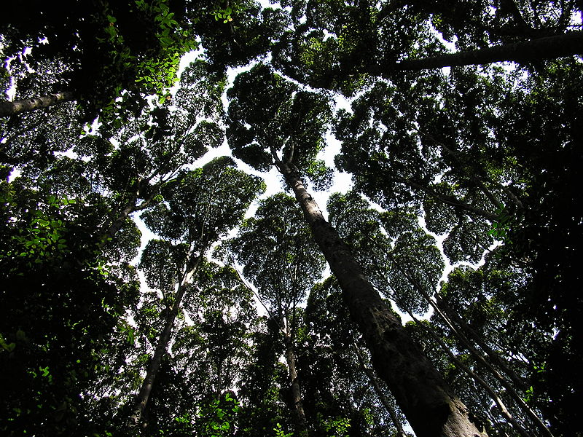
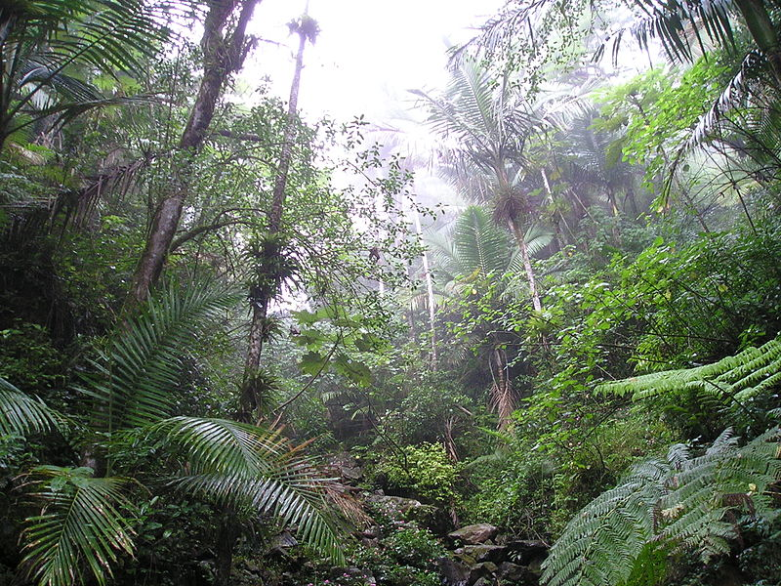
Tropical and Subtropical Moist Broadleaf
Found on the equatorial belt and between the Tropics of Cancer and Capricorn
Highest biodiversity, massive trees, diverse canopy, dense jungles
Temperatures are warm year-round, rain fall is high year-round
Notes:
Photo credits: By Mikenorton - Own work, CC BY-SA 3.0, https://commons.wikimedia.org/w/index.php?curid=5188293
By Alessandro Cai (OliverZena) - own work, Public Domain, https://commons.wikimedia.org/w/index.php?curid=1850117

Slide 16
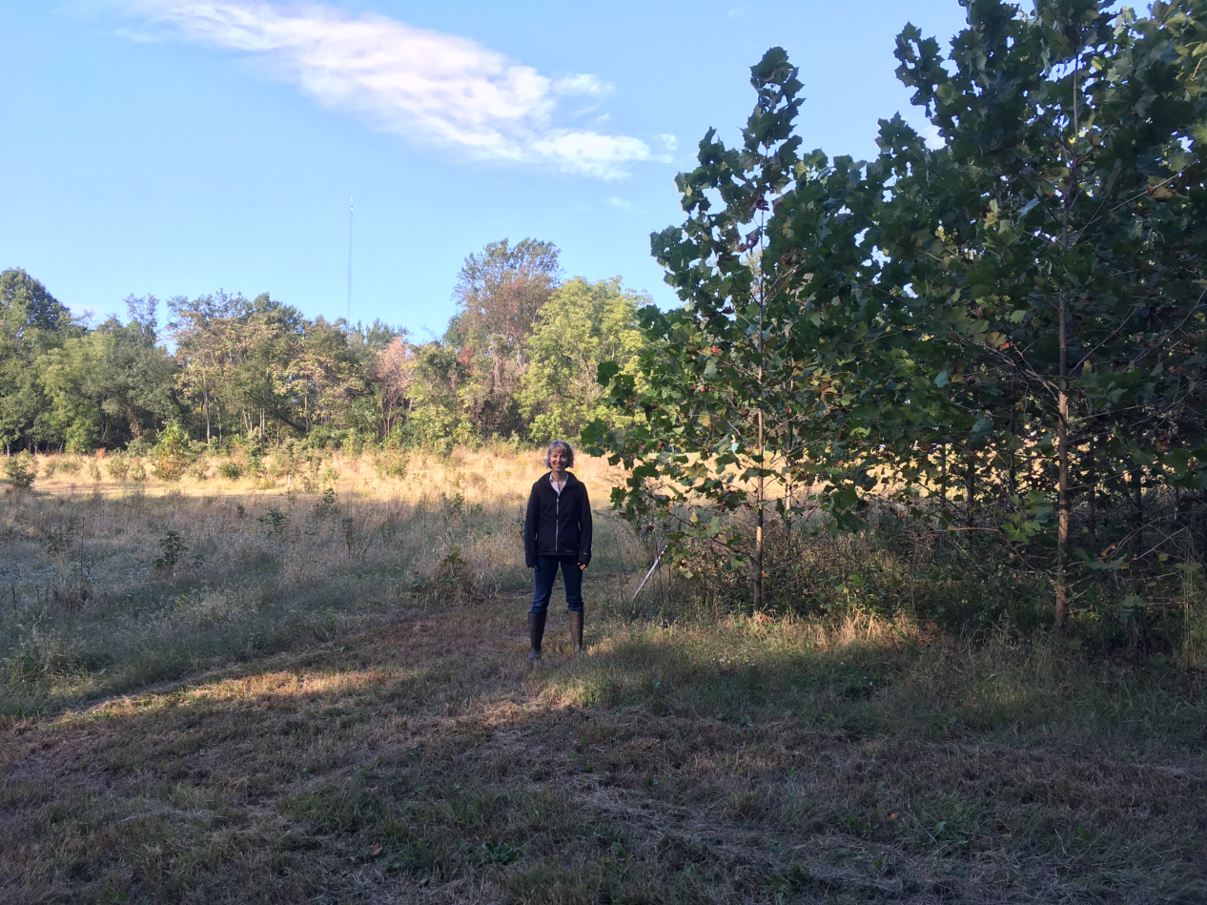
Forest Regrowth
The natural regrowth process of previously cleared land back into forests
This method is similar to reforestation, but relies considerably less on human actors
Notes:
Photo: Dr. Susan Cook-Patton stands in the Biodiversitree reforestation experiment in the Chesapeake Bay watershed.

Slide 17
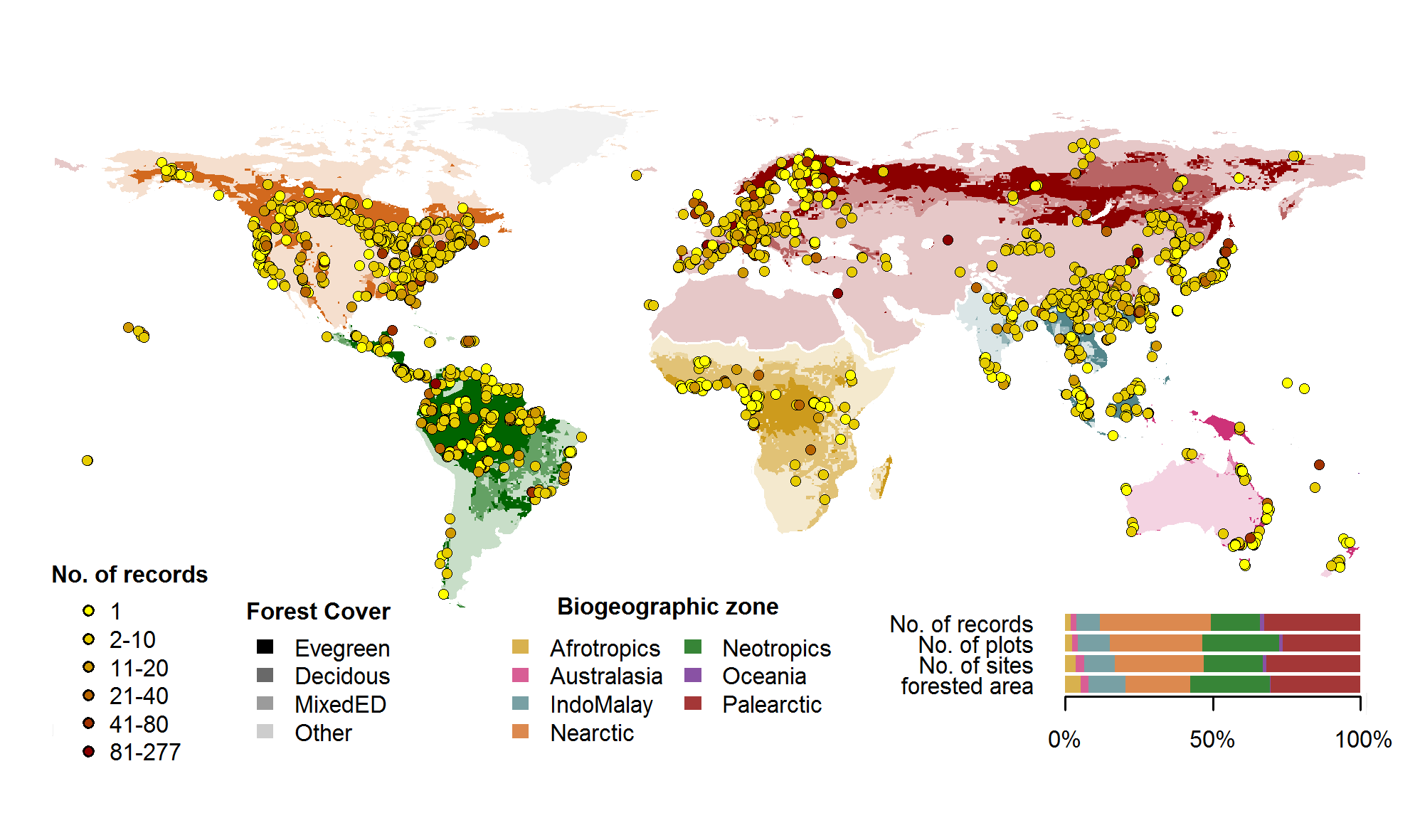
ForC Records
Notes:
This contains the ForC databases from around the world. Students will be working with data from different locations (https://forc-db.github.io/)

Slide 18
ForC: The Forest Carbon database
ForC is an open-access database containing over 40,000 records from 10,000 plots in 1,500 geographically distinct areas.
All data in ForC comes from published research by accredited scientists.
This database covers all forested biogeographic and climate zones
ForC can be used for ecological analysis of forest carbon cycling, evaluating models and remote sensing, and supporting international efforts to inventory forest carbon and greenhouse gas exchange.

Slide 19
Intergovernmental Panel on Climate Change
The IPCC is an intergovernmental body of the United Nations established in 1988
Its primary purpose is to provide objective information relevant to human-induced climate change.
Includes: Research, Policy Recommendations, Economic Impacts, Risks, Possible Response options, etc.
Notes:
Slides on IPCC

Slide 20
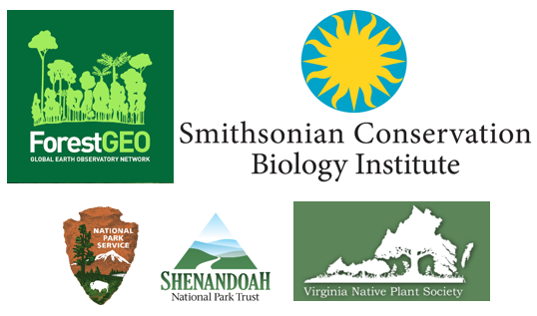
Acknowledgements
We would like to thank the following organizations for providing funding to make this endeavor possible

