Slide 1
Photo by: John Finnerty
Notes:
Coral Reef.

Slide 2
Photo by: Karina Scavo Lord
Notes:
Mangroves with corals growing on the roots

Slide 3
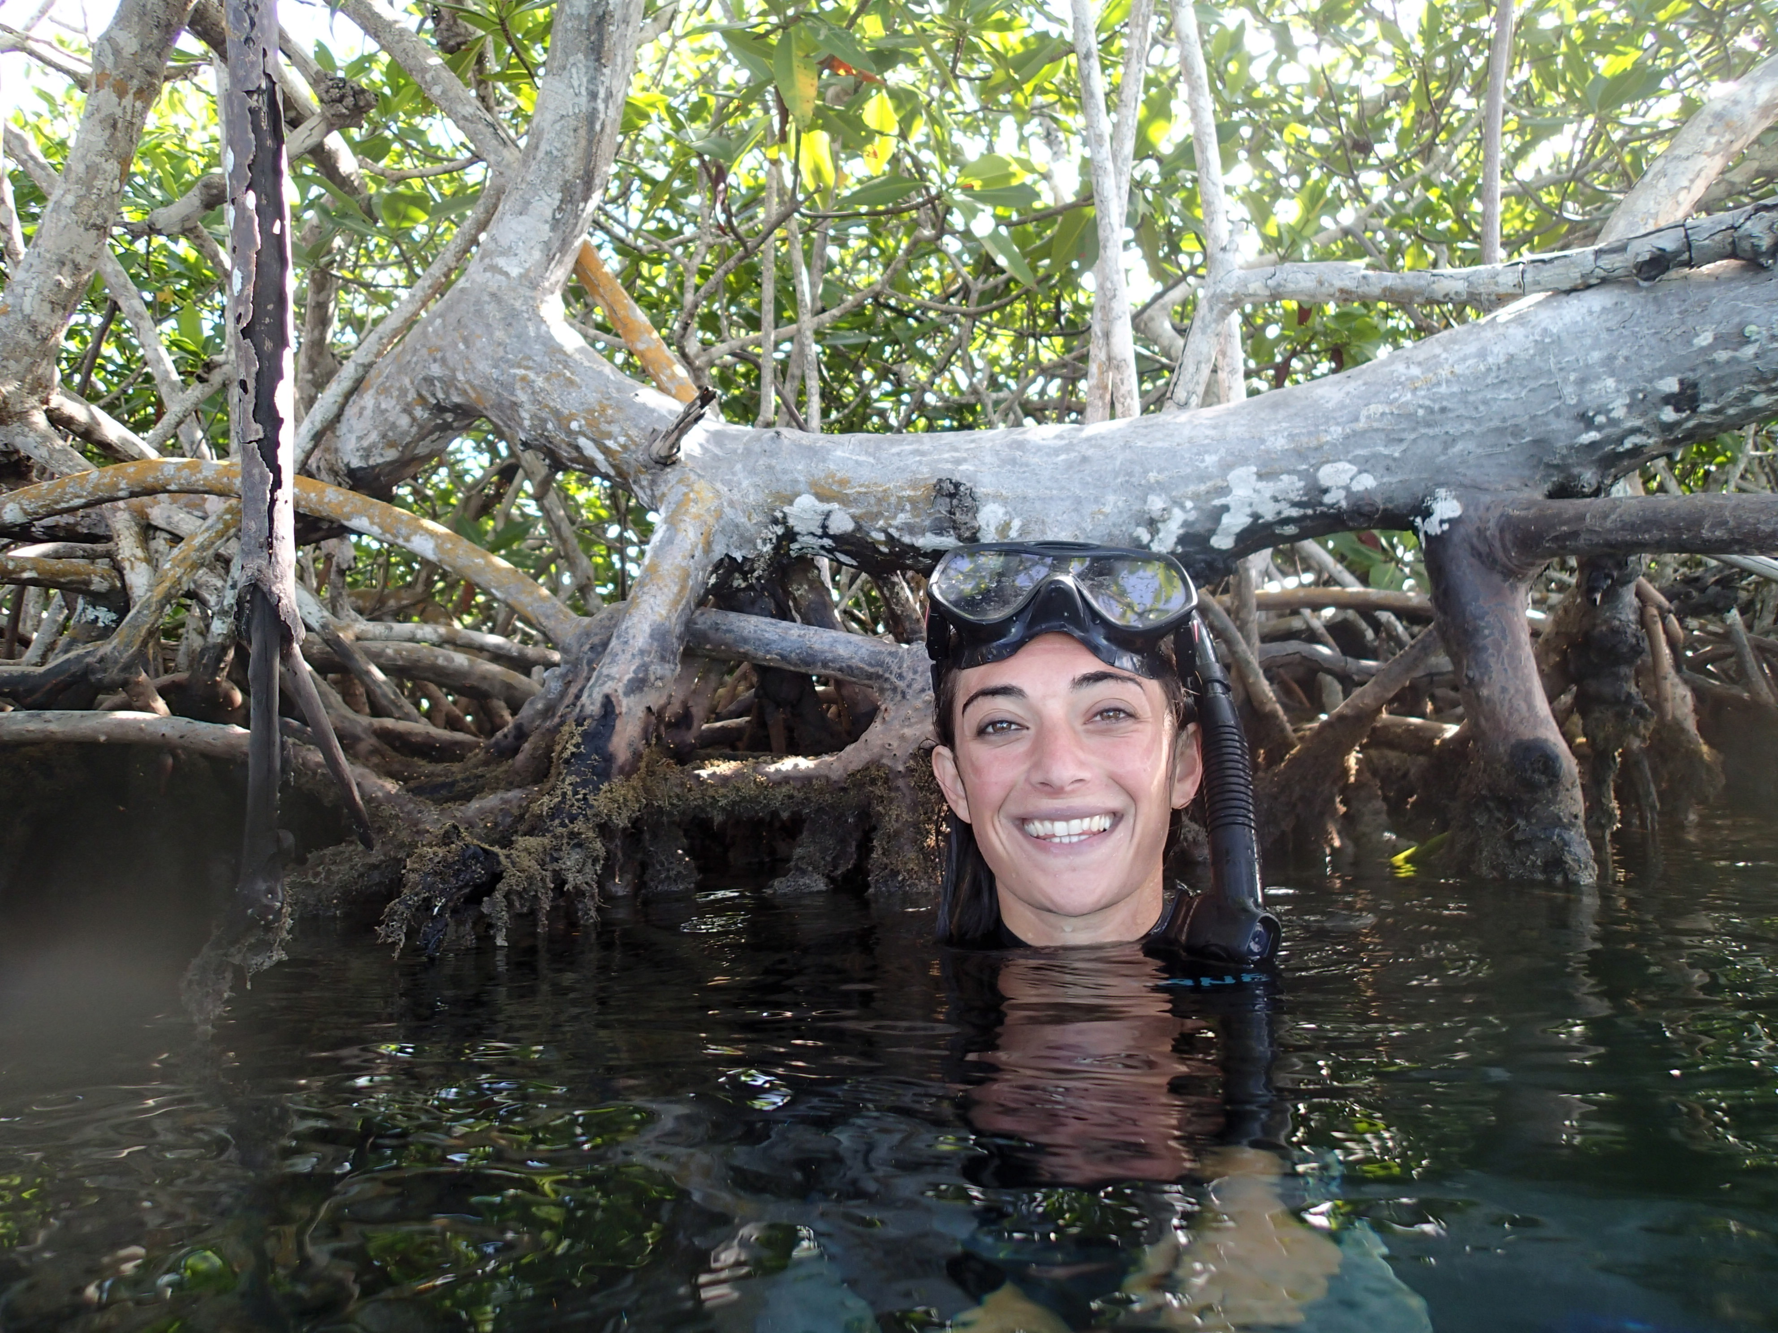
Notes:
Karina's Bio: "I am a marine ecology PhD candidate interested in the population demographics and genomics of reef corals living in marginal, non-reef environments, such as mangroves and seagrass meadows. As coral reefs decline worldwide, scientists are looking beyond the reef to coral communities growing in these non-reef environments, which may serve as climate refugia or as reservoirs of resilient or hardy coral individuals. To better understand if these habitats are important to reef recovery, I use empirical, theoretical, and molecular approaches."

Slide 4
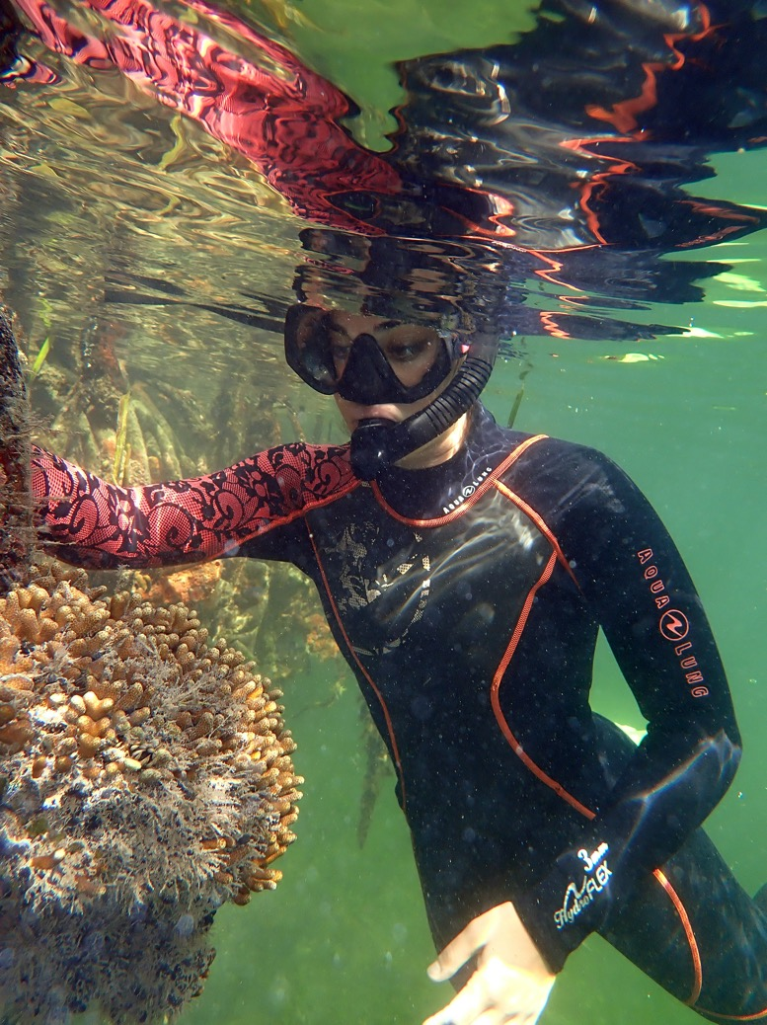
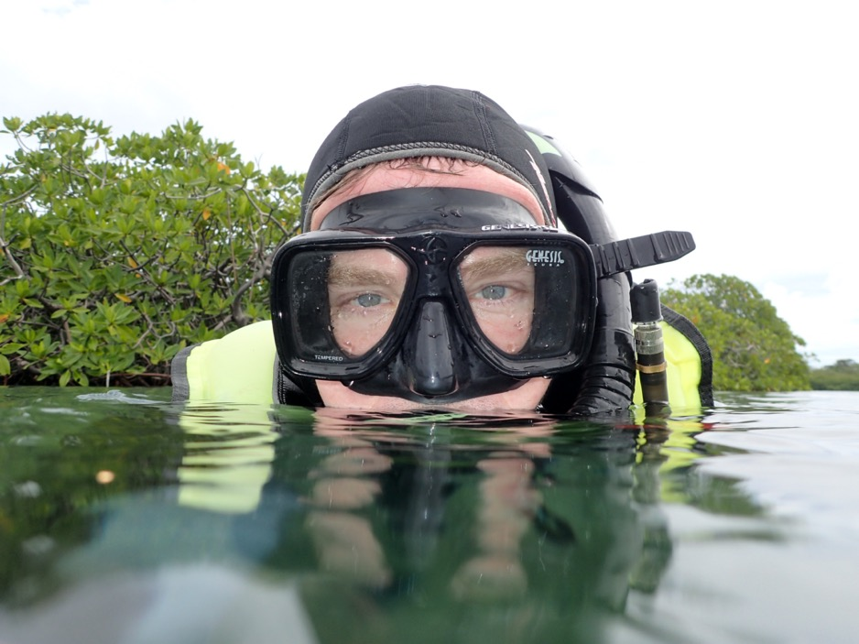
Notes:
Marine Biologists Karina (right) and John (left)

Slide 5
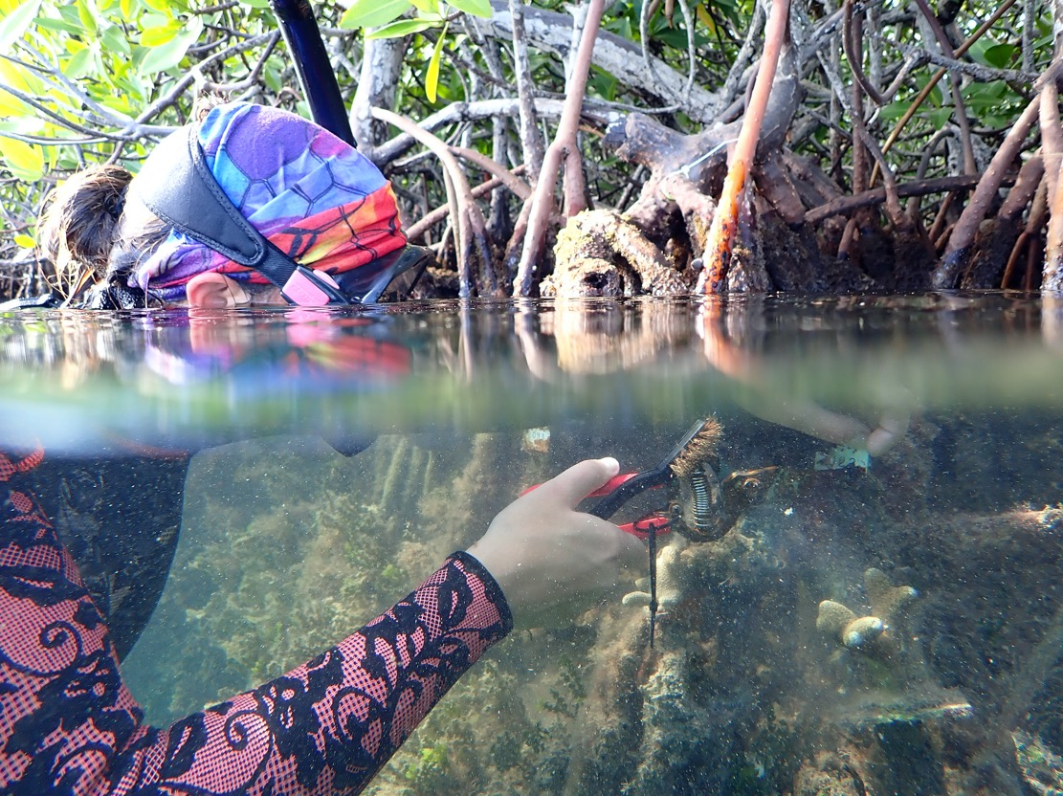
Notes:
Karina collecting data on a thin finger coral

Slide 6
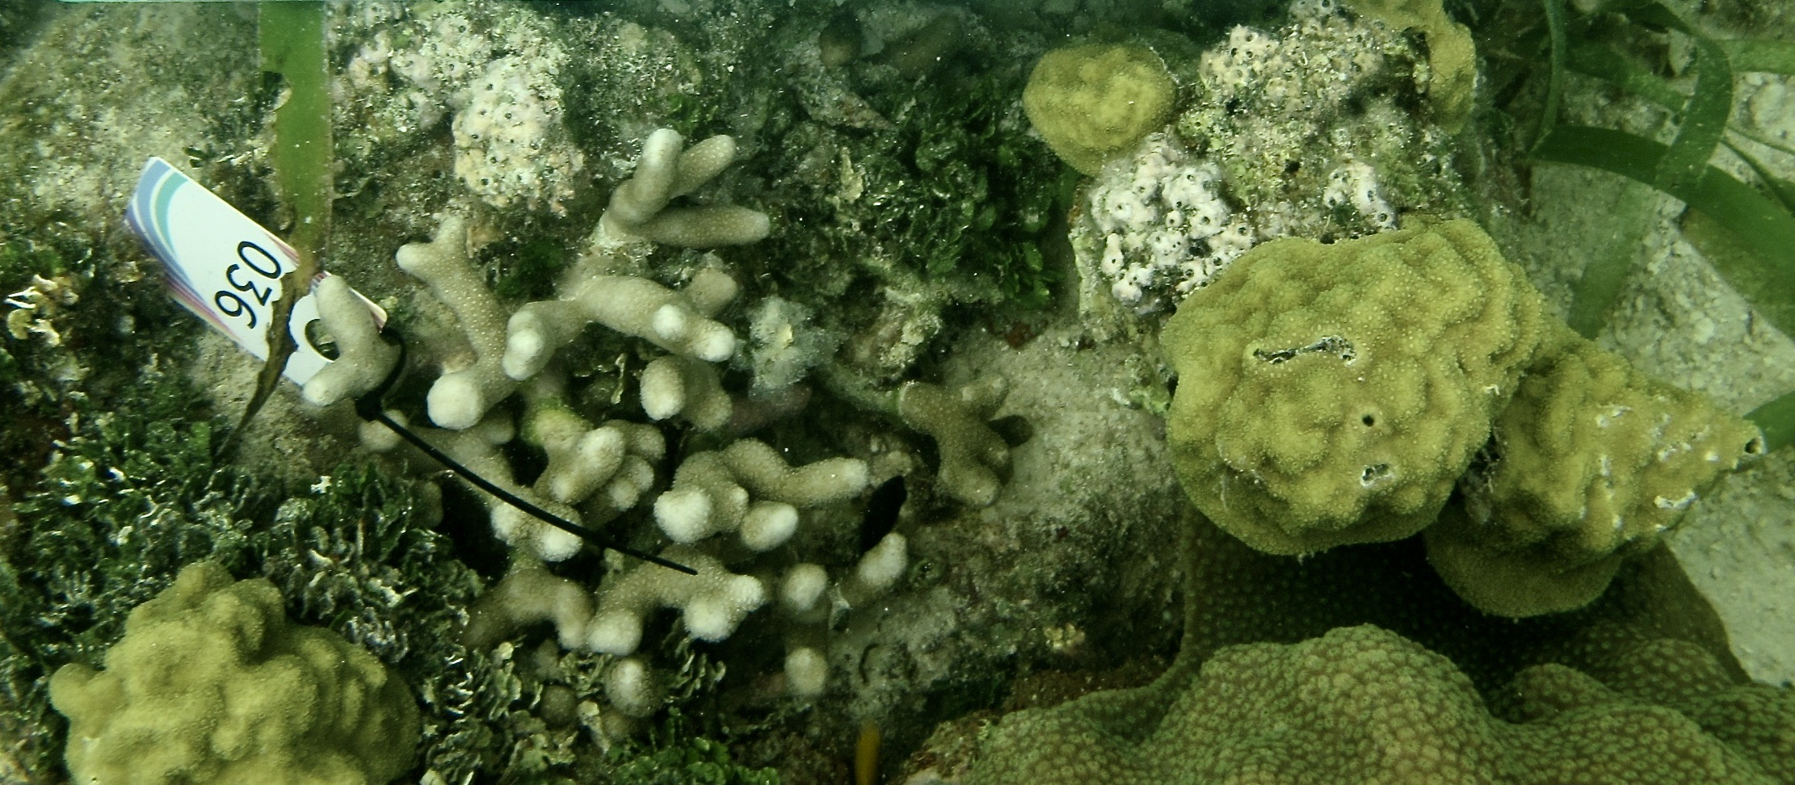
Notes:
The two study species of coral can be seen growing together - (left) branching thin finger coral and (right) mounding mustard hill coral and

Slide 7
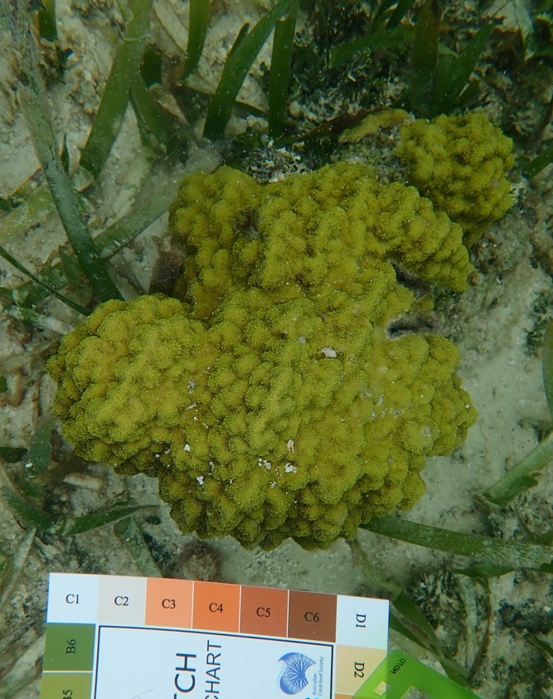
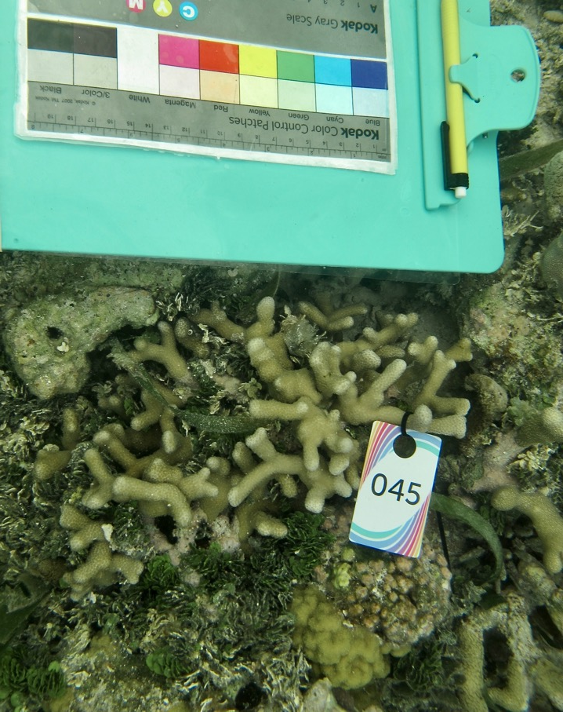
Notes:
Mustard Hill Coral (left) and Thin Finger Coral (right)

Slide 8
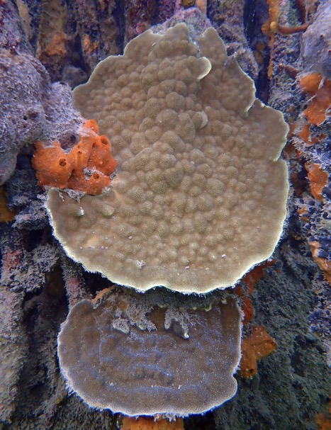
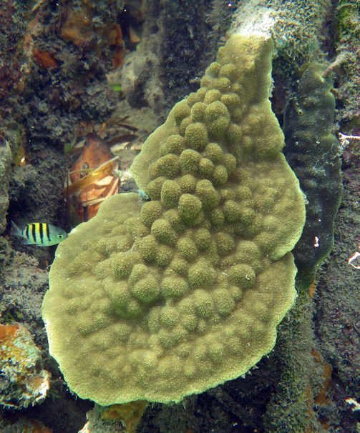
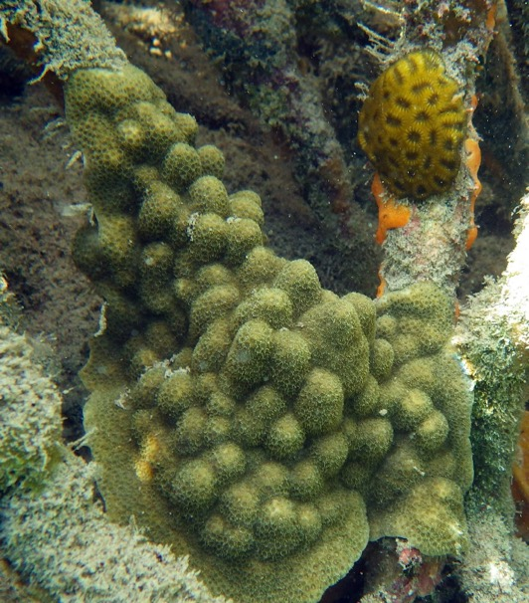
Photos by: John Finnerty
Notes:
Different forms of the mustard hill coral (mounding, plating, also sometimes can both mound and plate)
Determine the form of each colony of mustard hill coral #1, #2, #3 in the mangroves

Slide 9
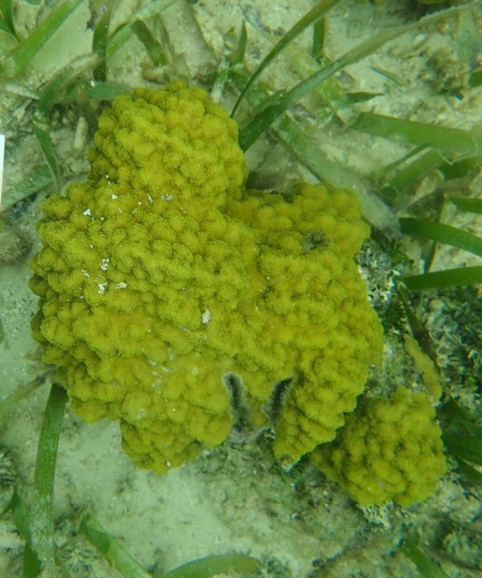
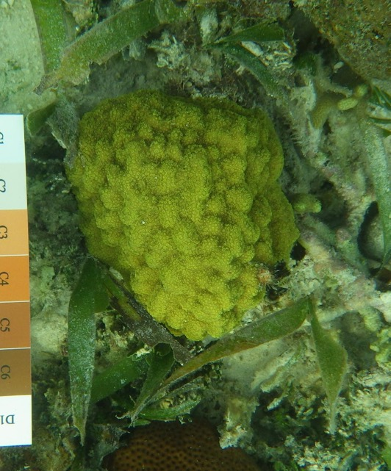
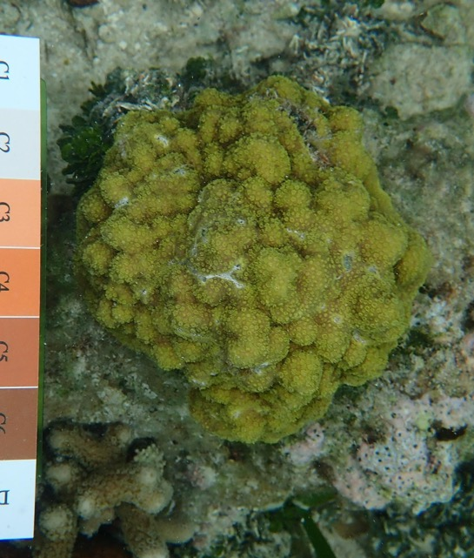
Notes:
Determine the form of each colony of mustard hill coral #1, #2, #3 on the reef

Slide 10
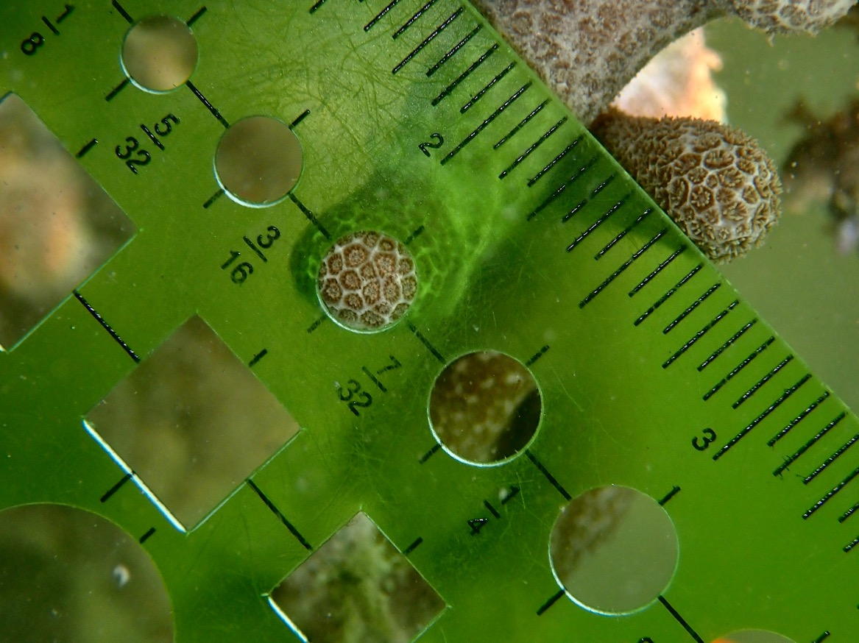
Notes:
Count the number of polyps within the green circle template for the thin finger coral in the mangroves

Slide 11
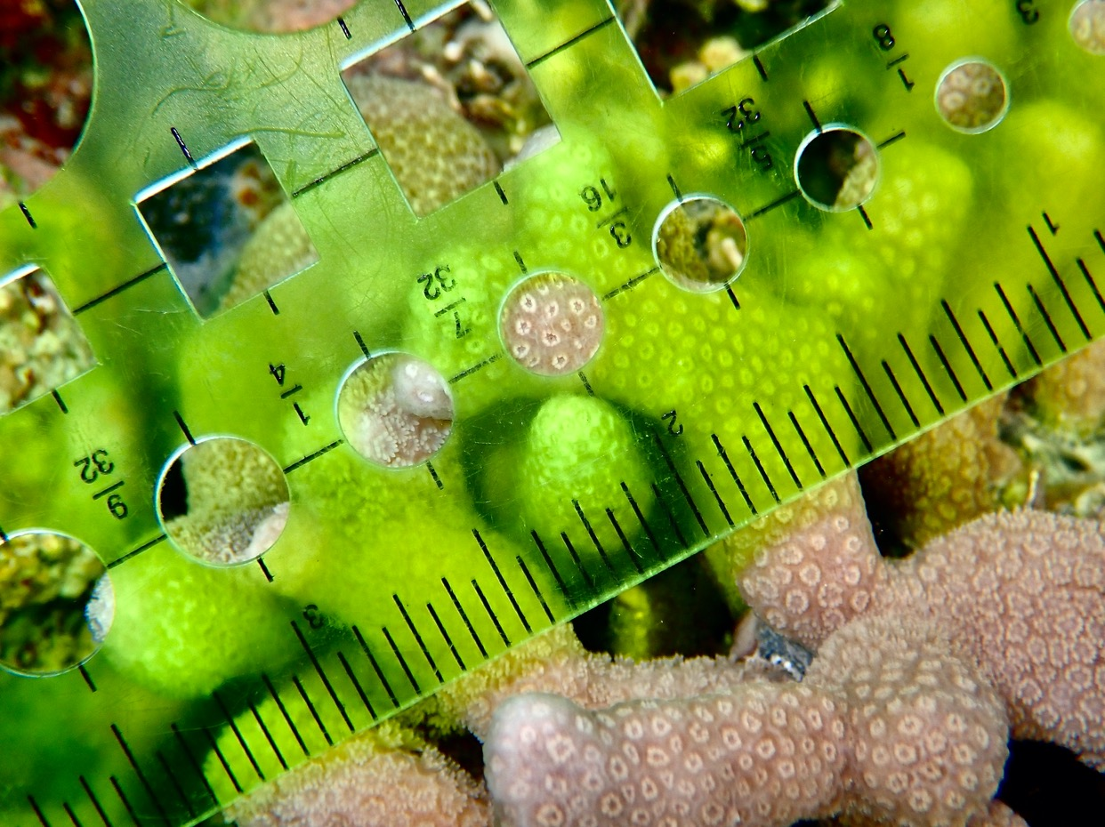
Notes:
Count the number of polyps within the green circle template for the thin finger coral on the reef

