Slide 1

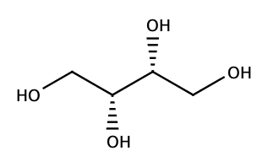
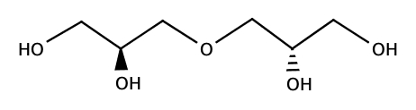
Working to reduce the plastics problem
Substance
Chemical Structure
Meso-erythritol (ME)
Diglycerol
(D)

Slide 2
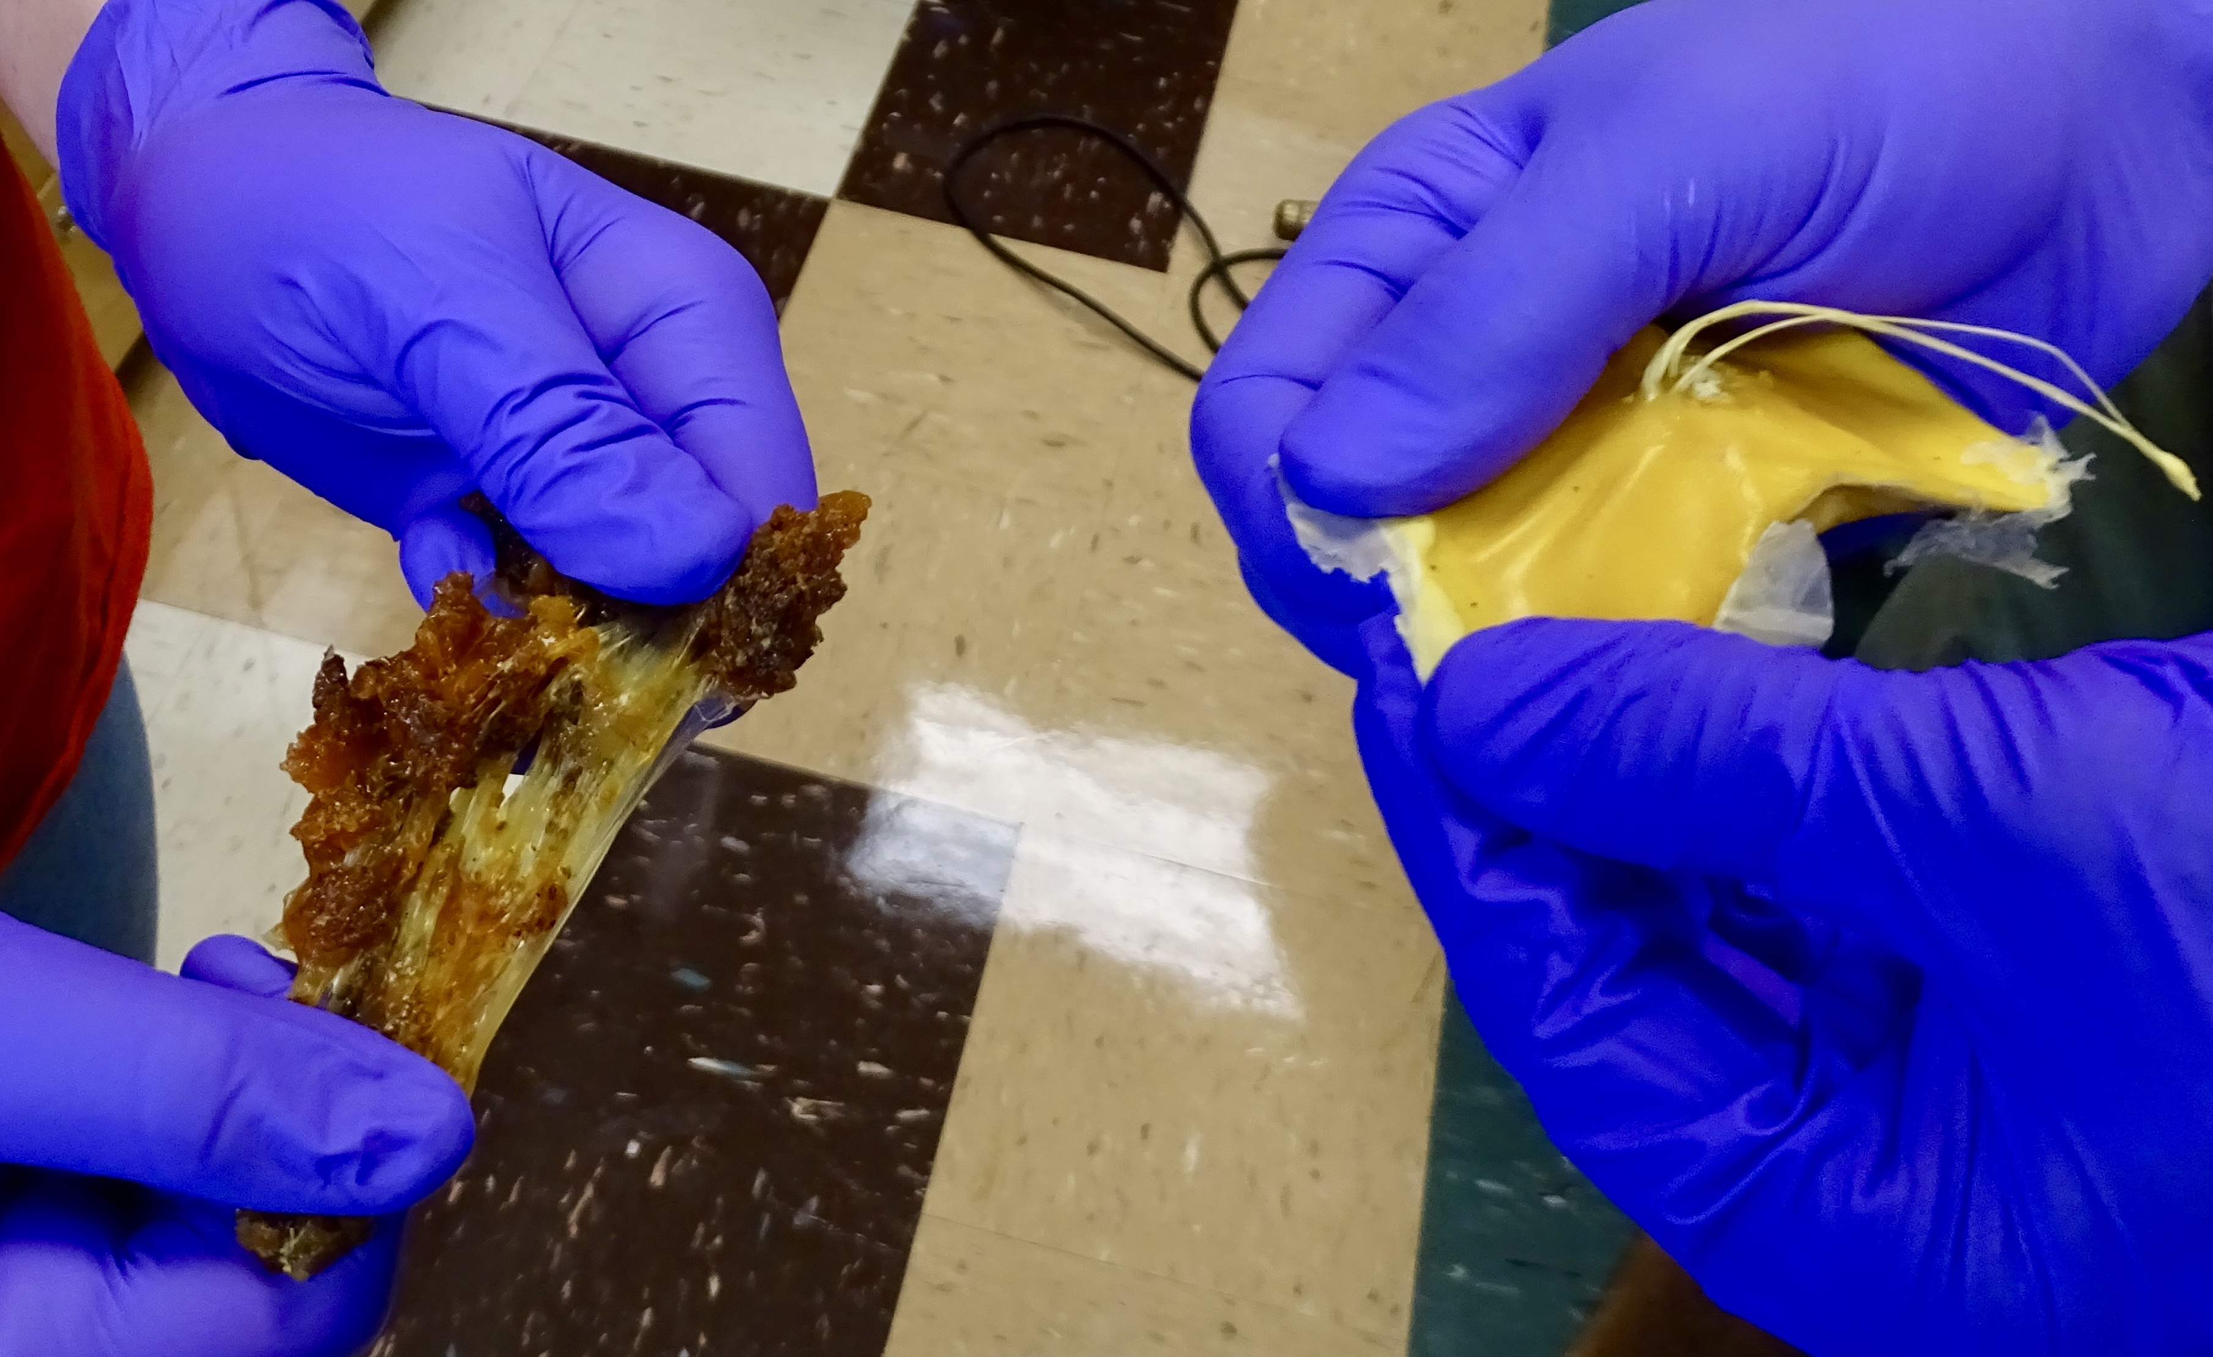
The sample on the right is made from 100% diglycerol and the left from 100% meso-erythritol.

Slide 3
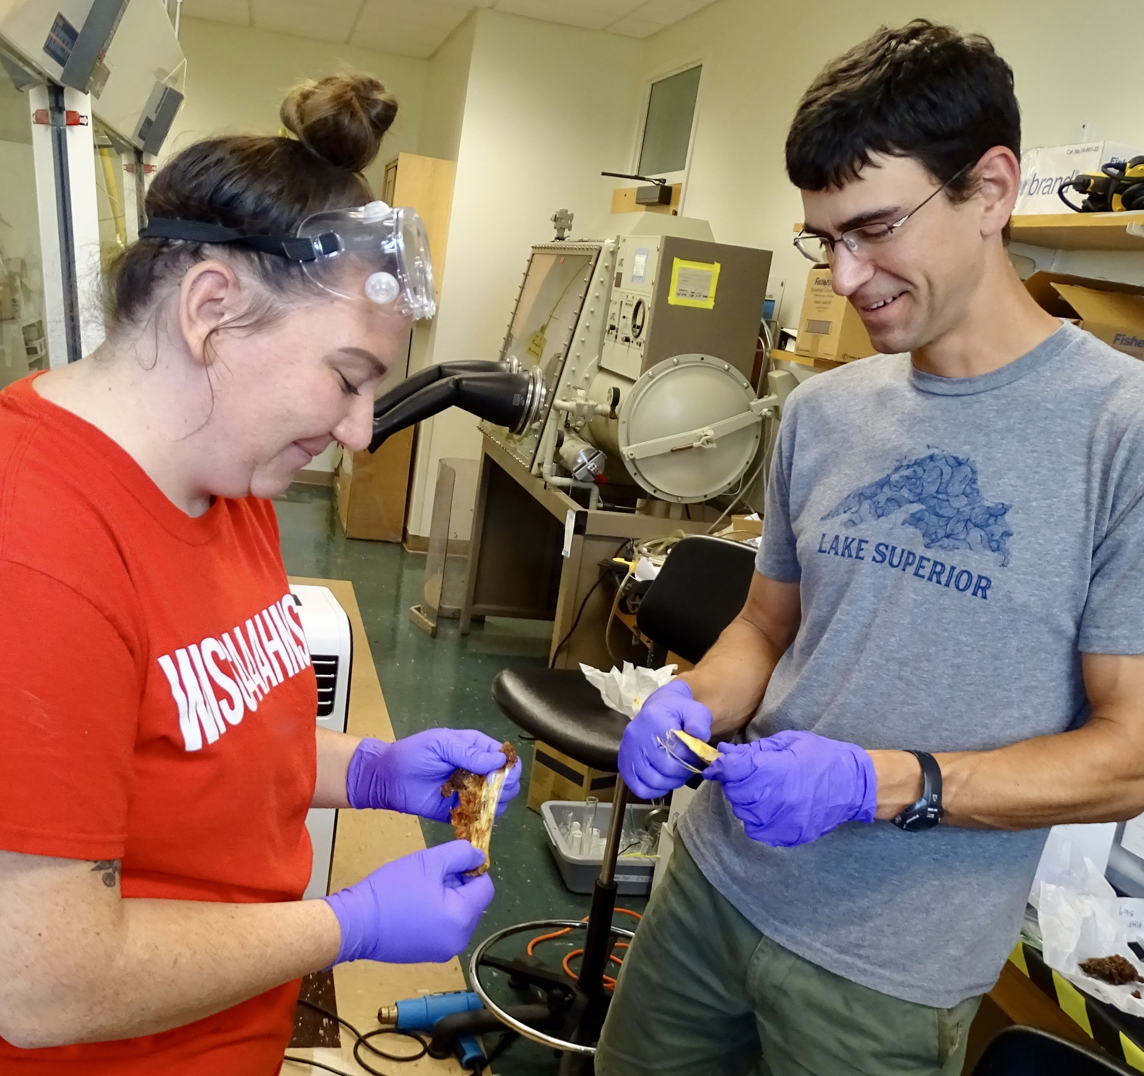
Nick (right) and one of his students (left) stretching the raw, preformed polymers.

Slide 4
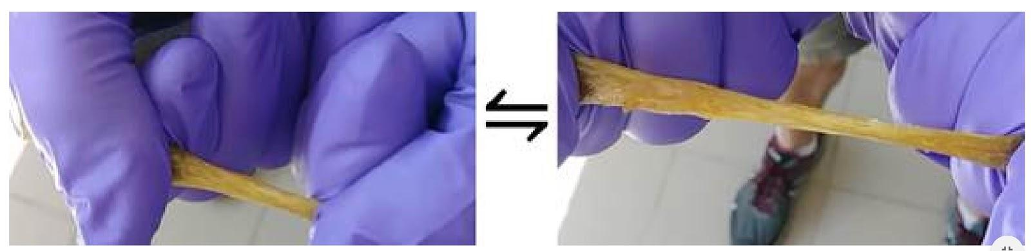
One of Nick’s students stretching a prepared elastomer.

Slide 5
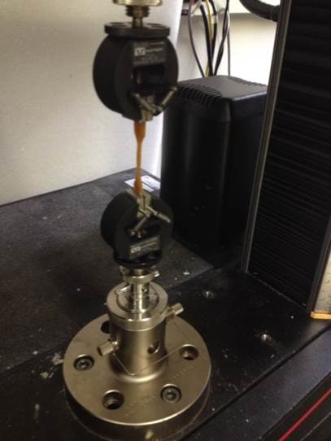
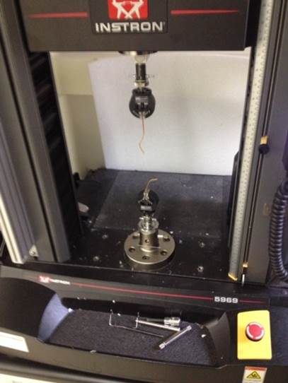
The Instron is a machine that tests materials by slowly stretching the material. While an elastomer is being stretched, the machine measures the stretch distance (strain) and the force applied (stress).

Slide 6
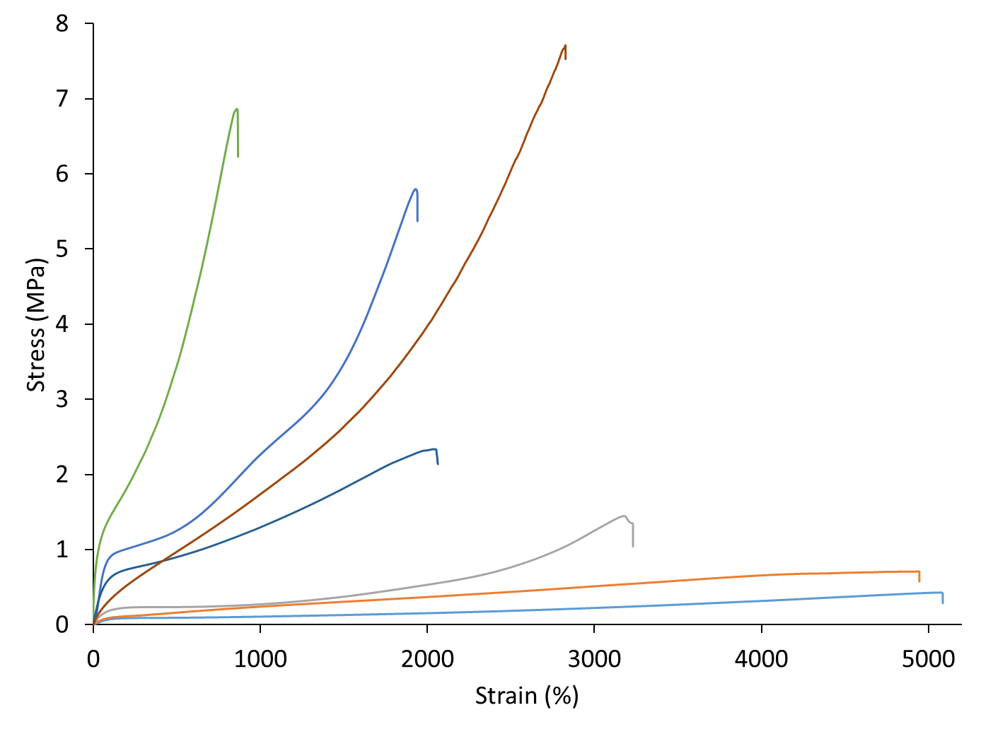
+
0% D
100% M
Rubber band
◼
25% D
75% M
▲
50% D
50% M
#
75% D
25% M
✷
100% D
0% M

