Slide 1

The end of winter as we’ve known it?
Featured scientist: Forrest Howk, Bayfield High School.
Written by: Richard Erickson, Bayfield High School and Hannah Erickson, Boston Public Schools

Slide 2
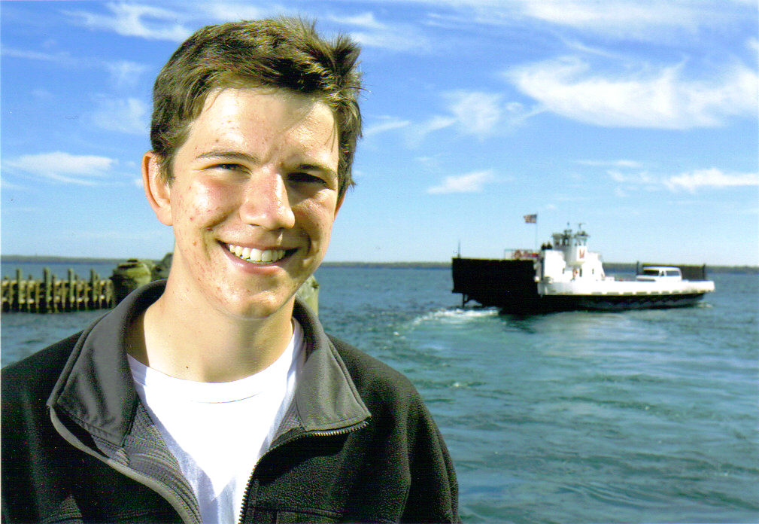
Forrest in front of the ferry that takes residents from the mainland town of Bayfield, and LaPointe, located on Madeline Island.
Notes:
As a boy growing up in Bayfield, Wisconsin, Forrest was familiar with the seasonal rhythms of Lake Superior and the nearby Apostle Islands. Forrest watched each year as ice formed in the Bayfield Harbor, stopping the boat traffic each winter. Eventually, as the ice thickened even more, an ice road would open between Bayfield and LaPointe.

Slide 3
The small town of LaPointe is located on Madeline Island just over two miles from the shore of Bayfield.
When the ice road opens, it frees the island residents from working around the ferry schedule and they can drive on the ice to get to the mainland.

Slide 4
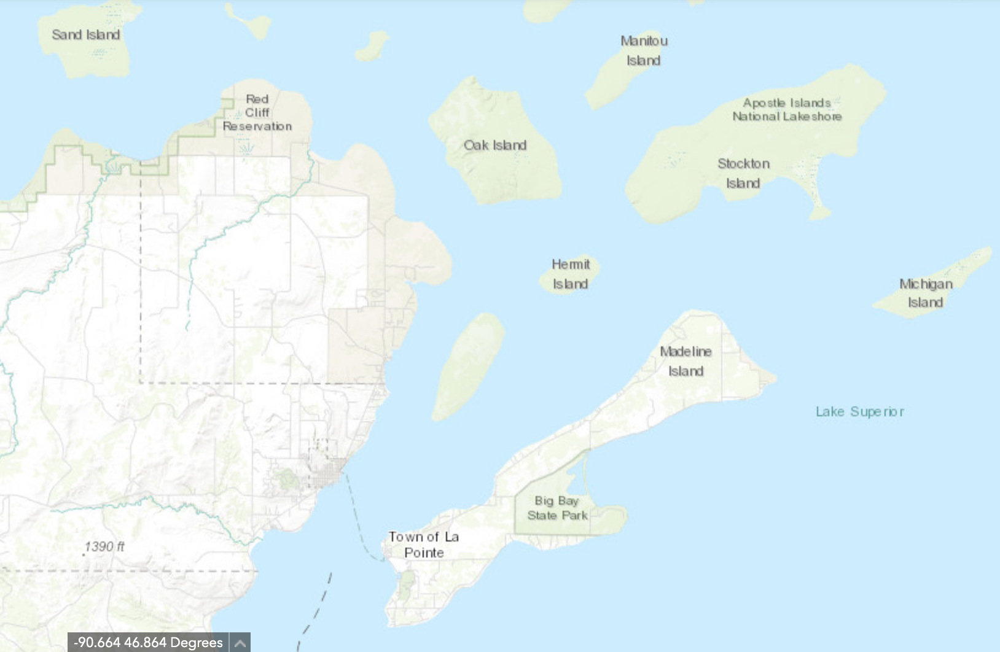
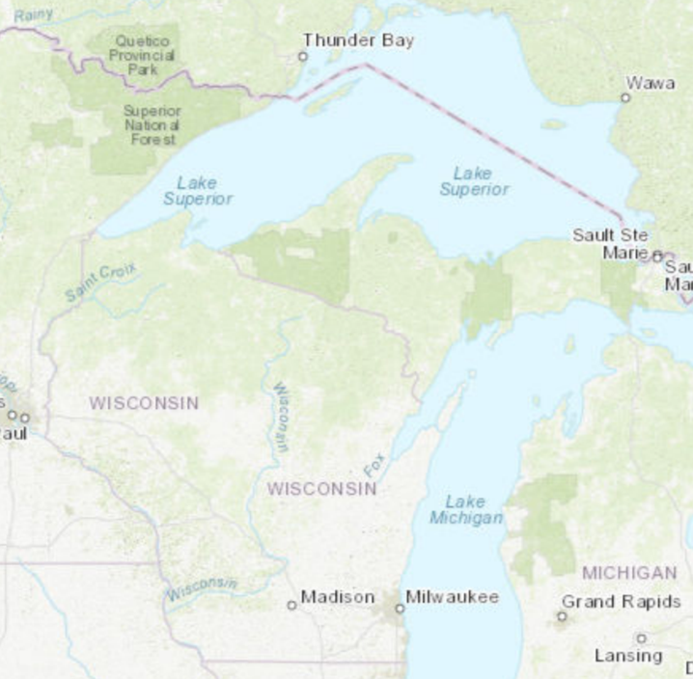
Bayfield
Ice Road

Slide 5
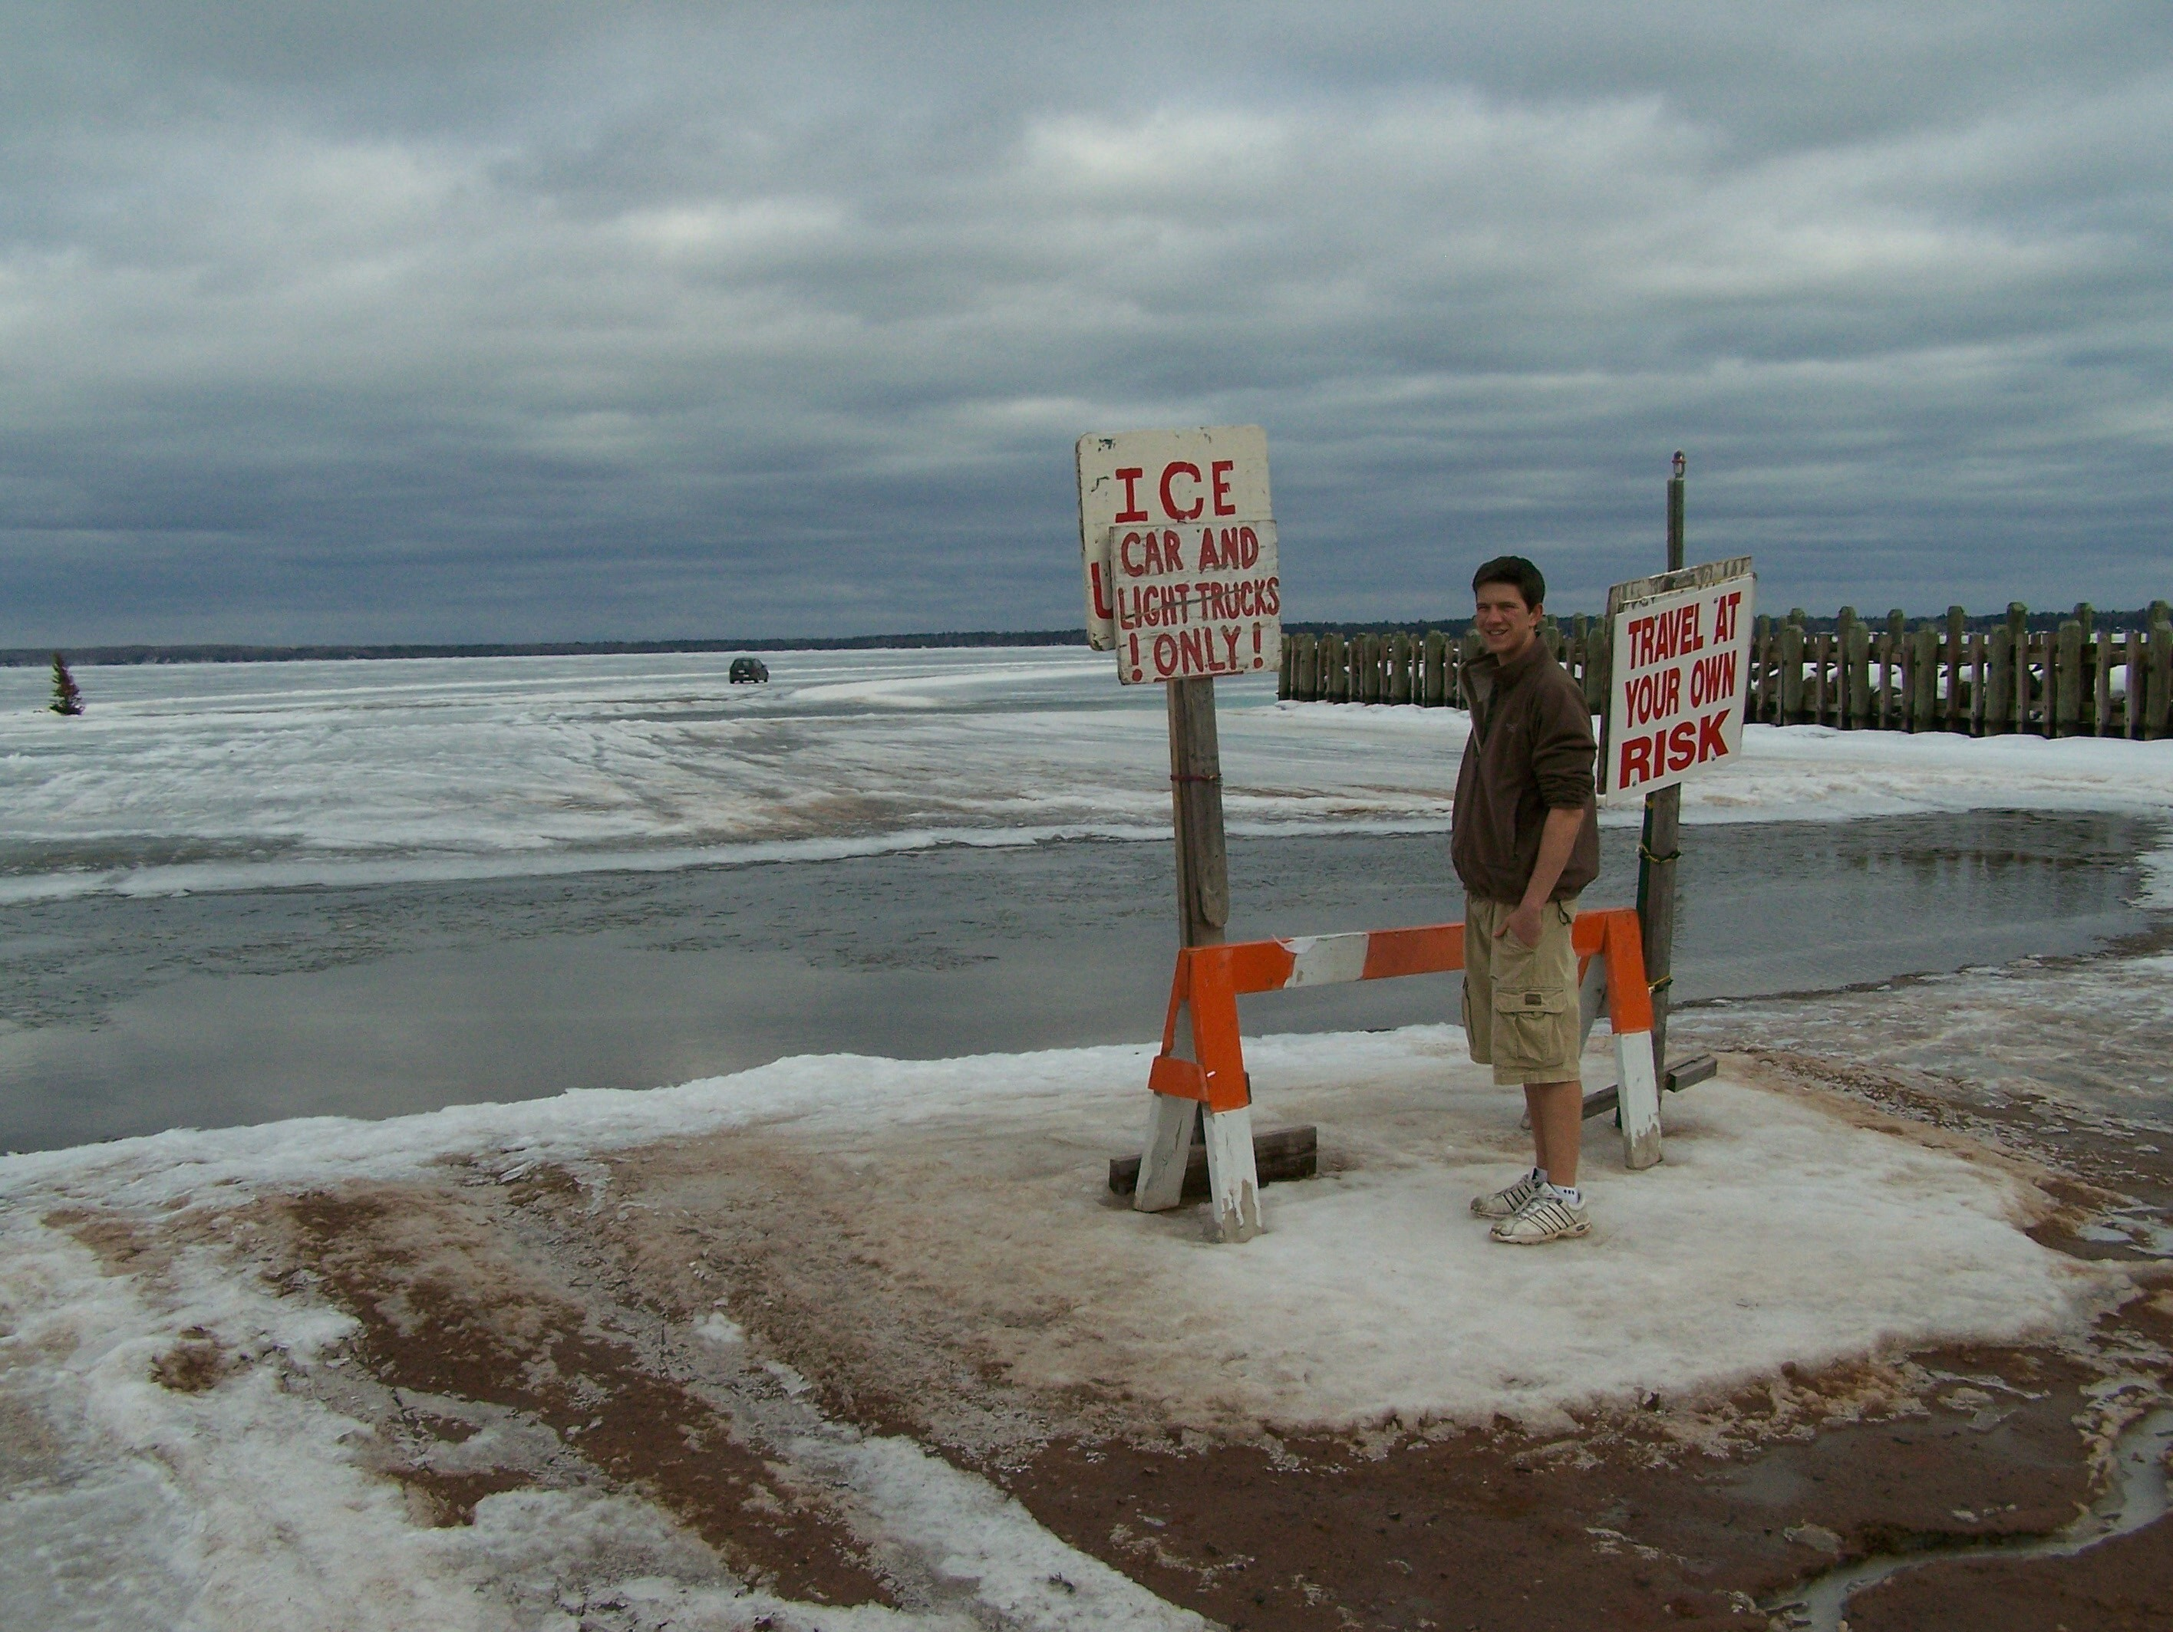
Forrest standing in front of the ice road that forms between Bayfield and LaPointe each winter, preventing ferry traffic but allowing cars to travel between the mainland and island.
Notes:
As a senior at Bayfield High School, Forrest became interested in conducting a scientific study related to the ice season on Lake Superior. He knew that Lake Superior plays a vital role in the lives of people who live and work on its shores and therefore all sorts of data are recorded to help understand and take care of it. Based on his own observations and comments of other area residents, Forrest thought that winters were getting shorter. He wanted to know whether the length of the ice season was changing over time.

Slide 8
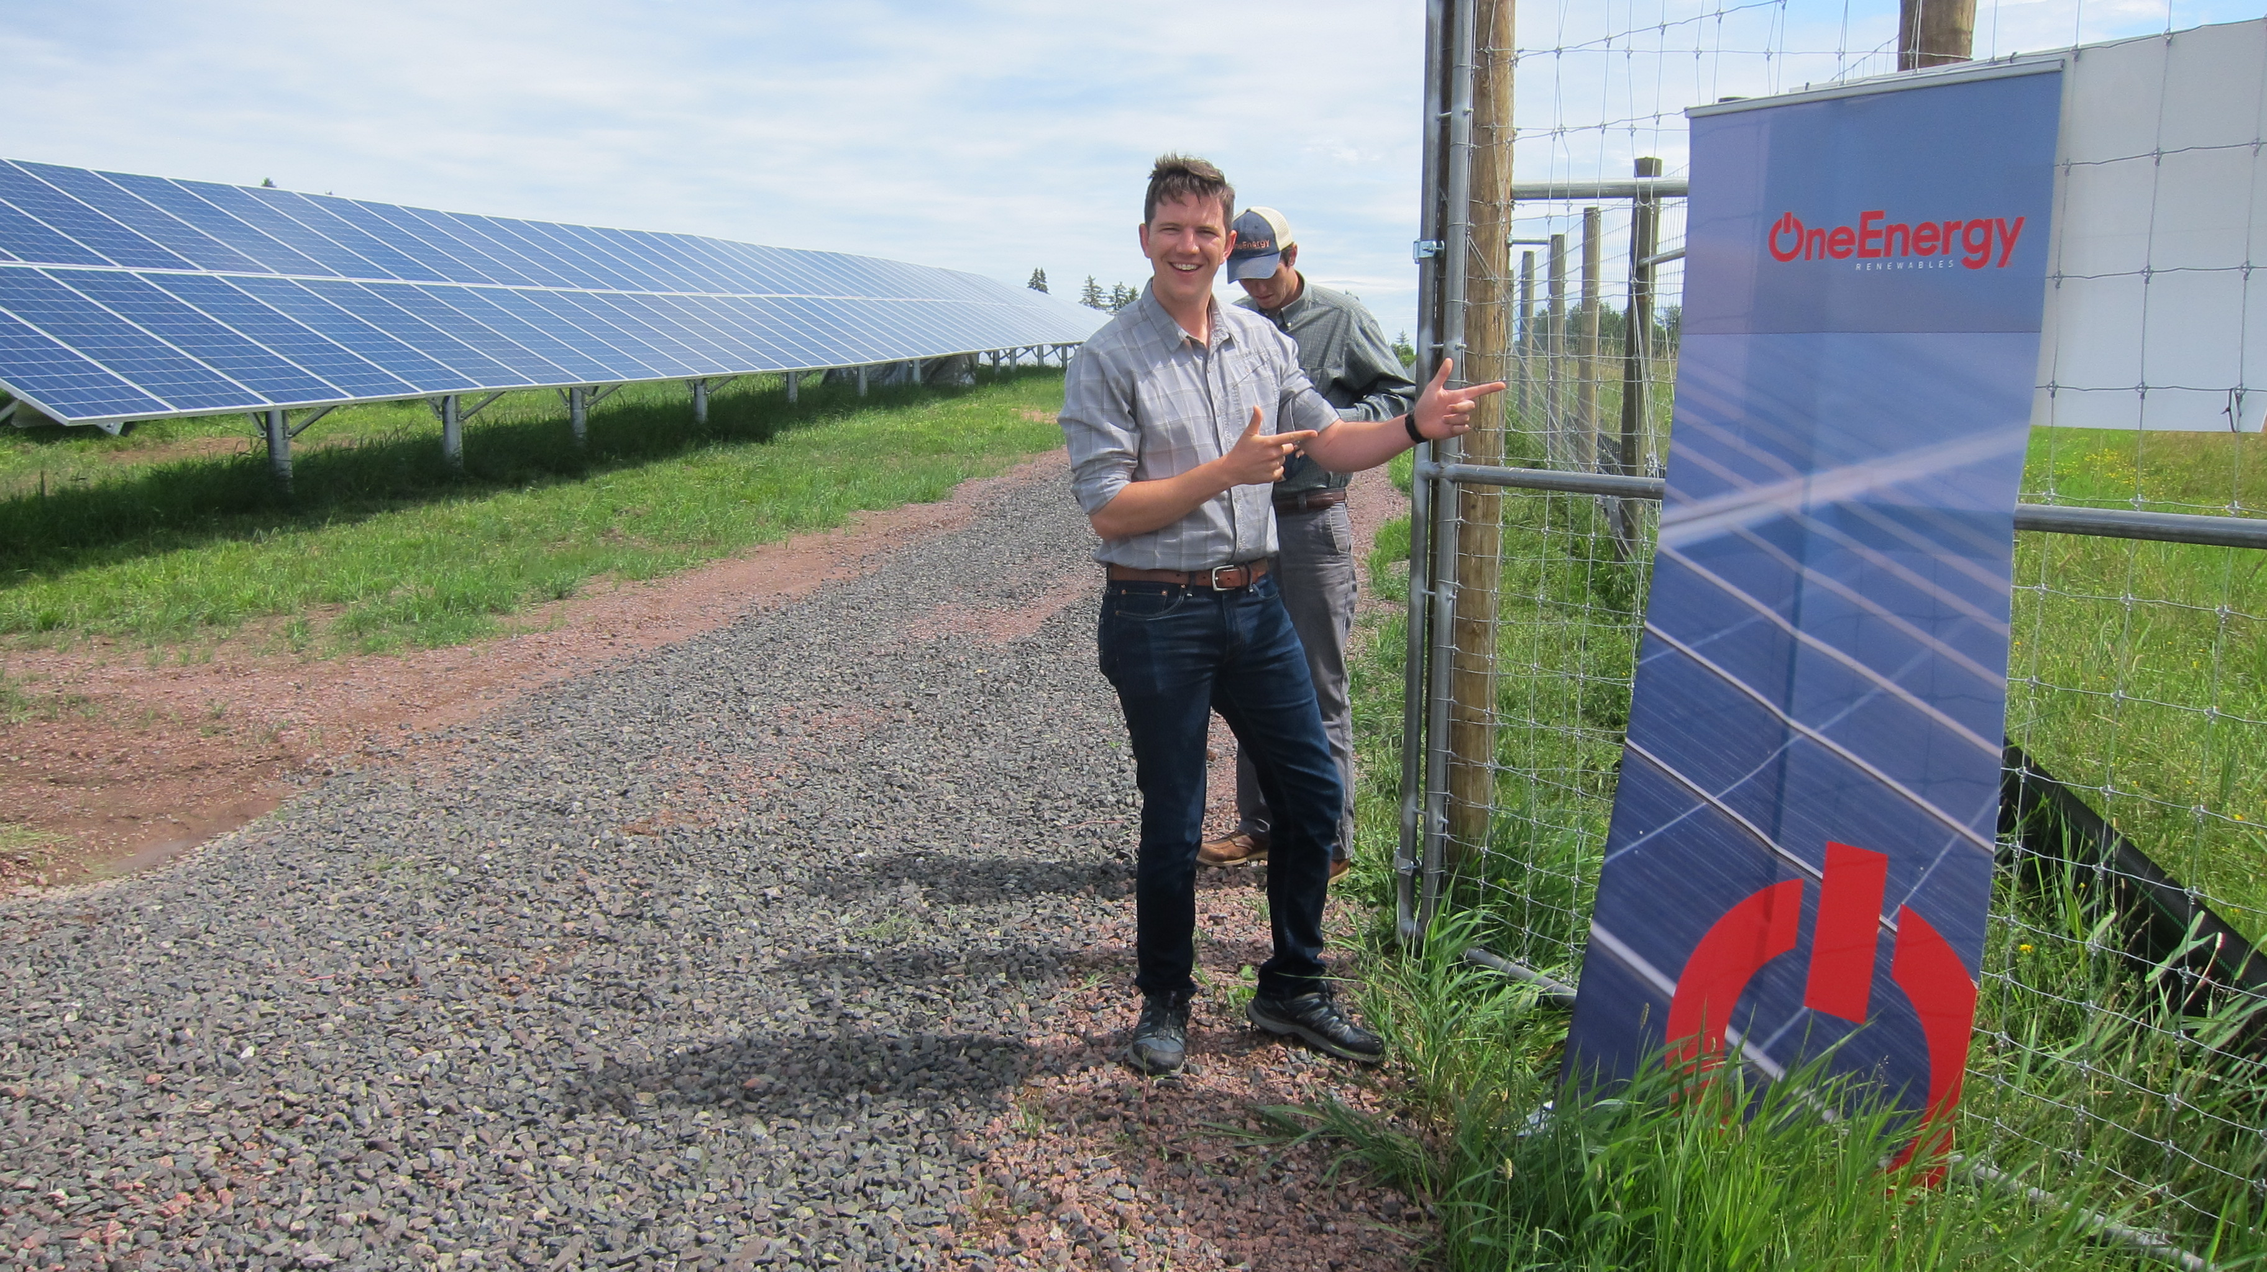
Notes:
After high school Forrest went on to study conservation biology at the University of Wisconsin-Madison and received a Master’s degree in public policy from the University of Washington-Seattle. He is now an associate in project development at OneEnergy Renewables, a company that helps with solar projects around the United States.

