Slide 1

Fishy Origins
Featured scientists: Carleigh Engstrom, Chelsea Barreto, Megan Phifer-Rixey and John Tiedemann from Monmouth University

Slide 2
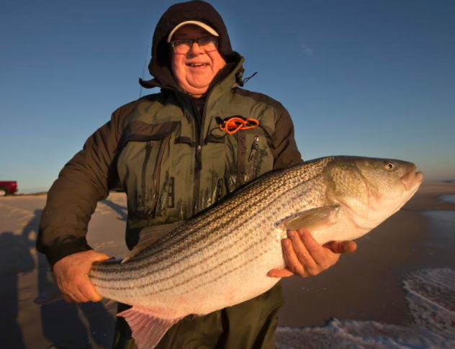
Striped Bass
Notes:
Striped bass, or stripers, make up one of the most important fisheries for seafood and sport fishing on the East Coast of the United States. Locations where fish reproduce are called spawning grounds. Young stripers spend 2-3 years developing in the spawning ground before moving downstream. Adult stripers return to the same location to breed later in life.

Slide 3
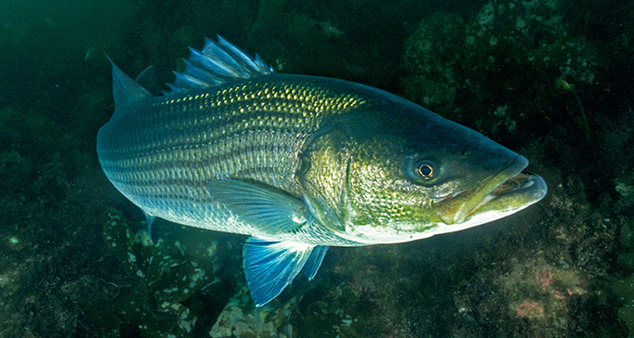
Striped Bass

Slide 4
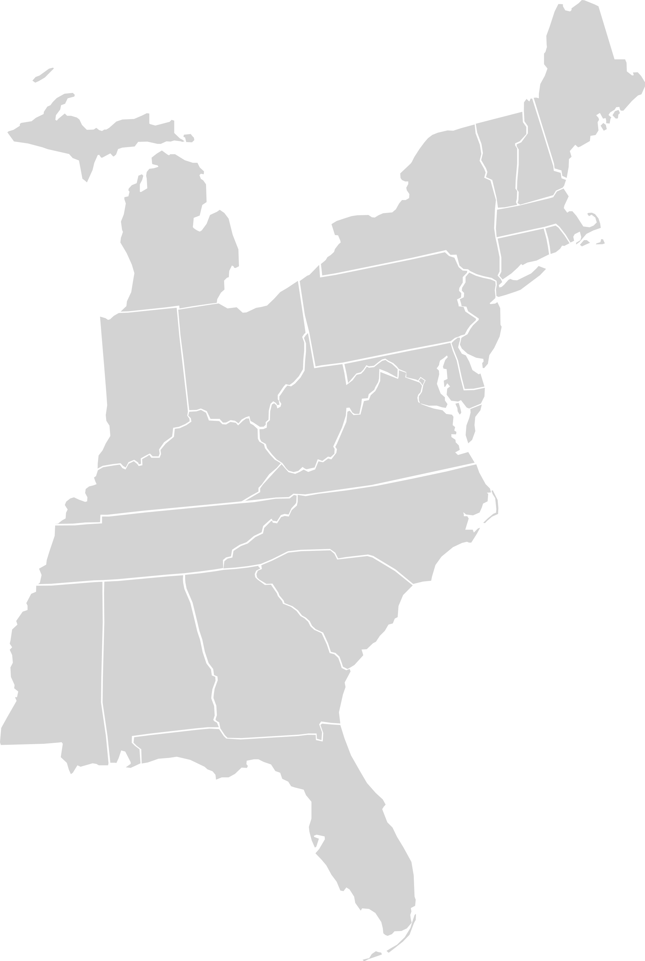
Stocks
(origins of stripers)
1️⃣
2️⃣
Hudson River
3️⃣
Chesapeake Bay/Delaware River
Albermarle Sound
NJ Coast sampled populations
1️⃣
Population 1
2️⃣
Population 2
3️⃣
Population 3
Notes:
There are four main spawning grounds for stripers on the East coast: the Hudson River, the Chesapeake Bay, Delaware River, and the Albermarle Sound. Stripers from these areas are considered to be different stocks. Because they all migrate to New Jersey, fish from different stocks combine, which results in a mixed stock.
For their study, the scientists caught stripers in three different locations off the New Jersey coast in 2017.

Slide 5
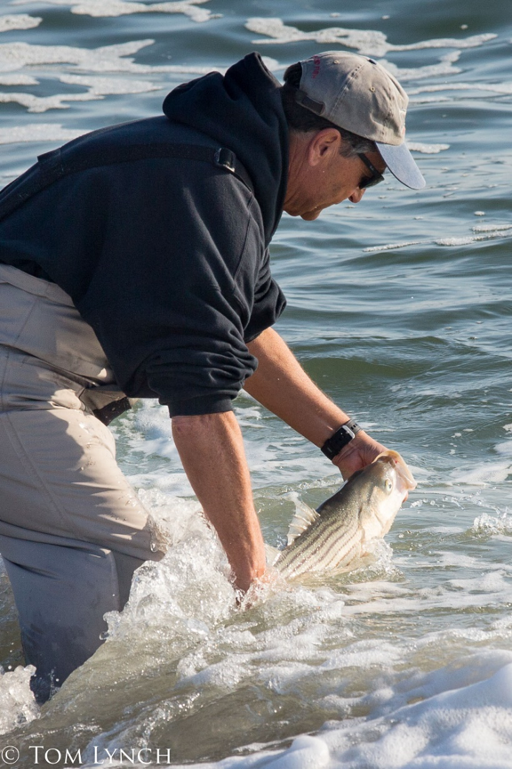
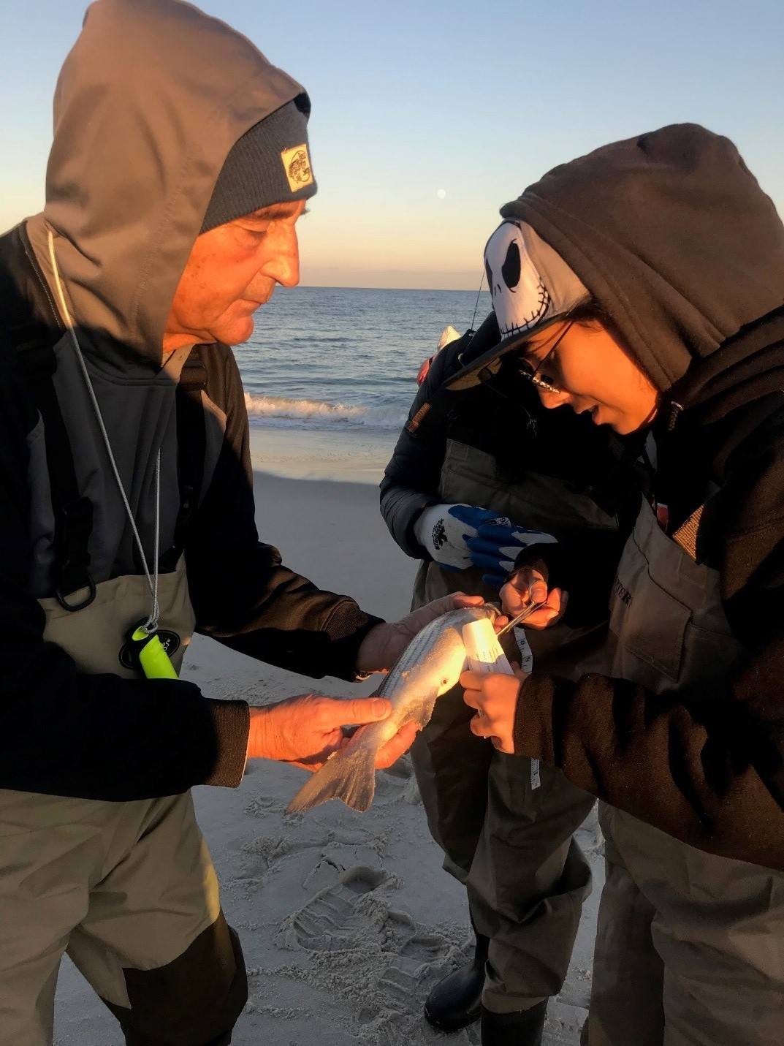
Notes:
(left) Fred Bogue holding a fish

Slide 6
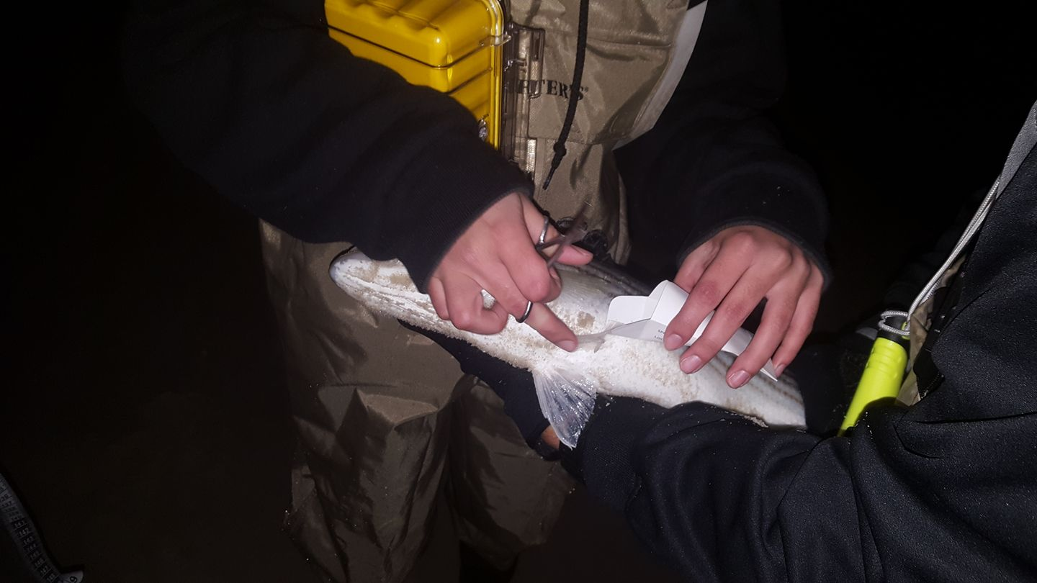
Clipping the pelvic fin

Slide 7
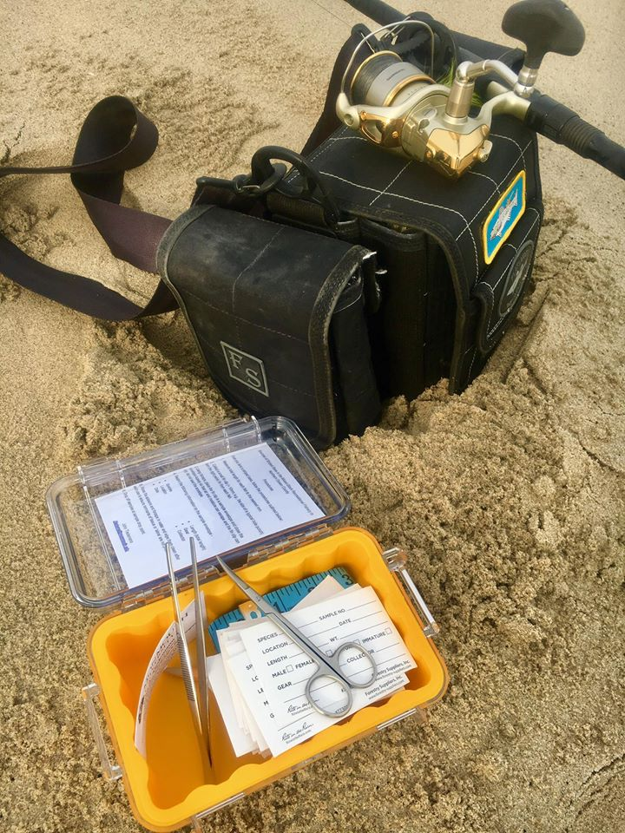
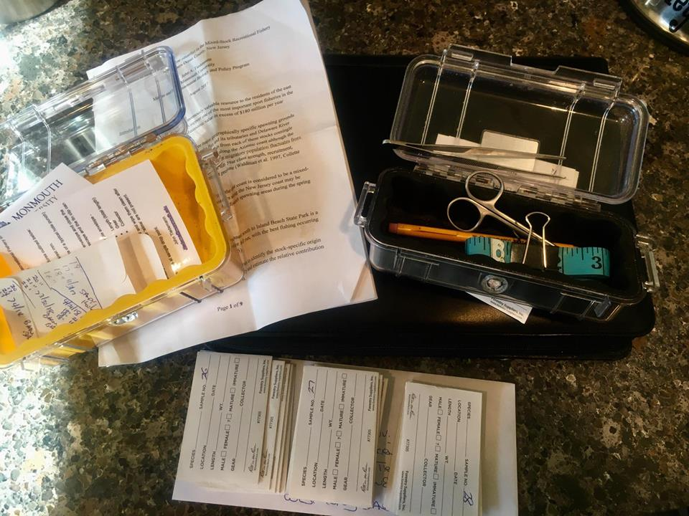
Fin clip kits
Notes:
The data for this study was collecting in a pretty interesting way. The scientists formed relationships with local fishermen who know where to find populations of striped bass. John distributed fin clip kits to fishermen, who then took samples from all the fish they caught. The samples where then returned to local fishing stores where the scientists would collect them.
While this citizen science led to a lot more data being collected than what the scientists could do on their own, it also means the data has some messiness to it. First, fishermen don’t like to reveal their best fishing spots, so we can only know approximately where the samples came from. Second, John did not tell the fishermen where to go, so each location was not evenly sampled (there was more effort in certain locations). Third, fishermen like to catch bigger fish, so they use fishing methods to try and catch the biggest fish possible. This means they likely caught more mature fish than young fish in their samples.

Slide 8
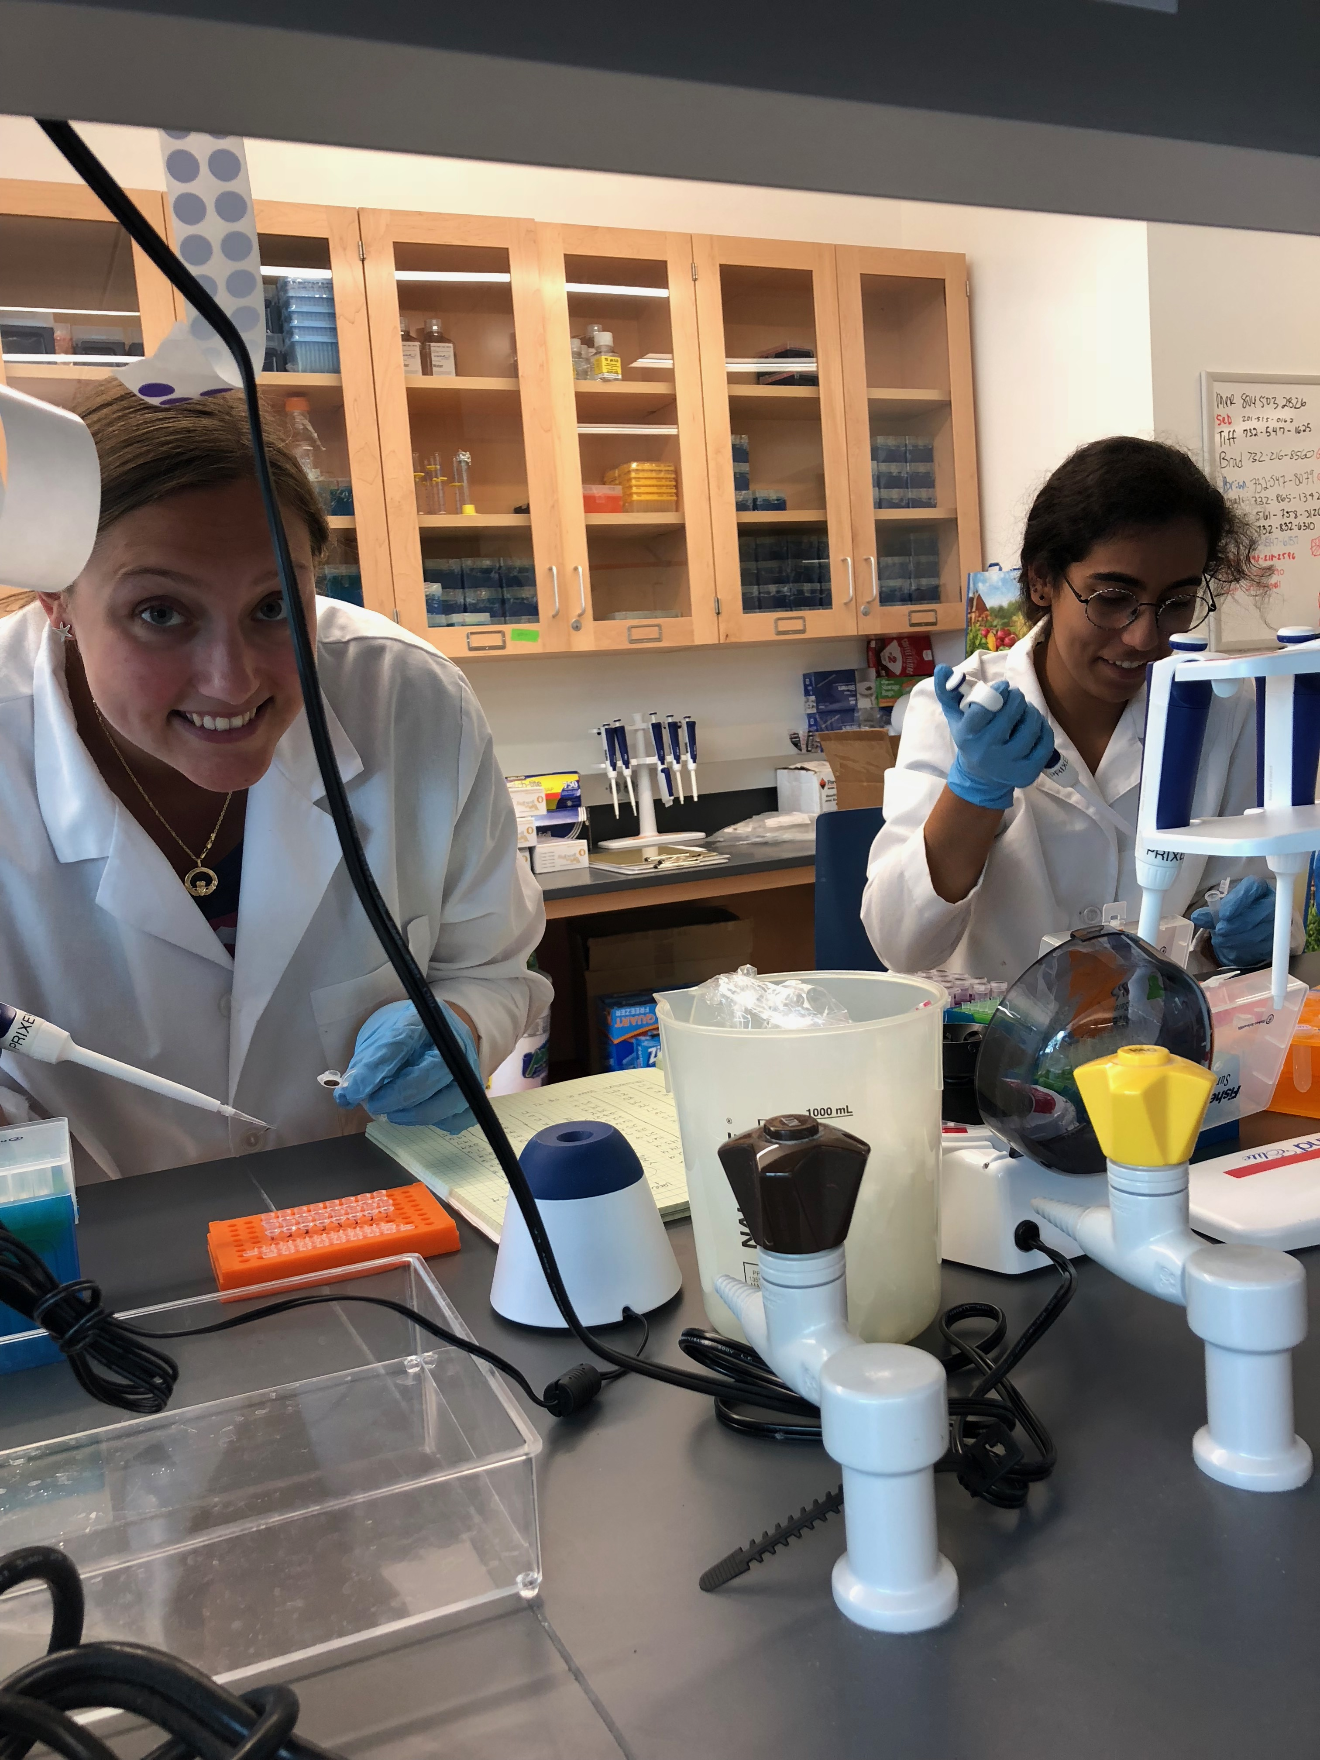
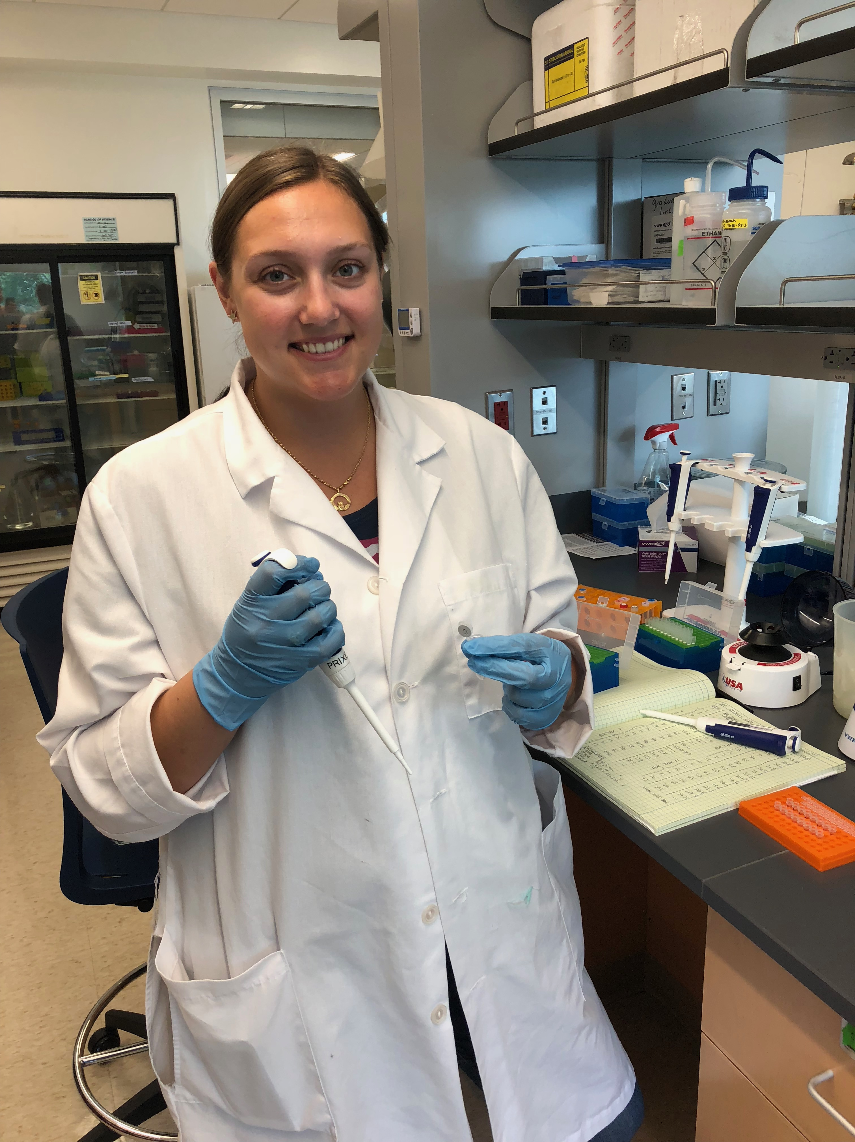
Extracting DNA for PCR

Slide 9
