Slide 1
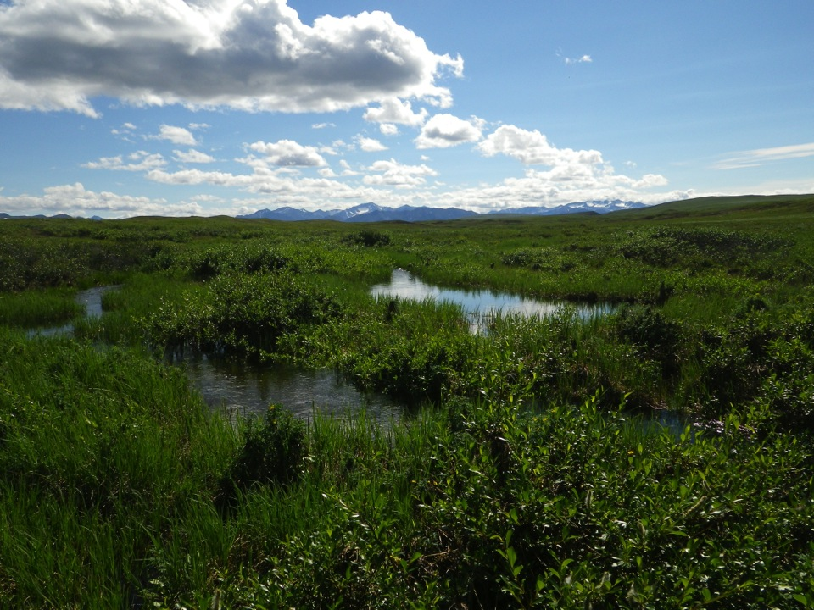
Streams as sensors: Arctic watersheds as indicators of change Data Nugget Slides

Slide 2
Where is the Arctic?
“Arctic”
Polar region above the “Arctic circle” 66° 33’N
Sun does not set and does not rise for at least one day per year
Region where average temperature for warmest month (July) is below 10°C (Koppen 1923)
Not geographically isolated
Glacial refuges
Ice-free coastal zone in summer
Relatively high plant and animal diversity
Notes:
“Arctic”: Not geographically isolated, Glacial refuges, Ice-free coastal zone in summer, Relatively high plant and animal diversity
Polar region above the “Arctic circle” 66° 33’N
Sun does not set and does not rise for at least one day per year
Region where average temperature for warmest month (July) is below 10°C (Koppen 1923)

Slide 3
What is permafrost?
Permafrost = Major C and nutrient ”sink”
“Permafrost is a term used to describe permanently frozen ground”
Richard D. Seifert, University of Alaska Fairbanks
Notes:
Land with underlying permafrost is called tundra. The arctic tundra is stark and treeless. Roots can't penetrate the frozen soil, so only moss, lichen, and low shrubs can grow there. In summer, the topmost layer of the permafrost melts, leaving behind soggy ground, marshes, bogs, and lakes.
Above-ground: Many permafrost landscapes can be recognized by distinct patterning of surface formed by repeated deep freezing in winter. Why? The very cold Arctic winter temperatures cause the frozen soils to contract across the land surface, resulting in a regular pattern of cracks much like drying cracks. Subsequently, the centimetre-wide and meter-deep cracks are then filled with snow melt water during the spring thaw. Thanks to the soil’s intense cold, the water then refreezes, creating vertical veins of ice that grow over decades to millennia into ice wedges.
Below-ground: “Permanently” frozen soil and rock. Permafrost is the Earth's largest "carbon sink". All the permafrost in the world stores more that twice the carbon that is present in the atmosphere (quoted from an interview posted on the NSIDC Web site). Under temperate conditions, dead animal and plant matter decays, releasing carbon dioxide and methane into the atmosphere. Frozen plant and animal matter does not decay, however (think about the frozen remains of human ancestors that have been discovered in recent years, like the Neolithic Ice Man Otzi, discovered in Germany in 1991). Some areas of permafrost have been frozen for thousands of years, preserving the plant and animal material trapped in its soils.

Slide 4
What is permafrost?
Permafrost = Major C and nutrient ”sink”
“Permafrost is a term used to describe permanently frozen ground”
Richard D. Seifert, University of Alaska Fairbanks
Notes:
Above-ground: Many permafrost landscapes can be recognized by distinct patterning of surface formed by repeated deep freezing in winter. Why? The very cold Arctic winter temperatures cause the frozen soils to contract across the land surface, resulting in a regular pattern of cracks much like drying cracks. Subsequently, the centimetre-wide and meter-deep cracks are then filled with snow melt water during the spring thaw. Thanks to the soil’s intense cold, the water then refreezes, creating vertical veins of ice that grow over decades to millennia into ice wedges.
Below-ground: “Permanently” frozen soil and rock. Permafrost is the Earth's largest "carbon sink". All the permafrost in the world stores more that twice the carbon that is present in the atmosphere (quoted from an interview posted on the NSIDC Web site). Under temperate conditions, dead animal and plant matter decays, releasing carbon dioxide and methane into the atmosphere. Frozen plant and animal matter does not decay, however (think about the frozen remains of human ancestors that have been discovered in recent years, like the Neolithic Ice Man Otzi, discovered in Germany in 1991). Some areas of permafrost have been frozen for thousands of years, preserving the plant and animal material trapped in its soils.

Slide 5
What is tundra?
Associated with areas of extreme near-polar climate which operates either directly, or through a series of environmental forcing (primarily thaw-layer dynamics) to limit productivity and biodiversity. But not always covered in snow!
Low annual precipitation (effectively a desert despite the freshwater stored in ice)
Flora and fauna characterized by substantial cold adaptation mechanisms
Shallow root systems
Low-lying plant bodies
Why? – Permafrost limits plant growth
Tundra =
treeless barren
Notes:
Land with underlying permafrost is called tundra. The arctic tundra is stark and treeless. Roots can't penetrate the frozen soil, so only moss, lichen, and low shrubs can grow there. In summer, the topmost layer of the permafrost melts, leaving behind soggy ground, marshes, bogs, and lakes.

Slide 6
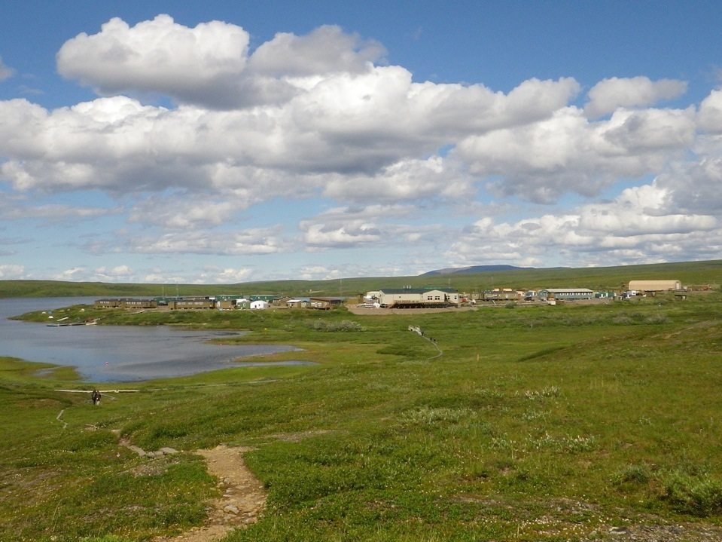
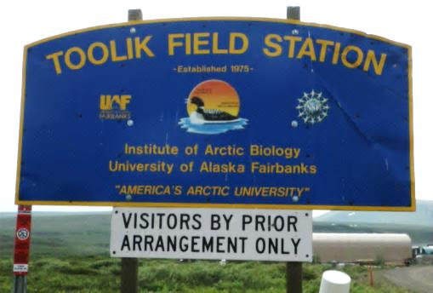
Where did the data come from?
Arctic Long-Term Ecological Research (LTER) Station at Toolik Field Station
Notes:
Toolik Field Station website: https://toolik.alaska.edu

