Slide 1
Fast weeds in farmer's fields
Featured scientists: Ashley Carroll from Gull Lake Middle School and Jeff Conner from the Kellogg Biological Station at Michigan State University

Slide 2
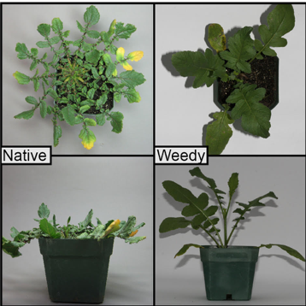
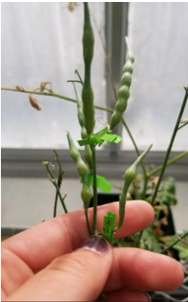
Notes:
Native and weedy radishes (left). Fruit of a radish plant (right).

Slide 3
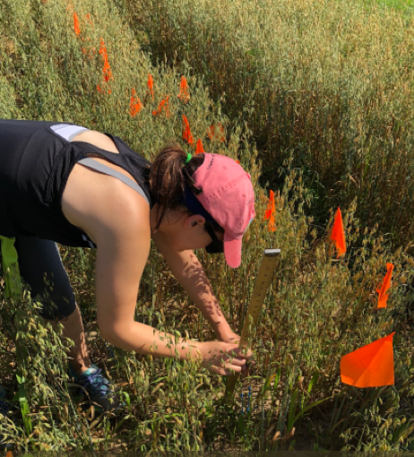
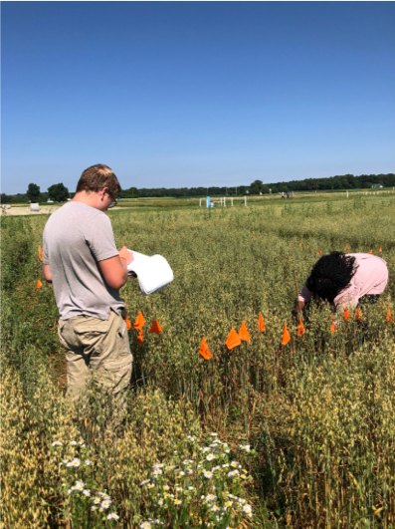
Notes:
Science teacher, Ashley Carroll collecting data on the traits of weedy and native radish (left). Two undergraduate students from Michigan State University making observations regarding the development of the weedy and native radish (right).

