Slide 1
Beetle, it’s cold outside!
Featured scientists: Caroline Williams & Andre Szejner Sigal, University of California, Berkeley & Nikki Chambers, Biology Teacher, West High School, Torrance, CA

Slide 2
Chill coma video
In the cold, insects and other ectotherms enter a reversible cold coma (chill coma)
Video: Heath MacMillan

Slide 3
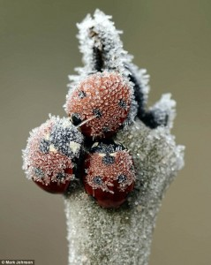
Insect cold hardiness
Cold requires individual to make protective molecules (e.g. sugars, sugar alcohols, amino acids, heat shock proteins)
Can be energetically expensive
Stress

Slide 4
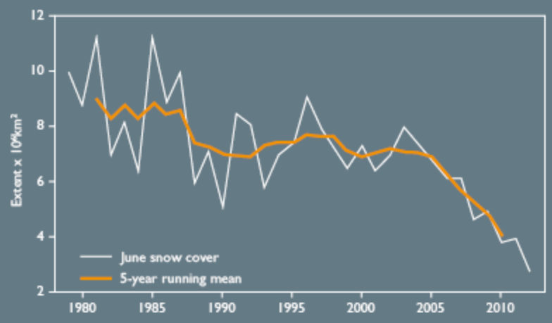
Climate change has caused there to be less snow cover in the winter

Slide 5
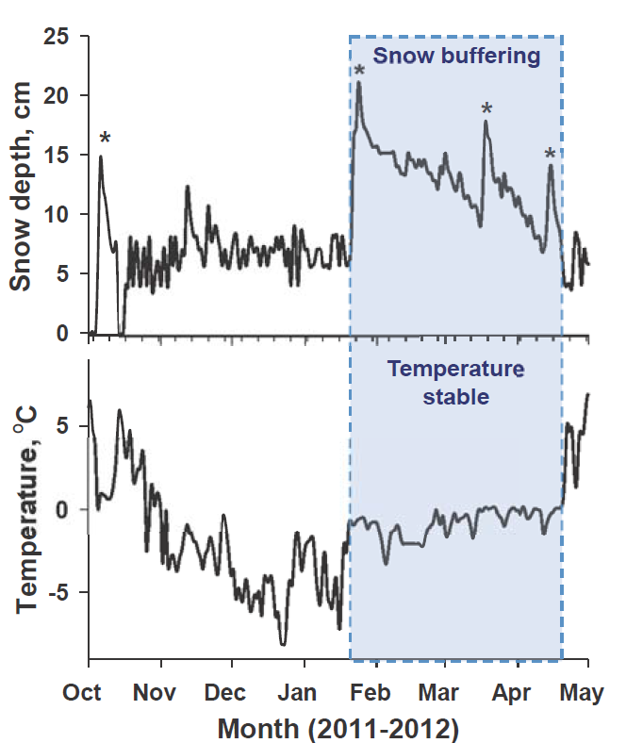
When there is more snow, the ground is warmer
Snow insulates the ground
Temperatures remain relatively warm and stable
Shocking result - colder soils in a warmer world!

Slide 6
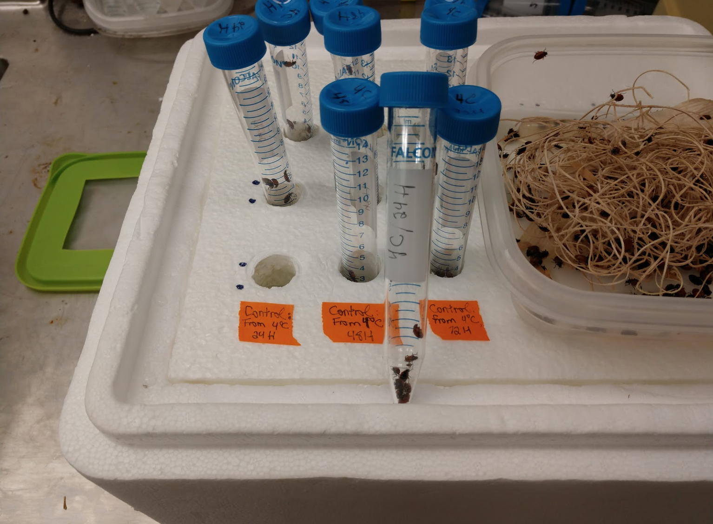
Beetles in their pre-testing habitat are on the right; tubes with beetles about to be immersed in a cooler filled with crushed ice are on the left.

Slide 7
more greenhouse gasses leads to atmosphere trapping more heat
leads to reduced snow fall and faster melting
soil exposed to cold air more often and for longer periods of time
climate change
warmer air temperature
less snow cover
colder soil temperature
colder ectotherm body temperatures
harms lady beetles and other ectotherms
longer chill comas
Notes:
Potential model

