Slide 1
Alien life on Mars –
caught in crystals?
Featured scientists: Charles Cockell, UK Centre for Astrobiology, University of Edinburgh, & Nikki Chambers, Astrobiology Teacher, West High School, Torrance, CA

Slide 2
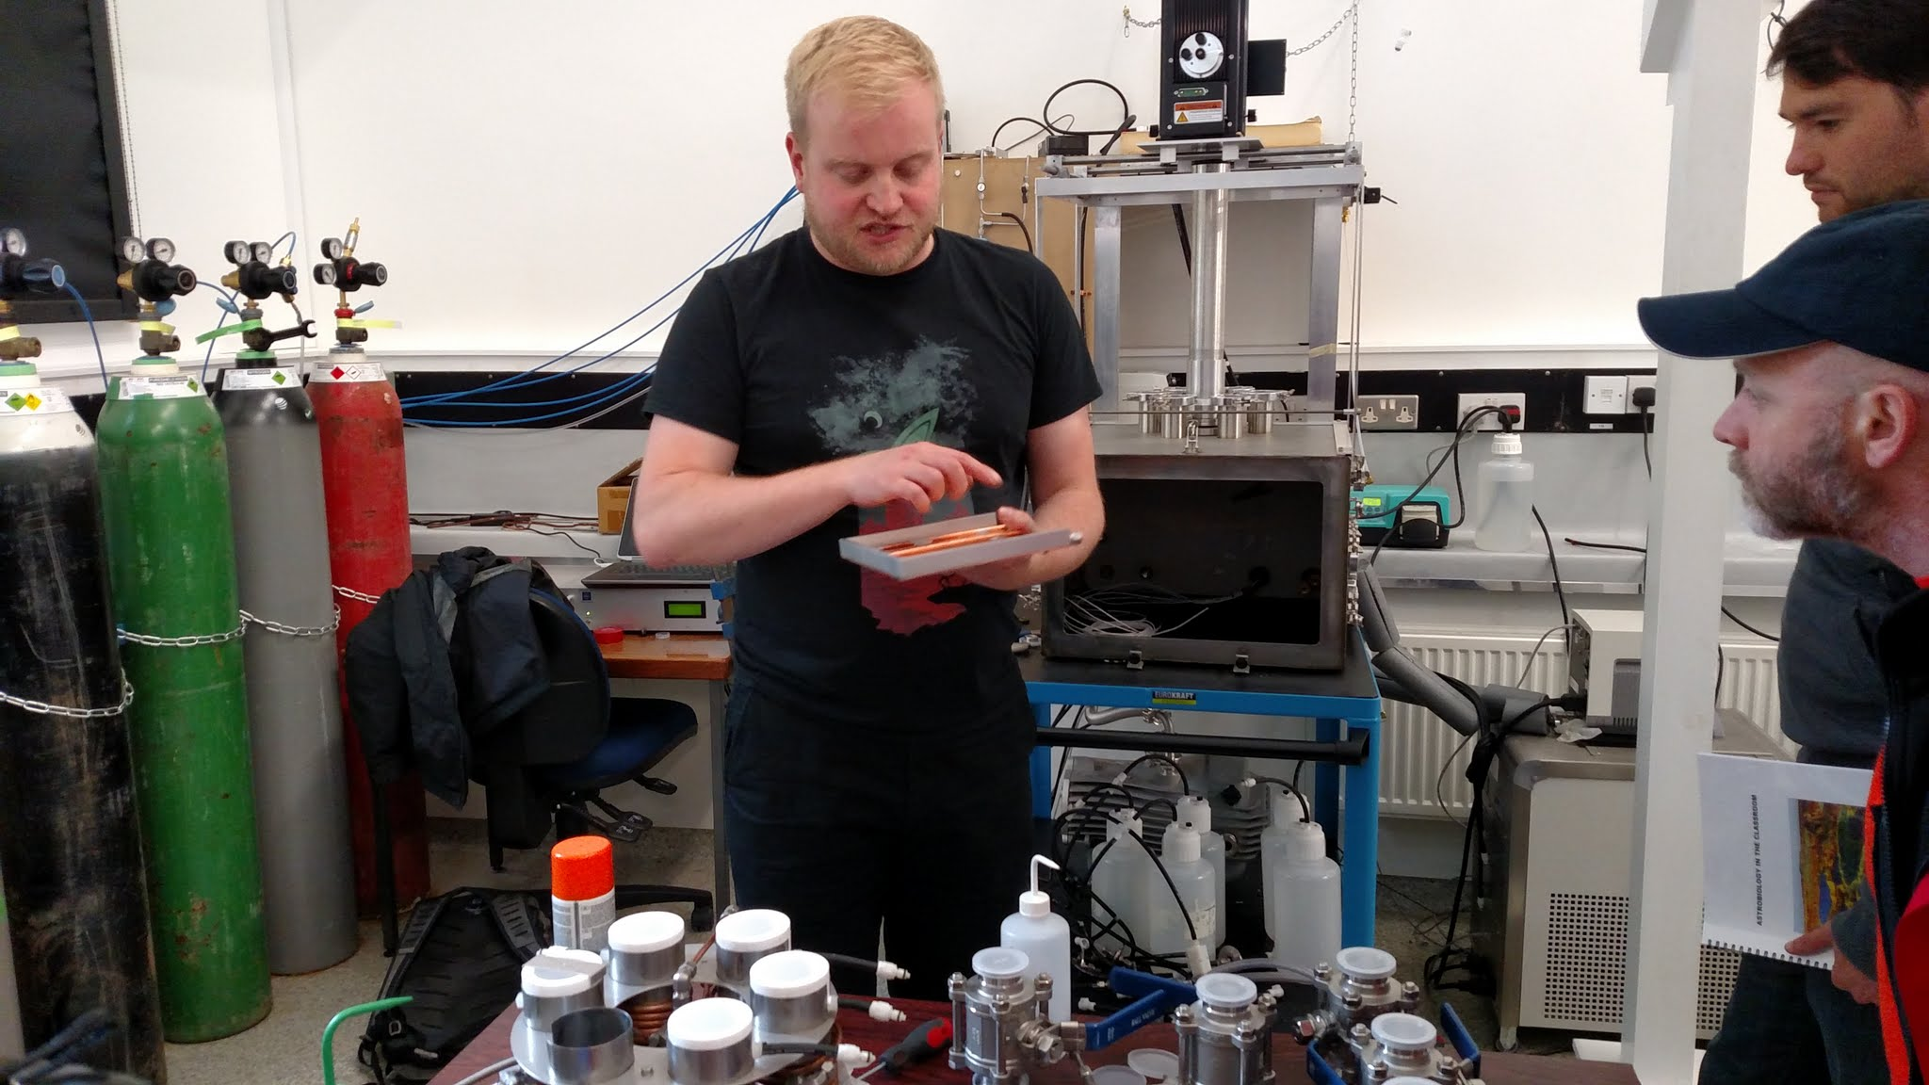
Photo of the astrobiology lab at the University of Edinburgh
Notes:
photos of the astrobiology lab at the University of Edinburgh

Slide 3
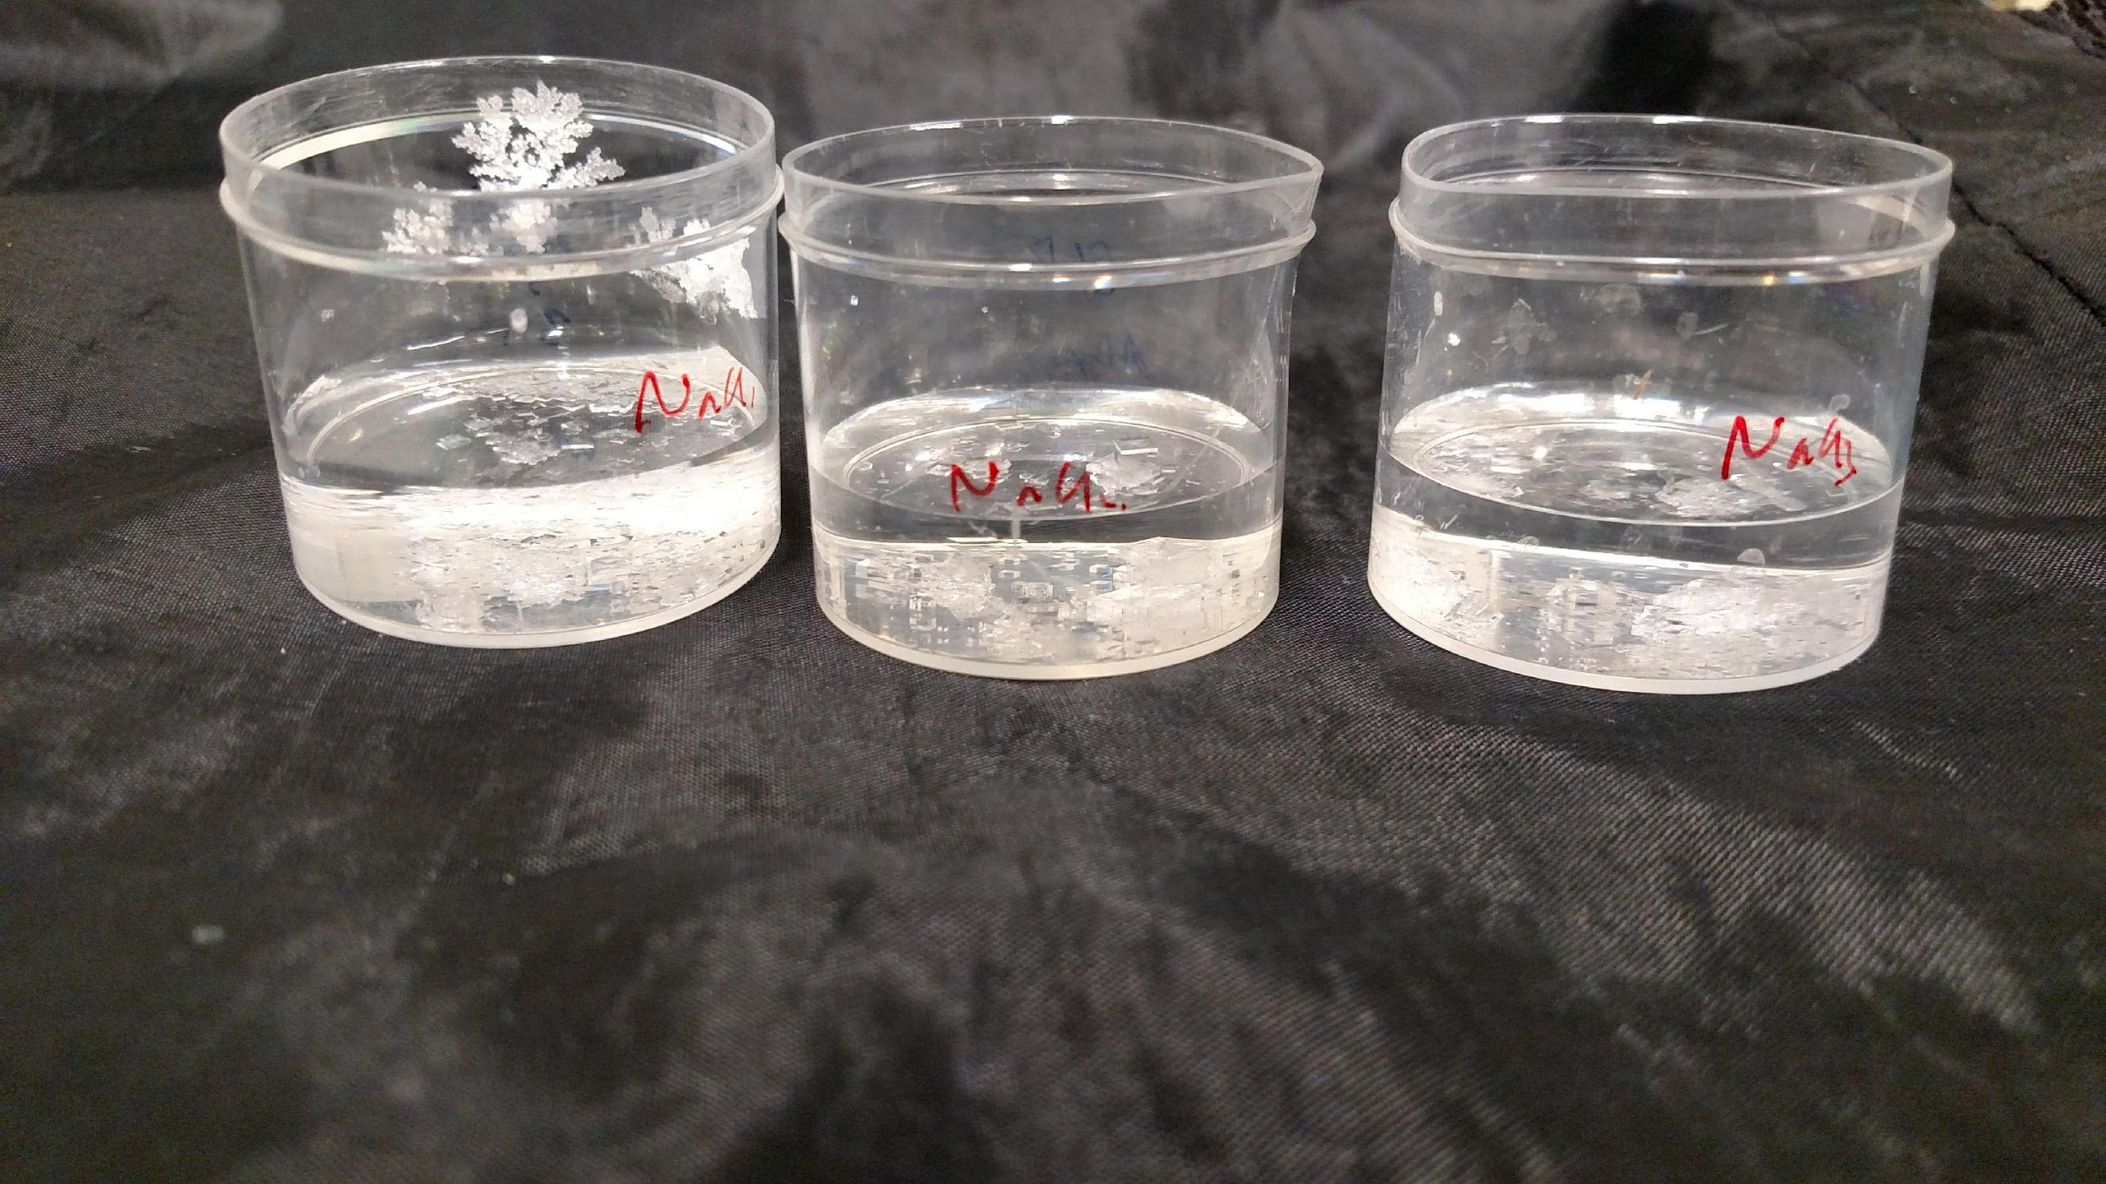
NaCl
Sodium chloride crystals forming – Day 3

Slide 4
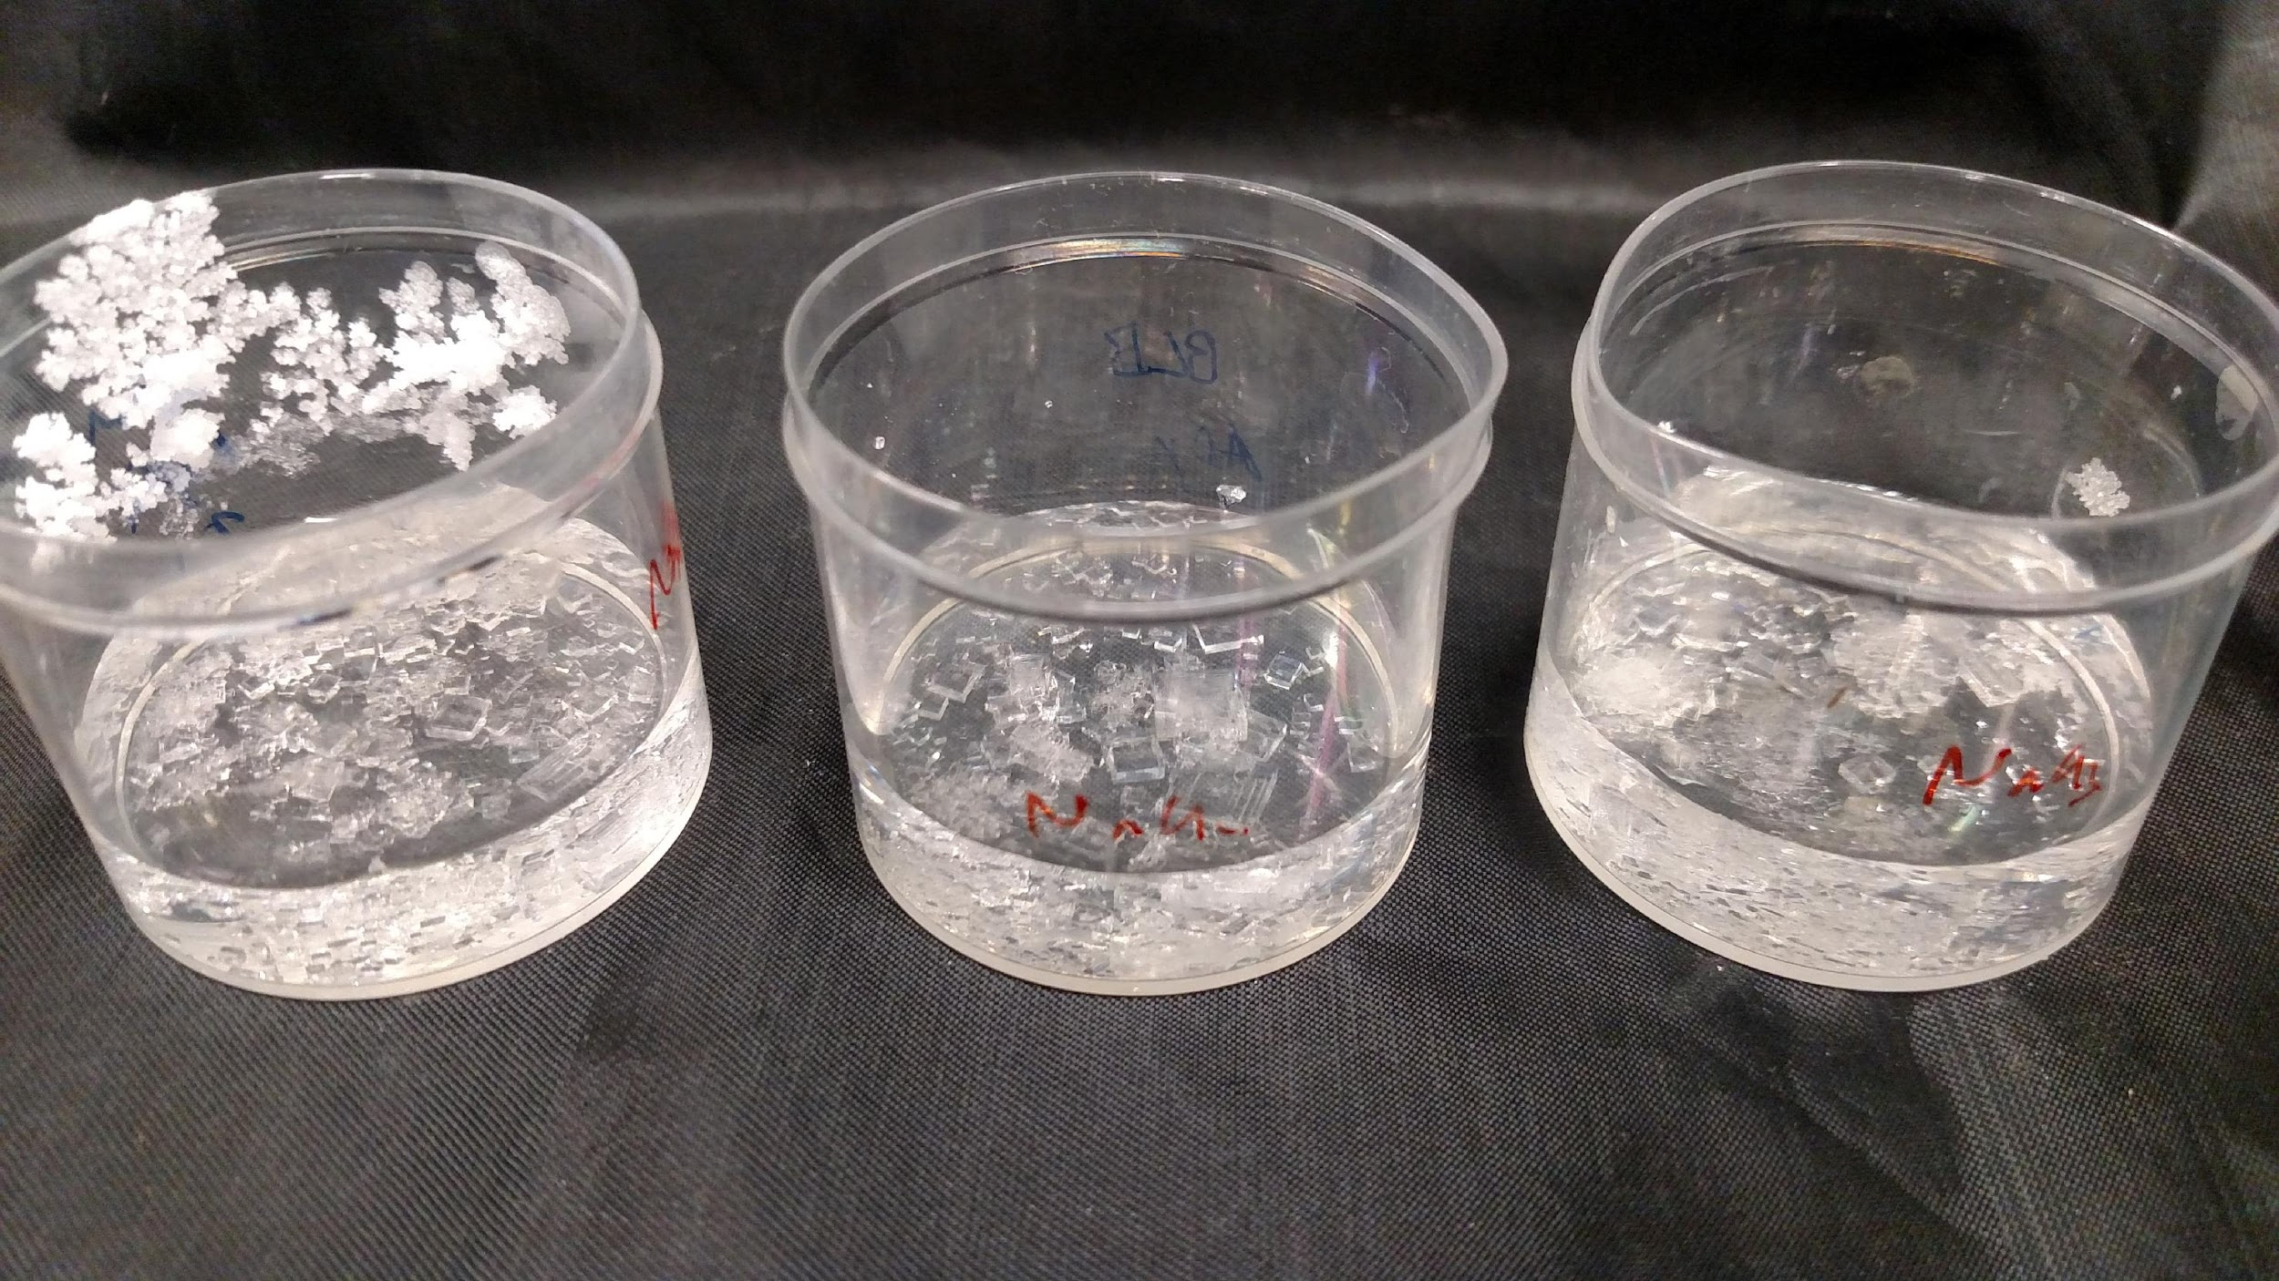
NaCl
Sodium chloride crystals – Day 7

Slide 5
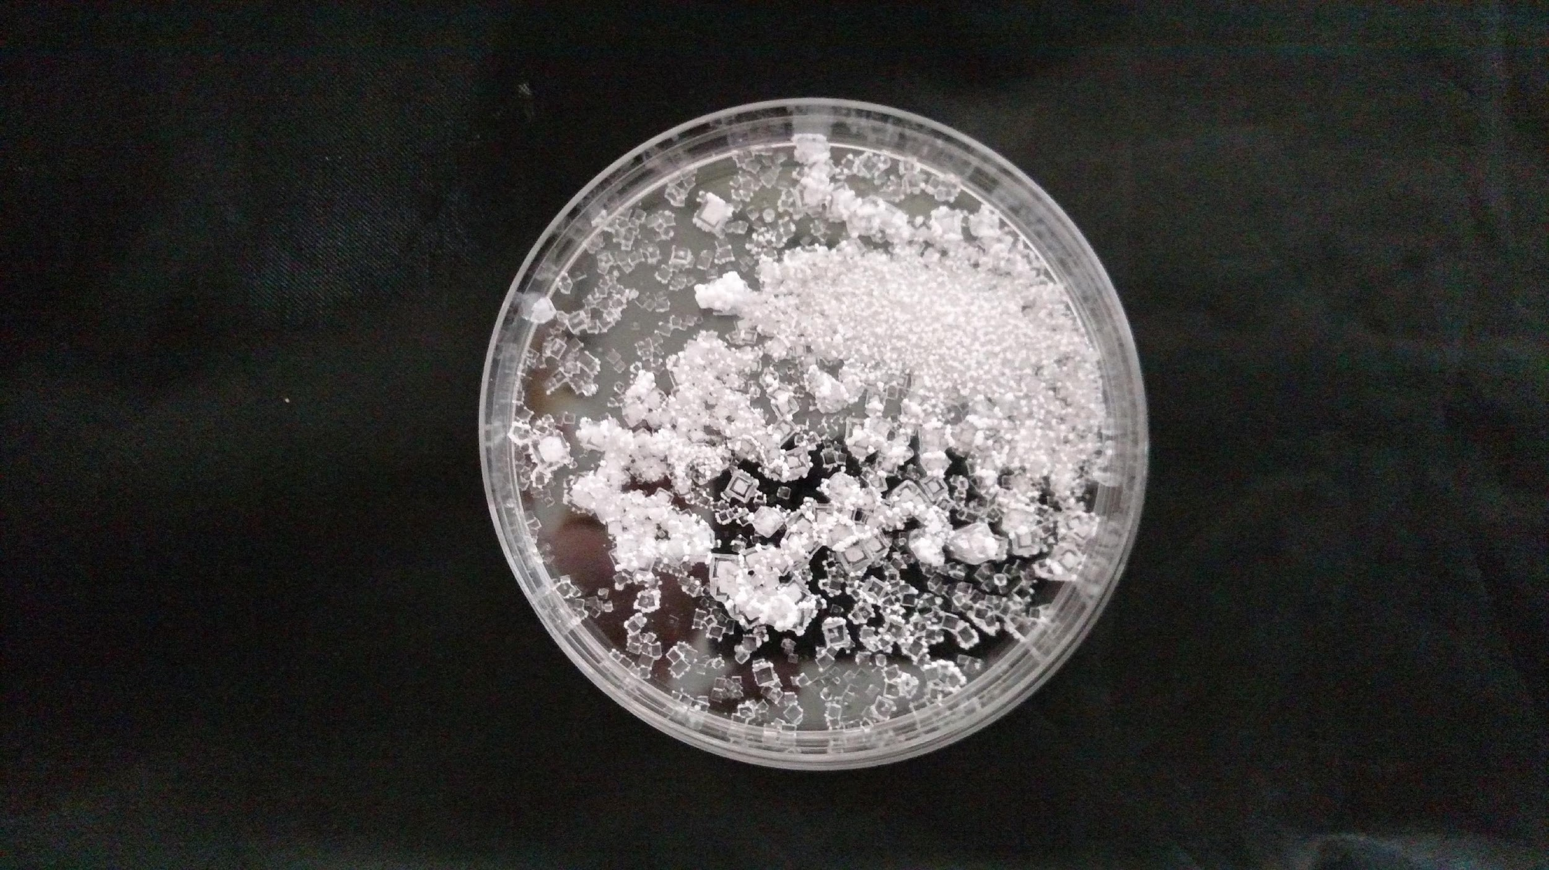
NaCl
Sodium chloride crystals, Day 14.
Very little mass change due to evaporation observed. No visible liquid water remains.

Slide 6
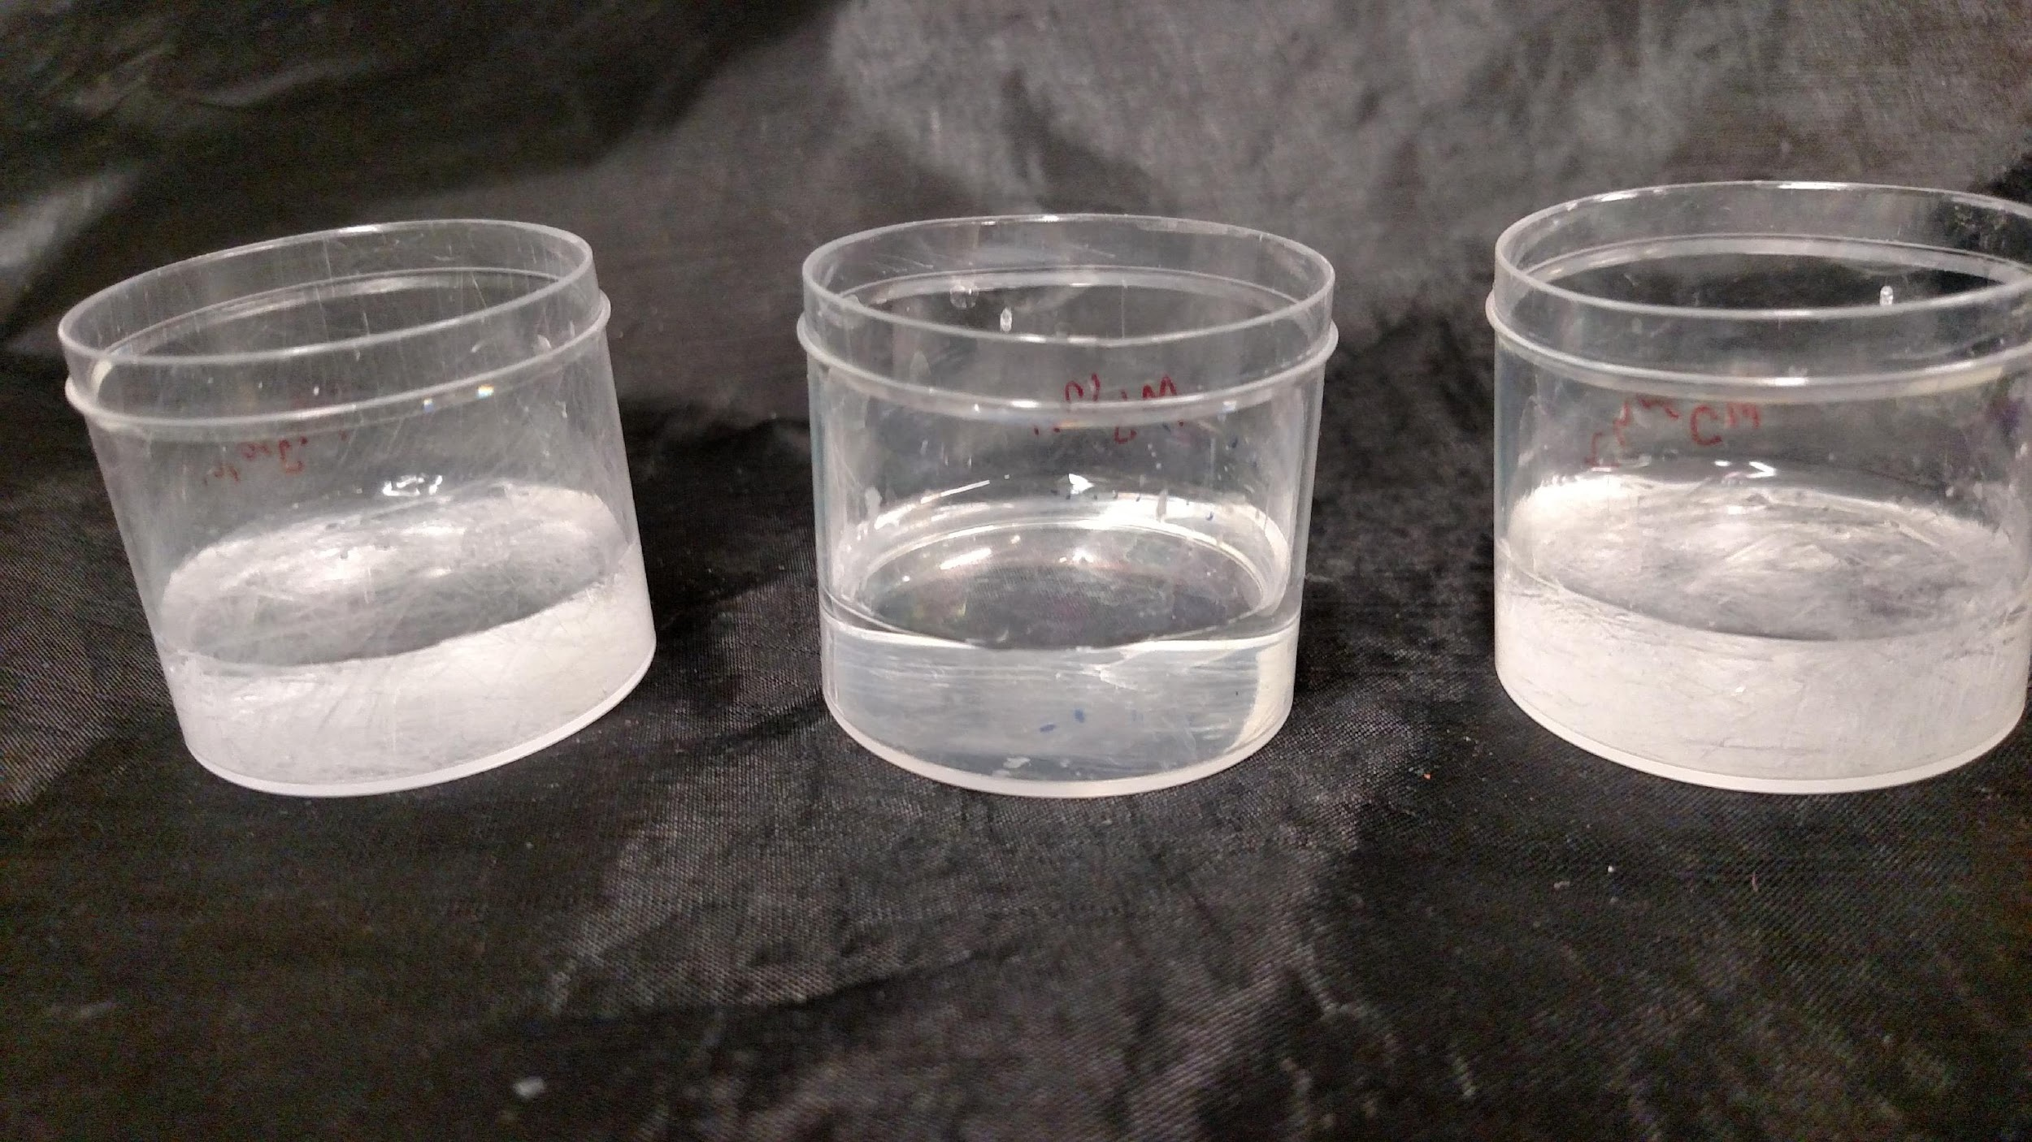
MgSO₄
Magnesium sulfate crystals forming – Day 3

Slide 7
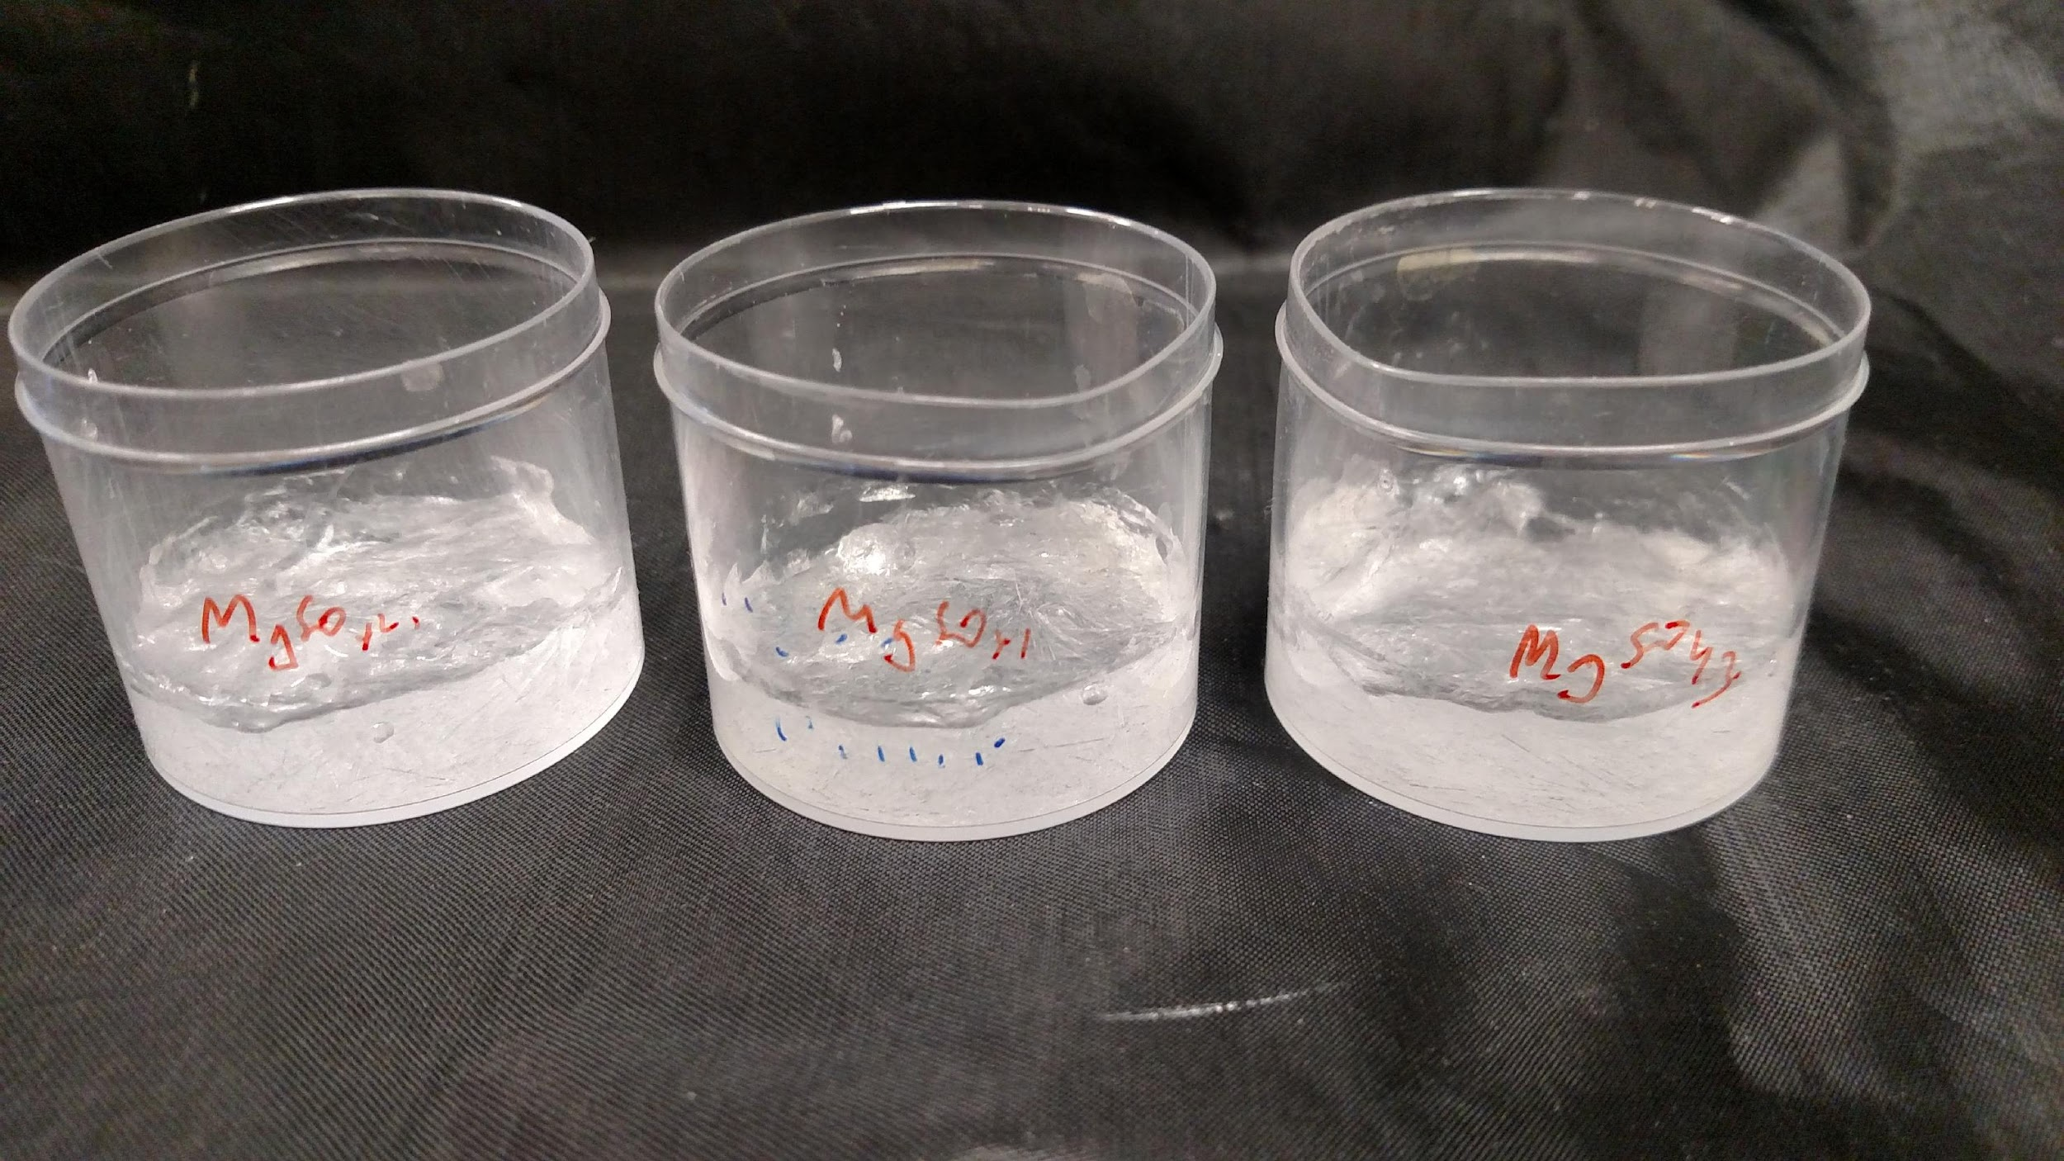
MgSO₄
Magnesium sulfate crystals – Day 7

Slide 8
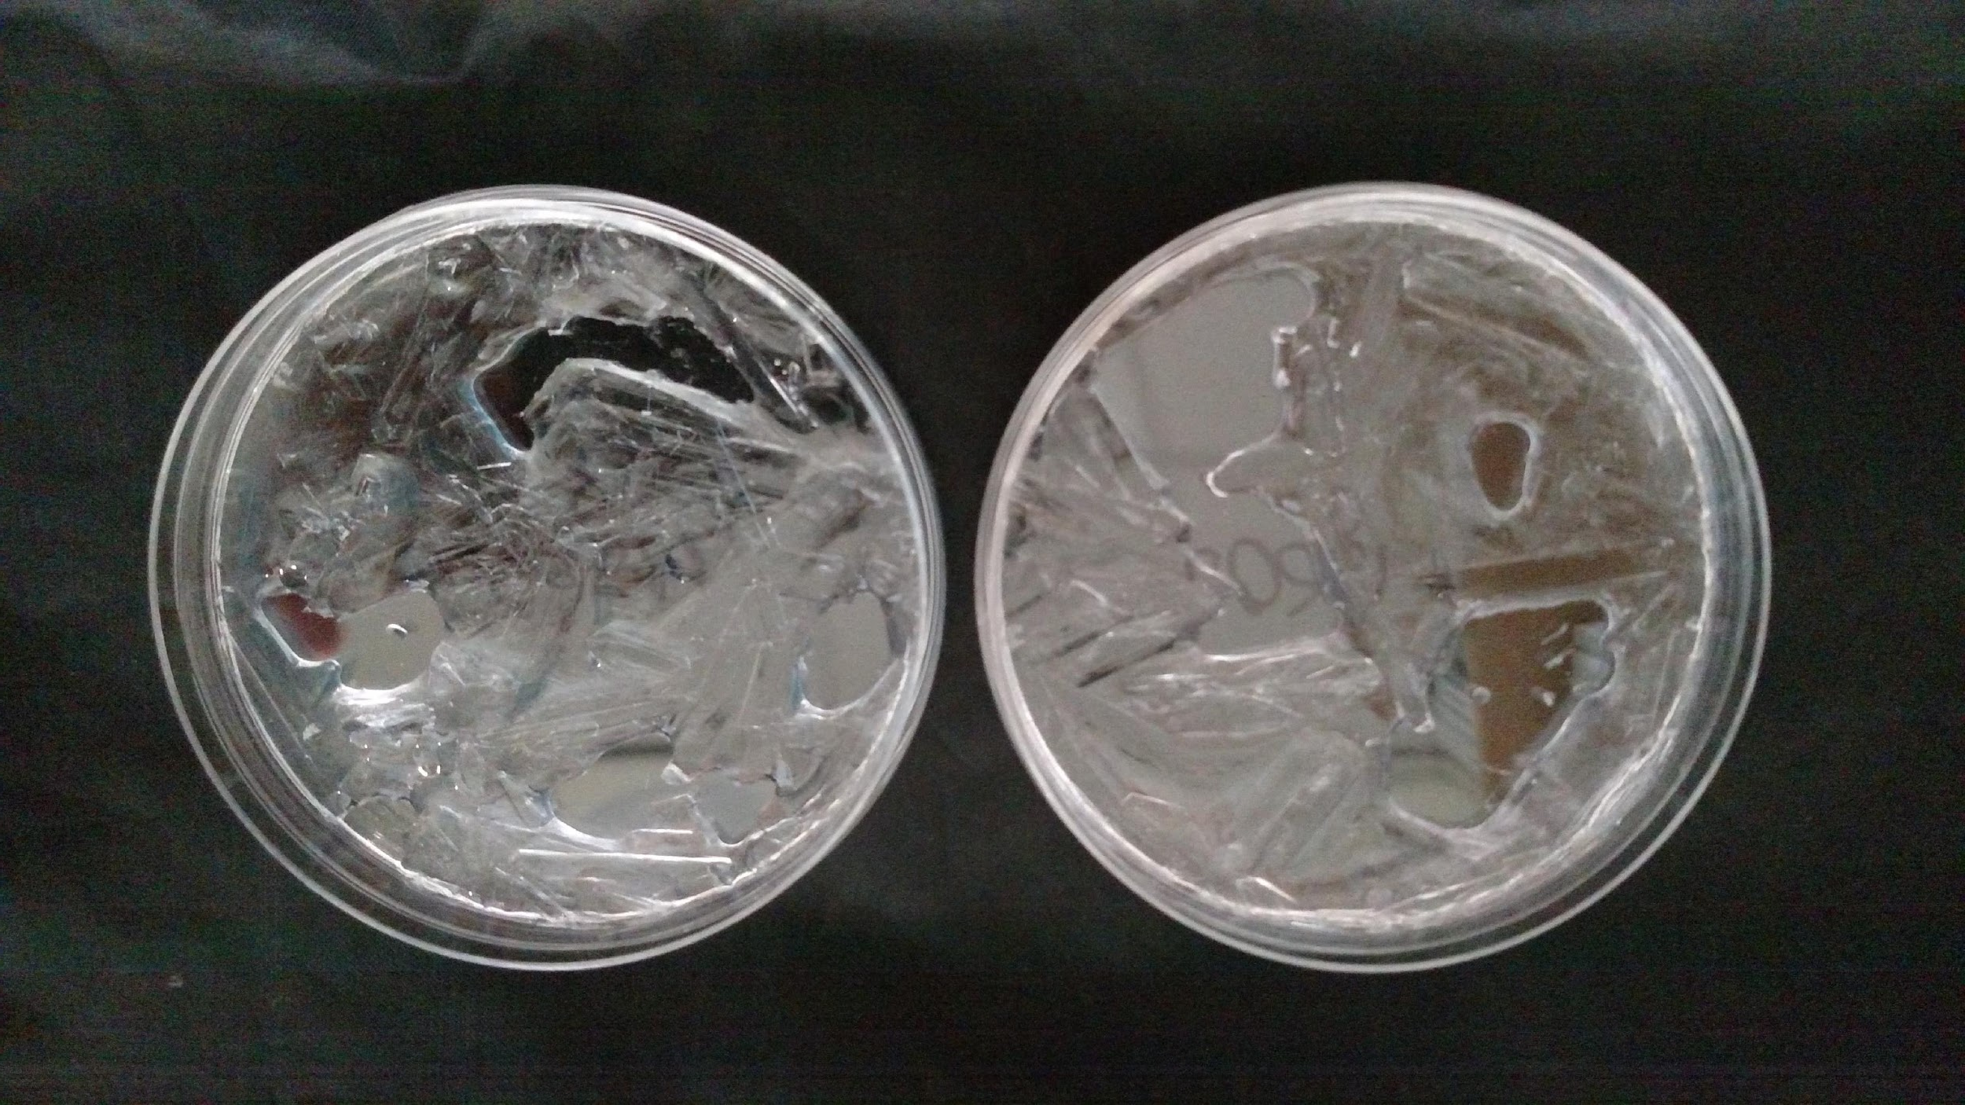
MgSO₄
Magnesium sulfate crystals, Day 14. No further mass change due to evaporation observed. Liquid water is visible in pockets throughout the crystals.

Slide 9
The lab is equipped with a low pressure flow-through chamber. This simulation chamber can be chilled to simulate flow-through in Mars-like conditions. It can be used to simulate pressure, temperature, UV illumination and has the facility to regulate the atmospheric gas composition by means of gas mass flow controllers.
Notes:
As students are discussing next steps and future research ideas (see Teacher Note)
https://www.astrobiology.ac.uk/facilities/low-pressure-flow-through-chamber

