Slide 1
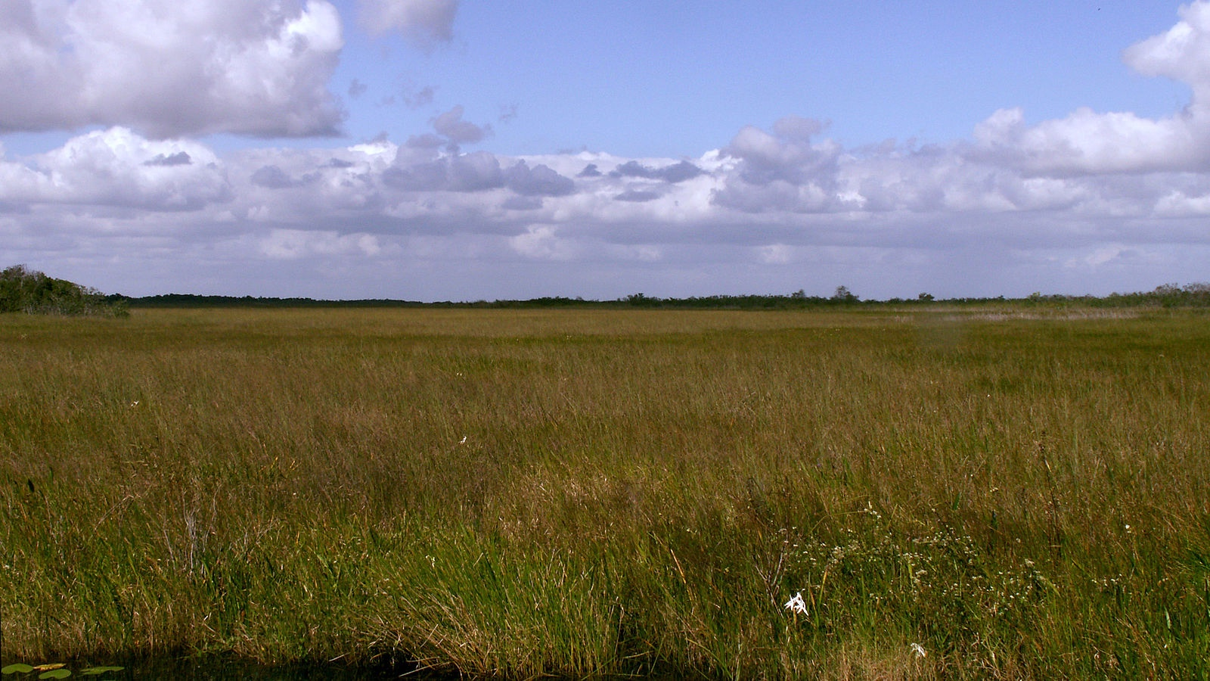
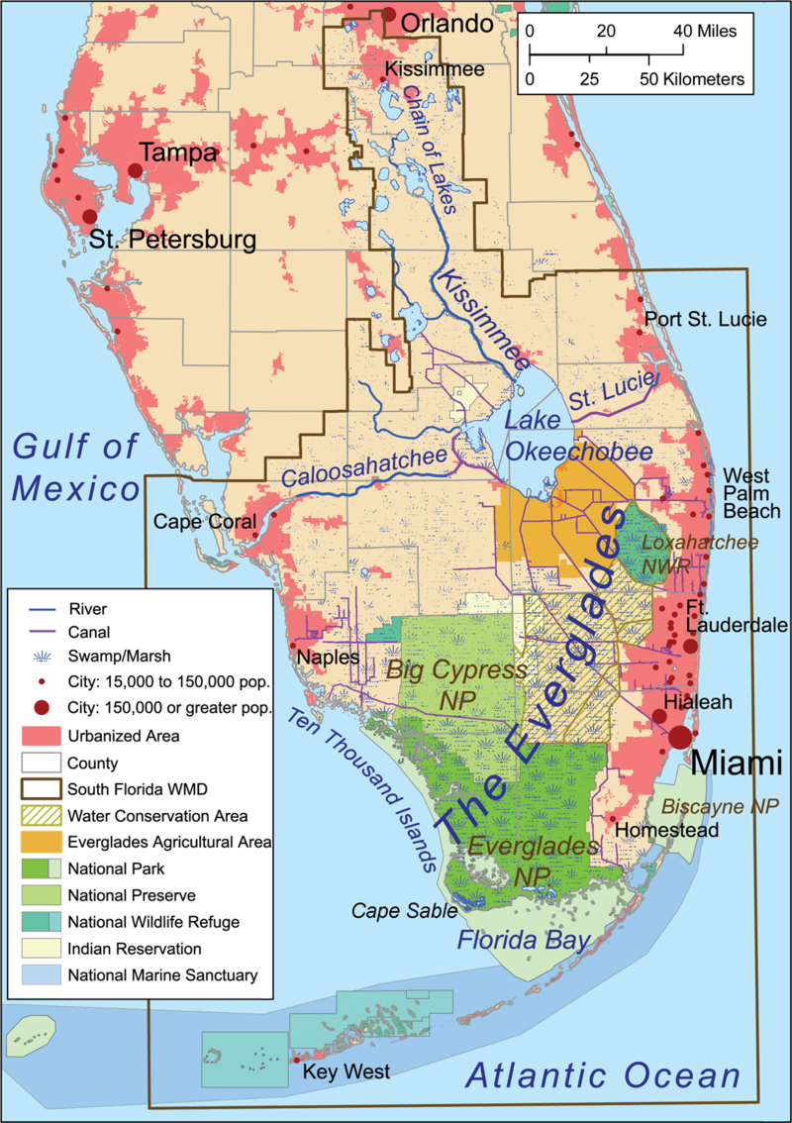
Notes:
As winds blow through the large expanses of grass in the Florida Everglades, it looks like flowing water. This “river of grass” is home to a wide diversity of plants and animals, including both the American Alligator and the American Crocodile. The Everglades ecosystem is the largest sub-tropical wetland in North America.
Sawgrass prairie in Everglades National Park north of Anhinga Trail
https://commons.wikimedia.org/wiki/File:Everglades_Sawgrass_Prairie_Moni3.JPG

Slide 2
Notes:
This is Shelby (left) and John (right), two scientists studying how climate change is impacting the Everglades. John became fascinated with the Everglades during his first visit 10 years ago and has been studying this unique ecosystem ever since. Shelby is interested in learning how climate change will affect the environment, and the Everglades is a great place to start!

Slide 3
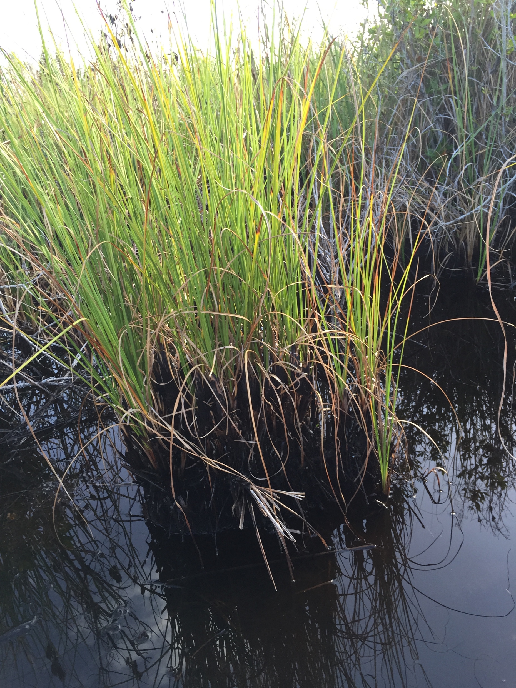
Shelby and John are ecologists who work in southern Florida. They are both very concerned with protecting the Everglades and other wetlands. Recently when John, Shelby, and their fellow scientists were out working in the Everglades they noticed something very strange. It looked like areas of the wetland were collapsing! What could be the cause of this strange event?

Slide 4
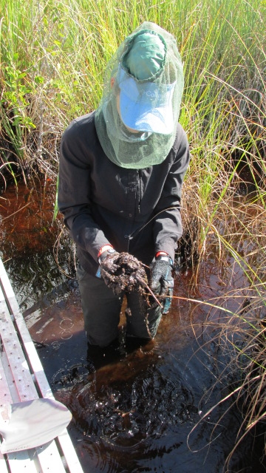
To figure out what was causing soil collapse, Shelby started by collecting soil samples from areas where she observed this phenomena. She then brought these soils back to the lab to run her experiment.

Slide 5
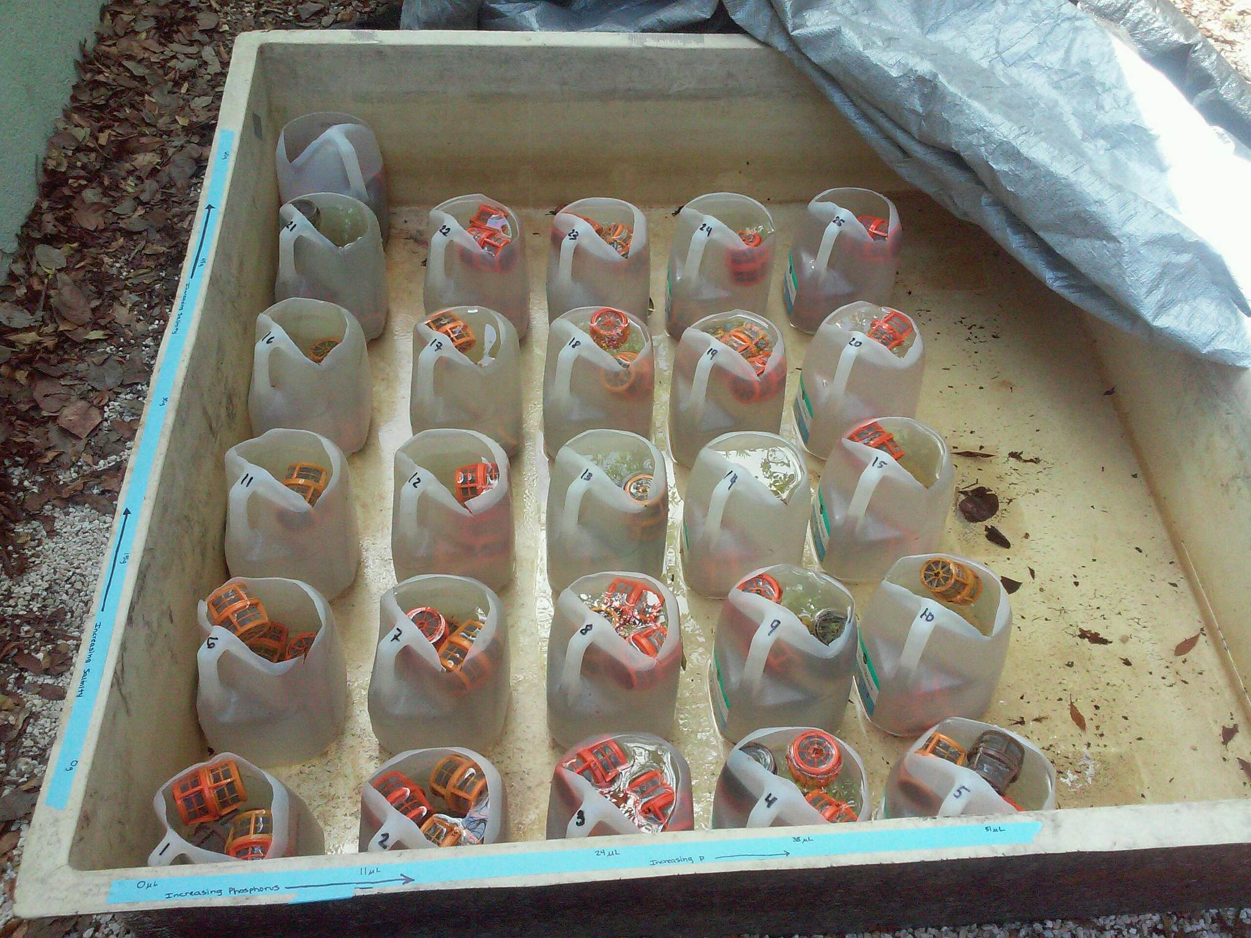
This image shows the experimental setup. Each container has a different salt and phosphorus concentration.

Slide 6
Chemical equation for aerobic respiration and photosynthesis. One byproduct of respiration is CO₂.
respiration
6CO₂ + 6H₂O ↔ C₆H₁₂O₆ + 6O₂
photosynthesis
Notes:
With rising seas, one important feature of the Florida Everglades may change. There are currently large amounts of carbon stored in the wetland’s muddy soils. By holding carbon in the mud, coastal wetlands are able to help in the fight against climate change. However, under stressful conditions like being submersed in sea water, soil microbes increase respiration. During respiration, carbon stored in the soil is released as carbon dioxide (CO₂), a greenhouse gas. As sea level rises, soil microbes are predicted to release stored carbon and contribute to the greenhouse effect, making climate change worse.

