Slide 1
What big teeth you have! Sexual selection in rhesus macaques
Featured scientists:
Raisa Hernández-Pacheco from University of Richmond
Damián A. Concepción Pérez from Wilder Middle School

Slide 2
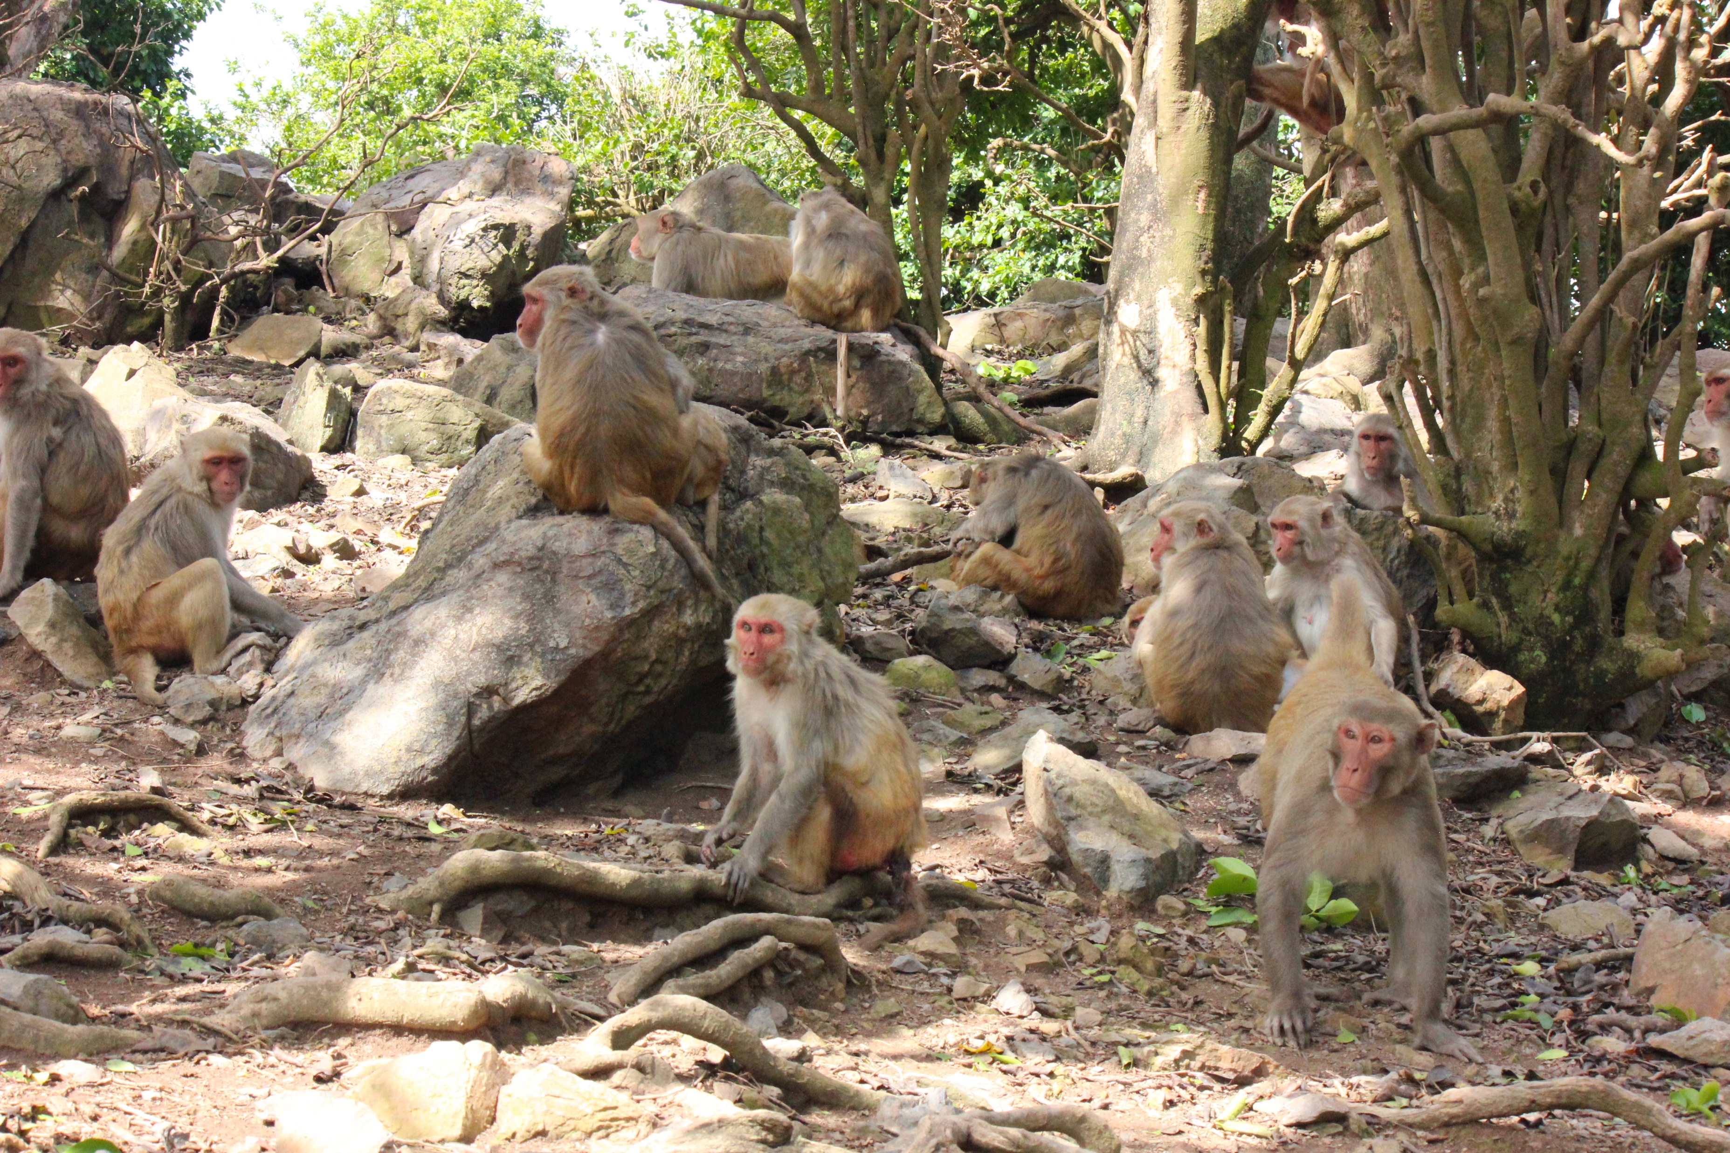
Notes:
Cayo Santiago rhesus macaques. Photo by Raisa Hernández Pacheco.
In Cayo Santiago there is one of the oldest free-ranging rhesus macaque colony in the world. This population has no predators and food is plentiful. Scientists at Cayo Santiago have gathered data on these monkeys and their habitat for over 70 years. Every year when new monkeys are born they are captured, marked with a unique tattoo ID, and released. This program allows scientists to monitor individual monkeys over their entire lives and record the sex, date of birth, and date of death.

Slide 3
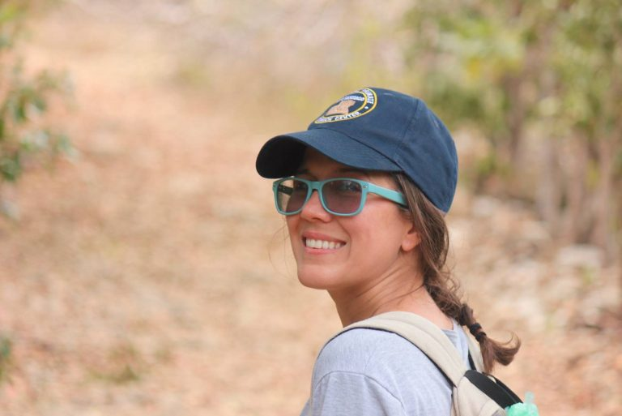
Notes:
Raisa Hernández Pacheco: Interested in understanding the drivers shaping population dynamics, Raisa has dedicated her studies to modeling the effects of biotic and abiotic factors on populations of invertebrates and vertebrates. She joined the Caribbean Primate Research Center and the Max-Planck Odense Center to study the long-term dynamics of the Cayo Santiago rhesus macaque population.

Slide 4

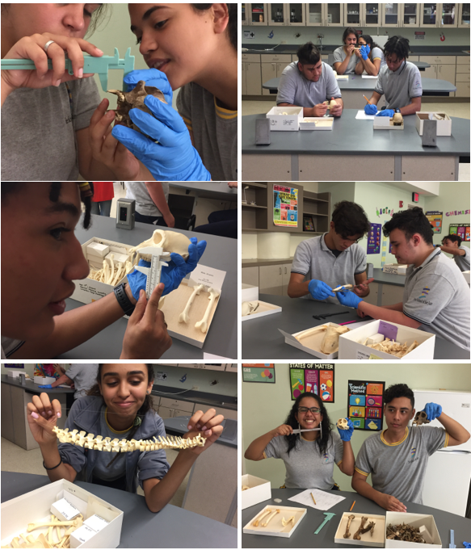
Notes:
Damián A. Concepción Pérez: I am currently a Physical Science Middle School teacher in Richmond, VA, and an Integrated Curriculum in Math and Science student at American College of Education. My main goal is to motivate my students about learning, enjoining science, and maybe pursuing a career in a STEM field by providing them engaging and fun experiences in the classroom.
Developer of “Unknown Bones” lesson plan - https://mathsciconcep.weebly.com/about.html

Slide 5
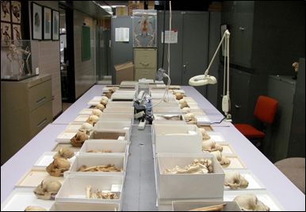
Research conducted at the Laboratory of Primate Morphology at the University of Puerto Rico Medical Sciences Campus.
Notes:
Photo from http://cprc.rcm.upr.edu/?q=lpm
The LPM strongly encourages researchers to visit and study the skeletal collection on site.
MORE IMAGES CAN BE FOUND IN THEIR GALLERY: http://cprc.rcm.upr.edu/?q=gallery

Slide 6
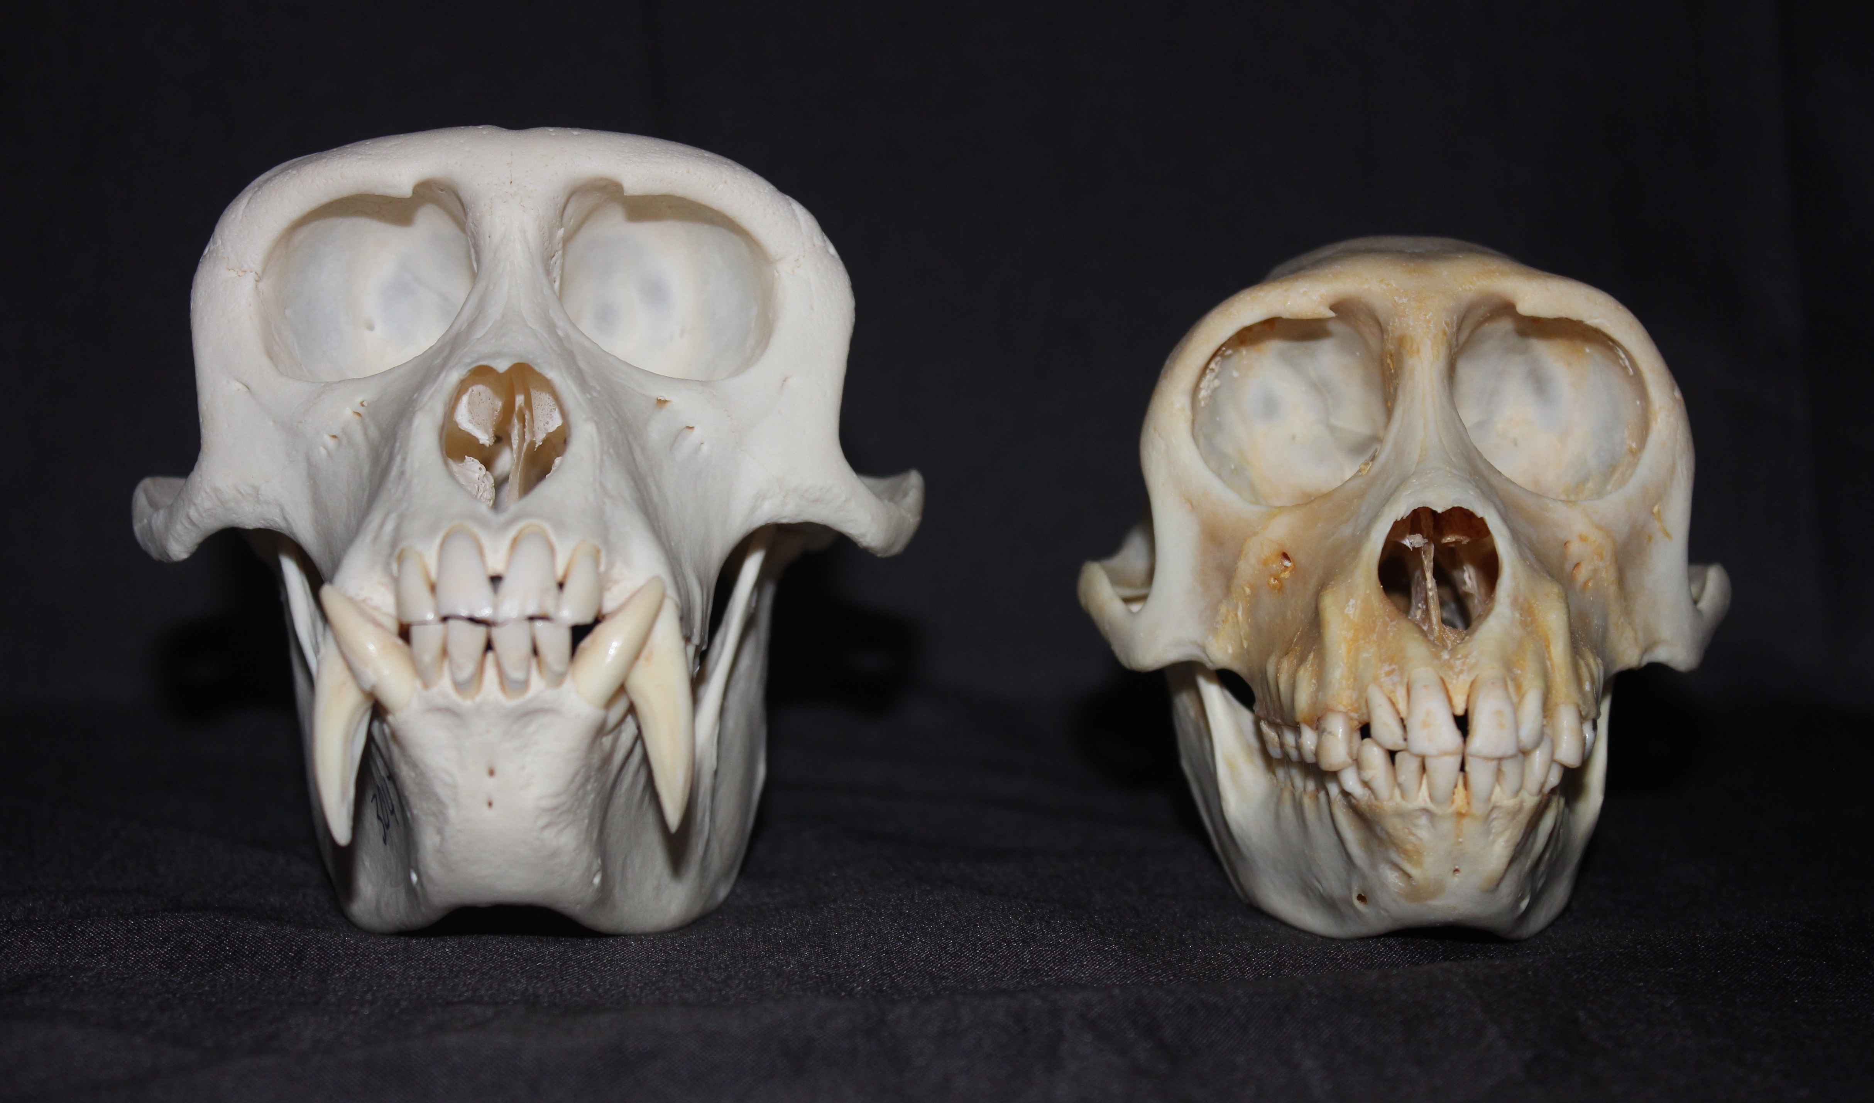
Notes:
Craniums of an adult male (left) and an adult female (right) rhesus macaque. Photo by Raisa Hernández Pacheco and Damián A. Concepción Pérez.
Once a monkey dies and its body is recovered in the field, skeletal specimens are stored in a museum for further research. These skeletal specimens can be used by scientists today to ask new and exciting questions.

Slide 7
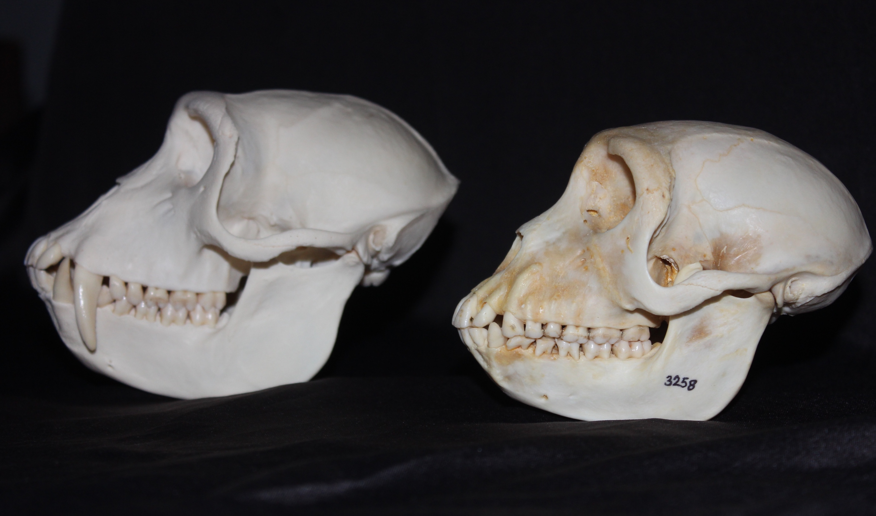
Notes:
Craniums of an adult male (left) and an adult female (right) rhesus macaque. Photo by Raisa Hernández Pacheco and Damián A. Concepción Pérez.

Slide 8
Notes:
Damián A. Concepción Pérez measuring canine length (left) and femur length (right) in a rhesus macaque skeletal specimen. Photos by Raisa Hernández Pacheco.
Raisa and Damián are both interested in studying sexual dimorphism in rhesus macaques. They want to find out what causes the differences between the sexes. To do this they chose to study the length of canine teeth in male and female monkeys. They measured canine length of four male and four female rhesus skeletal specimens dating back to the 1970s. Measurements were only taken from individuals that died as adults to make sure canines were fully developed and that differences in length could not be attributed to age. Raisa and Damián predicted that males would have significantly longer canines compare to those of females.

