Slide 1
Which would a woodlouse prefer?
Featured scientist:
Nora Straquadine from
Michigan State University

Slide 2
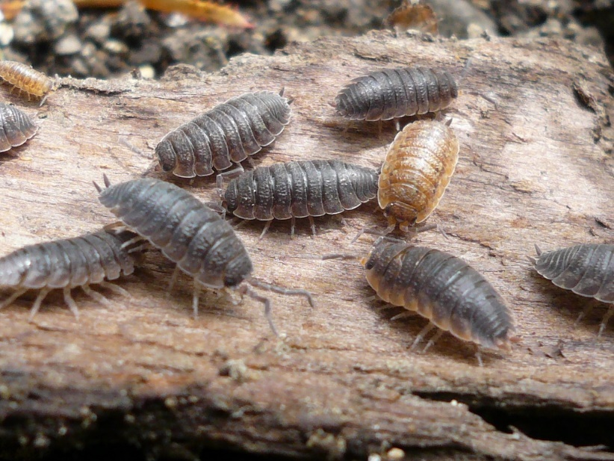
Woodlice are small crustaceans that live on land. They look like bugs, but are actually more closely related to crabs and lobsters!
Notes:
Photo credit Liz Henwood 2009. Here you can see the color variation in the woodlice.
Another name for woodlouse is sowbugs, which are different from pillbugs. They don't roll up to protect themselves and they have a second set of antennae even though they are not always visible. Also, they have slight tails that extend past their last abdominal segment. They are from the Family Oniscidae.

Slide 3
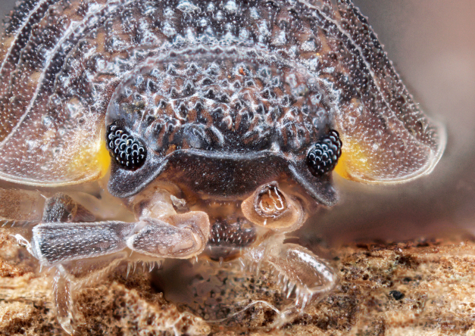
This is a close up of the eyes of a woodlouse. Compared to other crustaceans they have bad eyesight. Because they live in low light they have no need for great vision.
Notes:
Copyright 2012 Ernie Cooper www.macrocritters.wordpress.com

Slide 4
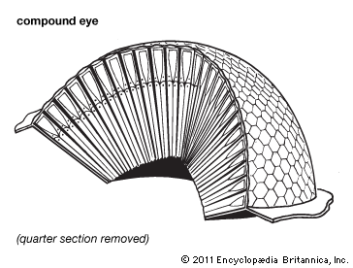
Close up of a compound eye, notice how there are multiple lenses compared to a human’s single lens.

Slide 5
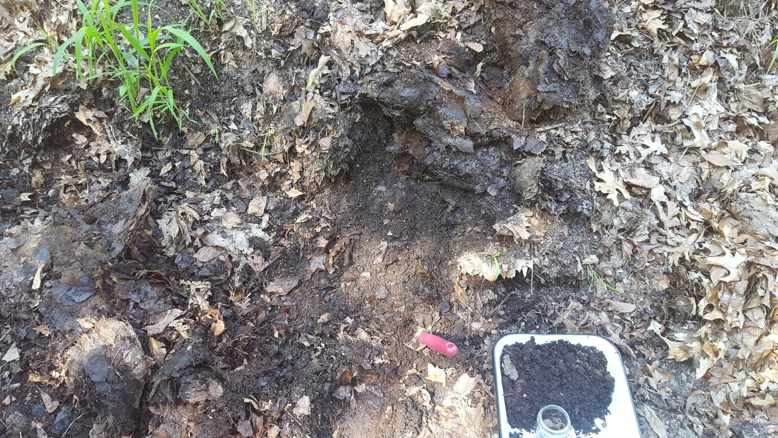
Picture of the compost pile where Nora collected the crustaceans she used for her experiment.

Slide 6
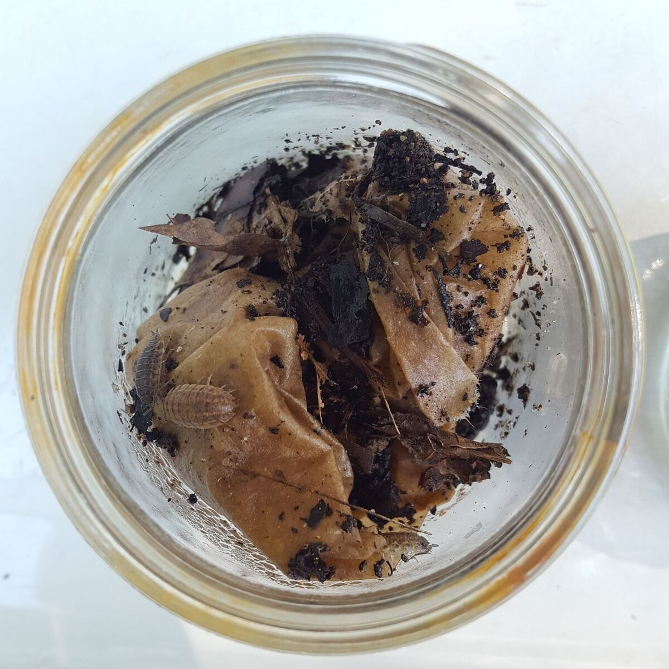
After the woodlice were collected from the compost pile, Nora put them into glass collection jars with a wet paper towel for moisture/humidity control.
Notes:
Ask students if they can see the woodlice in the image. It might be tough to see them against the brown paper towel and soil that is in the jar.
How many are in the photo? 3!

Slide 7
The tray where the preference trials were conducted. To the right of the tray is the soil pile, and to the left is the leaf pile. The center was purposefully left empty and wiped down before each run.

Slide 8
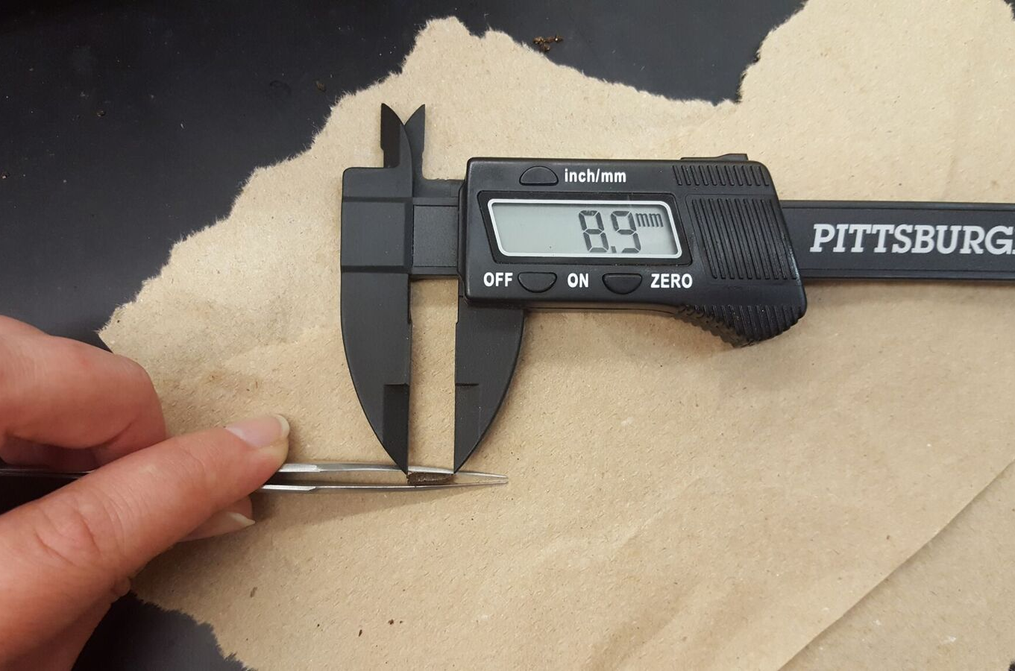
Nora measures a woodlouse’s length (mm) with calipers.
Notes:
References
Bruce-White, C., & Shardlow, M. (2011). A Review of the Impact of Artificial Light on Invertebrates. Peterborough, UK: Buglife-The Invertebrate Conservation Trust.
Elofsson, R. (2006). The frontal eyes of crustaceans. Arthropod Structure and Development, 35(4), 275-291. https://doi.org/10.1016/j.asd.2006.08.004

