Slide 1
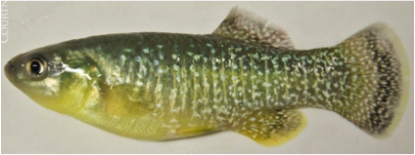
Make Way For Mummichogs
Featured scientists: Liz Duff and Robert Buchsbaum from Mass Audubon
Written by: Maria Maradianos, Samantha Scola, and Megan Wagner

Slide 2
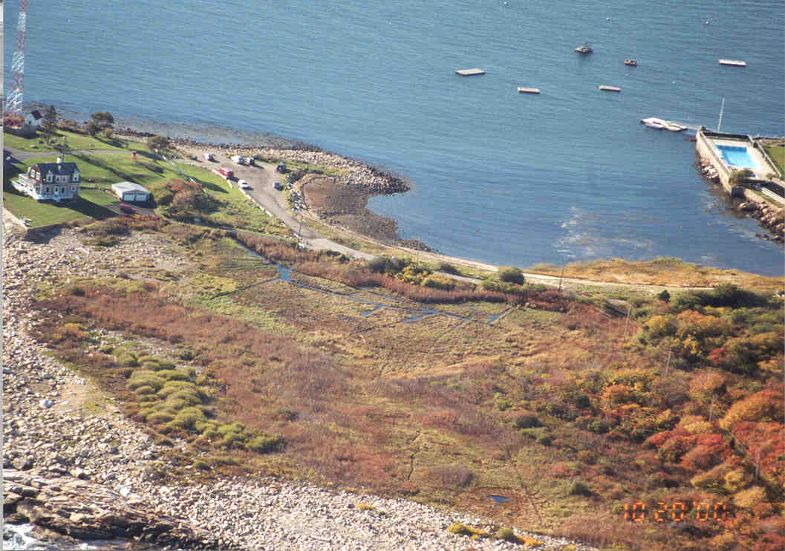
Notes:
This is an aerial view of the Eastern Point Wildlife Sanctuary before restoration. You can see here that there is no connection between the stream and ocean.

Slide 3
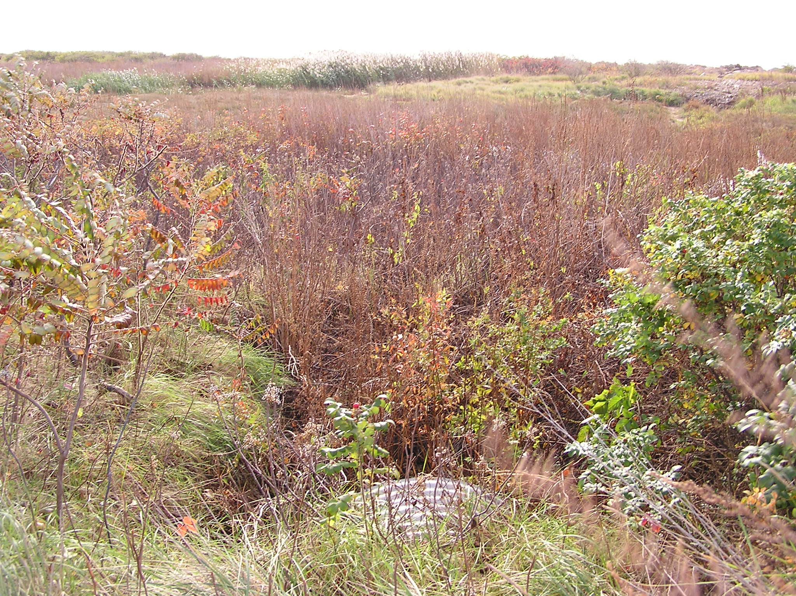
Notes:
Before the restoration metal culvert was so clogged. This prevented salt water from the ocean from reaching the marsh. This culvert under a road became filled with sand during the “Perfect Storm” in 1991. The salt marsh degraded, drying up at times due to lack of tidal flow, and at other times becoming ponded, because of poor drainage. Invasive species, such as purple loosestrife, flourished and fish populations declined.

Slide 4
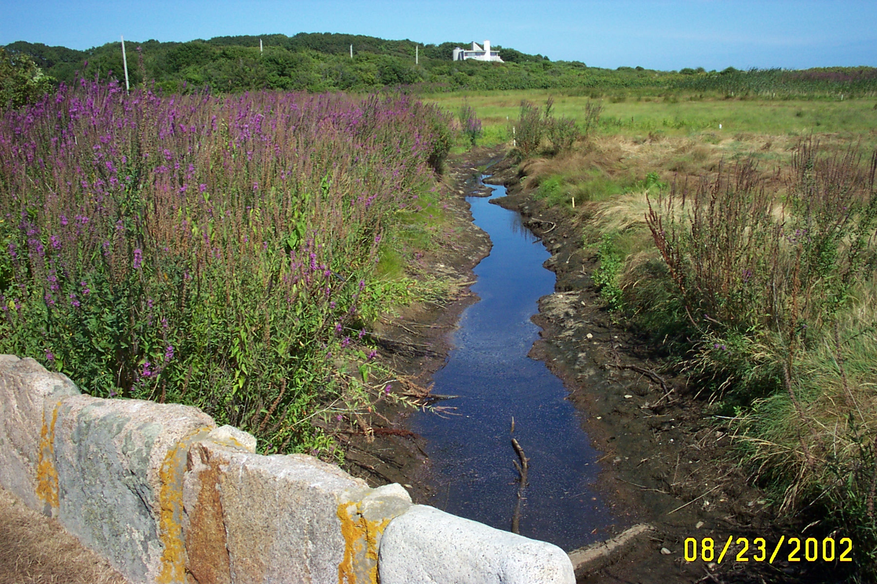
Notes:
Invasive species, such as purple loosestrife (purple flowers on left) flourished, and fish populations declined.

Slide 5
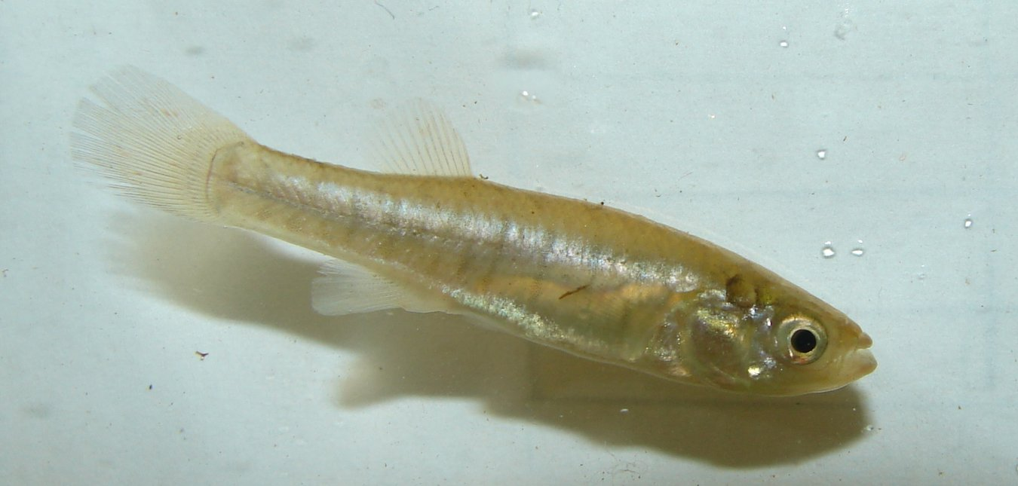
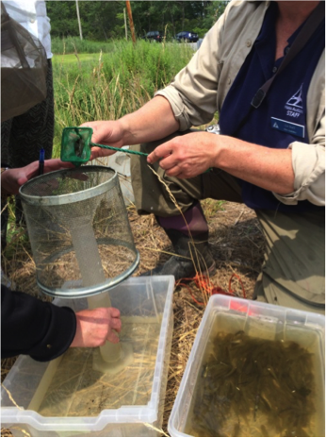
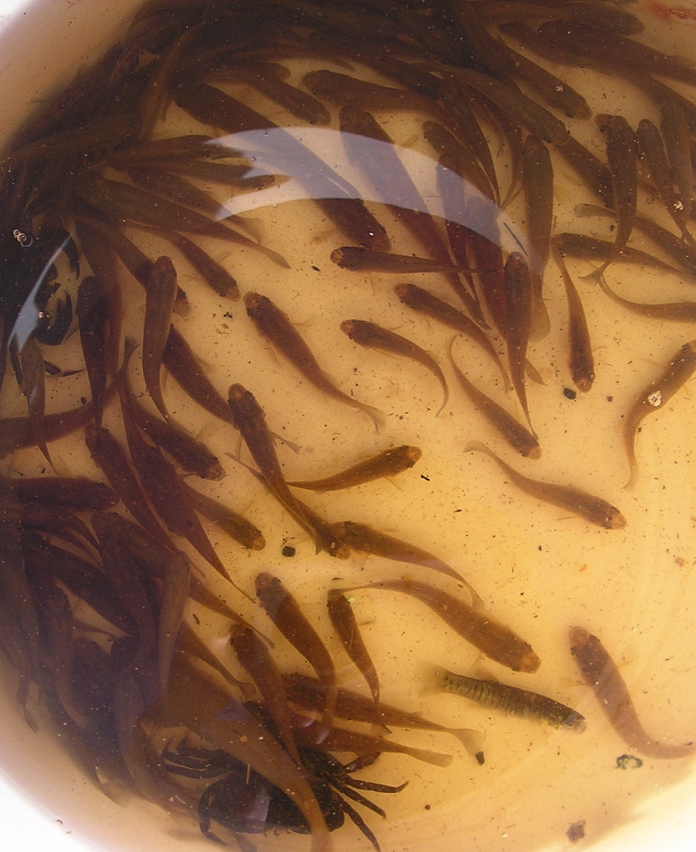
Notes:
In Gloucester, MA, students participating in Mass Audubon’s Salt Marsh Science Project helped examine the health of a salt marsh using mummichogs. The students set traps upstream of a road, which was acting as a tidal restriction, in 2002 and 2003. These traps collected mummichogs and other species of fish. The day after they set the traps, the students counted the number of each fish species found in the traps.

Slide 6
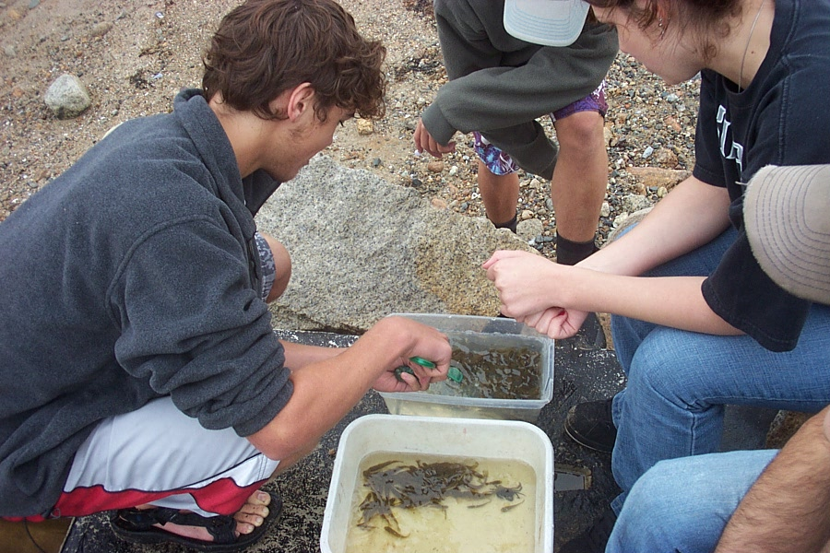
Notes:
Students participating in Mass Audubon’s Salt Marsh Science Project Count fish at Eastern Point Wildlife Sanctuary, Gloucester, MA

Slide 7
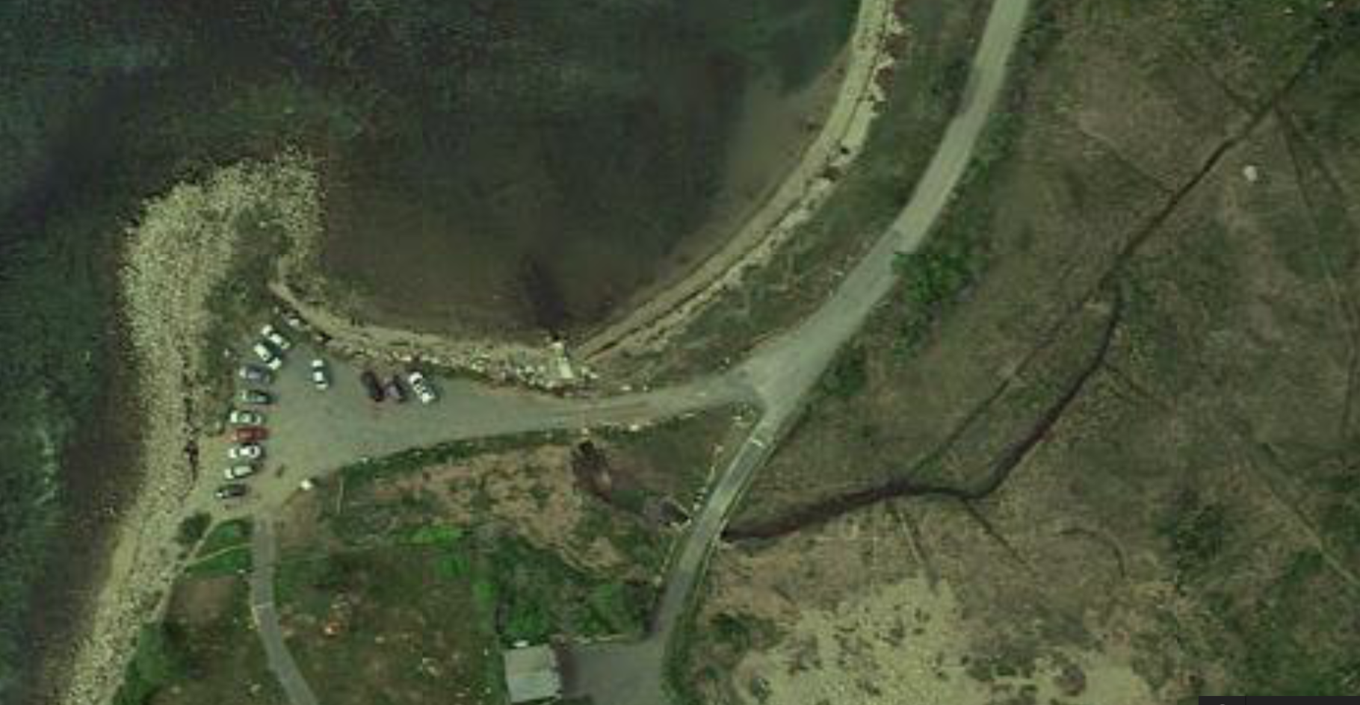
Fish Trap Locations
Atlantic Ocean
N
Road
1
4
2
Upstream of tidal restrictions
3
#
= Fish traps
= Tidal Restrictions
= New channel dug for restoration
Notes:
The data is from Traps #3 and #4, which were upstream of the tidal restriction. Trap #1 was set where the new channel meets the ocean, so there is no data from this site from before the restoration. Trap #2 was set in the new channel and did not exist before the restoration was performed.
This is a little confusing. If Site #1 and 2 are not included, you might consider removing this information completely or provide a map that shows the sites and then include the information as to why, for this analysis, Site 1 and 2 are not being examined. I think a map of the area would actually be very helpful in students visualizing the study site.

Slide 8
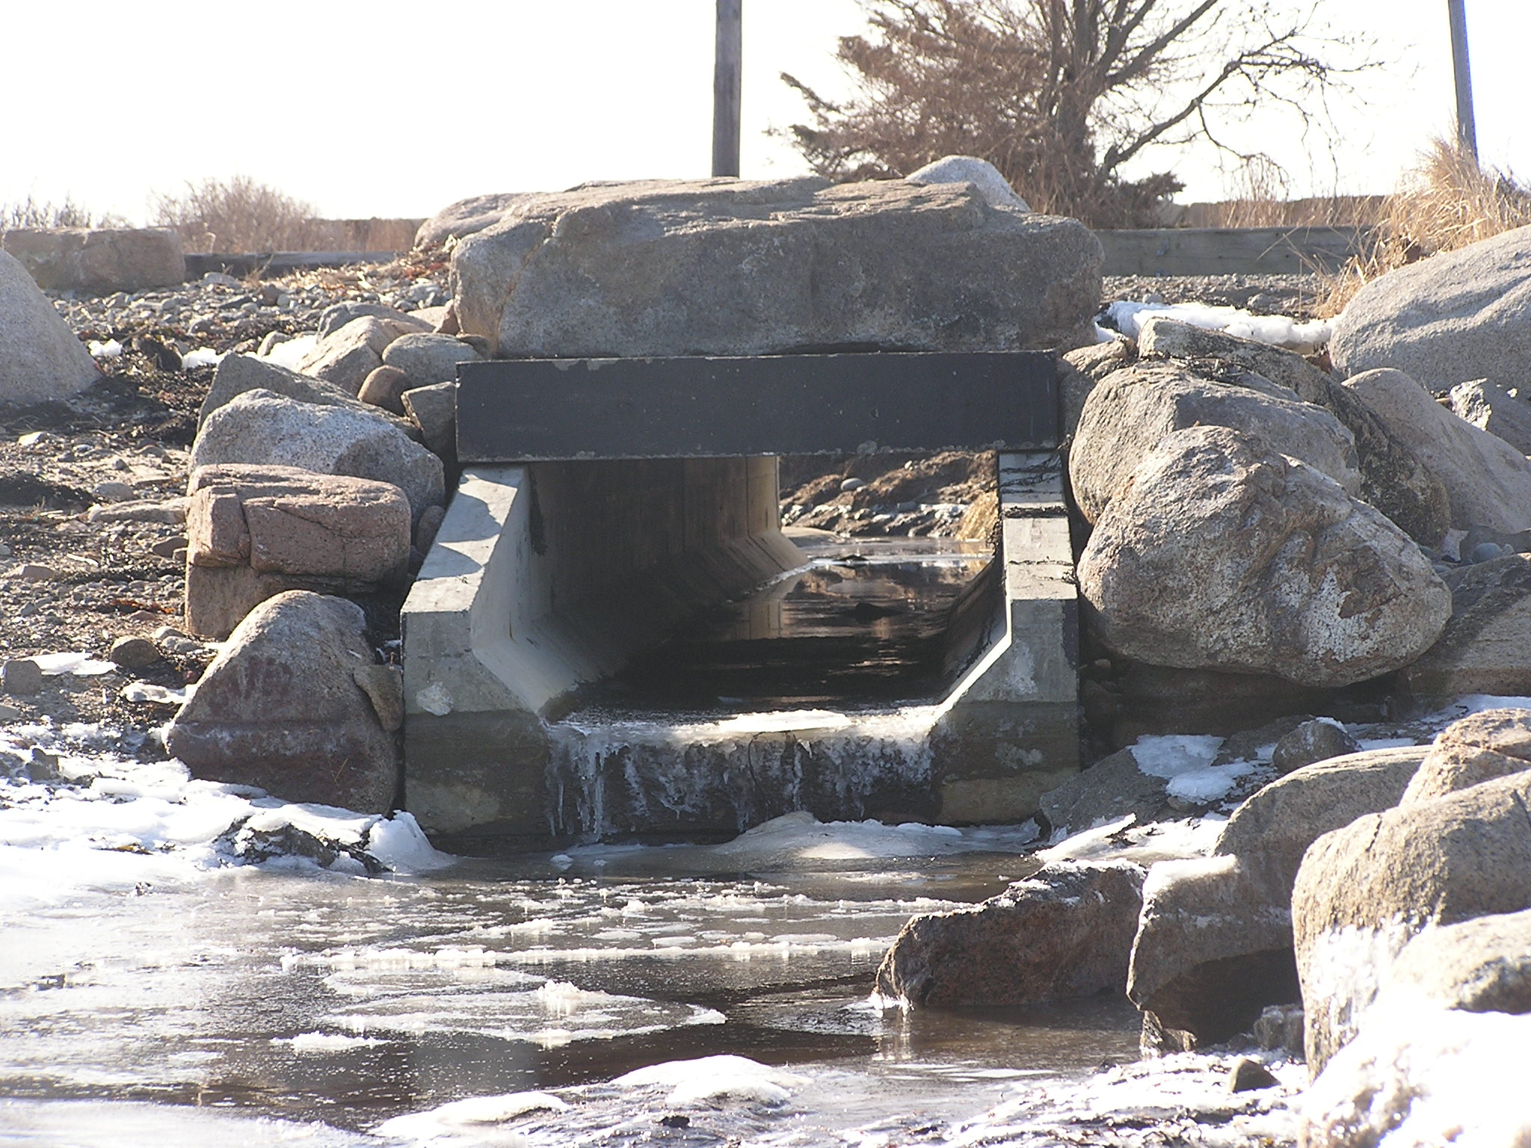
Notes:
People worked to design a new culvert system that would enhance fish habitat, improve tidal flow and drainage. Effort was made to prevent future clogging.

Slide 9
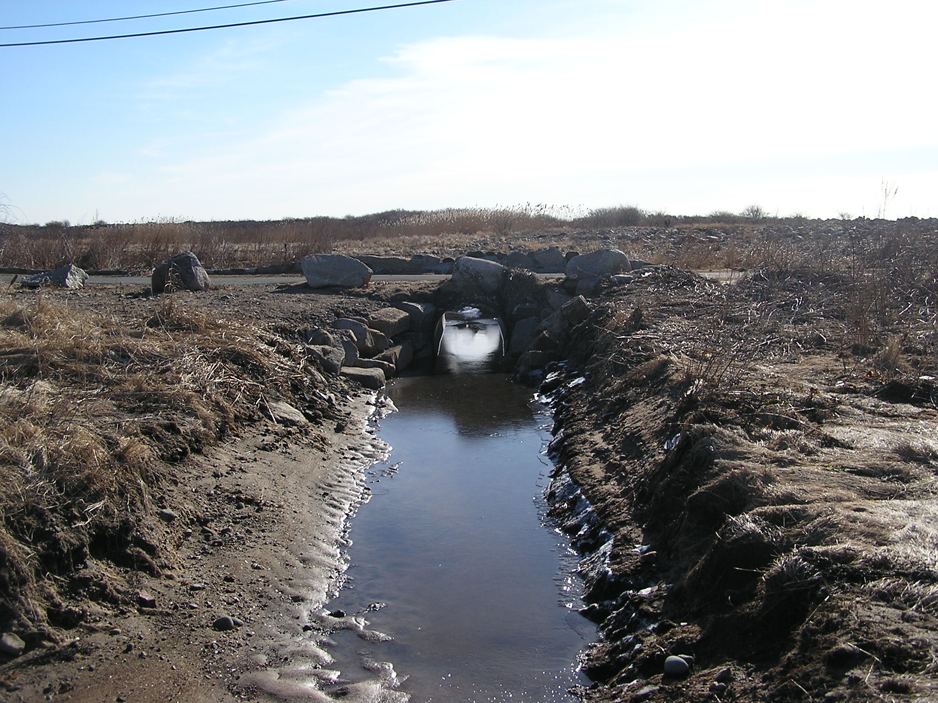
Notes:
In December 2003, a channel was dug, providing fish passage to a culvert under the road. This restoration brought back water flow between upstream and downstream of the tidal restriction.

Slide 10
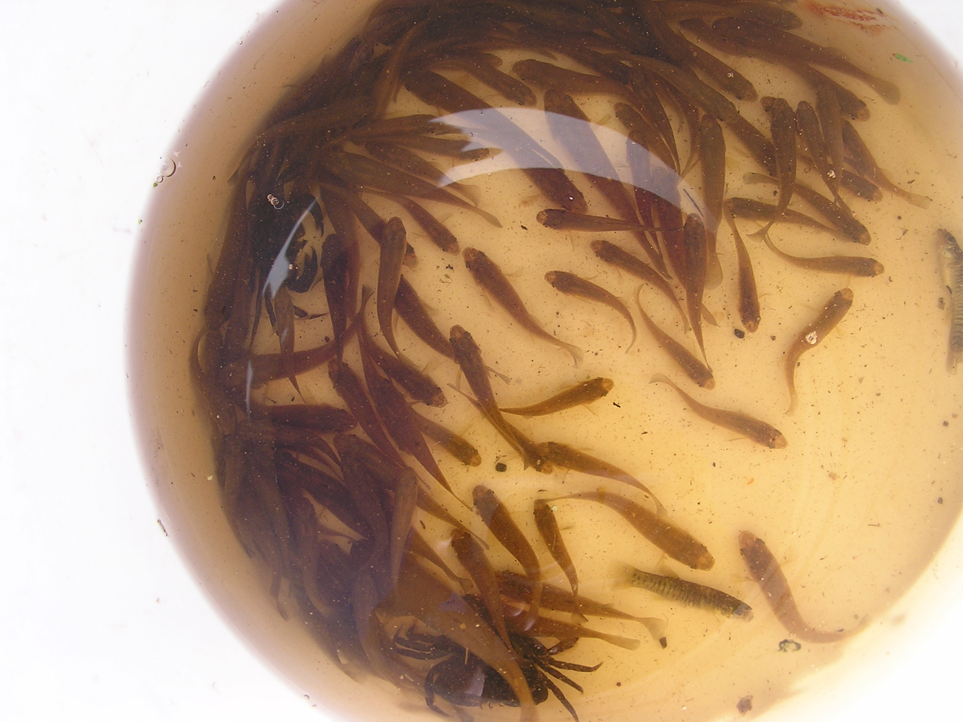
Notes:
Scientific Question: What effect did the removal of tidal restrictions have on the number of mummichogs found upstream?

