Slide 1
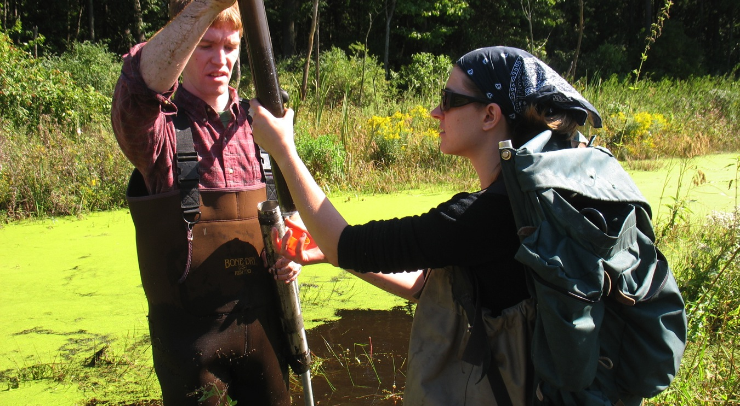
Notes:
This is me (Lauren) and Jon O’Brien taking a core (in our hands) out of the metal coring device that we used to get a core (metal thing in Jon’s hand). The coring device is basically a metal tube that a plastic tube sits inside. We push the whole thing into the mud and pull it back out to (hopefully) get a sediment core.

Slide 2
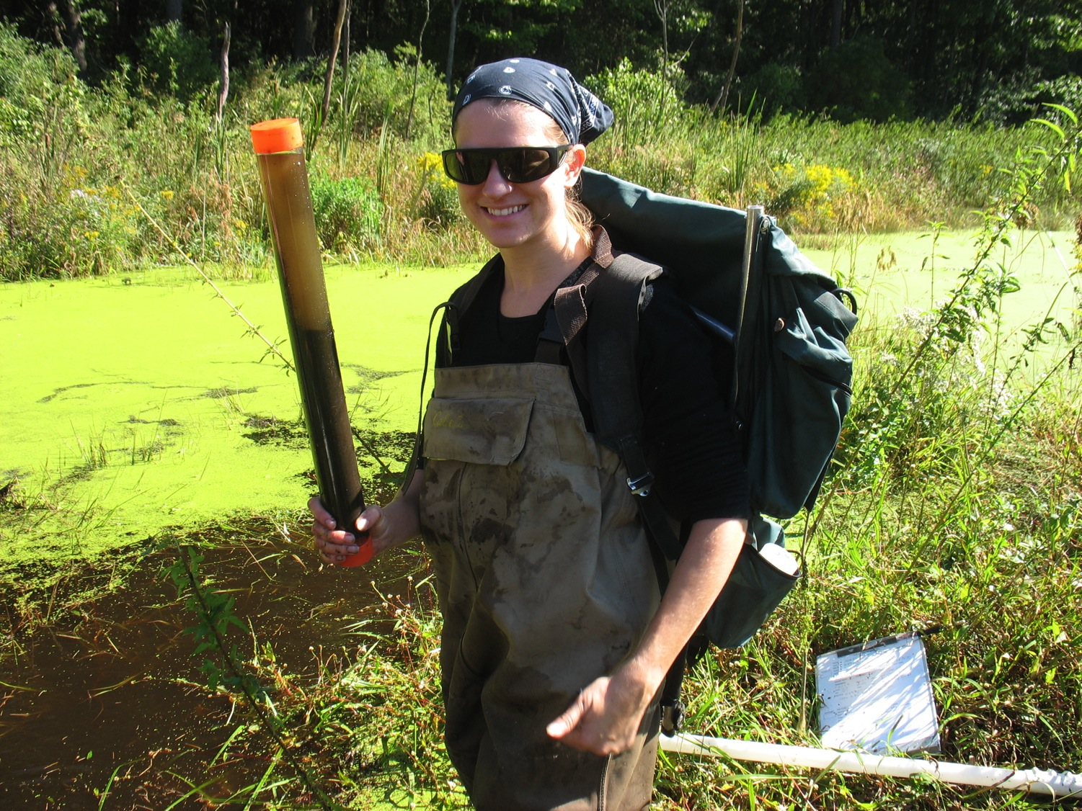
Notes:
A successful core! You can see that the tube has mud, as well as some of the water from the wetland that was on top of the mud.

Slide 3
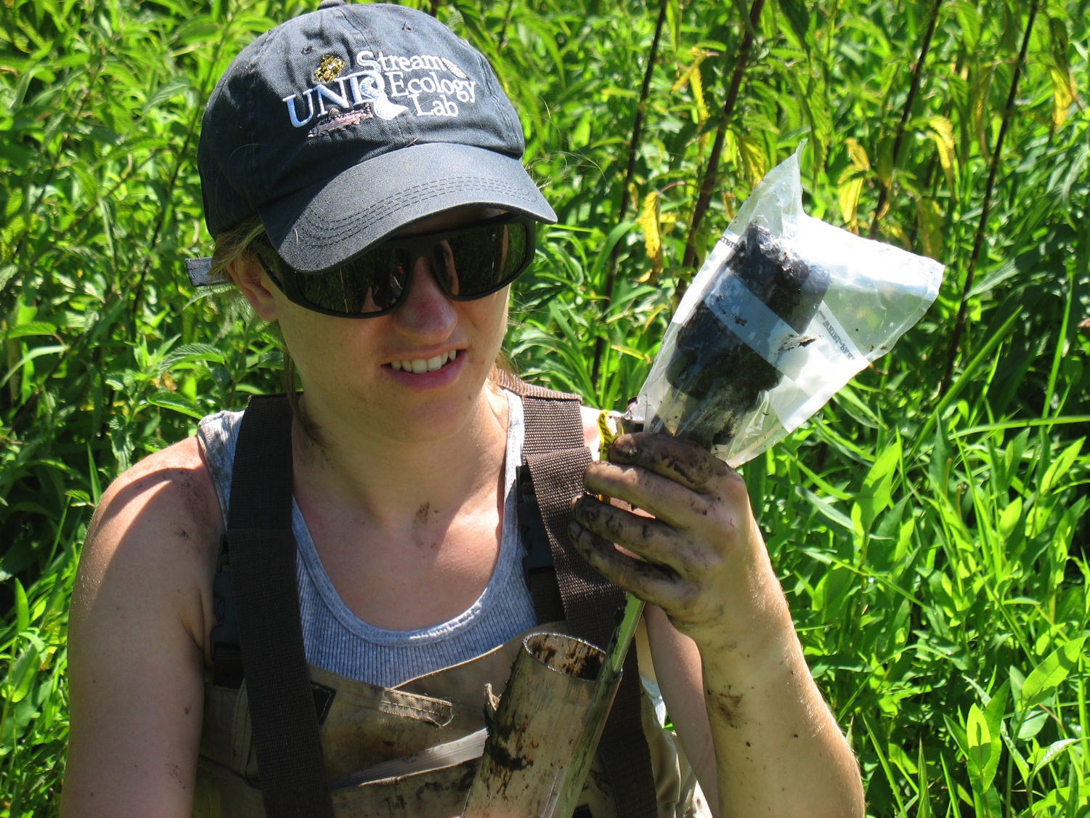
Notes:
Me in the field extruding a sediment core into a bag. “Extruding” means pushing the mud that’s in the plastic tube out using a metal rod with a hard stopper on the end—it’s like a mud push-up pop!

Slide 4
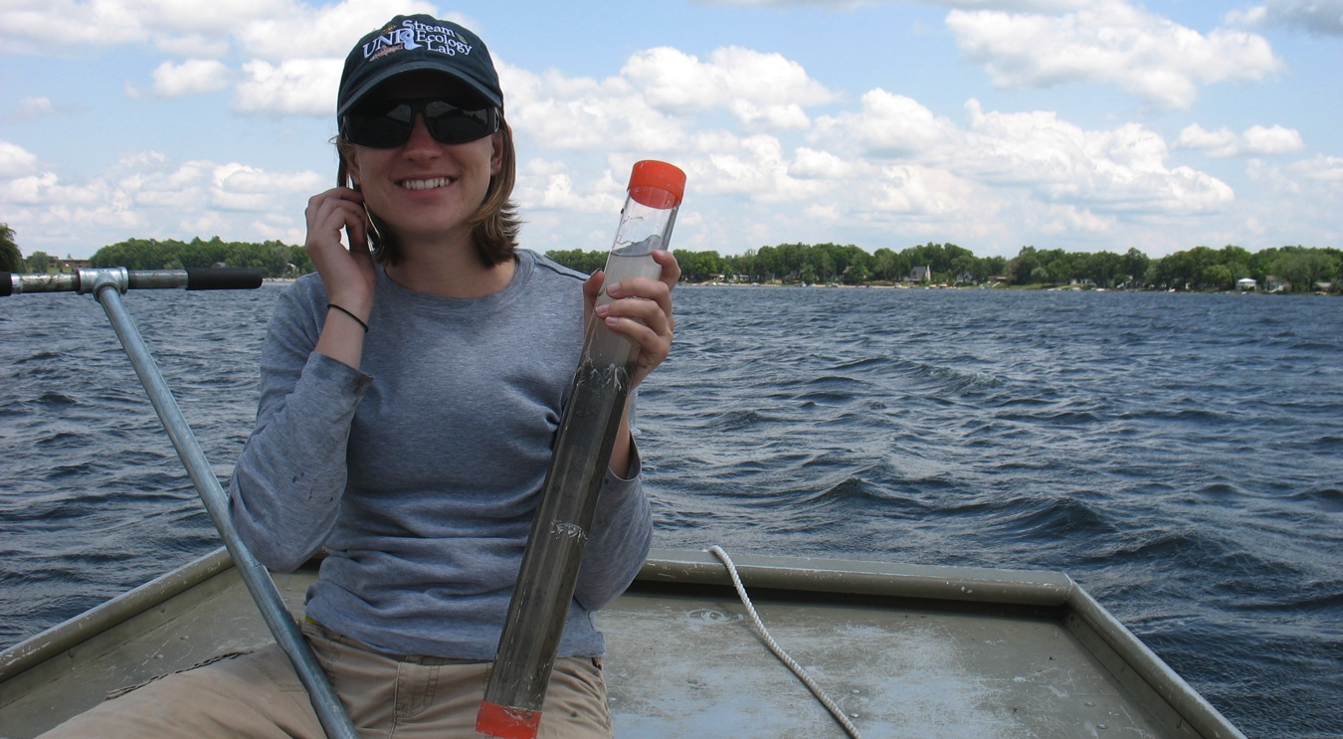
Notes:
We took sediment cores in all kinds of ecosystems - here I am with one that I took from a boat in Upper Crooked Lake.

Slide 5
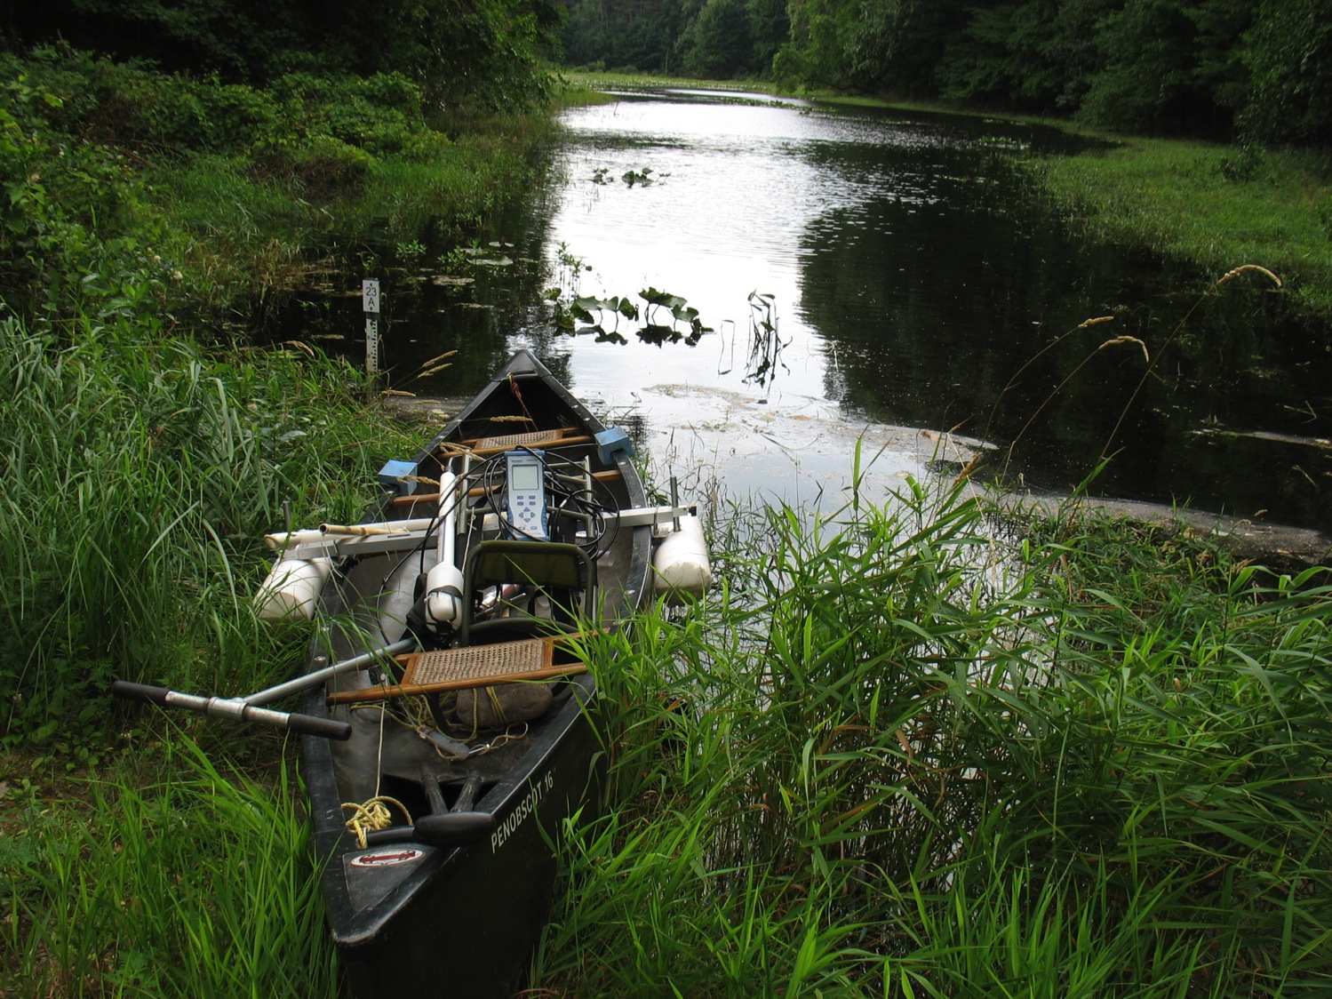
Notes:
Sometimes we took cores from canoes. In the canoe here, you can see the Hydrolab, which is a machine that we use to measure dissolved oxygen, pH, and temperature of the water. The white things on either side of the canoe are styrofoam floats that we used to prevent the canoe from tipping while we were taking a core. The metal rod with hands is the top of the coring device that you saw in the last photo.

Slide 6
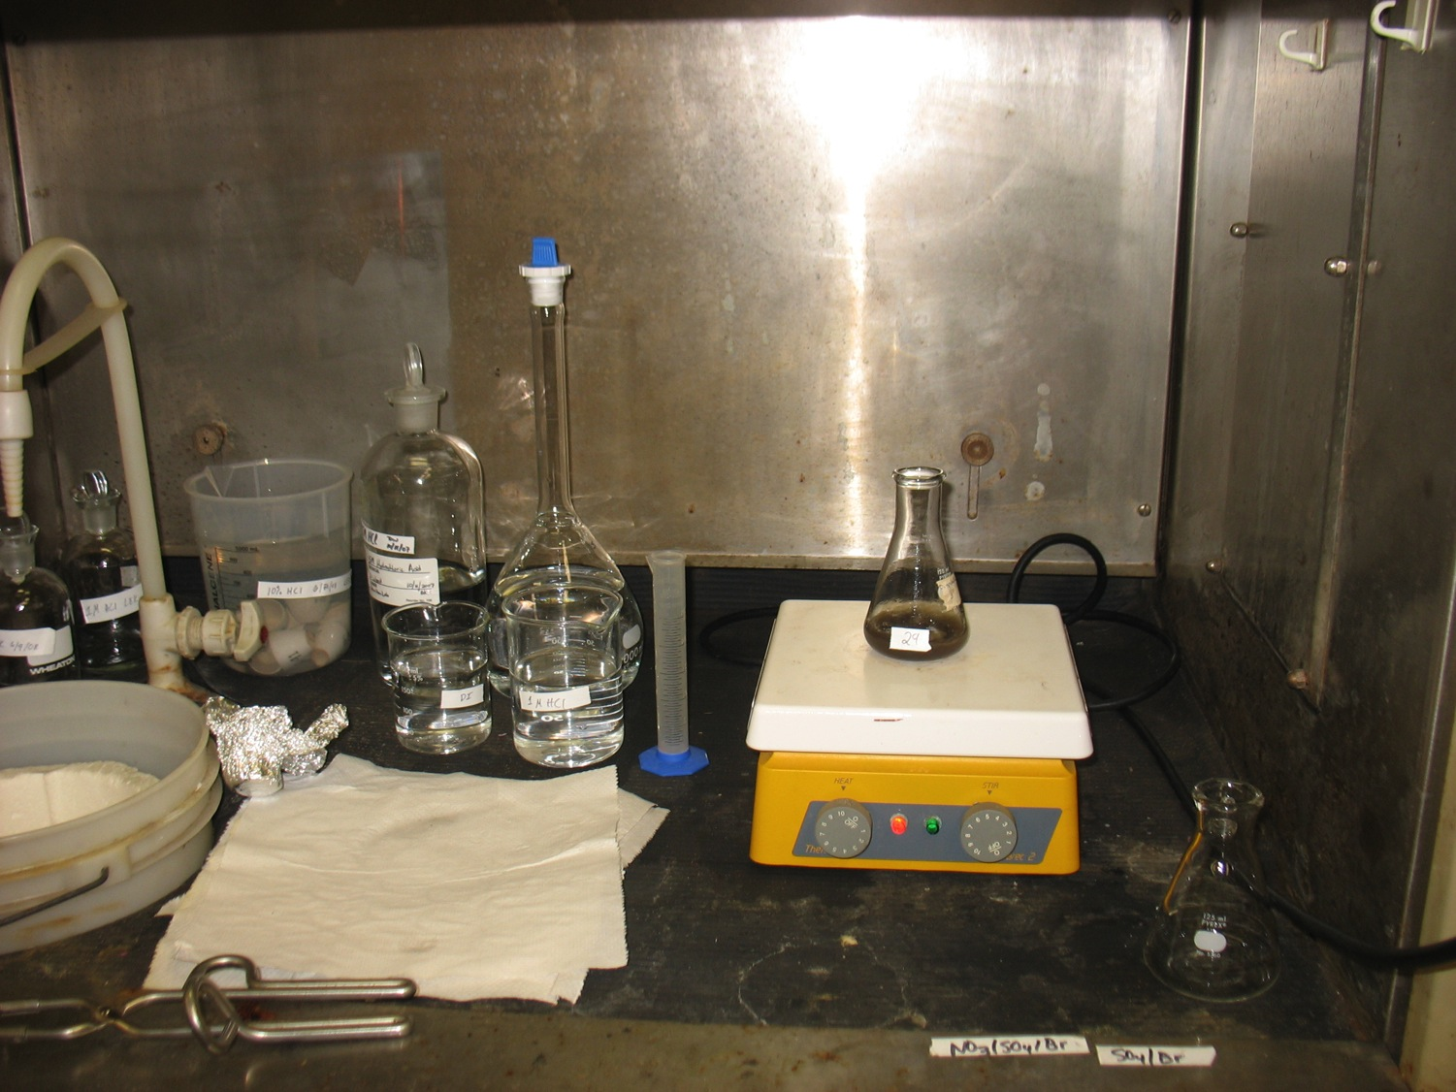
Notes:
After we took the sediment back to the lab, we would mix it up, dry it, combust (burn) it (which burns off all the mucky organic matter, but leaves the P behind), and then separate the P from the rest of what was left (mostly sand) by putting what’s left into boiling hydrochloric acid---you can see that we did this in a fume hood, and I was definitely wearing a lab coat and goggles for safety!

Slide 7
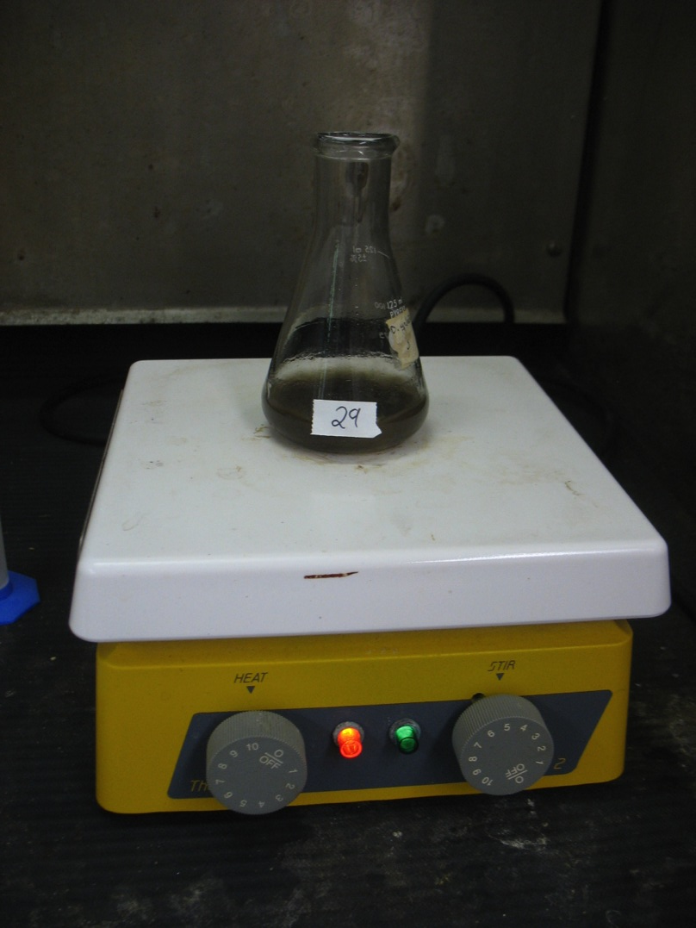
Notes:
A closer photo of the sediment sample in hydrochloric acid. The thing that it’s sitting on is called a Stir Plate—you put a little magnet inside the bottle and the plate makes the magnet spin, which stirs the solution. This stir plate is also a hot plate—we would turn up the heat to get the liquid to boil (and then used tongs to take the bottle off, because it was very hot!)

Slide 8
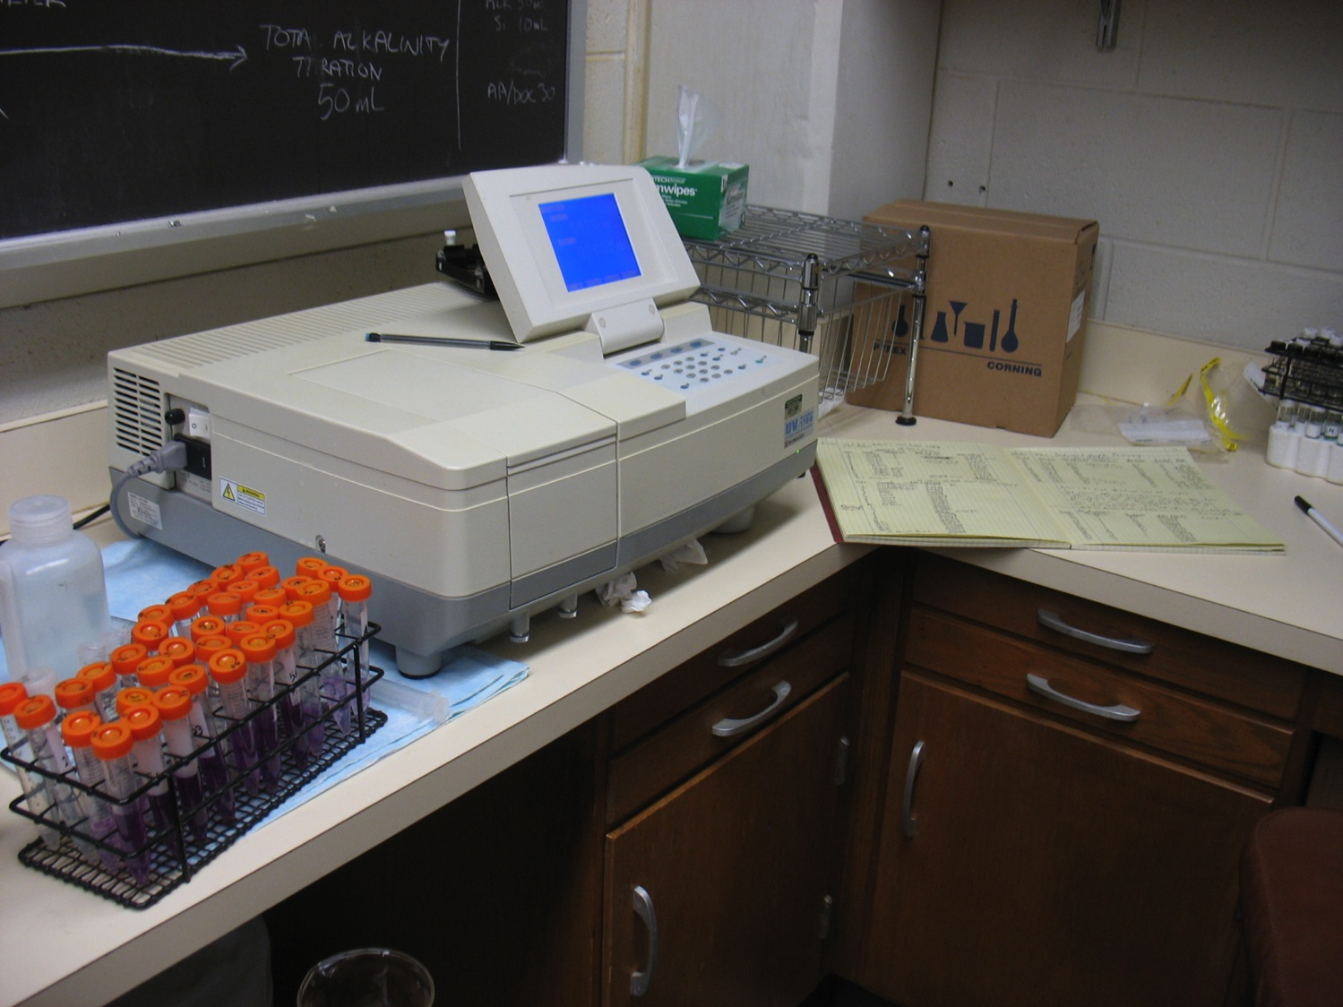
Notes:
This is a machine called a spectrophotometer that we us to then measure the amount of P in the liquid that we boiled the sediment sample in. We would add a chemical to the liquid, which turns a color when it reacts with P. The darker the color, the more P is in the sample. We measure the brightness of that color really accurately using the spectrophotometer (nickname: “Spec”)

Slide 9
Notes:
Which is the dependent variable? Which is the independent variable? WHY?

Slide 10
Locations with more organic matter in their mud tend to have more phosphorus

