Slide 1
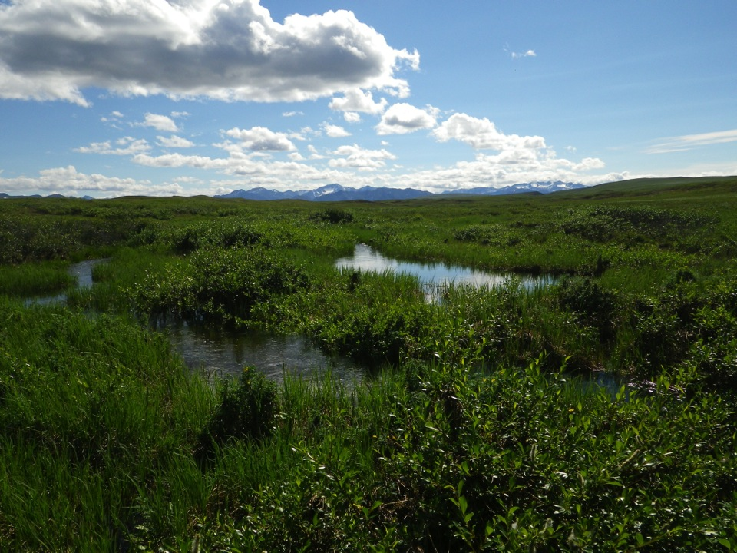
Limit by limit: How do nutrients control algal growth in Arctic streams? Data Nugget Slides

Slide 2
Liebig’s Law of the Minimum
The law of the minimum can be visualized as a leaky barrel.
Water = growth or production
Wooden stave = an essential nutrient
Optimum productivity occurs when the barrel is filled to the brim. Nutrient limitation is represented by shortening a stave, so the water (production) will drain to the level of the lowest stave.
Notes:
What is the limiting nutrient here? – Nitrogen
Note: limiting factors can also be conditions (e.g, predator/prey relationships, pests, etc.) not just nutrients!
The “structure” of food webs reflects both who is there (what species) and what connections these different species in the community have between each other. Algae helps make up the “base” of the aquatic food web. “Lower” levels of the food web – like small fish and insects - eat what is at the base of the food chain. “Higher” levels tend eat the lower trophic levels.
Changes in nutrient levels can affect the structure of aquatic food webs by reducing algal growth. When there is less algae at the base, there is less food and therefore less growth from the next food web level, and so on. Furthermore, if an organism is removed from the food web at any level, it can throw off the balance of the aquatic ecosystem. Increasing or decreasing the amount of algae that is available in an ecosystem can have lasting impacts on both lower and higher levels of the food web have to eat.

Slide 3
Nutrient Diffusing Substrata
Water
Nutrients slowly diffuse
into water
Glass disk for algae growth
Cup filled with nutrient-treated agar gel
Control
+N
+P
+N+P
Stream bottom
Notes:
NDS are commonly used to assess nutrient limitation in aquatic ecosystems. They are placed underwater for ~3-4 weeks to allow algae growth, and then brought back to the lab to assess algal growth.

Slide 4
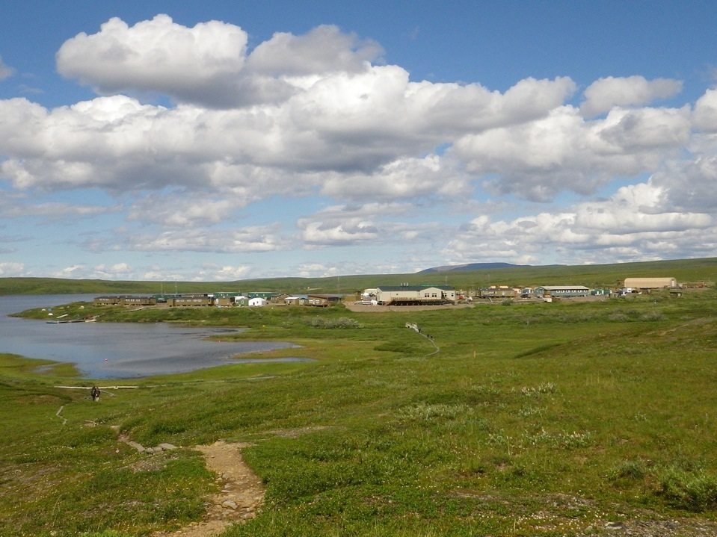
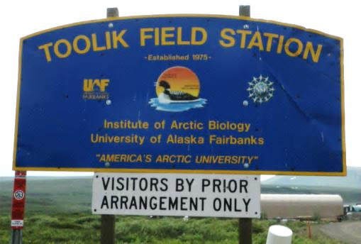
Where did the data come from?
Arctic Long-Term Ecological Research (LTER) Station at Toolik Field Station
Notes:
More about Toolik Field Station here: https://toolik.alaska.edu

Slide 5
Where did the data come from?
“I8” is a small lake within walking distance of Toolik Field Station.
Notes:
More about Toolik Field Station here: https://toolik.alaska.edu

