Slide 1
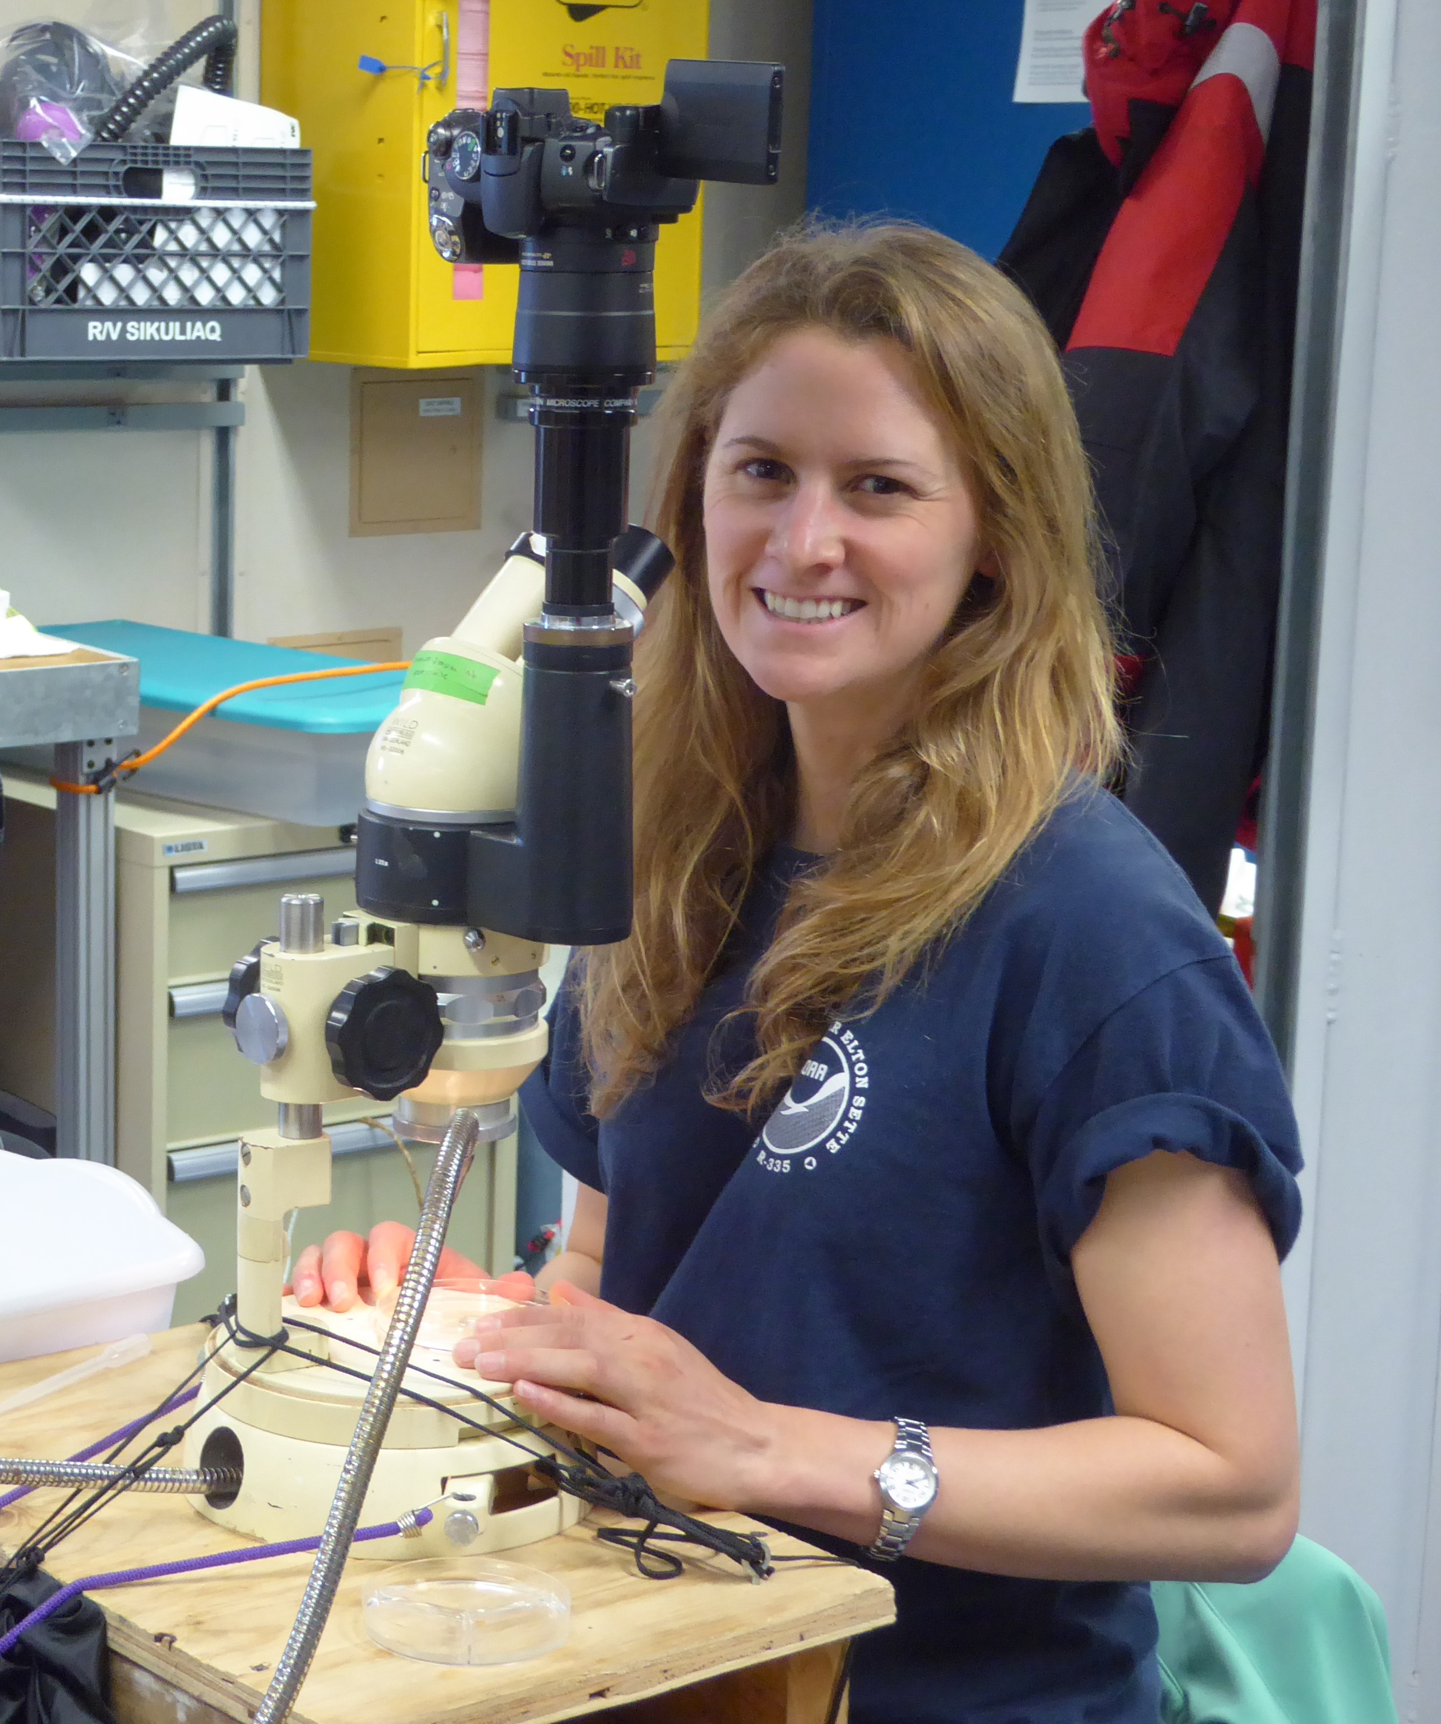
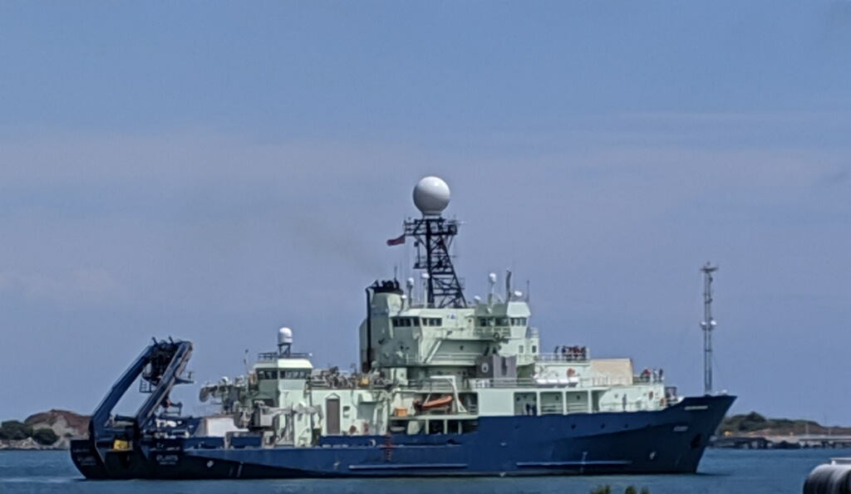
Laura Lilly identifies and counts zooplankton from a net tow using a microscope. Laura conducted these identifications while on a research ship at sea.

Slide 2
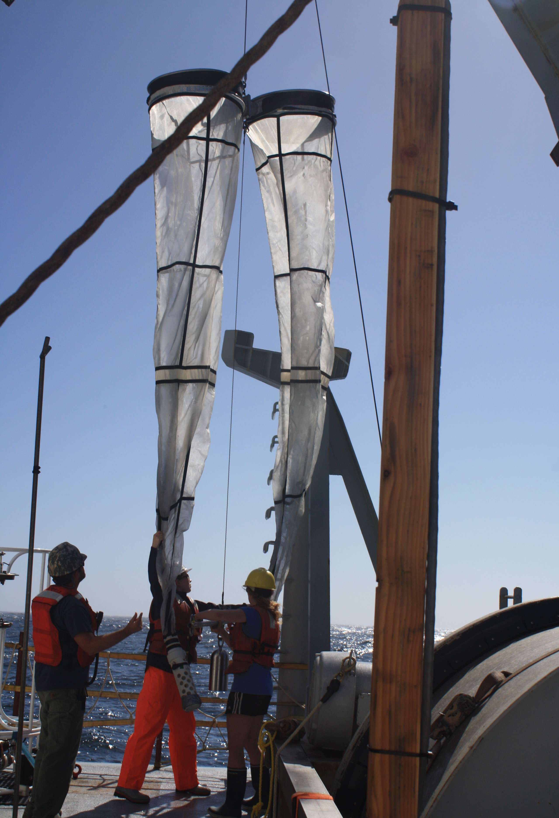
Scientists deploy a Bongo net to collect zooplankton samples. The Bongo net has a metal frame with two circular openings (like a Bongo drum) and two separate nets that each collect a zooplankton sample.

Slide 3
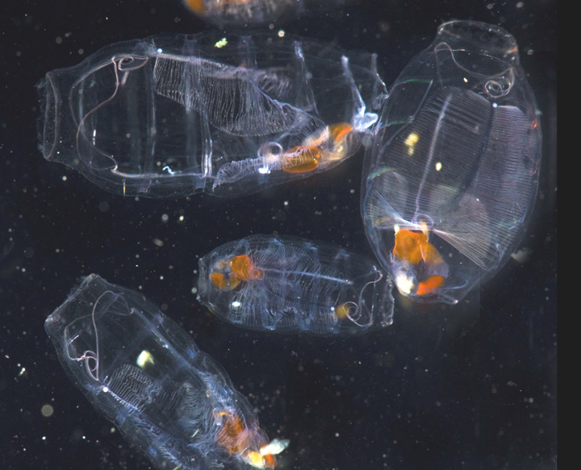
(above) A euphausiid, or “krill”, is a type of crustacean zooplankton, meaning that it is related to shrimp and crabs. It has a hard, segmented shell (exoskeleton). It is the main food source for blue whales and other whales and birds.
(left) Doliolids are a type of gelatinous zooplankton, meaning they have soft, watery bodies and not a lot of nutrition for other animals to eat. They can form large groups in the ocean called ‘blooms’

Slide 4
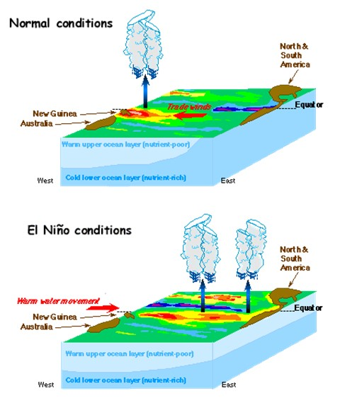
(top left) A 3D image of ‘normal’ ocean conditions in the Pacific Ocean. The light blue area shows a vertical profile of ocean temperatures, while the bright green and rainbow colors show water temperatures at the ocean’s surface. The red arrow and red-orange-yellow colors and puffy clouds on the west side of the Pacific Ocean show how Trade Winds blow from east to west across the Pacific. This piles up warm waters on the western side of the ocean and brings cool waters to the surface on the eastern side.
(bottom left) The same 3D image but during El Niño conditions. When El Niño happens, the wind stops blowing from east to west across the Pacific, so the hot surface waters flow back east toward South America. This causes warm waters to occur in place of the normally cool waters off South America.

