Slide 1

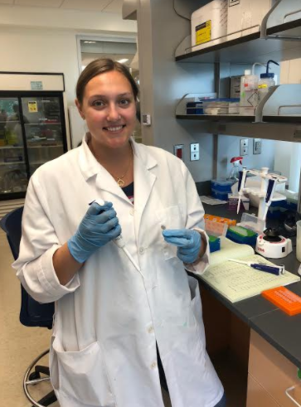
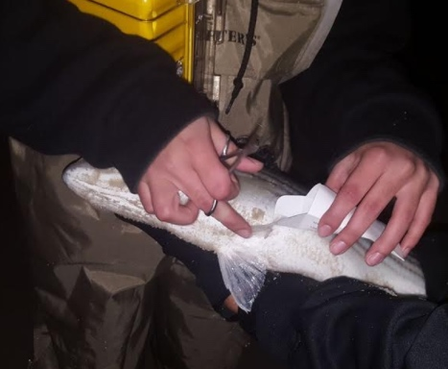

Let’s complete a Data Nugget!
_
Fishy origins
Featured Scientists: Carleigh Engstrom, Chelsea Barreto, Megan Phifer-Rixey, and John Tiedemann from Monmouth University

Slide 2
Workshop Logistics & Goals
_
Short introduction to Data Nuggets
Walk through Data Nugget based on striped bass research
Feel free to interject at any time
Please provide feedback on activities (constructive criticism more than welcome!)

Slide 3

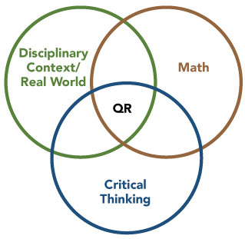
Quantitative reasoning (QR)
AAC&U 2007
Notes:
Similar to language literacy, quantitative literacy is a vital set of skills for students and should be promoted throughout K-12 and undergraduate education. QR is the application of mathematical principles using logic to solve problems.
In the context of science, QR covers a variety of skills, including the ability to understand numerical information found in graphs, tables, equations, and descriptive statistics; as well as express coherent and logical thinking about quantitative information (Mayes et al., 2014)
https://www.aacu.org/peerreview/2014/summer/elrod

Slide 4
Quantitative reasoning (QR)
A way of viewing the world through “mathematical eyes” and approaching every day problems with confidence and logical reasoning (Piatek-Jimenez et al. 2012, Vacher 2014)
Mathematics and statistics applied in real-life, authentic situations that impact an individual’s life as a constructive, concerned, and reflective citizen (Mayes et al. 2014)
Notes:
I like these two definitions of QR because they emphasize that QR is not necessarily about complex mathematical skills, but instead the application of simple skills to address complex, real life issues.

Slide 5
Quantitative reasoning (QR)
A way of viewing the world through “mathematical eyes” and approaching every day problems with confidence and logical reasoning (Piatek-Jimenez et al. 2012, Vacher 2014)
Mathematics and statistics applied in real-life, authentic situations that impact an individual’s life as a constructive, concerned, and reflective citizen (Mayes et al. 2014)

Slide 6
Quantitative reasoning (QR)
Challenge:
  Students in the United States consistently lag behind in science education outcomes (National Center for Education Statistics 2005)
  Students are graduating unable to apply quantitative knowledge to situations (Wilkins 2010)
  Little to no improvement between 1970-2012 (Mullis & Martin 2014)
Implications:
  Students with poor quantitative reasoning abilities are more likely to drop out of school, experience unemployment, earn less (McMillan & Marks 2003, Marks et al. 2005, Rumberger & Lamb 2003)
  Left unprepared to address pressing social and scientific issues (Steen 1999)
    These issues becoming more important as we increasingly rely on large, complicated datasets (NAP 2014)
Notes:
The challenge we face today is, despite the importance of QR, students are….
QR is becoming increasingly important as data become more commonplace throughout science and society
Similarly, with the rapidly expanding role of data in society, educators need to consider the importance of literacy in the context of data.

Slide 7
Science education reform
_
Instruction is moving…
…away from the rote memorization of facts
…towards critical thinking through 3D learning
  disciplinary core ideas (physical science, life science, earth & space science, engineering/technology/application of science)
  scientific and engineering practices (asking questions, developing & using models, planning & carrying out investigations, analyzing & interpreting data, using mathematics & computational thinking, constructing explanations and designing solutions, engaging in argument from evidence, obtaining/evaluating/communicating information)
  cross-cutting concepts (patterns, cause & effect, scale/proportion/quantity, systems & system models, energy & matter, structure & function, stability & change)
NGSS 2013
Notes:
To address this challenge, science education is undergoing a fundamental shift and increasingly incorporating QR into science. Educators agree that science should be taught as an active process: instead of students memorizing facts in textbooks, the focus should be placed on students’ ability to generate new knowledge by testing hypotheses and interpreting data (NRC, 2012). In other words, students should learn what it means to be a scientist, and how the scientific process can be used to make arguments from evidence.

Slide 8
Engaging in practices
_
  Analyzing & interpreting data
  Using mathematical thinking
  Constructing explanations
Science is more than a set of what we already know, but it is the way we understand the world and construct knowledge
Transfer skills to a new context
NGSS 2013
Notes:
In particular I will focus on ”engaging in practices”. Reveals the nature of science
Put the content together with the practice (3D learning)
These are things that we want citizens to have
How scientific knowledge is constructed
Introduce authentic data casually but don’t go into it in depth

Slide 9

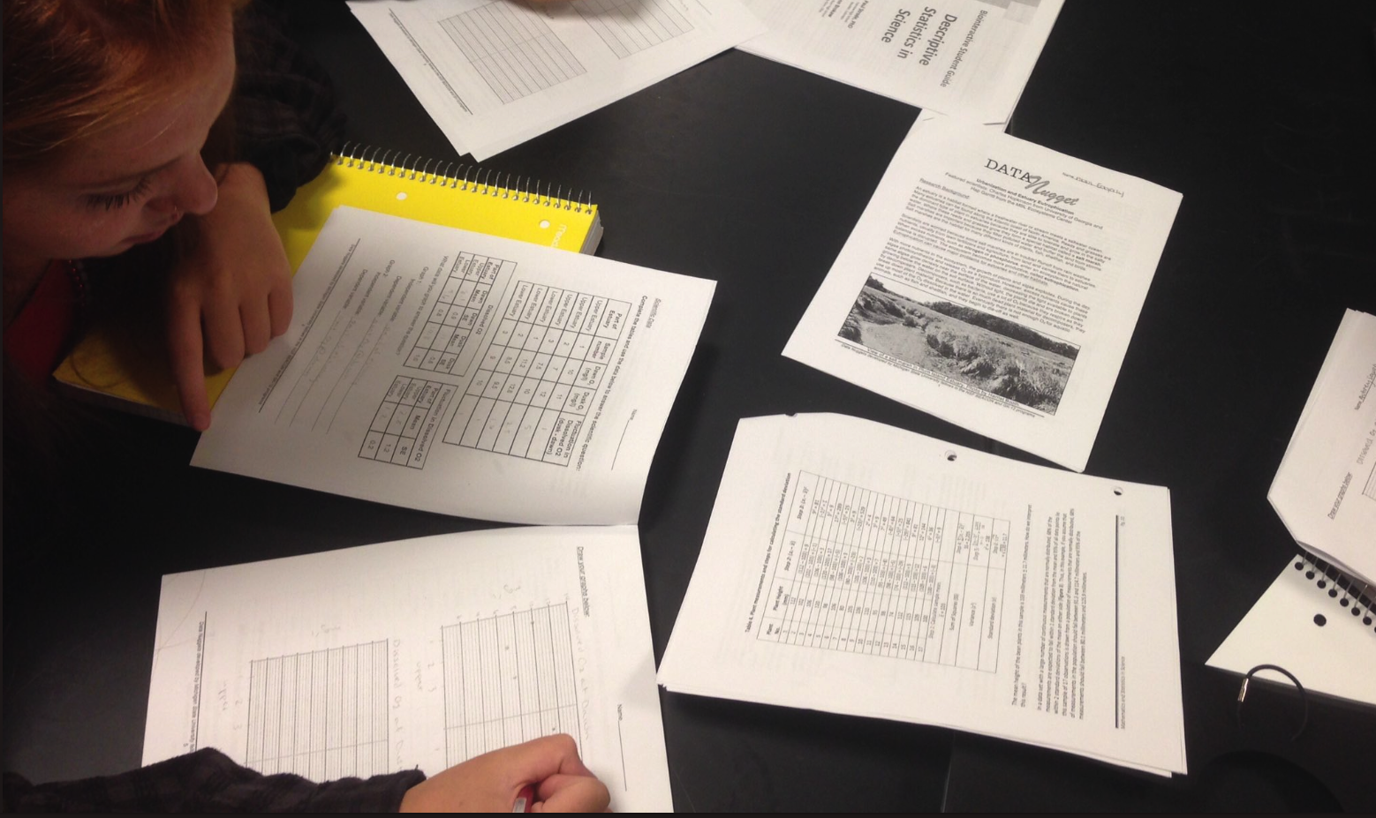
Using authentic data in the classroom could be a solution!

Slide 10
Free activities that bring real data into the classroom, along with all its messiness and complexity
Based on contemporary research
Guide students through the entire process of science, including data analysis & interpretation
Follow familiar template, but provide flexibility through teacher notes and suggested discussions
http://datanuggets.org
Schultheis & Kjelvik 2015
Notes:
To this end, we developed Data Nuggets, which are…
By using cutting edge research, DNs capture the attention of students by engaging them with more than just the conclusions of a study, but the story and process of the researcher behind the ideas and data

Slide 11
Data Nugget development
Notes:
Iterative development between scientist behind the data and the Data Nugget development team. Piloted in classrooms and reviewed by teachers and students. Revised based on feedback from scientists and science educators. You are part of this process!

Slide 12
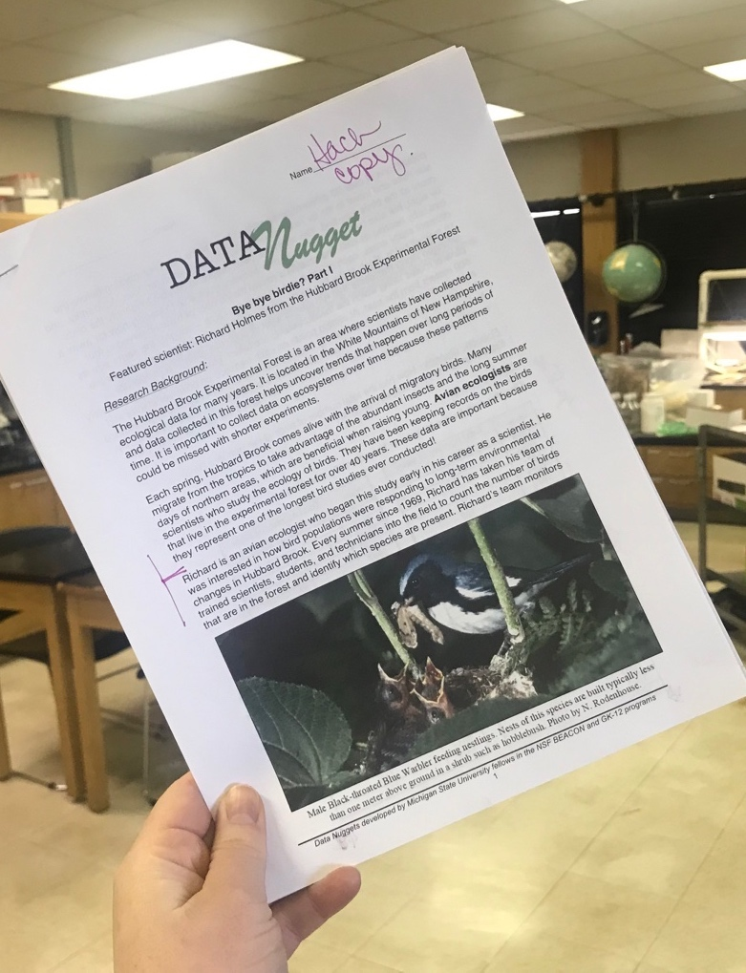
Research background
_
Introduce research and subject area
Relate topic to students’ experiences
Written in story format to engage reader

Slide 13
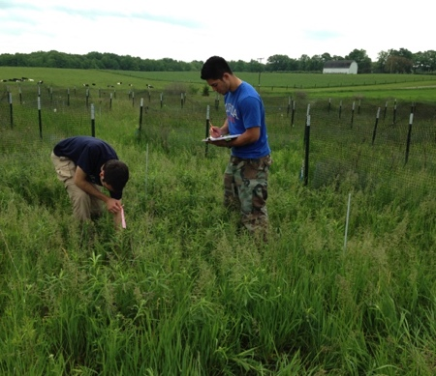
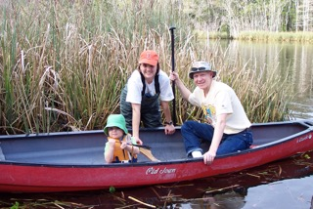
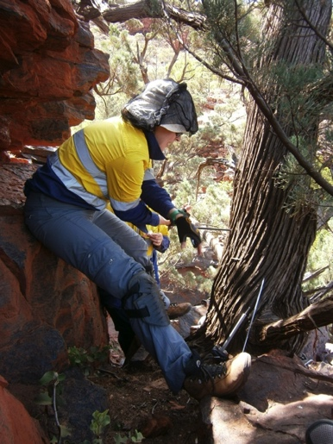


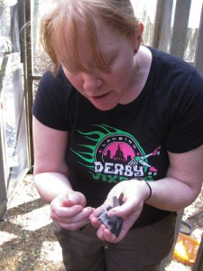
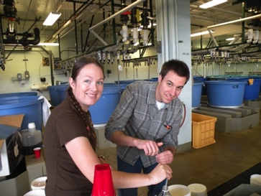
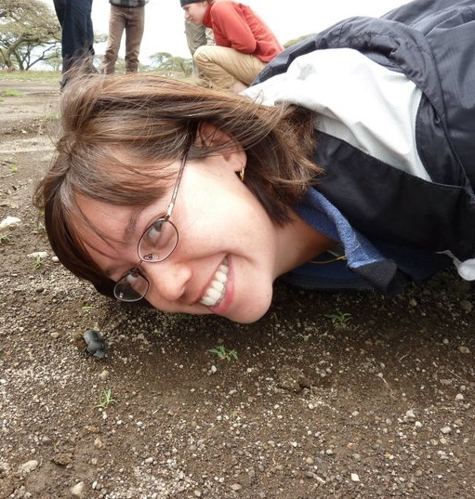

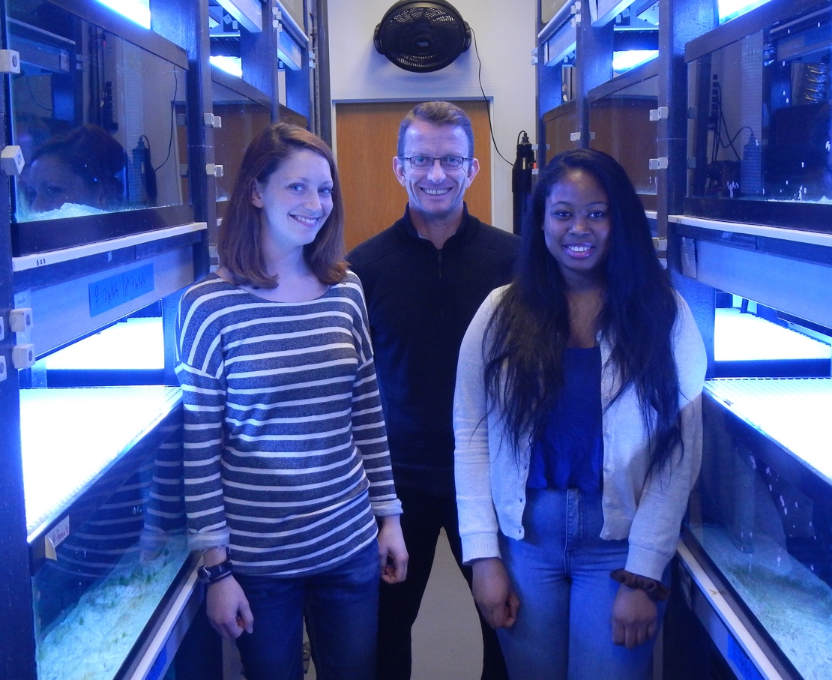
Notes:
Show scientists are approachable - Engage students with the researcher themselves, discussing more than just research findings
Scientists are still overwhelmingly white and male (Pollack 2015). This homogeneity excludes talented individuals and reduces productivity that can be achieved with increased workplace diversity (Reagans & Zuckerman 2001, Stahl et al. 2010). Barriers for underrepresented groups in STEM fields are often rooted in social rather than academic factors, such as negative stereotypes and a lack of same­race peers (Strayhorn 2010). These social constructs are reinforced by the stereotypical depiction of scientists in the media and popular culture (Dudo et al. 2011). Two common tropes include the “mad scientist” (e.g., in superhero movies) and the “awkward geek” (e.g., The Big Bang Theory ); neither is very approachable or appealing as a role model, and both are typically white men.
Ethnic minority students are more likely to see themselves as scientists if they are exposed to role models that they can identify with (e.g., their teachers, Price 2010). By redefining what a scientist looks like, we hope to encourage participation in science by all interested students.

Slide 14
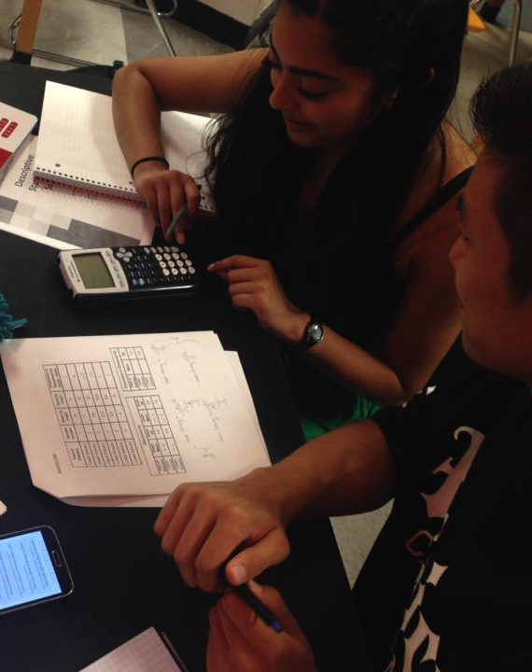
Data analysis
_

Slide 15
Data visualization
_
Graphing levels
  Increasingly challenges students over time (across semester or grades)
  Allows for differentiated instruction and scaffolding
Notes:
Second, activities are coded according to the graphing skills required. Type A activities provide the graph for the students, (allowing a focus on graph interpretation, making claims based on evidence, and explaining reasoning), Type B activities provide axis labels but requires students to graph the data, and Type C provides an unlabeled grid on which to draw a graph.

Slide 16
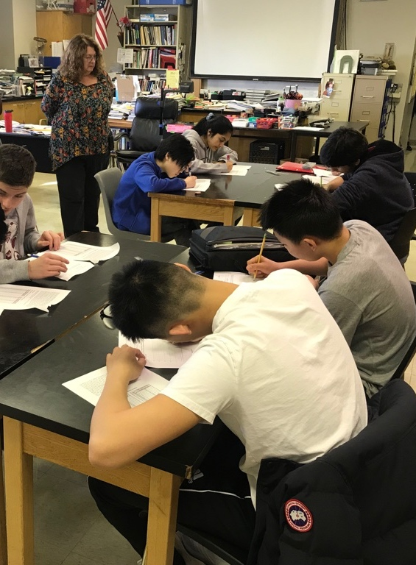
Constructing explanations
_
C-E-R framework to help students use data as evidence to support claims
Scaffolds student writing and provides expectations
Provides foundation for discourse
McNeill et al. 2006, McNeill & Krajcik 2008
Notes:
Explanations is a practice. The claims-evidence-reasoning (CER) framework has been productive in helping students develop strong scientific arguments, but students who use this framework often do not provide adequate/sufficient evidence or reasoning to support the claims they make when explaining phenomena.
Helps students evaluate how the evidence helps answer the scientific question presented in an experiment or reading material
CER framework trains student thinking about looking at data and assists them in making their understanding clear in written responses
Foundation for discourse that all students can engage in
Prepares them to be discerning, thoughtful citizens in the future (we hope!)

Slide 17
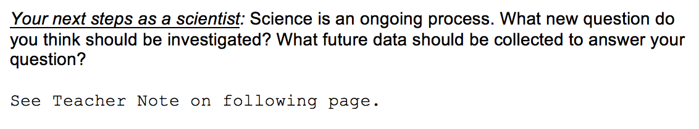
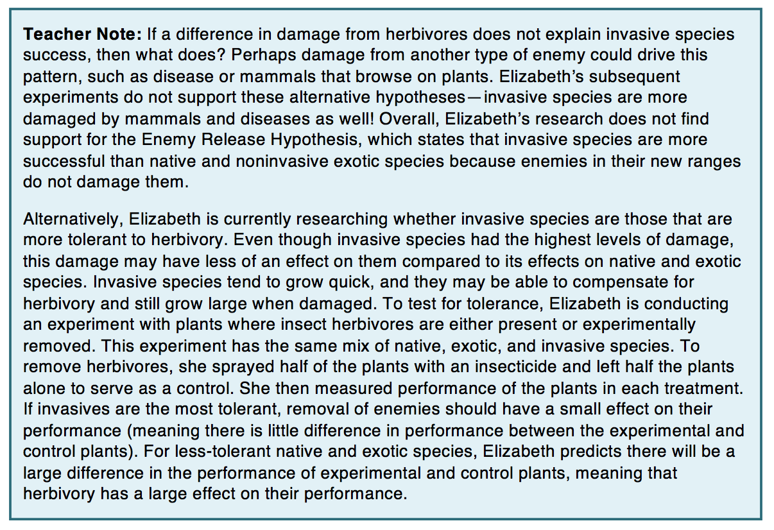
Next steps
_
Notes:
For each DN we have a version that students can do by hand, but we also want teachers to be able to build students’ quantitative skills and expand to issues of calculating statistics and hypothesis testing.

Slide 18

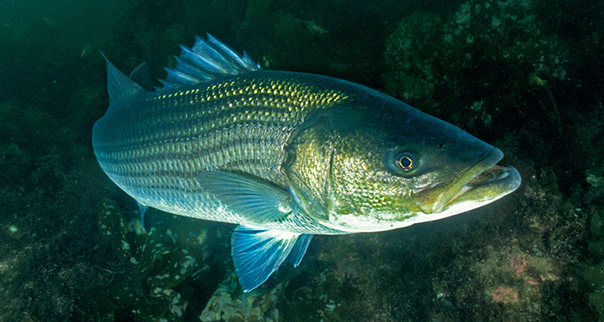
Let’s complete a Data Nugget!
_
Name that Data Nugget!
Notes:
We are now going to walk through a Data Nugget based on Chelsea and Carleigh’s research. We can keep in mind ways to adapt it to your classrooms. Work in partners. Start by reading the Research Background here. Read in the lens of your students, are there any areas they might get confused? Is this enough information?

Slide 19
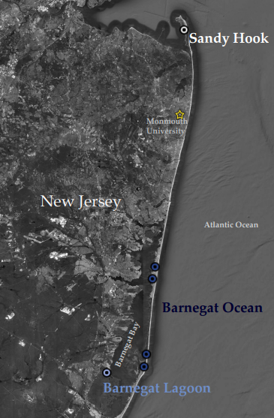
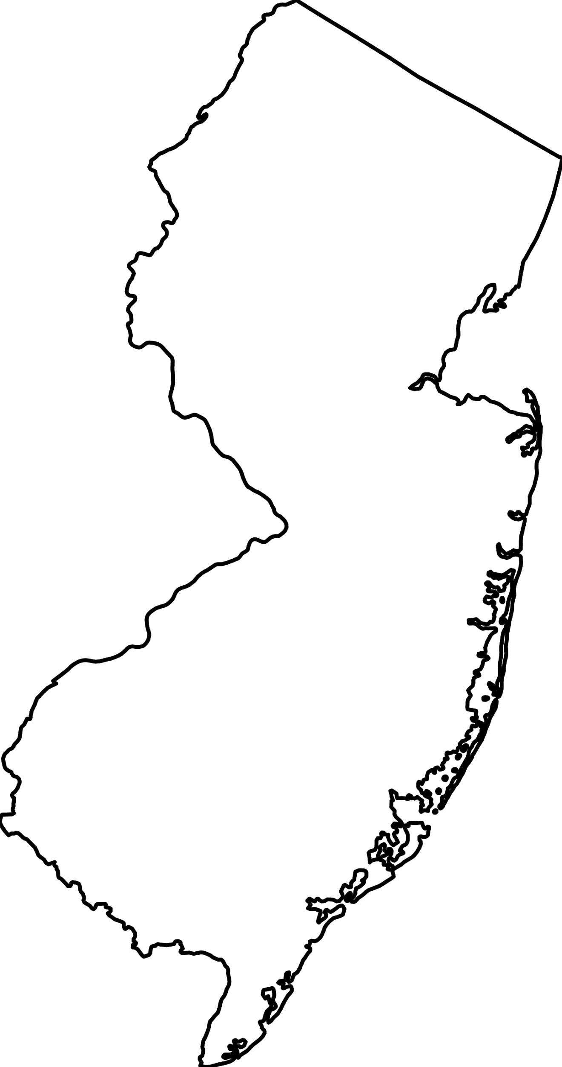

Slide 20

Striped Bass

Slide 21
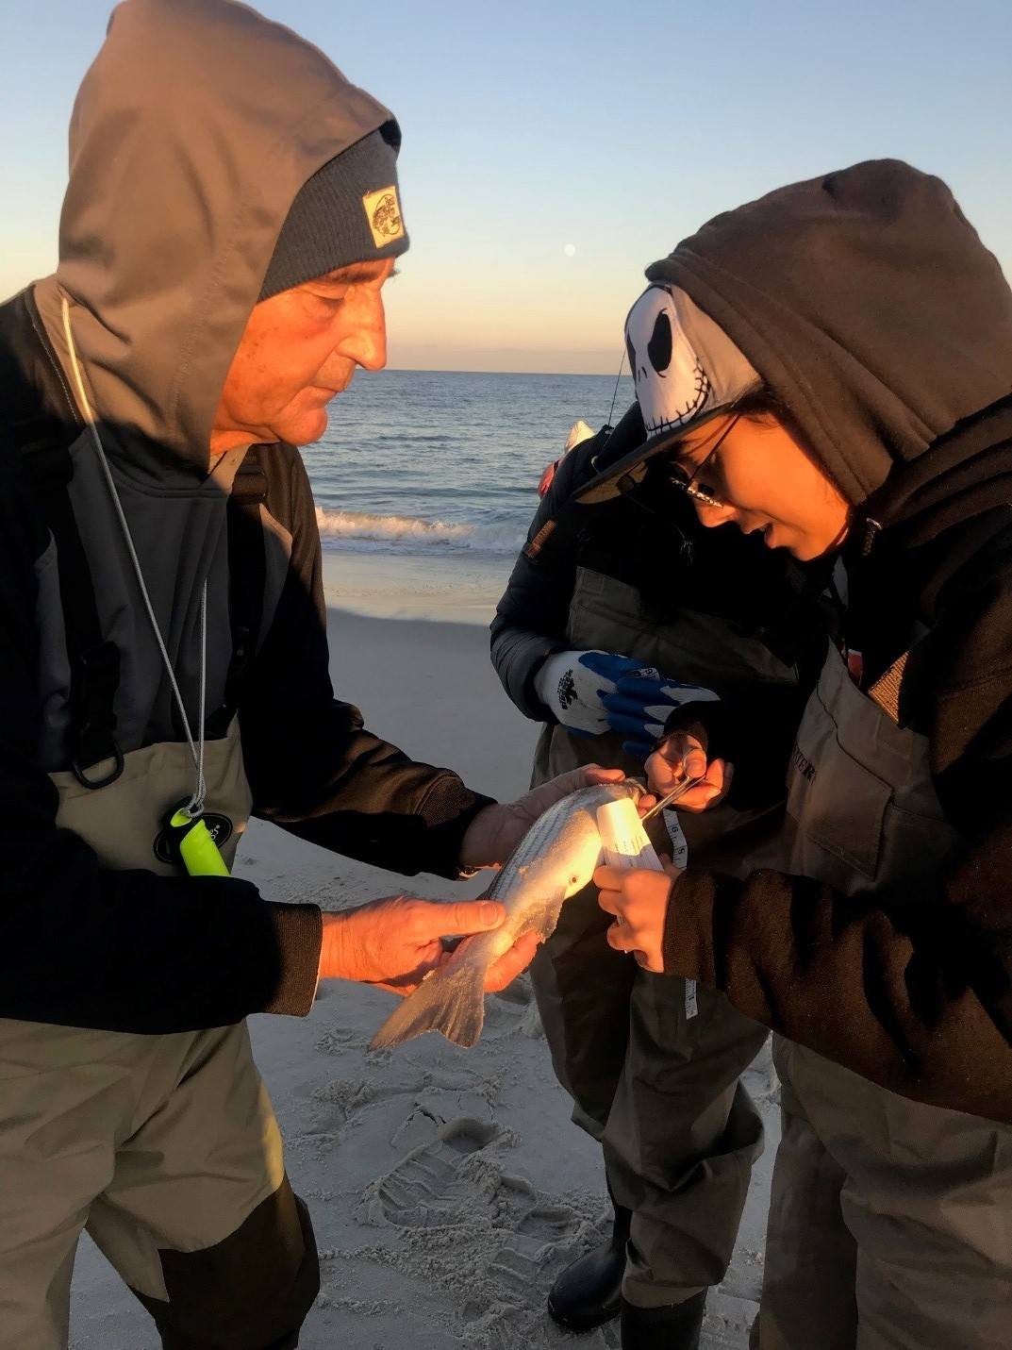
Catching Stripers
Notes:
John Tiedemann and Nikole Andre

Slide 22
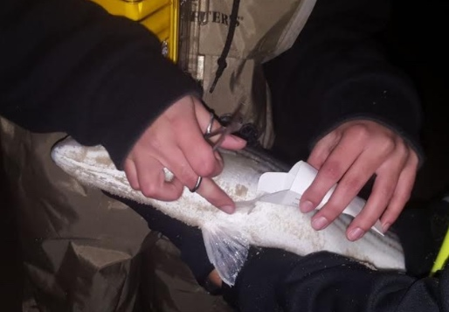
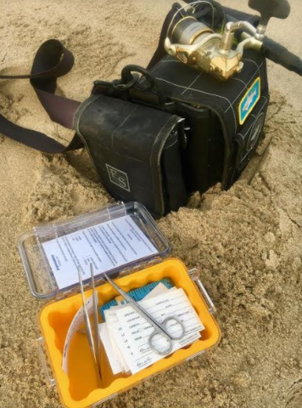
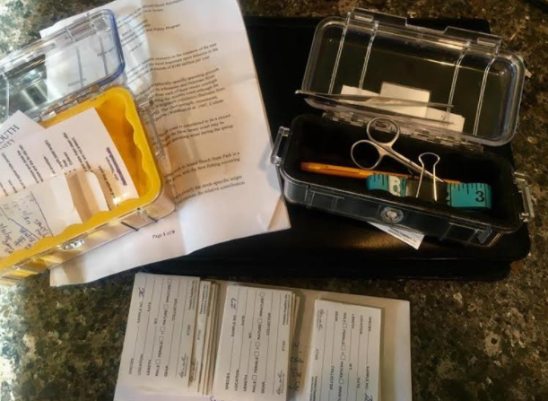
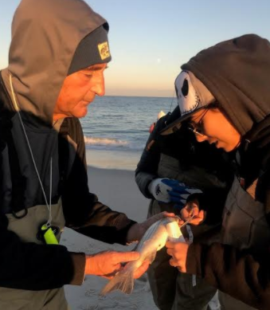
Clipping the pelvic fin

Slide 23
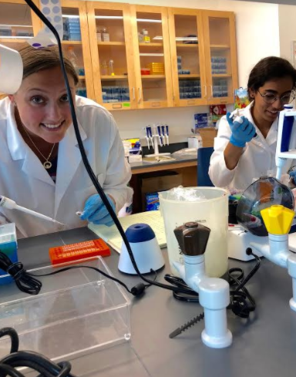
Extracting DNA for PCR
Notes:
Carleigh Engstrom and Nikole Andre

Slide 24


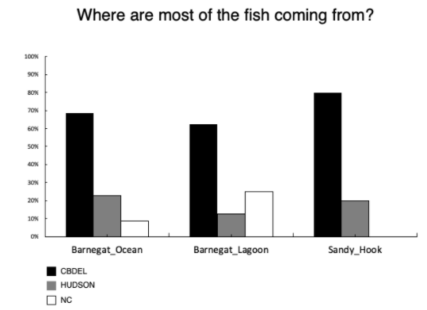
% of population from spawning ground

Slide 25
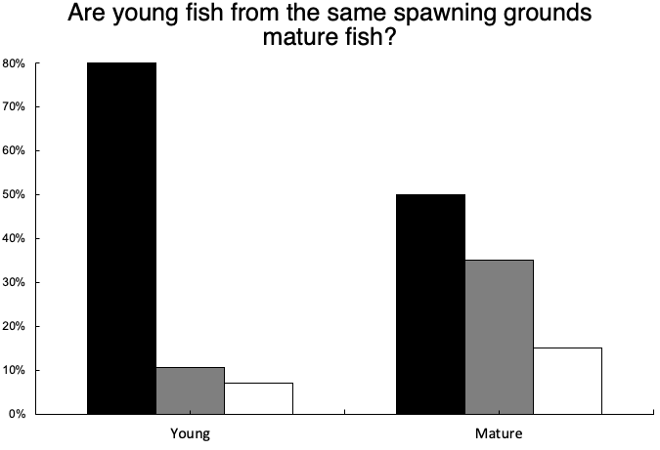

% of population from spawning ground

Slide 26
Please provide us with any suggestions on the Data Nugget!
Write down your thoughts or email us at datanuggetsK16@gmail.com
Conference Materials:
http://datanuggets.org/2019/11/nabt-2019/
Follow us on Facebook and Twitter for updates on new Data Nuggets and supplemental materials

