Slide 1
All washed up? The effect of floods on cutthroat trout
Featured scientists: Ivan Arismendi and Stan Gregory from Oregon State University
Written by: Leilagh Boyle

Slide 2
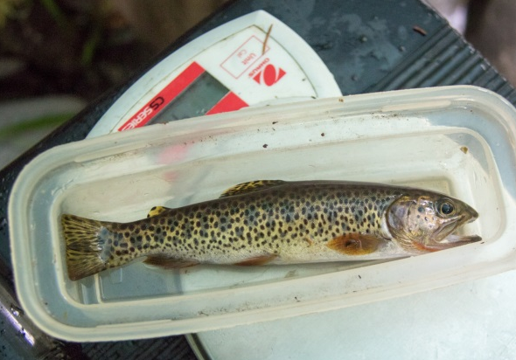
Figure 1: A cutthroat trout. It is momentarily unhappy, because it is not in its natural, cold Pacific Northwest stream habitat.

Slide 3
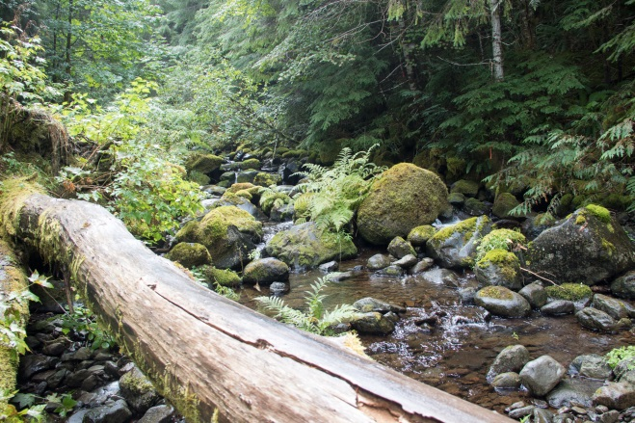
Figure 2. Mack Creek. This healthy stream is located within the old growth forests of the Andrews. It has a diversity of habitats because of its various rocks and wood. This creates refugia for juvenile trout.

Slide 4
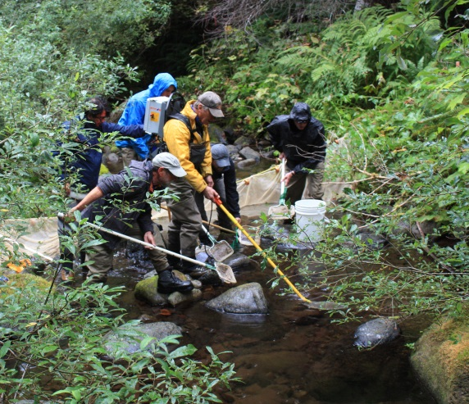
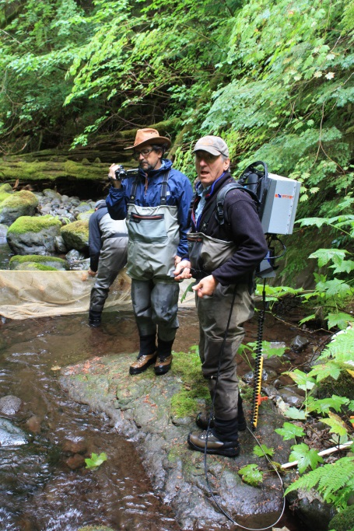
Figures 3 & 4. Researchers Ivan Arismendi and Stan Gregory preparing to electrofish for cutthroat trout.

