Slide 1


Winter drives responses of terrestrial organisms to climate change
Caroline Williams
Assistant Professor
Department of Integrative Biology
UC Berkeley

Slide 2
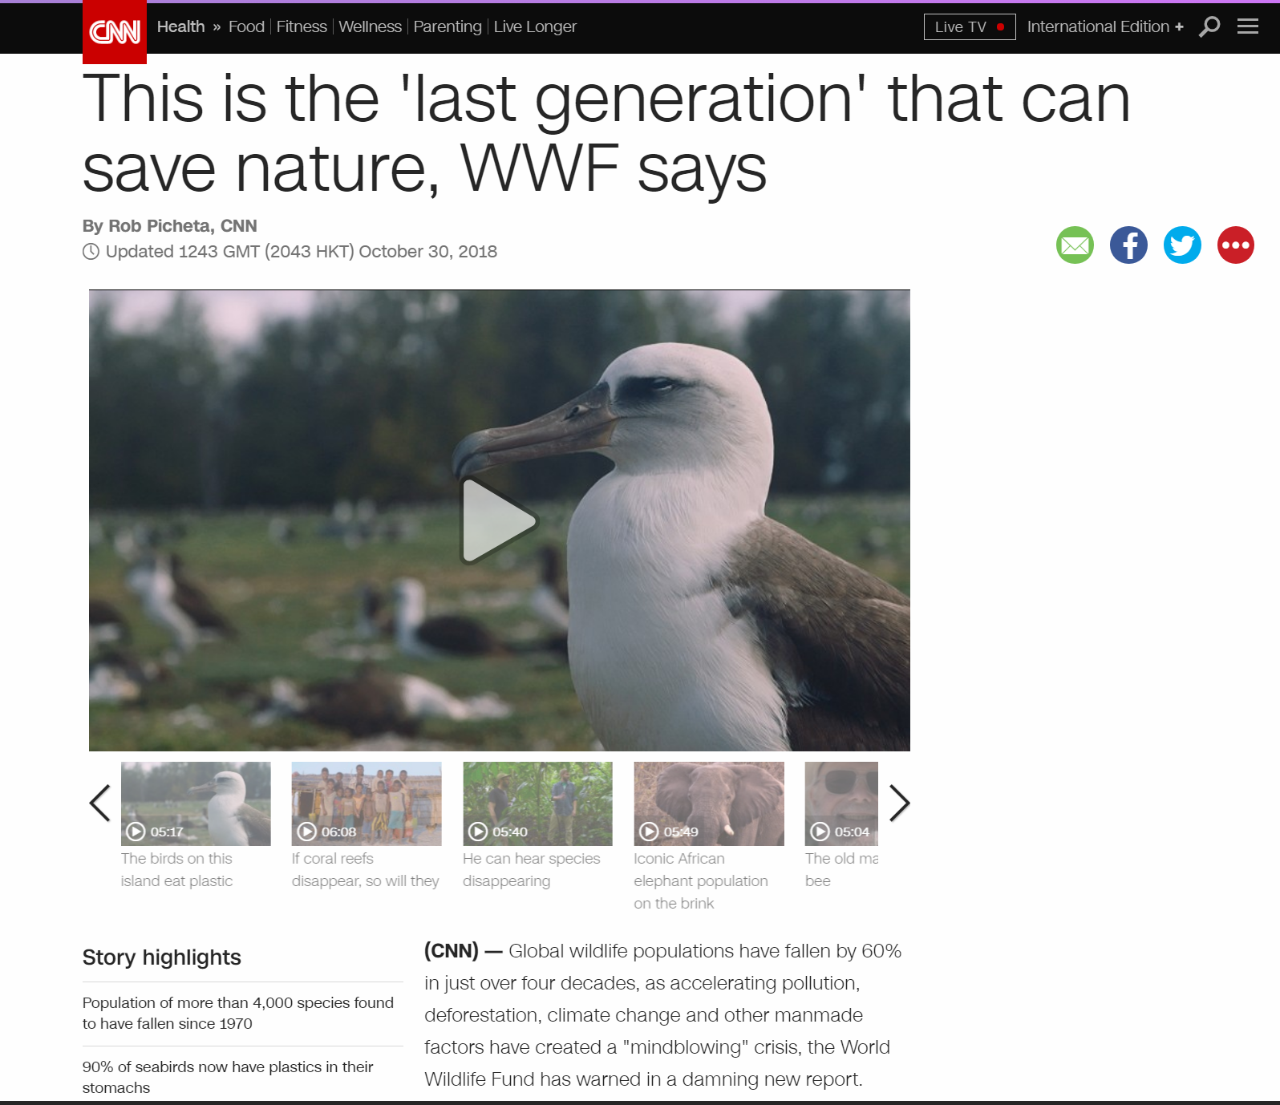
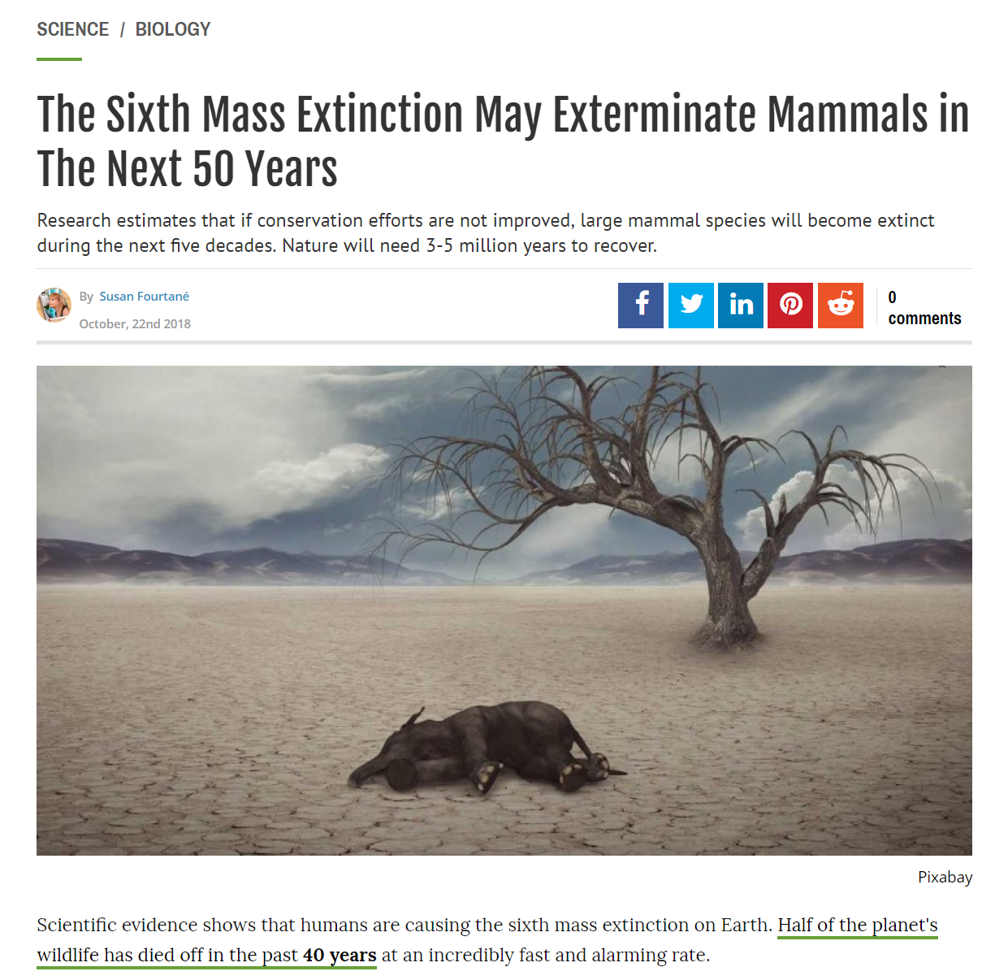
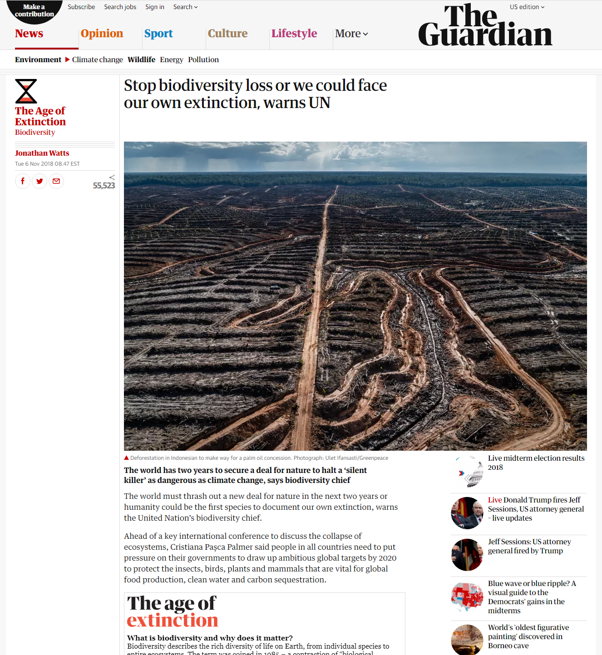
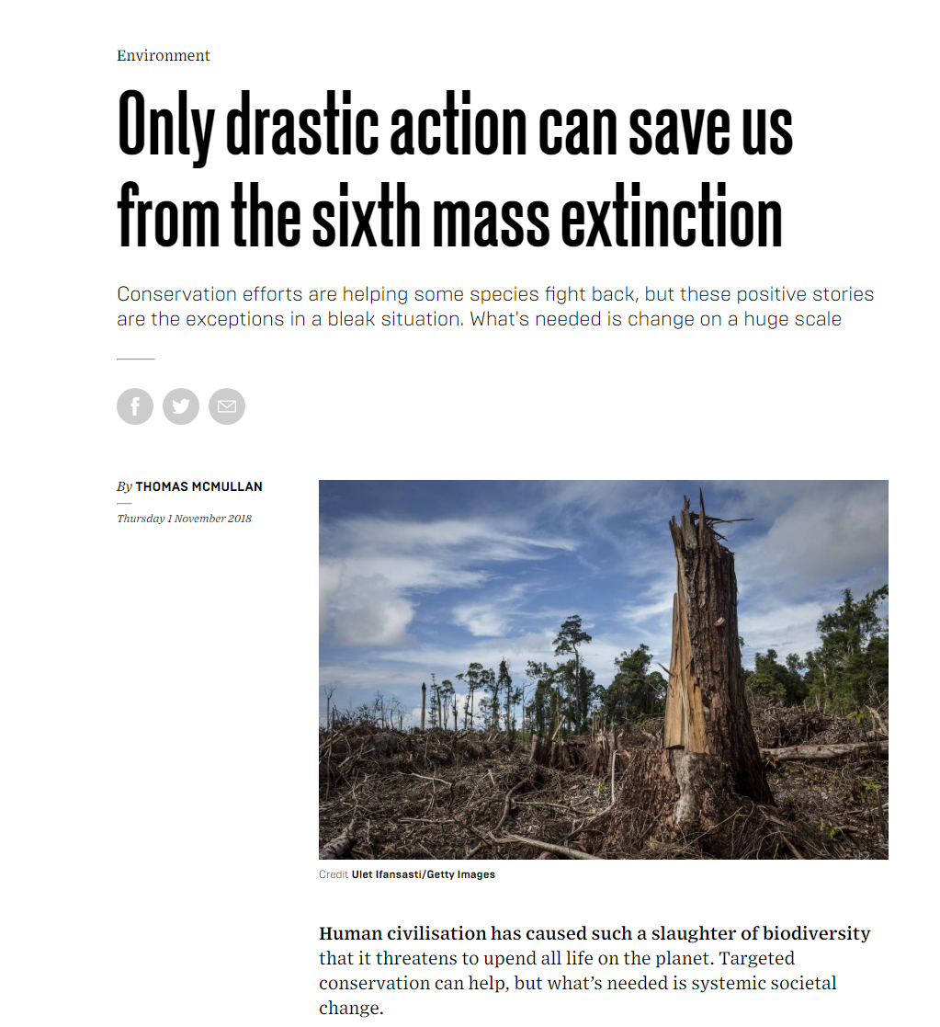
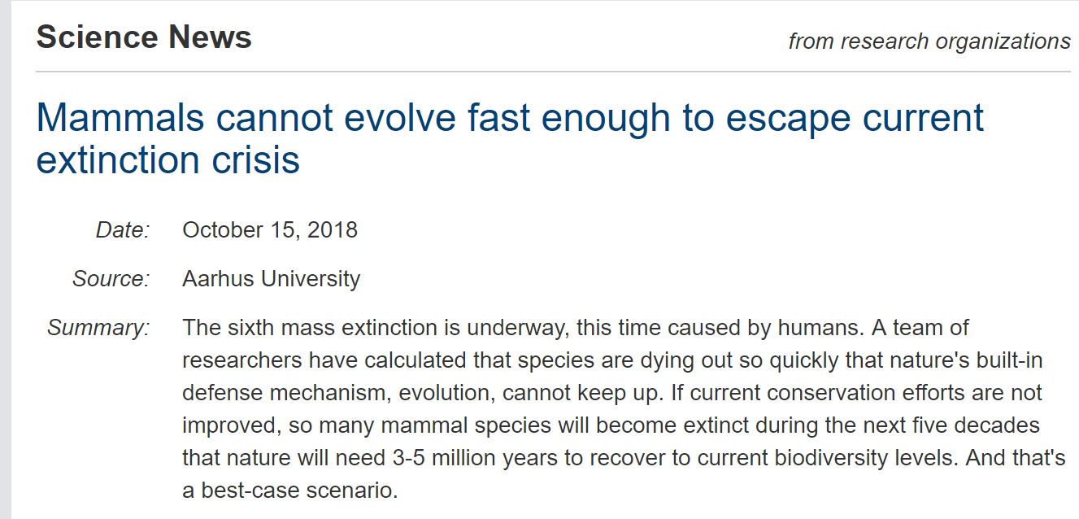
Global biodiversity crisis in the news

Slide 3
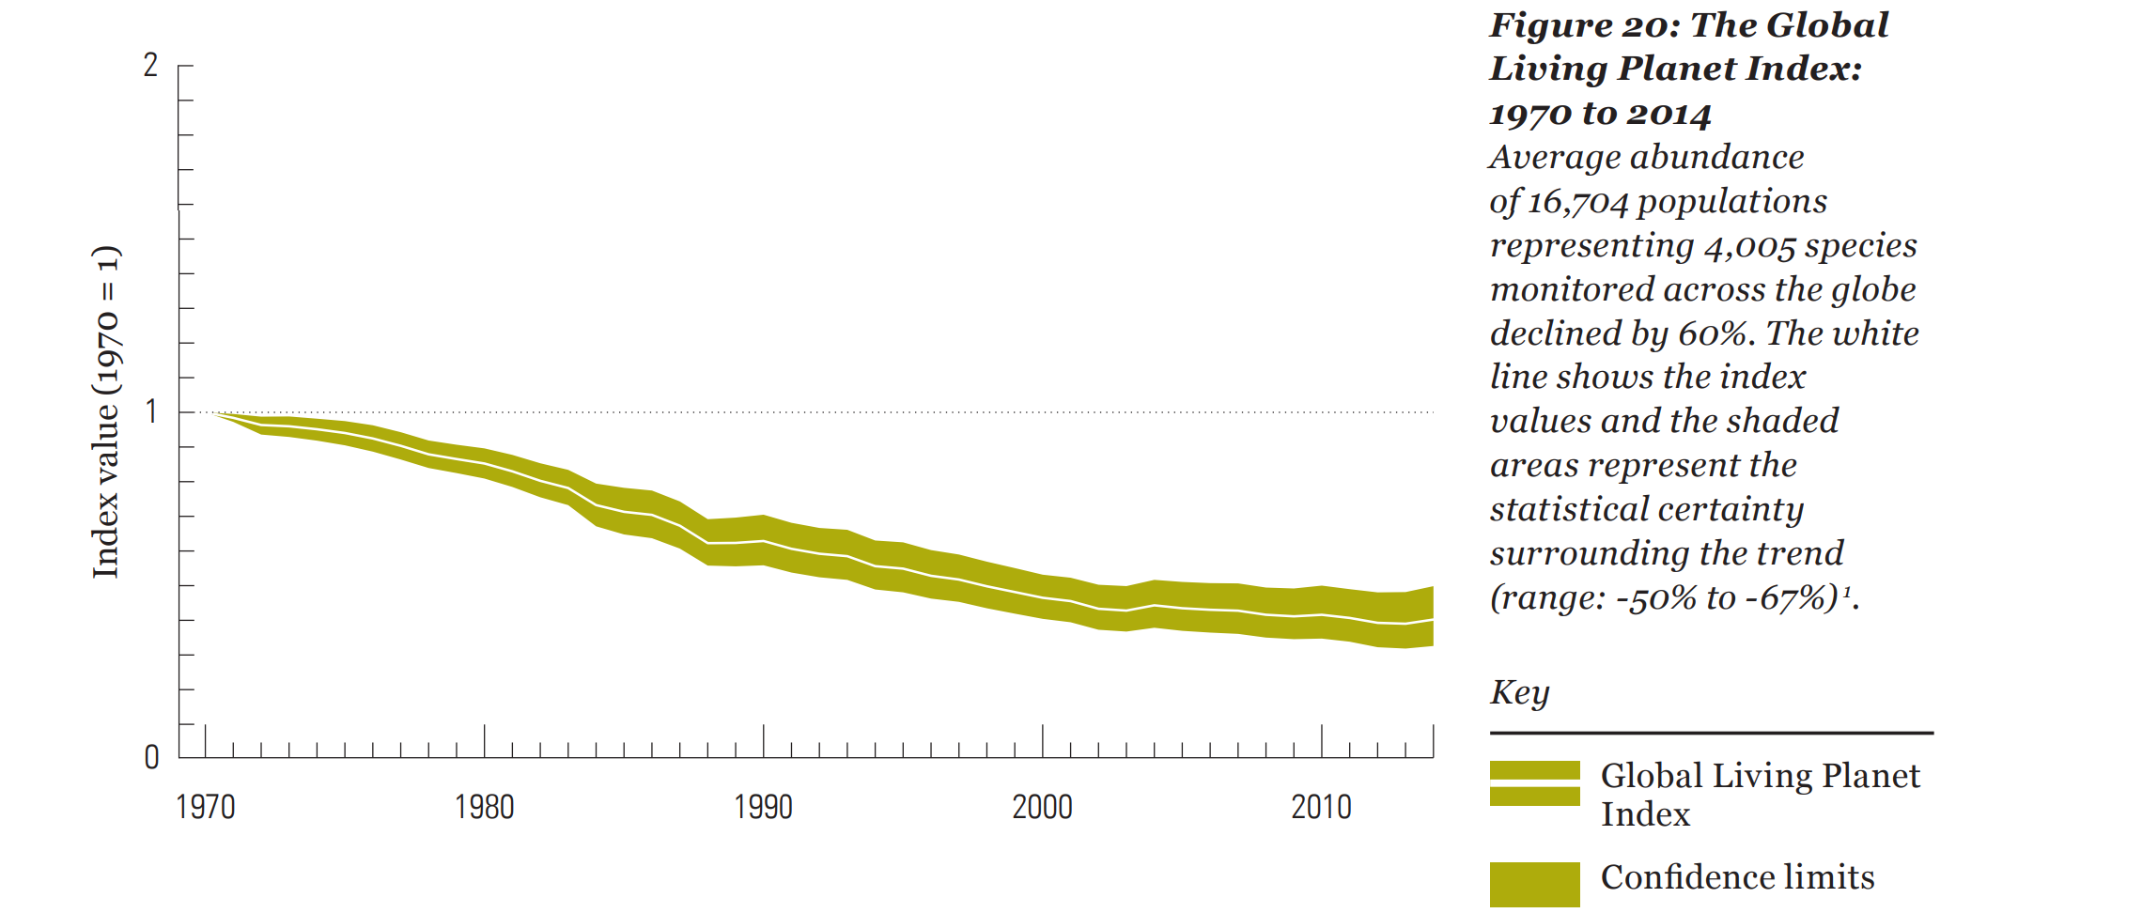
WWF Living Planet Index
Report released Oct 2018 documenting mammal, bird, fish and reptile declines worldwide
Average population declines of 60% relative to 1970

Slide 4
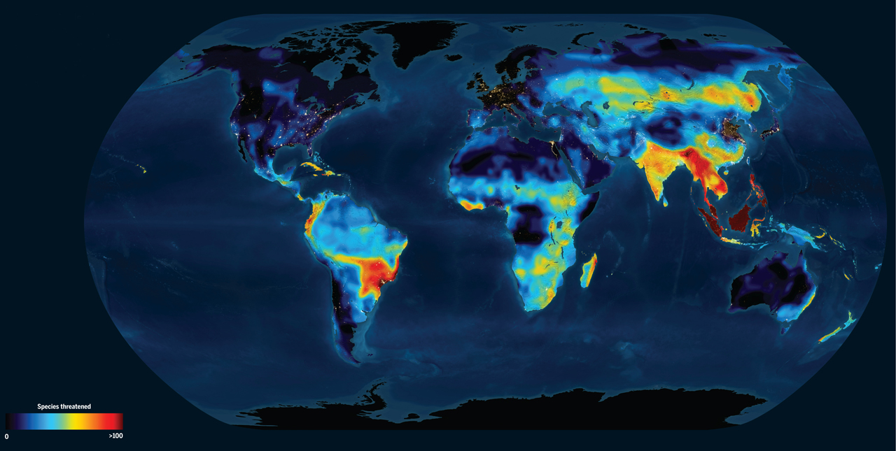
Hundreds of species are threatened with extinction globally
Special issue in Science, 2014: Vanishing fauna
Sacha Vignieri

Slide 5
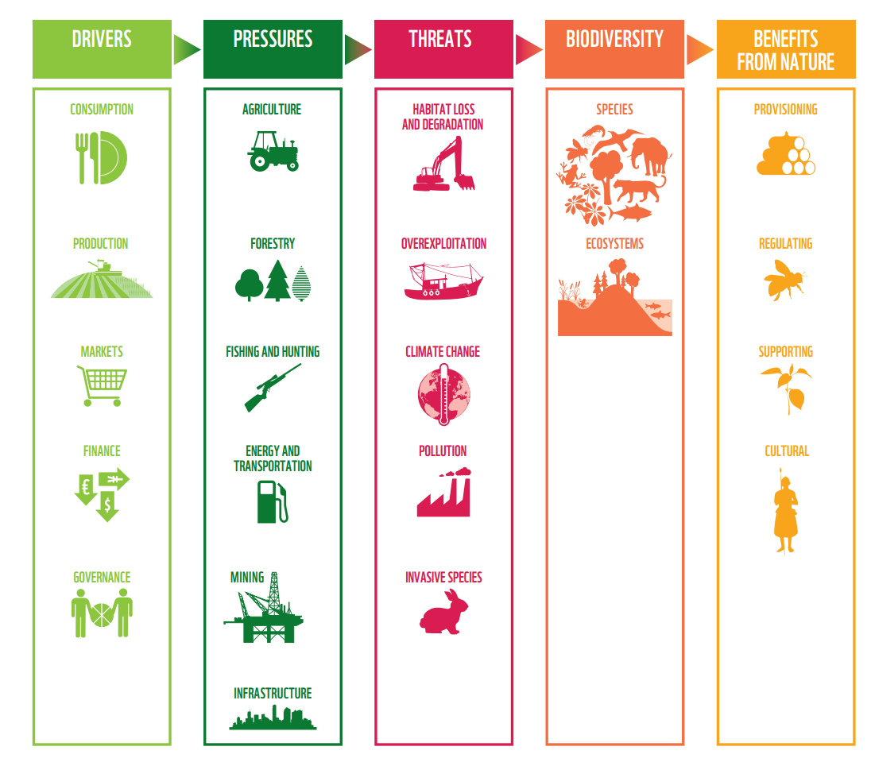
Threats to nature
Climate change synergizes with other threats to reduce biodiversity and ecosystem services
WWF Living Planet Report 2018

Slide 6
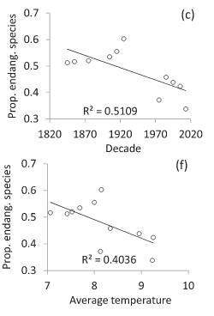
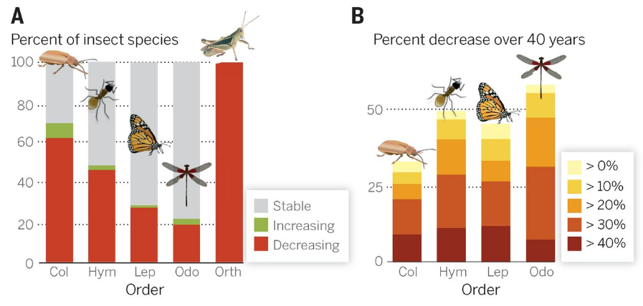
Insect declines are driven by temperature
Defaunation in the Anthropocene
Dirzo et al. 2014 Science
Habel et al. 2016

Slide 7
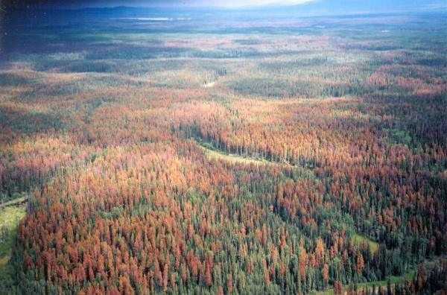
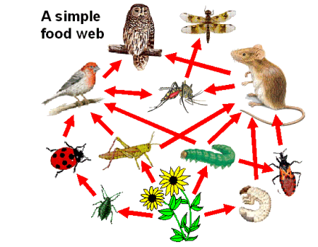
Insect population dynamics impact ecosystems
Dominate terrestrial biodiversity
Drive carbon flux and regulate forest dynamics
Pollinators, agricultural pests, predators
Support terrestrial food webs
Mountain Pine beetle outbreak
Photo: University of Wyoming
How will insect populations respond to climate change?
Graphic: NC State University, ENT425
Notes:
Say “For example”

Slide 8
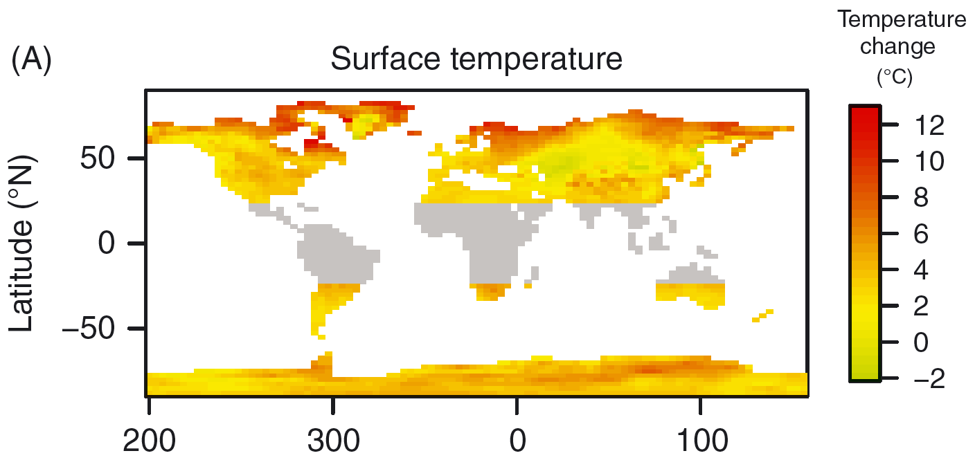
Winter climate is changing rapidly
Warmer average temperatures
Warmer minimum temperatures
Earlier snowmelt
Changes in precipitation
Projected January (northern hemisphere) or July (southern hemisphere) temperature changes by the end of the century
Williams et al. 2015 Biological Reviews

Slide 9
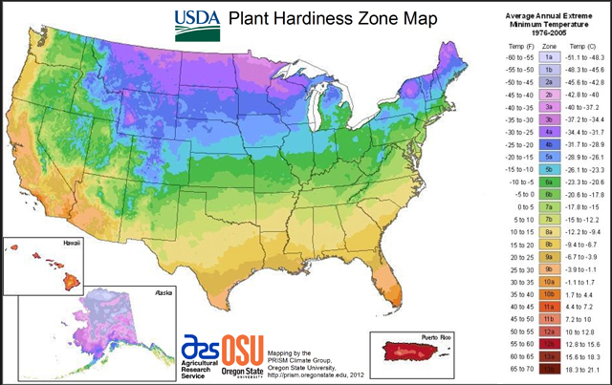
Winter cold sets distributions
for insects too…

Slide 10
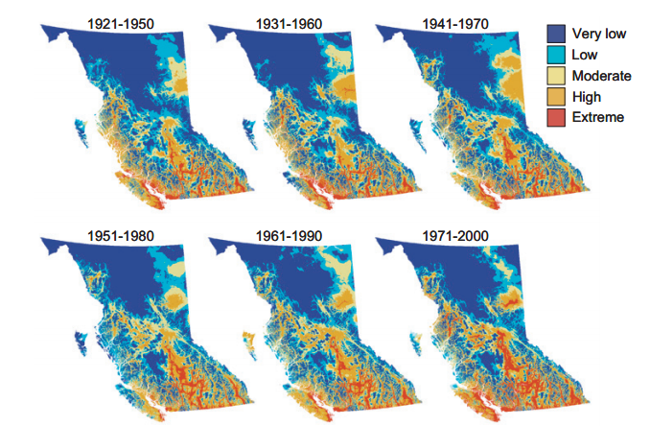
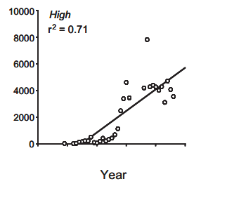
Winter climate change is increasing pest outbreaks
Number of infestations
Winter climate suitability for mountain pine beetle in British Columbia increased over the course of the century, leading to increased outbreaks (Carroll et al. 2003)

Slide 11
Winter warming is increasing numbers of some insects
Mountain Pine Beetle
Emerald Ash Borer
Spruce Budworm
Other pest species!
BUT… other species are not doing so well.

Slide 12

Two main stresses of winter
Low
temperature
Reduced resource availability

Slide 13
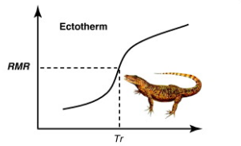
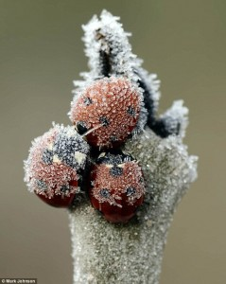

Ectotherms in winter
Nespolo et al. 2011
Energy Stress
Metabolic rate increases with temperature
Colder temperatures reduce energy stress
Provided it’s not too cold!
Cold stress

Slide 14
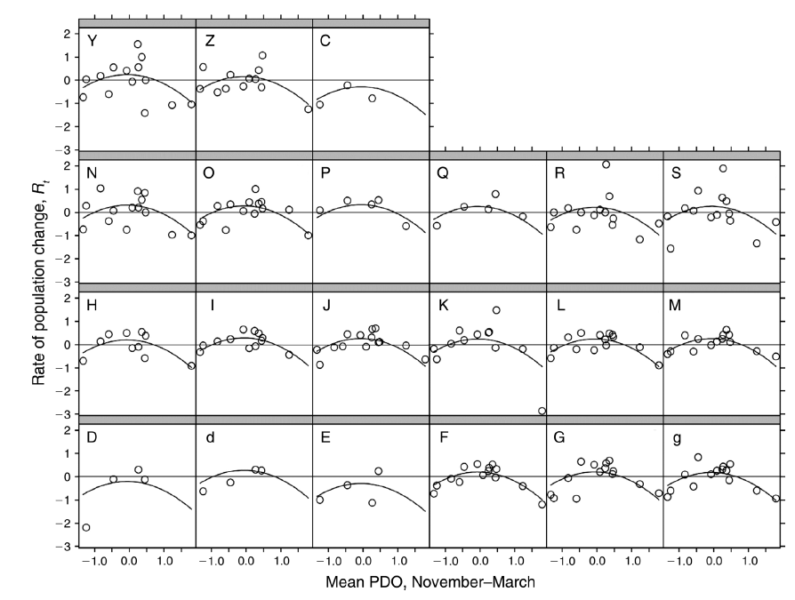
Goldilocks effect – not too warm, not too hot is best
Population changes in alpine butterflies with respect to winter conditions
Roland and Matter 2013

Slide 15
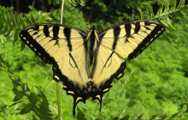
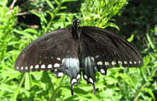
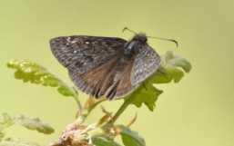
Winter warming increases mass and energy loss
Cool
Warm
All species lose more mass over winter in warm than cool conditions – but magnitude of impact differs
Williams et al. 2012

Slide 16
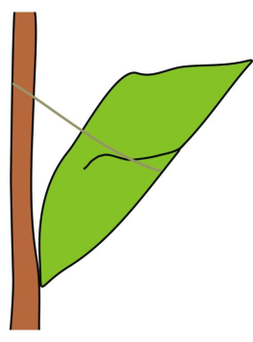


Energy reserves fuel reproduction
Increased metabolic costs can reduce the energy left for producing eggs

Slide 17


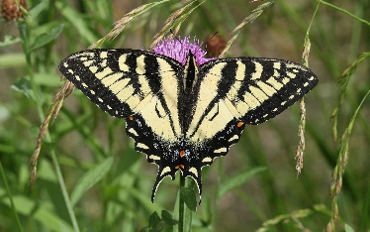
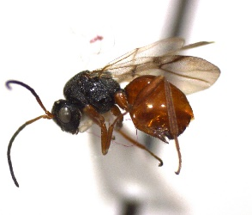
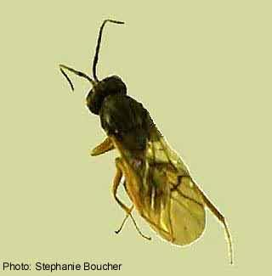
Winners and losers in warmer winters
Jake Williams et al. 2003 J Exp Zool
Mercader and Scriber 2008 Ecol Entomol
Williams et al. 2012 Climate Research
Williams et al. 2012 PLoS One
P. glaucus
P. canadensis
Papilio troilus
Erynnis propertius
Diplolepis variabilis
Diplolepis spinosa

Slide 18
Traits that will determine winners and losers:
Tolerance of heat, drought, other stresses
Energy conservation mechanisms
Seasonal timing responses
Dispersal ability
How rapidly can these traits change? Can animals keep pace?

Slide 19

Keeping pace with climate change
Time 1
Time 2
Evolutionary adaptation – change in gene frequencies over time
Depends on genetic variation, population size, strength of selection

Slide 20
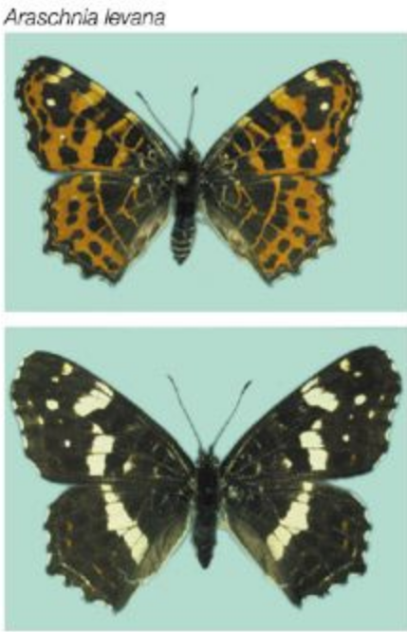
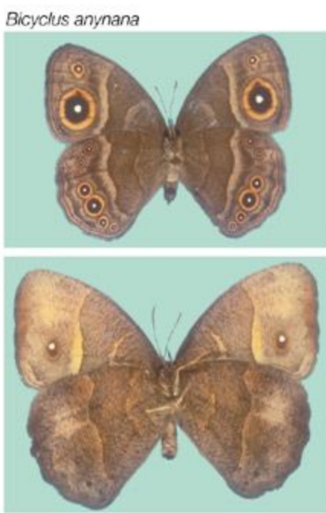
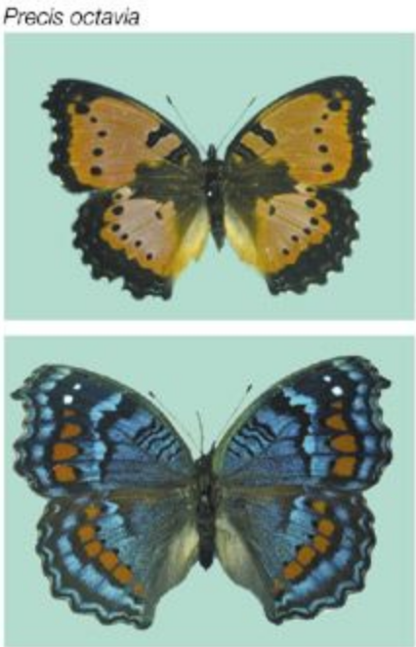
What will determine winners and losers?
Environment 1
Environment 2
Phenotypic plasticity – changes in phenotype caused by a change in the environment (without any changes in genotype)
How does physiological plasticity alter responses to winter conditions?

Slide 21
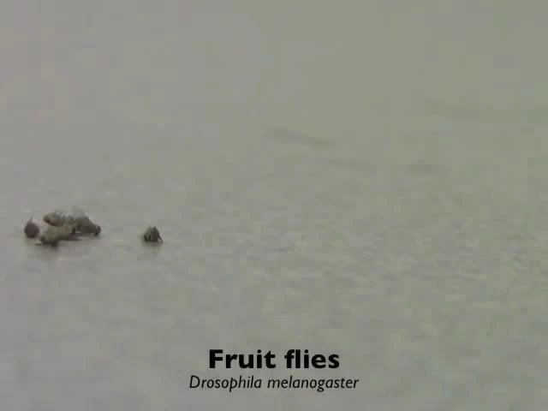
Insects in the cold
In the cold, insects and other ectotherms enter a reversible cold coma (chill coma)
Video: Heath MacMillan

Slide 22
Insect cold hardiness
Requires synthesis of protective molecules (e.g. sugars, sugar alcohols, amino acids, heat shock proteins)
Can be energetically expensive
Does cold hardiness increase energy stress?

Slide 23
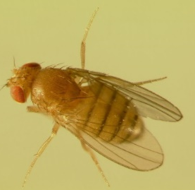
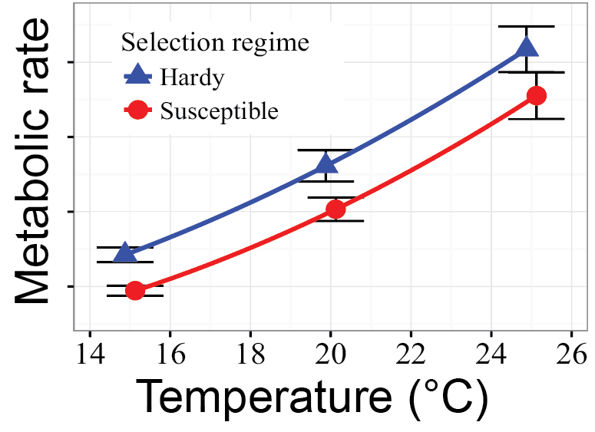
Cold hardy flies have higher energy use
Williams et al. 2016 ICB

Slide 24
Hardy flies have greater metabolic plasticity in the cold
Hardy
Susceptible
Higher metabolic rates before and after cold, lower rates during cold
Metabolic rate
Before
During
After
Time relative to cold exposure
Williams et al. 2016 Proc Roy Soc B

Slide 25
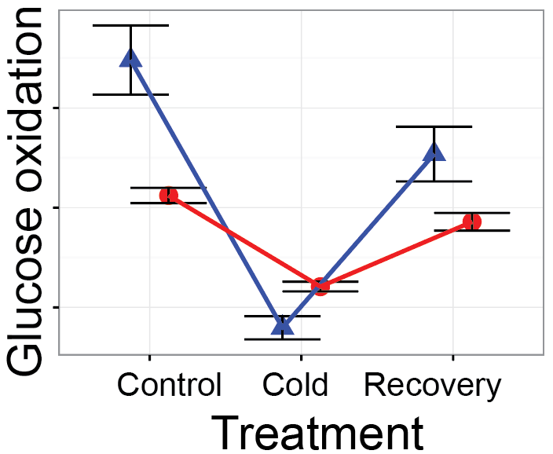
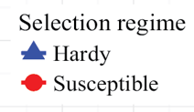
Cold hardy flies have higher rates of nutrient flow
Faster breakdown of ingested nutrients before and after cold exposure allows them to synthesize protective molecules, deeper shut down of metabolism in the cold

Slide 26
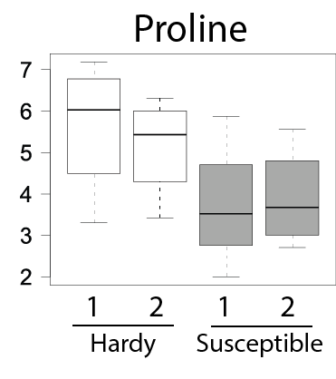
Cold adaptation increases biosynthesis of cryoprotectants
Physiological plasticity can evolve in response to changes in winter conditions, and this plasticity can determine how well organisms can survive cold temperatures
Williams et al. 2016 Proc Roy Soc B

Slide 27
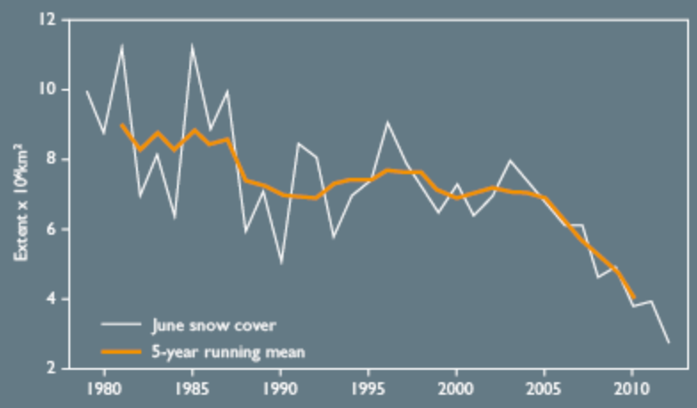
Snow will drive many important impacts of climate change

Slide 28
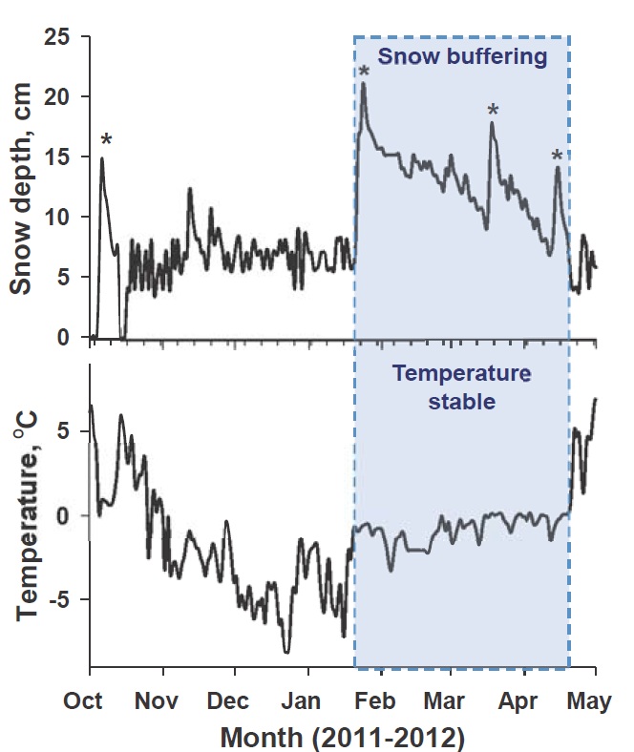
Snow modifies temperatures
Snow insulates the ground
Temperatures remain relatively warm and constant
“Colder soils in a warmer world”

Slide 29
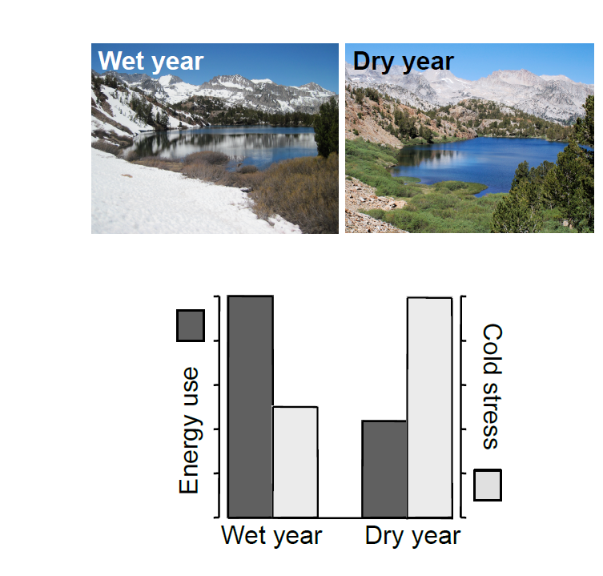

Snow cover impacts cold and energy stress
Dry years without snow cover will increase cold stress but decrease energy stress

Slide 30
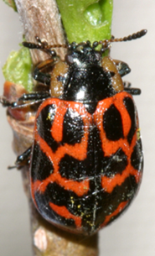

Model organism for studying evolutionary impacts of snow
Chrysomela aeneicollis
illustrations: Hiroko Udaka
Snowy year
(2006)
Dry year
(2007)
Data:
N. Rank and E. Dahlhoff

Slide 31

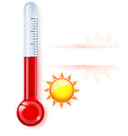
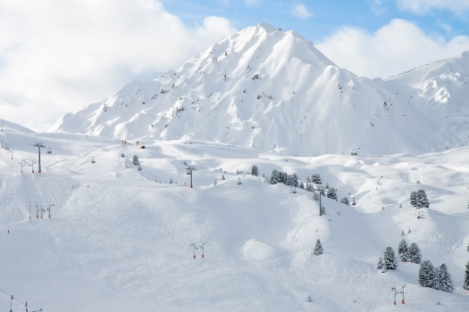
Impacts of winter climate change on insects
Energy Stress
Cold stress

Slide 32
Impacts of winter climate change on insects
Energy Stress
Cold stress
…it’s complicated!

Slide 33
Take away points
Winter climate change has been strongly impacting insect populations, but impacts have been inconsistent (some increases, some decreases)
Increasing winter temperatures decrease cold stress (good for insects) but increase energy use (bad for insects)
Studying responses to changes in winter temperature can help us predict winners and losers of climate change

Slide 34
The way forward
Study responses to winter warming and changes in snow cover in animals with a range of characteristics, to determine rules that govern responses - “Winners and losers”
Use this information to prioritize conservation efforts towards vulnerable species
Communicate the science of climate change to the next generation, and engage with them to learn their motivations, hopes, fears and priorities

Slide 35
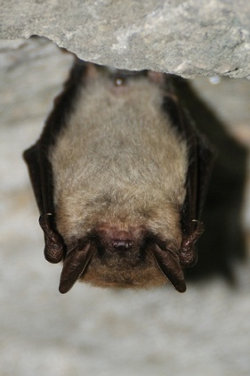
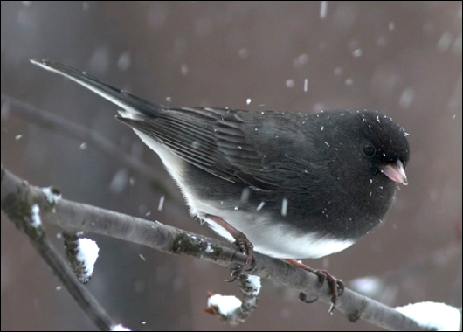
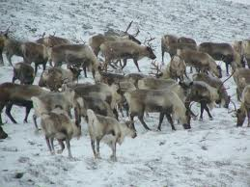
Not just insects

Slide 36
Urgent need for a new global deal for nature
50% of land and oceans designated as protected areas
“Carbon law” – halve emissions every decade
Pursue active carbon sequestration
“Herculean efforts” requiring large-scale international coordination and action

Slide 37
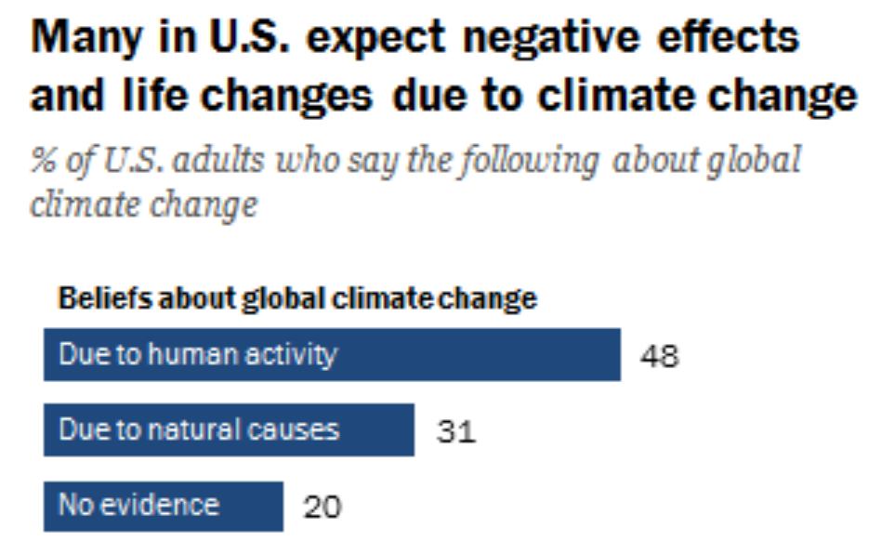
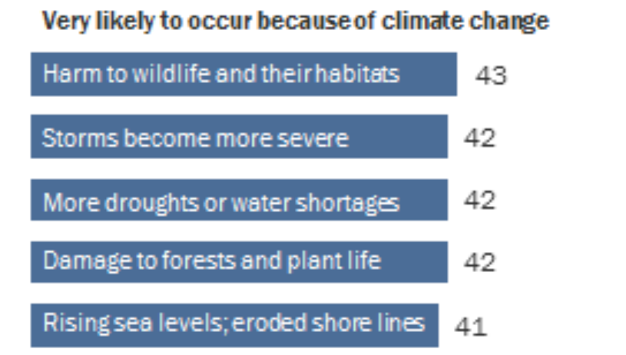
Pew Research Center Report 2016

Slide 38
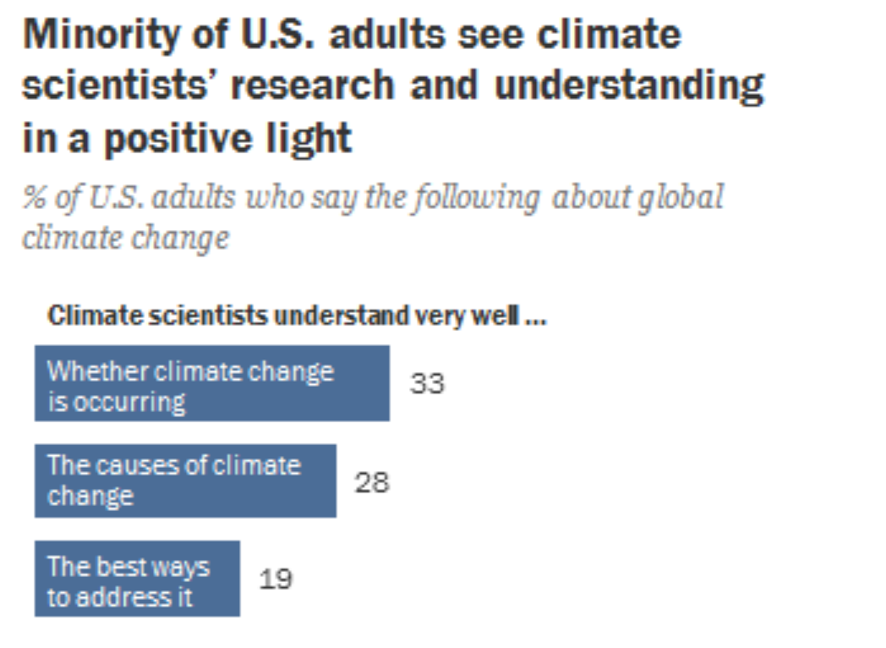
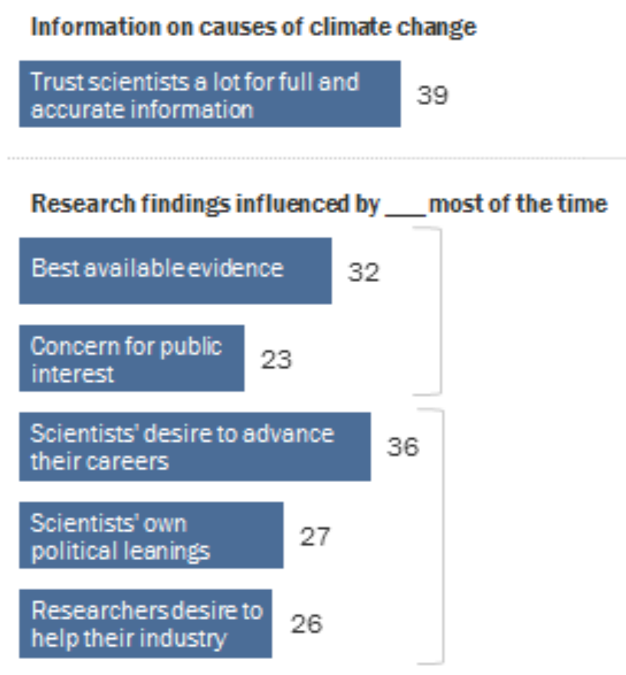
Pew Research Center Report 2016

Slide 39
An imperative for educators
Introduce students early in their career to how climate change is impacting biodiversity
Allow students to experience the process through which researchers study responses to climate change
Give students experience in data collection and interpretation
Encourage students to identify with STEM research and understand the strengths and limitations

Slide 40
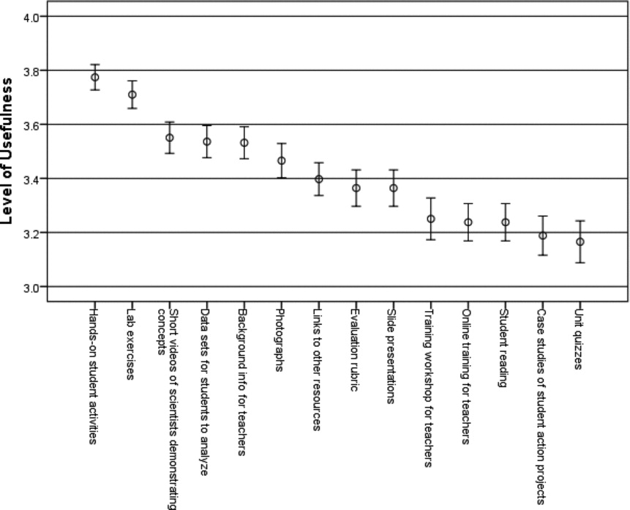
Hands-on activities are most useful for teachers
Monroe et al. 2014
746 US-based high school teachers

Slide 41
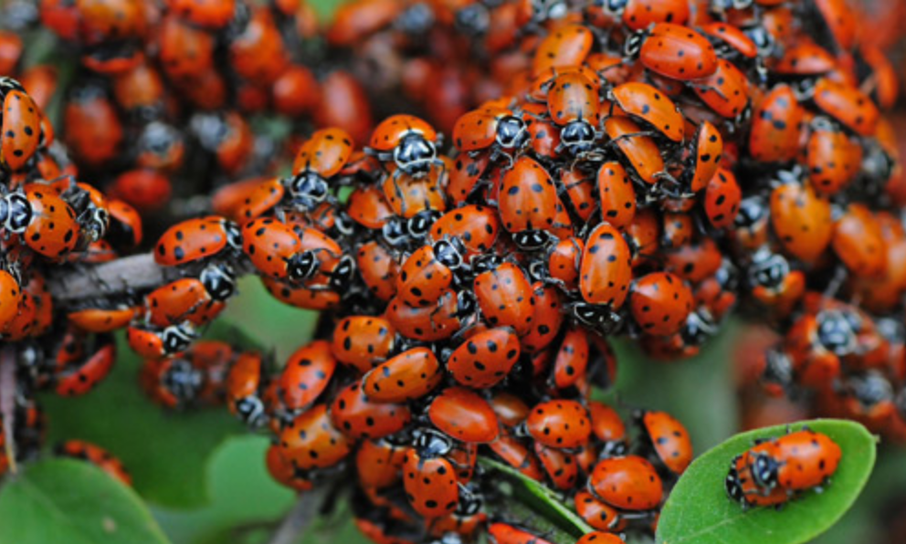

Using lady beetles to understand insect responses to climate change
Abundant and easily obtained from garden supply stores
Can be kept in refrigerator with little maintenance

Slide 42




Thank you!
NABT, Louise Mead, Elizabeth Schultheis, Melissa Kjelvik
Collaborators and coauthors: Brent Sinclair
Jessica Hellman
Daniel A. Hahn
Theodore Morgan
David Allison
Arthur Edison
Nathan Rank
Elizabeth Dahlhoff
Jonathon Stillman
Marshall McCue
Nishanth Sunny
Mario Guarracino
Alison Gerken
Tonia Schwartz
Peng Li
Xiangqin Cui
Lady beetle labs:
Nikki Chambers
Anna Thanukos
Ann Cortina
Aaron Matthieu
Andre Szejner Sigal
Ana Lyons
Teachers Researching Evolution program – Beacon and SSE

