Slide 1
Are forests helping in the fight against climate change?
Featured scientist: Bill Munger from Harvard University

Slide 2
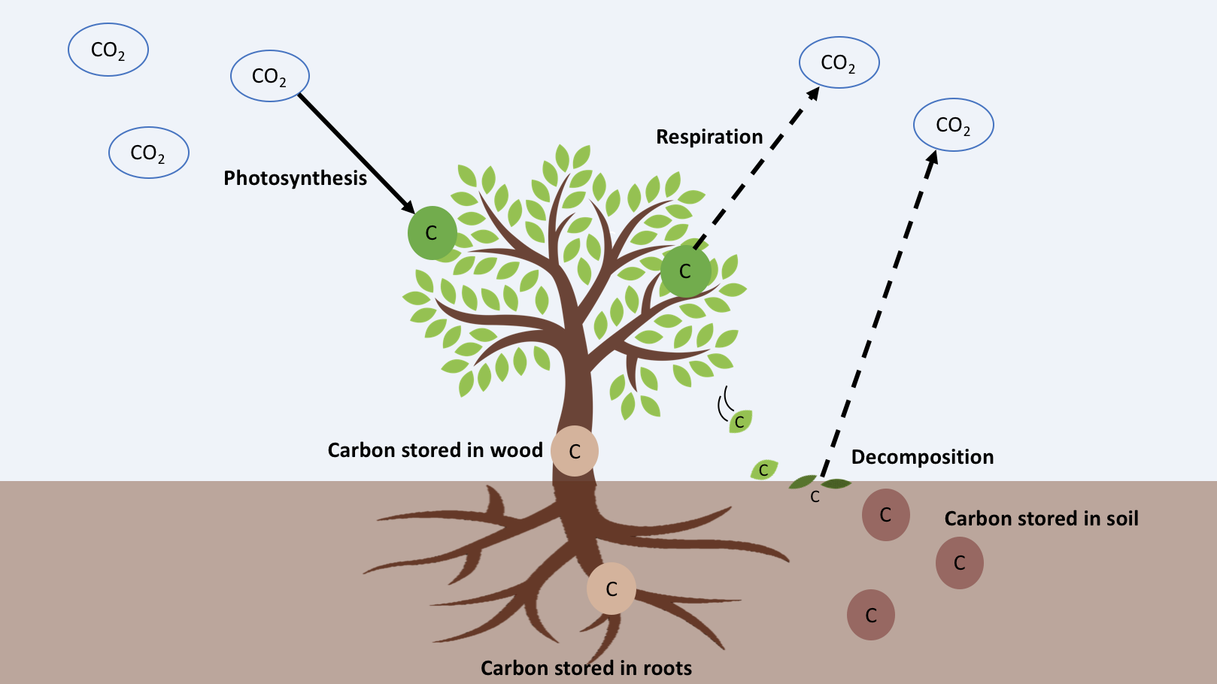
Notes:
All living organisms contain carbon, and when plants photosynthesize they must begin with carbon. Their leaves take CO₂ from the air and turn it into other forms of carbon they can use: sugars for food and other compounds to make their stems, roots, and leaves. Some of that carbon gets used up rapidly and is returned to the air as CO₂: this is a process called respiration. Some carbon that isn’t respired ends up stored in the tree’s trunk, roots, leaves and branches and stays there for a long time, keeping that carbon out of the air. This helps reduce the amount of CO₂ that is trapping heat closer to earth. When trees drop branches or die, the carbon that has been stored in their wood breaks down. During this process, which is called decomposition, some of that stored carbon returns to the air as CO₂. The rest of the carbon builds up on the forest floor, and over time it becomes soil. Once carbon is in soil, it is stored for a long time.

Slide 3
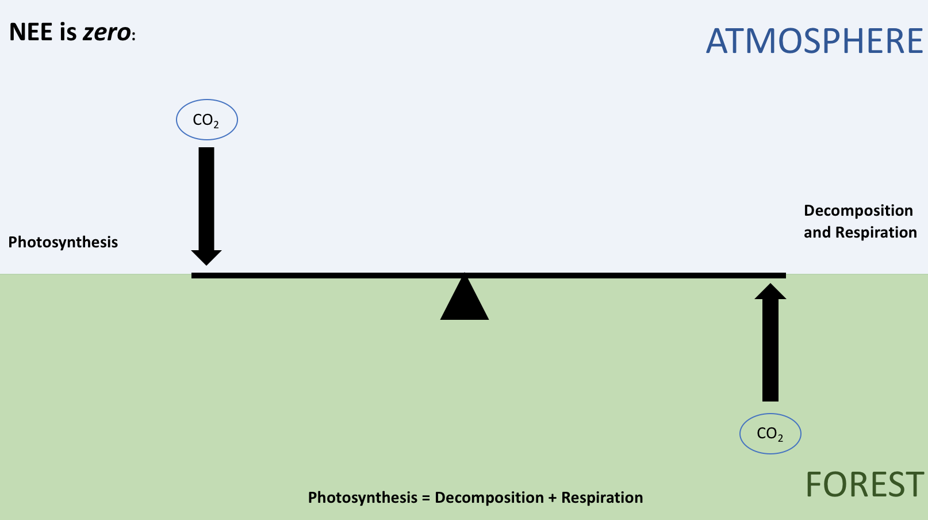
Notes:
We can think of forests as a balancing act between carbon building up in trees and soil, and carbon released to the air by decomposition and respiration.

Slide 4
Notes:
When a forest is building up more carbon than it is releasing, we call that area a carbon sink, because on the whole, more CO₂ is “sinking” into the forest and staying there. When more carbon is moving down and being taken out of the air and stored in plants and soils, the forest is a carbon sink, and NEE is a negative number. This happens when the sun is shining in the summer time and plants are photosynthesizing.

Slide 5
Notes:
When more carbon is being released by the forest through decomposition and respiration, that area is a carbon source, because the forest is adding carbon back into the atmosphere. When decomposition and respiration are greater than photosynthesis and more carbon is moving up into the atmosphere, the forest is a carbon source and NEE is a positive number. This happens at night and during the winter when photosynthesis stops.

Slide 6
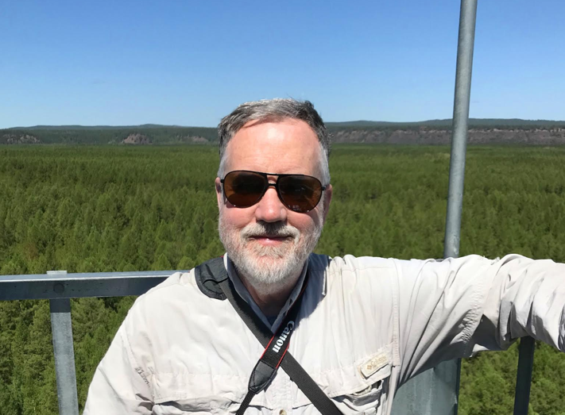
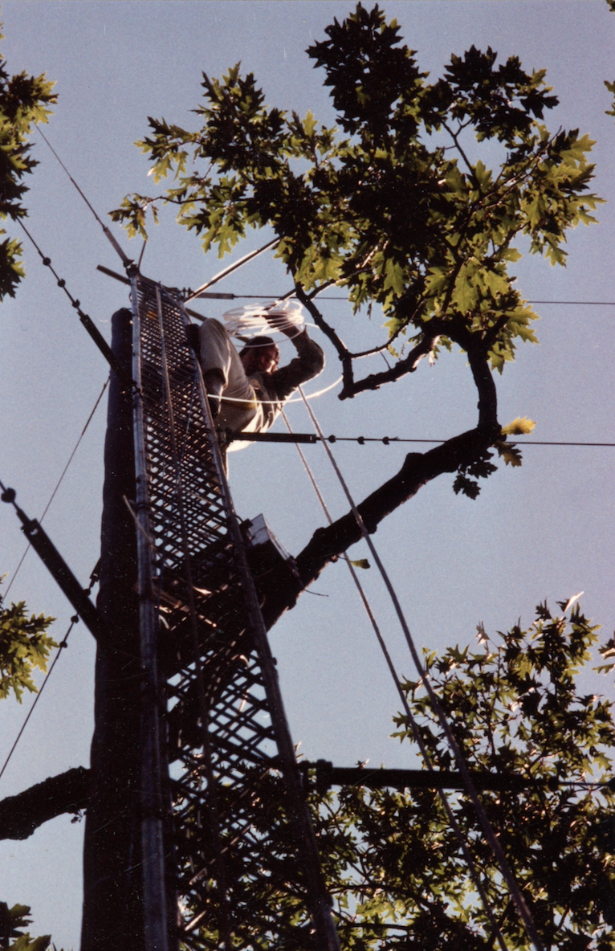
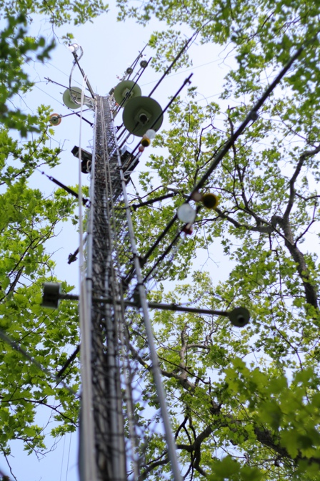
Pictures (left to right):
Bill Munger
photo credit Jialin Liu
Bill setting up the eddy flux tower in 1989
photo courtesy of Bill Munger
Eddy flux tower today in 2018
photo credit Rick Wehr
Notes:
Bill works at the Harvard Forest in central Massachusetts, a Long-Term Ecological Research site that specializes in setting up big experiments to learn how the environment works. Bill and his team of scientists realized they could measure the CO₂ coming into and out of an entire forest by building an “eddy flux tower”.

Slide 7
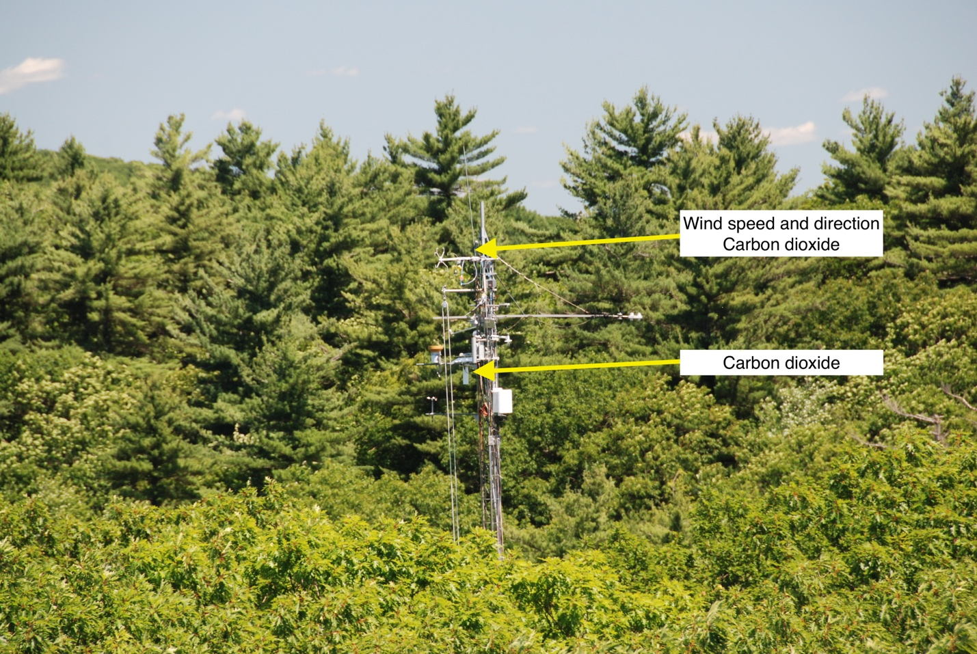
A view of the eddy flux tower at the Harvard Forest. In addition to the sensors measuring CO₂ and wind speed and direction, the tower has instruments that measure temperature, humidity, light, other greenhouse gases, plus cameras to take photographs of the tree canopy.
Photo credit: David Foster
Notes:
These metal towers stand taller than the forest trees around them, and use sensors to measure the speed, direction, and CO₂ concentration of each puff of air that passes by (an air puff is also called an “eddy”). By comparing the CO₂ in eddies moving up into the atmosphere from the forest, to the ones moving down into the forest from the atmosphere, Bill can calculate the Net Ecosystem Exchange (or NEE for short).

Slide 8
Vocabulary
Greenhouse gas: a gas that absorbs infrared radiation, trapping heat near the surface of the earth
Photosynthesis: a process where plants use sunlight to synthesize foods from carbon dioxide and water, which generates oxygen as a byproduct: 6CO₂ + 6H₂O + light energy = C₆H₁₂O₆ + 6O₂
Respiration: a process involving the production of energy from sugars, typically with the intake of oxygen and the release of carbon dioxide: C₆H₁₂O₆ + 6O₂ = 6CO₂ + 6H₂O + energy
Decomposition: the general process by which organic (carbon-based) substances, such as dead tissues or organisms, are broken down into simpler pieces. The byproduct of this process is CO₂
Eddy flux tower: a tower used to measure the net carbon balance of an ecosystem. Also referred to as eddy covariance or eddy correlation, it uses wind speed, wind direction and CO₂ concentrations to measure the NEE over a given area. The area measured depends on the height of the tower and the direction and speed of the wind.
Net Ecosystem Exchange (NEE): the net carbon balance of an ecosystem, often measured using eddy flux techniques. Note that natural systems will have both negative (sink) and positive (source) components: the NEE is the total net exchange once these are added up.
Carbon sink: an area or ecosystem that removes more CO₂ from the atmosphere than it contributes. The opposite of a carbon source- these areas have a negative NEE.
Carbon source: an area or ecosystem that removes less CO₂ from the atmosphere than it contributes. The opposite of a carbon sink- these areas have a positive NEE.

