Slide 1
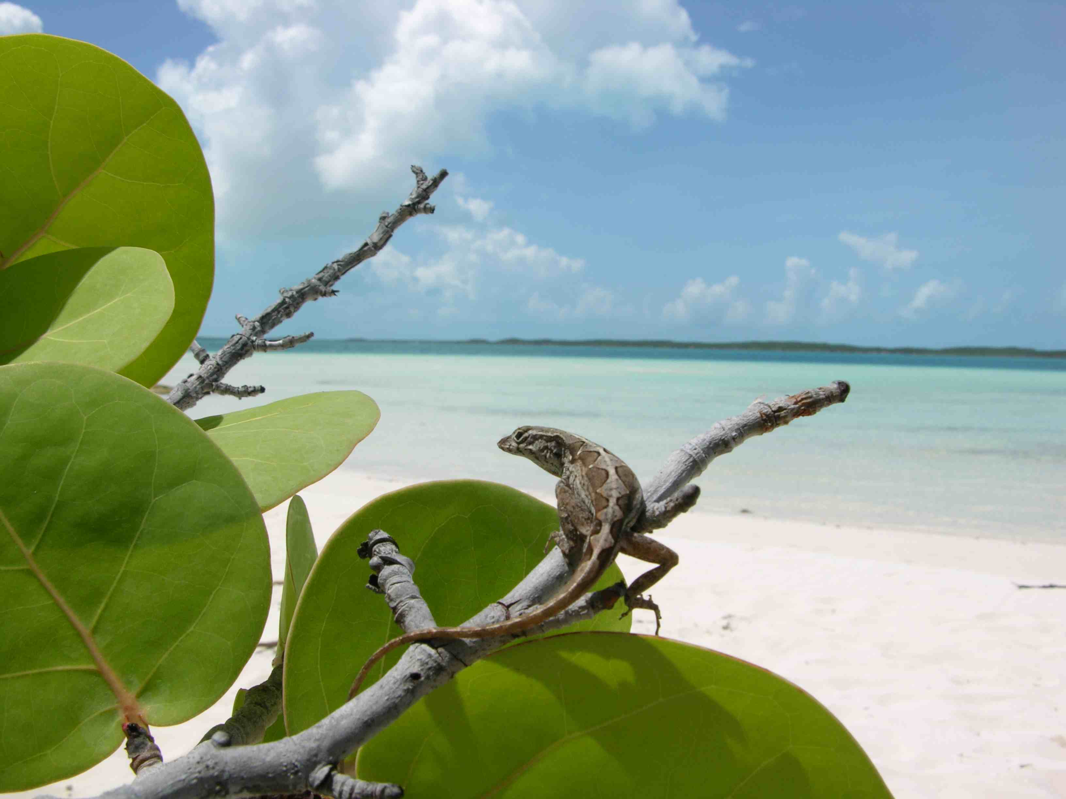
Using islands as living laboratories to
track natural selection in wild lizards
Robert Cox
University of Virginia

Slide 2
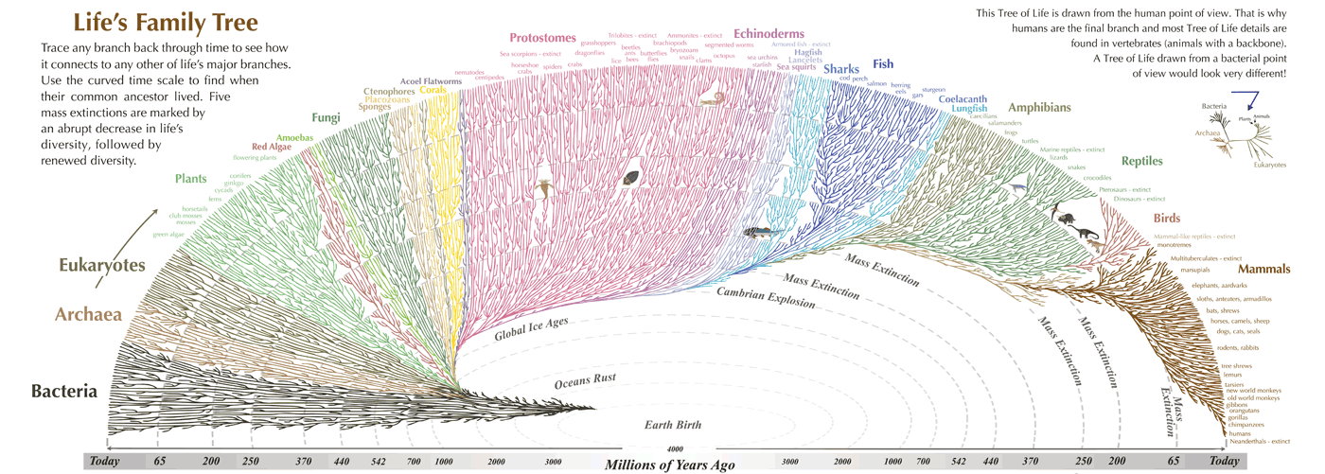
Evolution is a historical science...
The diversity of life has evolved...
on a timescale that is hard to comprehend, let alone study,
through unique events that are not amenable to experiments.

Slide 3
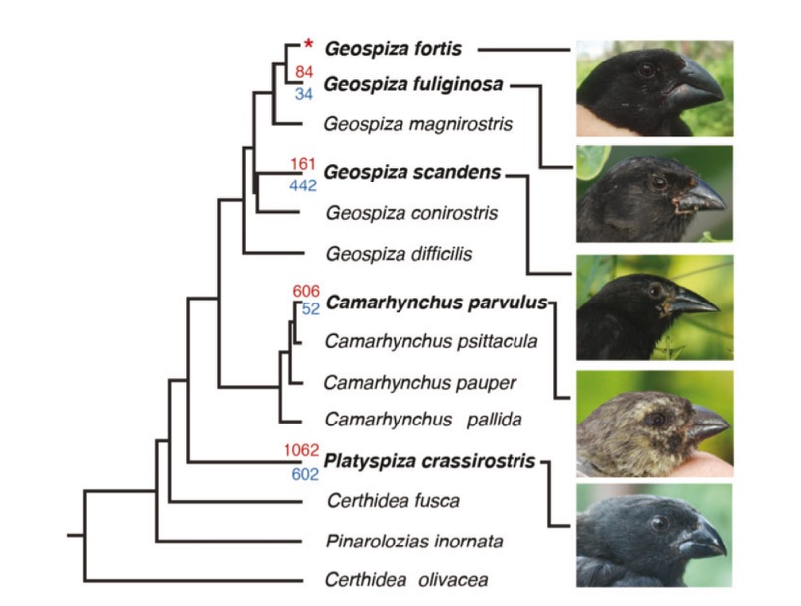
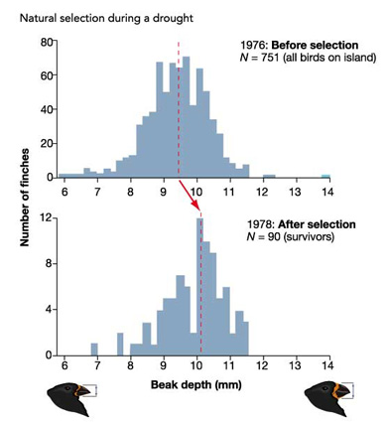
...but the underlying process is ongoing
Evolutionary patterns are often only evident across large timescales...
...but the underlying process of natural selection is always occurring
1-2 million years of evolution
1-2 years of natural selection

Slide 4
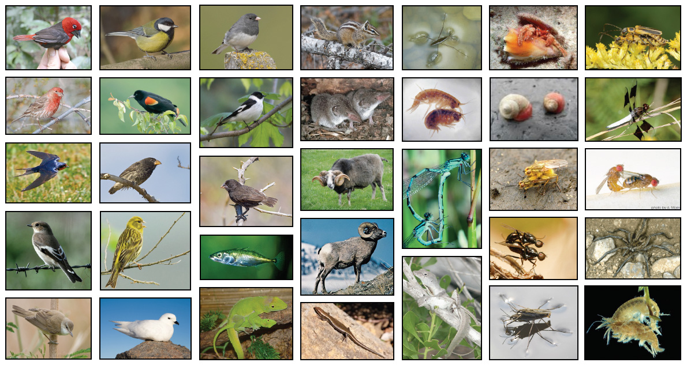
Studying natural selection in the wild
Animal species in which measures of natural or sexual selection in the wild are
available for the same trait in both sexes...a small handful of all selection studies.
Cox & Calsbeek (2009) American Naturalist

Slide 5
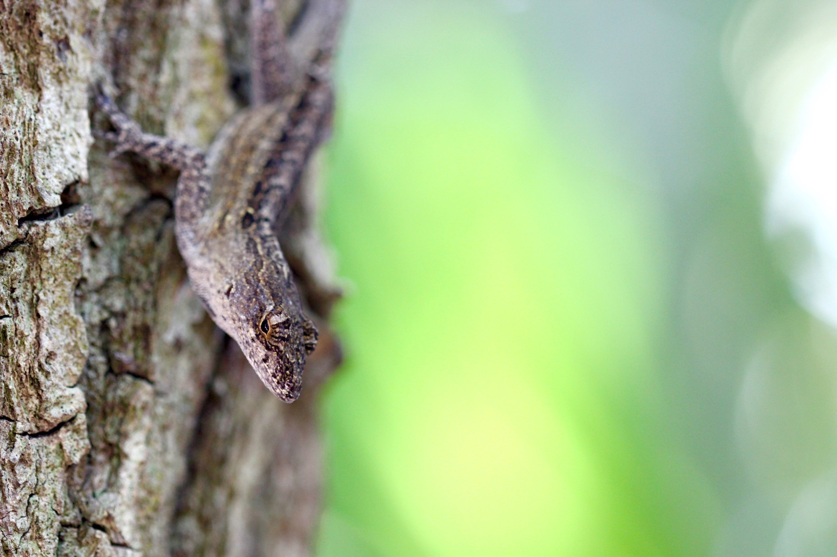
Studying natural selection in the wild
Juveniles
Hatched
Trait
Trait
Population Size
Adult
Females
Juveniles
Surviving
Adult
Males
Jan
Feb
Mar
Apr
May
Jun
Jul
Aug
Sep
Oct
Nov
Dec
Mating
Oviposition
Brown Anole
Anolis sagrei
Photo: Ariel Kahrl
Hatching

Slide 6
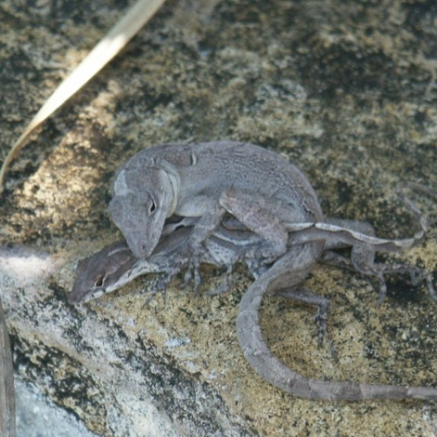
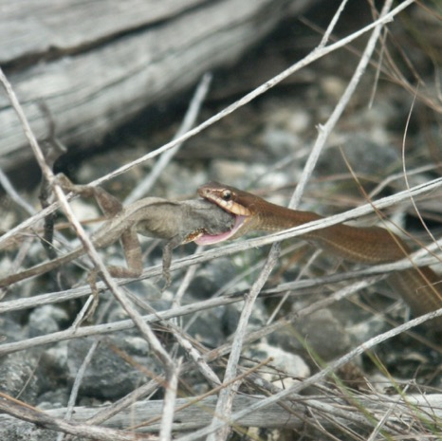
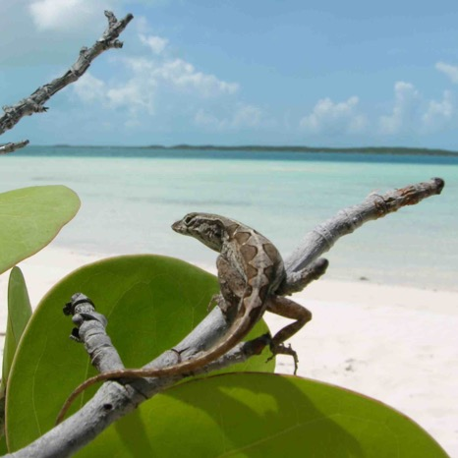
Studying natural selection in the wild
1. Visualizing natural
selection in the wild
2. Manipulating the
agents of selection
3. Manipulating the
traits under selection
Does natural
selection favor
sex differences
in body size?
Do predators
and competitors
shape natural selection?
Does investment
in reproduction trade off against survival?

Slide 7
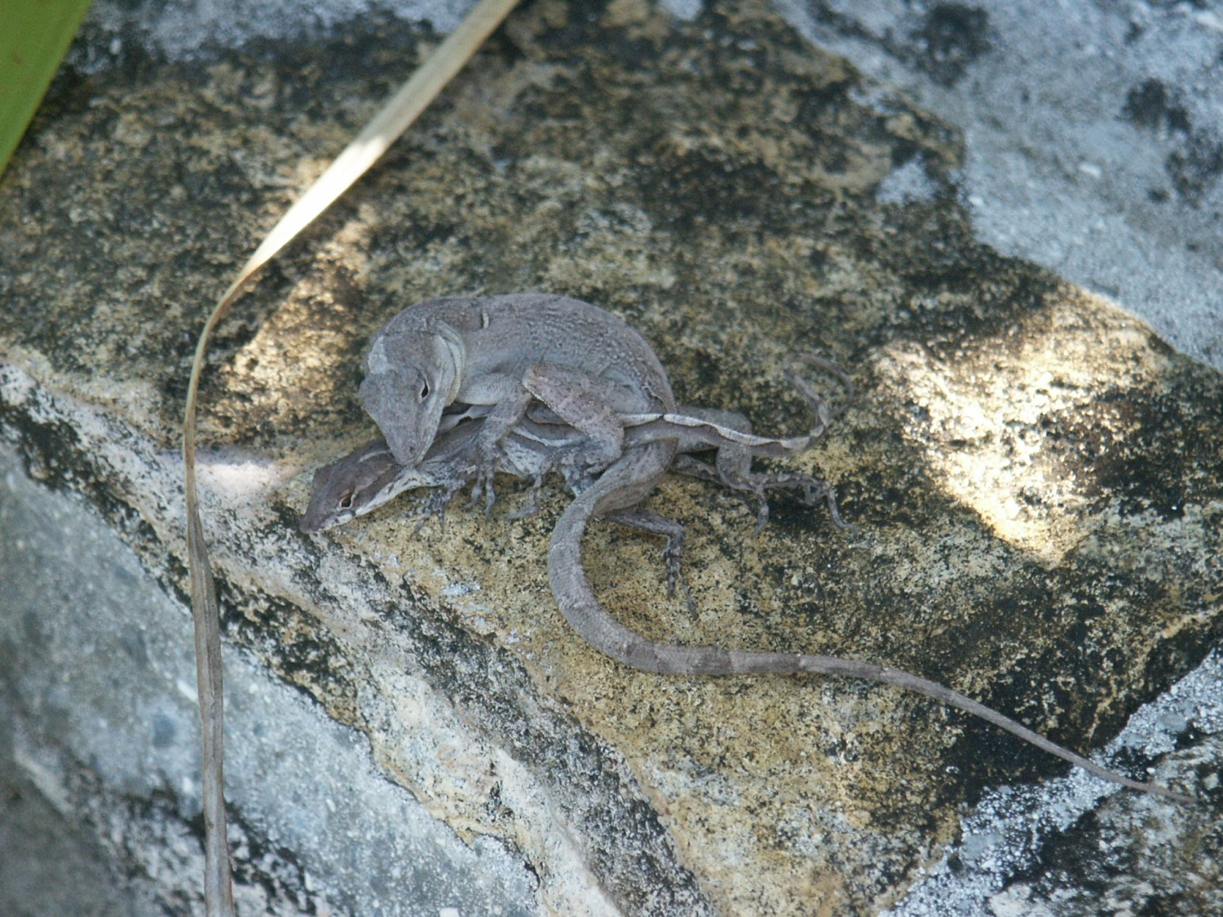
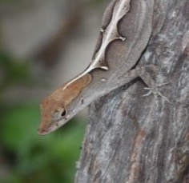
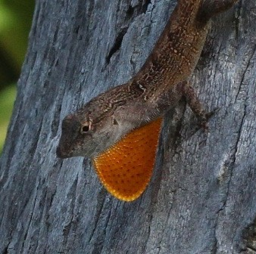
1. Does natural selection favor sex differences in body size?

Slide 8
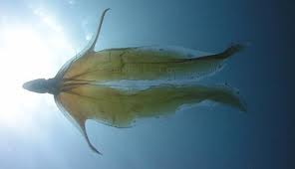
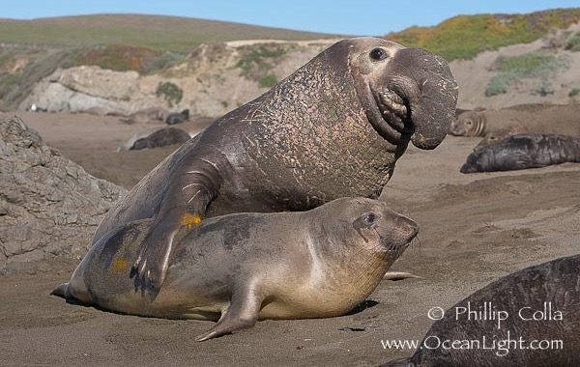

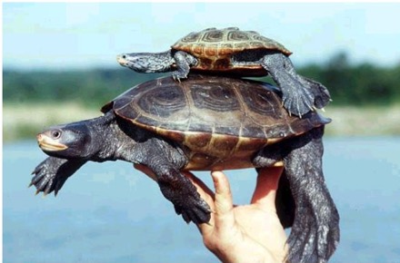
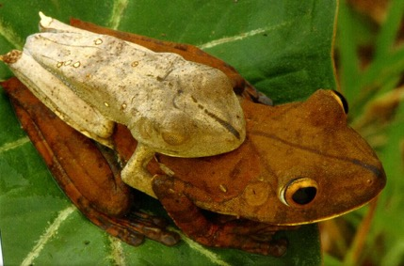
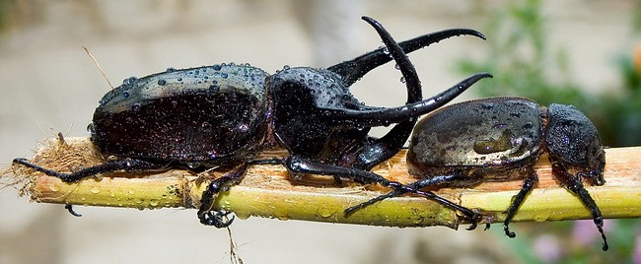
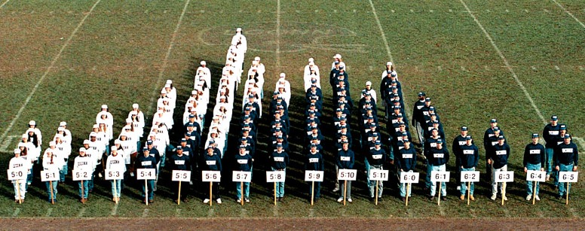
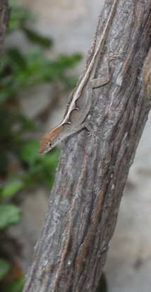
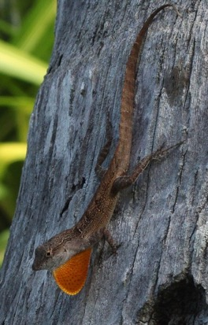
Sexual size dimorphism

Slide 9
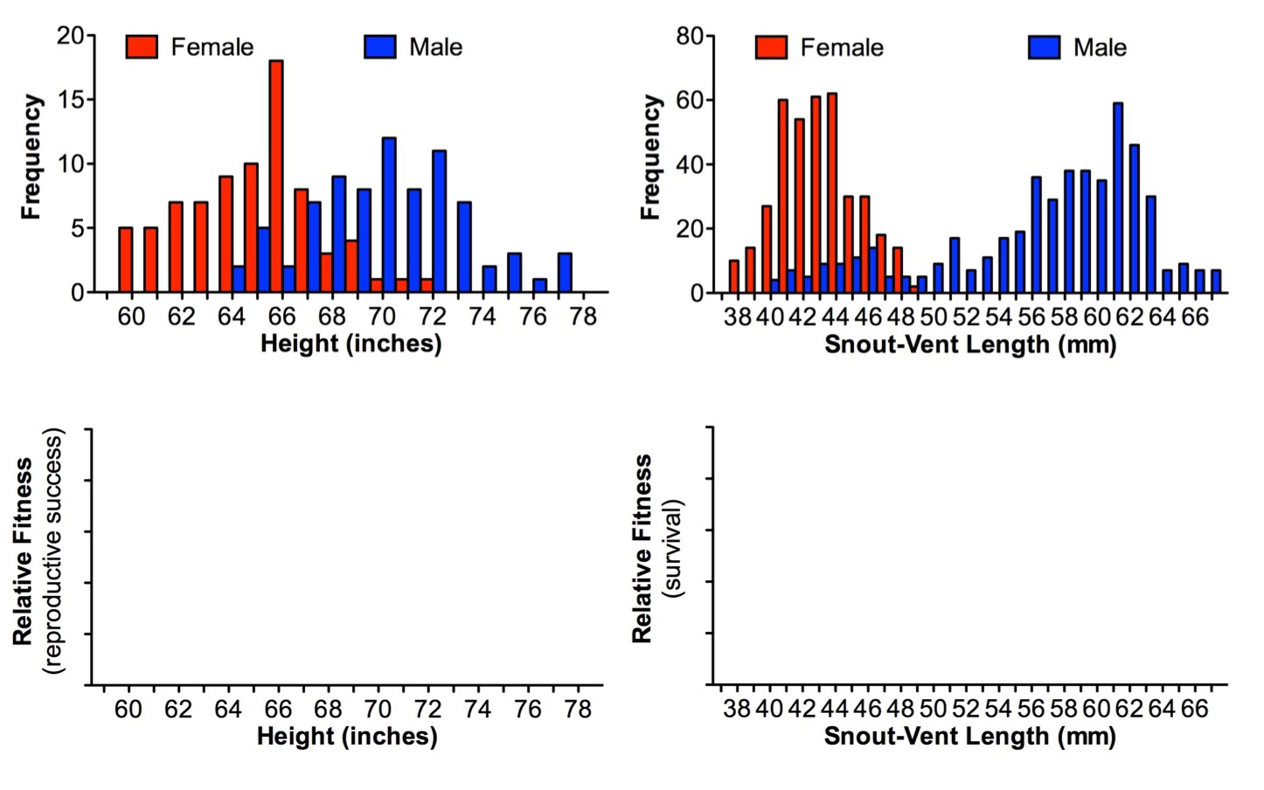
Sexual size dimorphism
Human males average 7% taller
Anole males average 32% longer
e.g., stabilizing selection
e.g., directional selection

Slide 10
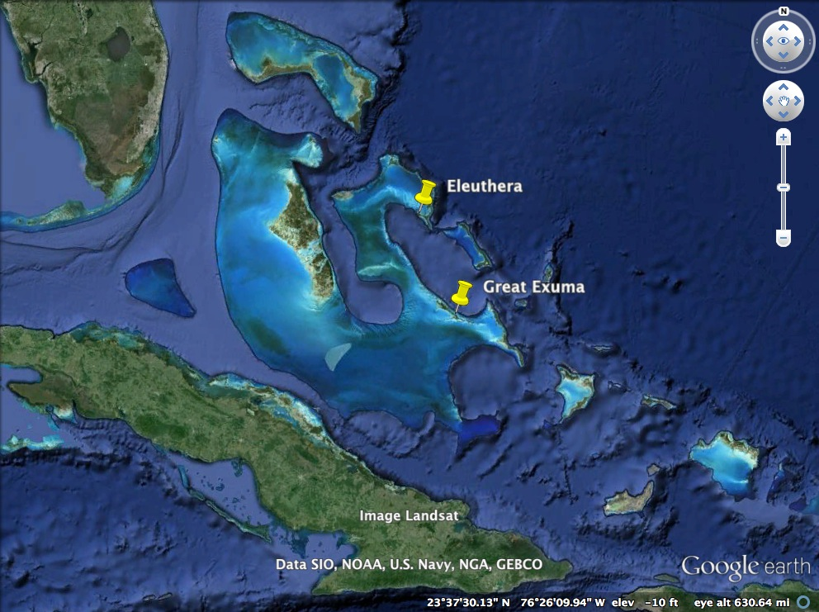
The Bahamas

Slide 11
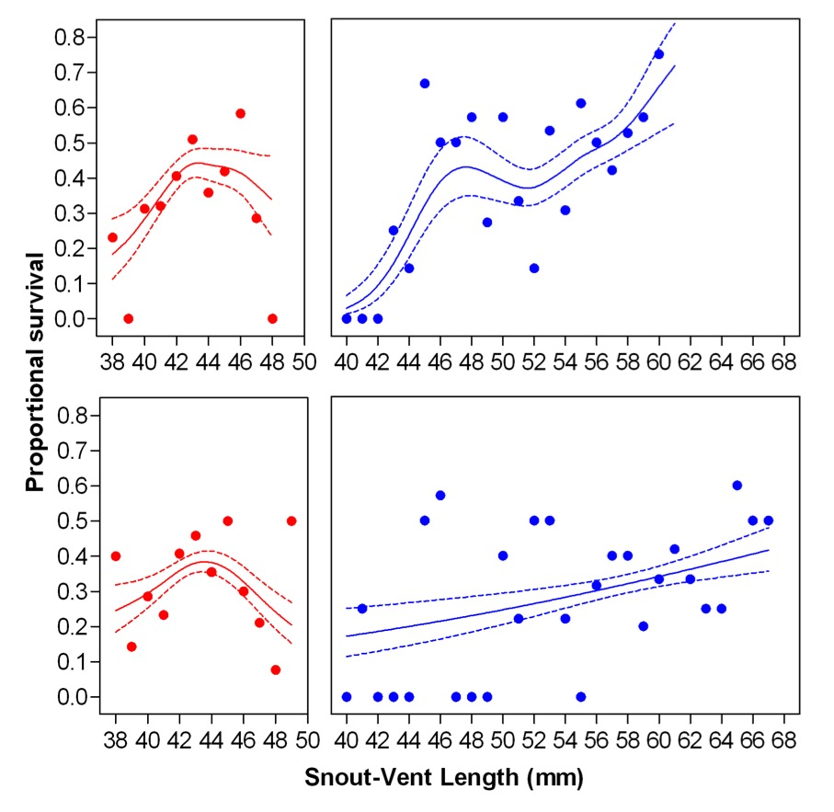
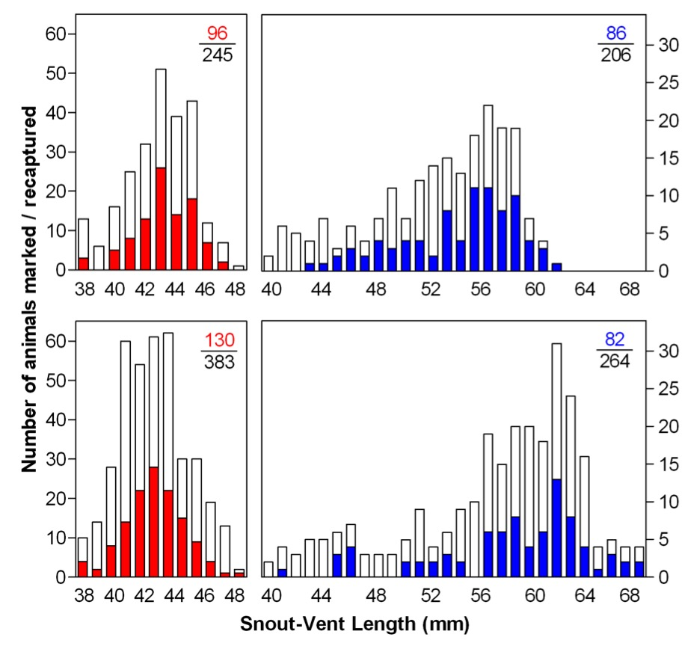
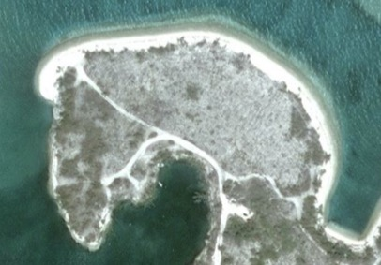
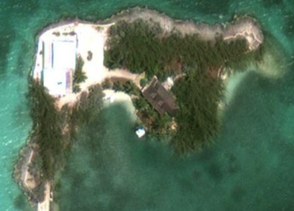
Visualizing natural selection on size
Eleuthera
May
Capture
Measure SVL
ID, Release
August
Recapture, ID
Measure natural
selection
Great Exuma
Cox & Calsbeek (2010) Evolution

Slide 12
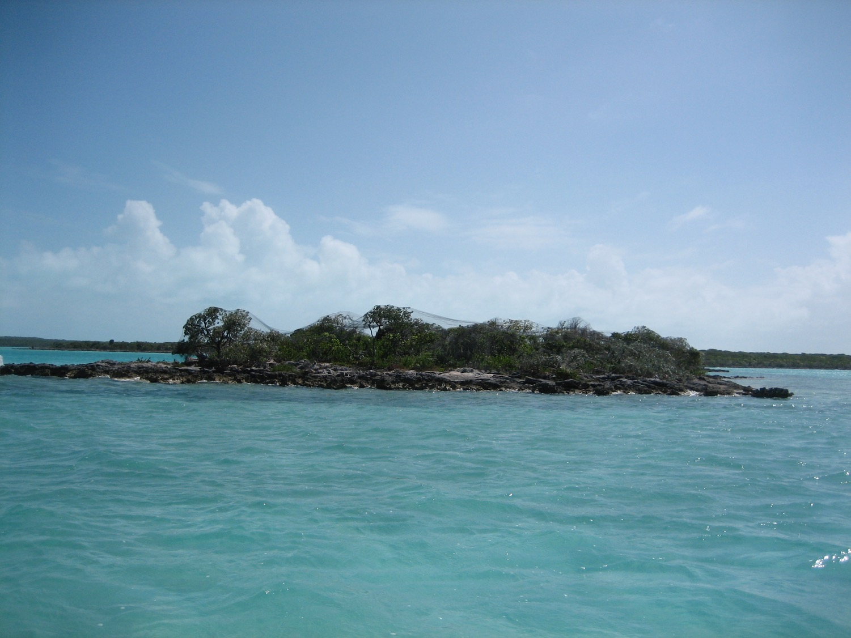
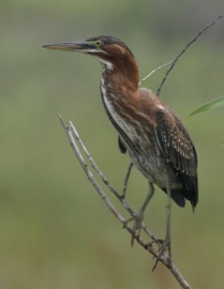
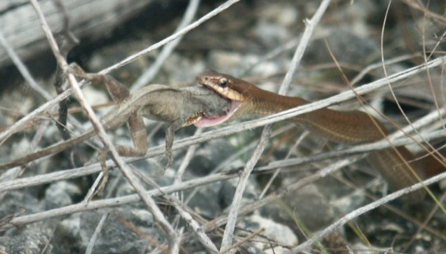
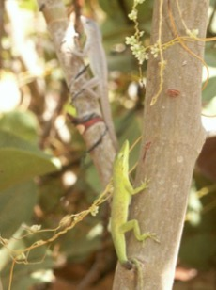
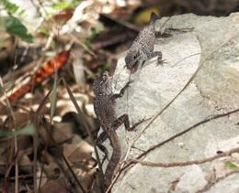
2. Do predators and competitors
shape natural selection on anoles?

Slide 13
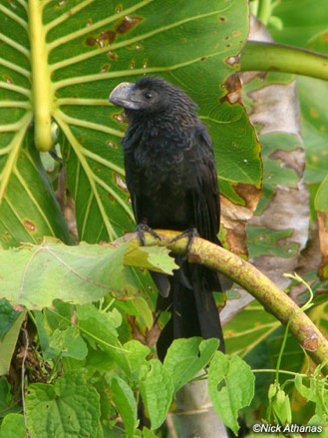

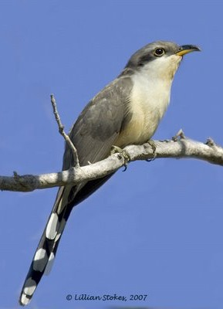
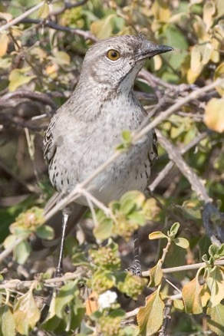
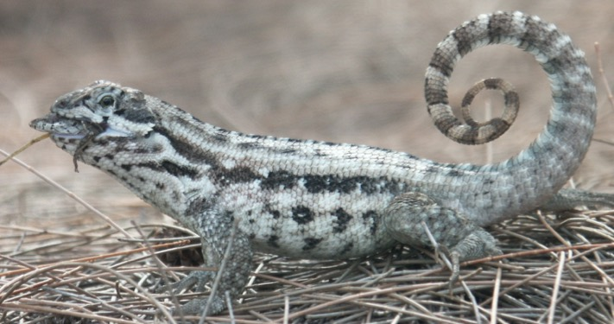
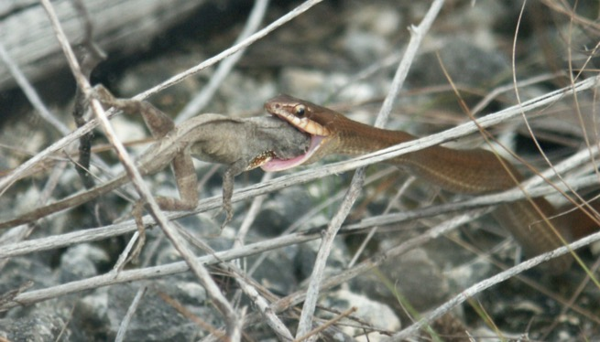
Common predators of anoles
Smooth-billed Ani
Green Heron
Mangrove Cuckoo
Bahama Mockingbird
Curly-tailed Lizard
Bahamian Racer

Slide 14
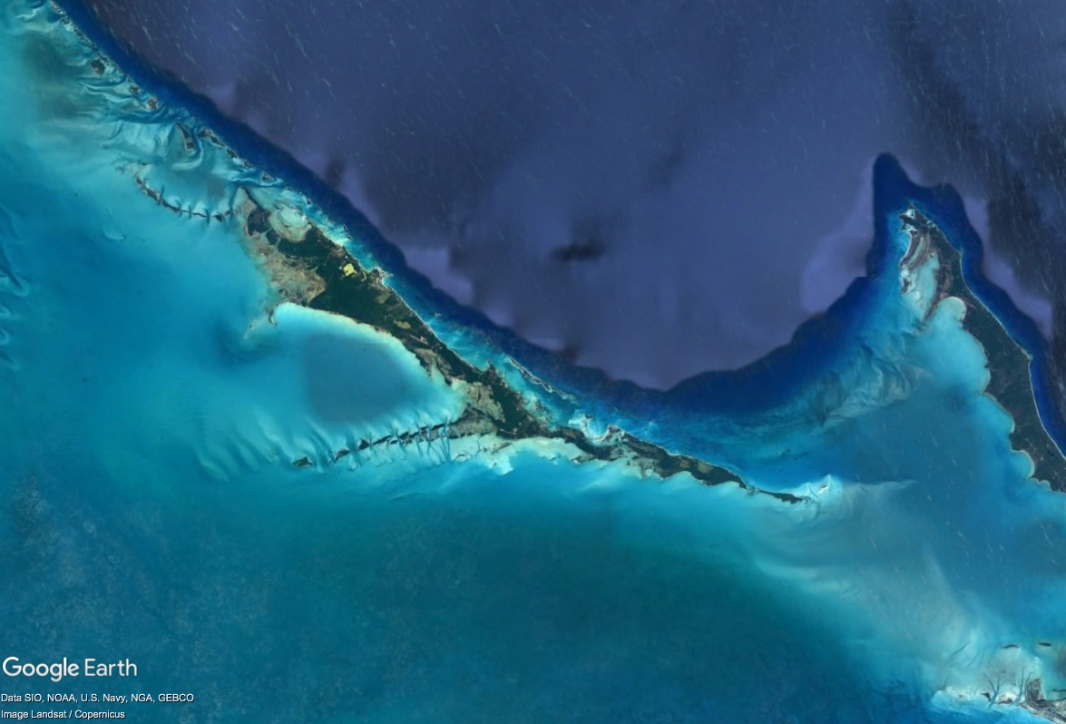

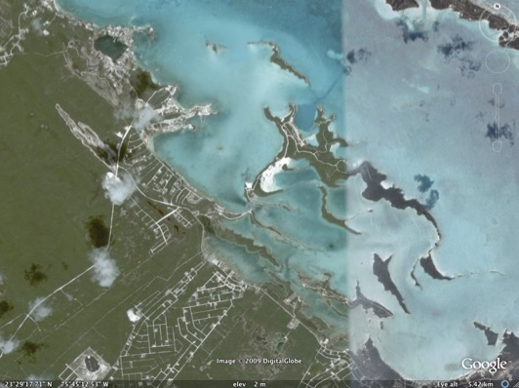
Great Exuma, Bahamas
Elizabeth
Harbour

Slide 15
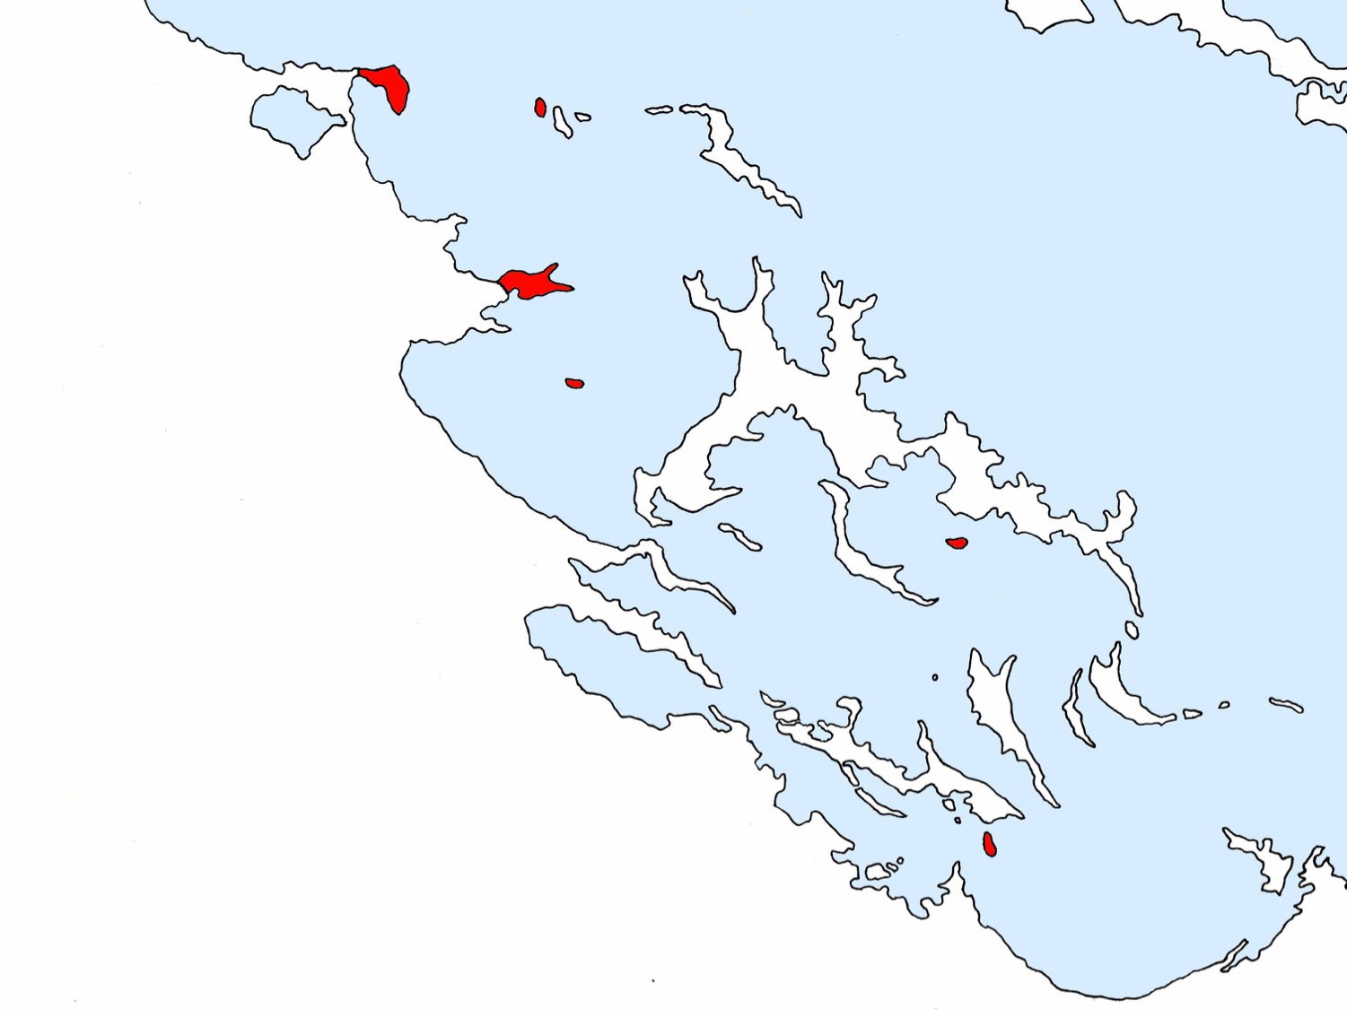



Regatta Point
Heron Cay
February Point
Flamingo
Bay Cay
Nightmare
Cay
Natural Predation Regime:
Great
Exuma
Offshore
Cays
Mystery Cay

Slide 16
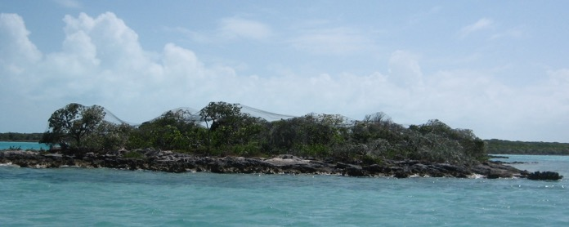
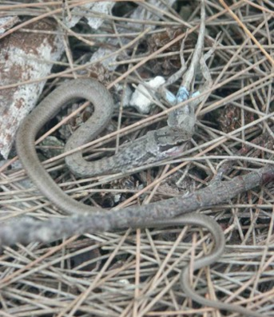
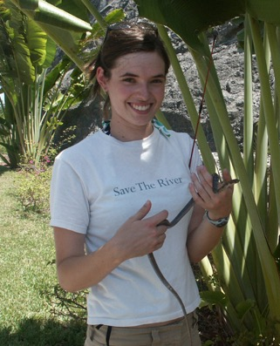
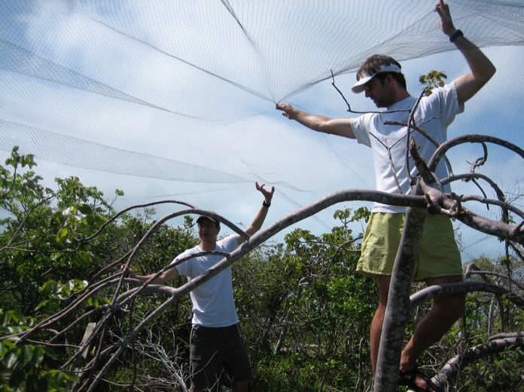
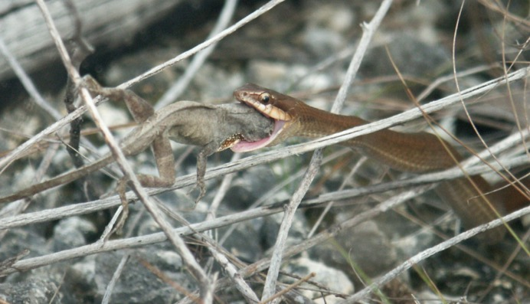
Predator manipulations
Bird exclusions
Snake additions

Slide 17

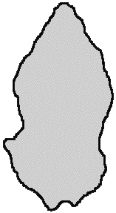

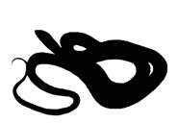
Predator and density manipulations
Birds excluded
Birds present
Snakes added
Low density
mean 0.14 per m²
High density
mean 0.26 per m²

Slide 18


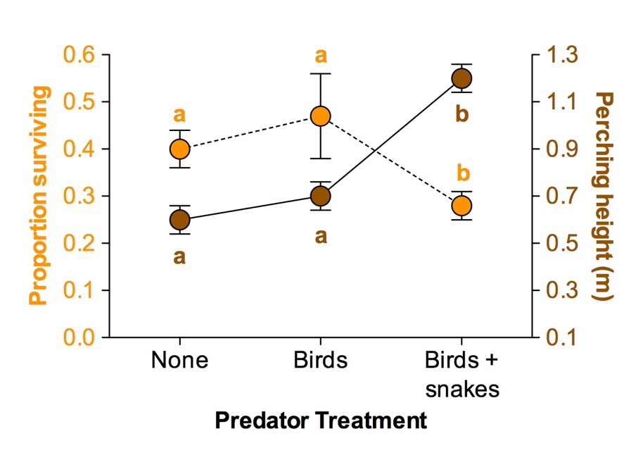
Predators influence survival & behavior
Calsbeek & Cox (2010) Nature

Slide 19
Quantifying natural selection
0.4
0.2
0.0
-0.2
-0.4
slope = 0.4
Relative Fitness
(survival)
Selection Differential
-3 -2 -1 0 1 2 3
Standardized trait (SD)
Trait, e.g. Snout-Vent Length
Hind-limb Length
Stamina on treadmill
Calsbeek & Cox (2010) Nature

Slide 20

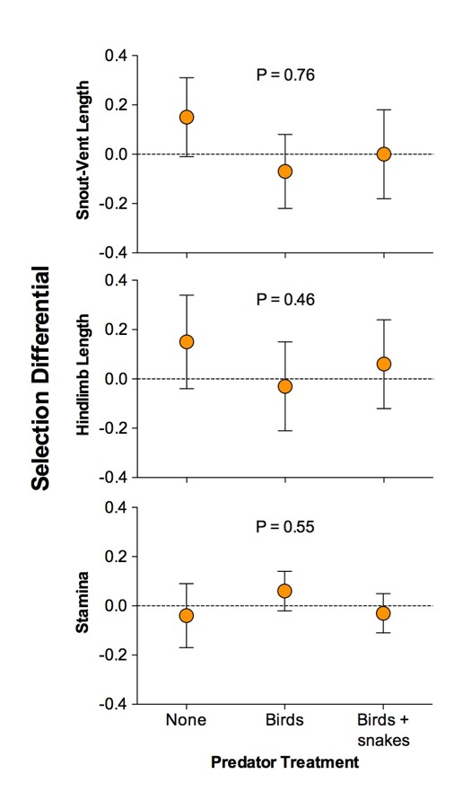

Predators did not alter natural selection
0.4
0.2
0.0
-0.2
-0.4
Relative Fitness
(survival)
Selection Differential
-3 -2 -1 0 1 2 3
Standardized trait (SD)
Trait, e.g. Snout-Vent Length
Hind-limb Length
Stamina on treadmill
Calsbeek & Cox (2010) Nature

Slide 21
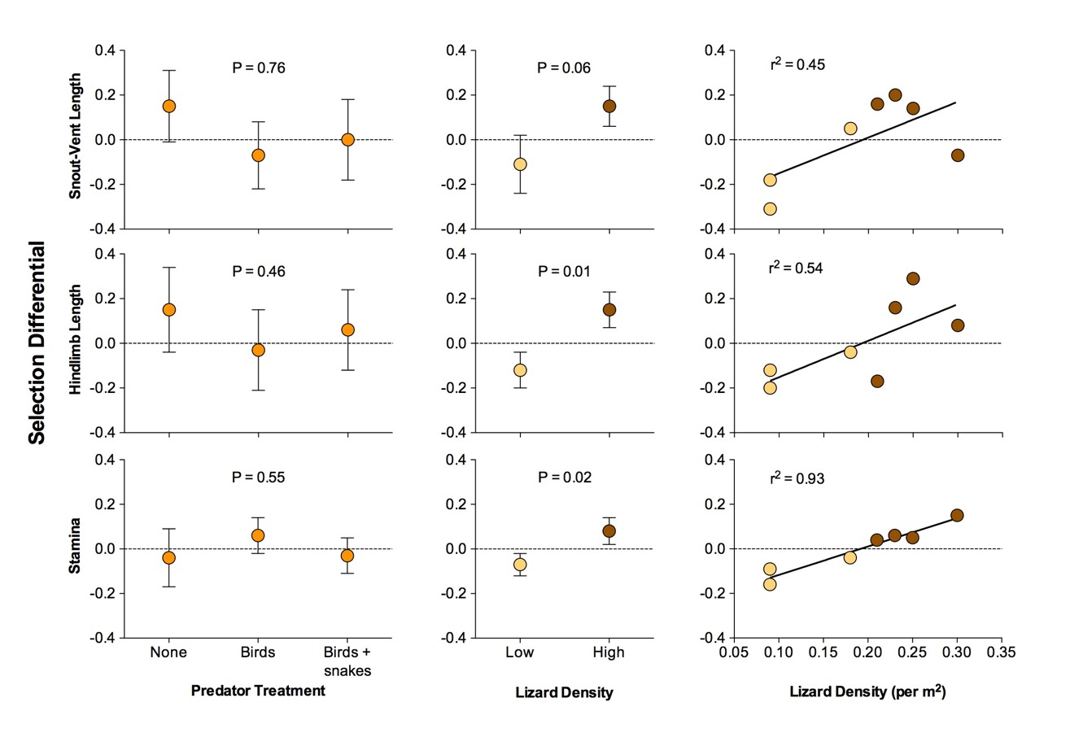
Density did alter natural selection
Calsbeek & Cox (2010) Nature

Slide 22
3. Does investment in reproduction trade off against survival?

Slide 23
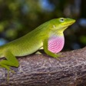






Pattern of evolution suggests a tradeoff
Data from 49 lizard species illustrating the reproduction-survival tradeoff
Precluded by
tradeoffs
r² = 0.49
P < 0.001
Annual Reproductive Effort
(total progeny mass / female mass)
AM Reedy, WJ Evans, and RM Cox (in prep)

Slide 24


Experimentally testing for tradeoffs
SHAM - egg and ovaries intact
OVX - egg and ovaries removed
Breeding-season
Over-winter
Treatment
1st recapture
2nd recapture
Mar
Apr
May
Jun
Jul
Aug
Sep
Oct
Nov
Dec
Jan
Feb
Mar
Apr
May
SHAM
OVX
Cox & Calsbeek (2010) Evolution

Slide 25



Reproduction reduces survival
Breeding-season
χ² = 13.27 P < 0.001
Over-winter
χ² = 8.46 P = 0.004
Cumulative
χ² = 18.53 P < 0.001
78
80
110
114
28
43
36
63
78
80
110
114
Breeding-season
Over-winter
Treatment
1st recapture
2nd recapture
Mar
Apr
May
Jun
Jul
Aug
Sep
Oct
Nov
Dec
Jan
Feb
Mar
Apr
May
SHAM
OVX
Cox & Calsbeek (2010) Evolution

Slide 26

Reproduction also reduces…
Growth and
energy storage
Hematocrit and
immune response
Locomotor speed
and stamina
Breeding-season
Treatment
1st recapture
Mar
Apr
May
Jun
Jul
Aug
Sep
Oct
Nov
Dec
Jan
Feb
Mar
Apr
May
SHAM
OVX
Cox & Calsbeek (2010) Evolution

Slide 27
Summary: natural selection in the wild
1. Visualizing natural
selection in the wild
2. Manipulating the
agents of selection
3. Manipulating the
traits under selection
Natural selection favors large males
and small females
Competitors shape
natural selection,
predators do not*
Investment in reproduction trades off against survival

Slide 28


volution
ducation
An NSF-funded teacher professional development program based on 3 core principles:
1. K-12 education is failing to teach evolution unequivocally as a central principle in biology
2. Students learn science best by doing science
Aaron Reedy:
co-founder and
teacher-scientist
3. Teachers can become more effective educators
by participating in scientific research

Slide 29







Evolution Education Teacher Fellows
2015
2015
Brandon Pope
Uplift Summit Prep (TX)
Nick Kiriazis
Venture Academy (UT)
2016
2016
Fred Hingst
Dewitt High School (MI)
Adam Rotche
Blacksburg High (VA)
2017
2017
www.EvolutionEd.org
Lucia Ferrante
Port Chester High (NY)
Aaron Willey
UNC School of Arts (NC)

Slide 30



Evolution Education Teacher Workshops
2015
2016
www.EvolutionEd.org
2017

Slide 31







Evolution Education Classroom Projects
Aaron Reedy’s biology class at Thomas Kelly
High School (Chicago) conducting new science
www.EvolutionEd.org

Slide 32
Evolution Education Classroom Projects
2015
2015
Brandon Pope
Uplift Summit Prep (TX)
Nick Kiriazis
Venture Academy (UT)
Do predator cues alter development of sex differences in mosquitos?
Does a cockroach have personality?
Do personalities differ in each sex?
2016
2016
Fred Hingst
Dewitt High School (MI)
Adam Rotche
Blacksburg High (VA)
www.EvolutionEd.org
What cues cause asexual duckweed plants to flower and have sex?
How can we use duckweed plants to improve water chemistry?

Slide 33


Evolution Education Classroom Projects
Students and teachers present their findings
www.EvolutionEd.org

Slide 34
Teachers as Scientists

Slide 35
Evolution Education Field Research
2015
2015
Brandon Pope
Uplift Summit Prep (TX)
Nick Kiriazis
Venture Academy (UT)
2016
2016
Fred Hingst
Dewitt High School (MI)
Adam Rotche
Blacksburg High (VA)
2017
2017
www.EvolutionEd.org
Lucia Ferrante
Port Chester High (NY)
Aaron Willey
UNC School of Arts (NC)

Slide 36






Evolution Education Field Research

Slide 37


Palm Coast, FL

Slide 38


Island H

Slide 39


Island H
96 ft

Slide 40
Mar
2015
May
2015
Jul
2015
Oct
2015
Mar
2016
May
2016
Jul
2016
Oct
2016
Mar
2017
May
2017
Jul
2017
Oct
2017
In 2015:
595 females
388 males
2,011 progeny
1,351 progeny
1,247 progeny
> 6000 total DNA samples for parentage
In 2016:
548 females
265 males
In 2017:
247 females
170 males

Slide 41


Sex differences in natural selection
Photo: Ariel Kahrl

Slide 42





Is it better to be bigger?
Photo: Ariel Kahrl

Slide 43





Is it dangerous to be a showoff?
Photo: Ariel Kahrl

Slide 44









Thanks!

