Slide 1
Notes:
https://www.slideshare.net/zarthustra7/zoom-by-istvan-banyai-23329406

Slide 6
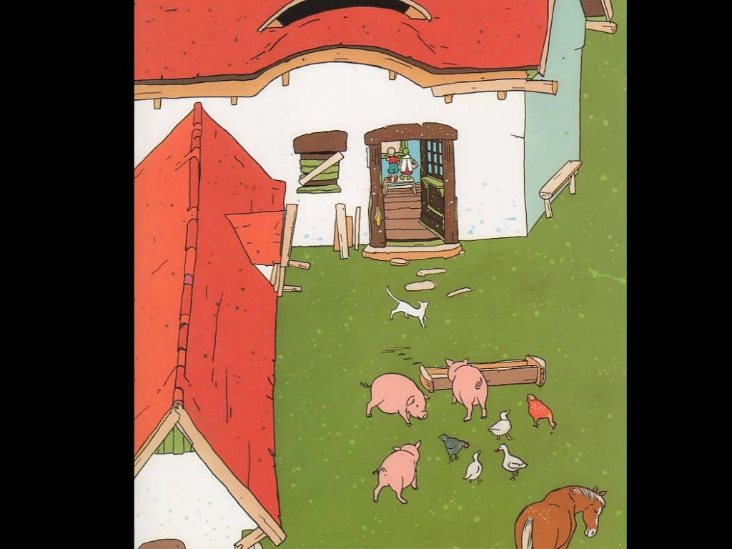

Slide 14
