Slide 1


Scientific Data in Schools:
Measuring the efficacy of an innovative approach to integrating quantitative reasoning
in secondary science
Teacher Professional Development  July 20-21st

Slide 2

PD DAY 1

Slide 3
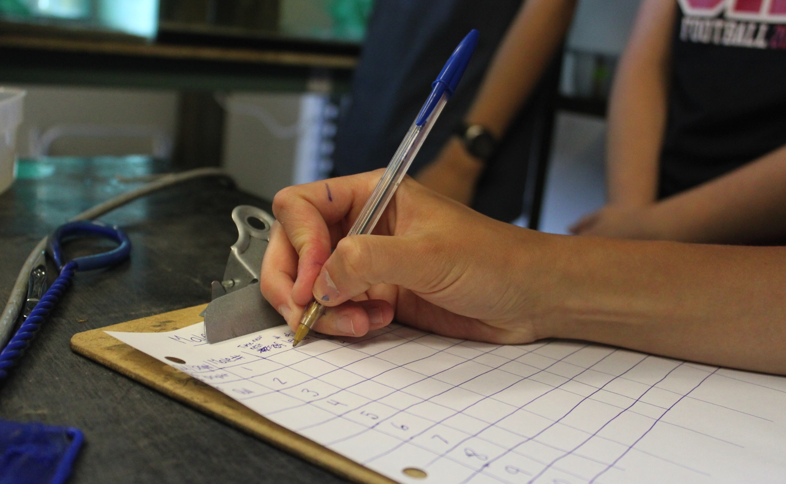
What are Data Nuggets?
_
Notes:
Liz leads – 1.25 hours
11:00-12:15 on first day of workshop

Slide 4
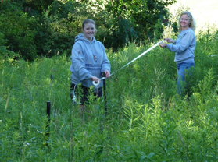
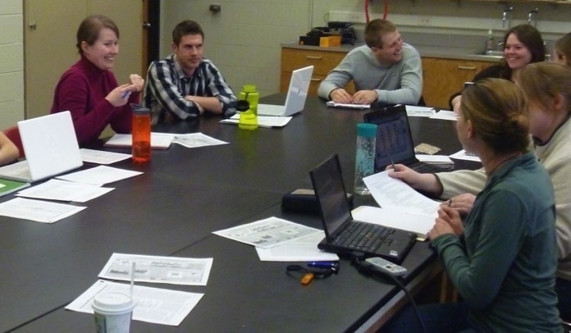
How Data Nuggets got their start
_
Teachers concerned about performing inquiry in the classroom
Complexity of research results and messiness of data
Students need practice working with data – graphing and interpreting
Notes:
Data Nuggets have been under development since 2011 and originated through conversations between science teachers and graduate students during the NSF GK-12 project “New GK- 12: Using the STEM Dimensions of Bioenergy Sustainability to Bring Leading-edge Graduate Research to K-12 Learning Settings” (NSF DGE 0947896). This unique opportunity for collaboration between teachers and scientists led to the creation of teacher-inspired resources. Teachers shared that they were lacking educational resources that helped their students practice working with real, messy data like that collected during classroom inquiry-based projects. Graduate students in the sciences, however, have lots of practice working with messy data and surprising results.

Slide 5
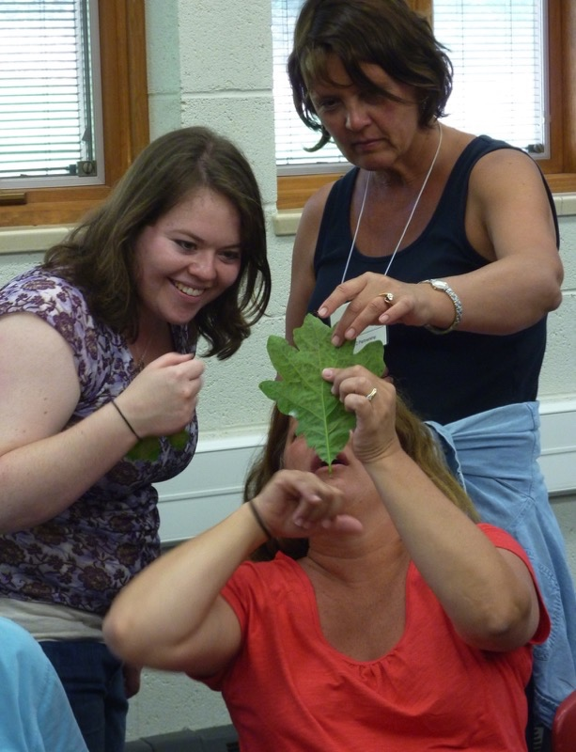
How Data Nuggets got their start
_
Co-created with teachers as part of NSF GK-12
Graduate students gain teaching experience
Teachers are exposed to contemporary science
Students practice scientific inquiry
Notes:
K-12 Partnership at KBS: 15 rural school districts. Over 80 teachers involved and ~10 graduate student teaching fellows
Graduate students gain teaching experience. Teachers are exposed to contemporary science. Students practice scientific inquiry

Slide 6
http://datanuggets.org
Free activities that bring real data into the classroom, along with all its messiness & complexity
Based on authentic cutting edge research
Guide students through the entire process of science, including data analysis & interpretation
Typically take 1-2 class periods & follow familiar template

Slide 7

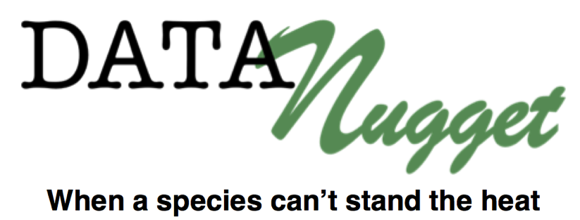
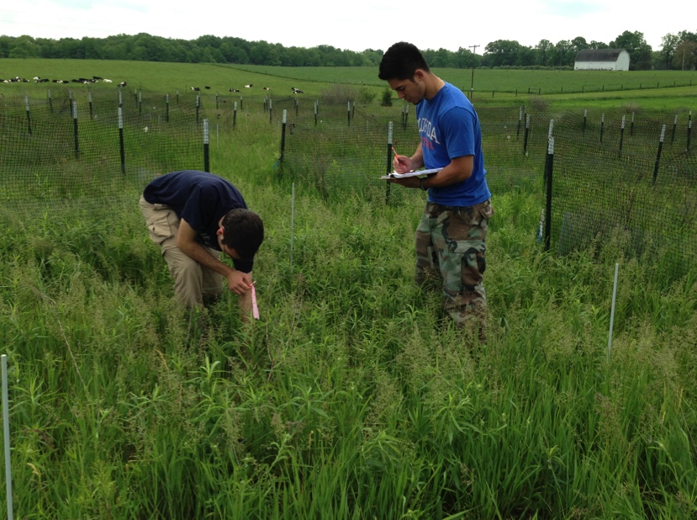
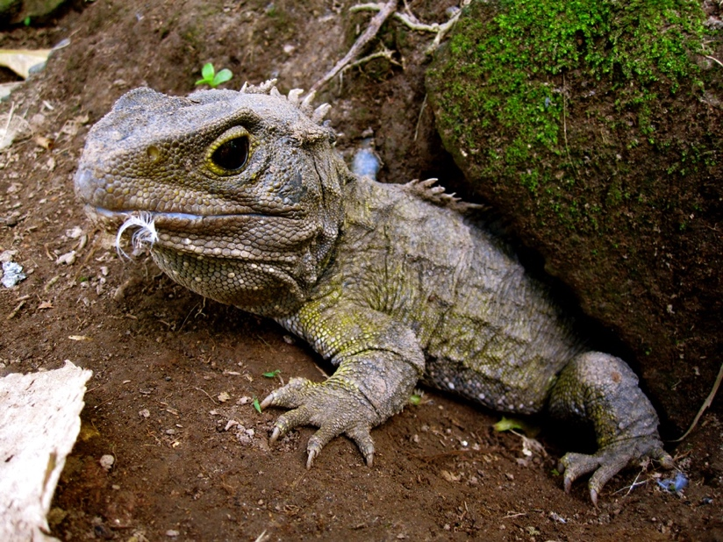
Complete a Data Nugget
_
Notes:
Now, we would like you to have a chance, as “teachers as learners” to complete a Data Nugget with a partner. We will take about 20-30 minutes to let you go through this activity. We will revisit your answers throughout the rest of the workshop.
Activity 3: Teachers complete a Data Nugget as a common experience with a partner.. Half of the participants complete “Do insects prefer local or foreign foods?” and half complete “When a species can't stand the heat”. When people are finishing up, find a partner pair that completed the other Data Nugget.
Each of you are going to complete 1 in a group and you’ll return to these groups throughout the PD. At night you may want to go home and read the other one.

Slide 8
Data Nugget Discussion
_
      Whole group report-out
      Summarize the research in your Data Nugget
      What quantitative reasoning themes were present?

Slide 9
Revisit workshop goals
_
Workshop In Context:
We will revisit these Data Nuggets throughout the workshop.
Notes:
Hand out teacher scenarios. Have teachers report out- summarize Mr. Diego and Mrs. Johnson’s strategies. What would they change? What do they like? What do they do that could be integrated into these courses?

Slide 10
Anatomy of a Data Nugget
_
Notes:
The goal of the Data Nugget is to take students through the entire process of science. And to do this in a way that is relatively quick so students can get repeated practice with all of these areas. Follow along in the Data Nugget you just completed. They all follow a familiar template.

Slide 11
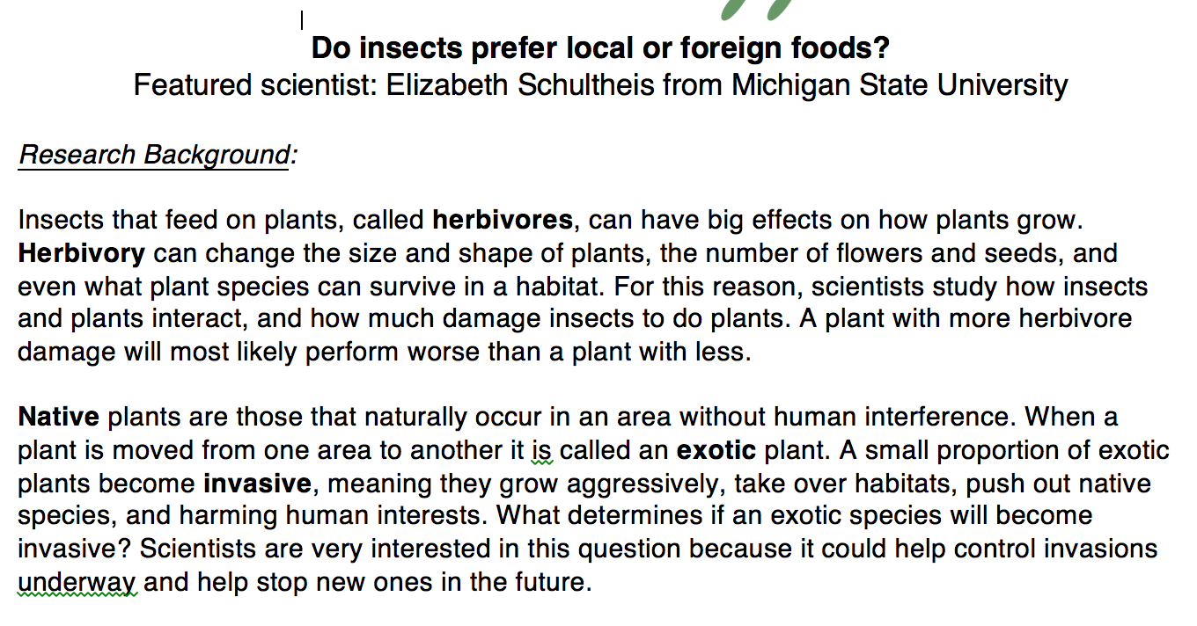
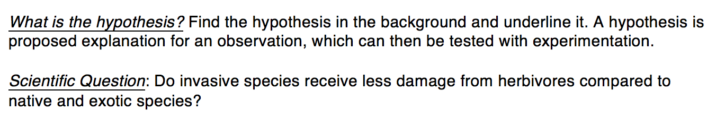
Research background
_
Background information
Question and Hypothesis
Notes:
The standard format of each Nugget provides a brief background about a researcher, their study system, and a real dataset from that work. Within each Nugget, students are challenged to answer a scientific question, are guided through the construction of graphs to facilitate data interpretation, and use data to support their claims. Data Nuggets serve to supplement existing science curriculum; because of their simplicity and flexibility, Data Nuggets can be used across grade levels and throughout the school year as students build confidence in their quantitative and scientific skills.

Slide 12

Research background
_
Scientists are still overwhelmingly white and male (Pollack 2015).
Ethnic minority students are more likely to see themselves as scientists if they are exposed to role models that they can identify with (Price 2010).
Overcome scientist stereotypes.
Notes:
Scientists are still overwhelmingly white and male (Pollack 2015). This homogeneity excludes talented individuals and reduces productivity that can be achieved with increased workplace diversity (Reagans & Zuckerman 2001, Stahl et al. 2010). Barriers for underrepresented groups in STEM fields are often rooted in social rather than academic factors, such as negative stereotypes and a lack of same­race peers (Strayhorn 2010). These social constructs are reinforced by the stereotypical depiction of scientists in the media and popular culture (Dudo et al. 2011). Two common tropes include the “mad scientist” (e.g., in superhero movies) and the “awkward geek” (e.g., The Big Bang Theory ); neither is very approachable or appealing as a role model, and both are typically white men.
Ethnic minority students are more likely to see themselves as scientists if they are exposed to role models that they can identify with (e.g., their teachers, Price 2010). By redefining what a scientist looks like, we hope to encourage participation in science by all interested students.

Slide 13
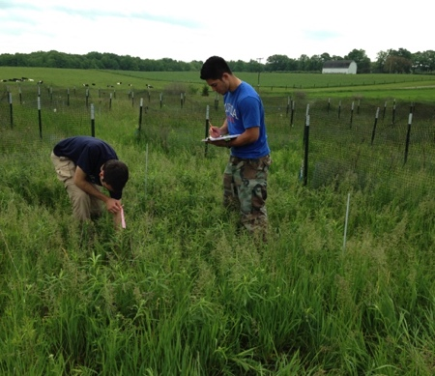
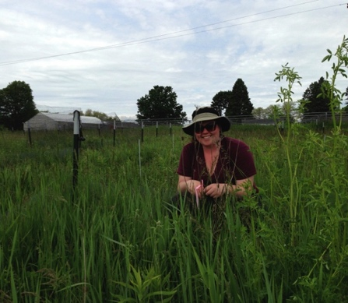
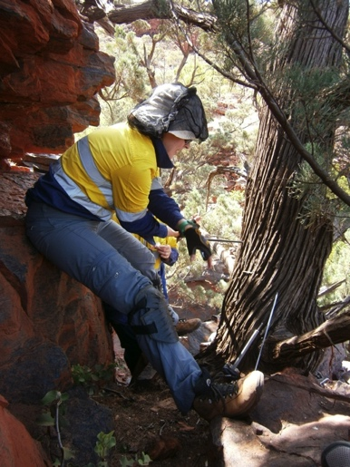
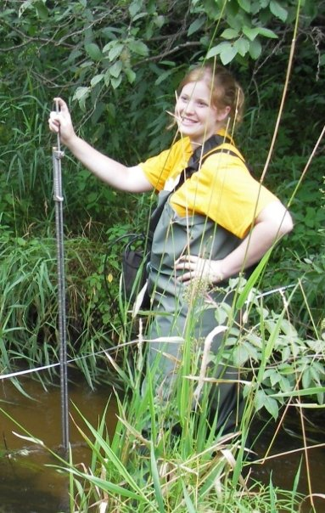
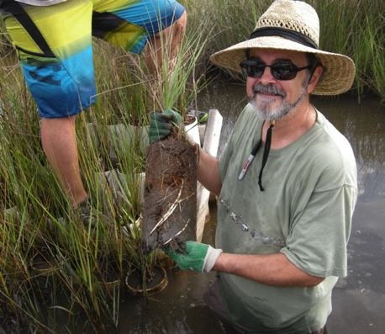
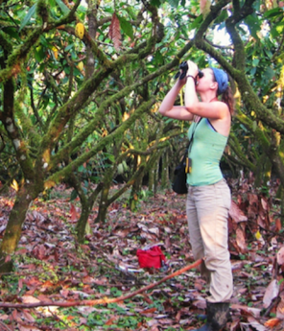
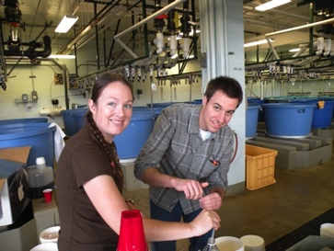
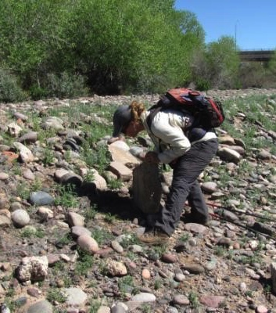



Slide 14
Content levels
_
  These correspond with Flesch-Kincaid readability statistics and science content standards
Notes:
Graphing and multiple content levels allow for differentiated learning for students with any science or reading background.

Slide 15
Data and data visualization
_
Notes:
*NOTE this example if from Won’t you be my urchin? A Level 1 Data Nugget. There are no error bars on this graph because this is not something that students would typically be familiar with at that grade level. If using this DN in an upper grade level you can add a place in the table for students to calculate SD or SE, or you can just have students mark the range on the graph to stimulate discussion of variation.

Slide 16
Graphing levels
_
  Each activity is provided in each level (A-C)
Notes:
Graphing and multiple content levels allow for differentiated learning for students with any science or reading background.

Slide 17
Scaffolding & Differentiated Instruction
_
Notes:
Touch on the “levels” and how you can use scaffolding - progression over time (e.g., start with A, eventually progress to B and C). Refer to table with the list of Data Nuggets with levels and key features. Allows for differentiated instruction, or teachers to scaffold certain skills early in the year and remove them over time.

Slide 18
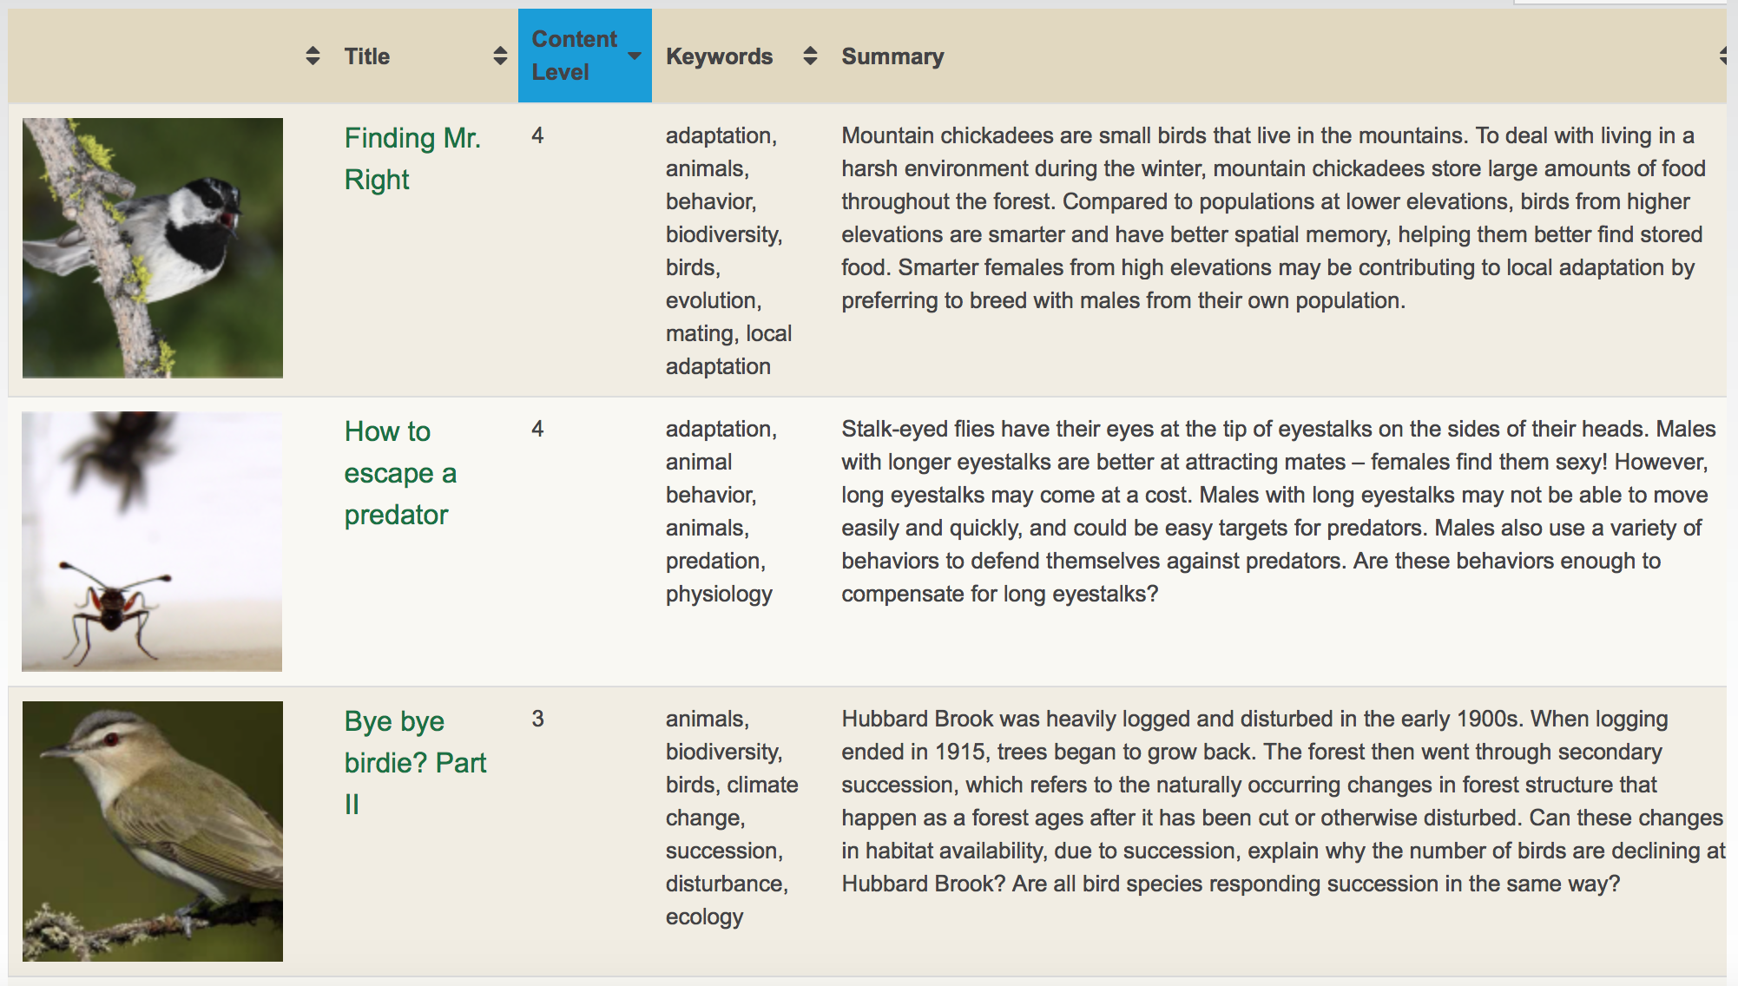
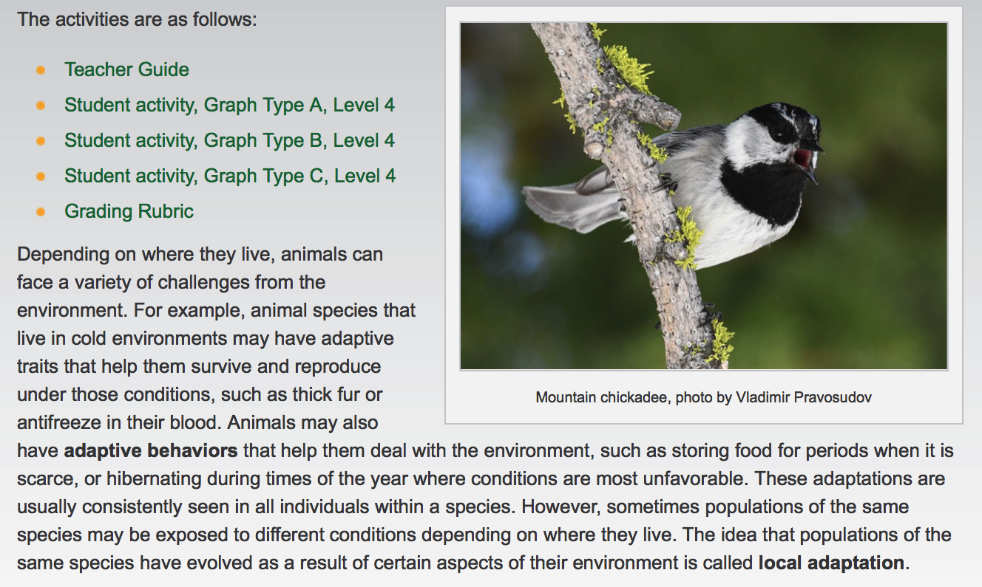

Slide 19
Constructing explanations
_
Interpret the data:
Make a claim that answers the scientific question.
What evidence was used to write your claim? Reference specific parts of the table or graph.
Explain your reasoning and why the evidence supports your claim. Connect the data back to what you learned about the threats facing tuatara populations.
Did the data support Kristine’s hypothesis? Use evidence to explain why or why not. If you feel the data were inconclusive, explain why.
Notes:
THIS PART WE WILL ELABORATE IN THIS SESSION
This one section of the DN we will go into more depth on and show you how to scaffold this part.

Slide 20
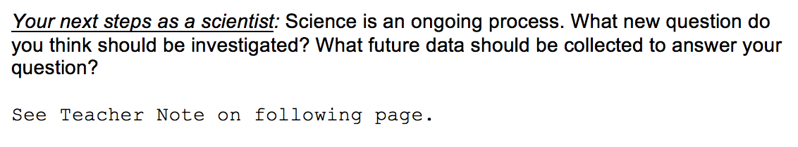
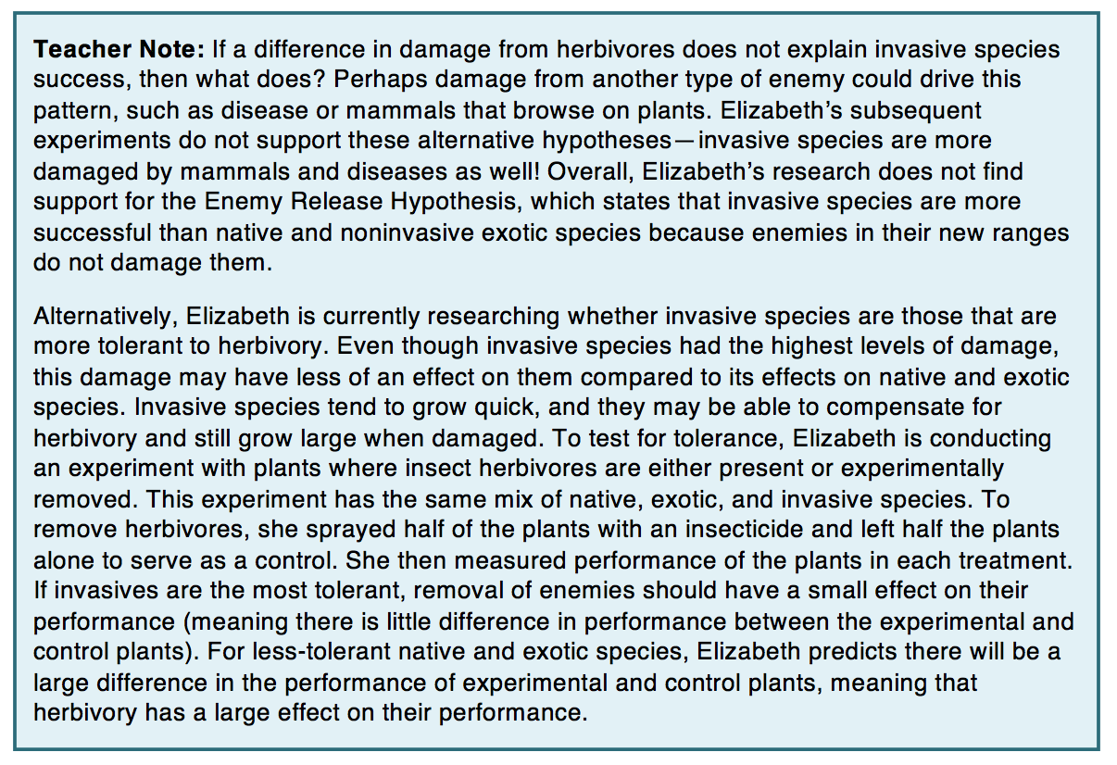
Scientist next steps
_
Notes:
For each DN we have a version that students can do by hand, but we also want teachers to be able to build students’ quantitative skills and expand to issues of calculating statistics and hypothesis testing.

Slide 21
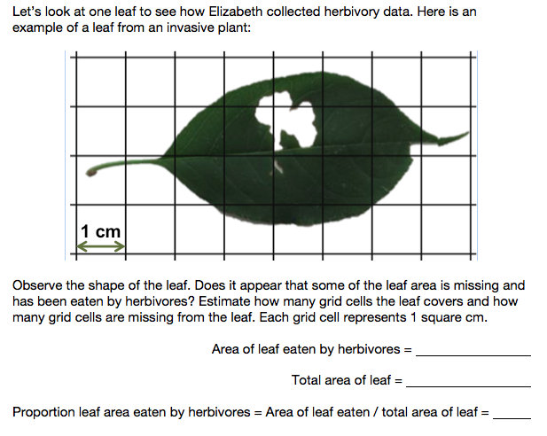
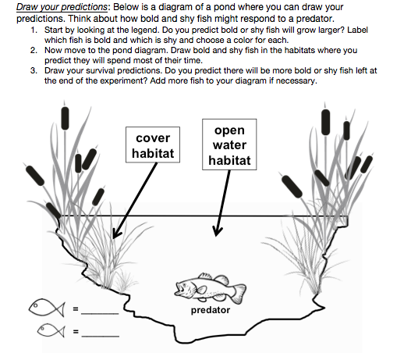
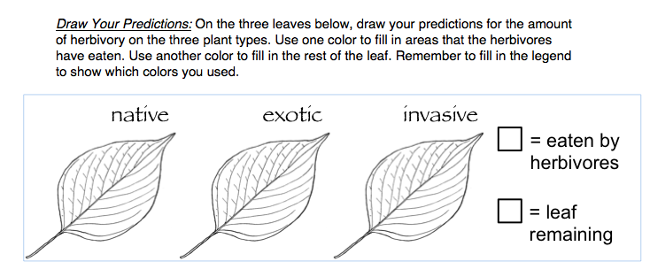
Student engagement activities
_

Slide 22
Using the teacher guide
_
Teacher Notes: Provide additional background information for teachers, as well as suggestions for discussion topics.
Checks for Understanding: Provide stopping points for teachers to assess student understanding.
Meta Moments: Provide stopping points for students to think about their own thinking.
Notes:
For each Data Nugget we have created a Teacher Guide to help facilitate use in the classroom and provide the teacher with any additional information they might need. This guide has the same structure as the student handouts, but has example student graphs and written responses, as well as suggested stopping points for class discussion and clarifications. There are three types of stopping points:
Teacher Notes: Provide additional background information for teachers, as well as suggestions for discussion topics. For example, we may share information provided by the scientist, detailing what their next research steps were after collecting the data presented in the activity.
Checks for Understanding: Provide stopping points for teachers to assess student understanding. These are particularly useful after students finish reading the Background Information sections or have just started to view and work with the data.
Meta Moments: Provide stopping points for students to think about their own thinking. Stepping back from the research, students can discuss the decisions they are making as they work though the Data Nugget, such as the way they chose to visualize their data to ease interpretation and support their claims.

Slide 23
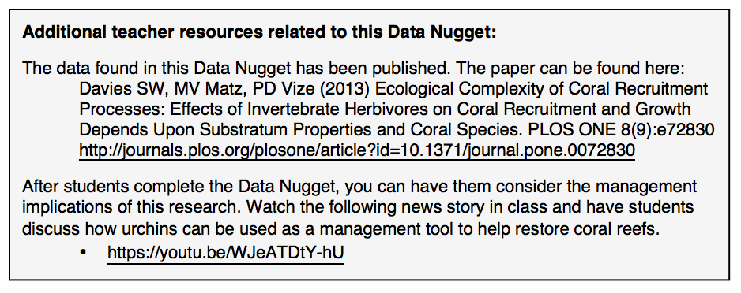
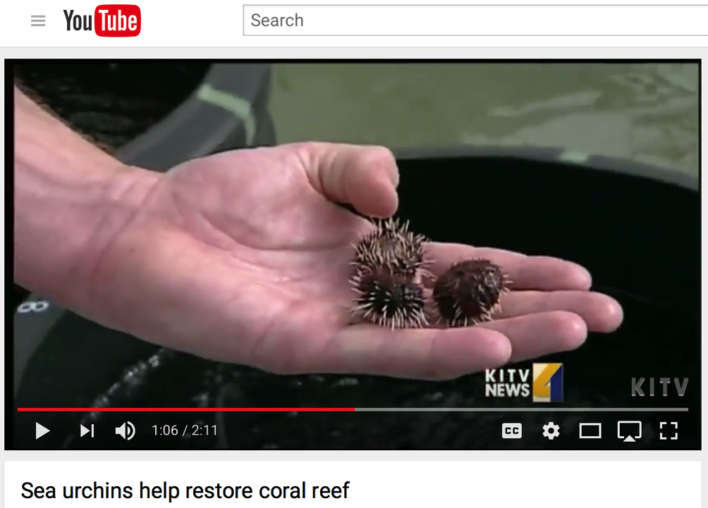
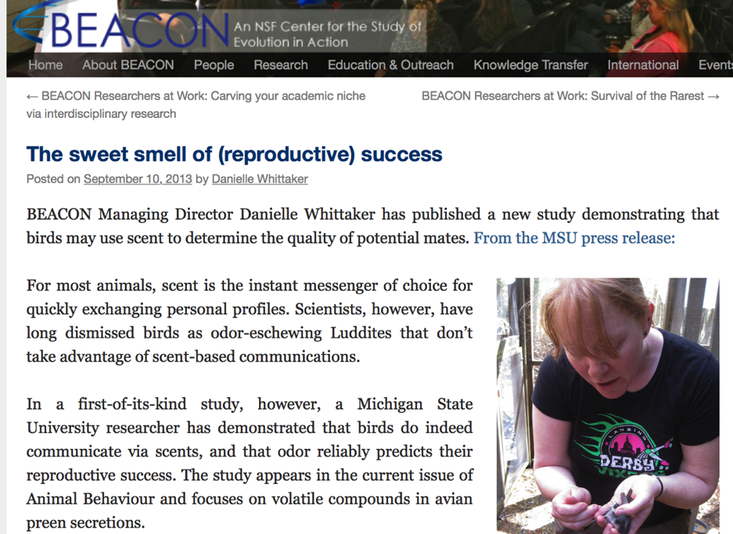
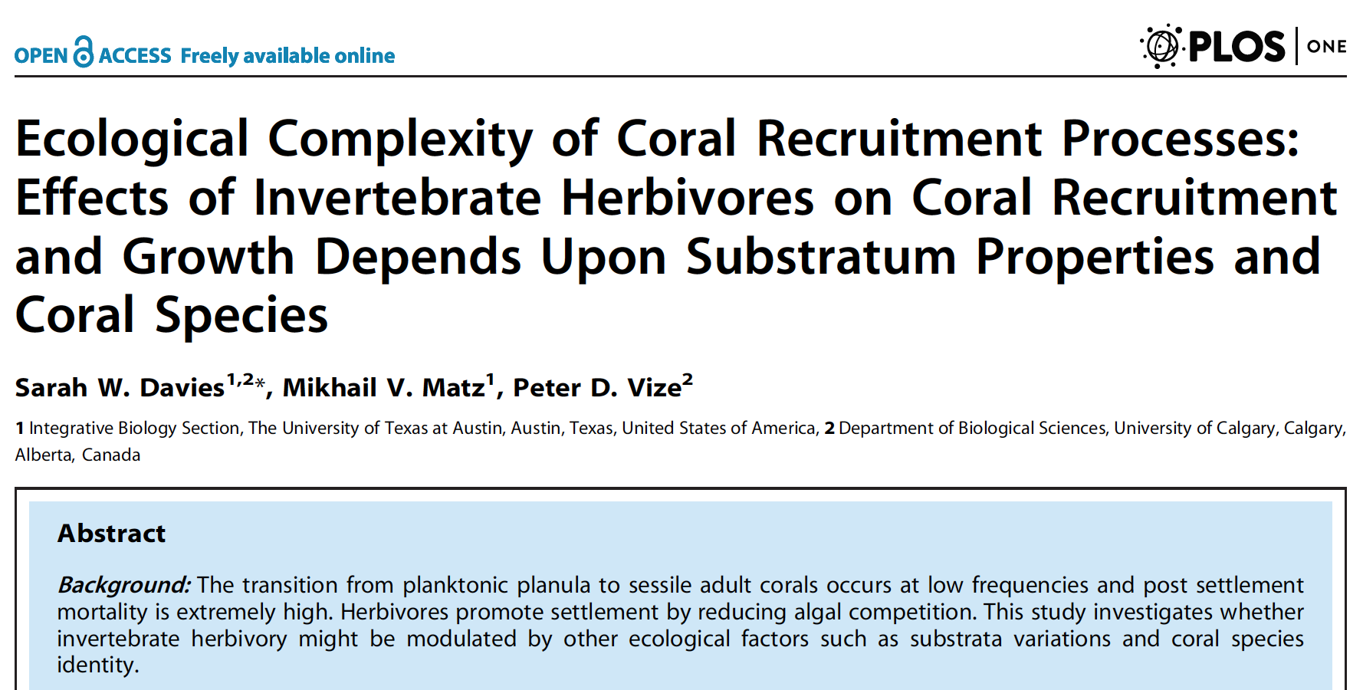
Using the teacher guide
_
Notes:
At the end of each teacher guide we provide a list of additional resources related to each Data Nugget. These may include primary literature, videos that the scientist has made about their research, blog posts or other popular articles about the research included in the Data Nugget, or additional photos and images.

Slide 24
Big Themes in Data Nuggets
_
Notes:
The goal of the Data Nugget is to take students through the entire process of science. And to do this in a way that is relatively quick so students can get repeated practice with all of these areas.

Slide 25
Pedagogical themes in Data Nuggets
_
Science Stories – Readers find stories more engaging, easier to comprehend, and more memorable. Stories are “sticky” because they appeal to our desire for causality and goals, and the reasoning behind an idea increases reader interest
Active Learning – Instead of memorizing facts and listening to a lecture, students are involved in the learning process. Data Nuggets engage students in activities, such as reading, writing, discussion, and problem solving. Teachers can use a variety of techniques while moving through activity.
Place-Based Learning – Connecting science to learners’ everyday place-based context makes the content more accessible, particularly for culturally and linguistically diverse students
Notes:
Science consists of millions of. These accounts--some electrifying, most pedestrian--become science when they can be tested and woven into cause-and-effect explanations to become part of humanity's material worldview. But they also constitute a fascinating narrative, which can be the key to helping the non-scientist understand the great ideas of science.

Slide 26
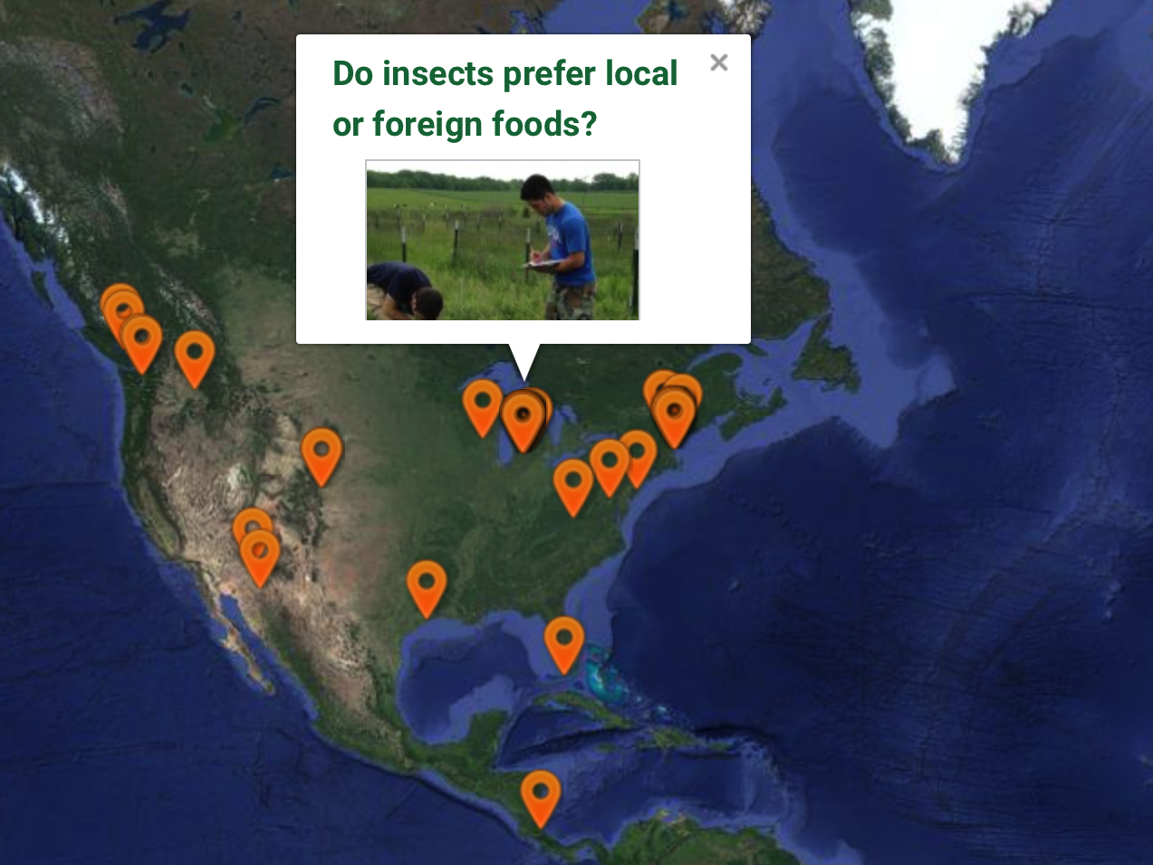
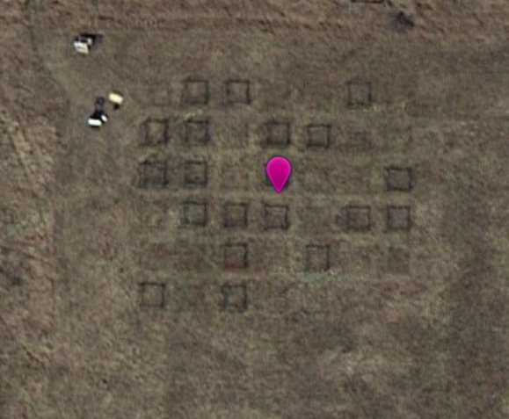
Notes:
We also have all Data Nuggets on a map for place based instruction. And you can use satellite view to get a closer look at the experimental site and give students a chance to explore the local area where the study was conducted.

Slide 27
Learning Objectives
_
Through the repeated use of Data Nuggets in the classroom, students will:
Understand that science is an active process and how we learn about the natural world.
Identify and differentiate between scientific questions, hypotheses, and predictions.
Build their quantitative skills by working with data, graphing, and interpreting quantitative information.
See science as an approachable and attainable career.
Notes:
The use of current research has the added benefit of capturing the attention of students by engaging them with more than just the conclusions of a study, but the story and process of the researcher behind the ideas and data. While using Data Nuggets, students get excited about a research topic while increasing their quantitative skills and competency with the scientific method.

Slide 28
Predicted student gains when using Data Nuggets
_
Teacher survey:
  “Students were more interested and engaged in science because they knew they were working with real data.”
  “Students were better able to think critically about data and communicate their findings to their peers and through writing.”
  “Because of their new comfort with data, students were more excited to conduct their own inquiry projects and graph.”
  “Ability to analyze and interpret data, identify data ranges and trends, and appropriately question the reliability of data and outliers, all improved.”
Notes:
After four years of iterative development we have observed the use of Data Nuggets in many classrooms and by hundreds of students, grades 4-12. Our preliminary observations indicate Data Nuggets are an effective tool to address the critical needs in STEM education today.
The survey was sent out to 163 K-12 teachers directly, including 135 in the Kellogg Biological Station K-12 partnership and 28 who attended Data Nuggets workshops at national and regional education conferences. Respondents were excited about the assessment of Data Nuggets, and 82% said they would like to be contacted to participate.

Slide 29
Notes:
Hand out publication

Slide 30
Journal Moment
_
      Revisit QR definitions:
      How can Data Nuggets help your students achieve the learning goals associated with quantitative reasoning in science?
Tomorrow we will return to the theme of
getting the most out of Data Nuggets in your classroom.
Notes:
Report- out some of the teacher’s ideas for this question after they talk with a partner.
HOMEWORK – go home and read the teacher guides for the two Data Nuggets you completed today and pay particular attention to the materials in the notes. Also look at the table for the 20 pack and start to think about which ones you’re interested in so we can plan tomorrow.

Slide 31
PD DAY 2
Notes:
Day 1 and 2 note: Frame the two ways to extend DNs beyond the student guide - first to use the DN as a teaching opportunity for big themes like process of science or graphing skills. Second, to use the notes in the teacher guide as a way to deepen the discussion around a particular DN and experiment and all the themes that could come up unique to that activity.
HOMEWORK – go home and read the teacher guides for the two Data Nuggets you completed today and pay particular attention to the materials in the notes. Also look at the table for the 20 pack and start to think about which ones you’re interested in so we can plan tomorrow.

Slide 32
Getting the most out of Data Nuggets
_
Notes:
Frame the two ways to extend DNs beyond the student guide - first to use the DN as a teaching opportunity for big themes like process of science or graphing skills. Second, to use the notes in the teacher guide as a way to deepen the discussion around a particular DN and experiment and all the themes that could come up unique to that activity.

Slide 33
Teacher Guides
_
Notes:
Hand out teacher guides that went along with DN they completed on day 1. Quick reminder of what’s in the teacher guide - Revisit teacher notes, check for understanding, supplemental materials sections of teacher guides. Now transitioning from what they are to how to use them in the classroom. More than just handing them out and having students complete the activity.

Slide 34
Using the teacher guide
_
Teacher Notes: Provide additional background information for teachers, as well as suggestions for discussion topics.
Checks for Understanding: Provide stopping points for teachers to assess student understanding.
Meta Moments: Provide stopping points for students to think about their own thinking.
Notes:
As a reminder

Slide 35

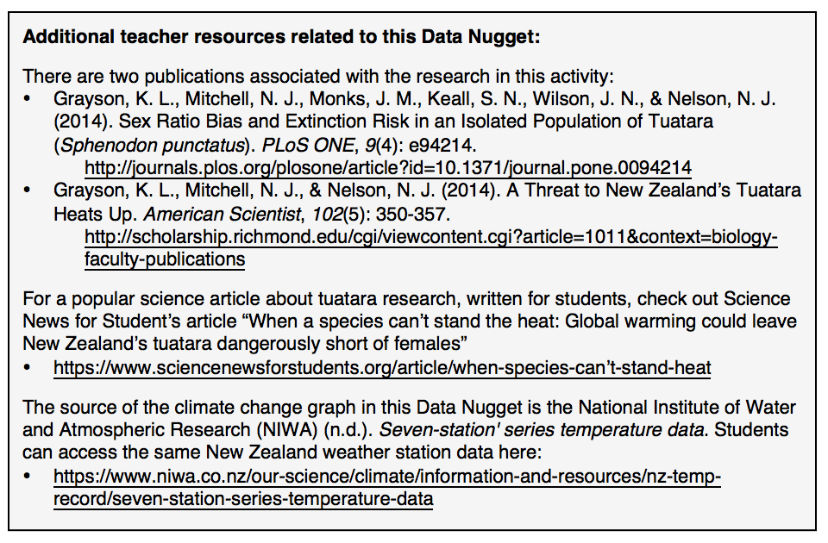
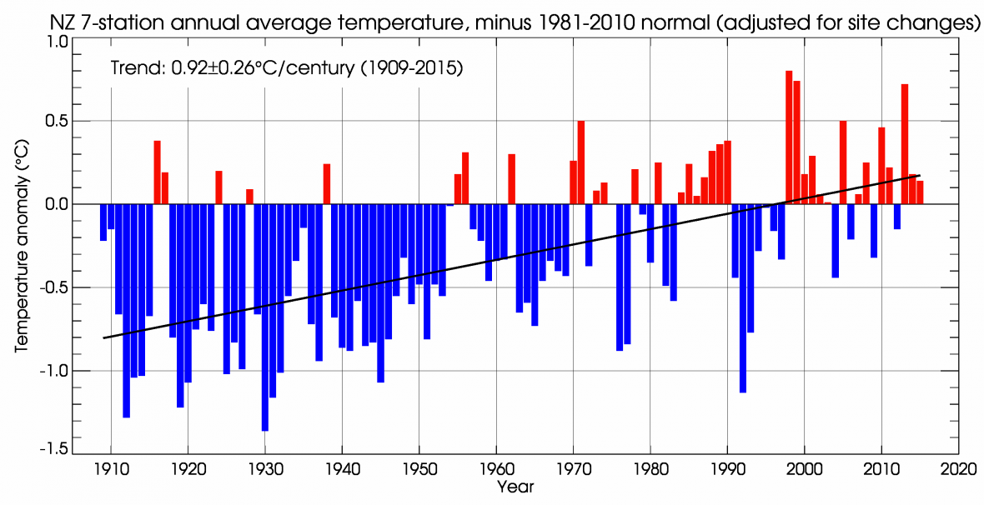
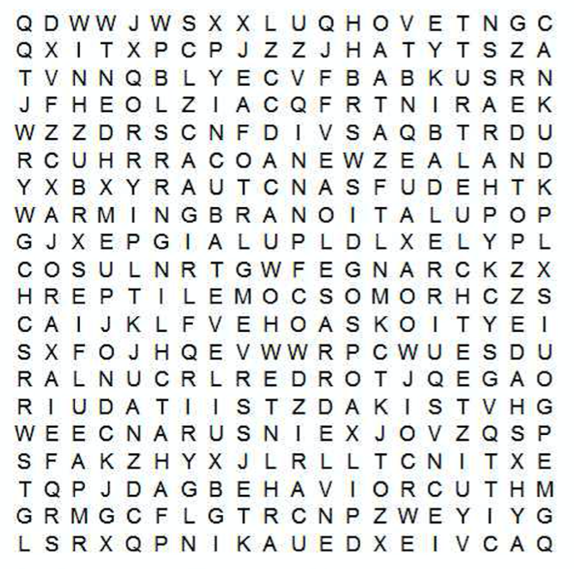
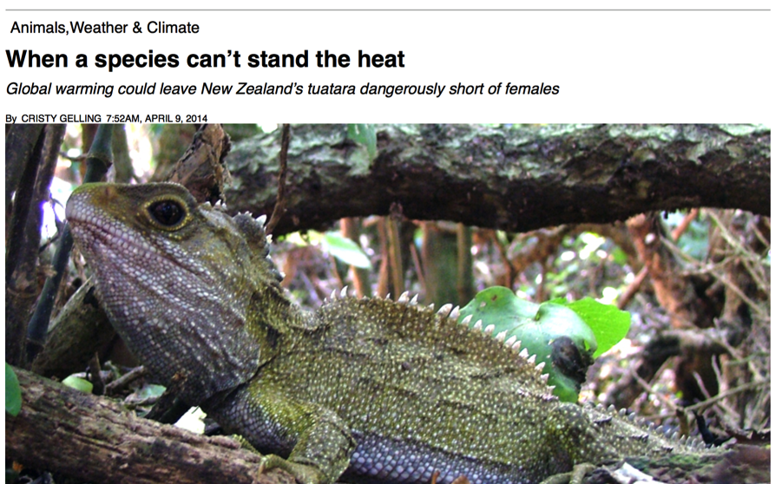
Using the teacher guide
_
Notes:
As a reminder – this one comes with a blog post, scientific article, link to the original climate change dataset that students can explore, and even a word search!

Slide 36
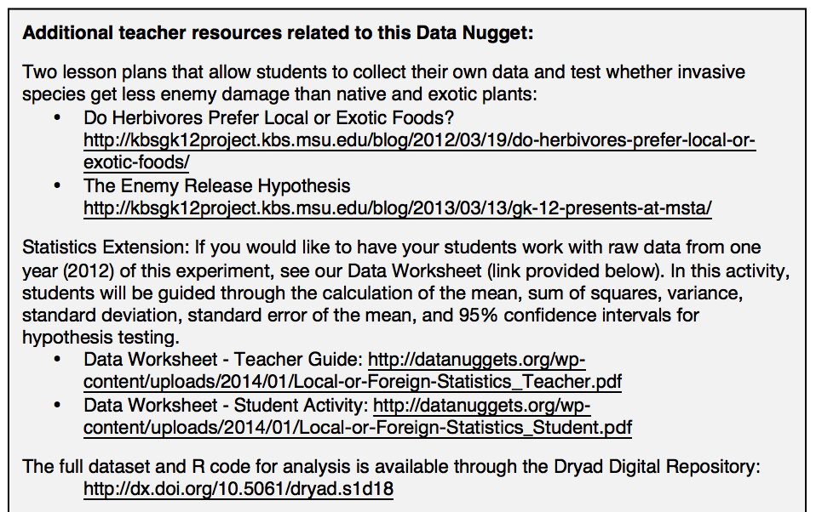
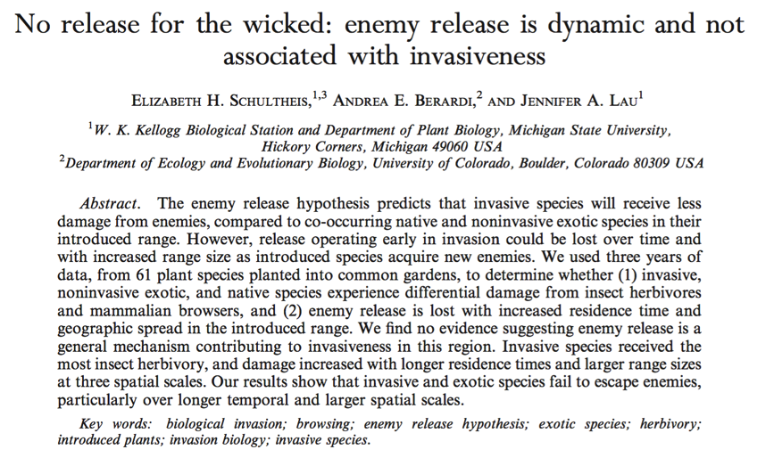
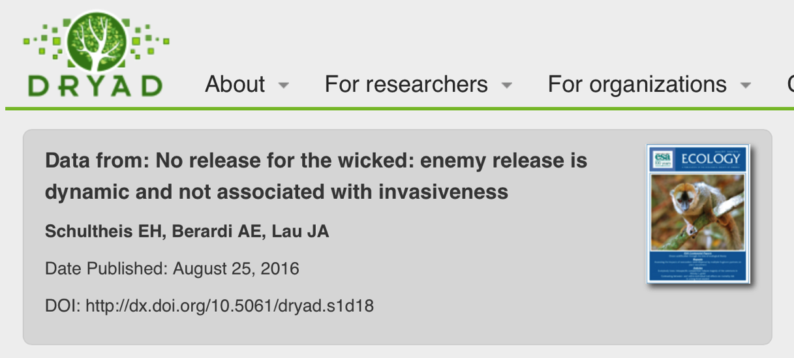
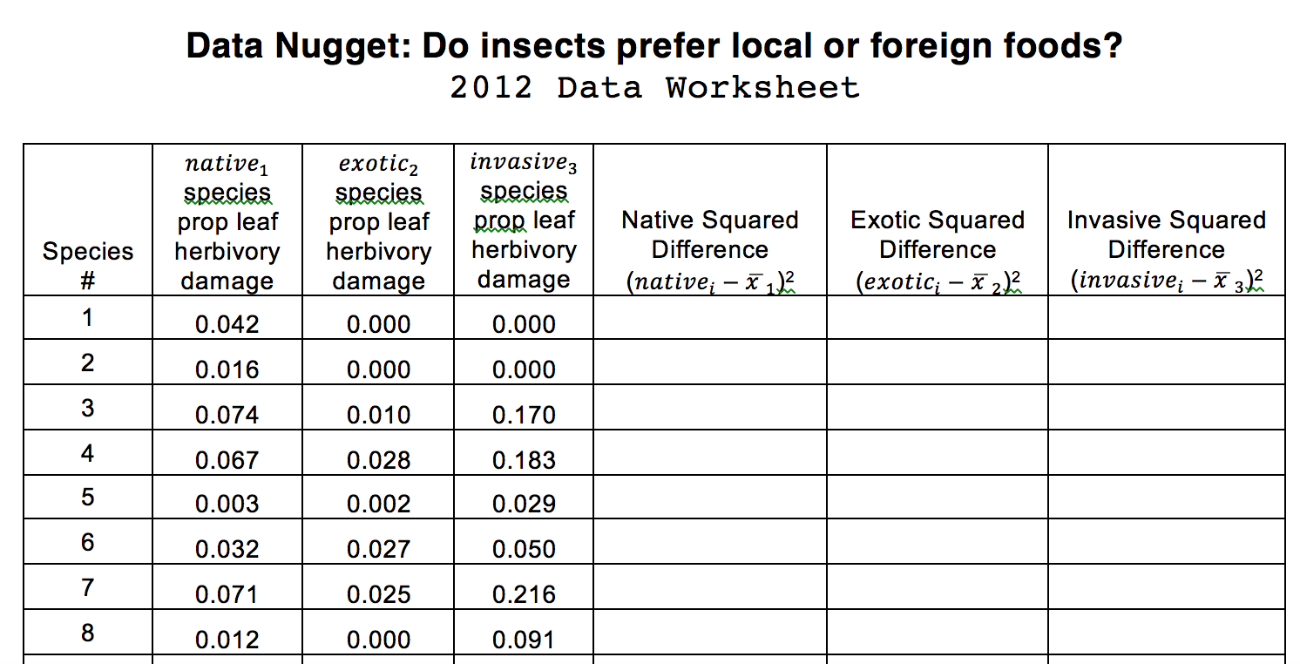
Using the teacher guide
_
Notes:
As a reminder – this one comes with a blog post, scientific article, link to the original climate change dataset that students can explore, and even a word search!

Slide 37
Teacher Guide Discussion
_
      Find your partner from the original Data Nugget activity and go through the teacher guide together.
      Would the extra materials change how you use this Data Nugget with your students? If so, how?
Notes:
Get into your small groups of your original Data Nuggets. Everyone should have read the teacher guide last night. Now, as a small group table discuss the following questions:
how would these extra materials change how you went through this DN? Compared to how you did the DN on the first day (worst case scenario, just sat down and completed it) how would you change the way it was used in your classroom?
Pick features of the teacher guide you like and think about the following question. What would your students get out of the discussion based on the teacher note that they would not get if they just completed the DN?

Slide 38
Activity: Share Strategies
_
      Identify two features from the teacher guide (ex. specific teacher notes) that would be most useful for your classes.
      What discussions might you have with your students, using these ideas as a jumping off point?
      Are there other topics you would cover that are not found in the teacher guide?
Notes:
While you can implement the DN without directly discussing it with your students, your students will get more out of the DN if you (as the teacher) are able to have conversations with them about it. We’ve provided some good discussion starters. Which TN do you think would be most useful for your classes? Are there other ways you would start discussions/topics you would cover with your students that you think would work better?”

Slide 39
Activity: Share Strategies
_
  Find the posters with the features you selected.
  Use a marker to record your group’s ideas for how you would use these features in your class.
  How would your students benefit from these strategies?
  Note: there are blank posters for you to share ideas that are not in the teacher guide!
Notes:
After talking with their partner, now they get up

Slide 40
Activity: Share Strategies
_
  Gallery Walk
  Walk around the room with your partner and read strategies from other groups.
  On each poster, use post-its to write any clarifying questions or comments.
Notes:
While you can implement the DN without directly discussing it with your students, your students will get more out of the DN if you (as the teacher) are able to have conversations with them about it. We’ve provided some good discussion starters that we’ve observed other teachers use [they’re in the TN] - and wanted to get your thoughts on them. Which TN do you think would be most useful for your classes? Are there other ways you would start discussions with your students that you think would work better?”

Slide 41
Journal Moment
_
      Take a moment to record some of the ideas you saw on the posters.
      What are some strategies you want to use to deepen student experiences using Data Nuggets?
Notes:
Report- out some of the teacher’s ideas for this question after they talk with a partner.

Slide 42
Data Nugget Discussion
_
      Whole group report-out
      Share an idea or strategy you will use in your classroom that you learned from someone else.
Notes:
Are there any strategies you learned at the PD that you might want to integrate with this DN?
Now that you’ve had time to discuss the teacher notes and what your students would get out of them, in a practical sense, How many of the teacher notes would be relevant for your class? How many would you have time to do? We don’t expect you to do every teacher note with every DN.

Slide 43
Activity: Case Studies
_
Form small groups and read the scenario assigned to you.
Describe how the teacher took opportunities to stop within the Data Nugget and check in with their students.
Were there any missed opportunities?
Notes:
Hand out teacher scenarios. Have teachers report out- summarize Mr. Diego and Mrs. Johnson’s strategies. What would they change? What do they like? What do they do that could be integrated into these courses?

Slide 44
Planning for DNs in the classroom
_
Notes:
In this session we’re going to help you plan for Data Nuggets in your classroom.

Slide 45
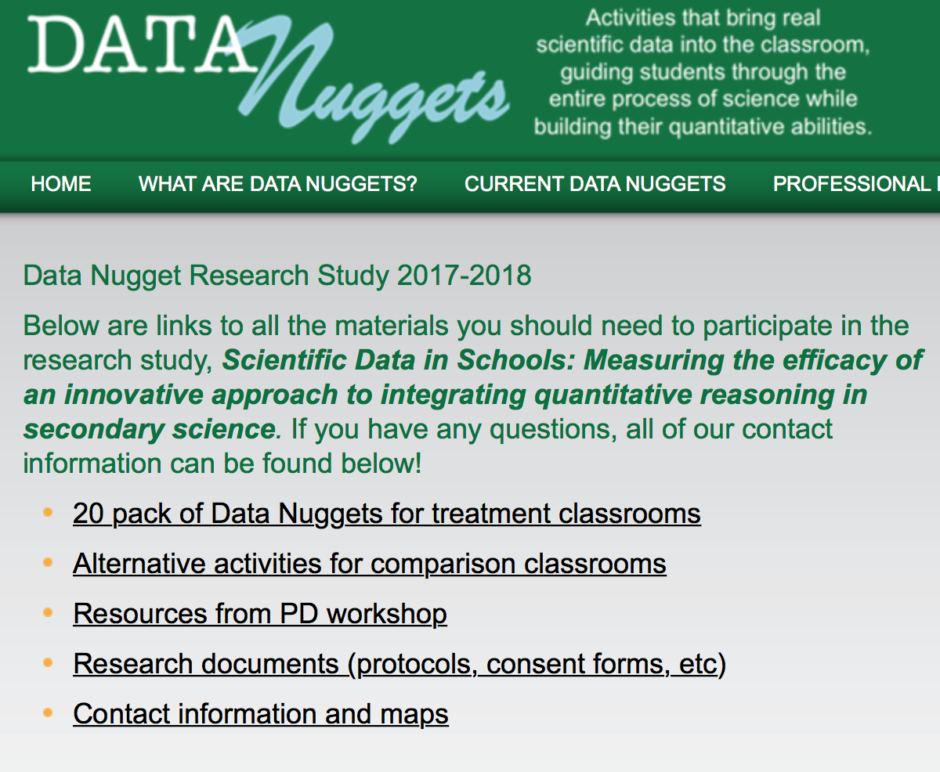

Slide 46
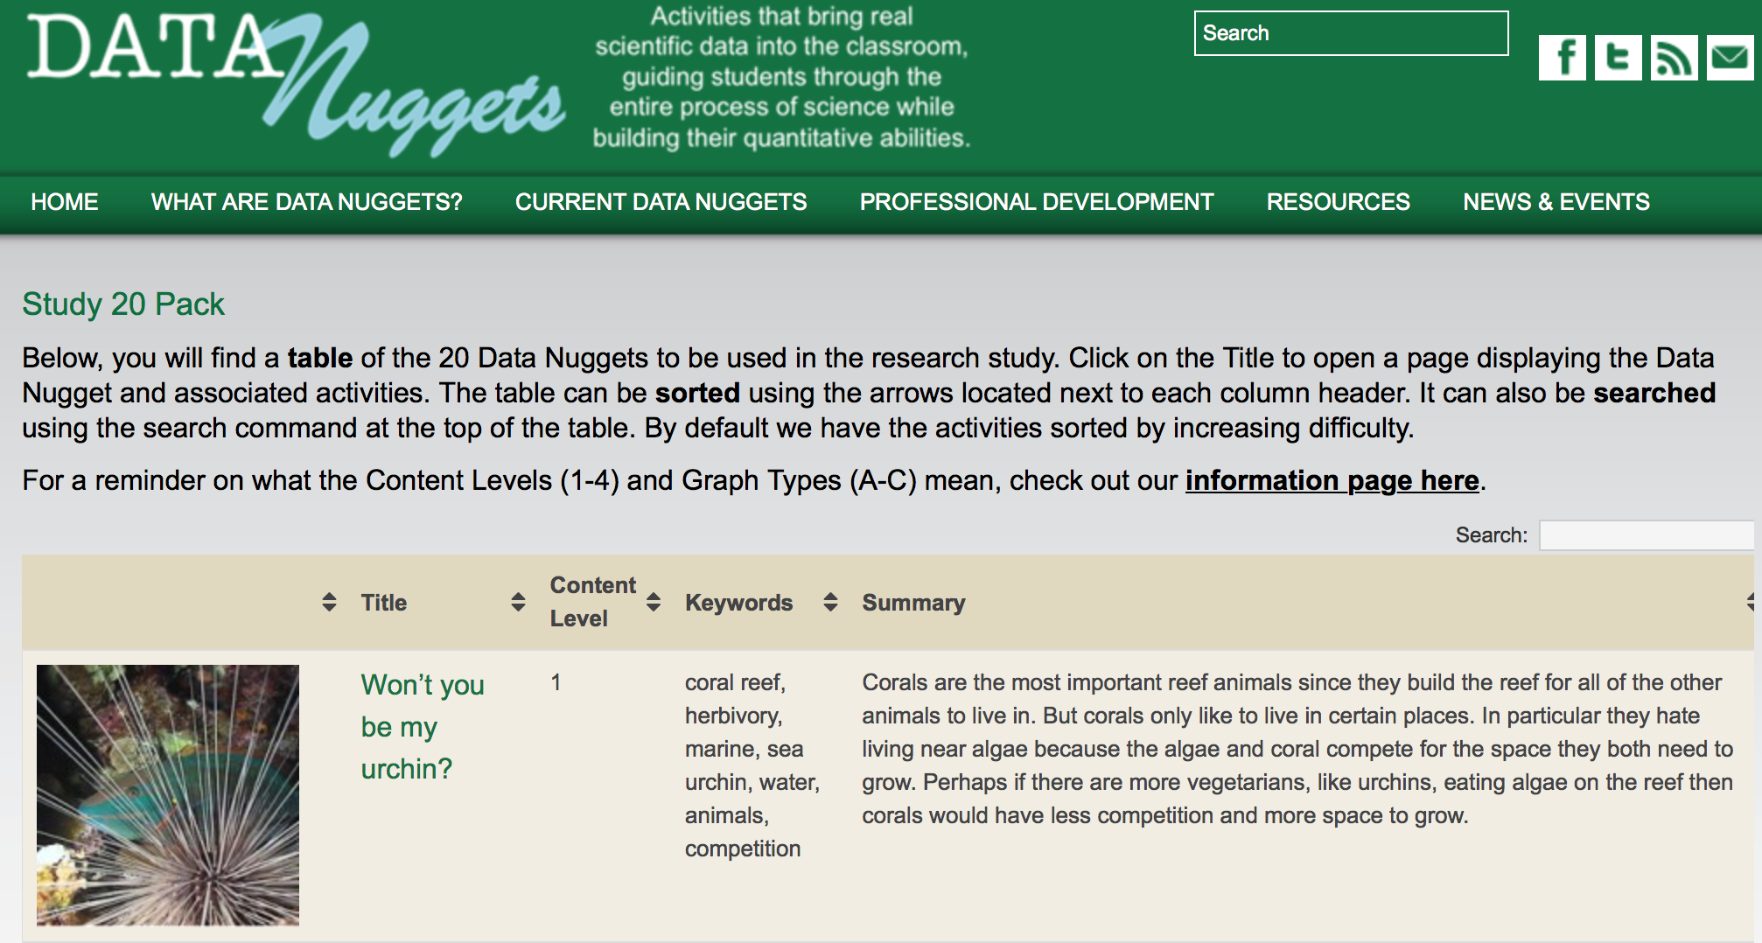
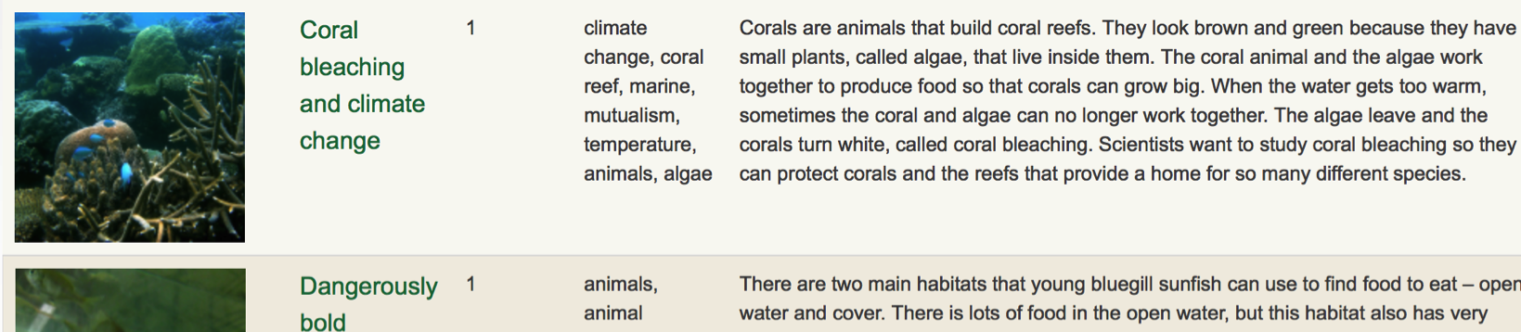

Slide 47
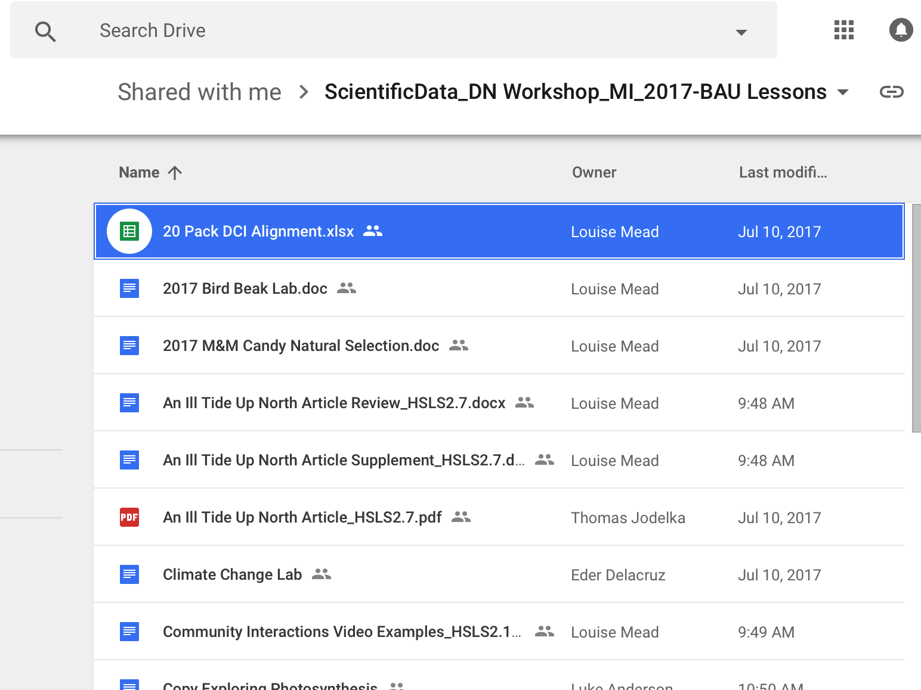

Slide 48
Course Planning Time
_
Discuss:
integrating Data Nuggets into your treatment class
alternative lessons for your comparison class
http://datanuggets.org/study
http://tinyurl.com/BAU-lessons
Notes:
Hand out teacher scenarios. Have teachers report out- summarize Mr. Diego and Mrs. Johnson’s strategies. What would they change? What do they like? What do they do that could be integrated into these courses?

