Slide 1
Increase your broader impacts while improving science education
Melissa Kjelvik , Alexa Warwick, and Elizabeth Schultheis
MSU BEACON Center

Slide 2

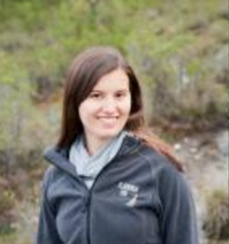



Who we are
_
Melissa Kjelvik
Postdoc: Science Education
PhD: Ecology and Animal behavior
Alexa Warwick
Postdoc: Science Education
PhD: Evolutionary biology
Elizabeth Schultheis
Molly Stuhlsatz
Louise Mead

Slide 3
Seminar Objectives
_
Introduce you to a broader impacts resource
  Increase your outreach
  Bring your research into K-16 classrooms
  Improve communication of your research
Help expand our program to include research from other disciplines
  We want to provide resources for teachers that reach outside of biology, connect to other fields
Notes:
Ask participants why they came and how they see Data Nuggets helping them. Creating a Data Nugget will help you think about the essence of your work and how it can be framed to captivate diverse audiences - from elementary students to fellow scientists. Data Nuggets are an avenue toward broader impacts as your research will be shared with K-16 audiences and improve the understanding of science in society.

Slide 4
Activities that bring real data into the classroom, along with all its messiness and complexity
Based on authentic cutting edge research
Provides a personal connection to scientists, sharing their process and motivation
Guide students through the entire process of science, including data analysis & interpretation
Notes:
Data Nuggets are built around data from recent and ongoing research, providing several benefits for researcher and student alike.

Slide 5
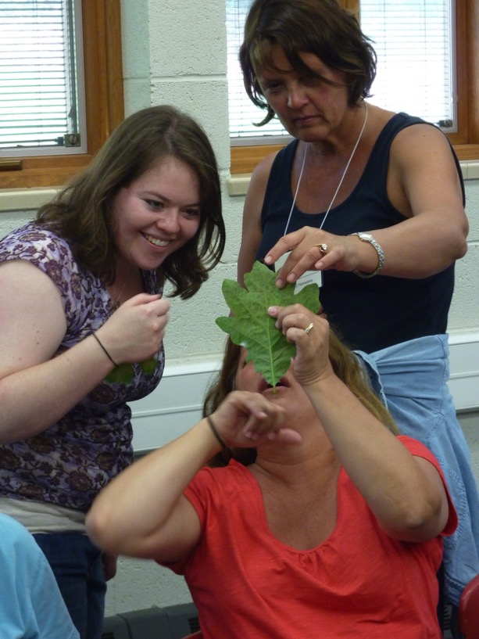
How Data Nuggets
got their start
_
Co-created by scientists and teachers at KBS
GK-12 graduate students gain teaching experience
Teachers are exposed to contemporary science
Students practice scientific inquiry
Notes:
K-12 Partnership at KBS: 15 rural school districts. Over 80 teachers involved and ~10 graduate student teaching fellows
Graduate students gain teaching experience. Teachers are exposed to contemporary science. Students practice scientific inquiry

Slide 6
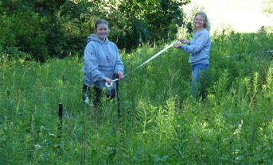
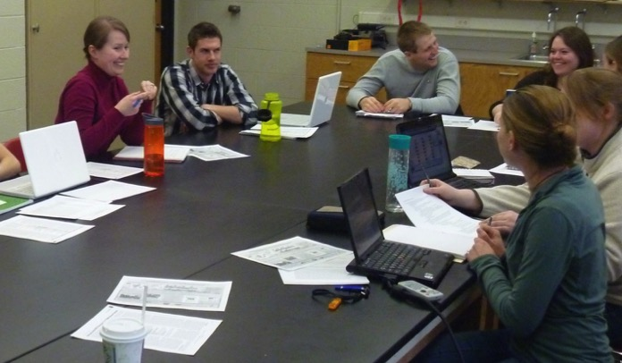
How Data Nuggets
got their start
_
Teachers concerned about performing inquiry in the classroom
Complexity of research results and messiness of data
Students need practice working with data – graphing and interpreting
Notes:
Data Nuggets have been under development since 2011 and originated through conversations between science teachers and graduate students during the NSF GK-12 project “New GK- 12: Using the STEM Dimensions of Bioenergy Sustainability to Bring Leading-edge Graduate Research to K-12 Learning Settings” (NSF DGE 0947896). This unique opportunity for collaboration between teachers and scientists led to the creation of teacher-inspired resources. Teachers shared that they were lacking educational resources that helped their students practice working with real, messy data like that collected during classroom inquiry-based projects. Graduate students in the sciences, however, have lots of practice working with messy data and surprising results.

Slide 7
Current Status
_
The Problem:
  Students in the United States consistently lag behind in science education outcomes (National Center for Education Statistics 2005)
  Students are graduating unable to apply quantitative knowledge to situations (Wilkins 2010)
  Little to no improvement between 1970-2012 (Mullis & Martin 2014)
The Implications:
  Students with low QR have lower career readiness and are less prepared for the workforce (McNeill and Krajcik 2012, McMillan & Marks 2003, Marks et al. 2005, Rumberger & Lamb 2003)
  Left unprepared to address pressing social and scientific issues (Steen 1999)
    These issues becoming more important as we increasingly rely on large, complicated datasets (NAP 2014)

Slide 8
Reform in Science Education
_
Fundamental shifts in science education
  Away from rote learning of facts
  Towards application of critical thinking and deep understanding
NGSS, ACT, Vision and Change emphasize:
  Ability to analyze and interpret data
  The use of mathematical thinking
  Communication of arguments based on evidence

Slide 9
Data Nugget goals:
_
Increase quantitative literacy
Introduce students to the process of science
Show scientists are approachable
  Engage students with the researcher themselves, discussing more than just research findings
Build interest in science
  Current research may engage students more than classic textbook examples
  Could increase students’ desire to pursue a career in science
Notes:
The use of current research has the added benefit of capturing the attention of students by engaging them with more than just the conclusions of a study, but the story and process of the researcher behind the ideas and data. While using Data Nuggets, students get excited about a research topic while increasing their quantitative skills and competency with the scientific method.

Slide 10
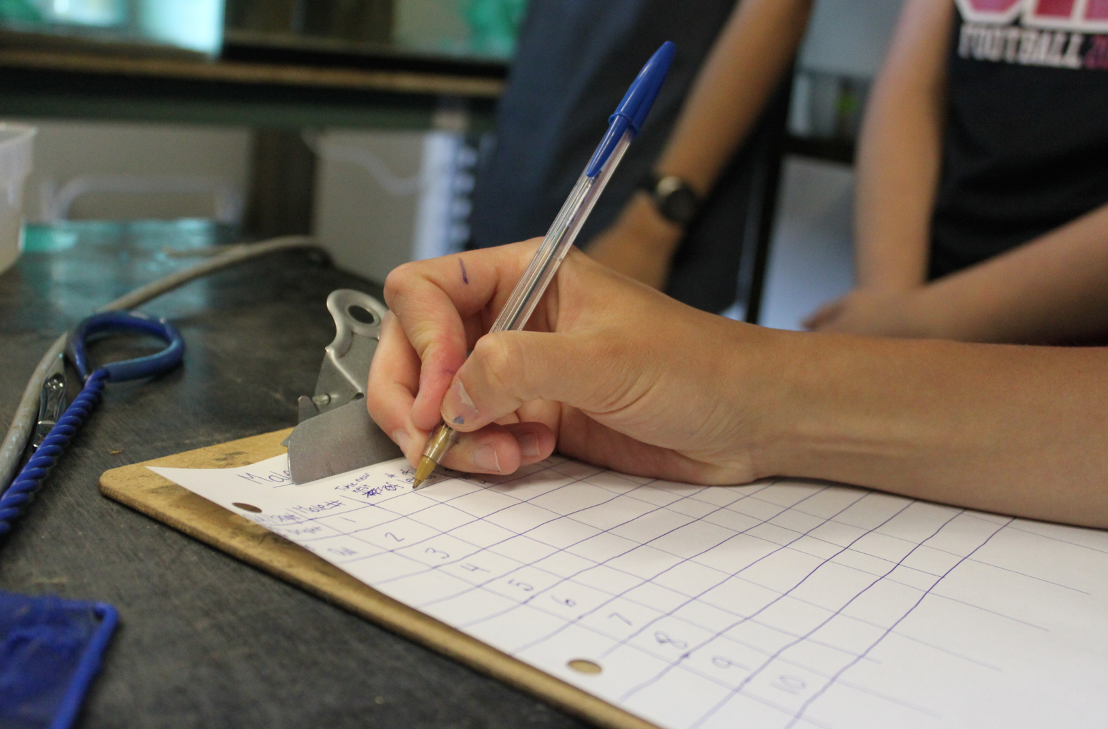
What makes a Data Nugget?
_

Slide 11
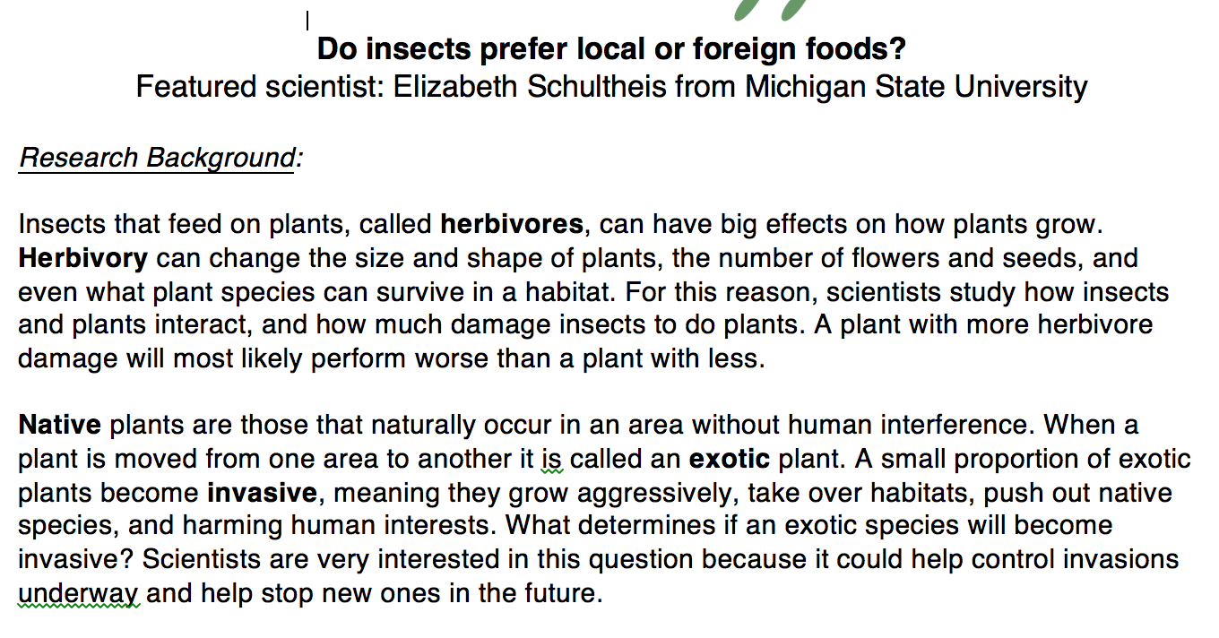
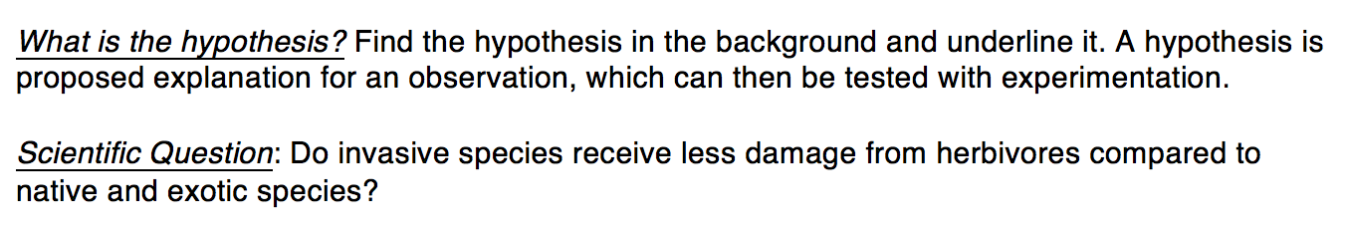
Parts of a Data Nugget
_
Background information
Question and Hypothesis
Notes:
The standard format of each Nugget provides a brief background about a researcher, their study system, and a real dataset from that work. Within each Nugget, students are challenged to answer a scientific question, are guided through the construction of graphs to facilitate data interpretation, and use data to support their claims. Data Nuggets serve to supplement existing science curriculum; because of their simplicity and flexibility, Data Nuggets can be used across grade levels and throughout the school year as students build confidence in their quantitative and scientific skills.

Slide 12
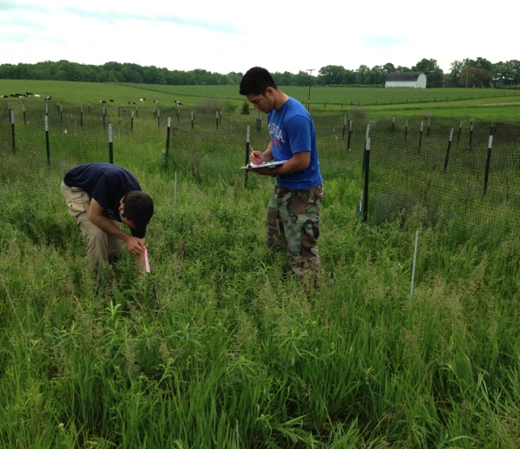
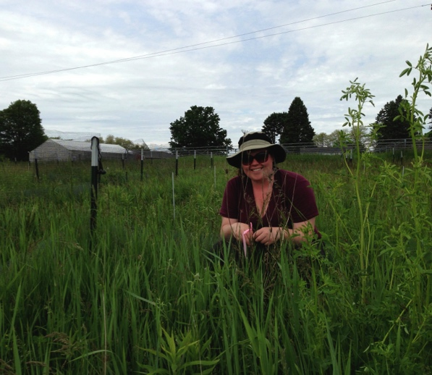
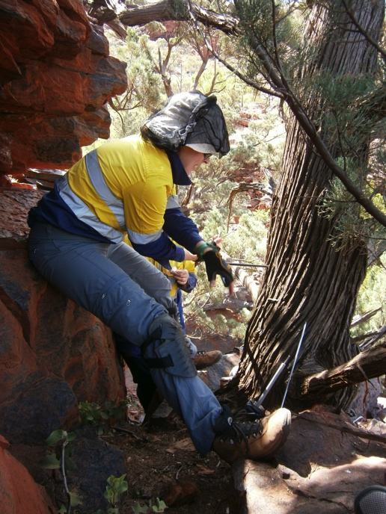
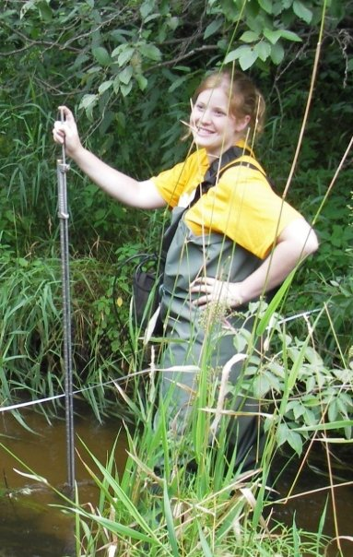
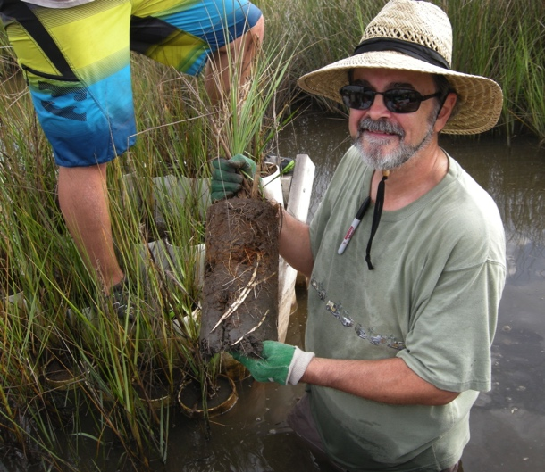
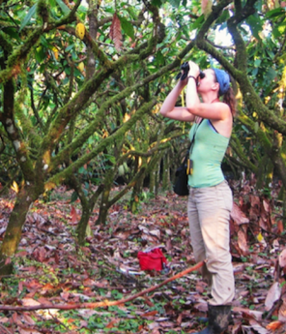
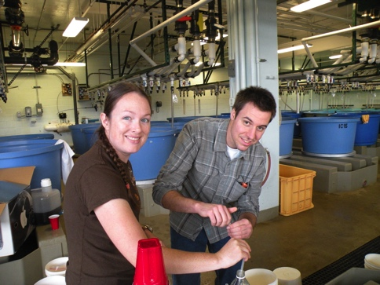
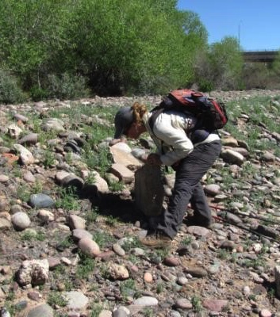

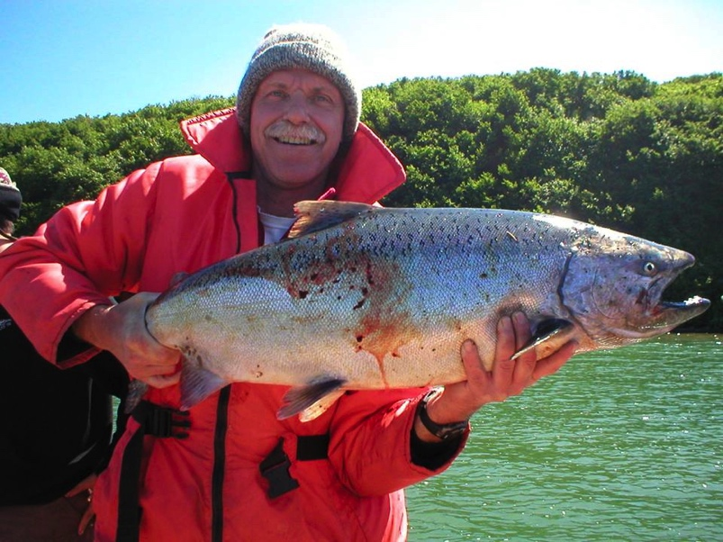

Slide 13
Content Levels
_
  These correspond with Flesch-Kincaid readability statistics
  Aligned with NGSS Standards
Notes:
First, each Data Nugget activity is ranked from 1-4 according to the reading, vocabulary, and content level of the background information provided to students. Readability for each activity is determined using the Flesch–Kincaid Reading Grade Level, which calculates how difficult a reading passage in English is to understand. Content level is determined by aligning each activity with science standards and discussions with our advisor panel of K-12 teachers. Activities of the highest level (4) are probably inappropriate for younger students, but level 1 activities are still appropriate to use with higher-level students if the quantitative skills they teach are relevant.

Slide 14
Parts of a Data Nugget
_
Dataset
Data Interpretation

Slide 15
Graphing Levels
_
  Each Data Nugget is provided in each type on our website
  Scientist provides us with Type A and excel file, we make the rest
Notes:
Second, activities are coded according to the graphing skills required. Type A activities provide the graph for the students, (allowing a focus on graph interpretation, making claims based on evidence, and explaining reasoning), Type B activities provide axis labels but requires students to graph the data, and Type C provides an unlabeled grid on which to draw a graph.

Slide 16
Constructing Explanations
Claim-Evidence-Reasoning
_
Make a claim that answers the scientific question. Describe the relationship between the dependent and independent variables and what that means.
Support your claim using data as evidence. Reference specific parts of the table or graph.
Explain your reasoning and how the data supports your claim. Connect the data back to what you learned about _______________.
What do the data from this study tell us about the scientist’s hypothesis? Use evidence to explain why or why not. If you feel the data was inconclusive, explain why.

Slide 17
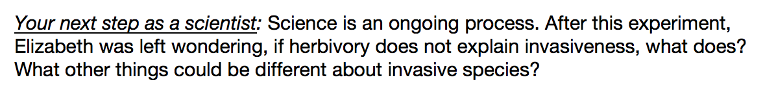
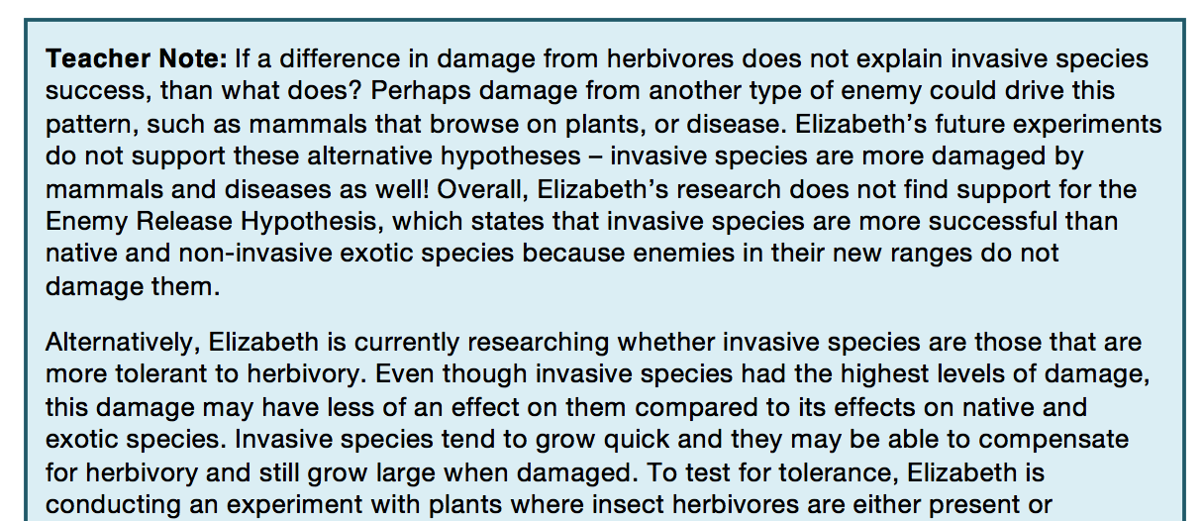
Scientist Next Steps
_

Slide 18
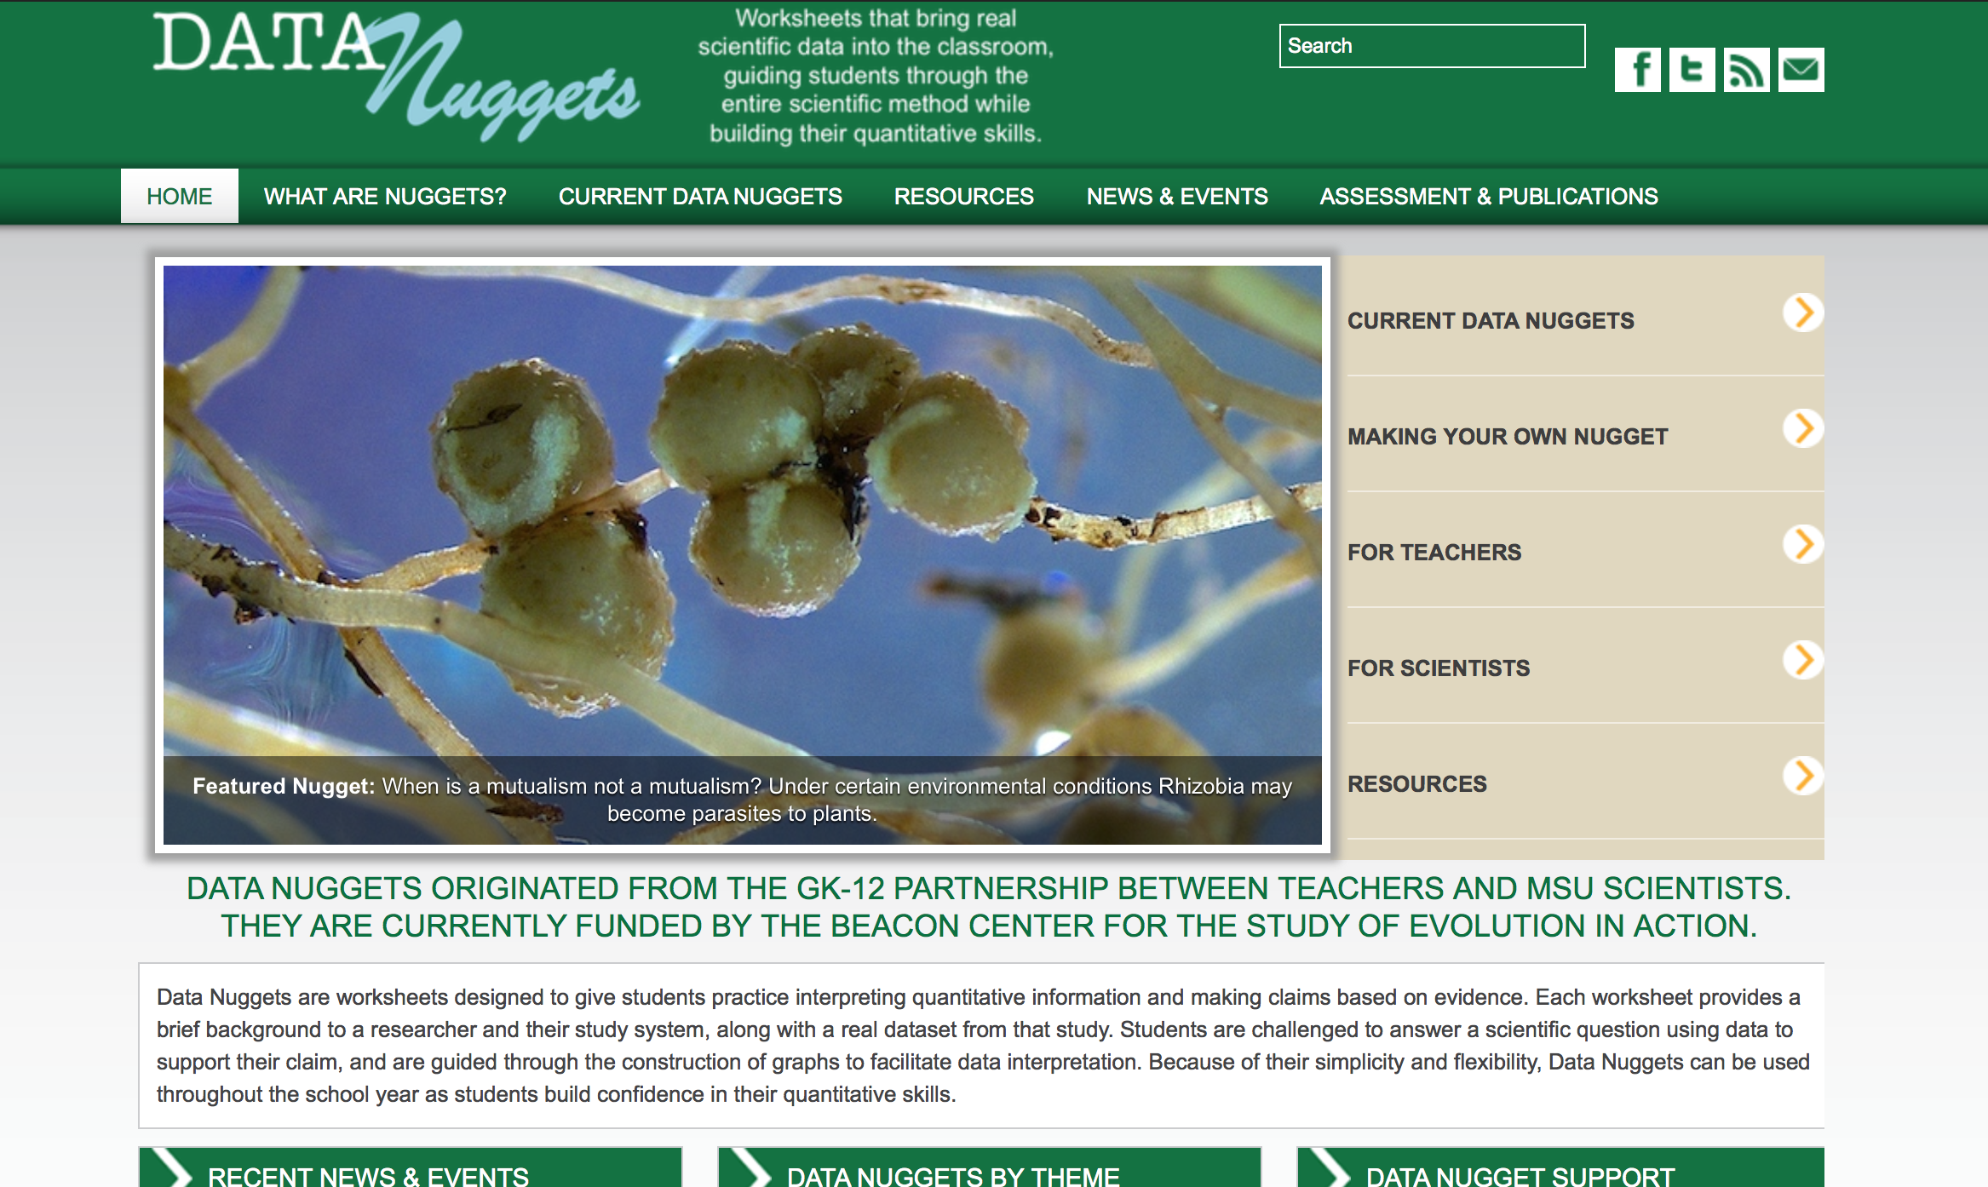
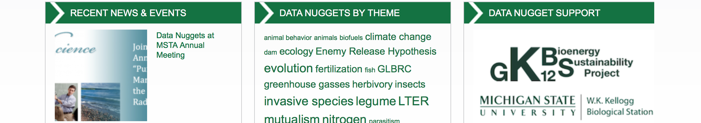
Notes:
We will host your Nugget on our website

Slide 19
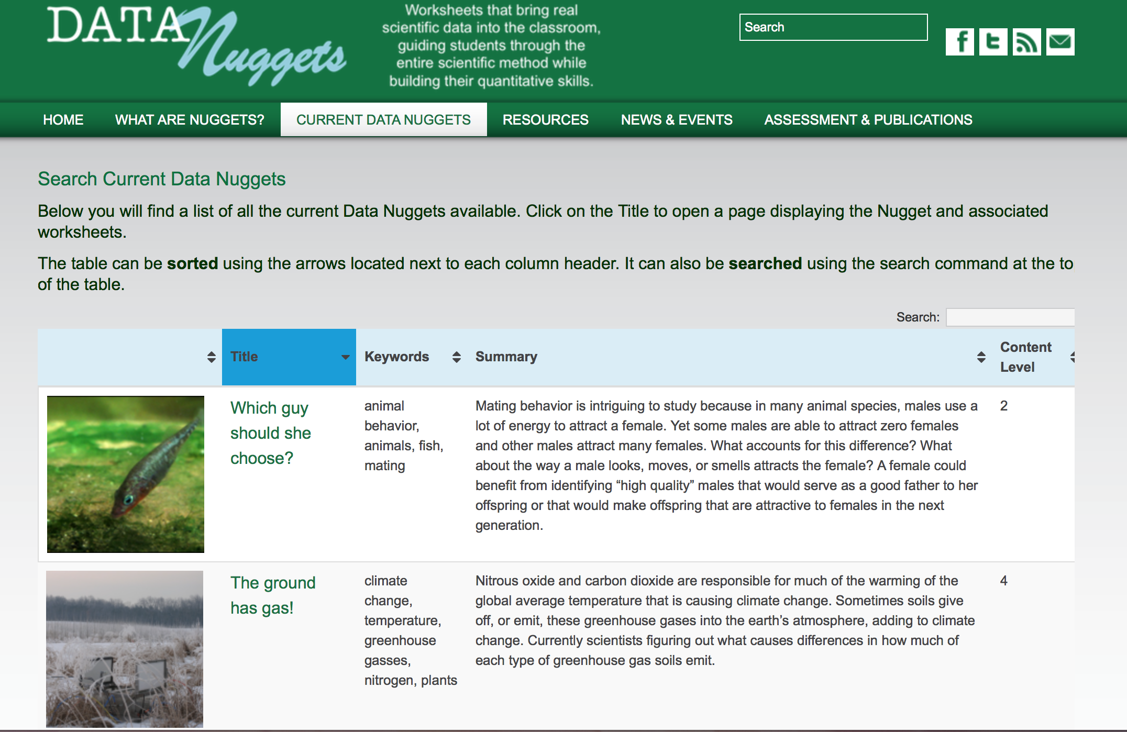
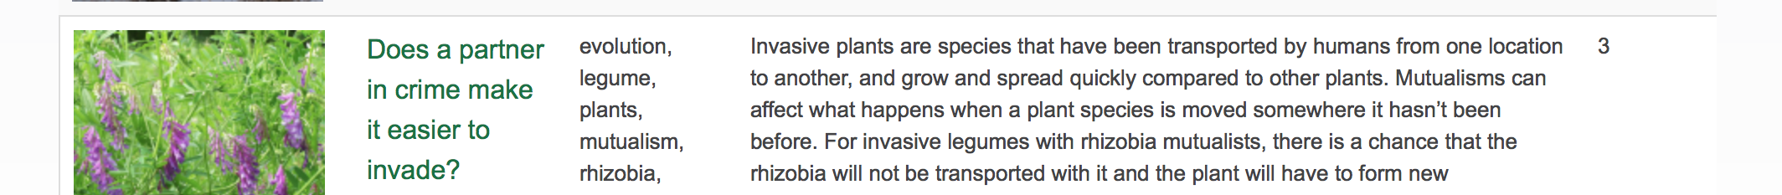

Slide 20
Current Funding
_

Slide 21
DRK-12 Efficacy Study
_
Collaboration with BSCS and MSU DN team
Compared to students in business-as-usual classrooms, do students using Data Nuggets have:
  better achievement in science content
  increased interest in science
  higher motivation outcomes

Slide 22
DRK-12 Efficacy Study
_
We predict students in classrooms using Data Nuggets will demonstrate:
Improved quantitative reasoning in the context of science
Improved understanding of the practices and processes of science, particularly in the areas of analyzing and interpreting data and using mathematics and computational thinking
Greater engagement in the practices of science in the classroom
Higher general interest in science

Slide 23
Teacher Survey Results
_
  “Students were more interested and engaged in science because they knew they were working with real data.”
  “Students were better able to think critically about data and communicate their findings to their peers and through writing.”
  “Because of their new comfort with data, students were more excited to conduct their own inquiry projects and graph.”
Notes:
After four years of iterative development we have observed the use of Data Nuggets in many classrooms and by hundreds of students, grades 4-12. Our preliminary observations indicate Data Nuggets are an effective tool to address the critical needs in STEM education today.
The survey was sent out to 163 K-12 teachers directly, including 135 in the Kellogg Biological Station K-12 partnership and 28 who attended Data Nuggets workshops at national and regional education conferences. Respondents were excited about the assessment of Data Nuggets, and 82% said they would like to be contacted to participate.

Slide 24
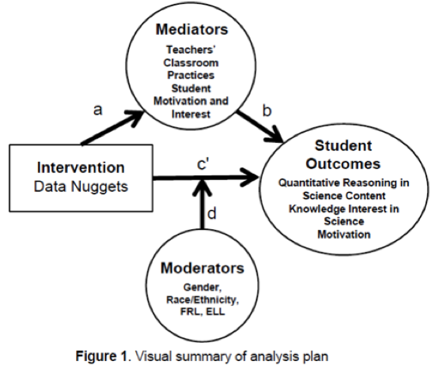
DRK-12 Efficacy Study
_
High schools in MI, CO, and CA
Multi-site randomized cluster design
  Minimum 30 teachers
  Half of each teacher’s classes receive treatment, half control
Notes:
A two-level hierarchical linear model (Raudenbush & Bryk, 2002) will be used to estimate the main effect of treatment. Specifically, student outcomes will be modeled at level 1 as a function of baseline achievement (pretest) and demographic variables, including free/reduced-price lunch status, gender, English language learner status, and race/ethnicity, all centered around the grand mean. Mean achievement for students in a given class will be modeled at level 2 as a function of a treatment indicator variable as well as a class-level mean baseline outcome score. The treatment effects of each site (teacher) will be modeled at level three as a function of teacher-level variables and the intercept of this model will represent the overall treatment effect.

Slide 25
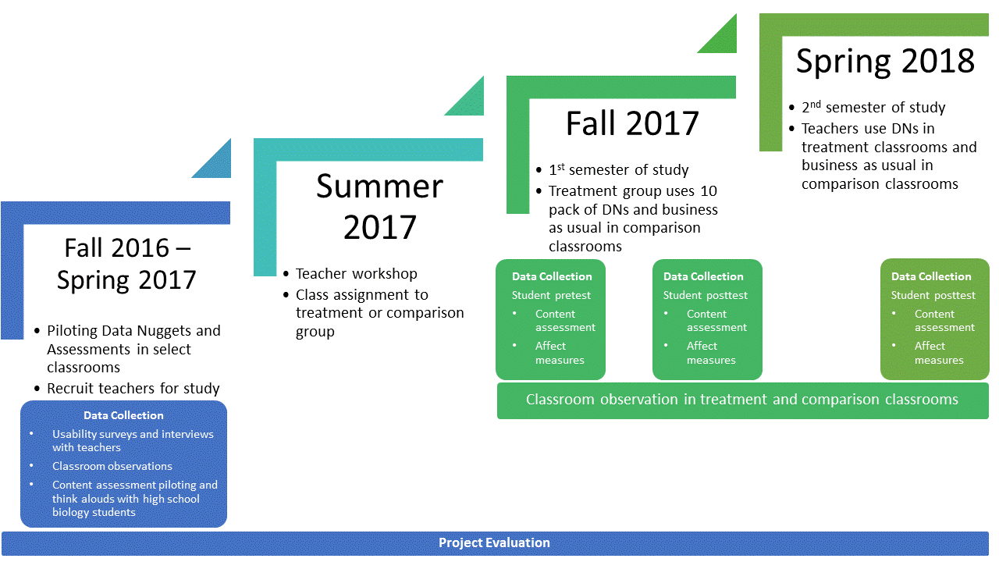
Timeline

Slide 26
Making your own Data Nugget
_

Slide 27
Why make a Data Nugget?
_
Increase your broader impacts
  Meet requirements of publicly-funded research
Improve your communication skills
  Uncover the core message of your work
  Explain your research to a variety of audiences
  Improve your research skills (Feldon et al. 2011)
Use them in your undergraduate classroom
Notes:
Ask participants why they came and how they see Data Nuggets helping them. Creating a Data Nugget will help you think about the essence of your work and how it can be framed to captivate diverse audiences - from elementary students to fellow scientists. Data Nuggets are an avenue toward broader impacts as your research will be shared with K-16 audiences and improve the understanding of science in society.

Slide 28
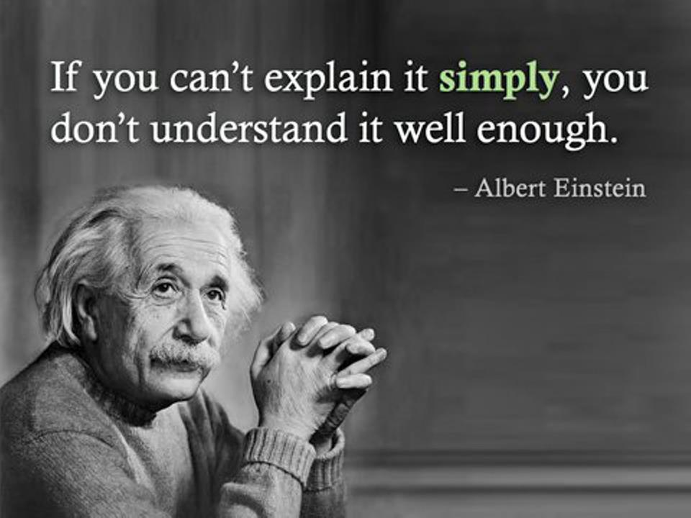
Notes:
If you can explain it to a 4th grader you can explain your work to fellow scientists and other members of society.

Slide 29
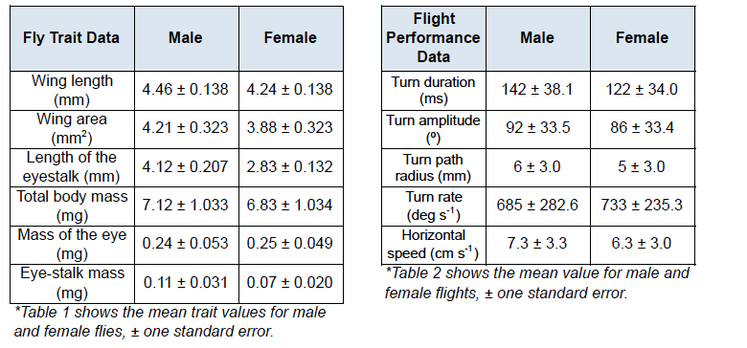
Steps for Making a DN
_
Think about your own data and scientific questions
  Published research or work-in-progress
  Could have multiple parts
Identify a dataset (or subset/summary of the data)
Notes:
Is there a topic you want to share with students? What do you want them to come away knowing more about?
You have the stalk-eyed fly example – more examples up front

Slide 31
Steps for Making a DN
_
Think about your own data and scientific questions
Identify a dataset (or subset of the data) to use
Consider what background information is needed to understand the data and answer the question
Provide additional details for the instructor to use
Send a rough draft to the Data Nuggets team to get feedback (email information on website)

Slide 32
Data Nugget Iterative Development Process
Research Scientist
Data Nugget
Team
MSU + BSCS Working Groups
Teacher + Scientist Reviewers
Classroom Pilot
Turn around time for posting is ~1 month

Slide 33
Steps for Making a DN
_
Think about your own data and scientific questions
Identify a dataset (or subset of the data) to use
Consider what background information is needed to understand the data and answer the question
Provide additional details for the instructor to use
Send a rough draft to the Data Nuggets team to get feedback (email information on website)

Slide 34
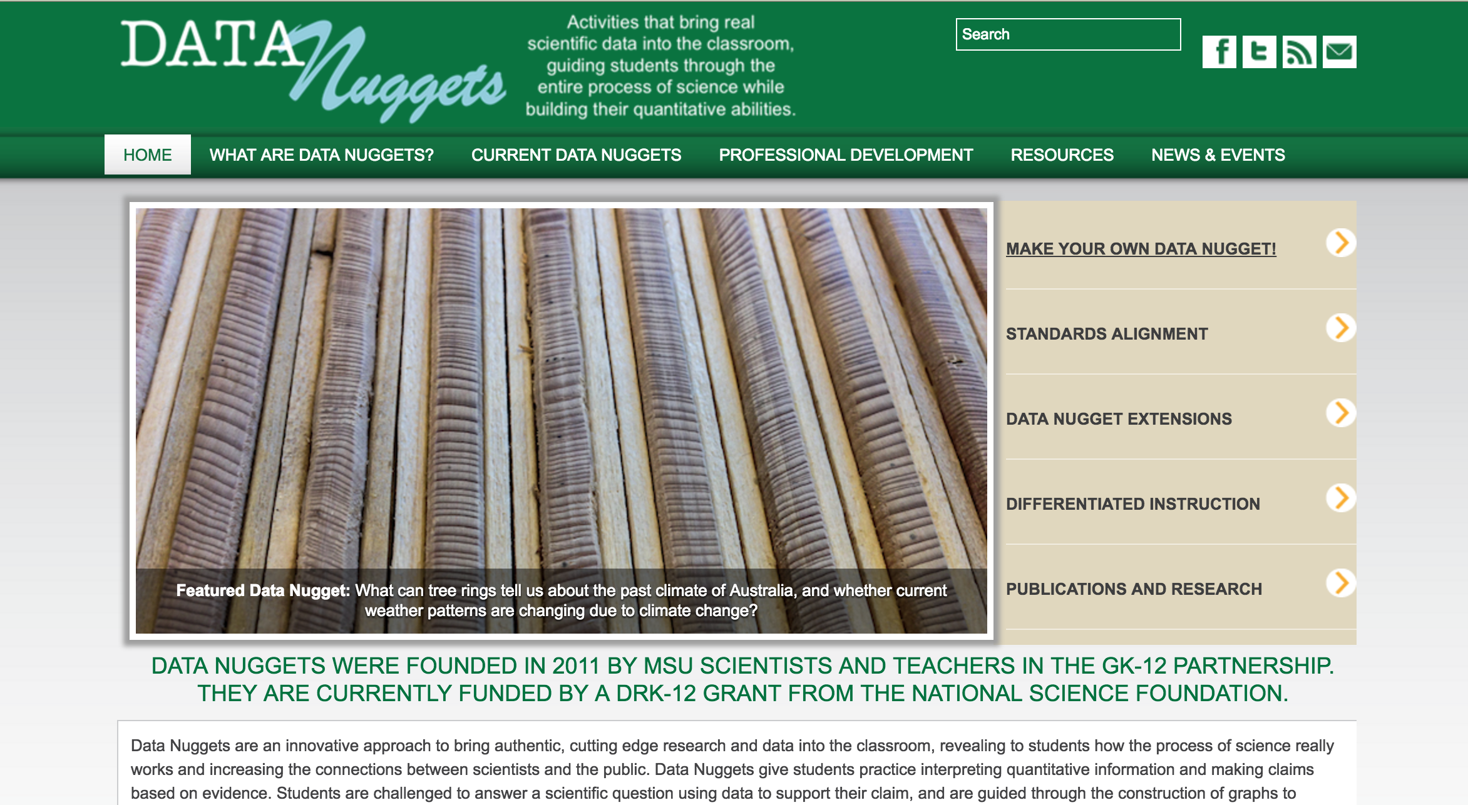
Data Nugget Template
_

Slide 35
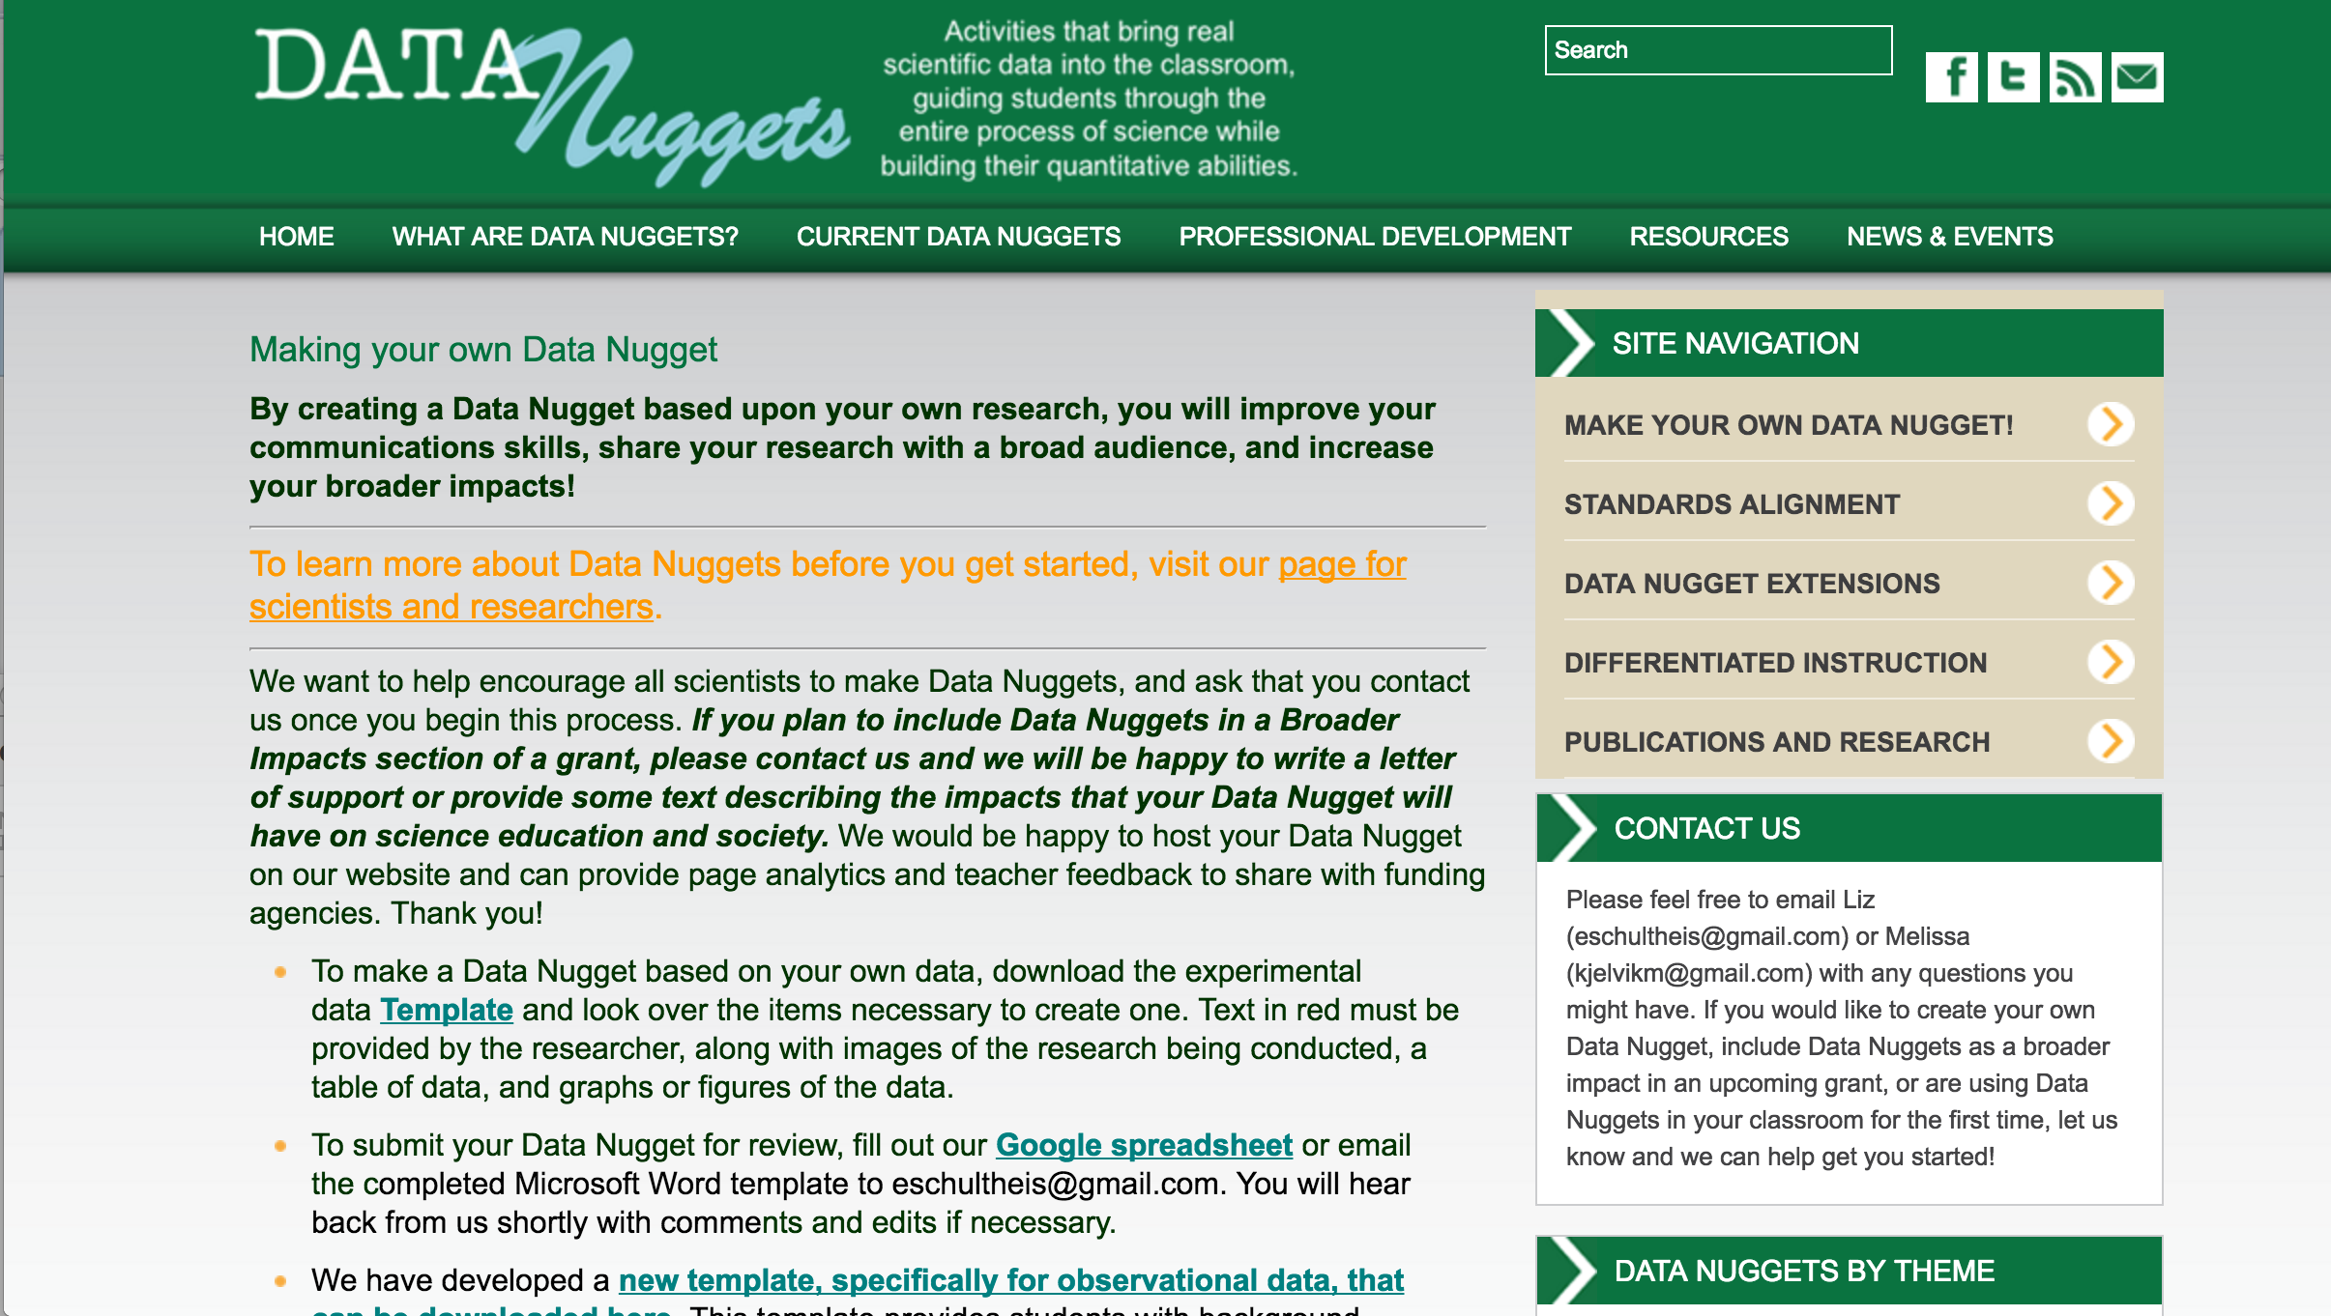
Data Nugget Template
_
Screenshot

Slide 36
Data Nugget Template
_

Slide 37

Data Nugget Template
_
Prompts for each section of the Data Nugget
  Background, Question/Hypothesis, Data/Graphing, Data Interpretation (CER), Next Steps
Not shown - additional teacher guide sections that the Data Nuggets team will identify from your draft

Slide 38
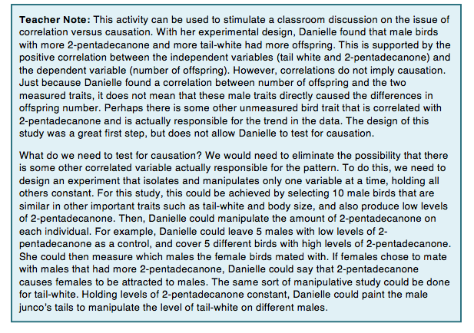
Teacher Guide Additions
_
Teacher Notes: Provide additional background information for teachers, as well as suggestions for discussion topics.
Checks for Understanding: Provide stopping points for teachers to assess student understanding.
Meta Moments: Provide stopping points for teachers to have a conversation with their students about the process of science itself. Stepping back from the research, students can discuss the decisions they are making as they work though the Data Nugget.
Notes:
For each Data Nugget we have created a Teacher Guide to help facilitate use in the classroom and provide the teacher with any additional information they might need. This guide has the same structure as the student handouts, but has example student graphs and written responses, as well as suggested stopping points for class discussion and clarifications. There are three types of stopping points:
Teacher Notes: Provide additional background information for teachers, as well as suggestions for discussion topics. For example, we may share information provided by the scientist, detailing what their next research steps were after collecting the data presented in the activity.
Checks for Understanding: Provide stopping points for teachers to assess student understanding. These are particularly useful after students finish reading the Background Information sections or have just started to view and work with the data.
Meta Moments: Provide stopping points for teachers to have a conversation with their students about the process of science itself. Stepping back from the research, students can discuss the decisions they are making as they work though the Data Nugget, such as the way they chose to visualize their data to ease interpretation and support their claims.

Slide 39
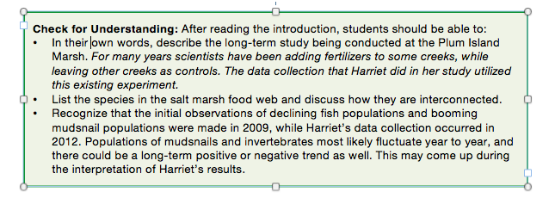
Teacher Guide Additions
_
Teacher Notes: Provide additional background information for teachers, as well as suggestions for discussion topics.
Checks for Understanding: Provide stopping points for teachers to assess student understanding.
Meta Moments: Provide stopping points for teachers to have a conversation with their students about the process of science itself. Stepping back from the research, students can discuss the decisions they are making as they work though the Data Nugget.

Slide 40
Teacher Guide Additions
_
Teacher Notes: Provide additional background information for teachers, as well as suggestions for discussion topics.
Checks for Understanding: Provide stopping points for teachers to assess student understanding.
Meta Moments: Provide stopping points for teachers to have a conversation with their students about the process of science itself. Stepping back from the research, students can discuss the decisions they are making as they work though the Data Nugget.
Notes:
For each Data Nugget we have created a Teacher Guide to help facilitate use in the classroom and provide the teacher with any additional information they might need. This guide has the same structure as the student handouts, but has example student graphs and written responses, as well as suggested stopping points for class discussion and clarifications. There are three types of stopping points:
Teacher Notes: Provide additional background information for teachers, as well as suggestions for discussion topics. For example, we may share information provided by the scientist, detailing what their next research steps were after collecting the data presented in the activity.
Checks for Understanding: Provide stopping points for teachers to assess student understanding. These are particularly useful after students finish reading the Background Information sections or have just started to view and work with the data.
Meta Moments: Provide stopping points for teachers to have a conversation with their students about the process of science itself. Stepping back from the research, students can discuss the decisions they are making as they work though the Data Nugget, such as the way they chose to visualize their data to ease interpretation and support their claims.

Slide 41
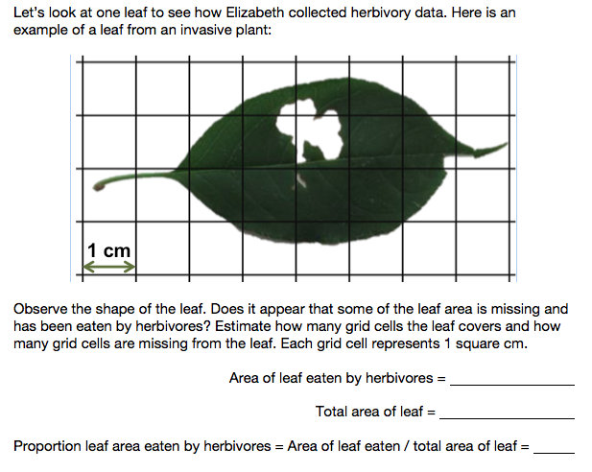
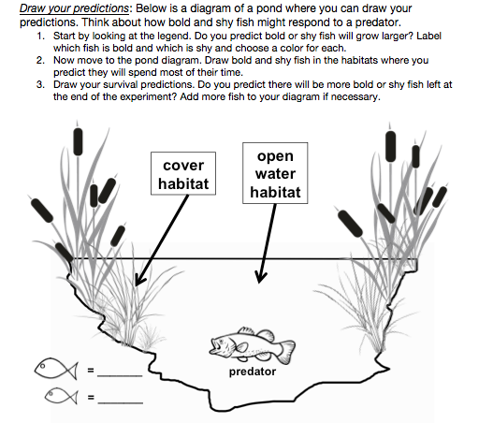
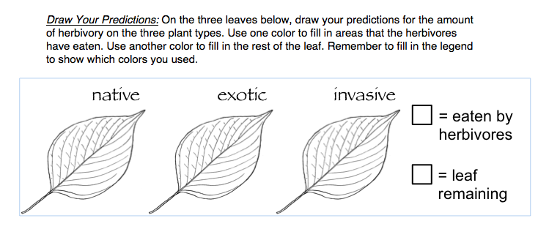
Student engagement activities (OPTIONAL)

Slide 42
Data Nugget Template
_
Prompts for each section of the Data Nugget
Additional teacher guide sections (optional)
Student engagement activities (optional)
Submit:
  Completed word document template with data
  Photos and/or images
  [Later] Meet the scientist photo and description

Slide 43
Expanding Data Nuggets
_
Help expand our program to include research from other disciplines
  We want to provide resources for teachers that reach outside of biology, and connect to other fields

Slide 44
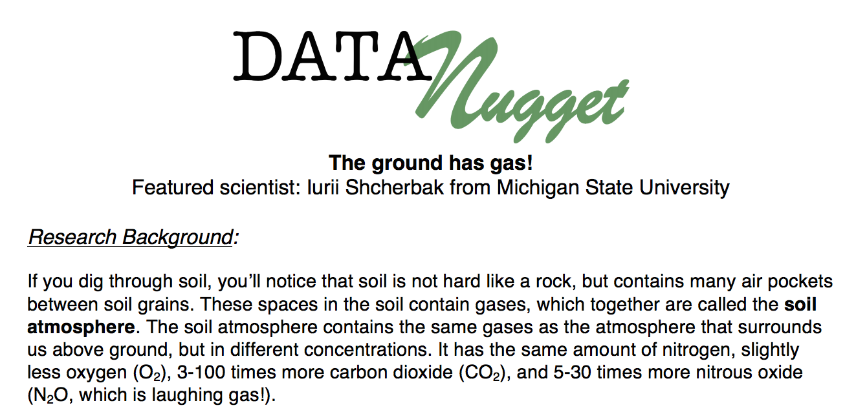
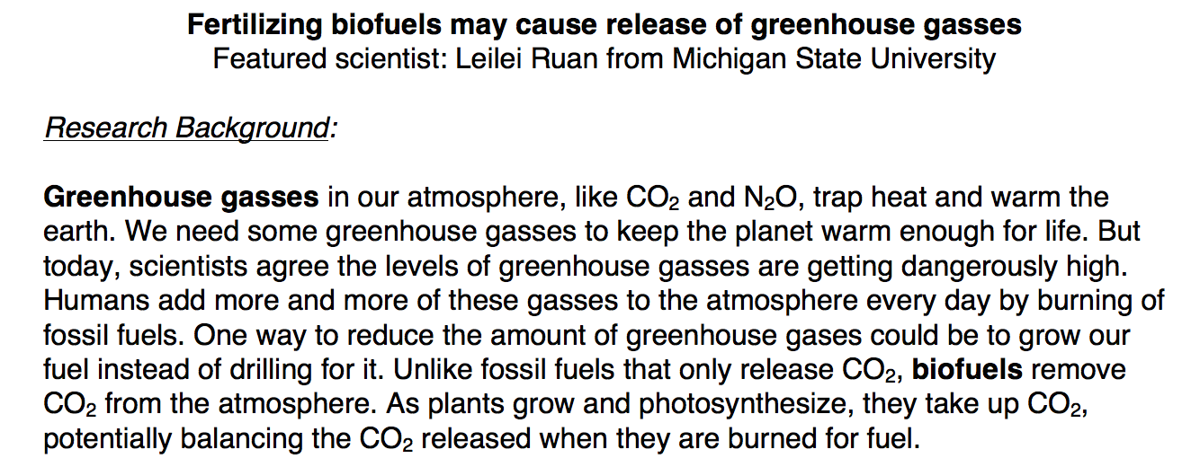
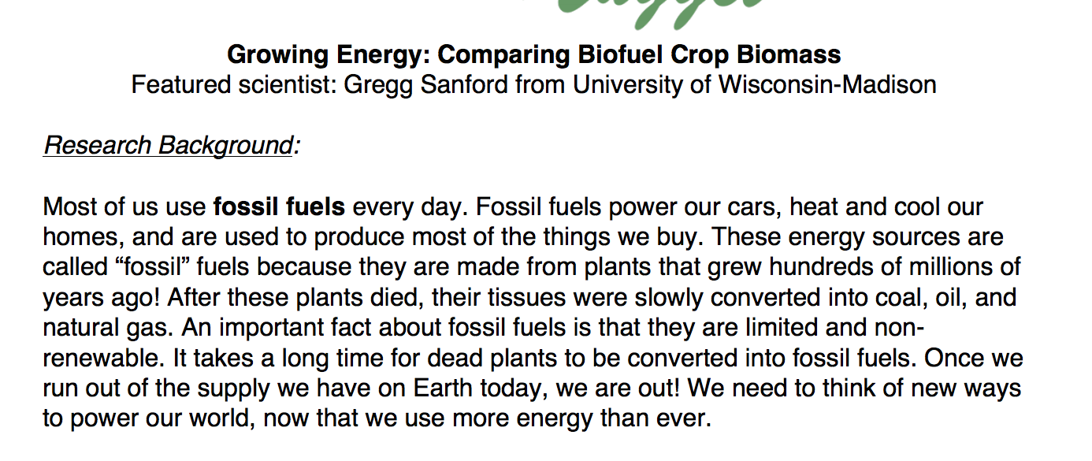
Biogeochemistry

Slide 45
Expanding Data Nuggets
_
Help expand our program to include physical sciences research
  We want to provide resources for teachers that reach outside of biology, and connect to other fields
Dissemination step is already provided!

Slide 46
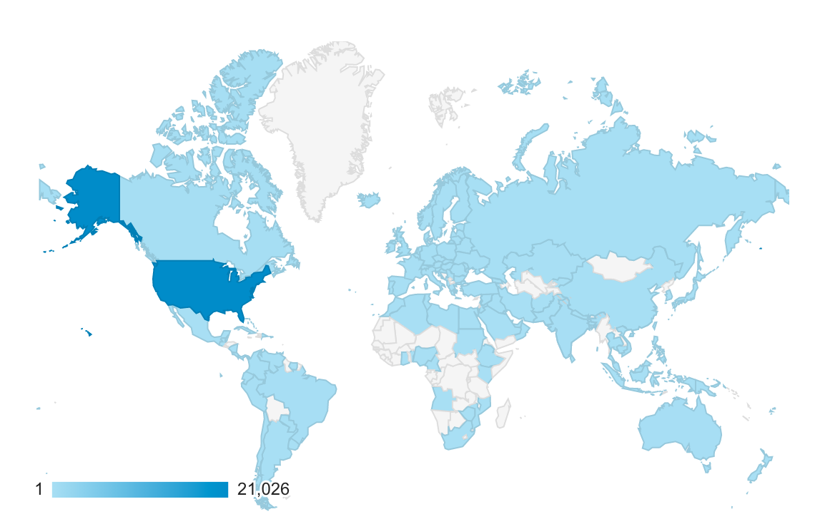
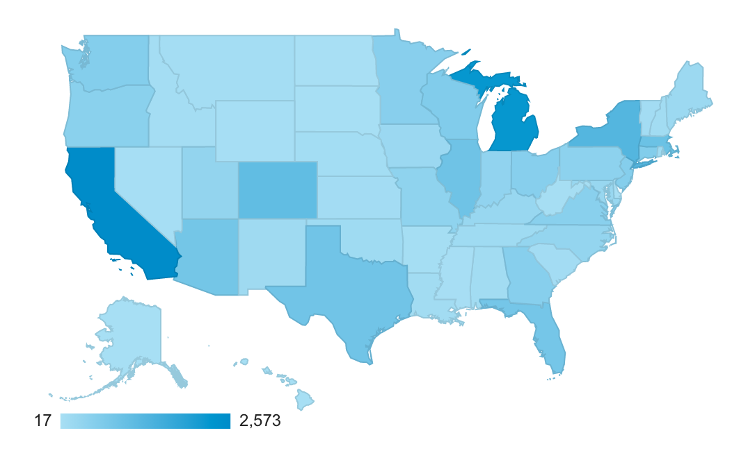
Expanding Data Nuggets
_
2,087 unique users in the last month
15,463 unique users in the last year

Slide 47
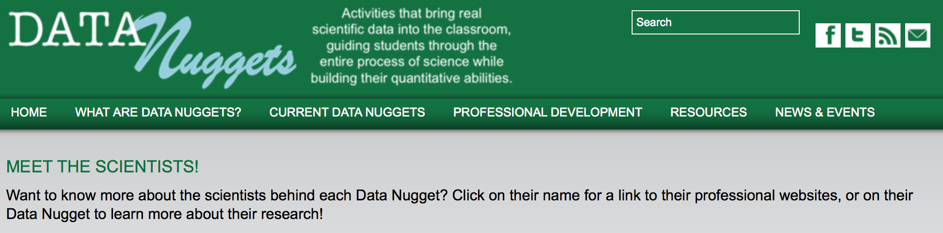
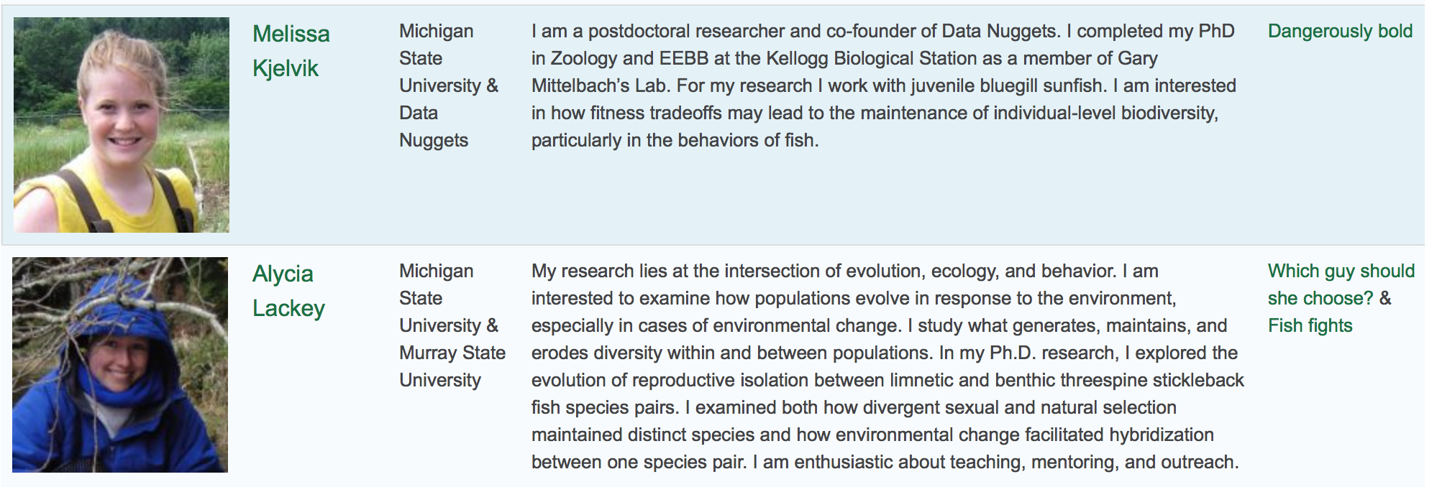
Your info here!
Notes:
In addition we just added a “Meet the Scientists” page where we have a blurb about the scientist and their interests. There is also a link to their professional webpage and the Data Nuggets that they have created. This allows students to explore more about the work going on in the lab if they are interested in doing a follow up project on the Data Nugget.

Slide 48
Steps for Making a DN
_
Think about your own data and scientific questions
Identify a dataset (or subset of the data) to use
Consider what background information is needed to understand the data and answer the question
Provide additional details for the instructor to use
Send a draft to the the Data Nuggets team to get feedback

Slide 49
Data Nugget Iterative Development Process
Research Scientist
Data Nugget
Team
MSU + BSCS Working Groups
Teacher + Scientist Reviewers
Classroom Pilot

Slide 50
Seminar Feedback
_
Please fill out the short survey being passed out.
If you would like to make your own DN then include your name and email address.
If enough people are interested we can hold a longer workshop to help guide scientists through the process.

Slide 51
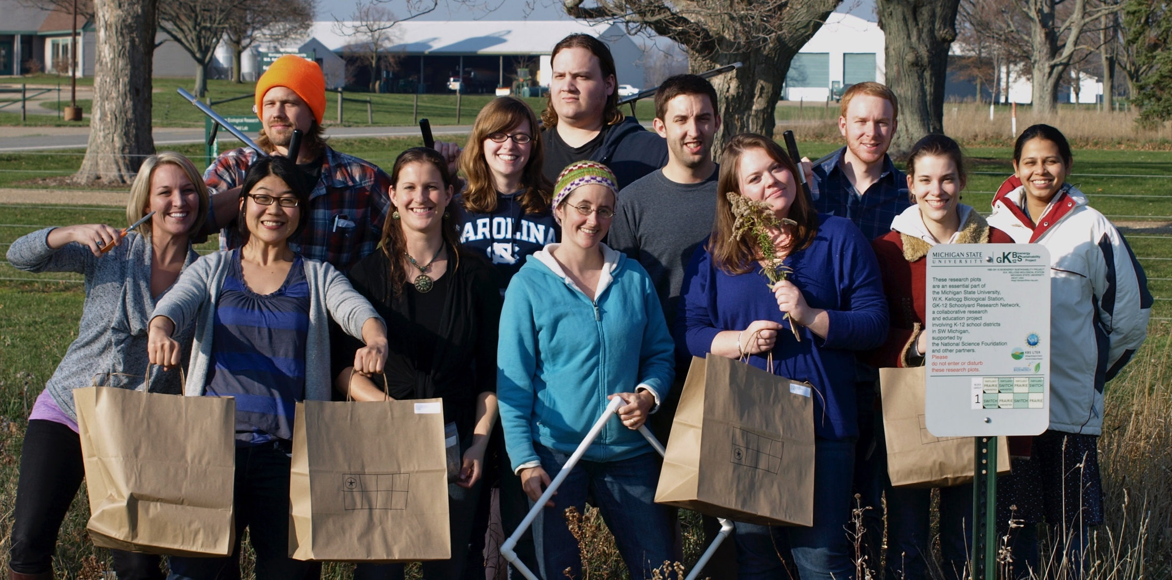
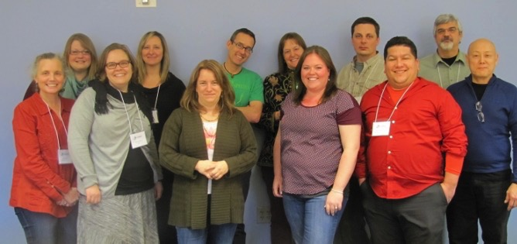




Thank you!
_
Notes:
NIMBioS Working Group: Expanding Data Nuggets Meeting 1 participants (L to R): Louise Mead, Melissa Kjelvik, Molly Stuhlsatz, Laurel Hartley, Julie Morris, Paul Strode, Kristin Jenkins, Elizabeth Schultheis, Jeremy Wojdak, Ariel Cintron-Arias, Robert Mayes, Gordon Uno

