Slide 1
Bringing authentic research and data into the classroom to unearth students’ quantitative
and inquiry skills
Liz Schultheis, Melissa Kjelvik
Michigan State University
BEACON Center for the Study of Evolution in Action

Slide 2
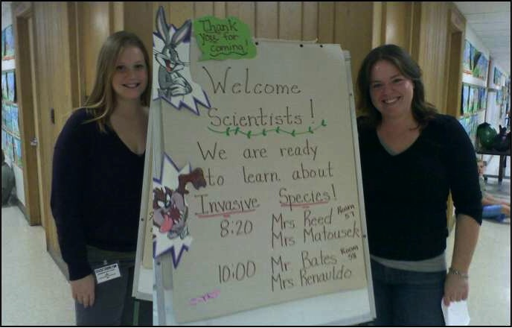


Who we are
_
Melissa Kjelvik
Co-founder of DNs and Postdoc. Biologist studying animal behavior.
Liz Schultheis
Co-founder of DNs and Postdoc. Biologist studying invasive plants.

Slide 3
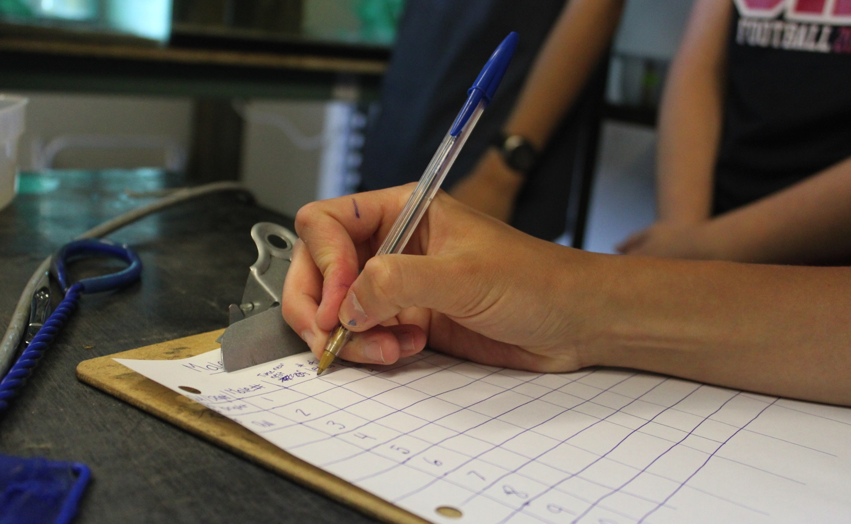
What is a Data Nugget?
_
Notes:
Reminder: Have participants visit website and pull up a DN to look at while we talk.

Slide 4
What are ?
_
Activities that bring real data into the classroom, along with all its messiness and complexity
Based on authentic cutting edge research
Guide students through the entire process of science, including data analysis & interpretation
Take 30-60 minutes and follow familiar template

Slide 5
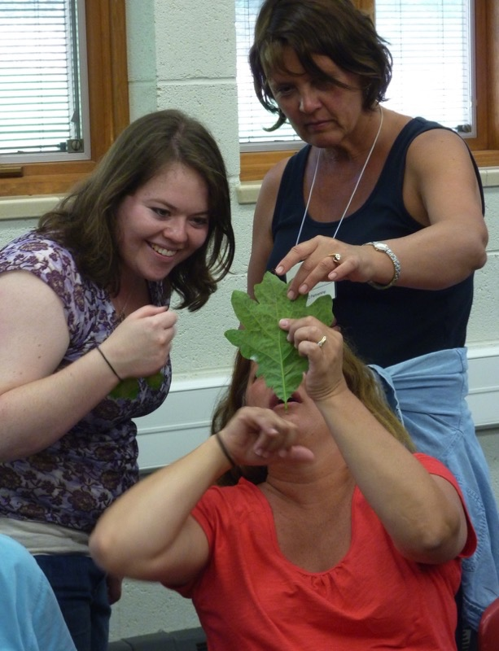
How Data Nuggets
got their start
_
Co-created with teachers at KBS as part of GK-12
Graduate students gain teaching experience
Teachers are exposed to contemporary science
Students practice scientific inquiry
Notes:
K-12 Partnership at KBS: 15 rural school districts. Over 80 teachers involved and ~10 graduate student teaching fellows
Graduate students gain teaching experience. Teachers are exposed to contemporary science. Students practice scientific inquiry

Slide 6
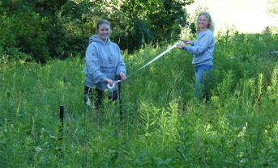
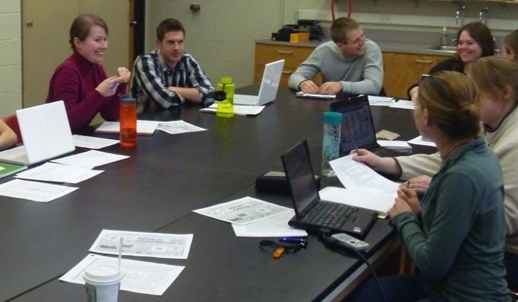
How Data Nuggets
got their start
_
Teachers concerned about performing inquiry in the classroom
Complexity of research results and messiness of data
Students need practice working with data – graphing and interpreting
Notes:
Data Nuggets have been under development since 2011 and originated through conversations between science teachers and graduate students during the NSF GK-12 project “New GK- 12: Using the STEM Dimensions of Bioenergy Sustainability to Bring Leading-edge Graduate Research to K-12 Learning Settings” (NSF DGE 0947896). This unique opportunity for collaboration between teachers and scientists led to the creation of teacher-inspired resources. Teachers shared that they were lacking educational resources that helped their students practice working with real, messy data like that collected during classroom inquiry-based projects. Graduate students in the sciences, however, have lots of practice working with messy data and surprising results.

Slide 7
How Data Nuggets
got their start
_
Quantitative literacy: way of viewing the world through “mathematical eyes” and approaching every day problems with confidence and logical reasoning (Piatek-Jimenez et al. 2012, Vacher 2014)
Critical need in STEM education
  Students are graduating unable to apply quantitative knowledge to situations (Wilkins 2010)
  Students with poor quantitative literacy more likely to drop out of school, experience unemployment, earn less (McMillan & Marks 2003, Marks et al. 2005, Rumberger & Lamb 2003)
Notes:
It turns out that the needs of our GK-12 teachers addressed a broad national need from K-16 as well.
Quantitative literacy covers a variety of skills, including the ability to understand quantitative information such as graphs, tables, mathematical relations, and descriptive statistics; as well as exhibit coherent and logical thinking about quantitative information.
Through this collaboration, Data Nuggets were created to bring real data from current and ongoing research into the classroom and take students through the process of science, from the inception of ideas to the analysis and interpretation of data.

Slide 8
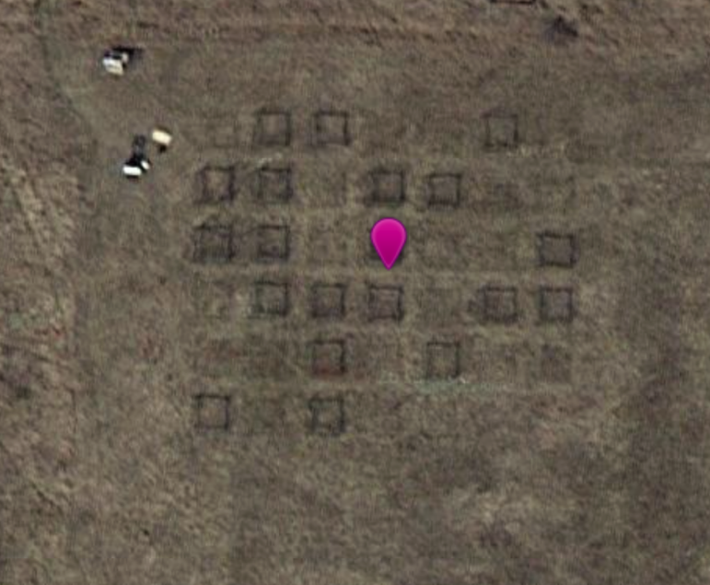
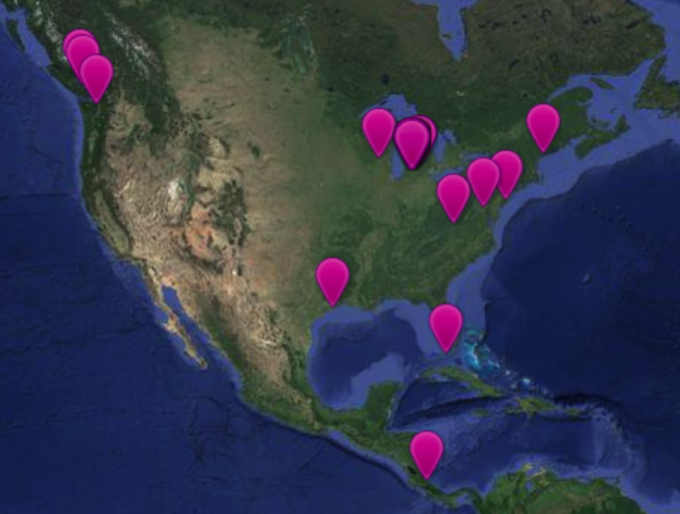
Pedagogical Themes in
Data Nuggets
_
Science Stories – Readers find stories more engaging, easier to comprehend, and more memorable. Stories are “sticky” because they appeal to our desire for causality and goals, and the reasoning behind an idea increases reader interest
Active Learning – Instead of memorizing facts and listening to a lecture, students are involved in the learning process. Data Nuggets engage students in activities, such as reading, writing, discussion, and problem solving. Teachers can use a variety of techniques while moving through activity.
Place-Based Learning – Connecting science to learners’ everyday place-based context makes the content more accessible, particularly for culturally and linguistically diverse students
Notes:
Science consists of millions of. These accounts--some electrifying, most pedestrian--become science when they can be tested and woven into cause-and-effect explanations to become part of humanity's material worldview. But they also constitute a fascinating narrative, which can be the key to helping the non-scientist understand the great ideas of science.

Slide 9
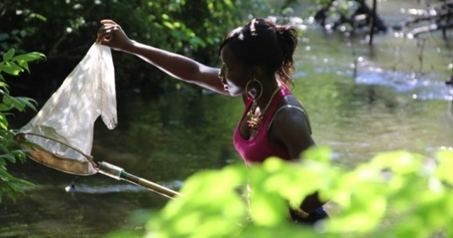
Data Nugget goals:
_
Increase quantitative literacy
Introduce students to the process of science
Show scientists are approachable
  Engage students with the researcher themselves
  Not all “white men in lab coats”
Build interest in science
  Current research may engage students more than classic textbook examples
  Science is an interesting and attainable career
Notes:
The use of current research has the added benefit of capturing the attention of students by engaging them with more than just the conclusions of a study, but the story and process of the researcher behind the ideas and data. While using Data Nuggets, students get excited about a research topic while increasing their quantitative skills and competency with the scientific method.

Slide 10
Predicted student gains when using Data Nuggets
_
Teacher survey results:
  “Students were more interested and engaged in science because they knew they were working with real data.”
  “Students were better able to think critically about data and communicate their findings to their peers and through writing.”
  “Because of their new comfort with data, students were more excited to conduct their own inquiry projects and graph.”
  Ability to analyze and interpret data, identify data ranges and trends, and appropriately question the reliability of data and outliers, all improved.
Notes:
After four years of iterative development we have observed the use of Data Nuggets in many classrooms and by hundreds of students, grades 4-12. Our preliminary observations indicate Data Nuggets are an effective tool to address the critical needs in STEM education today.
The survey was sent out to 163 K-12 teachers directly, including 135 in the Kellogg Biological Station K-12 partnership and 28 who attended Data Nuggets workshops at national and regional education conferences. Respondents were excited about the assessment of Data Nuggets, and 82% said they would like to be contacted to participate.

Slide 11


DRK-12 Efficacy Study
_
Do students in classrooms using Data Nuggets have better achievement, interest in science, and motivation outcomes than students in business as usual classrooms?
Molly Stuhlsatz, BSCS
Louise Mead,
MSU
Elizabeth Schultheis, MSU
Melissa Kjelvik,
MSU

Slide 12
DRK-12 Efficacy Study
_
We expect students in classrooms using Data Nuggets will demonstrate:
Improved quantitative reasoning in the context of science
Improved understanding of the practices and processes of science, particularly in the areas of analyzing and interpreting data and using mathematics and computational thinking
Greater engagement in the practices of science in the classroom
Improved general interest in science

Slide 13
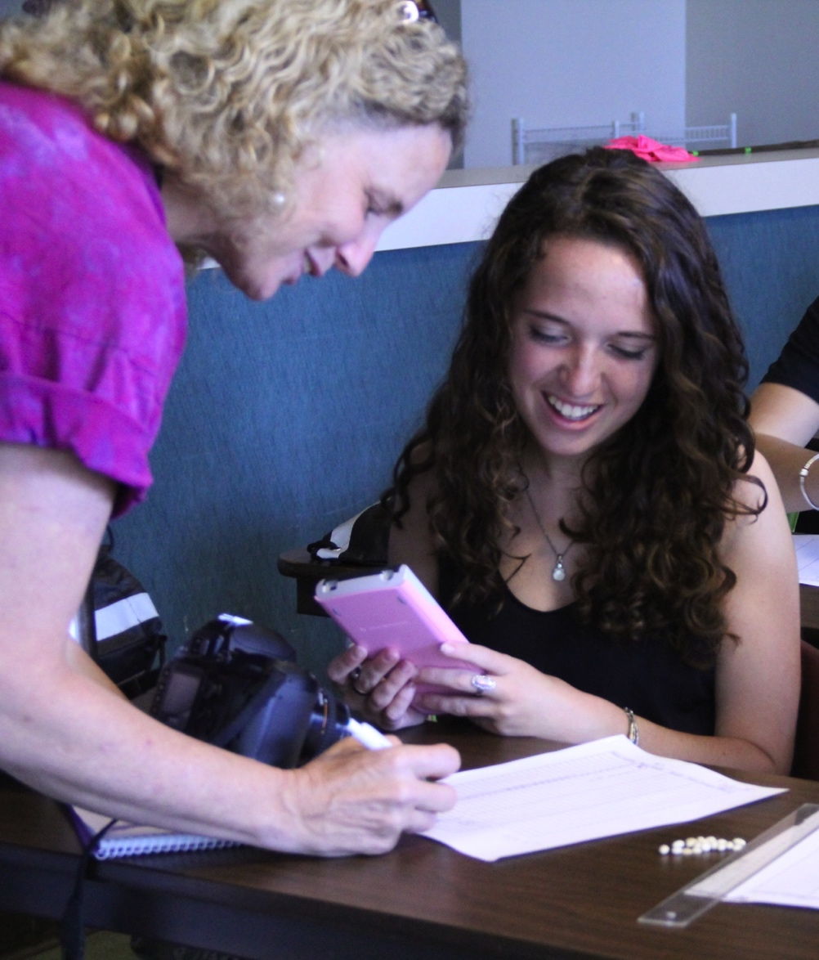
Workshop Goals:
_
  Learn how you might integrate Data Nuggets into your courses
  To help you create your own Data Nugget
  Increase available resources for undergraduates to interact with data
Notes:
We have been up to this point K-12 focused, this helps us increase upper level DNs.
Also our chance to learn how you see DNs integrating into your classes

Slide 14
Why make a Data Nugget?
_
Develop hands-on data interpretation resources for your courses
Broader impacts for future grants
  Needed for NSF grant funding
  Share research findings broadly
Improved communication skills
  Uncover the core message of research
  Explain research to a variety of audiences
Notes:
Ask participants why they came and how they see Data Nuggets helping them. Creating a Data Nugget will help you think about the essence of your work and how it can be framed to captivate diverse audiences - from elementary students to fellow scientists. Data Nuggets are an avenue toward broader impacts as your research will be shared with K-16 audiences and improve the understanding of science in society.

Slide 15
Why make a Data Nugget?
_
Streamlined and efficient process
  Template gives you structure when making activity, but gives you ability to be creative and customize the issues that are unique to each experiment or dataset
  We have lots of experience helping researchers make Data Nuggets – over 40 Data Nuggets online
Notes:
Ask participants why they came and how they see Data Nuggets helping them. Creating a Data Nugget will help you think about the essence of your work and how it can be framed to captivate diverse audiences - from elementary students to fellow scientists. Data Nuggets are an avenue toward broader impacts as your research will be shared with K-16 audiences and improve the understanding of science in society.

Slide 16
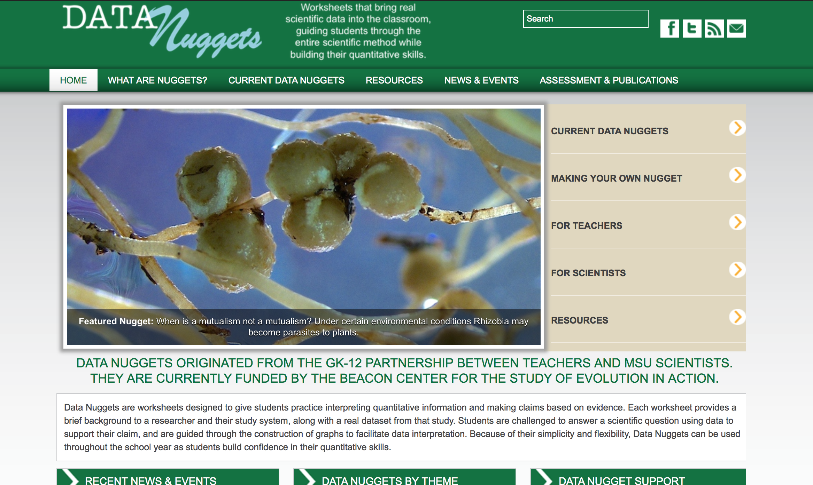

Notes:
We will host your Nugget on our website. We have thousands of visitors a month and hundreds of teachers in contact with us. We can give you Google analytics if you ever need to report out.

Slide 17
Discuss with a neighbor
_
What do you currently teach?
How could Data Nuggets be integrated to increase quantitative reasoning skills?
Notes:
Ask participants why they came and how they see Data Nuggets helping them. Creating a Data Nugget will help you think about the essence of your work and how it can be framed to captivate diverse audiences - from elementary students to fellow scientists. Data Nuggets are an avenue toward broader impacts as your research will be shared with K-16 audiences and improve the understanding of science in society.

Slide 18
Parts of a Data Nugget
_

Slide 19
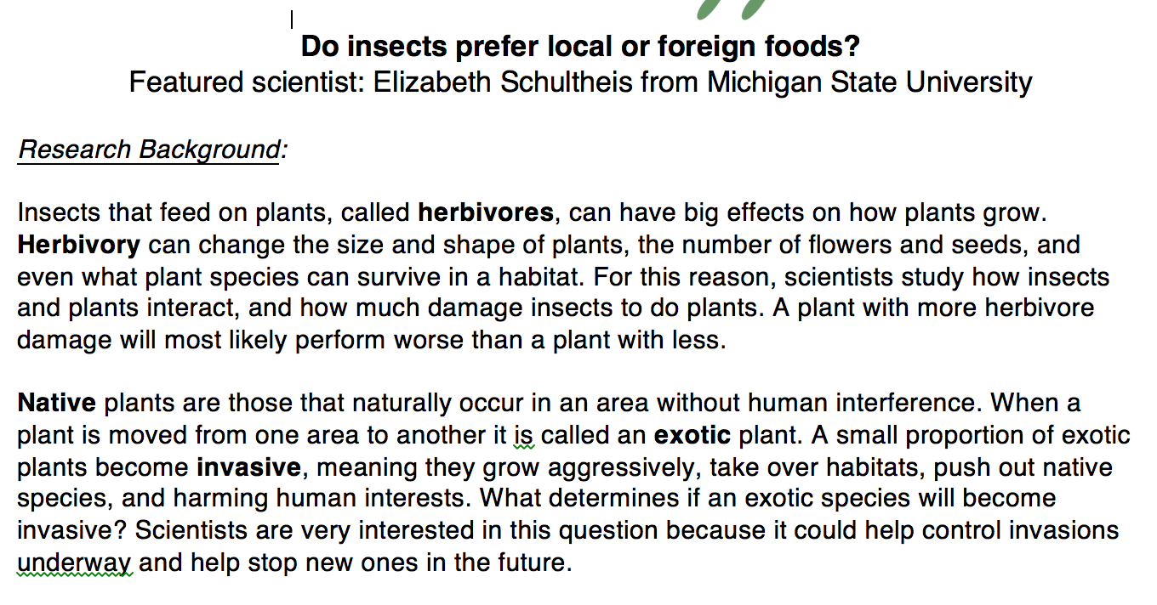
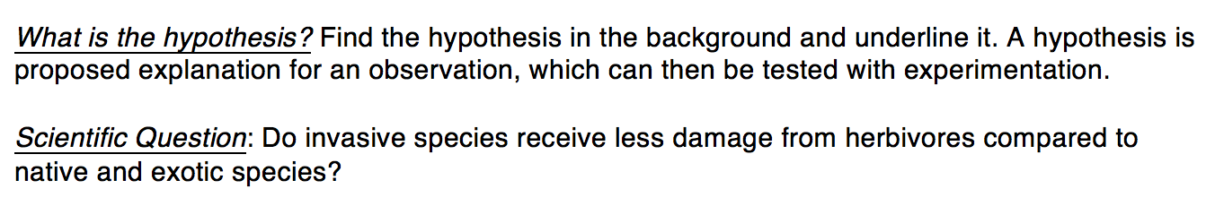
Research Background
_
Background information
Question and Hypothesis
Notes:
The standard format of each Nugget provides a brief background about a researcher, their study system, and a real dataset from that work. Within each Nugget, students are challenged to answer a scientific question, are guided through the construction of graphs to facilitate data interpretation, and use data to support their claims. Data Nuggets serve to supplement existing science curriculum; because of their simplicity and flexibility, Data Nuggets can be used across grade levels and throughout the school year as students build confidence in their quantitative and scientific skills.

Slide 20
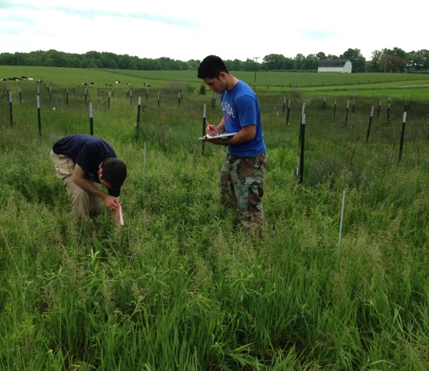
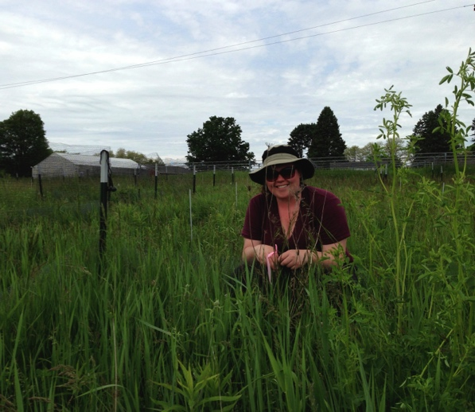
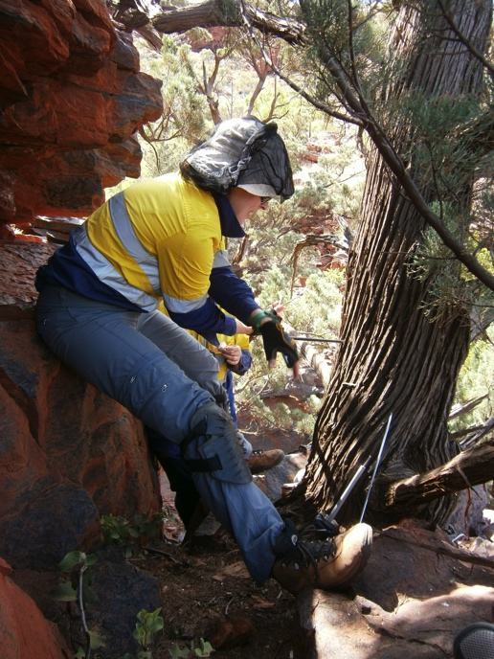
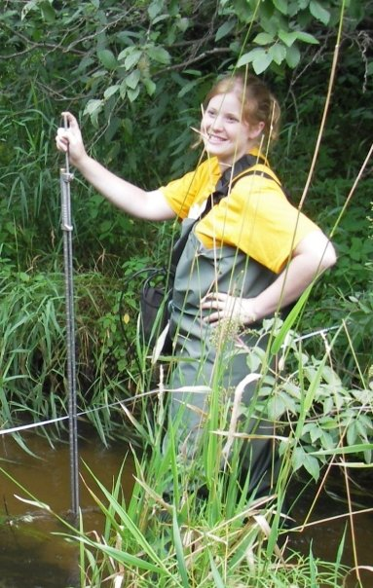
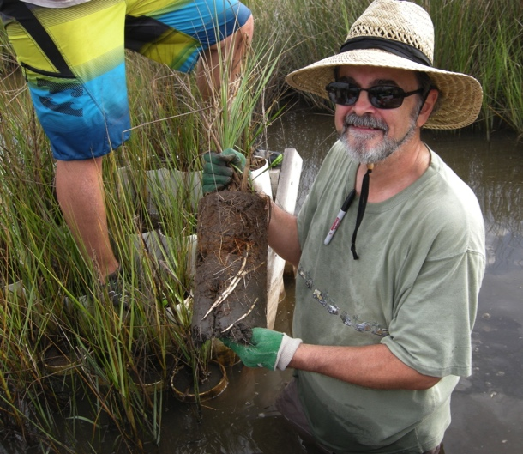
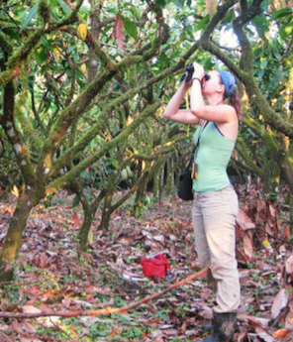
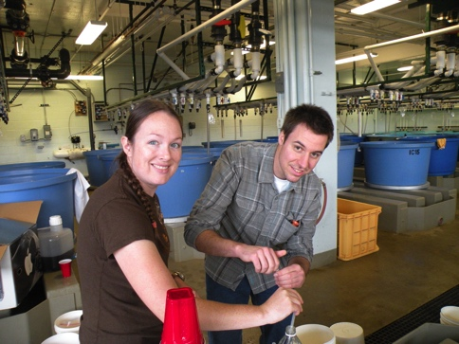
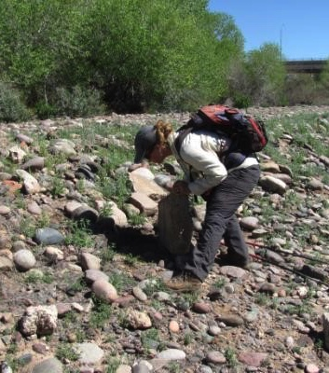

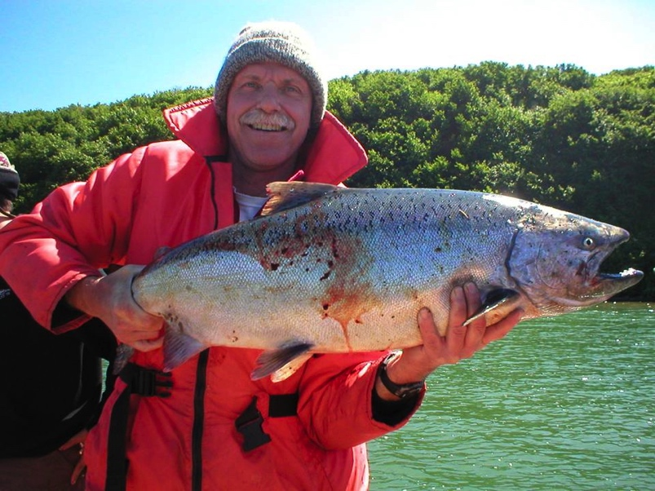

Slide 21
Content Levels
_
  These correspond with Flesch-Kincaid readability statistics
Notes:
Graphing and multiple content levels allow for differentiated learning for students with any science or reading background.

Slide 22
Data and Data Visualization
_
Dataset
Data Visualization

Slide 23
Graphing Levels
_
  Each Data Nugget is provided in each type on our website
  Scientist provides us with Type A and excel file, we make the rest
Notes:
Graphing and multiple content levels allow for differentiated learning for students with any science or reading background.

Slide 24
Data Levels
_
  Statistics extension activities provided if teachers want their students to work with “big data”
Notes:
For each DN we have a version that students can do by hand, but we also want teachers to be able to build students’ quantitative skills and expand to issues of calculating statistics and hypothesis testing.

Slide 25
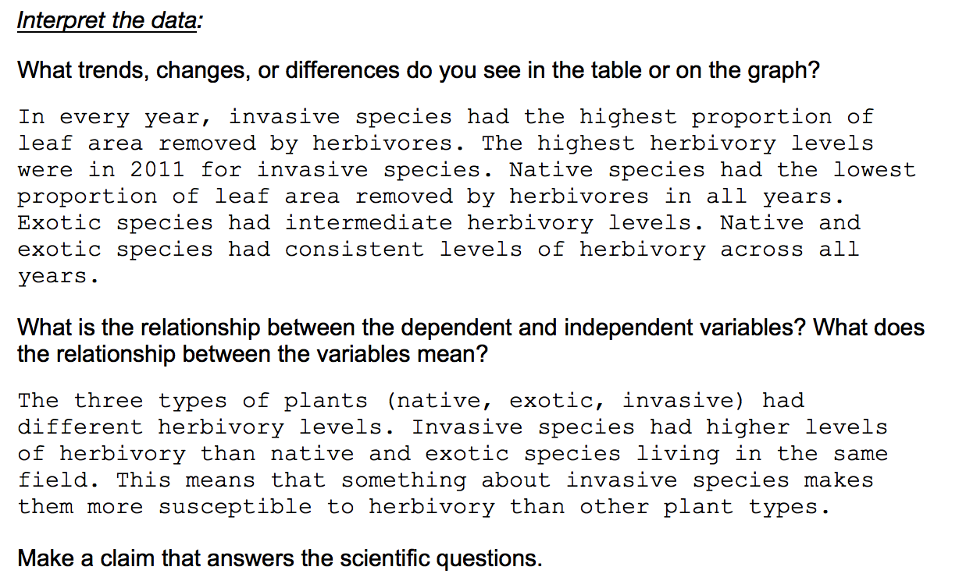
Constructing Explanations
_
Notes:
For each DN we have a version that students can do by hand, but we also want teachers to be able to build students’ quantitative skills and expand to issues of calculating statistics and hypothesis testing.

Slide 26
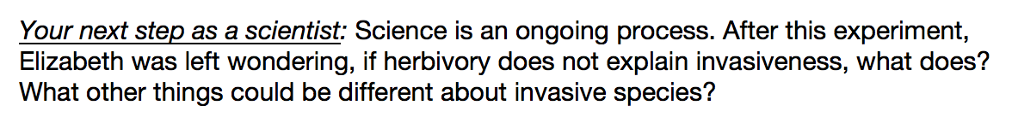
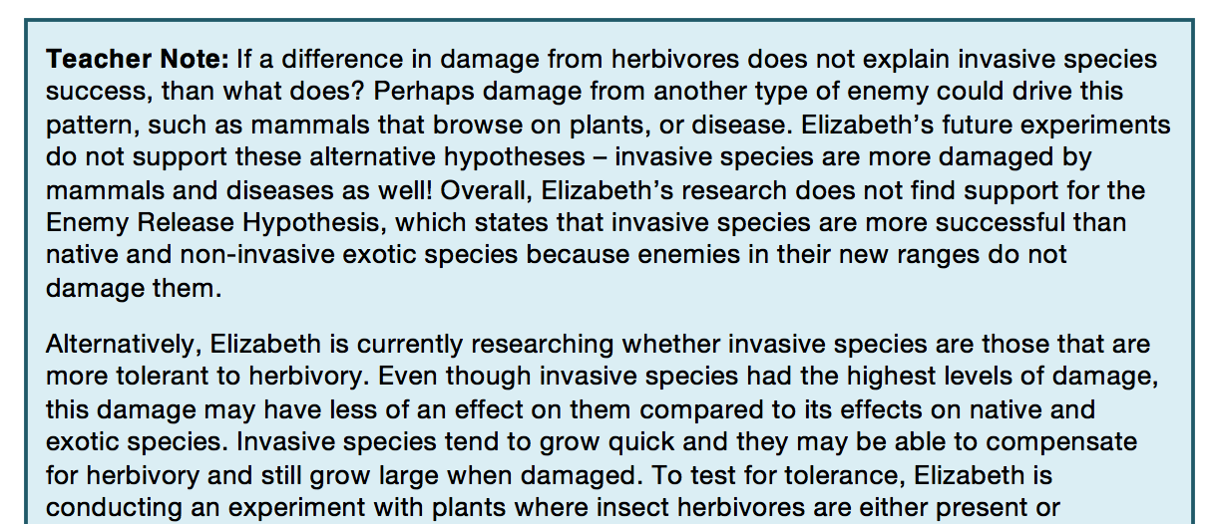
Scientist Next Steps
_
Notes:
For each DN we have a version that students can do by hand, but we also want teachers to be able to build students’ quantitative skills and expand to issues of calculating statistics and hypothesis testing.

Slide 27
Making a Data Nugget
_

Slide 28
Large, freely available datasets
_
Great tools to have students interact with data
So many datasets- how to best use them?
Supplementing data exploration and inquiry activities with Data Nuggets could be a good way to ease students into a large dataset
  Introductory lesson before jumping in to data analysis
  DN is a good place to start inquiry, students can follow-up on their own questions
  DN could serve as a model for students to write their own
    lab report-style, practice communicating and visualizing data
http://datanuggets.org/resources/data

Slide 29
Example dataset sources
_
Citizen Science data:
  eBird
  NEON’s Project BudBurst
  National Phenology Network
Data Repositories
  LTER sites
  KBS long-term ice cover
  Dryad and DryadLab

Slide 30
DryadLab
_
Currently 3 activities using curated dryad data
  A walk through the woods: evolutionary tradeoffs of structural adaptations in wood
  Survivorship in the natural world: survivorship curves
  Staying alive: Extinction risk factors
Students engage in scientific inquiry using the data.
Data Nuggets could be made to introduce concepts or supplement these activities

Slide 31
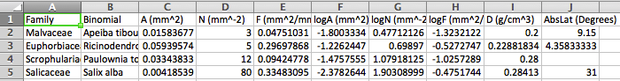
A Walk through the Woods
_
A (mm^2) = Average cross sectional vessel area
N (mm^-2) = Number of vessels per unit cross sectional area
F (mm^2/mm^2) = (F = A*N) Fraction of cross sectional area that is in vessels
D (g/cm^3) = Wood density
AbsLat (Degrees) = Average of absolute value of latitude
Students investigate hypotheses regarding tradeoffs between transport and mechanical support
Fast vs. safe transportation through vessels

Slide 32
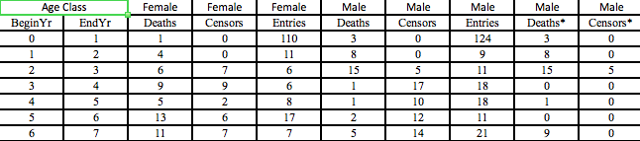
Survivorship in the Natural World_
7 datasets with mortality data for primate species
Within each species there are data for males and for females
Real-life data from seven wild primate populations provide examples of real survivorship curves
Students can predict what they expect curves to look like for different species

Slide 33
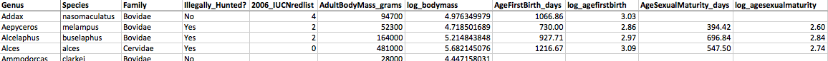
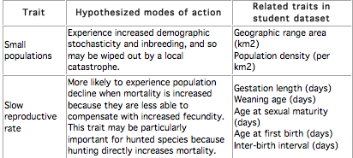
Staying Alive
The dataset contains average size, reproductive, population density and range data for 212 species of artiodactyl from across the globe.
Students investigate characteristics of artiodactyl species hypothesized to predispose them to extinction.

Slide 34
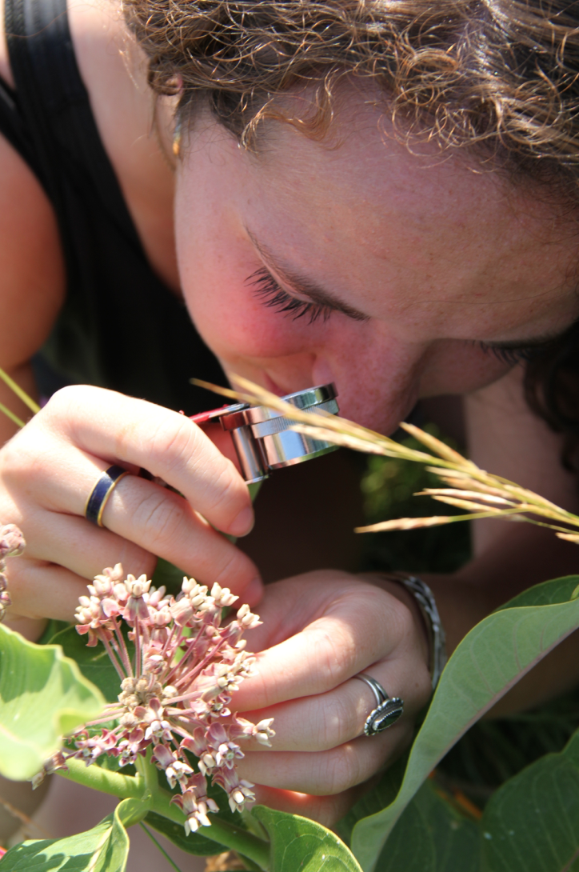
Activity 1: Dataset & Graph
_
Take a few minutes to explore the datasets
Which dataset fits with your course content?
Choose a dataset to work on and break into groups focused on the same dataset

Slide 35
Activity 1: Dataset & Graph
_
Think of a question you can investigate with your students using this dataset.
What is one big scientific question you want to answer?

Slide 36
Activity 1: Dataset & Graph
_
Make a small data table
  Table can have misleading (extra) data
Make a graph or figure that you would use to interpret the results

Slide 37
Activity 2: Scientific Question & Hypothesis
_
How would you define a hypothesis?
How textbooks define hypothesis:
  A proposed explanation for an observation.
      Wilbraham A.C. et al. (Pearson Prentice Hall 2008) Chemistry: the Molecular Nature of Matter and Change
  A reasonable explanation for observations - one that can be tested with additional experiments.
      Serway and Faughn (Holt, Reinhalt, and Winston 2009)
  A tentative answer to a well-framed question - an explanation on trial.
      Campbell and Reece (2008) Biology, 8th Ed.:

Slide 38
Importance of good hypothesis
_
Many of your students may come to your classrooms with misconceptions about hypotheses and predictions.
Before students enter a large dataset and start looking for patterns, important for them to have come up with a hypothesis they would like to test.
Give us an idea of why a particular phenomenon occurs (explanatory power).
Testable because they generate expectations about what we should observe in different situations.

Slide 39
Which hypothesis do you like best?
Table salt will dissolve in water more quickly than rock salt.
The surface area of a dissolvable substance determines the rate that it dissolves.
Salt with more surface area will dissolve more quickly in water than salt with less surface area.
Notes:
This is an activity you could do with your students when they are developing their own hypotheses.

Slide 40
Activity 2: Scientific Question & Hypothesis
_
Write your scientific question and hypothesis.
Email Liz & Melissa a slide with your graph, scientific question and hypothesis (eschultheis@gmail.com and kjelvikm@gmail.com).

Slide 41
Activity 3: Template
_
Finalize your Data Nugget by filling in all components of the template and share with 2-3 people for feedback
http://datanuggets.org/making-your-own-nugget/
Email materials to Liz and Melissa
  eschultheis@gmail.com
  kjelvikm@gmail.com

Slide 42
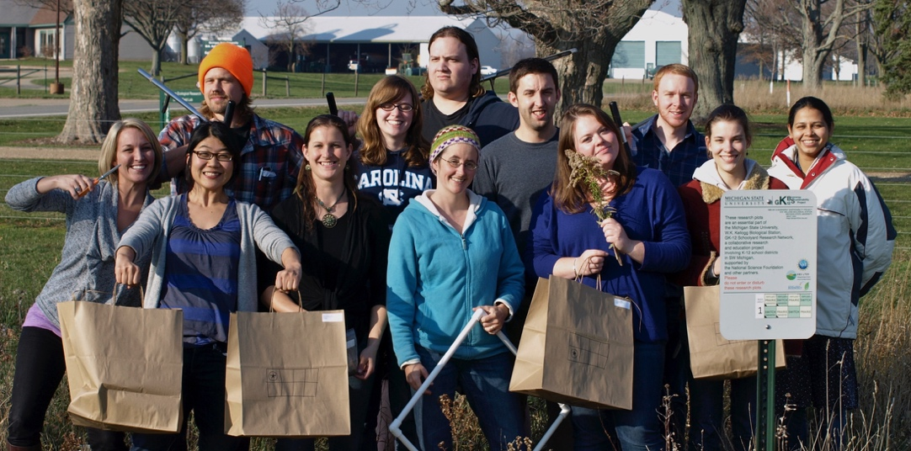
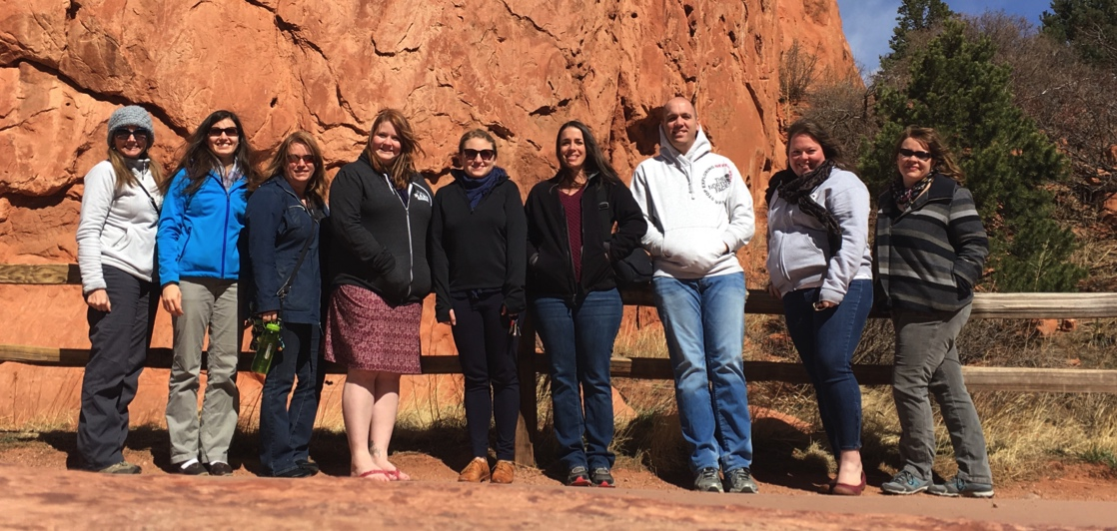



Thank you!
_
Follow us on Facebook and Twitter!
@Data_Nuggets #DataNuggets

